Slide 1
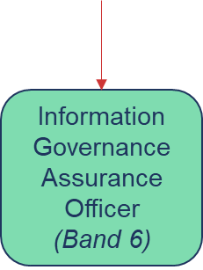

Information Governance Team Structure
Head of Information Governance / Deputy Data Protection Officer
(Band 8a)
Information Governance Manager
(Band 7)
Information Governance Manager
(Band 7)
Information Governance Manager
(Band 7)
Information Governance Manager
(Band 7 0.4 WTE)
Information Governance Assurance Officer
(Band 6)
Information Governance Support Officer (Band 4) VACANCY
Updated Jan 2026

