Slide 1



Psychological Impact
of Lip Filler in
Cleft Patients
WELSH CENTRE FOR CLEFT LIP
AND PALATE
Presented by Dr Aimee Pudduck
Consultant Clinical Psychologist
Prepared by: Ari Corbett, Trainee Clinical Psychologist
Contact:
Other contributors:
Dr Tom Henwood Clinical Psychologist,
Mr Tomas O’Neill Consultant Cleft Surgeon
Dr Charlotte Ekhardt Consultant Orthodontist
Notes:
Hello and introduction
Trainee on placement in Cleft Lip and Palate Team in South Wales, University of Cardiff DClinPsy

Slide 2
WHAT? WHERE? WHY?
  Lip filler is offered as part of a dedicated clinic based on patient need
  Cleft patients often have appearance related concerns and associated psychological impact on self-image, self-confidence and quality of life affecting mental health
  Offering of filler is not standardised across all Cleft centres at and so data is scarce
  The Welsh Centre for Cleft Lip and Palate have begun to build an evidence base to evaluate this intervention and it’s psychological impact on Cleft patients
  Patient and stakeholder data show initial findings
Notes:
Cleft patients often have appearance related concerns which are associated with impact of self-image, self-confidence and quality of life with related impact on mental health. HA filler offers a timely and non-invasive treatment option for cleft patients who are not suitable for or do not wish to have surgery. There is anecdotal evidence of pros and cons of psychological impact of offering this service and the WCCLP are offering this service routinely as part of their provision of cleft related care; therefore it is important to evaluate the treatment being offered to better understand the outcomes and psychological impact as well as inform MDT working across disciplines

Slide 3
DEMOGRAPHICS OF SAMPLE
26
Sample
Participants
26 participants
Age range from 17-68 years old
22 female
4 male
17-68
Type of Cleft
CL - 10
UCLP- 12
BCLP -4
Years Old
22:4
Data Collected
Paired pre and post data collected on Cleft Q Lip Module.
9 items assessing satisfaction with lip appearance.
Female:Male
Notes:
Details of investigation sample: quantitative Cleft Q data and qualitative stakeholder interview data, there is evidence of medical effectiveness and Cleft Q data but this does not address psychological impact beyond satisfaction with the look of lips
Sample:
26 participants
17-68 y/o
22f 4m
CL- 10
UCLP-12
BCLP-4

Slide 4
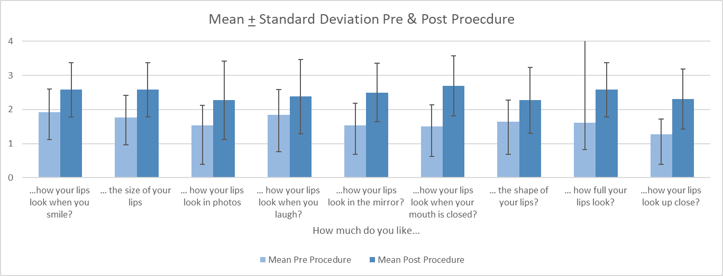
Notes:
This is the pre and post data from the Cleft Q which shows improvement on satisfaction with the appearance of the lips on all items. Anecdotally there is evidence that there is a ceiling affect with satisfaction when some patients do no achieve perfection and we are collecting and analysing more data to investigate this.

Slide 5
KEY STAKEHOLDER THEMES
Positive Impact
Meeting Patient Need
Management of Expectations
Scale of Impact for Intervention
Perception of Intervention
  On appearance and self-confidence
  Increased social functioning
  Less self-consciousness
  More engagement in social activities, going out more
  More smiling and laughing
  Less self-conscious when being photographed
  Meeting patient need with Cleft specialists expertise
  Accessibility of the intervention
  Protecting patients in an unregulated market
  Creating safe and accessible services without too many barriers- barriers that may hinder access to interventions that could Improved QoL
  Importance of patients feeling safe with trusted Cleft MDT specialists
  Role of Psychology to support cohorts more at risk for appearance related issues
  Balancing impact and expectations of social media with LF intervention for Cleft
  Patient plateau and disappointment when not reaching perfection
  Psychology screening on appearance related issues and expectations without creating unnecessary barriers to access
  Non-invasive intervention for a significant psychological impact on the patient
  Understanding how impactful the appearance of lip clefts can be on quality of life and how debilitating the psychological impact of this is, can it be addressed earlier in non-surgical way
  Taboos around aesthetic interventions more generally
  Bridging the gap between aesthetic skill and medical intervention
  LF for Cleft is in a medical setting which makes it more acceptable for some
  Gender difference in the uptake of the intervention and patient expression of need
Notes:
Key Stakeholders were interviewed and preliminary thematic analysis was carried out to elicit key themes, which were as follows:
Positive Impact
Meeting Patient Need
Management of Expectations
Scale of Impact for the Intervention
Perception of the intervention

Slide 6
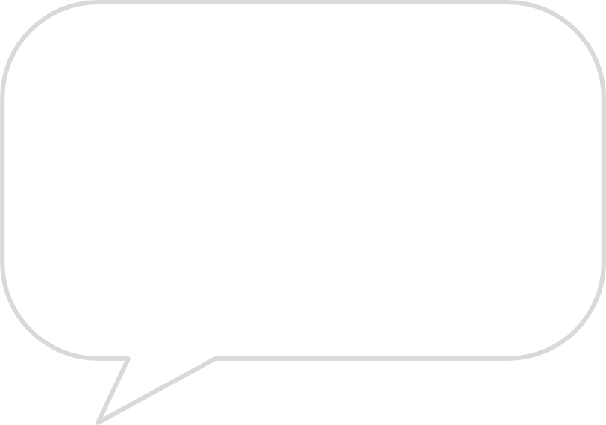

STAKEHOLDER QUOTES
“Delivering the service because it seemed to have such a positive effect, not just on what the patients were reporting about how they perceived the appearance of their lips, but also on how that then had an impact on their social interactions, their self-confidence, ability to enjoy life in general, the joie de vivre was just a lot more elevated”
“There have been tears of joy in the clinic. There have been I can feel my lips touching that part for the first time ever.”
“There’s a taboo element of aesthetics more generally, linked with being shallow and interventions looking extreme- it is more medicalised from a Cleft perspective which is a benefit. There may be gender effect here. Making it more medicalised makes it more acceptable for some people, anecdotally older women men in general.”
“There is reassurance and strength in having the fillers in Cleft care, because they are coming to someone who openly acknowledges what the issues are, and has the expertise to treat them- this is validating for the patient to know you are acknowledging what they are concerned about .
Also teams are static and they know the faces of those around them delivering the intervention. Patients feel really cared for and understood in this setting.”
”I've noticed that patients are talking about being less self-conscious in photographs. They are more confident in their own appearance.”
“But to the person who has that area they're concerned about, they assume that the entire world is just looking at it. So being able to go to some extent to improve how they feel about that, is wonderful. And it's such a tiny, tiny intervention.”
Notes:
Stakeholder quotes. Unfortunately I do not have time to read all of them, but I would just like to highlight this one which is particularly relevant to how the intervention is delivered in the context of NHS Cleft MDT care:
“There is reassurance and strength in having the fillers in Cleft care, because they are coming to someone who openly acknowledges what the issues are, and has the expertise to treat them- this is validating for the patient to know you are acknowledging what they are concerned about .
Also teams are static and they know the faces of those around them delivering the intervention. Patients feel really cared for and understood in this setting.”

Slide 7
CONCLUSIONS AND FUTURE DIRECTIONS
Conclusions
Areas for Research
Future Directions
Initial findings show that this intervention is effective and has positive psychological impact on patient quality of life as well as being a non-invasive treatment
Does psychological impact vary by type of cleft?
Exploration of the cultural difference around desirability in facial aesthetics
Exploration of gender and age in relation to need, uptake of intervention, and satisfaction
Psychological screening/support for subgroups with severe appearance related concerns
Qualitative exploration of the psychological impact of lip fillers
Storage of data is paramount in order to continue to build this evidence base rigorously to fuel further understanding of this topic and make meaningful sense of the data
Addition of a psychological component to pre and post measures
Notes:
In conclusion our initial findings show: that this intervention is effective and has positive impact psychological impact on patient quality of life as well as being an effective and non invasive treatment
Areas for research include:
Does psychological impact vary by type of cleft?
Exploration of the cultural difference around desirability in facial aesthetics
Exploration of gender and age in relation to need, uptake of intervention, and satisfaction
Psychological screening/support for subgroups with severe appearance related concerns
Qualitative exploration of the psychological of lip fillers
Future Directions:
Storage of data is paramount in order to continue to build this evidence base rigorously to fuel further understanding of this topic and make meaningful sense of the data
Addition of a psychological component to pre and post measures

Slide 8
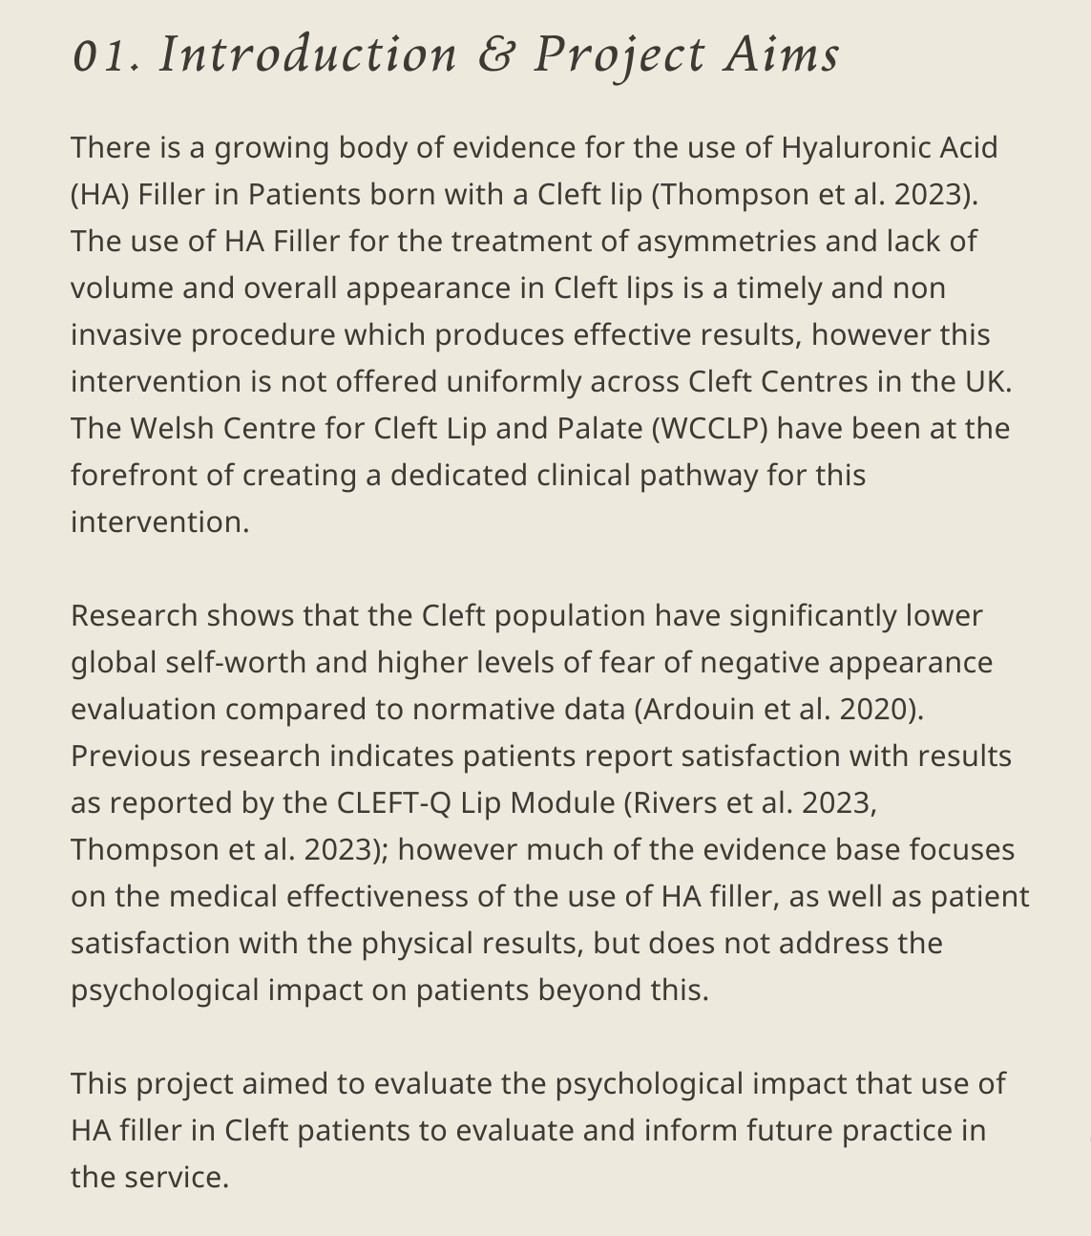

Slide 9
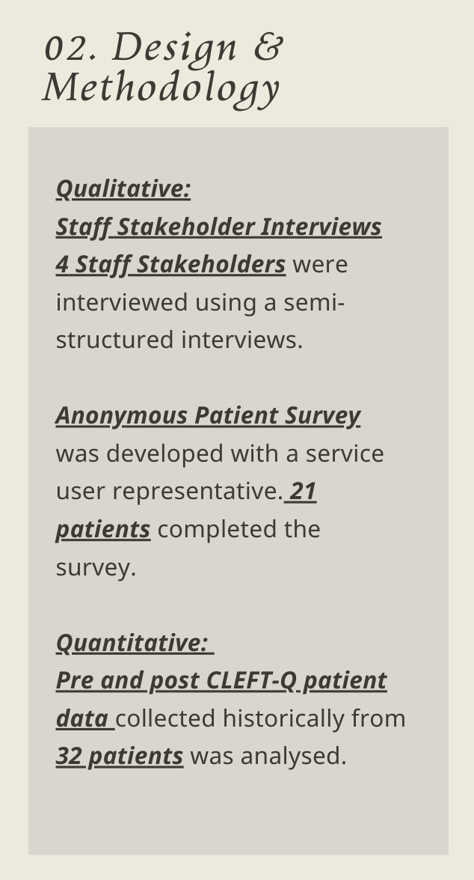

Slide 10
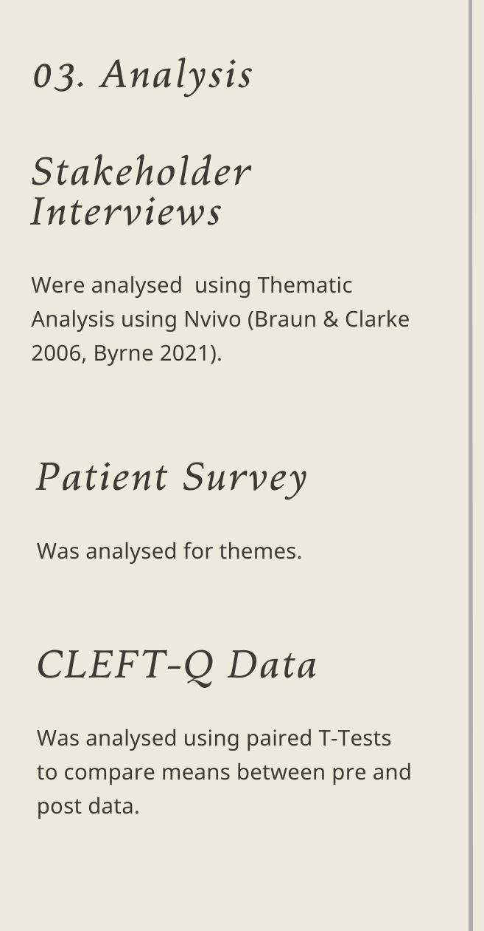

Slide 11
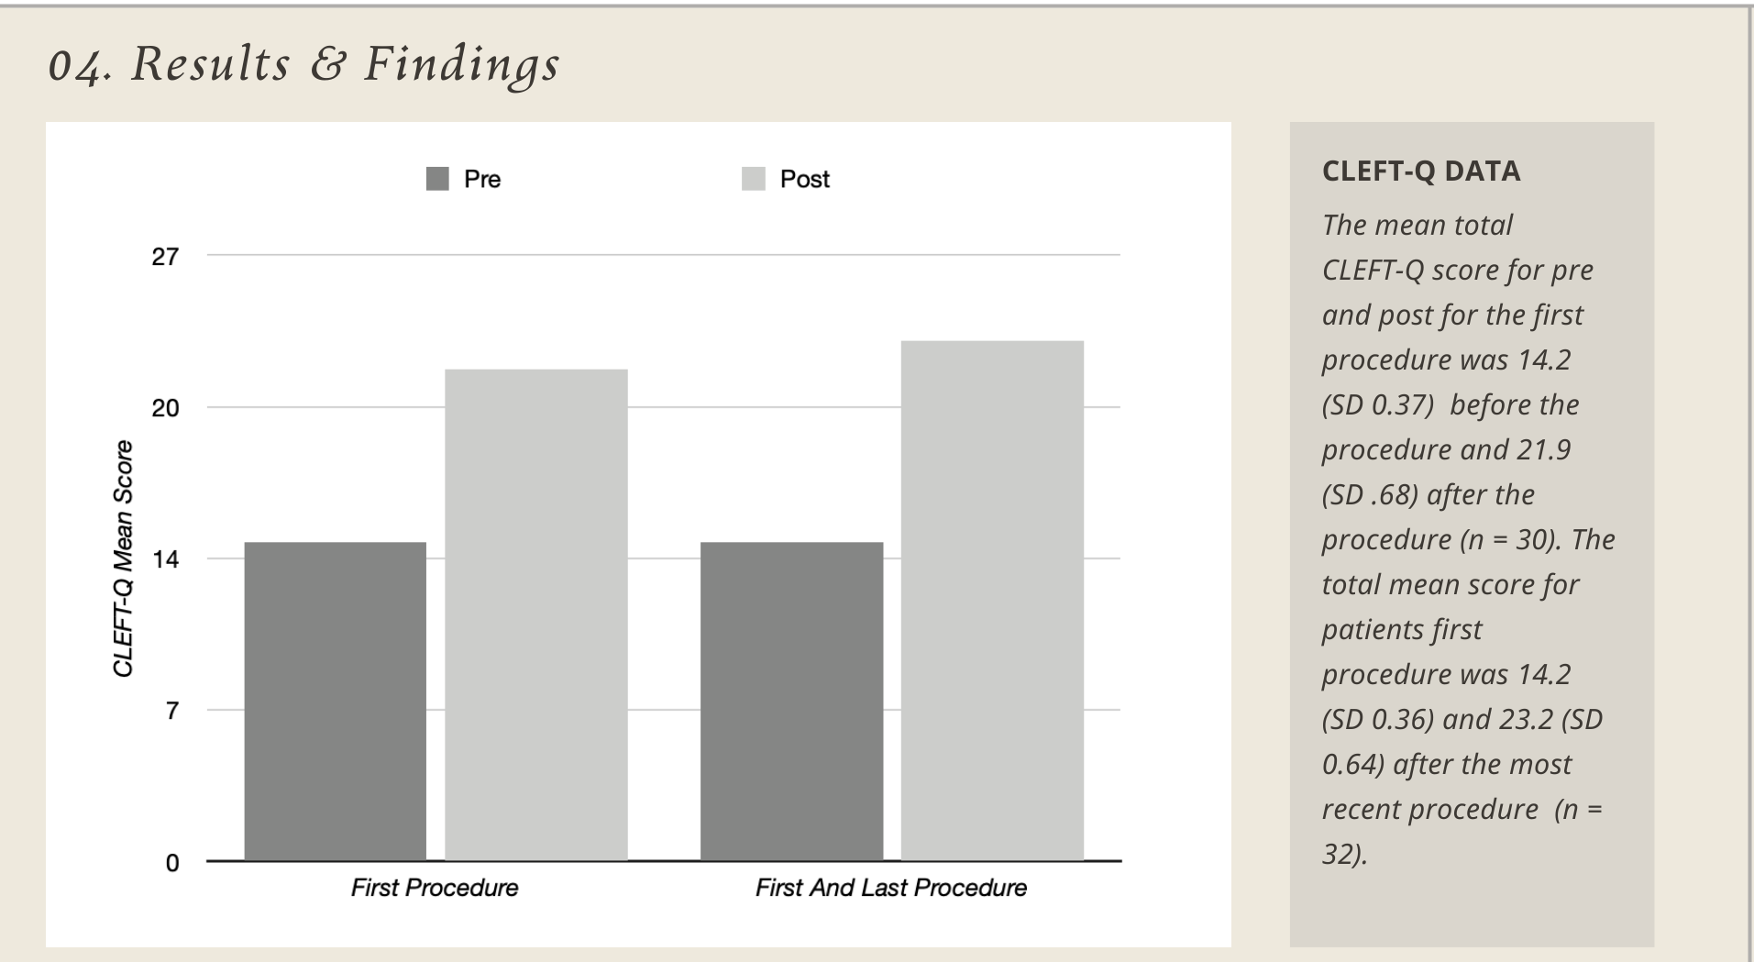

Slide 12
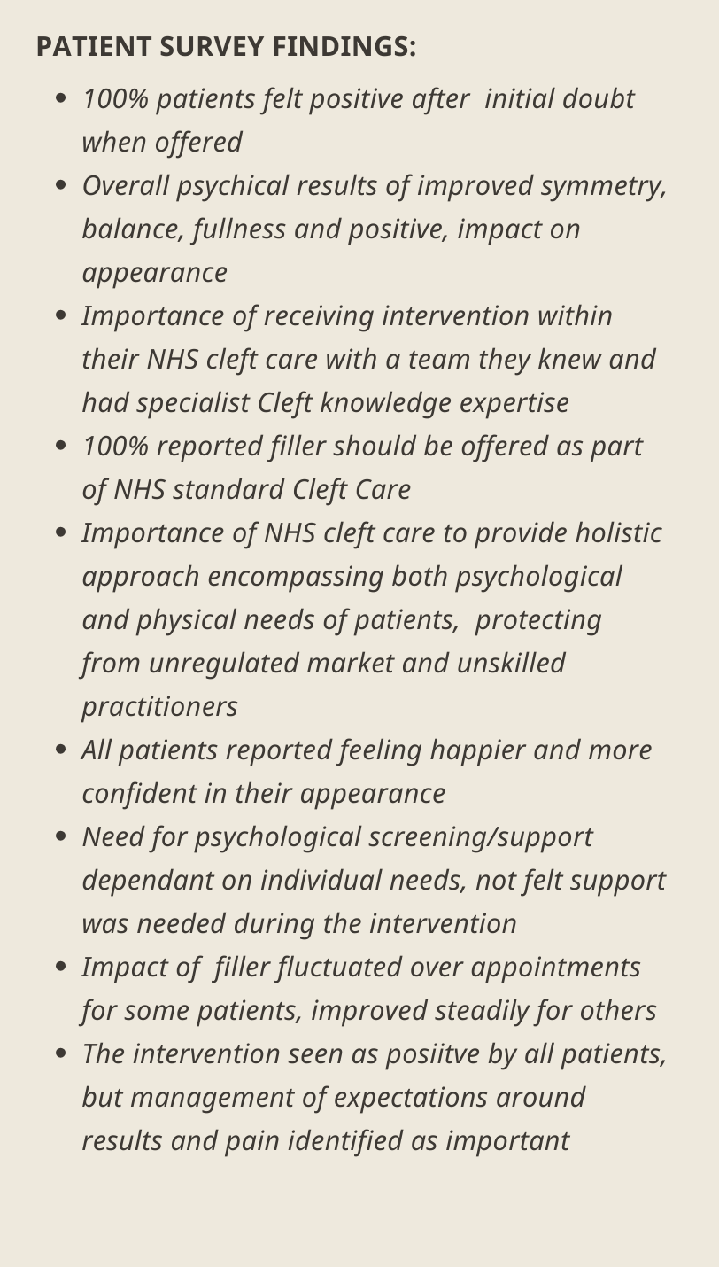

Slide 13
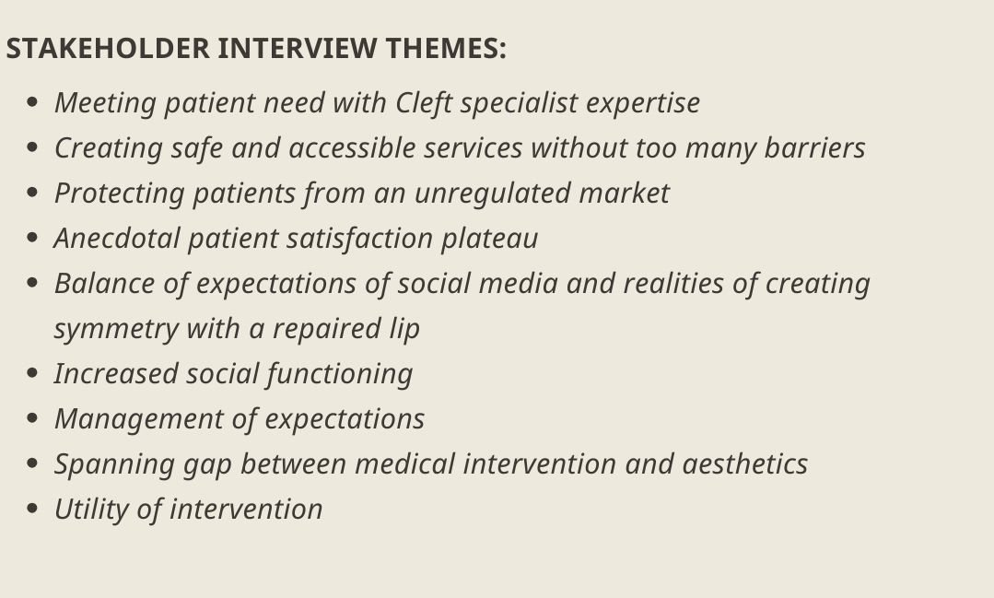

Slide 14
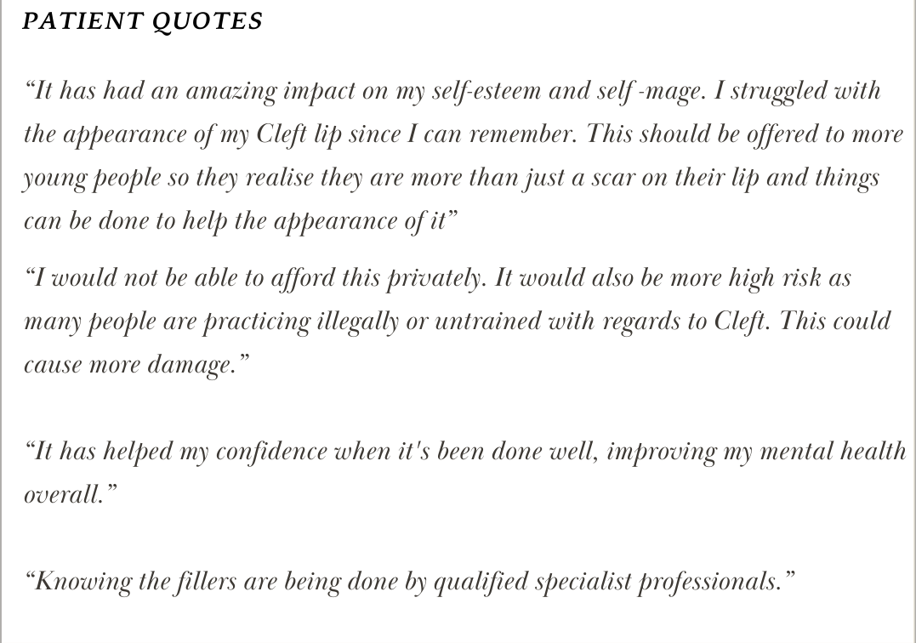

Slide 15
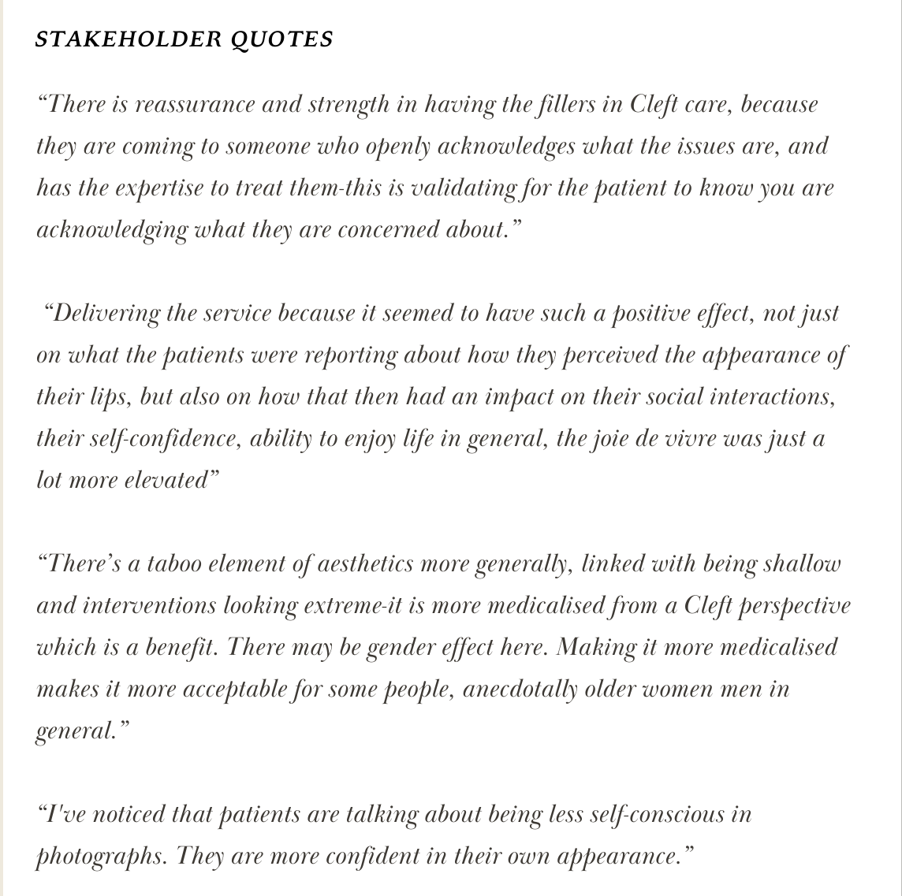

Slide 16
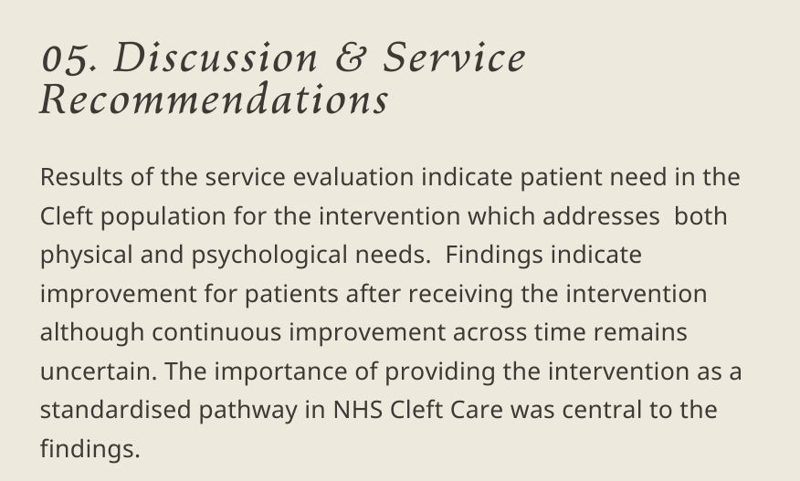

Slide 17
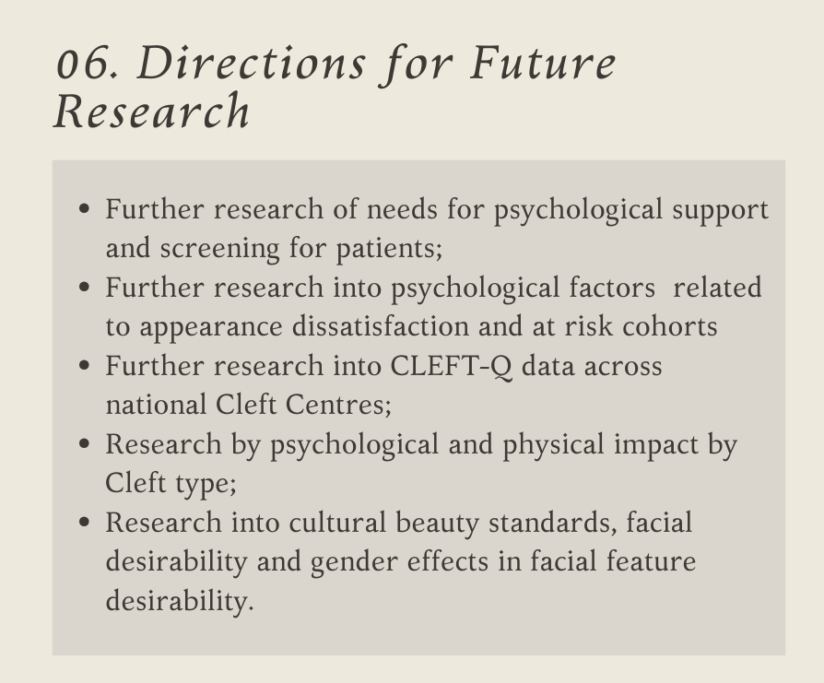

Slide 18
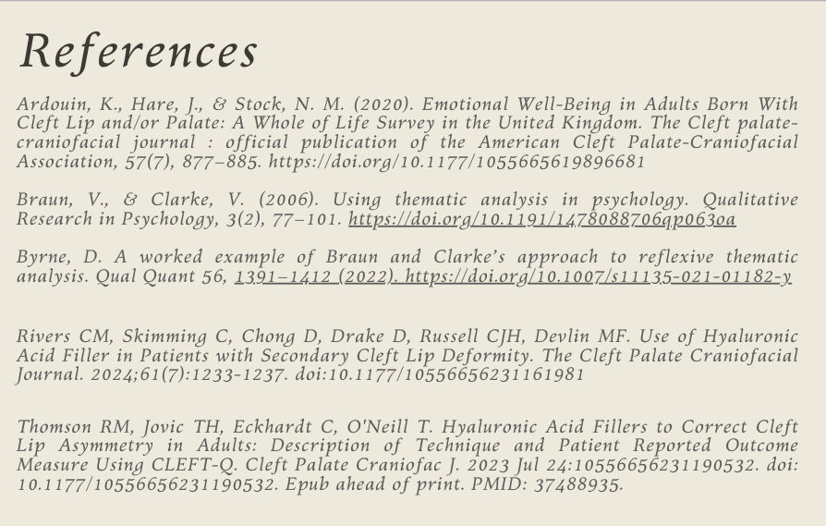

Slide 19
Discussion Points
Are other services offering lip fillers?
What other lip procedures are offered?
Should psychology be involved?
Ensuring continuity of service
How/ what to assess/ measure

