Slide 1
Annual General Meeting
21st July 2022

Slide 2
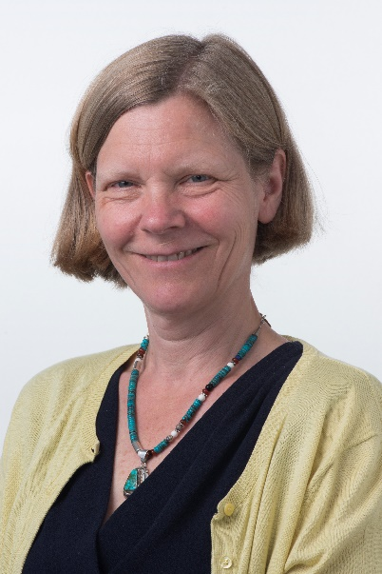
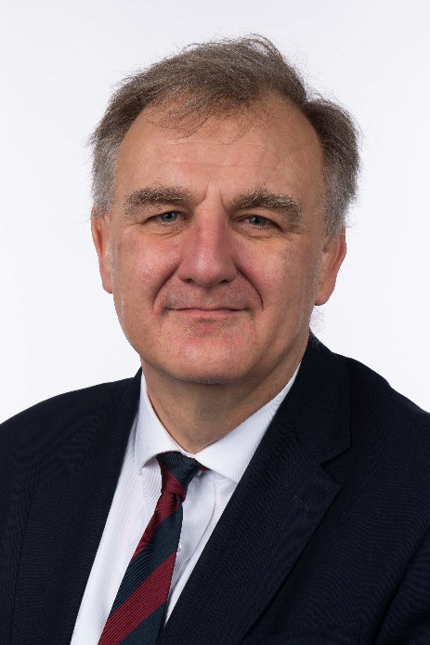
Welcome
Emma Woollett, Chair
Introduction
Mark Hackett, Chief Executive

Slide 3
Changing for the Future
Following a public engagement process over the summer months, we are now starting to take forward our proposals as part of ‘Changing for the Future’;
It’s an ambitious service improvement and change programme which will create more sustainable and effective services for our patients;
This includes recreating our three main hospitals as centres of excellence and some of the changes include:
  Redesign of acute medical services;
  Centralising orthopaedic services at Neath Port Talbot Hospital;
  Primary care pathways to support planned care;
  Virtual wards;
  Investment in palliative care services;
We have already started to make some of the changes:
  £4m investment at Singleton Hospital for a new theatre dedicated to eye surgery;
  4 new theatres at Neath Port Talbot Hospital in a modular building for orthopaedic surgery;
  £21m invested recurrently in surgical capacity, outpatients and diagnostics;
  Delivering the dermatology service differently through virtual group consultations and virtual review of lesions;
  Spirometry, echocardiogram and audiology services in primary care preventing referral to hospital;
  Providing direct access to investigations to GPs to prevent referrals to hospital.

Slide 4
Primary, Community and Therapies Developments
It isn’t just hospital care we have been transforming and some examples include
  Virtual wards launched in four of the eight primary care clusters to provide support for the frail elderly and those with complex health and social care needs in their own homes rather than in hospital;
  Primary care clusters focussed on delivering pre-diabetes, obesity services and prehabilitation lifestyle support for patients with urgent suspected cancer referrals;
  Strengthened bespoke primary care cluster models of mental health and emotional wellbeing support based on population needs;
  Increased audiology and physiotherapy first contact practitioners across clusters;
  Digital services, such as ‘AskmyGP’ and ‘Consultant Connect’ remain in place;
  Therapy services increased support to acute hospitals and since September 2021 have developed a seven-day occupational therapy service;
  Increased provision of community pharmacy independent prescribing services and access to palliative care medicines.

Slide 5
Finance and Performance
For 2021-22, we had a budget of £1.1billion and reported an end-of-year revenue deficit of £24.304m - this was in line with the forecast made at the start of the year;
However, it was a breach of our financial duty to balance, as was the failure to achieve an approved three year plan;
We delivered a balanced capital plan and even had an underspend, with a year-end position of £67.385m when our plan was £67.417m, which was a record amount;
Improving our cost base was a big focus for us to help reduce our deficit and we achieved £28.2m savings against our £27m plan;
We invested £10m in developing new services in 2021-22 and the rest has met increased costs which were unforeseen in the health board.

Slide 6
Access to our services is not as we would like it to be, with our communities waiting a long-time for some treatments impacting on patient and staff experience;
There are a number of initiatives in place to improve our performance;
  £3m has been invested at Morriston Hospital to create an ambulatory assessment unit. The majority of patients attending our emergency department can be seen, assessed and treated within 48 hours (some in the same day) – this new unit will bring together a range of services to see these patients without them needing to be admitted to a specialist ward;
  Investment in care homes beds, domiciliary care and ‘Home First’ for patients to use for a maximum of six weeks once they are ready to leave hospital while their permanent home or care package is finalised;
  Creating a centre of excellence for planned care diagnostics and cancer at Singleton Hospital and for orthopaedics, spinal care, diagnostics and rehabilitation at Neath Port Talbot Hospital;
  Considerable investments to support the most frail patients with virtual wards and palliative care teams;
  Older Persons Assessment Service (OPAS) which provides multi-disciplinary comprehensive geriatric assessment and successful redirection of patients back to the community. It has been recognised nationally with a number of awards;
  Improving access to outpatient services;
  Changing the way we work to provide more primary care delivered services, such as dermatology.

Slide 7
Quality
Quality of care has been an important focus for us;
Five quality priorities were included within the annual plan; sepsis, falls, end-of-life care, suicide and infection control. Good progress is being made across all of these and will carry on into next year;
Particular focus is being given to infection control as our rates are stubbornly and unacceptably high.
There are areas in which care had not been of the optimum standard came to light during the year and we have been tackling these;
These, coupled with internal and external audits of quality governance, found that there was urgent need to develop a quality management system;
Work is now underway to create this.

Slide 8
Children and Young People
Implementation of tuberculosis screening clinics for children and young people;
Sepsis pathway successfully implemented in paediatrics;
Medical students ranked the service the best performing speciality for 6th year;
Multi-organisation milk hub opened in Singleton Hospital which transports donor milk to local health boards;
National and international publications of Bevan project ‘Developing a Tool-kit for the Assessment of Autism Spectrum Disorder’;
Expanded capacity within the general paediatric psychology service and establishment of a school in-reach service for the psychological needs of children with medical conditions;
‘Children's Rights Promises’ launched which sets out 10 promises and lets children and young people know they will be respected, listened to and looked after when receiving care.

Slide 9
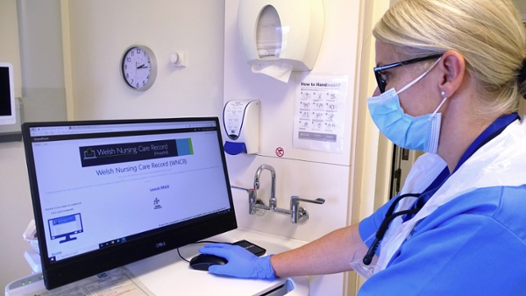
Other Achievements
Donated a plot of land near Morriston Hospital to a not-for-profit independent venture to grow a range of crops as part of a community supported agriculture initiative;
Solar farm at Morriston Hospital officially opened;
First health board in Wales to implement the Welsh Nursing Care Record as well as extended use of e-prescribing across our hospitals;
Extension of the rapid diagnosis clinic at Neath Port Talbot Hospital to provide a one-stop shop to see suspected colorectal cancer and neck lumps, thanks to a donation from Moondance Cancer Initiative.

Slide 10
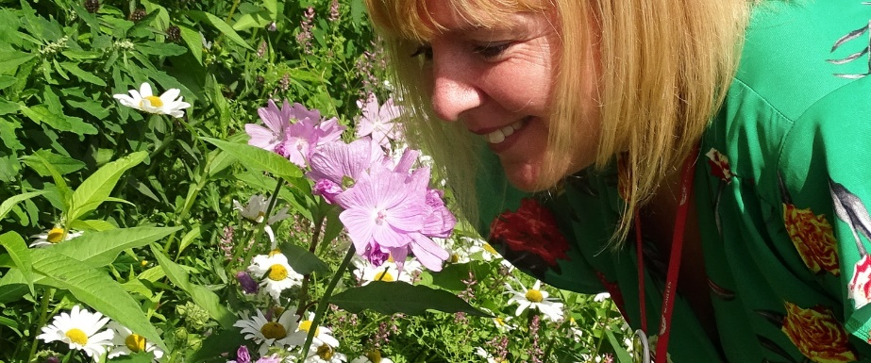
Staff Health and Wellbeing
Investment in our long-Covid services and wellbeing support;
Apprentice Academy recruited 22 apprentices and had 24 apprentices progress beyond their qualifications and gain employment;
The third cohort of our graduate trainee manager programme, Graduate Gateway, was rolled out in May 2021;
The wellbeing service has worked with charitable funds, the estates department and staff to deliver new, secure cycle shelters across the hospital sites in order to promote cycling to work;
More outdoor spaces for staff (and patients and visitors) to enjoy;

Slide 11
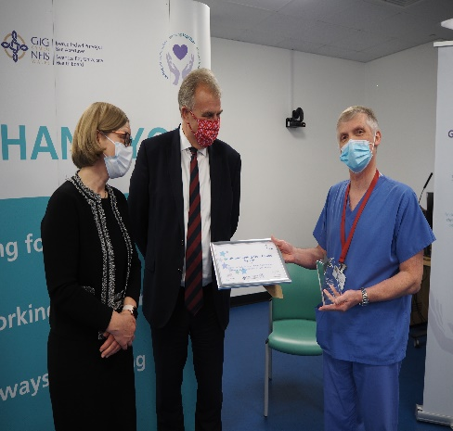
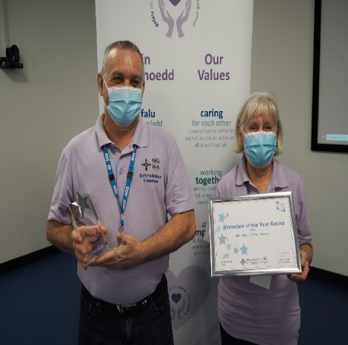
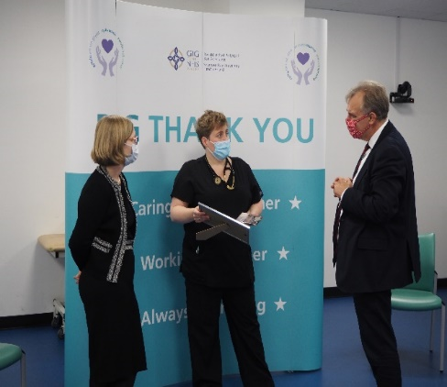
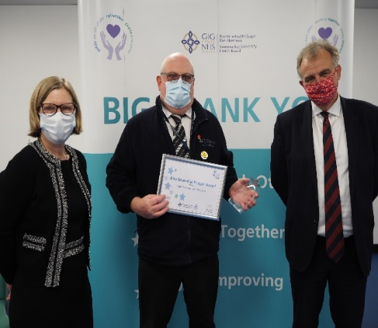
Staff Recognition
15,684 staff and 150 volunteers received Covid ‘thank you’ cards
343 staff received long service recognition packages;
112 ‘Living Our Values’ awards nominations received, with this year seeing the introduction of our first hybrid event and the virtual part of the awards on the evening of 4th November 2021 had over 650 views.

Slide 12
Next Year
Just some of what we hope to achieve over the next 12 months include:
  Expand the local primary mental health service;
  Deliver a wellness centre model across the Swansea Bay region;
  Roll-out virtual wards in all eight clusters to include palliative care and care of the elderly;
  Centralise medical take at Morriston Hospital including seven-day same day emergency care centre and amalgamated urgent primary care centre/ ambulatory emergency care/acute GP unit;
  Implement infection prevention and control reduction targets for primary and secondary care;
  Improve the recognition and compliance of end of life care;
  Invest in population health schemes;
  Modernise learning disabilities services.

Slide 13
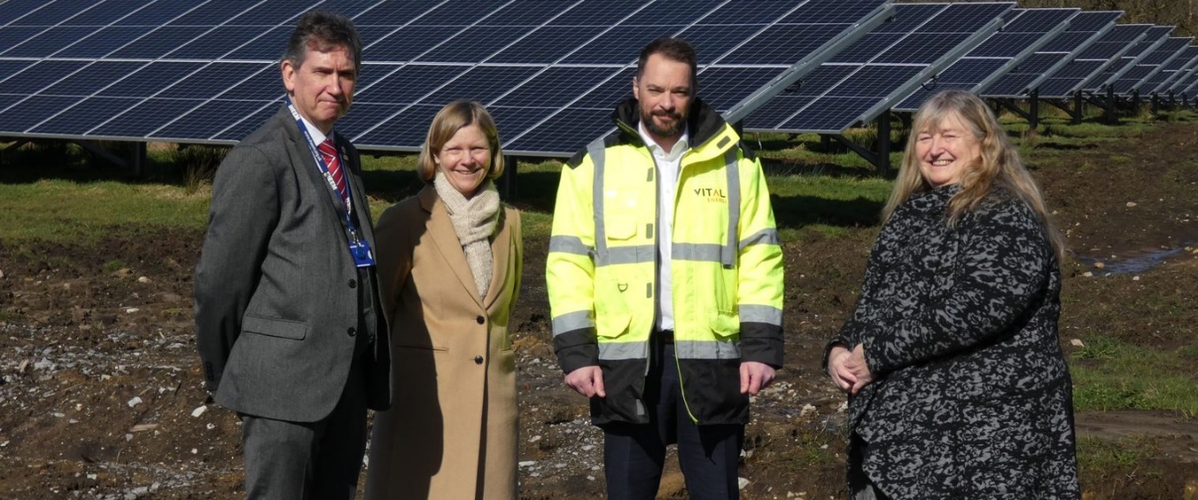
Thank You
Thank you all for attending – this year has been challenging as we move out of responding to Covid and start to recover;
But it has provided us with an opportunity to learn and make the changes to provide better health, better care, better lives.
Any questions?

