Slide 1
Swansea Bay University Health Board
Integrated Performance Report
January 2026

Slide 2
Report Overview
The Health Board Integrated Performance Report will provide updates against all areas under escalation with Welsh Government, all performance metrics outlined within the NHS Wales Performance Framework 202-26, along with updates against the Delivery Expectations and the Ministerial Enabling actions as outlined in the NHS Wales Planning Framework 2025-2028
Section 1: Updates against all Escalation areas with Welsh Government
Section 2: Performance against the Health Board’s Strategic Objectives
Section 3: Service Specific Updates

Slide 3
Section 1:
Updates against all Escalation areas
with Welsh Government

Slide 4

Delivery against Targeted Intervention and Enhanced Monitoring Criteria 2025/26
TI Area (Level 4) | Criteria to achieve | Performance (Dec -25)
Cancer | 60% performance maintained for 3 months against the SCP target. | 52% (Nov- 25)
UEC | Continuous reduction of ambulance handovers over an hour of at least 11% in three consecutive months and maintained for 3 months (Based on Q2/Q3 2023 baseline | 329 (104% increase)
 | Continuous improvement towards no more than 7% of patients waiting over 12 hours at each individual site and across HB | 9.95%
 | Median time from arrival at emergency department to assessment by a clinical decision maker should not exceed 60 minutes | 84.87%
 | Continuous reduction in delayed pathways of care of 5% for three consecutive months and then maintained for three months (based on Oct-Dec 23 baseline) | 169 (5.6% Reduction)
HCAIs | A clear improvement plan based on a root cause analysis to address the issue of hospital onset HCAIs. | In place
 | C-Diff: reduce the number of hospital onset infections by 40% and maintain for 3 months (from a baseline of the average number of cases in quarter 3 of 10 cases to no more than 6 per month | 10 cases
 | Staph aureus: reduce the number of hospital onset infections by 25% and maintain for 3 months (from a baseline of the average number of cases in quarter 3 of 4 cases to no more than 3 per month | 3 cases
 | E-coli: reduce the number of hospital onset infections by 20% and maintain for 3 months (from a baseline of the average number of · cases in quarter 3 of 5 cases to no more than 4 per month) | 4 cases
 | Klebsiella: reduce the number of hospital onset infections by 10% and maintain for 3 months based on 2017/18 figures (baseline –54 cases in 2017/18, reduce to average of at most 4 per month) | 7 cases
Finance | Detailed Updates included in the monthly Escalation Report
Strategy & Planning | Detailed Updates included in the monthly Escalation Report
Maternity & Neonates | Detailed Updates included in the monthly Perinatal Report
Dashboard

Slide 5
Delivery against Targeted Intervention and Enhanced Monitoring Criteria 2025/26
Escalation Area (Level 3) | Criteria to achieve | Performance (Dec-25)
CAMHS | 80% of LPMHSS mental health assessments undertaken within 28 days from the date of receipt of referral | 98%
 | 70% of therapeutic interventions started within 28 days following an assessment by LPMHS | 70%
 | 85% of HB residents in receipt of secondary mental health services who have a valid care and treatment plan | 98%
Planned Care | 100% of open outpatient pathways to be waiting less than 52 weeks and maintained for 3 month | 100%
 | Continuous improvement towards 75% of all open outpatient pathways waiting less than 26 weeks | 78.44%
 | 100% of open pathways to be waiting less than 104 weeks and maintained for 3 months | 100%
 | Continuous improvement towards 80% of all open pathways waiting less than 36 weeks | 75.11%
 | 12% reduction in the number of patients delayed by 100% for their follow up appointment in three consecutive months and maintained for 3 months (Based on the November 2024 baseline.) | 20.76%
 | 68% R1 ophthalmology patient pathways to be waiting within or no longer than 25% of their target date for an outpatient appointment and maintained for 3 months | 71.94%
 | 85% of patients waiting for a diagnostic test to be waiting less than 8 weeks and maintained for 3 months | 66.84%
 | 85% of patients waiting for a diagnostic endoscopy to be waiting less than 8 weeks and maintained for 3 month | 43.95%
 | 85% of patients waiting for a NOUS and non cardiac MRI to be waiting less than 8 weeks and maintained for 3 months. | 67.65%
 | 90% of patients waiting for therapies to be waiting less than 14 weeks and maintained for 3 months | 100%

Slide 6
Section 2:
Summary of the performance against the Health Boards Strategic Objectives

Slide 7





SBUHB Strategic Objectives and Quality Aspects
Our refreshed Strategic Objectives –aligned to ‘a Healthier Wales’ articulate the future state of Swansea Bay UHB as a high-quality organisation. We have set out what this looks like for our population, communities, staff , partners and services and are developing strategic indicators that will tell us if our efforts are delivering our objectives
People of Swansea Bay live healthier, equitable and more equal and prosperous lives
Every child has the best start in life
All children, young people and adults are enabled to maximise their capabilities and have control over their lives
Good work and fair employment is created for all
A healthy standard of living is ensured for all
Healthy and sustainable places are created through placemaking
The role and impact of ill-health prevention is strengthened
Racism, discrimination and their outcomes are tackled
Environmental sustainability and health equity are pursued together
Care is high quality, safe, efficient and delivers the best possible outcomes for people
Care is safe, it helps people and avoids harm
Care is evidence based, effective and improves outcomes
Care is timely and delivered by the right person in the right place
Care is efficient
Care delivers equitable outcomes regardless of demographic, socioeconomic or geographic factors
Care is person centred and delivered with compassion, dignity and mutual respect
Care is delivered in safe and appropriate settings supported by innovative digital solutions
Care is delivered around the patient in the most appropriate setting as close to home as possible supported by digital and data solutions
Care settings are fit for purpose, appropriately designed and equipped
Secure, trusted and insightful data and digital platforms empower staff to deliver more and higher quality care and improved patient outcomes and population health
We have a digitally inclusive culture, where patients, clinicians and non-clinical colleagues work collaboratively to create effective and efficient services and patients are empowered to make informed and meaningful choices about their health and care
Through where and how they are delivered, services contribute to the environmental, economic, social and cultural well-being of Swansea Bay
The health board is a great place to work where staff feel valued and work together towards a common goal
Our Workforce is engaged, motivated and healthy; they feel valued, fairly-rewarded and supported
The Health Board is recognised as an employer of choice
We have a well-planned workforce with the right number of skilled people working on the right things
People feel ready for our digital future
People are supported to develop the skills and capabilities they need
People role model collective and compassionate leadership and live our values
We are diverse and inclusive, ensuring all voices are heard
The health board is a resilient, financially sustainable and responsible organisation
The health board is financially balanced and able to invest in service transformation and change
Decisions are made balancing short-term improvements and long-term impacts
Resources are used efficiently and proportionately, reducing waste and variation
The environmental impact of health care delivery in Swansea Bay is minimised
The health board invests in and works with others locally and responsibly, using our assets to positively contribute to the community
Citizen stakeholders are meaningfully involved and engaged in decision making
The health board has the capacity to effectively plan for and respond to incident and emergencies

Slide 8
People of Swansea Bay live healthier, equitable and more equal and prosperous lives
Childhood Immunisations | Target | Sep-25
Percentage of children who are up to date with the scheduled vaccinations by age 5 (‘4 in 1’ preschool booster, the Hib/MenC booster and the second MMR dose) | 95% | 90.2%
Percentage of children receiving the Human Papillomavirus (HPV) vaccination by the age of 15 | 90% | 84.2%
Influenza & Covid Immunisations
Percentage uptake of the influenza vaccine in adults 65 years and over | 75% | 67.6% (25/26)
Percentage uptake of the COVID-19 vaccination for all those eligible | 75% | 51.9% (Nov-25)
Smoking Cessation
Percentage of adult smokers who make a quit attempt via smoking cessation services | 5% Annual target | N/A
Percentage of adult smokers who make a quit attempt via smoking cessation services who are CO-validated as quit at 4 weeks | 40% annual target | N/A
Screening
Percentage of patients offered an index colonoscopy procedure within 4 weeks | 90% | Please note: PHW data is currently not available for the measures outlined in the Performance Framework
Percentage of well babies entering the new-born hearing screening programme within 4 weeks | 90%
Percentage of eligible new-born babies who have a conclusive bloodspot screening result by day 17 of life | 95%
DE
DE
DE
DE

Slide 9
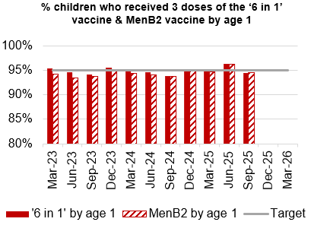
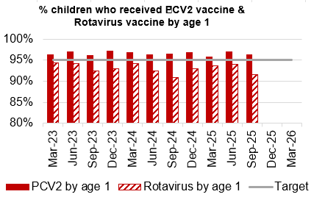
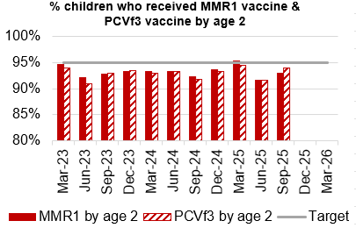
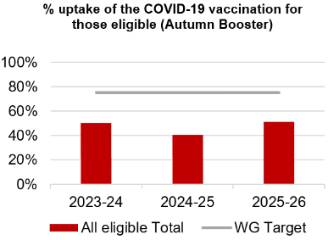
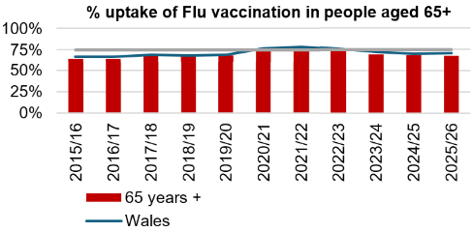
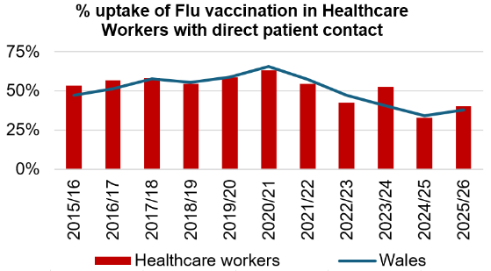
Immunisations
Actions/Updates
Performance against the immunisation targets is reported in arrears on a quarterly basis
Updated targets have been set for the new financial year which can be seen on the graphs above

Slide 10
Care is high quality, safe, efficient and delivers the best possible outcomes for people
Accident & Emergency | Target | Dec-25
4 -hour performance | 95% | 71.96%
12-hour performance | 0 | 1,053
Number of Delayed Pathways of Care (HB wide) | Continuous Reduction | 169
Number of cancelled Electives | 0 | 17
Median time of arrival to assessment within 60 minutes | 97% | 84.87%
Ambulance
Median emergency ambulance response time to purple: arrest category calls | 6-8 minutes | 6.41
Median emergency ambulance response time to red: emergency category calls | 6-8 minutes | 7.41
Total Handovers lost over 15 minutes | 0 | 938
Total Handover Delays > 45 minutes | 0 | 396
DE
TI
DE
TI
TI

Slide 11
Care is high quality, safe, efficient and delivers the best possible outcomes for people
Stroke | Target | Nov -25
Percentage of admission within 4 hours | 95% | 37.5%
Percentage of stroke patients receiving a CT scan within 20 minutes | 40% | 11.5%
Percentage of patients assessed by a stroke consultant within 14 hours | 95% | 48.1%
Percentage of patients to receive a mechanical Thrombectomy | 10% | 0%
Planned Care | Target | Dec – 25
Percentage of patients waiting < 26 weeks for an outpatient appointment | 75% | 78.44%
Total number of patients waiting < 36 weeks | 80% | 75%
Number of patients waiting at Stage 1 > 52 Weeks | 0 | 0
Total number of patients waiting > 104 Weeks | 0 | 0
Diagnostics & Therapies | Target | Dec – 25
Number of patients waiting > 8 weeks for diagnostics | 0 | 6,042
Number of patients waiting > 8 weeks for an Endoscopy | 0 | 1,760
Number of patients waiting > 14 weeks for Therapies | 0 | 0
Number of children waiting > 6 weeks for Audiology | 0 | 127
TI
TI
TI
DE
TI
DE

Slide 12
Care is high quality, safe, efficient and delivers the best possible outcomes for people
FUNB | Target | Dec -25
Number of patients waiting for an outpatient follow-up (booked and not booked) who are delayed past their agreed target date (All Specialties) | N/A | 77,580
Total number of patients waiting 100% over their target date | 0 | 46,418
Total number of patients waiting for a follow-up appointment | N/A | 162,627
Mental Health & Learning Disabilities | Target | Dec – 25
Percentage of mental health assessments undertaken within (up to and including) 28 days from the date of receipt of referral | 80% | 98%
Percentage of therapeutic interventions started within (up to and including) 28 days following an assessment by LPMHSS | 80% | 89%
Percentage of patients waiting less than 26 weeks to start a psychological therapy in Specialist Adult Mental Health | 80% | 41.7%
Quality & Safety | Target | Dec – 25
Number of service user feedback experience responses on CIVICA | Monthly improvement | 5,489
Percentage of complaint responses sent within 30 working days | 80% | 54% (Oct-25)
Number of Nationally Reported Incidents | N/A | 13
Number of New Never Events | N/A | 0
TI
DE
DE
DE

Slide 13
Unscheduled Care

Slide 14
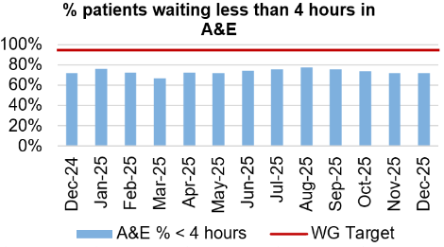
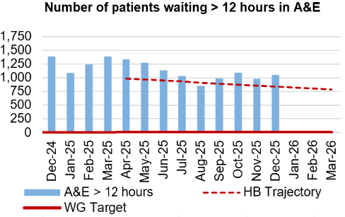
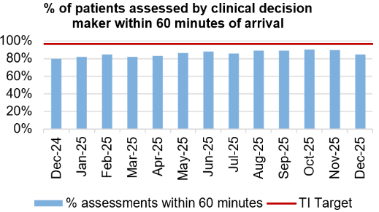
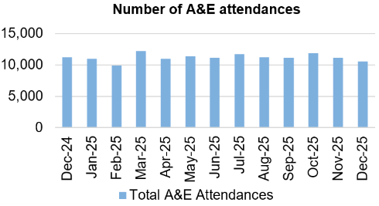
Unscheduled Care
Dashboard
Actions/Updates
Full implementation of D2RA model – Focus on D2RA has rapidly shifted into understanding the demand and capacity position for pathway 2 beds and utilisation of that bed pool. Therapy led audit undertaken in December of all patients occupying a pathway 2 bed. Data analysis in progress with Deloitte’s support. Early indication is that there is opportunity to work with Local Authority partners to potentially reduce the Pathway 2 bed pool and enhance the Pathway 1 offer. The reset fortnight in December demonstrated good opportunity for partnership working, with a focus on those patients who are clinically optimised. This process has continued and there has been some improvement in patient flow. Planning for the transfer of 30 clinically optimised patients from Morriston to Singleton took place during December 2025 and the plan was implemented w/c 5th January 2026.
UEC Care co-ordination Hub – The single point of access has been in place since the 1st October 2025 and the first data submission took place on the 21st November. There is specific focus on the “clinical conversation before convey”, aimed at reducing conveyance of patients from care homes where clinically appropriate to do so. Work is also focussed on the management of patients who fall with the implementation of a level 2 Falls service made up of therapy technicians and a registered therapist, supported by St Johns ambulance provision.

Slide 15

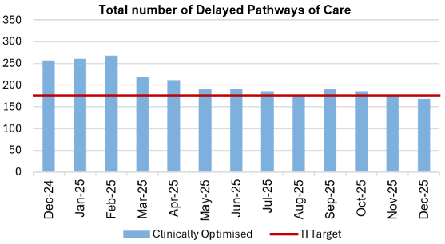



Pathways of Care Delay: Action & Intervention
Site | Delayed Pathways of Care: December 9th | Delayed Pathways of Care: December 17th | Delayed Pathways of Care: December 23rd | Delayed Pathways of Care: December 30th
Learning Disabilities | 9 | 9 | 9 | 9
Mental Health | 34 | 36 | 33 | 33
Morriston Hospital | 95 | 73 | 65 | 70
Neath Port Talbot Hospital | 38 | 33 | 27 | 34
Singleton Hospital | 21 | 18 | 15 | 19
Total | 197 | 169 | 149 | 165
3.25%
WG target -15% reduction in total delays,
20% reduction in assessment delays,
20% reduction in total days delayed from March 2024 baseline
What specific improvements will be delivered?
Further optimize assessment and recovery bed models
Continue refining IDH processes to improve consistency and timeliness
Expand and standardize alternative settings to support discharge and flow
Progress joint work on NPT transfers to Singleton
Maintain POCD sprint methodologies and system-wide coordination
Deloitte Activity in conjunction with West Glamorgan:
  Map D2RA pathways
  Process mapping workshops
  Changes required escalated to appropriate board
Reduce LOS through improved Board Rounds and enhanced MDT approach
What have we done to achieve the positive reduction
Discharge Sprint utilized to focus on long delay cohort, of which 2/3 discharged – ongoing reviews on back of success
Established assessment and recovery beds to support earlier decision-making and flow
Adjusted IDH processes to better meet increased demand and acuity
Increased use of alternative settings to reduce pressure on acute beds
Maintained a multi-agency focus on longest delays, supported by POCD sprint approaches
Used existing escalation and coordination arrangements to manage system pace and complexity
92.6%

Slide 16
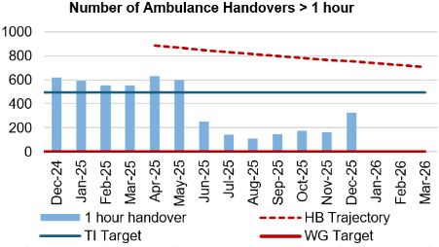
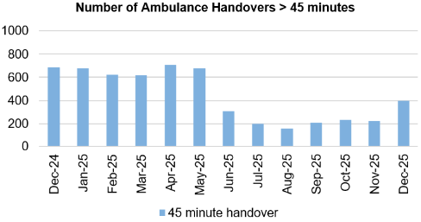
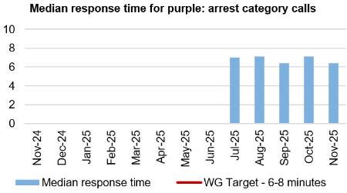
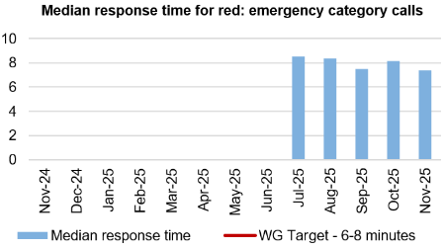
Ambulance
Dashboard
Actions/Updates
Revised flow operating model: The revised operating models implemented as part of the test of change in Morriston remain in place. However, increase in demand for emergency care, high levels of patient occupancy driven by medical bed day utilisation has challenged the Health Board’s ability to maintain flow and thus the level of ambulance handover performance achieved following the tests of change. The emergency pressures have tipped the Health Board into two formal Business Continuity incidents, consistent with the pattern currently seen across NHS Wales. A complicated Infection Control picture further contributes to the interruption of patient flow with capacity reduced as a result of winter illnesses.
UEC capital redesign – Recent communication from the Chief Executive to the Director General of NHS Wales sets out an urgency to progress to an Electronic Patient Record across the Urgent and Emergency care services. Whilst there remains ambition to co-locate front door assessment processes with the emergency department, this programme of work cannot be progressed in the absence of Capital investment.

Slide 17
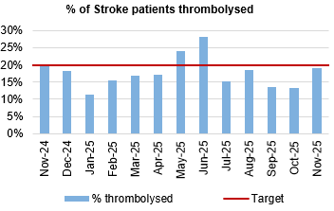
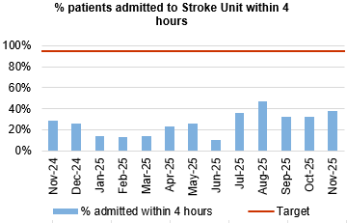
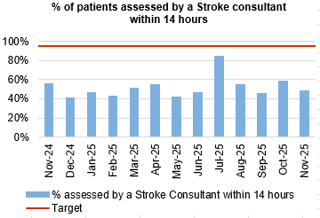
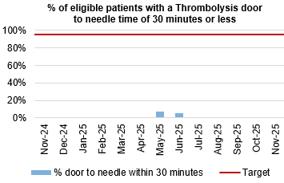
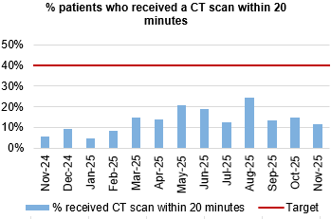
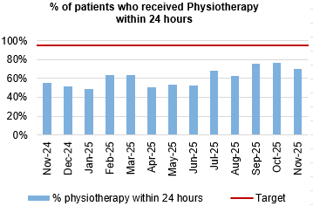
Stroke
Actions/Updates
The directorate management team have introduced several successful ‘Stroke Tests of Change’ in order to improve the flow of stroke patients between Morriston and Neath Port Talbot Hospital, and several actions are currently underway to support further improvement:
  Further increase the stroke Ring-Fenced capacity to enable timely admission
  Development of a dedicated stroke weekend plan
  Implementation and expansion of the CT Perfusion service which will improve access to Thrombolysis and increase compliance
  Introduction of the Tenecteplase to improve time to Thrombolysis
  Implementation of the stroke ACP/CNS Pre-Triage Assessment
  Expansion of the stroke specialised team - CNS/ACP cover 07:30am to midnight 7 days per week.

Slide 18
Planned Care

Slide 19
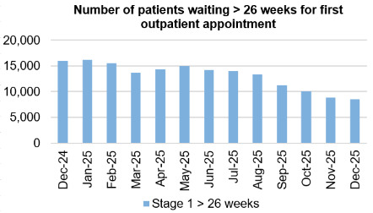
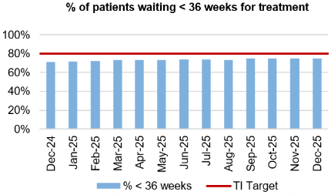
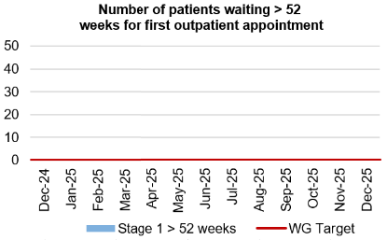
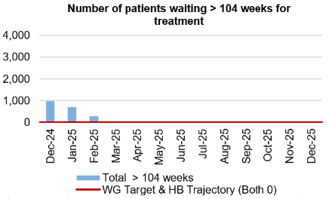
Planned Care
Dashboard
Actions/Updates
The Health Board have maintained the Stage 1 > 52 weeks target of 0 for December 2025.
The Health Board have maintained the number of patients waiting > 104 weeks for treatment target of 0 for December 2025.
Focus has now been placed on achieving a new Targeted Intervention Target for patients waiting >36 weeks for treatment. Welsh Government have provided updated de-escalation criteria for all planned care metrics which reflect encouragement towards an improved position.
Key Risks to delivery include the current physical infrastructure to hold additional clinics, workforce availability, funding and willingness of patients to attend out of hours

Slide 20
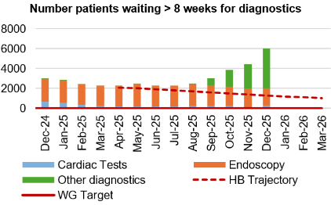
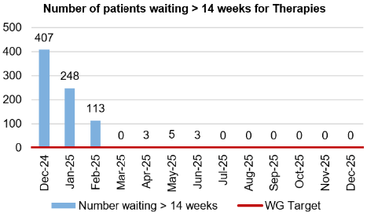
Diagnostics and Therapies
Actions/Updates
The total number of patients waiting > 8 weeks for diagnostics has increased in December to 6,042 compared to 4,434 in November 2025. The increase in the number of patients waiting > 8 weeks for diagnostics is mainly a result of a significant increase in Radiology waits.
As part of the recovery plan, the WG have funded a mobile Endoscopy unit which has been sited on Morriston Hospital to support additional capacity. The unit was unfortunately non-operational throughout the month of December 2025, due to a leak in the roof. The unit has however been running live activity again since the 30th December and is supporting the reduction of the number of patients waiting > 8 weeks for an Endoscopy.
The number of patients waiting > 14 weeks for therapies has been reported as 0 in December 2025

Slide 21
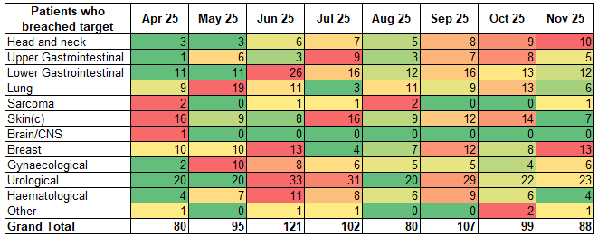
Cancer Performance & Breaches
Actions/Updates
Disappointingly, in October performance fell to 56% and then to 52% in November 2025. It is worth noting that the volume treated in November was particularly low, the lowest since February 2022. There are approximately 60 pathways that are awaiting pathology results at the time of submission, this reduction is predominantly noted for the skin pathway, where volumes reported are 63% lower than November 2024. This is due to delayed pathology reporting, as such we expect the number of confirmed and treated cancers, and consequently performance, will increase at resubmission.
Early indications are that performance between July and September will increase by 1-2%, October performance has already increased to 58% with results still outstanding.
Proactive arrangements are being made with pathology to ensure 4-8 weeks notice for the authorisation of results to support our SCP position at first submission and reduce variation at resubmission

Slide 22
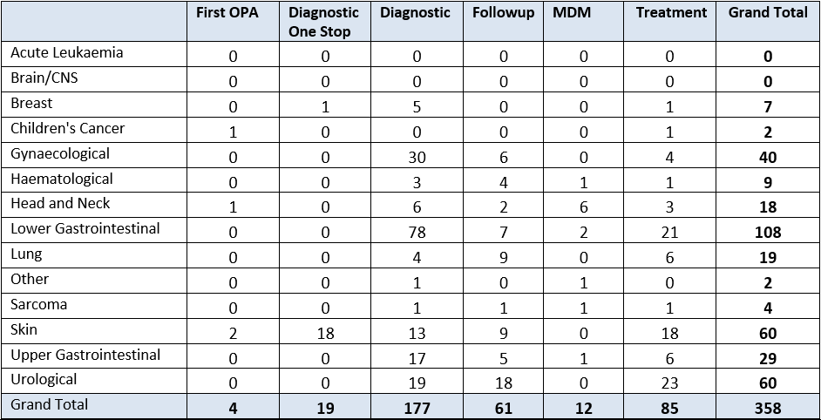
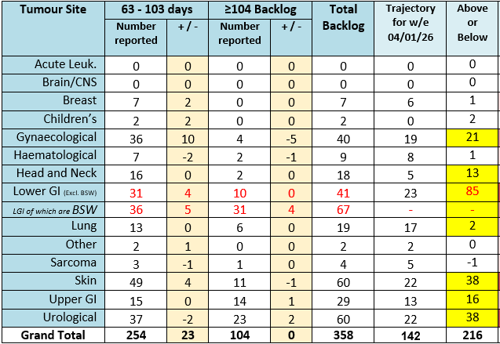
Cancer Backlog
Actions/Updates
All cancer tracking vacancies were filled in November 2025.
An increase in the cancer backlog was anticipated at the end of December, moving into January as a consequence of the holiday period and patient led deferrals.

Slide 23
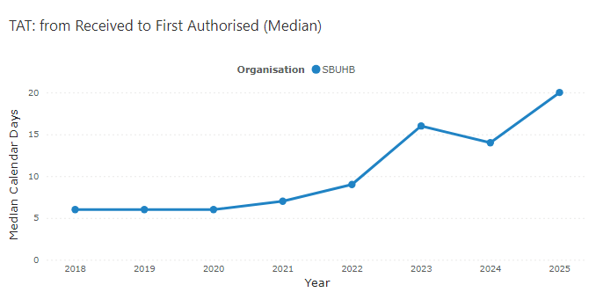
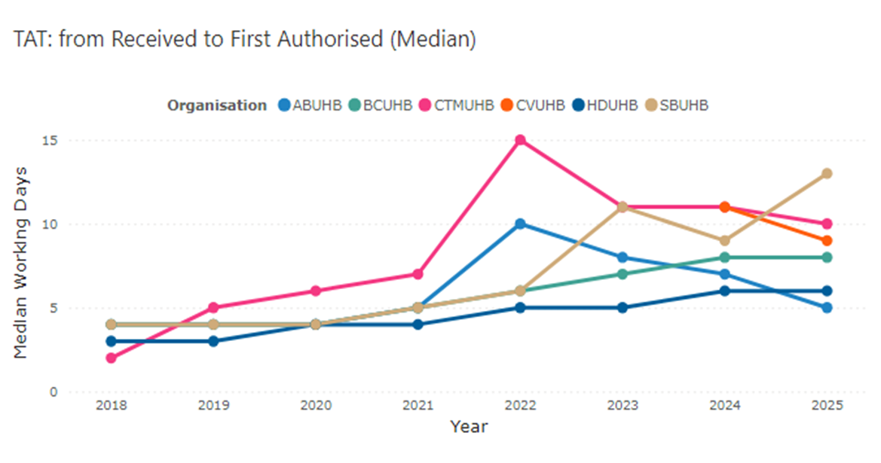
Pathology
All Cellular Pathology Samples
SCP Samples
Actions/Updates
Turnaround Time (TAT) overall have increased in the last year, reaching a peak in December 2025.
Single Cancer Pathway TAT’s have followed the same pattern; however, the median is lower due to the samples being prioritised.
Additional outsourcing was commissioned in October 2025 to address the accumulated backlog of skin and GI SCP samples following the cessation of planned care outsourcing during a three-month period prior to September 2025.
An escalation process has been implemented internally so that SCP samples can be identified and expedited on request to ensure samples reach MDT as soon as possible, TAT’s still remain too high.
Consultant staffing has reduced further in Q3 25/26 due to retirement and short-term notice of a resignation of a locum, vacant sessions are being used to supplement additional outsourcing whilst recruitment is attempted to increase the current staff in post.
Additional BMS hours are still being relied upon to supplement the existing workforce whilst ongoing recruitment takes place.

Slide 24
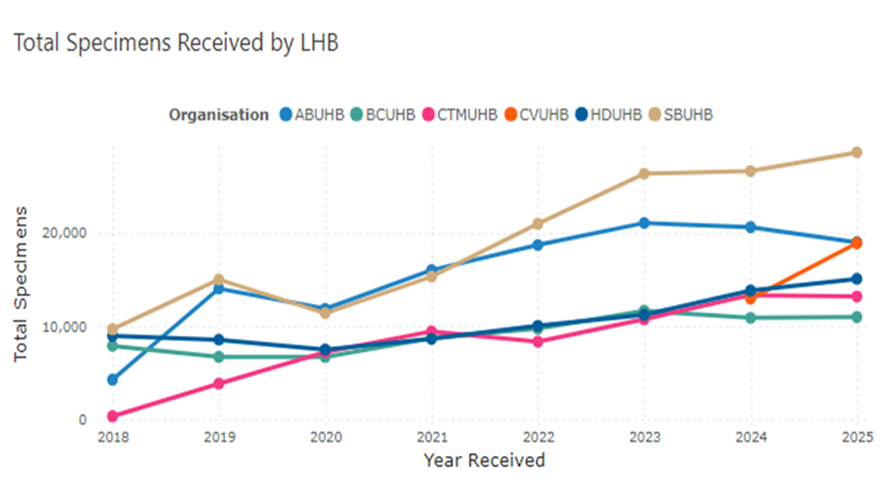
Pathology
SCP Samples
Actions/Updates
The national Cellular Pathology Dashboard shows that SBUHB as an organisation has by far the highest volume of SCP requests processed via its laboratory.
This does not fit with the population size of the organisation in comparison to our peers, this warrants further investigation by tumour site and specialty, this has been identified as an issue through the analysis work Deloitte are currently supporting.
The viability of the CTM SLA has also been reviewed, there is scope to disaggregate this and provide an option to reduce demand into cellular pathology from outside of SBUHB in 2026/27, thus providing clinical capacity back into the system, full financial analysis will be available in February, a formal request will then be made to our executive team via Morriston SLT to serve notice on the current agreement.
The service is considering options as to how the level of activity required to meet the current demand levels can be delivered from 1st April, formal paper will come to execs via Morriston SLT in February.

Slide 25
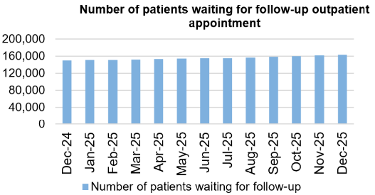
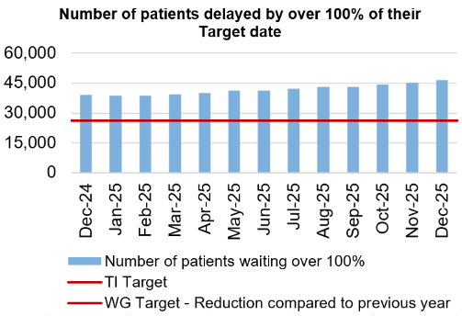
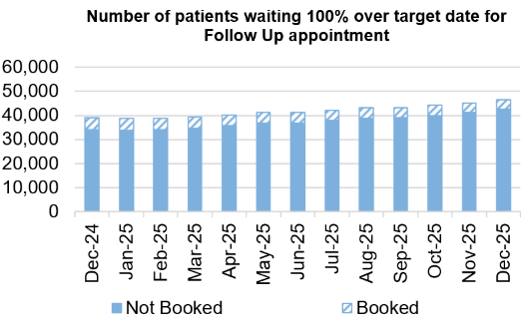
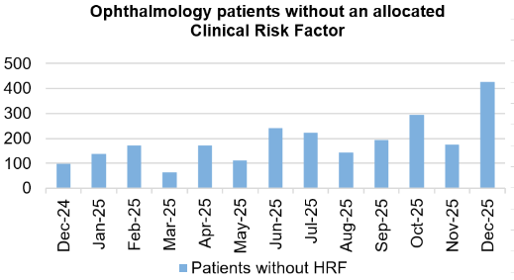
Follow-Ups & Activity

Slide 26
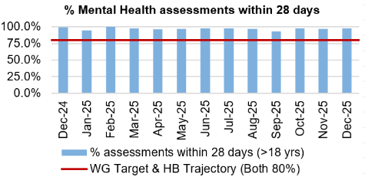
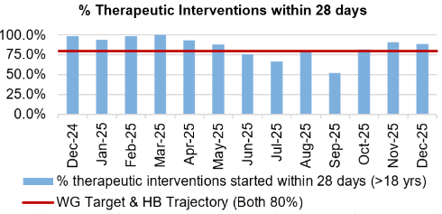
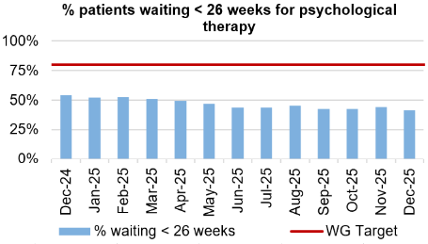
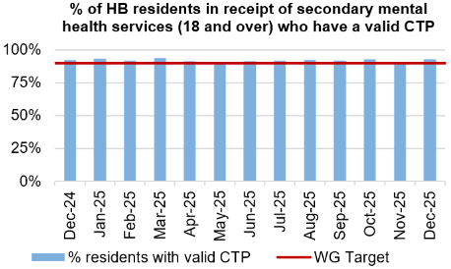
Mental Health & Learning Disabilities
Actions/Updates
The service continues to meet all of the Welsh Government targets, apart from for patients waiting < 26 weeks for Psychological therapies. Waits within this area continue to be a concern Nationally and the service are working closely with Welsh Government colleagues for a solution.
The Health Board continues to report on the work being undertaken as part of the Transformation programme, routine updated are provided to Board.

Slide 27
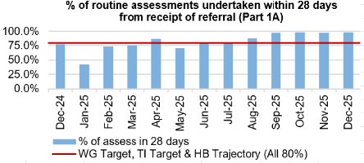
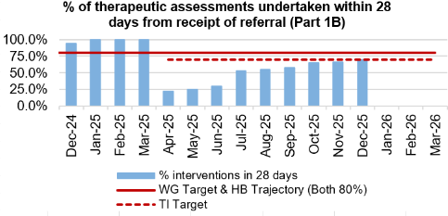
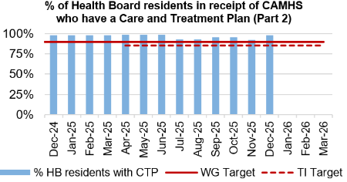
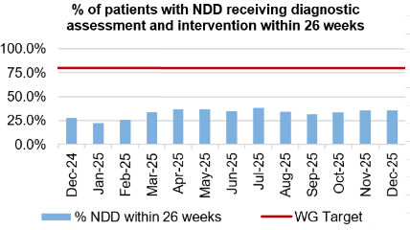
Child and Adolescent Mental Health Service (CAMHS)
Actions/Updates
CAMHS Part 1B:
  Recruitment to vacancies has been successful (1.65wte recruited, due to start in February and March 2026), however sickness and maternity leave weakens the capacity pool to almost pre-recruitment levels presently. The CAMHS Directorate continues to utilise agency staff to offset staffing gap.
  This has resulted in 4 months of small, but consistent improvement in the Part 1B performance irrespective of staffing challenges, which is now at 70% (submitted for Dec 2025). Weekly meetings continue to oversee booking and clinic capacity utilisation, and to utilise our staffing resource as flexibly as possible.
Part 1A has been maintained at 98% in December, with Part 2 also maintaining performance against the trajectory reporting 98% in December.

Slide 28
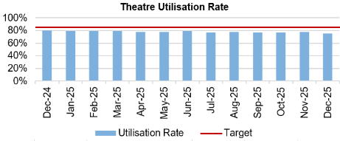
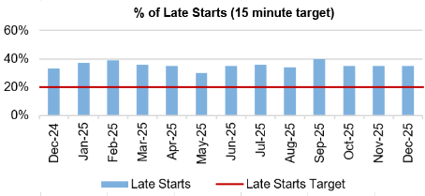
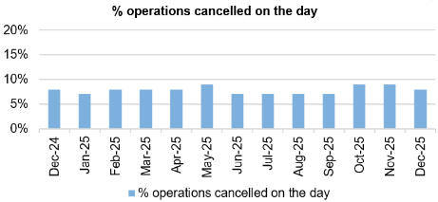
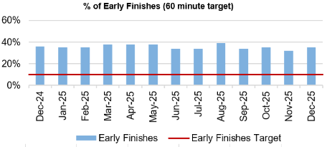
Theatre Efficiency
Actions/Updates
The Planning Framework sets out enabling actions that must underpin the delivery priorities to successfully achieve the core service and changes required. These include value projects, digital innovations, workforce developments, financial sustainability and ways of working. The enabling actions and planning framework have been incorporated into SBUHB’s Theatre performance framework and work is currently underway to report against these measures.
A specific update around Theatre performance has been included in Appendix 1.

Slide 29
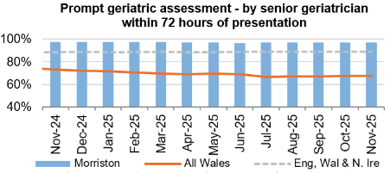





Fractured Neck of Femur (NOF)

Slide 30






Primary Care
Actions/Updates
GMS escalation levels are currently remaining steady as we head into the winter period.
The number of ACORNS completed is showing a steady increase towards the target as the year goes on.
Floride varnish remains over target for both children and adults.
The number of patients for eye health care Wales (emergency eye care) has increased from an average of 2,245 per month last year to an average of 2,641 per month this year to date. There is a slight increase in the number of patients receiving low vision services with an increase in domiciliary visits in particular.
Common ailments consultations continue to increase with an average of 900 more consultations per month in comparison to 24/25. If this trend continues this would be a further 17% increase on last year.

Slide 31
Quality & Safety

Slide 32




Infection, Prevention & Control
Dashboard
Actions/Updates
Gold C. difficile High Incidence Management Group.
Monitoring of C. difficile Standards: Risk Assessment & Governance Framework. Continuation of QI Project in Acute Medical Unit focusing on AMS and 72-hour review and improving switch to oral route for administration.
Scoping exercise to explore the feasibility of extending role of ward based enhanced cleaner. Trial of new Microfibre cleaning systems
Primary care QI projects to reduce urinary tract infections in care home residents.
Scoping the development of an equipment decontamination facility.
Review of prescribing guidelines for antibiotic prophylaxis during prolonged surgical interventions.

Slide 33




Serious Incidents and Risks
Actions/Updates
There were 13 Nationally Reported Incidents reported in December 2025 and there were no new never events reported. The detail surrounding the nature of the reported NRI’s can be found on the subsequent pages.
In December 2025, there were 105 open risks with a score >20 recorded for the Health Bord which is slightly higher than the figure reported in November. There were 246 open risks with a score >16, which again is a slight increase compared to 243 in November 2025.
There were 140 hospital falls recorded in December 2025

Slide 34

NRIs/NE’s/EWNs – December 2025
What is the data telling us?
Graph 1 – Number of NRIs/NE’s reported to P&I (includes retrospective reporting of: 3 avoidable in-patient falls; 1 avoidable pressure damage; 1 prison death; 2 Must Reports
Graph 2 – 37 NRIs open with NHSWP&I – 14 open past closure date of which 6 are awaiting outcome of external reviews; 2 infant deaths require receipt of external review before closure can occur; 6 remain under investigation
Graph 3 – Outcome forms submitted in month (67% performance)
What are we doing about it?
Weekly review with PSI investigator to:
  monitor progress of corporate investigations; identify barriers
  escalate outstanding actions required
Fortnightly service group meetings:
  service group investigations - progress towards closure date discussed
  updates on PSI investigation given
  escalate to service group barriers identified with corporate PSI investigations
Service Group Directors contacted separately for outstanding actions
Data presented and discussed at health board Patient Safety and Compliance Group; Quality and Safety Group; Patient Stakeholder and Experience Group - Service Group assurance sought against outstanding actions for completion of investigation / outcome form
What do we expect to see change and when?
Reduction in number of overdue investigation outcomes forms
Reduction in number of NRIs/NEs reported through recommendations/learning monthly.
EWNs – December 2025
Ombudsman Public Interest report re Orthopaedic waiting times
Patient known previously to SBU MH Services charged with murder in Birmingham area
Abscondment of patient detained under Section 3 MHA (has since returned)
NMC hearing – gross misconduct
GMS – data breach involving patient email addresses
Risk or adverse publicity - Parents approached ‘Wales On-line’ following care episode

Slide 35
NRI Learning (YCFFs) – December 2025
Domain 1 – Situational Factors | Team Factors: Absence of feedback Known to mobilise with Zimmer frame without assistance – patient on 15-min checks Low staff morale due to ward move Staff from other areas have joined to support team but needed to settle Although evidence of turning patient 4-hrly, gaps seen on skin bundle Individual Staff Factors: Ward recently relocated from neighbouring hospital | Patient factors: Birth outside midwifery led guidance a home. Counselling of risks documented in detail Uncooperative at times / did not always accept help when offered Complex medical history with LD/MH diagnoses Extreme pre-term infant born at 22+2 weeks – expected mortality due to risks BAPM framework History of previous falls suffering fractured NOF and ongoing cognitive impairment Declining mobility (COPD/AF/frailty) – identified placement in nursing home prior to admission to hospital
Domain 2 – Local Working Conditions | Workload and staffing issues: Staff sickness within team – maintained with support from other areas Due to vacancies in RNs/sickness – reliant on bank staff each shift Leadership, supervision and roles: Unclear responsibilities – CTP did not accurately reflect services open to the patient at the time of the incident MHS assessment not undertaken as required following assessment by LD Psych – lack of understanding of process for initiating MHA assessment Failure to undertake 15-min checks in place | Drugs, equipment and supplies: Recommendation from external review for community midwives to carry pulse oximetry, oxygen and portable suction Recommendation in relation to PPH management in Community Multiple mattress failures have occurred on ward. On initial transfer to ward, approx. 1/3 of the mattresses delivered failed
Domain 3 – Organisational Factors | Physical environment: No mobile phone signal at property Support from other departments: Delay in provision of care due to lack of organisational clarity between MH & LD services Transfer to an appropriate ward/hospital Difficulties in findings a bed Lack of out of hours support | Staff training and education: TVNs and PDNs providing updated training to staff due to knowledge gaps identified
Domain 4 – External factors | National Policies: Infection prevention management
Domain 5 – Communication and Culture | Safety culture: Patient Safety awareness Lack of awareness of harm Attitude to risk management The presence of spilled water on floor likely contributed to fall due to loss of balance/slipping Previous pressure damage reported on the ward not identified to the wider team | Verbal and Written communication: Poor communication between staff. Poor communication/handover between teams Documentation did not clearly record the rationale for not using flat lifting equipment following the fall despite the patient’s known injury history and difficulties weight-bearing. Inconsistencies in the Purpose T and skin inspection assessments. Not clearly documented on SIGNAL when PU identified Poor written communication

Slide 36




Falls Prevention
  December 2025
Page 1
What is the Data telling us?:
In-patient falls rate remains below National average
December 2025 saw the lowest reported incidents for falls in for 18 months (15% lower than same time previous year)
Falls rate by ward has seen biggest reduction at Cefn Coed site across all older persons wards
Falls related attendance to MIU down 14% compared to same time last year. ED MGH up 4% when comparing the same period.
There have been 5 NRI falls related incidents in the last 12 months (Sept'24-Aug'25) compared to 10 in the previous 12 months = 50% decrease
Care Home falls project continuing roll out – now live across 8 homes and preparatory work across other sites complete – current ambulance call out rate at under 17% (compared to previous 94%)
Underlying causes:
Ageing population with increasing frailty picture
Increased demand on WAST and front door services
Limited alternative WAST response to level 1 and level 2 falls regionally
Inconsistent approach to falls advice in community/primary care
Reduced access and provision of falls clinics across region
Insufficient access to appropriate strength and balance exercise provision
Some ward areas including AMU do not have an environment which enables safe monitoring of patients at risk of falls
Risk assessment and care planning inconsistent and inaccurate in some areas of HB
Safe Care partnership work on deconditioning progressing
HB wide falls incident
Cefn Coed Falls rates/1000 bed days
What are we doing about it:
Regional Falls Prevention taskforce enabling collaboration
Primary Care action plan agreed
Roll out of level 1 falls response across care homes and Dom care
Enhanced falls response service launched (initial data suggests 50% stay home rate from otherwise inevitable conveyence)
Falls page on Waiting Well internet pages
Falls response project won NHS Wales award and shortlisted for HSJ award
Safe Care partnership work on deconditioning concluded
3 patient engagement events attended with over 40 meaningful interactions with members of public re falls prevention and active ageing
What do we expect to see change?
Reduction in WAST call out from care homes following falls incident (goal – 30% reduction per site by March '26) - ON TRACKI
Falls rate not exceeding 5.0 (falls/1000beddays) over proceeding 12 months – ON TRACK
Reduction in conveyance to hospital via WAST for level 2 falls (WG target of 25% reduction) - OFF TRACK - initial data suggests minimal impact currently on level 2 falls however service evolving to offer enhanced response to patients in ED and OPAU to improve admission rates

Slide 37




Patient Experience & Concerns
Actions/Updates
There were 5,070 friends and family surveys completed in December 2025 which is a reduction on the previous month where 5,565 surveys were completed.
Of those surveys completed, the 92% of patients would highly recommend the services they received.
There were 224 concerns received in October 2025, and 54% of those concerns had responses sent within 30 days in October.

Slide 38
Complaints – December 2025
What is the data telling us?
Graph 1 – is indicating that a number of complaints are not compliant with the 30 working day target for responding to formal complaints in line with the Putting Things Right Guidance.
Graph 2 – 162 new formal complaints in December which is a decrease compared to 170 in November.
Graph 3 - The average number of days taken to close a formal complaint has decreased by 4 working days compared to the previous month. Average days for October being 29 days which is within the Welsh Government target of 30 working days.
Graph 4 - The number of overdue formal complaints is increasing bi-weekly. As of the 30th December, 330 formal complaints were overdue
What are we doing about it?
Bi-weekly report run on all overdue complaints which is sent to each Service Groups requesting updates.
Bi-weekly drop-in sessions where complaint handlers can join to discuss any issues.
Bi-weekly meetings with Service Groups to discuss open complaints and Ombudsman cases.
Test to Change in SNPT to trial new way of managing complaints and trying to resolve early on.
What do we expect to see change and when?
Reduction in the overdue complaints by January 2026, in readiness for the new Putting Things Right Guidance being introduced in April 2026.
Early engagement with the complainant combined with listening meetings which will support an empathetic and compassionate handling of the complaint.
**Please note two graphs only go up as far as October, this is due to the 30 working days for complaints received in Nov/Dec not being up yet

Slide 39
Patient Experience – December 2025
What is the data telling us?
Graph 1 – Illustrates that Swansea Bay UHB’s overall score consistently exceeds the benchmark of 85%, maintaining a performance of 90% or higher.
Graph 2 – Displays the overall satisfaction scores across the different Service Groups.
Graph 3 – Highlights wards/clinics achieving scores above 100%, based on more than 25 responses..
Graph 4 – Identifies the wards/clinics with the lowest satisfaction percentages.
What are we doing about it?
The system generates weekly feedback summaries for Service Group Leads, enabling timely action on low scores and recognition of positive feedback and comments.
Ongoing drop-in feedback sessions are held to support teams in using Civica effectively and managing their feedback constructively.
For alerts flagged as very poor or poor, the Action Manager is triggered. This tool tracks the progress and resolution of issues within Civica, managed by the PALS and Quality & Safety departments.
What do we expect to see change and when?
We expect departments to take ownership of their low scores and implement improvements based on the feedback provided. Our role is to ensure timely alerts and supply weekly comment reports to support this process.
Graph 1
Graph 3
Graph 2
Graph 4

Slide 40




Quality & Safety
Actions/Updates
The percentage of completed discharge summaries was 71% in December 2025, which is higher than the figure which was reported in November.
There were 134 Pressure Ulcers reported in November 2025, of which 32 were recorded in the Community.
The percentage of episodes clinically coded within 1 month of discharge remained the same in November, reporting 63%.

Slide 41


Pressure Damage
Quarter 3 2025 : 9 % reduction in total numbers of HB acquired incidents reported and 15 % reduction comparing April - Nov 2024 to April to Nov 2025.
Primary and community services have seen 27% decrease compared to the previous 2 quarters. (PCS shows quarter-to-quarter fluctuations: both increases and decreases. A sustained decrease is atypical and should be examined carefully).
The inpatient incident rate is 1.8 per 1,000 bed days, 0.1 % increase to previous quarter.
Morriston has seen a total rate reduction from (R2.4) to (R 2.1 ) NPSSG has seen a total rate of (R 1.5).
The highest inpatient rates were observed in Morriston (R 2.6) early 2025, and the lowest NPSSG (R 1.1). PCS rates prove challenging due to inaccuracy on caseload dashboards. These figures are reflecting increased numbers but do not reflect avoidability status.
Severity: 90 % of all HBA incidents remain superficial in nature .
10% are deep in nature.
76% of deep damage ulcers developed under PCS in patients’ own homes, 24 % In our hospital settings.
The HB have seen an 8% reduction in deep tissue damage reflecting the last cleansed data.
70% all HBA investigated deemed unavoidable (15% improvement)- since Quarter 1
Over 90% of all community damage incidents investigated were deemed unavoidable.
Governance & Learning Of incidents closed in the last quarter: we now see an Improving picture that 65% of all incidents have been investigated and closed. This still requires work and the efficiency of investigating and scrutiny is key to this.
70% deemed unavoidable 30% deemed avoidable, which is a significant improvement however with 35% not investigated or closed, this does not reflect total status until end of next quarter.
Graph 1 Total numbers of Incidents HB acquired. November and December require cleansing and scrutinising, not a reflective number.
Actions to Address Pressure Ulcers:
Governance & Oversight: Pressure Ulcer Strategic Group, scrutiny panels, peer reviews.
Audits & Data: audits and review
Education & Training: Multilayered education across staff groups
Pathways & Policies: Development of PU pathways, policies, and improvement plans
Resources & Technology: Centralised Tissue Viability service, digital wound imaging, bed contract finalisation. Shared education, champions and skills programme
Collaboration: Shared responsibility and learning
Leadership- Strengthen leadership and accountability
Improvement Goals
↓ 20% PU rates in acute sites; ≤1.6/1000 bed days.
↓ 20 % avoidable PU in HB.
↓ Reduce total number of HBA incidents by 10%
↓ Reduce HB acquired Deep damage by 10%
Improved staff skills, governance, and learning culture.
Equitable access to tissue viability services & medical photography across sites.
Better supported care homes.
Patients consistently receive “right care, right time.”
Graph 3

Slide 42


Mortality: Action & Intervention
3.25%
The summary of deaths in the Emergency Department can be seen below:
Mortality Data Summary
The crude mortality rate has seen an increase in December 2025, reporting 1.53% compared to the previous figure of 1.32% in November 2025.
Crude mortality over the last 4 years is within the control limits and the recent data reflects the predicted decline of mortality as expected during summer months
The summary of deaths in the Emergency Department has remained relatively stable in recent months
92.6%

Slide 43
Maternity & Neonates

Slide 44




Maternity & Neonates
Perinatal Mortality - Stillbirths | Perinatal Mortality - Neonatal Deaths
There have been 11 stillbirths during this period, all are included in the MBRRACE reporting data. One case did not receive any antenatal care within Swansea Bay; one was an unknown pregnancy that delivered pre-hospital with maternity services involved postnatally to provide care and support.
There have been seven neonatal deaths between January 2025 and November 2025 and of these cases only five are reportable to MBRRACE as two were over 28 days of life. Of these five, only two will be represented in the MBRRACE report as deaths <24 weeks gestation are not included in the final report for analysis. The three deaths not included in MBRRACE analysis were extremely pre-term (less than 24 weeks) at the limit of viability .
There have been no deaths reported since August 2025. This is lower than what has been seen in recent years for SBUHB. December data required to make a final assessment.
Perinatal Morbidity – HIE Grade 2 and 3 | Maternal Morbidity – PPH <1.5litres
There have been five cases of HIE reported in this period. All babies survived to discharge with good outcomes. There is limited data published to allow National benchmarking. Latest published data from National Neonatal Research Database (NNRD) is 4 years out of date (Department of Health, 2021 data). This reports a UK average incidence for Moderate and Severe HIE cases of 1.59/1000 births (1.49-1.70).
Due to the low number of HIE and births in SBUHB a rolling 12-month HIE incidence reporting is more appropriate. This shows that in November our moderate to severe rolling 12-month HIE rate was 1.84/1000 births. This represents a 45% decrease since its peak in April 2024 of 3.32/1000 births. The 2025 HIE rate up until November was 1.68/1000 births.
The NMPA published 2023 data for National benchmarking and reported postpartum haemorrhage incidence as 3.41/1000 births (2.98-3.79). SBUHB rate for postpartum haemorrhage in 2025 was reported as 2.49/1000 births, lower than the National benchmark. This showed a steady reduction from 2024 data, of 3.51/1000 births.

Slide 45


Maternity & Neonates
Maternity Triage - BSOTS
Birmingham Symptom Specific Obstetric Triage System (BSOTS) is the Maternity services emergency department to support women experiencing concerns or urgent complications with their pregnancy or postnatal period. The following metrics help the system understand how effective, efficient, timely and safe our triage system is in responding to these. In October 466 women were reviewed in triage and assessed for ongoing care requirements. Initial trigae within 15 minutes, standard is 90% - rate in October 90.80%. There were 4 incidents reported due to delay in obtaining medical review following initial assessment and risk stratification for yellow, amber and red pathways, which amounts to a breach of time for review of 6.9%. There were no incidents relating to harm reported as a result. Where breach in time to review is identified, an additional measure which looks at what time review was achieved will be introduced. Singleton Maternity Triage Team celebrated 1 year since roll out of BSOTS in November 2024. During this period 5955 women attended for review - 4426 women self-referred, 526 were referred by Antenatal Clinic, 588 were referred by other allied health professionals.
Workforce – Maternity Staffing Establishment | Workforce – Neonatal Staffing Establishment

Slide 46



Maternity & Neonates
Perinatal Training Compliance
 | There have been some challenges within the Neonatal medical workforce due to unavailability, this has been mitigated with flexible working arrangements which has meant there has been no gap in service. A Neonatal Consultant was successfully recruited on the 9th December, with 1 expected return following maternity leave in January. Obstetric workforce – 2 fixed term gaps for career break and other leave have been covered with no vacancies impacting on services. Training compliance is improving across the board and individual staff out of compliance have been emailed to complete their mandatory training. Respective line managers follow up is in place.

Slide 47
Care is delivered in safe and appropriate settings supported by innovative digital solutions
Communication with primary care ​ | Target​ | Oct 25​ | Nov 25 ​ | Dec 25 ​
% of discharge letters sent to GP ​ | 100% | ​69% | 73%​ | 71%​
Digital Inclusion ​ | Target​​ | ​ | ​ | ​
Total number of citizens that have downloaded the NHS Wales App | ​TBC | 72,651 | 75,406 | 77,829 (16% of population)
Total number of outpatients that have downloaded the Swansea Bay Patient Portal | 50%​ | 33,949 | 37,388 | 40,699 (​14% of outpatients)
% of Digital Health Assessment forms Completion Rate | 60%​ | 34.32%​ | 27.22%​ | 56.15% (2652 completed forms)
Diagnostic requesting ​ | ​ | ​ | ​ | ​
% of secondary care pathology tests raised electronically ​ | ​90% | ​83% | ​83.2% | ​85%
% of primary care pathology tests raised electronically ​ | ​95% | 95%​ | 95%​ | 95%​
Supporting safe discharge ​ | Target​ | ​ | ​ | ​
% of patients with a recorded estimated date of discharge | ​100% | 38% | 35% | 37%

Slide 48


Care is delivered in safe and appropriate settings supported by innovative digital solutions
National and Local Digital System availability​ | Target​ | Oct 25​ | Nov 25 ​ | Dec 25 ​
National | ​99.90% | 99.96% | 99.98% | 99.998%
Local | ​99.90% | 99.996% | 100% | 100%
Data Driven Organisation​ | Target​ | Oct 25​ | Nov 25 ​ | Dec 25 ​
No. Staff attended Digital Intelligence Data Literacy Course | 10 | 0 | 10 | 0
No. Unique Users Accessed Digital Intelligence Analytical Tools | 356 | 493 | 480 | 456
M365 Digital Champions engagement over the previous 12 months

Slide 49
Care is delivered in safe and appropriate settings supported by innovative digital solutions
A summary of the digital projects and their delivery status has been outlined below for Quarter 3:
Title | RAG Status | Rationale for RAG Status
D01 & D04 - Unscheduled and Emergency Care Solution encompassing delivery of the WECDS dataset | Amber | There is a requirement to provide a digital system to span UEC, rationalising the 7 different systems currently deployed across the UEC footprint. The solution must deliver against the WECDS dataset whilst also serving as replacement solution for the national WEDS solution in the MIU. The contract for WEDS in the MIU expires in May 2026. The digital team along with operational colleagues are developing a document to set out the proposed way forward for consideration by Execs at the end of Jan.
D02 - Pathology digital system replacement (LIMS 2.0) | Red | SBUHB Cellular Pathology’s go-live was delayed from November due to defect resolution and bulk data upload issues. A revised date of 12 January 2026 is confirmed. Blood Sciences aims for an ambitious Wales-wide go-live by end of Q1, but 217 critical defects pose significant risk. Microbiology is planned for a “big bang” implementation by April 2026, with confidence in meeting this deadline. Blood Bank faces risks as its current LIMS module becomes unsupported from August 2026, and the national migration plan is only now being worked up. To mitigate delays, a backup plan with estimated SBUHB costs of £0.4m per quarter is under review. These delays are recorded on the Health Board risk register (Datix ID 3114, score 16).
D03 - Radiology digital systems replacement (RISP) | Red | SBUHB is scheduled to go live with the Radiology system on 23 February 2026, with strong resource commitment across digital and operational teams. Quarter 3 saw good progress in system configuration and PACS data migration. Risks remain around testing (starting 5 January) and checks of scanner connectivity (21 January–11 February) potentially surfacing critical defects. The project team is closely monitoring the critical path and dependencies with DHCW, Soliton, and Philips. Concerns persist about Philips’ capacity to meet milestones; escalations continue, including a request to meet with their Managing Director in early January. Financial risk exists if Philips misses deadlines, with a potential impact of £150k. The Fuji PACS contract has been extended to March 2027 as mitigation to any further delays.

Slide 50
Care is delivered in safe and appropriate settings supported by innovative digital solutions
Title | RAG Status | Rationale for RAG Status
D05 - Patient Portal/NHS App | Green
D06 - Connecting Care (Rio Implementation across Integrated Teams) | Green
D07 - Hybrid Mail | Green
D08 - Signal | Green
D09 - Welsh Clinical Portal - Hospital Initiated Referrals | Green
D10 - Digital Health Assessments | Green
D11 - Welsh Nursing Care Record - Paediatrics | Green
D12 - Digital Maternity Cymru | Amber | RAG status remains as Amber due to ongoing concerns regarding the limited integrations scheduled for delivery in readiness for go live in March 2026. A clinical risk assessment has been undertaken, which is being escalated nationally. There is also slippage within the configuration workstream, however the team remain committed to working to meet the challenging timescales which were agreed nationally.
D13 - e-Prescribing & Meds Management (shared medicines record) | Amber | There is still a dependency on System C to provide us with development timescales and costs. We are working with System C to review what is required to develop the integration to the SMR, with a view this capability will be on their roadmap for 26/27.
D14 - WPAS and associated services disaggregation | Green
D15 - Implement Open Eyes (Open ERS/Open EPR) | Amber | Open Eyes continues to well received by the Ophthalmology Service. Welsh Government have written to all organisations to mandate the implementation of the Electronic Referral System solution to support WGOS pathways which is currently being configured nationally by DHCW. Timescales for completion are unavailable. In addition, DHCW are yet to engage with Health Boards to agree a rollout schedule.
D16 - Welsh Intensive Care Information System - Implementation | Green
D17 - Expand Electronic Test Requesting to cardiology | Amber | Timescales elongated for a number of integrations due to: - Awaiting supplier quote for Development (SpaceLabs) - Timelines extended for all cardiology integrations - New API DHCW Process to undertake
D18 - Systemic Anti-Cancer Therapy (SACT) | Green | Contract extended for 3 years. New procurement process for replacement system being planned
D19 - In-Touch - Go Live with 'In Touch' in Singleton Hospital | Green

Slide 51
Care is delivered in safe and appropriate settings supported by innovative digital solutions
Title | RAG Status | Rationale for RAG Status
D20 - Millcare System in Sexual Health | Green
D21 - WPAS Roll out across Mental Health, Learning Disabilities and Primary Care and Therapies | Green
D22- Cyber Secure Back Ups | Green
D23 - NPT wireless equipment replacement | Amber | Prioritisation of another Delivery Action with support ending soon (D29 - Call Manager Upgrade to Cloud Voice)
D24 - Laptop, PC, iPad and Printer Replacement | Green
D25 - Additional Server Equipment including Storage | Green
D26 - Imprivata Rollout | Green
D27 - Implement New Core Network at Morriston & Singleton | Amber
D28 - Windows 10 Removal | Green
D29 - Call Manager Upgrade to Cloud Voice | Amber | The implementation had stalled in Q3 due to the lack response from a third-party supplier (Call Recording Supplier). Work now continues with the migration partner and the migration is now due to commence in January 2026.
D31 - Creation of a measures to be visualised in Dashboard pulling data from various systems | Green
D32- Re-banding of Coding Staff and Development of Auto-coding Software | Green
D33 - Data Literacy and Value | Green
D34 - National Data Resource (NDR) | Green
D35- Health Records Centralisation | Green
D36 - Digital Cellular Pathology | Amber | Publication of national Invitation to Tender delayed as not all Health Boards have yet agreed a Business Case.
D37 - eTriage | Amber | This is on hold as the requirements to integrate with WEDS (Symphony) did not make the investment worthwhile, due to the Symphony contract expiring August 2026. SBUHB will continue to engage with DHCW to inform the integration requirements for the UEC App.

Slide 52


The health board is a great place to work where staff feel valued and work together towards a common goal
Dashboard
Actions/Updates:
Performance against the performance and development review compliance has improved slightly in December 2025 to 73.73% from 72.79% in November 2025. Performance is currently below the Welsh Government target of 85%
Compliance with the 85% Welsh Government target has been maintained over the last year with regards to staff completing mandatory training. Performance has improved slightly to 88.79% in December 2025 from 88.10% in November 2025.

Slide 53

Workforce Sickness
November 2025
Reason | FTE Days Lost | %
Anxiety/Stress/Depression/Other psychiatric illnesses | 12,168.16 | 37.7%
Cold, Cough, Flu - Influenza | 4,105.96 | 12.7%
Other musculoskeletal problems | 3,031.99 | 9.4%
Gastrointestinal problems | 2,078.51 | 6.4%
Other known causes - not elsewhere classified | 1,649.89 | 5.1%
Actions/Updates:
The in-month workforce sickness rates have increased slightly in December 2025 to 8.04% from 7.60% in November 2025
The 12-month rolling rate also increased slightly in December 2025, reporting 7.17% compared to 7.13% in November 2025.
Anxiety/Stress/Depression/Other psychiatric illnesses has remained the top reason for sickness absence over the last year
Detailed pieces of work are being undertaken within the service groups to address large areas of sickness with workforce colleagues

Slide 54

The health board is a resilient, financially sustainable and responsible organisation
Revenue Financial Position
The Plan submitted at the end of March, which has not been approved reported a £58.7m deficit with a requirement to deliver £55.4m of savings. The Control Total for the Health Board set by Welsh Government remains £17.1m.
In Month 09 there is an in-month overspend of £3.8m which is £1.1m below the planned deficit of £4.9m for the month.
The YTD overspend is £55.2m. This is £11.2m above the planned deficit of £44m.

Slide 55


The health board is a resilient, financially sustainable and responsible organisation
Workforce Spend
The pay budgets are underspent by £1.1m in Month
Variable pay is £0.904m lower in December 2025 (£4.161m vs £5.065m) when compared to the same period last year.
The biggest spends are attributable to ADH, Bank and Agency which make up 84% of the total variable pay spend.
Percentage of non-NHS invoices paid within 30 days of receipt of goods or valid invoice
PSPP was achieved in month at 97.74% vs a target of 95%. (Cumulatively we remain above the target at 96.38%).
There still remains issues with delays in receipting of invoices which is affecting the achievement of PSPP.

Slide 56


The health board is a resilient, financially sustainable and responsible organisation
Capital Financial Position
The forecast outturn capital position for 2025/26 is an overspend of £0.140m. Allocations are anticipated from Welsh Government which will balance this position.
Any All Wales Capital schemes where a high/medium risk is reported are closely monitored and discussed at the Capital Review progress meetings with Welsh Government.
Agency spend as a % of the total pay bill
Agency spend as a total percentage of the total play bill has decreased in November 2025 to 1.24% from 1.25% in October 2025.

Slide 57
Section 3:
Service Specific Updates

Slide 58
Neurodevelopmental Disorders Service

Slide 59


Improvement actions
Increased sessional commitment of Specialist Grade, General Paediatrics from 4 sessions to 6 sessions
  into the ND Service WEF beginning of December 2025. Clinician has completed the CPD accredited ADHD course for Professionals facilitated by Sheffield Children’s NHS Foundation Trust, in partnership with the British Academy of Childhood Disability (BACD); they are now continuing with their in-house training with our SB UHB ND team.
Audit of ADHD pathway underway to identify further efficiencies; time allocated for Specialist Grade to liaise with ADHD Clinicians in neighbouring UHBs to share best practice and prudent working practices.
Insourcing process - tender exercise concluded. Regrettably no contract was able to be awarded following tender evaluation. Permission granted to pursue opportunities to reduce the overall numbers of CYP waiting >104 weeks with procurement, further update awaited.
Number of referrals received
Performance
December 2025 EOM Waiting List
EOM December 2025 Waiting List Overview bottom right.
Final three months of 2025 saw an increased number of referrals. The number of referrals received by the Service during 2025, when compared with 2024, (top right) were slightly higher overall.
Clinical capacity impacted by absence (1.5 wte) for the period reported. One member of the team has recently returned to work, currently on phased return.

