Slide 1
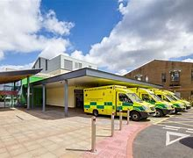
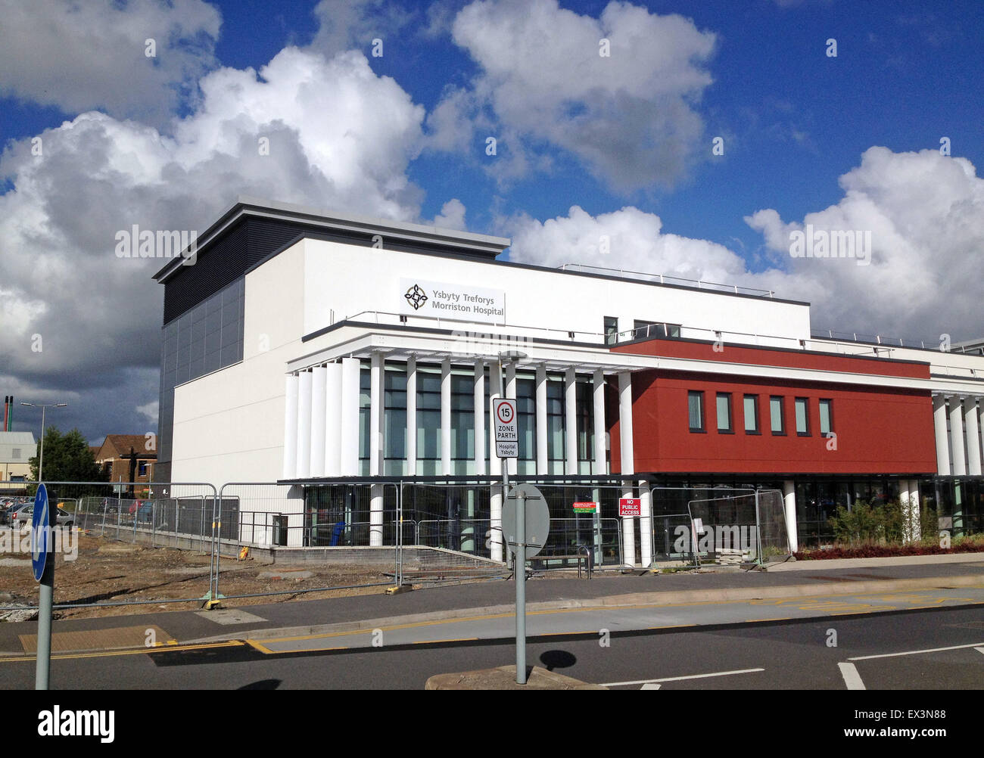
UEC Redesign –Morriston SBHUB
Patient Flow Tests of Change
Swansea Bay University Health Board
31st July 2025.

Slide 2
🔍 Background: Why are we doing this?
Patient care and environments of care compromised
Poor staff experience – perception-no action taken
Urgent and Emergency Care pressures sustained
Multiple reviews including external bodies: GIRFT/HIW/MAG – ED overcrowding, patient harm, increased mortality
Clinically optimised patient flow problem – high volumes of patients waiting for onward care or placement
Overcrowding of all ‘front door’ services – OPAU/AMU/ED
Significant patient flow challenges – long waits for beds in ED & AMU
Ambulance handover challenges – long delays for patients to get to hospital in an emergency

Slide 3
🔄 Tests of change…..
PDSA: ED assessment & referral to medicine
PDSA: 7-day SDEC service model
PDSA: Criteria to reside
PDSA: Change in medical assessment model in AMU (yellow zone)
PDSA: Speciality assessment and patient assignment to specialty or GIM Bed pool
PDSA: Your next patient/continuous flow across specialty bed base including surgical specialties
6 week period of PDSA’s supported by additional capacity – Anglesey Ward

Slide 4
🔄 Flow model..
General Medicine assessment & <48 hrs..-AMU
Specialty Wards*
General Medicine >48 hrs..-Anglesey
SDEC
OPAU
Decompressed ED
Critical Care DTA
clinically optimized patients Ward E/IDH*
* Specialty Wards/Ward E: Your next patient flow model
______________________________________________________________________________________________________
UEC Care Co-Ordination Hub

Slide 5
Anglesey Ward PDSAs
Schedule
W/C
2.6.25
9.6.25
16.6.25
23.6.25
30.6.25
7.7.25
ANGLESEY WARD
ED ASSESS/REF TO MED
AMU (YELLOW) CHANGE OF MODEL
SPEC ASSESS/ASSIGN TO SPECIALITY
7 DAY SDEC
CRITERIA TO RESIDE
YOUR NEXT PATIENT
CRITERIA LED DISCHARGE

Slide 6
🏥 What’s Going Well?:
Anglesey Ward opened with support and commitment from staff being flexible and estates team rescuing the day at the eleventh hour following an electrical issue
Huge positivity and ‘can do’ attitude demonstrated by our staff providing quality services to patients
Emergency Department being de-escalated to a level whereby it can function as an ED to provide more timely care for patients
Early recognition from outside organisations around ambulance handover performance providing a safer service to sick patients waiting in the community
No un-necessary deaths in the emergency department as a result of no bed being available

Slide 7
🏥 What’s Going Well cont’d
The admission of appropriate General Medical patients to Anglesey
Rollout of ‘Your Next Patient’
Development of speciality lists – ‘Right patient, right bed’
Improved processes e.g. Medical Handover
Headspace to focus on bottlenecks in patient pathways

Slide 8
What is the measurement telling us?

Slide 9
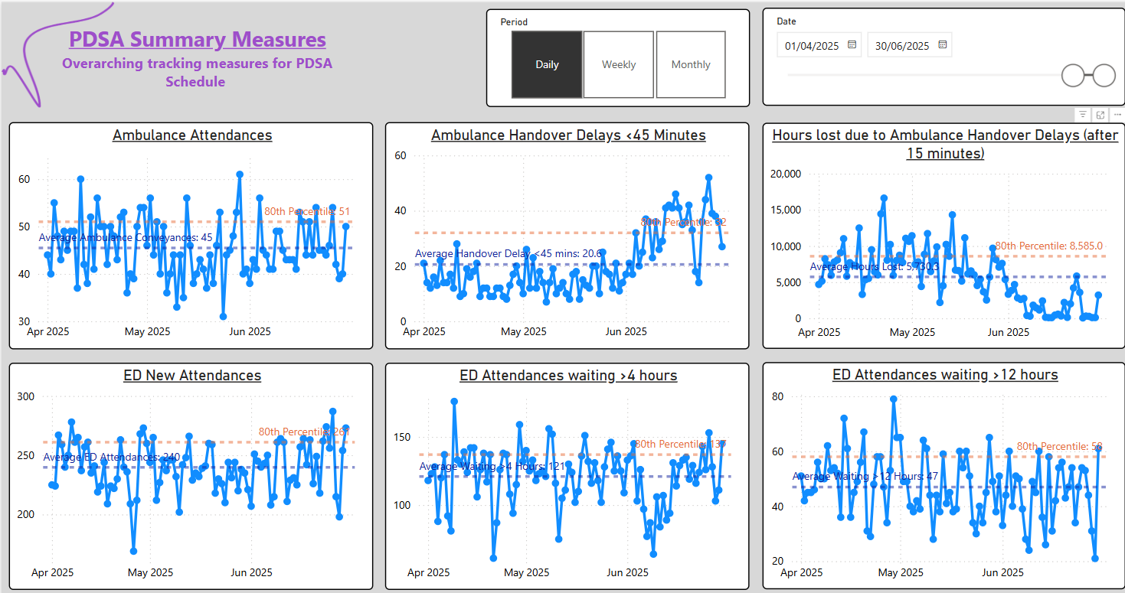


ED Ambulance Attends: Constant
ED New Attends: Variable: 220 to 260
<45 Minute Handover: STEP CHANGE IMPROVEMENT
Pre and post PDSA 80th Centile cited)
  P80th - from 18 to 41, daily
  average from 15 to 32
Hours Lost: Significant reduction in lost hours (minutes shown):
P80th, from 9,835 minutes (163Hrs) to 2,810 minutes (46 Hours) daily: 66% improvement
average from 7,669 (128hrs) to 1,817 (29hrs) : 76% Improvement
ED Attends >4 Hrs: Less Volatile
ED Attends> 12 Hrs: marginal improvement
  P80th - from 59 to 54, daily
  average from 48 to 44, daily
PDSA
PDSA

Slide 10
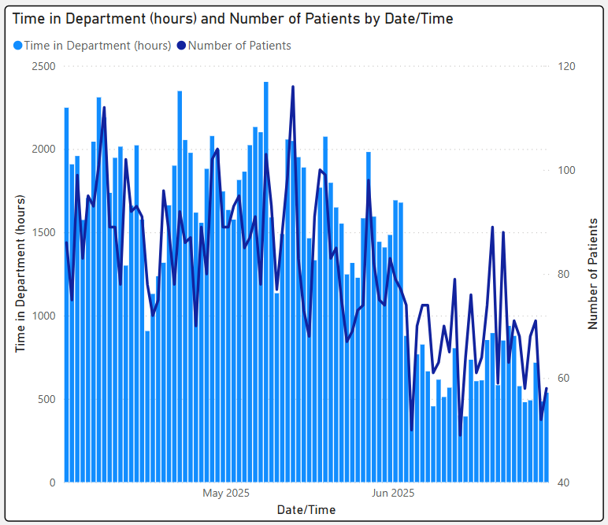
Patient Waits in the Emergency Department
PDSA
Both the total number of patients in ED & the total time (hours) spent in ED has reduced significantly.

Slide 11
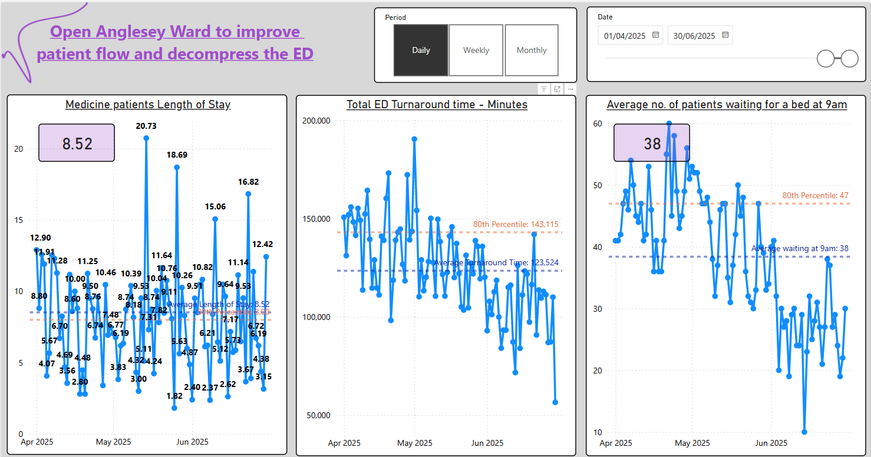

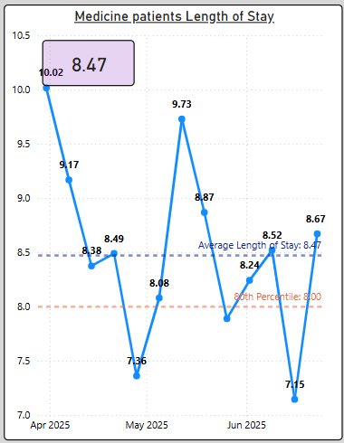

*note the differing time range on the chart axis
Length of Stay: (tracking)
ED Turnaround Time :
  Marked reduction since pilot commenced (includes every patient disposal) . *GIRFT indicates the potential for significant harm associated with delays in ED.
Pts awaiting admission in ED : 80th Percentile reduced to 31 (total) from 49 (total)

Slide 12
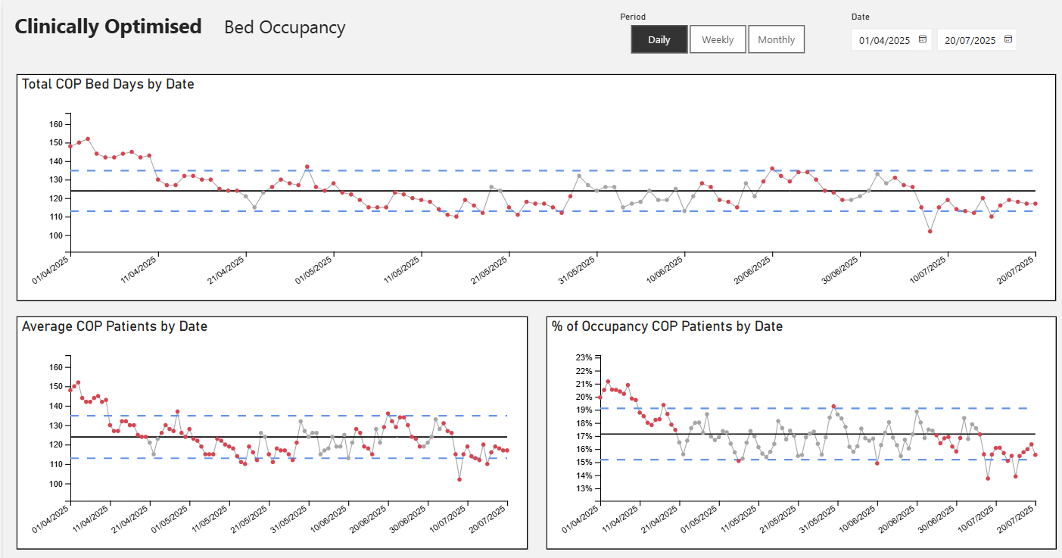
Clinically optimised patient numbers and occupancy

Slide 13
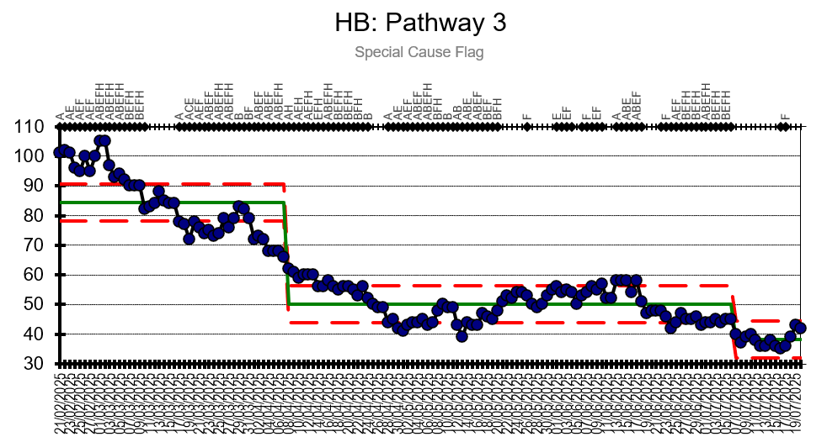
Clinically Optimised - D2RA Pathway 3

Slide 14
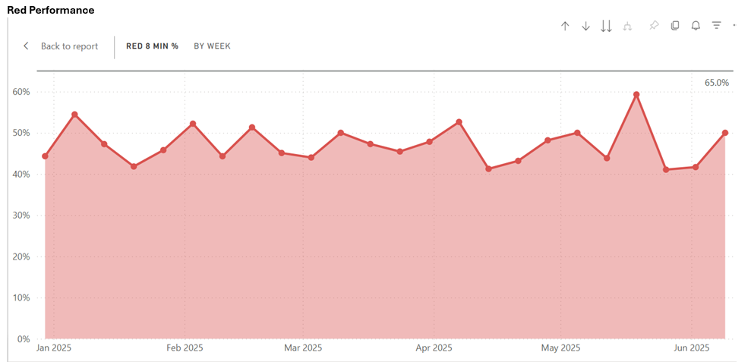
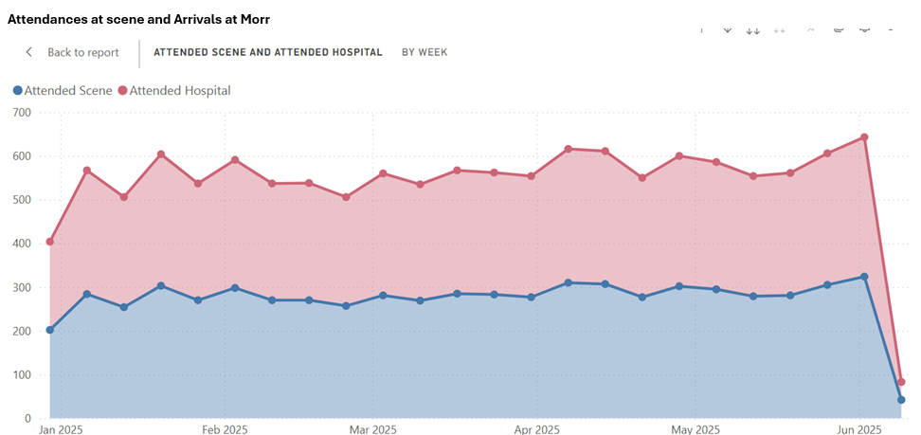
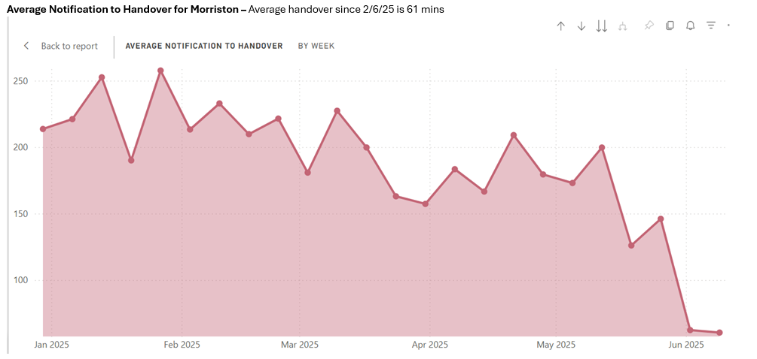
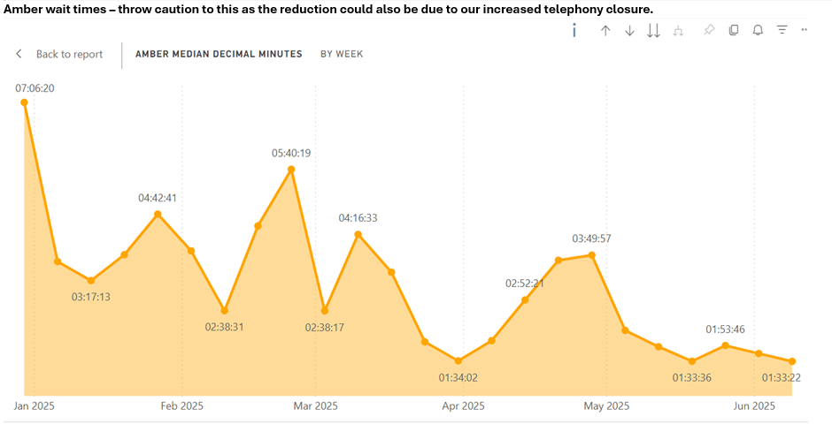
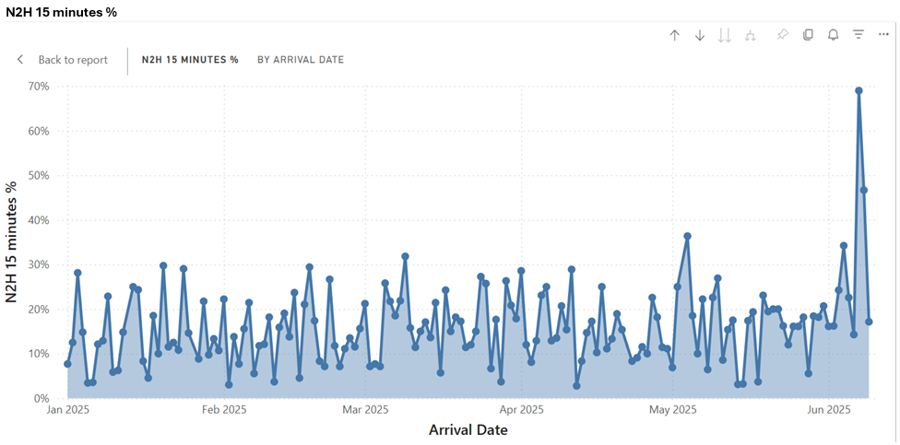
WAST performance metrics
Average Notify to Handover for Morriston: Significant improvement
RED performance: static
Amber Wait Times: reduction may be due to increased telephony closure
Attendances at scene and Arrivals at Morriston: static
N2H%: Huge increase noted on most recent 2 days within period

Slide 15
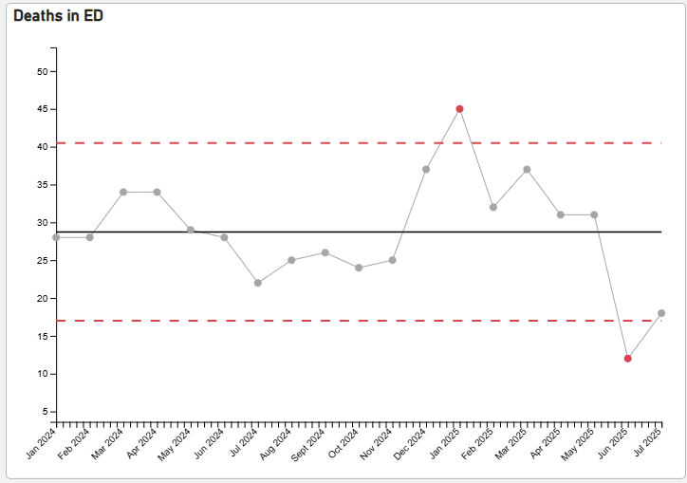
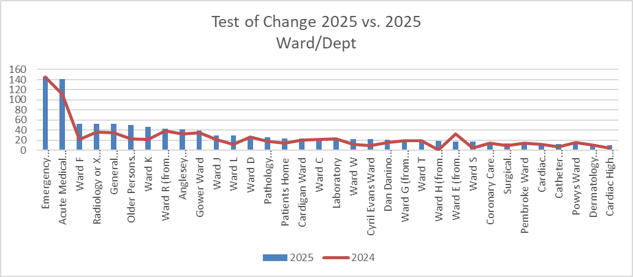
Test of Change: Safety Reporting
Data Extract: 01/06/2025 to 27/07/2025 (based on Date Reported)
Data items: 1313*
Deaths in the Emergency Department
Source: Mortality Power BI (30/07/2025)
Severity of Safety Incidents at Reporting
38 of the 43 RED incidents reported have been downgraded to Low/No Harm events.
Significant case review (SCR) process commenced for remaining 5 incidents.
Top 5: Safety Reporting Classification | 2025 |  | 2024
Accident Injury | 249 | 19% | 236 | 22%
Pressure Damage, Moisture Damage | 206 | 16% | 154 | 14%
Treatment, Procedure | 127 | 10% | 83 | 8%
Infection Prevention and Control | 122 | 9% | 87 | 8%
Infrastructure (including staffing, facilities, environment, security) | 93 | 7% | 63 | 7%
June 2024 = 28, June 2025 = 11
July 2024 = 22, July 2025 = 18
Test of Change 2025 vs. 2024 Outcomes
AMU | 2025 | 2024
Pressure Damage, Moisture Damage | 38 | 30
Accident, Injury | 37 | 26
Behaviour (including violence and aggression) | 12 | 4
Access, Admission | 9 | 2
Infrastructure (including staffing, facilities, environment, security) | 7 | 8
Anglesey | 2025 | 2024
Accident, Injury | 13 | 17
Pressure Damage, Moisture Damage | 4 | 6
Records, Information | 2 | 1
Infection Prevention and Control | 1 | 3
Infrastructure (including staffing, facilities, environment, security) | 1 | 0
* Data Adjusted to exclude Non-healthcare Acquired Pressure/Moisture Injuries
Notes:
The above update is from 2nd June 2025 to 29/07/2025 inclusive
1st June to 29th July 2024 and 2025
Straight comparison between the two time periods. The output data (both years) has been adjusted to excluded non-healthcare acquired pressure injuries.
The adjustment was required because it was skewing the data in June 2025, as the process of transfer of potential community acquired pressure/moisture injury from the Emergency Department to PC&T as not been happening (has been escalated to Louise).
Observation
Reduction of deaths in the ED which was observed in June 2025 has been sustained in July 2025. At the point of reporting (29/07/2025), 18 deaths compared to 32 in the month immediately prior to ToC. For noting; the volume of deaths in ED has been historically low (22 in 2024) so annual comparison may be misleading in isolation.
in general, there have been more safety incidents reported in 2025 than in same period 2024 (1313 vs. 1077). This is due primarily to ACT/Virtual Ward and Dermatology coming on stream in July 2024 . As evaluation progresses this will become less relevant
There were two significant incidents reported in ED and Anglesey during ToC, both of which have progressed to Significant Case Review. The ED event occurred outside following a patient leaving against medical advice and the Anglesey case whilst reported during ToC it occurred when Cardigan Ward was temporarily relocated to Anglesey pre-ToC (this has progressed to SI).
Increase in reporting on Ward F – related to Your Next Patient and staffing issues
Increase in Radiology reflective of more throughput
Increase in Ward K – higher than expected number of in-hospital falls (Low or No harm)
Increase in ITU – cluster of IPC reports
Increase in OPAS - reflects the increase in template and flow between 2024 and 2025

Slide 16
Morriston Hospital Test of Change – Headline News
Ambulance Handover Delays <45minutes:INCREASED to 41 per day from 18 per Day – 127% improvement
AVERAGE TIME TO HANDOVER: REDUCED to 0hrs:47 minutes from 2hrs:43 minutes – 71% improvement (SOURCE: Joint Commissioning Committee)
Deaths in ED: Significant decrease in the number of deaths within the Emergency Department – 11 in June 2025 compared to 28 in June 2024. 63% reduction against May 25.
Hours Lost: REDUCED from 163 Hours per day to 49 hours per day: 70% improvement (for context, we see 51 ambulance conveyances per day)
ED TURNAROUND TIME (TOTAL TIME SPENT IN ED, DAILY): REDUCED from 2,496 Hours to 1,996 hours daily – 20% improvement
TOTAL NUMBER OF PATIENTS AWAITING ADMISSION AT 9 a.m.: REDUCED from 49 Patients to 27 patients– 45% improvement
WEEKDAY (MEDICAL) DISCHARGES: – REDUCED VARIATION – providing greater confidence and assurance managing FLOW.
  Variation has reduced from +/- 13 to +/- 7 discharges – a 46% improvement
SDEC: INCREASED to 114 transfers from ED in June compared to 33 per month between Feb 25 and May 25

Slide 17
🏥 What We Can Do Better?
Use of Your Next Patient Spaces – monitoring length of stay
Use all capacity across SBUHB to ease pressures at the front door and in the community
Develop robust night and weekend plans to ensure equity of care by day and night/weekends
Ensure all specialities equally support their patients in ED in a more timely manner
Release capacity in all assessment areas to ensure smooth transition from ED to specialities
Improve flow through the Acute Medical Assessment Unit

Slide 18
So where next.....
PDSA | Next steps
Anglesey Ward | Keep Anglesey Ward open – end March 26
Continue 7 day SDEC | Continue to provide 7 day SDEC and test different workforce models and pathways
Trusted referral pathway ED to SDEC | Continue as the referral numbers on weekdays have improved.
AMU assessment model | Further work is required as the tests of change have not improved flow through the AMU.
Criteria to Reside | Redesign PDSA’s ? Test closer to point of Decision to Admit
Criteria Led Discharge | Continue to refine/extend
Your Next Patient | Implement as ‘business as usual’.

Slide 19
Continuous improvement journey…
Based on the learning, we need to … | PDSA
Improve patient flow at ward level | Test the optimal hospital flow framework with support on one ward
Improve access to acute stroke care and rehabilitation | Test a change in the stroke pathway to give the MDT management of flow across the whole pathway from point of arrival in hospital to point of discharge from hospital or transfer to a rehabilitation bed in NPTH
Redesign the SDEC Clinical Model | Test the impact of Clinicians from ED and Acute Medicine in delivering a 5 day SDEC service
Improve AMU Patient Flow | Test different models of working in the AMU
Improve ways of working in the Emergency Department, with a particular focus on assessment | Design tests of change in the ED working model based on the learning from recent PDSA’s
Criteria to Reside | Redesign PDSA’s ? test closer to point of Decision to Admit
Criteria Led Discharge | Continue to refine/extend the PDSA as early signs of improvement in weekend discharge
Reduce the number of patients conveyed from Care Homes | Test the implementation of ‘ticket to ride’ whereby paramedics attending an emergency call in a Care Home will discuss the case with Clinicians in the UEC Hub prior to conveyance

Slide 20
Conclusion…
The transformational change in the UEC pathway has resulted in significant improvements in care and clinical journey times for patients.
Patients can expect to be on the appropriate ward to meet their clinical needs.
The Emergency Department can respond to life and limb threatening patients immediately and those patients outside of these categories are being handed over the majority of time within one hour.
Patients in our communities can expect to receive an ambulance response in a timely manner.
The consistent placement of additional patients in the ED Blue trolley bay has been eradicated.
Patients are not sleeping night after night in the Emergency Department where the light never goes off and their food is served on cardboard trays with wooden cutlery.

Slide 21
What are people saying?
“Its fantastic to not be greeted by a sea of yellow on my way into work”
Service Group Director Morriston
“It is culturally different here in Morriston”
HEIW
“Its like being at Morriston 20 years ago when we could handover our patients”
Paramedic
“I never thought this could be achieved in Morriston.”
Senior Manager in UEC
“It feels energetic, it feels positive and it feels more united”
Clinical Site Matron
“I’ve worked in ED for over a year and there has always been extra patients in blue trolley bay…I can’t believe it!”
ED Nurse
“ There’s just one word…phenomenal”
BI Partner
“It’s an absolute pleasure to be part of discussions with such positivity on how the last 3 weeks have panned out, but also reflection on where further improvements can still be made”
Chief Operating Officer
“I feel proud to be part of a great team who have engaged in the innovation to make things better for our patients and staff”
Asst Director UEC
“This is really good, I had six jobs yesterday”
Paramedic

