Slide 1
Tackling Diabetes Together
Anjula Mehta, Acting Executive Medical Director
Jennifer Davies, Executive Director Public Health (Interim)
Notes:
This slide can be used for presentations which are from a health board-wide perspective or for a whole HB audience as the graphic device to the right of the slide includes all four service group colours and red for the corporate team.

Slide 2
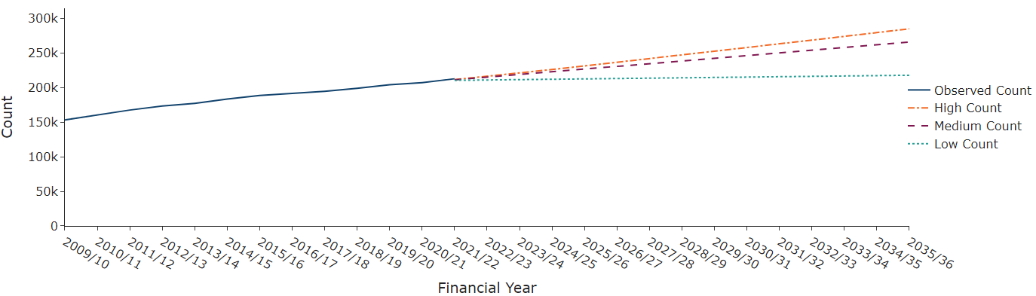
Case for change
Type 1 and 2
Risk Factors
Prevalence
Complications
Trends
Costs

Slide 3
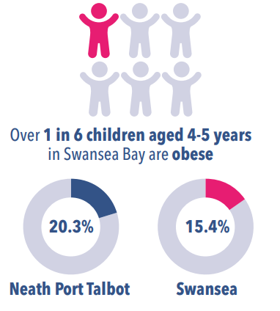
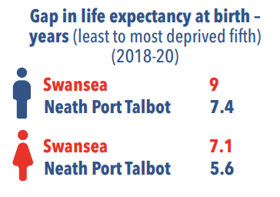

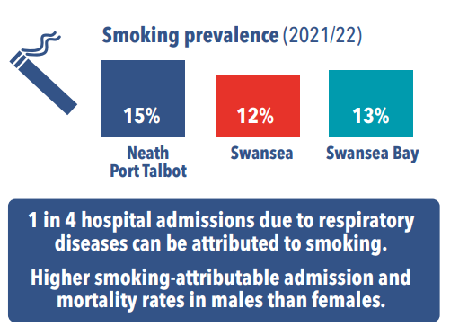
Impact of poverty and Health Harming Behaviour
Notes:
This is a generic copy slide.

Slide 4
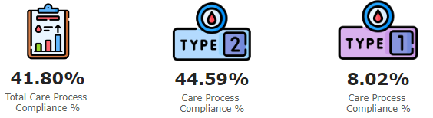
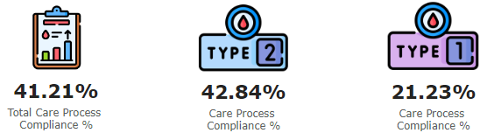
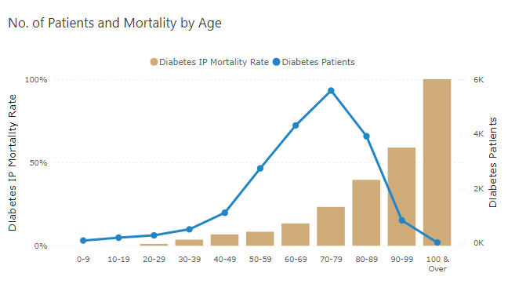
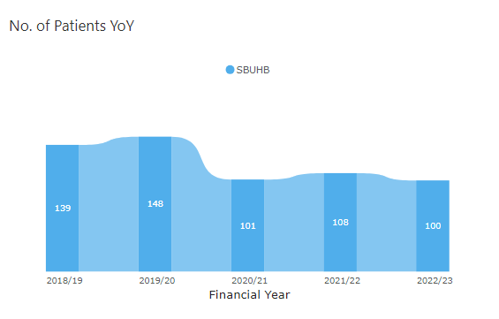
Diabetes pathway
Prevention
Early Diagnosis
Optimisation - 8 care standards
Managing complications
Supportive Treatment
Amputations

Slide 5
Tackling Diabetes Together
Tacking Diabetes Together (TDT) is a national programme, led by Public Health Wales, agreed with the Minister and at NHS Leadership Board in December 2023.
TDT Workstreams
1. Preventing poor outcomes from diabetes
2. Preventing onset of Type 2 diabetes for those with modifiable risks
3. Preventing onset of risk factors for type 2 diabetes
4. NHS /Social Care Workforce targeted engagement
5. Communications
6. Monitoring, analysis and evaluation
Notes:
Used the TDT programme structure to outline work in train/planned that will contribute towards the programme
2024/25 will focus on creation the system conditions for change, mapping health board contributions & selecting advanced delivery areas
Whole of system response, national support and local delivery.
Improved outcomes for all SBUHB diabetes patients.
High uptake of evidence-based prevention programmes.
Referral mechanisms to be embedded in routine care.
Development and implementation of evidence-based programmes which prevent the onset of risk factors for T2DM
A focus on preventing obesity and increasing physical activity.
Health and Social Care to be systematically supported to maintain healthy weight and reduce risk factors.
Effective stakeholder support and motivation.
Development of population level process and outcome indicators for the TDT.

Slide 6
Delivering the TDT Strategic Aims
Overarching enablers
GMS Contract (Diabetes)
Population health strategy
VBHC strategy
Annual/Cluster IMTP
HB Vision
Clinical services Plan
Diabetes Planning and Delivery Group - re-established meeting Sept 2024
Partnership forums RPB/PSB
More people living well with diabetes as measured through a reduction in amputations and other diabetes pathways
Stop the prevalence of diabetes type 2 increasing

Slide 7
Delivering the Strategic Aims 24/25
More people living well with diabetes as measured through a reduction in amputations and other diabetes pathways
Delivery of SBUHB Diabetes Goal: improve the 8 Care Processes
Consultant diabetologist supporting each cluster
Podiatry: foot surveillance as part of the 8 care processes
VBHC: pathway mapping & PROMS
City Cluster: Pilot of podiatry led vascular diagnostic service.
Podiatry assessment: lower limb and activation level/patient centred individual management plans
Technology - Telehealth, urine self testing, foot surveilance app

Slide 8
Delivering the Strategic Aims 24/25
Stop the prevalence of diabetes type 2 increasing
One Bay Way: weight management, diabetes & smoking pathway redesign
Delivery of SBUHB Diabetes Goals: Develop a Diabetes Community Service &
  Rollout Prediabetes service.
All Wales Diabetes Prevention Programme (AWDPP): 38 surgeries across 7 clusters are already implementing plans underway for the further roll-out across surgeries in 2024/25
Llwchwr Cluster: Co-production of a community-based educational programme to facilitate lifestyle change.
HMQ in Hospital: pilot implementation & evaluation
Systems approaches to population health: healthy weight, neighbourhood wellbeing, poverty, climate change - place based & people focused
Social Prescribing via clusters

Slide 9
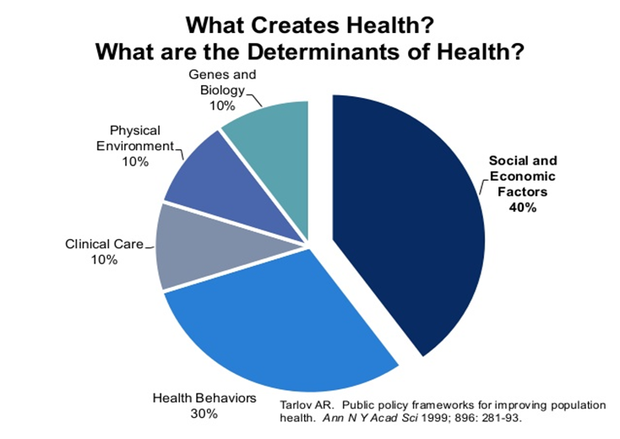
Prevention is better than cure

Slide 10
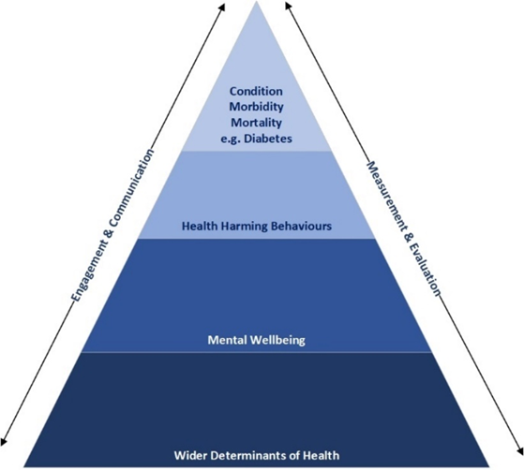

We know what works
Notes:
This is a generic copy slide.

Slide 11
Key Messages
Importance to address accelerating burden of diabetes with coherent strategy with focus on prevention and optimisation of care
TDT provides nationally directed framework and opportunities to develop All Wales approach
SBUHB has developed governance structures to progress existing work stream contributing to strategic aims of TDT
Recognition that a long-term commitment to TDT will require:
  Different ways of working and behaviour change
  Focus on prevention through a wider determinants lens to address root causes
  Need to understand differential engagement / outcomes as part of addressing inequalities
  Resource allocation / re-allocation
  Focus through our planning processes
  Development of our tactical capability across health board/clusters/partners
  Segmentation, stratification and impact modelling to identify local at risk groups and understand health and wellbeing needs of our population
Notes:
This is a generic copy slide.

Slide 12
Next steps
The board is being asked to support:
the strategic objectives of the Tackling Diabetes Together programme
SBUHB to sign up to the national TDT programme
Our population health focus and approach when developing whole system diabetes care pathways
The board is asked to note:
Ongoing work in improving 8 care standards compliance
Progress with AWDPP and AWWMP
Need to commission a population health needs assessment

Slide 13
Diolch
Thank you

