Slide 1


Working together
Caring for each other
Always improving
Swansea Bay UHB
Annual Plan 2025/26

Slide 2
Foreword
Welcome to Swansea Bay University Health Board's Plan for 2025 – 2028. It sets out our key priorities and programmes of work for the next three years, providing detail on the actions and outcomes we commit to deliver in 2025/26. The plan reflects three overlapping drivers: the health needs of our population which are particularly significant in some communities; the Cabinet Secretary's priorities informed by the people of Wales and our vision to become a high-quality organisation, delivering excellent care and supporting healthy lives.
Our continued commitment in Swansea Bay UHB (SBUHB) is to deliver safe, high-quality care for our patients - working in collaboration with partners to achieve this and fostering an environment and culture within which we can all thrive and our populations receive the best services possible, both now and in the future.
We are acutely aware we face several challenges, particularly ensuring the safety and financial sustainability of our health care services. We are committed to delivering the Welsh Government expectations regarding improving our financial position and delivering our plan. We will do this by improving efficiency, productivity, and delivering the best value in our system, as well as reshaping the way we deliver some of our services, with a greater focus on illness prevention, early intervention and building capacity in community-based care.
We continue to experience particularly busy and pressured times in our urgent and emergency care services. The Health Board remains committed to supporting urgent and emergency care services to run towards these problems and do everything we can to look after our patients and one another.
We have continued our focus on recovering planned care services - our great progress has been nationally recognised and as a consequence of the improvements delivered in performance and outcomes related to planned care and child and adolescent mental health, Welsh Government have de-escalated the Health Board in those areas from Targeted Intervention. However, we know there is more work to do and improving waiting times for patients remains a continued focus.
We have embarked on a programme of improvement in our maternity and neonatal services which we will continue, and we will establish a transformation programme for our mental health services and services for learning disabled people working closely with local authority and third sector partners. Our work in these areas will be informed by people with lived experience of our services, and their families and carers.
We will also commit to work with team colleagues across the organisation to ensure that everyone feels safe in work, empowered and engaged, and where diversity is celebrated so that everyone feels a sense of belonging.
The Board recognises its role in leading and governing the organisation through the next three years as we transition to a sustainable model of care, and we are committed to doing this in the best interests of our patients, communities and colleagues.

Slide 3
Contents
Strategic Context | Pages
Introduction and About the Health Board | 4-7
Strategic Purpose | 8
Strategic Objectives | 9
Achievements 24/25 | 10-12
Policy context/requirements | 13
Risks and Challenges, Performance delivery | 14-16
Path to Sustainability | 17-18
Strategic Plan on a Page | 19-20
Enabling Actions | 21-22
Financial Summary | 23-26
Delivering Performance | 27-28
Ways of Working | Pages
Ways of Working | 30
Wellbeing Goals/ Future Generations Act | 31
Becoming a Pop Health Organisation | 32-34
Quality Safety, Patient Experience | 35-37
Partnerships overview | 38-41
Service Delivery | Pages
Plan Approach | 43-47
Primary & Community Care | 48-51
Unscheduled Care | 52- 55
Planned Care | 56-62
Cancer | 62-64
Mental Health & Learning Disabilities | 65-69
Women’s Health, Maternity & Neonatal | 70-72
Children & Young People | 73-75
Cross System and Specialised | 76-77
Enabling Delivery | Pages
Working in Partnership – Clusters, Regional working, WGRPB, PSB | 78-87
Workforce | 88- 92
Digital | 93-97
Sustainability | 98-99
Research, Development and Innovation | 100
Finance | 101-103
Capital and Estates | 104-106
Governance and Delivery | 107-108

Slide 4
Introduction
This Plan summaries the key priorities, programmes of work and actions we will be taking forward in 2025/26 as we increase the pace on our journey to become a high-quality organisation that delivers excellent care and supports improved health and wellbeing in our communities. The plan integrates our service plans, workforce, digital, capital and finance to present an integrated approach to achieving our goals for the next three years, as we progress our five strategic objectives (referenced later in the Plan). The Plan is set in a three-year context as many of the programmes of work continue beyond 2025/26, but most of the detailed actions relate to' in-year' delivery in the first year of the plan. We also plan to refresh our Strategy this year, building on the engagement that took place with our teams, communities and partners two years ago. There is recognition of the need to be clearer on what our vision means for our communities, patients and our colleagues – both internal and external.
We also recognise that the delivery of the 2025/26 Plan does not get us to the financial position expected of us by Welsh Government, and therefore the requirement is for us to submit an Annual Plan, with a clear trajectory to get to a sustainable financial position where we are in balance each year, with the opportunity to reshape where we invest our resources, recognising the need for greater focus on illness prevention, managing wellbeing and building capacity in neighbourhood-based services for local communities.
This plan is underpinned by three key high-level drivers:
Responding to the health needs of our population which are significant in some communities – where life expectancy and healthy live years lived are deteriorating in some populations. We know that many families are struggling in the current economic climate – and the impact of the changes at Tata Steel are significant – which impacts on peoples' health and wellbeing. We also have high rates of death from suicide and substance use which we are committed to tackling with partners.
Delivering the Cabinet Secretaries priorities: improving access for planned care, emergency and urgent care, cancer care and mental health; improving women's health services recognising the inequalities that exist; increasing the focus on illness prevention and building our capacity in community-based services.
Continuing progress against our five strategic objectives on our journey to deliver excellent services for our patients, and support communities to live well.
The Plan is shaped by three themes for 2025/26 - ensuring safe care; living within our means and continued improvement in priority areas which reflect the focus of our work this year. Sitting below this plan and detailed annual delivery plans for each Service Group and Corporate Department, which provide us with the granularity we need to be confident of delivering the improvements we need week in, week out to ensure we achieve the targets set.
During the year we are also reviewing our operating framework to strengthen our approach to performance and accountability and governance – from Board to ward/team and will review our organisation design to ensure we are organised for delivery and success.

Slide 5








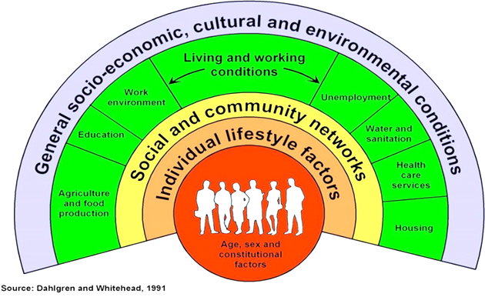


About our Health Board
The Health Board has responsibility for assessing the health needs of our population in Swansea and Neath Port Talbot local authorities and then commissioning, planning and delivering healthcare for those people. We also have a joint responsibility for improving the health and wellbeing of our diverse communities. We recognise that we are one part of a broader social, economic, environmental and health economy in the Swansea bay region. The lives and health of people in our communities are impacted by wider determinants of health and as an anchor institution we have a role in addressing and responding to these in all that we do.
Our Population
396,000
of Children in Swansea Bay are living in poverty
1 in 6
children aged 4 years old in Swansea Bay are not fully up to date with their vaccinations.
20%
Approx. population
Healthy Behaviours
9% of the population in Swansea and 4% of the population in NPT were born outside the UK. 5% and 1% of our population’s main language is not English.
Life Expectancy
9% of 16+ years old in Swansea, and 10% of those in NPT, are long-term unemployed
Female
81.5 years
14% Adults currently smoke
Male
77.3 Years
Gap in Life Expectancy
Most deprived vs least deprived
16% Adults drink above guidelines
Health inequalities
There are persistent inequalities in Swansea Bay, linked to differing experiences of the wider determinants of health (such as education, housing and income) throughout life.
19.9 Healthy years
14.6 Healthy
years
7.9
years
64% Working age adults not a healthy weight
6.8 years
Female
Male
9% of the population in Swansea and 3% of the population in NPT are from a non-white ethnic group.
Only 79% of the population in Swansea and 76% of the population in NPT believe their health is either Good or Very Good, while 1 in 14 people in Swansea and 1 in 11 in NPT believe their health is either Bad or Very Bad.

Slide 6















Our Services
In addition to serving our Swansea Bay population we also provide a range of specialist and tertiary services for a much larger population across South Wales, and in the case of burns and plastics services we provide service to South Wales and South-West England. We also host the Major Trauma and Spinal Networks on behalf of the South Wales Health Boards and the Emergency Medical Retrieval Service (EMRTS) on behalf of all health boards. Our joint work with Hywel Da, formalised in our joint committee, now provides us with the opportunity to plan and deliver services together for a total population of nearly 1m people ​​​
H1
Morriston Hospital
Singleton Hospital
Neath Port Talbot Hospital
Gorseinon Hospital
H2
Neath Port Talbot
H3
H4
H4
H1
H3
We also have:
45 GP practices​
91 Community Pharmacies​
58 Dental Practices ​
32 Optometry practices​
Swansea
H2
In a single year across the Health Board there are:
22,257
ED Attendances
54,321
MIU Attendances
505,847
Outpatient Appointments
138,315
Diagnostic Procedures
30,178
Inpatient and Daycase Procedures
260,815
District Nursing visits
52,000
Common Ailments Scheme Consultations
107,202
Eye Care Examinations
16,548
Calls to 111
Press 2
6,600
Referrals to Local MH services
2M
GMS
Consultations
800,000
GMS Consultations were urgent or acute
85,000
Referrals from Primary care
30,498
Urgent Dental Care Appointments
5,292
Psychological
Therapy Referrals
Data for 23/24 or 24/25 where available

Slide 7



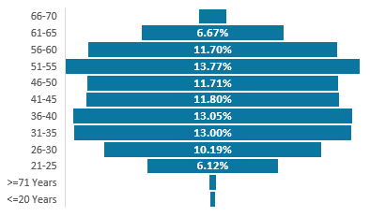
Our Workforce
We are a teaching and research-active health board – working closely with our partners in Swansea University and local colleges to train the next generation and to contribute to finding solutions to the healthcare challenges we face today. Our workforce is diverse although we have more to do to ensure that our workforce reflects the diversity of our local communities. Much of our workforce live in our area – so the services we provide are for them, their families and friends. ​​
14,327
Members of Staff
Staff Group
Age Profile
22%
Male
70%
Female
Our Finances
Data for March 24/25
Revenue resource allocation: £1,264,375,000
£213,437,000
Expenditure on primary healthcare services
£169,888,000
Expenditure on healthcare from other providers
£309,640,000
Total Operating Expenses: £1,281,188,000
Expenditure on hospital and community health services
£1,073,680,000
Capital Resource allocation
Data for 23/24

Slide 8
Our Strategic Purpose
As an Integrated Health Board, we have two equally important functions to fulfil. We must:
  •Improve the population’s health so people can stay well
  •Deliver high quality care when people need it
In improving delivery of these two functions, we will support people to have better health; provide better care for people when they need it; and consequently, we will support people and communities to have better lives. There are four ways as a health board we can impact on the lives of people in our communities:
Healthcare Provider
Employer
Anchor Institution
Productive Partnership
We are a provider of healthcare services that directly impacts and influences people's health
We are one of the largest employers in the region, employing over 12,500 people
We are an anchor institution whose long-term sustainability is tied to the wellbeing of our population
We can make a difference by working with and through others including our communities
Four Pillars of our Population Health Strategy 2024
In viewing our responsibilities through these four pillars we can see that our actions can have wide ranging impacts. We can also see that through an intentional approach of challenging ourselves to think beyond our role as a health care provider we can shape our activities in ways that contribute positively to the Swansea Bay area. With these pillars in mind, we have developed our organisational Strategic Objectives to reflect the breadth of our responsibilities. These five strategic objectives were developed through engagement with staff and Board and have incorporated the aims of our key Health Board Strategies e.g. People Strategy, Population Health Strategy, Digital Strategy, Quality Strategy, Carbon Action Plan.
We have set out for each Strategic Objective what high quality looks like in Swansea Bay if we achieve it. Work has also been undertaken to develop Strategic Indicators that will support the Board to monitor our contributions to achieving our objectives. These indicators form an important element of our planning and performance framework, ensuring links between operational and system planning and organisational strategy.
8
Notes:
Strategic Summary
Strategic Objectives (wellbeing of FGA Goals alignment)
Plan on a Page

Slide 9





Our Strategic Objectives
Our Strategic Objectives set out what the future of Swansea Bay UHB looks like for our population, community, staff and partners.
People of Swansea Bay live healthier, equitable and more equal and prosperous lives
Every child has the best start in life
All children, young people and adults are enabled to maximise their capabilities and have control over their lives
Good work and fair employment is created for all
A healthy standard of living is ensured for all
Healthy and sustainable places are created through placemaking
The role and impact of ill-health prevention is strengthened
Racism, discrimination and their outcomes are tackled
Environmental sustainability and health equity are pursued together
Our Wellbeing Objectives
Care is high quality, safe, efficient and delivers the best possible outcomes for people
Care is safe, it helps people and avoids harm
Care is evidence based, effective and improves outcomes
Care is timely and delivered by the right person in the right place
Care is efficient
Care delivers equitable outcomes regardless of demographic, socioeconomic or geographic factors
Care is person centred and delivered with compassion, dignity and mutual respect
Care is delivered in safe and appropriate settings supported by innovative digital solutions
Care is delivered around the patient in the most appropriate setting as close to home as possible supported by digital and data solutions
Care settings are fit for purpose, appropriately designed and equipped
Secure, trusted and insightful data and digital platforms empower staff to deliver more and higher quality care and improved patient outcomes and population health
We have a digitally inclusive culture, where patients, clinicians and non-clinical colleagues work collaboratively to create effective and efficient services and patients are empowered to make informed and meaningful choices about their health and care
Through where and how they are delivered, services contribute to the environmental, economic, social and cultural well-being of Swansea Bay
The health board is a great place to work where staff feel valued and work together towards a common goal
Our Workforce is engaged, motivated and healthy; they feel valued, fairly-rewarded and supported
The Health Board is recognised as an employer of choice
We have a well-planned workforce with the right number of skilled people working on the right things
People feel ready for our digital future
People are supported to develop the skills and capabilities they need
People role model collective and compassionate leadership and live our values
We are diverse and inclusive, ensuring all voices are heard
The health board is a resilient, financially sustainable and responsible organisation
The health board is financially balanced and able to invest in service transformation and change
Decisions are made balancing short-term improvements and long-term impacts
Resources are used efficiently and proportionately, reducing waste and variation
The environmental impact of health care delivery in Swansea Bay is minimised
The health board invests in and works with others locally and responsibly, using our assets to positively contribute to the community
Citizen stakeholders are meaningfully involved and engaged in decision making
The health board has the capacity to effectively plan for and respond to incident and emergencies

Slide 10
Achievements 2024/25
In 2024/25 we delivered against 92% of the actions in our Annual Plan (239/259 actions). Where we have been unable to deliver, these actions have been rolled over into this plan or we have revised the actions based on the circumstances of non-delivery and mitigations required. Some of our achievements are highlighted below.
Over the last 12 months our staff have consistently strived to improve services and deliver the best quality care to every patient, . They have had many successes locally, regionally and nationally
People of Swansea Bay live healthier, equitable and more equal and prosperous lives
Women can access more support to stop smoking through the roll out of the ‘Help me quit for baby’ smoking cessation pilot.
We're supporting earlier intervention with emotional wellbeing through a community psychology service which is in place in three areas as of April 2025 (Cwmtawe Bay and Upper Valleys Clusters), with plans to expand to other areas.
Our Diverse Outreach Workers will continue to work with minority communities whose voices aren’t typically heard through further funding being secured.
People can seek support to be as fit and healthy as possible while waiting for surgery thanks to the Waiting Well website now available.
Care is high quality, safe, efficient and delivers the best possible outcomes for people
We continue to be best in Wales in managing and reducing waiting times for procedures.
Lung cancer patients can now access cutting-edge liquid biopsy technology, potentially transforming their diagnostic and treatment pathways as part of a nationwide rollout.
More people can access the Regional Diagnostic Centre with the expanded service now fully operational.
We’re supporting people get home from hospital through a single Integrated Discharge Hub (IDH) providing live triage, discharge planning with Discharge to Recover Then Assess (D2RA) planning from acute sites, liaising with community teams to ensure safe supported discharges under the IDH.
A new Waiting Well team has been introduced to help people both maintain and improve their health, reduce the risk of them having their operation postponed, and to have better outcomes when they are awaiting and recovering from their surgery or treatment.
An award-winning surgeon at Morriston Hospital has scored a world first by inventing a surgical instrument designed to improve patient safety. Consultant plastic surgeon Muhammad Umair Javed has created a microsurgery dissector, for use during breast reconstructions.

Slide 11
Care is delivered in safe and appropriate settings supported by innovative digital solutions
The Health Board is a great place to work where staff feel valued and work together towards a common goal
Children have a better care environment with the work to reconfigure the Children’s Emergency Unit to provide a new main entrance, a friendly waiting area, an upgraded children’s and adolescent mental health support room and crucially, two new treatment bays complete.
Women have greater choice in where to give birth with the successful re-opening of the Neath Port Talbot midwife-led Birth Centre in September 2024.
Surgery is improving with the use of advanced technologies; the Robot theatre is now operational.
Hospital Electronic Prescribing and Medicines Administration, or HEPMA for short, is transforming the way medication is being managed in Swansea Bay hospitals. It helps by providing accurate and informative medicines data on patients. We have successfully rolled out HEPMA across all Learning Disability sites and it is now live across all inpatient ward areas.
The Swansea Bay Patient Portal (powered by Patients Know Best) which helps patients better manage their overall care and be more in control; all from the comfort of their own homes is now ready to go live for hundreds of thousands of patients to sign up to it.
Across our estate we have replaced refurbished the flooring and ceilings across 17 wards, installed a new electricity substation to meet hospital’s increased power needs, installed three new modular theatres for orthopaedic spinal and urology work in Neath Port Talbot Hospital and opened a new 38,000 square foot central medical records building.
Staff wellbeing is being supported with a new preventative health checks for staff that has resulted in excellent uptake and positive feedback
Staff turnover has improved with a new retention lead appointed targeting retention interventions and a focussing on flexible working.
A new Brilliant Basics digital management development platform was launched which aims to provide managers with quick and easy access to information including bitesize learning packages, toolkits and user guides
Staff now have 24/7 access to resources and live learning opportunities on a dedicated Civility and Healthy Working Relationships
The Health Board is a resilient, financially sustainable and responsible organisation
We have a community of engaged and passionate staff leading on initiatives in clinical spaces as well as joint collaborations with Swansea University and the private sector to promote and implement sustainability schemes
We are developing understanding of sustainability and synergies with existing work across the Health Board, including Quality, Value Based Healthcare and cost improvement.
Hundreds of children suffering from malnutrition in Africa were helped with support from Swansea Bay and Swansea Bay Health Charity. through the health board’s support of the ELWA Hospital in Liberia’s capital Monrovia

Slide 12

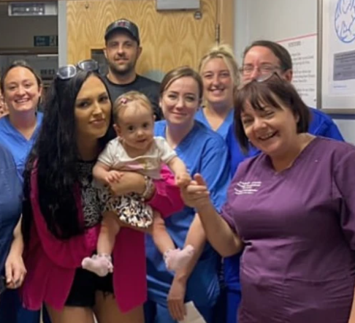
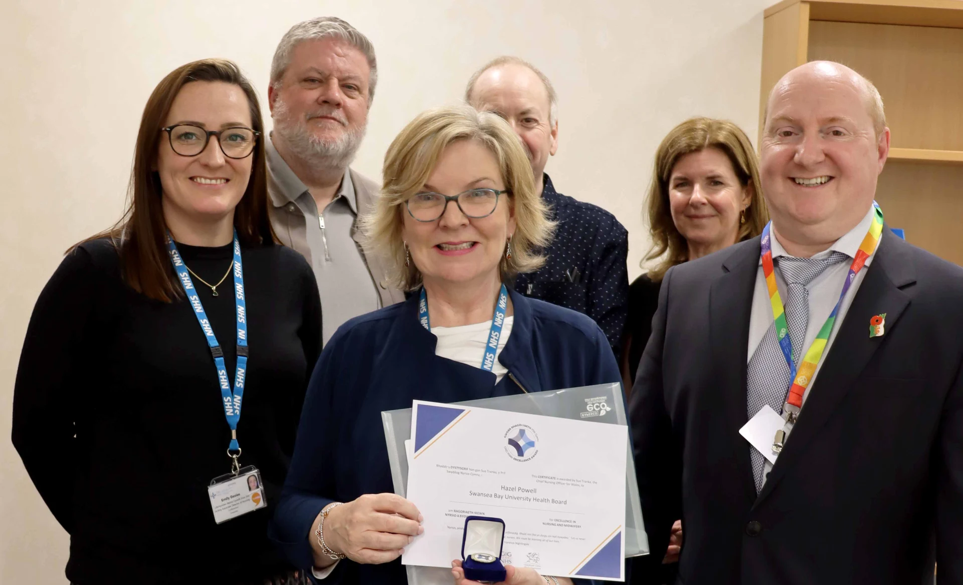

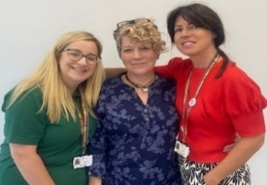
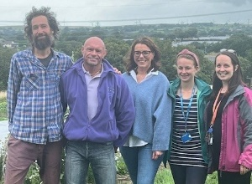

Staff Achievements
Colleagues in our Neonatal Intensive Care Unit (NICU) were awarded a prestigious UK MUM Award for Excellence in Neonatal Care. The team was nominated by Rachel Stonehouse and her partner Corey, whose daughter Imogen was born extremely prematurely, weighing just over a pound, and spent 98 days being cared for in the NICU at Singleton before she was ready to go home.
The Outpatient Parenteral Antimicrobial Therapy (OPAT) which treats patients safely at home and keeps them out of hospital has been recognised for its excellent care. The service’s approach to working collaboratively to ensure the best outcomes for patients led to the team winning the Delivering Our Partnership Compact Award at the health board’s most recent One Bay Way Awards.
Hazel Powell was awarded with a Chief Nursing Officer for Wales Excellence Award. She was nominated for her work which has seen the number of patient falls in hospitals drop below the average for Wales and, through partnership working, a drastic decrease in falls in care homes.
First recipients of newly-rebranded One Bay Way Staff Awards :
The One Bay Way Staff Awards recognise many fantastic projects, ideas, leadership developments and improvements to patient care. Winners from among the 15 award categories included:
Excellence in Equality, Diversity & Belonging Award: Practice Development Nurse Omobola Akinade, joined the health board after leaving her native Nigeria in 2005. Recognised for leadership and advocacy, she effectively promotes
Always Improving Award: The Paediatric Occupational Therapy Team has made value-based changes to ensure person centred care is received as soon as possible. The effectiveness and quality within the service has been used as a benchmark for C&YP services across Wales.
inclusivity and support among her colleagues, enhancing community spirit and team cohesion within the health board.
Sustainability in Healthcare Award:
Cae Felin Community Agriculture project engages the community, including Brain Injury Unit patients and local schoolchildren. The partnership has planted 1,500 trees, built beds and established a rainwater system, fostering growth and connection. It produces veg boxes, which are purchased through membership schemes.
Arts in Health Award: Recognising the isolation many felt during the pandemic, the Library Services Team created a patient book trolley, filled with donated books and other items.
The trolley has expanded to include radios, large print books, tablets and religious texts. Patients have shared how these resources have improved their wellbeing, reduced anxiety and provided much-needed companionship.

Slide 13
Policy Context
Our planning and Plan for 25/26 and beyond is informed by the policy context of health and care in Wales and the priorities and directives of Welsh Government.
Ministerial Priorities
Timely access to care
Population health and prevention
Building community capacity
Mental health access
Women's health
We indicate throughout our plan where our actions will contribute to delivering the Ministerial Priorities. Population Health and Prevention and Building community capacity are central to how we seek to plan and deliver services working with our statutory and non-statutory partners across the south Wales region and locally. See Annexes 2a-e for the detailed Ministerial Templates.
Enabling Actions
Operational Productivity and Efficiency
Workforce Productivity
Maximising value for money
Improving Value, Optimising Outcomes, Minimising Variation
We have mapped the actions within our plan to the Enabling Actions, and this is indicated throughout the Plan. Annex 1 contains full details on how we have adopted and are working towards the Enabling Actions and our current baseline against each action.
Quality
Quality and Engagement Act 2020
Duty of Quality Health and Care Quality Standards
Reducing Health Inequalities
Our system objectives are aligned to key Quality Standards reflecting our Strategic Objective to ensure care is high quality, safe, efficient and delivers the best possible outcomes for people. Where appropriate changes will be assessed through Quality Impact assessment and our newly developed integrated impact assessment process to ensure quality and equality impacts are considered. Work will also be undertaken to embed our Strategic Equality Objectives into our planning approaches.
Well-being of Future Generations
Ensure that best decisions are made that address both the here and now and the future.
Five Ways of Working: Long Term Prevention, Involvement, Collaboration, Integration.
The Health Board’s Wellbeing Objectives are set out under our first Strategic Objective (page 6.) , Our commitment to our wider responsibilities are also the reason behind our Four Pillars approach to looking at our actions and responsibilities. We are committed to embedding the ways of working and have set out our approach on page 18.

Slide 14
Risks and Challenges
Our plan is informed by our risks and challenges. Our highest risks to delivery are Unscheduled and Cancer and in achieving financial sustainability. The required prioritisation of these areas was reinforced through our planning processes and our immediate actions and the way in which we will manage delivery are reflective of their importance.
We are also highly cognisant of the challenges faced across maternity, neonatal and mental health services and these areas will require additional focus this year to ensure continued improvement in the quality of services delivered for our population.
We will also respond to the recommendations of the Ministerial Advisory Group when they are fully published and will identify actions to address the issues raised.
Workforce Challenges And Opportunities
Ensuring we are a great place to work, and staff feel valued is a key strategic objective. This mean fostering a culture of openness where everyone can be their best selves. We recognise that our people deliver our services, and it will be a measure of the temperature of how it feels to work in Swansea Bay. Our aspiration is for a culture of engagement, inclusivity and one where we value our staff.
If we do this right, working in social partnership and taking our teams with us, this will enable us to achieve our objectives, support delivery of our vision and the population we serve.
This approach will be critical in how we carry out service transformation, and achieve financial sustainability, balancing the risks of the potential for higher levels of sickness absence, reduced health and well-being and a more problematic social partnership landscape with increased employee relation cases.
These strategic workforce challenges are the key areas of focus and as such they outweigh more common challenges such as recruitment difficulties in some hard to fill specialties for consultant posts for example.
Health Board Risks
Highest Scoring Health Board Risks | Score
Access to Unscheduled Care Service If we fail to provide timely access to Unscheduled Care then this will have an impact on quality & safety of patient care as well as patient and family experience and achievement of targets. There are challenges with capacity/staffing across the Health and Social care sectors. | 25 | Pages 52-55
Access to Cancer Services There is a risk of delay in diagnosing patients with cancer, and consequent delay in commencement of treatment, which could lead to poor patient outcomes and failure to achieve targets. | 25 | Pages 56-62
Access to Cancer Services (Systemic Anti-Cancer treatment (SACT)) The demand & complexity of planned treatment regime for cancer patients requiring chemotherapy currently exceed the available chair capacity, risking unacceptable delays in access to SACT treatment in Chemotherapy Day Unit with impact on targets and patient outcomes. | 25 | Pages 62-64
Finance: Forecast Deficit Risk Forecast deficit is not met due to insufficient progress on COVID cost reduction, savings identification, run rate reduction and the potential for new in-year pressures. | 25 | Pages 101-103

Slide 15
Delivery against Targeted Intervention and Enhanced Monitoring Criteria 2024/25
TI Area (Level 4) | Criteria to achieve | Performance (Feb-24)
Cancer | 60% performance maintained for 3 months against the SCP target. | 52% (Jan-25)
UEC | Continuous reduction of ambulance handovers over an hour of at least 11% in three consecutive months and maintained for 3 months (Based on Q2/Q3 2023 baseline | 554
 | Continuous improvement towards no more than 7% of patients waiting over 12 hours at each individual site and across HB | 12.4%
 | Median time from arrival at emergency department to assessment by a clinical decision maker should not exceed 60 minutes | 84.6%
 | Continuous reduction in delayed pathways of care of 5% for three consecutive months and then maintained for three months (based on Oct-Dec 23 baseline) | 273
HCAIs | A clear improvement plan based on a root cause analysis to address the issue of hospital onset HCAIs. | In place
 | C-Diff: reduce the number of hospital onset infections by 40% and maintain for 3 months (from a baseline of the average number of cases in quarter 3 of 10 cases to no more than 6 per month | 11 cases
 | Staph aureus: reduce the number of hospital onset infections by 25% and maintain for 3 months (from a baseline of the average number of cases in quarter 3 of 4 cases to no more than 3 per month | 5 cases
 | E-coli: reduce the number of hospital onset infections by 20% and maintain for 3 months (from a baseline of the average number of · cases in quarter 3 of 5 cases to no more than 4 per month) | 8 cases
 | Klebsiella: reduce the number of hospital onset infections by 10% and maintain for 3 months based on 2017/18 figures (baseline –54 cases in 2017/18, reduce to average of at most 4 per month) | 3 cases
Finance | Demonstrate financial governance and financial control environment mechanisms are robust and sufficient assurance is received on their effectiveness.
 | Clearly articulate the drivers of the current deficit to inform a triangulated approach to identify and deliver actions that will improve efficiency and maximise the use of resources.
 | Demonstrate clear policies / processes supporting identification, delivery and monitoring of savings opportunities.
 | Demonstrate and evidence an integrated planning approach and strategy to deliver a (recurrent) breakeven position over the medium-term, with a clear roadmap and key milestones for delivery.
 | Submit a balanced three-year medium-term plan in line with the current planning framework.

Slide 16
Escalation Area (Level 3) | Criteria to achieve | Performance (Feb-25)
CAMHS | 80% of LPMHSS mental health assessments undertaken within 28 days from the date of receipt of referral | 42%
 | 65% of therapeutic interventions started within 28 days following an assessment by LPMHS | 100% - meets de escalation criteria
 | 80% of HB residents in receipt of secondary mental health services who have a valid care and treatment plan | 98% - meets de escalation criteria
Planned Care | 100% of open outpatient pathways to be waiting less than 52 weeks and maintained for 3 month | 100%
 | 100% of open pathways to be waiting less than 104 weeks and maintained for 3 months | 99.69%
 | 80% of open pathways to be waiting less than 52 weeks and maintained for 3 months | 86.02%
 | 15% reduction in the number of patients delayed by 100% for their follow up appointment in three consecutive months and maintained for 3 months (Based on the November 2023 baseline.) | -5.7%
 | 65% R1 ophthalmology patient pathways to be waiting within or no longer than 25% of their target date for an outpatient appointment and maintained for 3 months | 76.11%
 | 80% of patients waiting for a diagnostic test to be waiting less than 8 weeks and maintained for 3 months | 79.53%
 | 80% of patients waiting for a diagnostic endoscopy to be waiting less than 8 weeks and maintained for 3 month | 38.78%
 | 80% of patients waiting for a NOUS and non cardiac MRI to be waiting less than 8 weeks and maintained for 3 months. | 100%
 | 85% of patients waiting for therapies to be waiting less than 14 weeks and maintained for 3 months | 97.92%
Strategy and Planning | Improved integrated planning evident across the organisation to develop an approvable IMTP for 2024-26, providing a route map towards the UHB’s longer-term ambition. | In progress
 | Effective regional planning taking place to ensure patients have access to the best possible care with clear demonstration that services of higher risk are more sustainable and benefit the population the organisation serves. | In progress
 | Clearly agreed clinical strategy and development of a clinical plan to lead future planning and investment decisions. | In progress

Slide 17
Our Path to Sustainability
Our ambition is to be an organisation that delivers the best outcomes for our population, preventing illness and maintaining wellbeing; being a centre of excellence for research and innovation and for teaching and training; and being a great place to work, where staff feel valued and work together towards a common goal.
We recognise that our current performance and delivery in certain areas is not what the people of Swansea Bay deserve. People are waiting too long for planned procedures, spending too much time in our emergency department and experiencing delays to their cancer treatments. This is reflected in the Health Board being put into Targeted Intervention (TI) for performance in these areas.
We are committed to working hand in hand with Welsh Government to improve, through driving a quality focused effort for the benefit of our patients, our staff and our finances. We firmly believe that high quality services will result in better outcomes and greater efficiency and that is why we are unambiguously focusing our decision-making based on clinical considerations and on getting things right first time, preventing illnesses rather than treating them, treating the patient as an individual and focussing on outcomes.
To achieve our Strategic Objective of being a resilient financially sustainable and responsible organisation, we are setting out a pathway to sustainability. We must continue to drive productivity and efficiency to achieve financial grip and control, and we must also simultaneously seek transformational solutions to address the challenges in both service delivery and population health and wellbeing.
This plan has therefore been developed on the basis that actions we take must fall into the below three categories.
Financial Grip and Control
Short-Term Service Change and Safe Services
Long-Term Sustainability
This Plan will therefore lay the foundations for delivering our long-term ambitions and achieving sustainability through a recovery and sustainability programme approach. We will balance the immediate needs to address risks and our financial position while planning and enacting transformational change that will bring about long-term sustainability.
Our first priorities are ensuring strong financial grip and control; delivering our key performance targets; and maintaining safe services for our patients. In addition to this, Special Programmes will be in place in 2025/26 to address particular risks and fragile service areas identified where we will deliver transformation at pace.
Simultaneously we will work to ensure the organisation has a clear vision that is supported by our staff and our community. To achieve this, in 2025, we will refresh our organisational strategy and engage on our vision and ambitions. With a strong strategic direction agreed, we will develop a Clinical Services Plan (CSP) that builds on the work delivered through our CSP 2019. This will also be underpinned by our People Strategy, which has already told us what is important to our staff.

Slide 18
Our Path to Sustainability
Financial Grip and Control
Efficiency and Productivity through Enabling Actions
Savings Delivery
Recovery and Sustainability Programme actions aligned to National Value and Sustainability Board
Short-Term Service Change and Safe Services
Delivering Performance against Ministerial Priorities
Deliver transformation at pace to address particular risks and fragile service areas:
  UEC and Planned Care including key condition pathways: Frailty, Diabetes, Cardiovascular, Respiratory
  Mental Health, Emergency Department, Children, Maternity-Neonatal, Cancer, Regional Pathology
Long Term Sustainability
Ensuring clarity of vision and effective delivery:
  Refreshed Organisational Strategy and Clinical Services Plan built upon robust Strategic Populational Health Needs Assessment, Horizon scanning and Strategic Demand and Capacity Modelling.
  Aligned strategies for Digital, People, Estates, Quality, Safety and Patient Experience, Population Health, Environmental Sustainability, Research, Development and Innovation,
  Productive partnership working with Communities, Patients, Clusters, Regional Partnership Board, Third Sector, Public Services Board, NHS Partners.

Slide 19
Plan on a Page 2025/26
Strategic Objective
Priority Areas or 2025/26
What This Means for People
Expand sustainable NDD services
Produce a Women’s health strategic framework and Health Hub
Embed Community based Psychology
Reduce Falls by supporting the development of a system wide single approach to responding to falls
People are supported in the community to stay well so they only need to go to hospital if necessary
People can access community-based treatment and services more easily
People of Swansea Bay live healthier, equitable and more equal and prosperous lives
I
7 Day sustainable service model in UEC
Deliver a Hospital at Home service
Right size Theatres and Anaesthetics
Outpatients Transformation (Health Pathways,3Ps,Modernisation)
Cancer Centre Developments – oncology and haematology redesign, SACT expansion, 2nd CT SIM
Deliver Maternity and Neonatal Safety Programme
Care is high quality, safe, efficient and delivers the best possible outcomes for people
People will not wait as long for treatment or care
People will be supported to leave hospital when they are well enough to do so
Care is delivered in safe and appropriate settings supported by innovative digital solutions
Urgent infrastructure improvement in ED & MH
Theatre refurbishment programme
Digital solution for community and mental health integrated teams
Single Electronic Patient Record phase 1: USC
People will receive care in suitable settings that are safe and designed to enable the best delivery of care
Services and care is more efficient through effective digital support
The Health Board is a great place to work where staff feel valued and work together towards a common goal
Advice and support to encourage attendance at work
Embed our retention plan
Supporting the creation of an environment to enable staff to speak up safely
Lay the foundations to work towards a transformation programme to move the organisation to stabilisation.
Staff feel supported to stay healthy and well
Supported culture and sustainable organisation
The Health Board is a resilient, financially sustainable and responsible organisation
Workforce planning addressing variable pay and job plans
Embed sustainability, decarbonisation and adaptation into Health Board decision making
Deliver Financial Savings through grip and control on spending and recovery and sustainability programme
Negative environmental impacts of care delivery are reduced
The Health Board is able to invest money in services

Slide 20
Strategic Plan on a Page
Strategic Objective
Indicative Actions 26/27
Planning Actions
Establish sustainable model for Weight Management Pathway
Establish sustainable model for Diabetes prevention programme
Deliver Children's and Young People's Strategy
Develop new approach to needs assessment reflecting changing population need
Develop a process for ongoing horizon scanning for the future
Undertake deep dives into areas of unmet need in our population
People of Swansea Bay live healthier, equitable and more equal and prosperous lives
Develop model for Mental Health Emergency Department
Implement Stroke improvement plan
Develop secondary care diabetes and endocrine service
Continue to develop the D2RA service
Deliver LD inpatient service modernisation improvements to older people's mental health services
Build resilient Cellular pathology service
Development of refreshed Clinical Services Plan​
Undertake a community model review​
Develop comprehensive Cancer Strategy​
Develop detailed regional work programme with Hywel Dda UHB
Care is high quality, safe, efficient and delivers the best possible outcomes for people
Care is delivered in safe and appropriate settings supported by innovative digital solutions
Critical Care and Burns Expansion
Implement further Theatre developments
5th Linac (Radiotherapy treatment machine) for SWW
Improvements to LD inpatient estate
Single Electronic Patient Record further phases
Primary and Community Estates Strategy
The Health Board is a great place to work where staff feel valued and work together towards a common goal
Transform our coaching and mentoring opportunities to increase accessibility for all our people
Improve the recruitment experience of our candidates
Provide further training for digital and data solutions, working with Trade Union partners to source funding where required
Assess our cultural baseline and create the right culture to facilitate workforce transformation and re-design
Develop Demand & Capacity plan​
The Health Board is a resilient, financially sustainable and responsible organisation
Updated approach to climate mitigation (emissions reduction) ensuring this is being undertaken across the organisation and embedded into all strategies and action plans
Continued delivery of savings and effective financial grip and control
New Climate Action Plan developed

Slide 21
Enabling Actions
Welsh Government has set out a number of Enabling Actions in their Planning Guidance 2025/26. A summary of what we will be delivering is described below, with detailed actions at Annex 1.
Operational Productivity and Efficiency – UEC
Improve timely access to care, reducing the length of wait in key areas of the UEC stream through addressing variation
Key priorities: Implement key initiatives aimed at enhancing patient care and operational efficiency. Focus on falls and breathing problems in the reworking of pre-hospital pathways. Expand management of frailty to prevent unnecessary pre-hospital admissions. Improvements to front door services including 7 day working and enhancing operational management to streamline patient flow. Working with our partners in the Local Authorities through the RPB to deliver and embed ‘Discharge to Recover & Assess’ model.
Operational Productivity – Planned Care
Improving timely access to care, reducing unwarranted variation in clinical productivity
Key priorities: Transforming and modernising outpatient services including introducing patient-initiated follow-ups and virtual reviews, enabling active discharge processes to streamline patient flow. Right-sizing theatre and anaesthetic capacities, while also improving efficiencies within all surgical specialities. Taking forward the major capital prioritised case to operationalise the OR1 Theatres at Neath Port Talbot Hospital
Workforce Productivity
Maximise workforce productivity and efficiency, strengthening value and effective deployment of workforce
Key priorities to strengthen the value and deployment of our workforce: Strategic initiatives to significantly reduce agency expenditure. Focus on effective execution of job planning policy ensuring that 100% of Consultants possess an agreed job plan, supported by speciality level reviews of job plans aligned to robust demand and capacity planning. Improve Occupational Health advice to facilitate employees' swift return post-sickness absence, fostering improved attendance and workplace morale.

Slide 22
Maximising Value for Money
Continue to optimise value for money and contribution to overall efficiency through key non-pay areas, optimising both efficiency and effectiveness
Key Priorities: Non-pay - examples including review of skin products substitutes used in Burns & Plastics and Dermatology, seeking to achieve cost efficiencies without compromising quality. Medicines –Develop comprehensive Medicines Management Strategy building on existing work to optimise the use of medicines, support patient outcomes, and manage resources effectively. CHC - Implement strengthened commissioning approach in 2025/2026. Ongoing refresh of the Health Board Estates Strategy which will include primary care estate.
Improving Value Optimising Outcomes and Minimising Variation
Support improvements in outcomes, effectiveness, and value, through optimising how resources are utilised and focus on improving outcomes
Improving cancer care remains a key priority for the Health Board; this includes the delivery of cancer pathways that are wider than the Single Cancer Pathway key performance metric, for example, time to diagnostics (straight to test), SACT and radiotherapy pathway waiting times are essential for excellent patient outcomes. Delivery of the National Optimal Pathways for Cancer remains the ambition for all tumour sites, and we are committed to working towards these optimal standards. Diabetes - We have taken a number of strategic and operational actions to improve performance against the diabetes eight Care Standards and has signed up to the Tackling Diabetes Together programme. The aim is also to build on work already undertaken, to establish a community multi-disciplinary diabetes service to deliver specialist care .

Slide 23
Financial Plan Summary
Journey Through 2024/25
The 2024/25 Annual Plan submitted on 28 March 2024 reported a deficit of £50.1m after the delivery of £26.1m of savings, with an expectation that operational spend remained within the allocated budgets. Through Quarter 1 and 2 the reported deficit significantly exceeded the plan and immediate actions were taken.
On 26 September 2024 the Health Board submitted a revised Financial Assessment for 2024/25. The assessment and accompanying letter summarised a high degree of confidence in the delivery of £64.1m deficit position by the 31 March 2025, with further opportunities of £13.3m giving the Health Board line of sight to £50.8m; £0.7m above the previous forecast. In December 2024 Welsh Government (WG) issued an additional £6.4m of recurrent funding to the Health Board, which has reduced the deficit forecast to £43.7m. The Health Board Target Control Total remaining unchanged.
On 19 December 2024 a Special Board meeting was provided with a detailed assessment of the 2024/25 outturn forecast based on the information available following Month 8 (November 2024). This identified a significant operational overspend running at £88.1m above the deficit plan. £11.0m was addressed recurrently through changes in the 2024/25 planning assumptions, but with no material change in the overall expenditure trend of the Health Board in 2024/25, the options to strive to achieve the planned deficit figure of £43.7m were predominantly non-recurrent in nature.
Plan 2025/26
The combination of increased operational expenditure seen in 2024/25 and the use of non-recurrent options to mitigate in year pressures has led the organisation to a significant underlying run rate carrying from 2024/25 into 2025/26.
The Health Board recognises that limited delivery of recurrent savings historically (mitigated by reliance on non recurrent solutions), along with run rate pressures are the main drivers of the current financial forecast.
In 2025/26 the Health Board has assessed the new costs in year of £36.9m offset by Welsh Government allocation increase of £15.2m (1.77%).
The Cost-Up assessment building in national and local growth, alongside inflation and changes to the commissioning contracts has been undertaken through a combination of:
• Collaborative work with other Health Boards to test and challenge the assumptions;
• Nationally agreed rates for inflation;
• Directed changes to areas like the Welsh Risk Pool;
• LTA discussions with all commissioners;
• Detailed clinical assessment of areas such as NICE
The combined value of these Cost-Up exceeds the WG increase in funding of 1.77%, but this does not reflect the additional funding to be provided by WG for the impact of the 2025/26 Pay Award or the changes in Employers National Insurance Contributions from April 2025.
This presents a net pressure in-year for 2025/26 of £21.7m. Had there been no opening run rate pressure, a reasonable savings target of 2% or £22m would have been sufficient to balance the plan. This would have been deliverable based on historic performance.

Slide 24
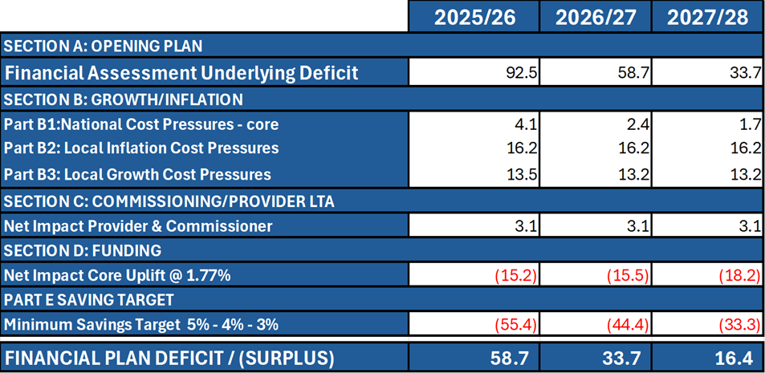
Financial Plan 25/26 Summary
Given the scale of underlying run rate coming into 2025/26 the organisation has set an ambitious savings delivery target of 5% for 2025/26. 5% is considered to be the maximum deliverable savings level in a financial year. Even after delivery of this 5% savings requirement the closing assessed Plan for 2025/26 of £58.7m deficit remains in excess of the forecast closing position from 2024/25; this is also in excess of the Health Board’s Target Control Total of £17m.
The combination of the opening run rate, costs above allocation in 2025/26 and a 5% savings programme result in a forecast deficit of £58.7m for 2025/26. A summary of the financial outlook for Years 2025/26 – 2027/28 is provided in the table below:
This outlook assumes allocations and wage award funding are broadly the same as 2025/26 and that cost pressures and service growth are also broadly stable.
Savings delivery is adjusted to 4% and 3% for future years to account for deliverability after 5% in year 1
Going into 2025/26 the Health Board must deliver a sustainable model of care whilst focusing on reducing its expenditure on a recurrent basis, through recurrent savings delivery to achieve financial sustainability. The Health Board recognises that £58.7m deficit needs to reduce sustainably and at pace, with this forecast representing the most granular assessment available at this point in time.
The Health Board urgently wishes to explore what external support could be available to support the Health Board to deliver this. In addition, the Health Board is considering the further choices and options that it would wish to discuss with Welsh Government to reduce the forecast deficit further. This would only be possible when the 5% savings target is delivered with certainty.

Slide 25
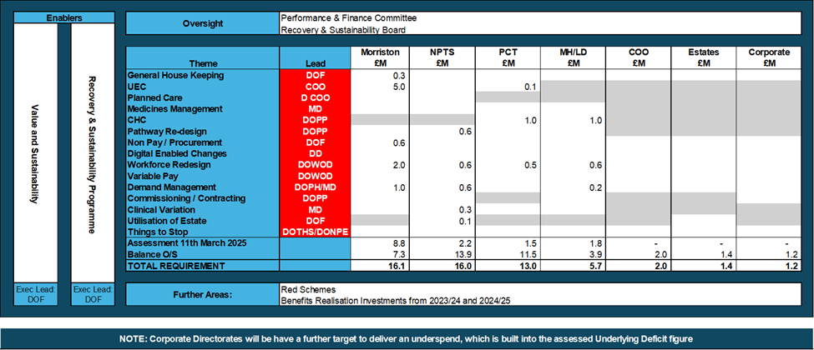
Financial Plan 25/26 Summary
Along with immediate cost control, the Health Board must focus on sustainability over 3 years, allowing the Health Board to deliver its recognised Target Control Total as soon as possible, through the delivery of a detailed service plan and savings programme supported by and underpinned via the Recovery & Sustainability Programme (established in October 2024) aligned to: -
1. National Value & Sustainability Programmes
2. Delivery of the Cabinet Secretary’s Enabling Actions
3. External Support to identify and support delivery of recurrent service changes and opportunities
The Recovery and Sustainability Programme has been refreshed for 2025/26 to include twelve core workstreams aligned to the Health Board’s overall savings delivery framework. Current vacancy control and variable pay management will remain in place running into 2025/26 until assurance of plan delivery is in place.
The governance route for 2025/26 remains unchanged with Recovery & Sustainability Board having full oversight of delivery of 2025/26 Savings requirement, alongside processes to reduce operational spend, reporting directly into the Performance & Finance Committee. Executive leadership will oversee the delivery of the benefits set out in items 1 to 3 above with clear assignment of leadership to these as per the illustration below.
As noted above the Health Board has been working collaboratively to identify areas of work to achieve the challenging savings target for 2025/26. An element of the target has been identified to date, these schemes are focusing on recurrent approaches to reducing expenditure, which will increase in Quarter 1 supported by external capacity to identify and deliver schemes.
A summary on the level of savings identified and aligned to the Health Board themes is summarised below:

Slide 26
Financial Plan 25/26 Summary
In addition to the currently identified savings, there are 29 further schemes which are yet to be costed and which must be translated into delivery plans as matter of urgency and alongside these, benchmarking of our urgent emergency care system, procurement improvements, medicines management opportunities and variable pay improvements to a value of £28.9m have also been identified and will be translated into this plan urgently.
Where the Health Board has certainty the financial impact is reflected within the 3 Year Assessment, but there are other areas that have the potential to impact on the delivery of the plan in year. Assessing the certainty, timing and choices has meant they are reflected only as a risk at this point.
The risks in 2025/26 have been categorised as those: -
• Risks Aligned to Choices Made in Development Plan – for example Health Board choses a high level of savings delivery and there is the risk that target will not be met in full.
• Risks the HB will need to manage above plan that may have a financial consequence – for example planned changes to its workforce.
The risks are set out in detail within the Minimum Data Set (Annex 3)
For 2025/26 based on the current cost, risk, quality, safety and funding assumptions outlined above, the Health Board cannot see a position where a safe and sustainable service model can be contained within a financial plan for 2025/26 that meets the WG set Target Control Total. The 3-year element of the plan, at a very high level, demonstrates that the Target Control Total could be achieved within 3 years and the Health Board is clear that this must be achieved as soon as possible.
The Health Board is clear that whilst this plan represents the current reflection of service configuration and delivery, the forecast 2025/26 deficit must be reduced at pace with a re-assessed position in terms of when Target Control Total will be achieved an urgent next step following submission of the Plan.

Slide 27
Delivering Performance
In line with the Ministerial Priorities, we have baselines and trajectories for our key services that reflect our resources (workforce, finance and capacity) and ambition to deliver in 2025/26. Detailed Ministerial Templates at Annexes 2a-e
Planned Care delivery in 25/26: These trajectories are predicated on the receipt of the Planned Care Monies from Welsh Government (£5.2M).
We will maintain zero 104 week waits for treatment, as achieved by 31st March 2025
We will maintain our ‘best in Wales’ position on 0 patients waiting over 52 weeks for a first outpatients' appointment
We will work towards reducing the number of patients waiting over 8 weeks for a diagnostic endoscopy, and continue to maintain our current position of patients waiting over 8 weeks for all other diagnostics (80% TI target)
Cancer Care Delivery in 2025/26
•We will deliver a 12-month improvement trend, patients starting first definitive cancer treatment within 62 days from point of suspicion (regardless of the referral route), building toward achieving the national target of 80% by 31 March 2026.
•We will reduce wait times across the following pathways:
Time to Radiotherapy -
•Scheduled - % within 21 days, % within 28 days
•Urgent SC - % within 7 days, % within 14 days
•Emergency - % within 1 day, % within 2 days
•Elective delay - % within 21 days, % within 28 days
Time to SACT
•Priority 1 (Emergency -within 48 hours)
•Urgent/Priority 2 - within 14 days (for Curative, Palliative/Disease Control, Haematology remission and Neoadjuvant intent)
•Routine/Priority 3 - within 21 days (for adjuvant intent)
Unscheduled Care Delivery
We will reduce ambulance patient handovers >1 hr
We will reduce ED waits >12 hrs
We will deliver a 12-month reduction trend in Number of people who are delayed in hospital as measured by the Delayed Pathways of Care Dashboard
Quality & Safety in 25/26:
We will focus on the reduction of cases of HCAI across the Health Board and evidence continuous improvement accompanied by a strong QI approach
We will continue to implement our duty of quality
We will monitor delivery of the quality priorities through the Quality digital dashboard
Mental Health Services in 25/26
We will maintain 80% target of mental health assessments undertaken within (up to and including) 28 days from the date of receipt of referral
We will maintain 80% target of therapeutic interventions started within (up to and including) 28 days following an assessment by LPMHSS
We will support the continued delivery of national mental health and learning disabilities performance targets
We will appropriately develop the facilities across our mental health services with the support of capital projects and implement recommendations where possible.

Slide 28
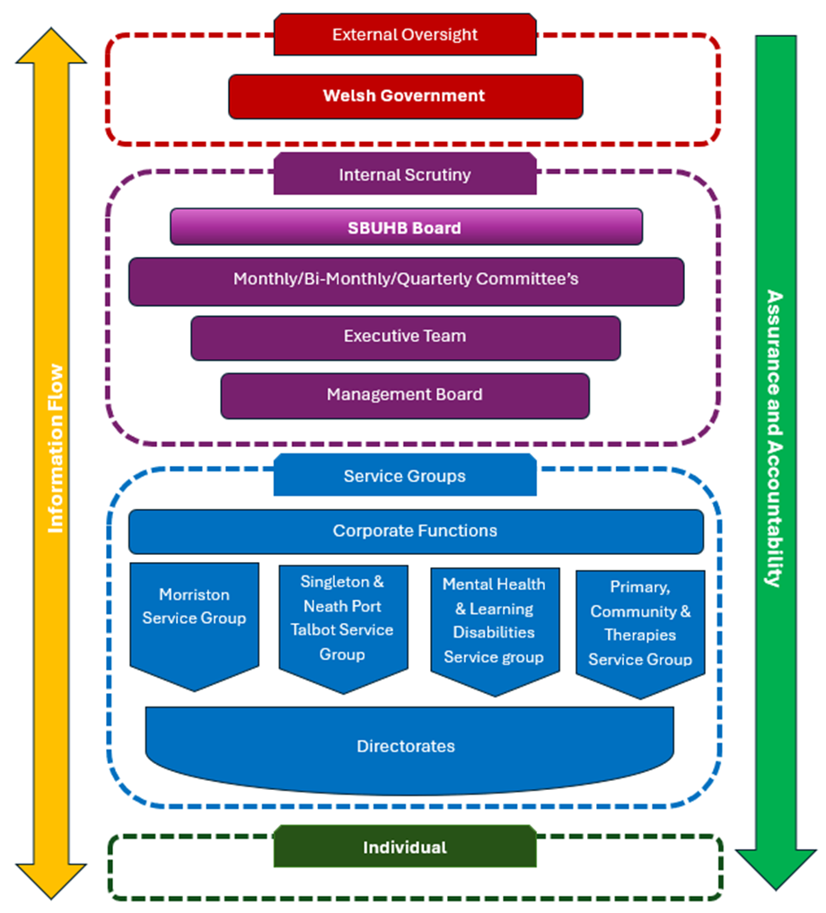
Population health and prevention
We will achieve the vaccination targets outlined in the NHS performance Framework (2025-26)
We will increase the % of patients (aged 12 years and over) with diabetes who received all eight NICE recommended care processes
Building Community Capacity
100% of GP practices achieving all National Access Standards for In-hours GMS
We will support the increase in number of people accessing Pharmacist Independent Prescribing Service for acute minor conditions and routine contraception services where the patient reports they would have otherwise visited their GP
We will continue to revise trajectories on the basis of agreed TI targets, aligned with allocation of Planned Care ‘Recovery’ funds focused in the highest priority areas to ensure delivery of our performance ambitions.
Performance Reporting
The diagram outlines the high-level reporting structure in place within the Health Board which provides appropriate Governance structures surrounding delivery against strategic objectives, along with monitoring and managing performance.
The management of the delivery of the outlined performance measures will be supported by monthly performance review meetings with individual service groups, along with general management across the Health Board of all key performance priorities.
Each quarter, a formal review against delivery of the Health Board plan will be undertaken with services, with formal updates provided to Board.
The levels of assurance will be managed and reported appropriately from individual level all the way through to the Board and subsequently Welsh Government

Slide 29
Ways of Working

Slide 30

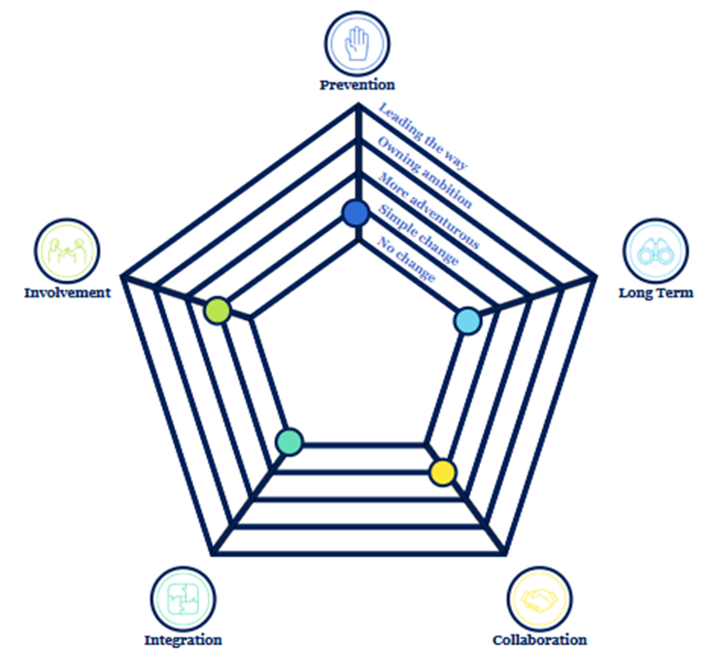
Our Ways of Working
In Swansea Bay UHB, we recognise the importance of the five ways of working as a behavioural framework as set out in the Wellbeing of Future Generations Act that as a Health Board we are looking to embed to deliver legislative sustainable development principles. In 2024/25, we have undertaken the Ways of Working Journey Checker and assessed how we have adopted, implemented pursue the five ways of working. This Plan and our longer-term plans support incorporation of the five ways of working into our organisational culture.
Long Term – This Annual Plan seeks to balance the immediate challenges faced across our services and pathways with our vision for a more population health focused organisation. We recognise the significant challenge in doing this whilst we strive for stronger financial control and achievement of our Targeted Intervention targets. But we are also confident that through a refresh of our Organisational Strategy and Clinical Services Plan we can seize and maximise the opportunities available to us to delivery significant, sustainable and forward-thinking transformation.
Prevention – We have a population health strategy, strategic objectives, wellbeing objectives and strategic indicators that set out how as an organisation we can address future problems acting though our four functional pillars. We are developing and will in 25/26 publish a horizon scanning report, an updated Health Needs Assessment and a Service Baseline Assessment in addition to further improving demand and capacity planning and modelling. These will help to identify the challenges and problems so that we can act to prevent them and enable us to deliver our Strategic Objectives.
Integration – The Health Board’s Well-being Objectives are a fully integrated element of our Organisational Strategic Objectives. However, we recognise that we have more work to do to communicate and engage on our Strategic Objectives and will do so, both internally and with our partners. We are committed to being a purposeful anchor institution, undertaking a baseline assessment as the foundation to delivering our anchor mission and working across other public bodies long term to develop an anchor system.
Involvement – We have good examples of two-way co-production in service change such as in Cymner Health Centre. The Health Board has developed stronger approaches to understanding patient experience and the needs of specific patient cohorts to inform decisions and services. Our approach to the EQIA process will be strengthened and be more coordinated and will Strategic Equality Plan: We All Belong.
Collaboration – Our new Strategic Partnership Group provides a forum for the health board to promote and support collaboration in formal and informal ways. We have developed a Partnership Collaborative framework and have strong relationships across the Regional Partnership and Public Service Boards and the Third Sector network.
Our Ways of Working Journey Checker Analysis

Slide 31
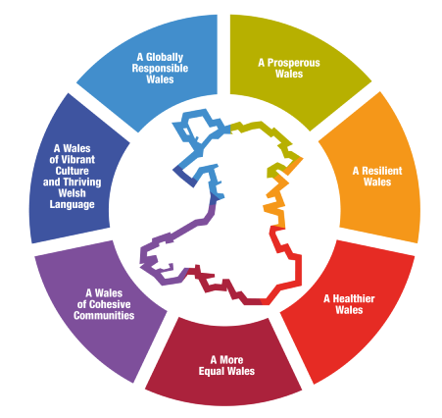
Well-being Goals
Our Well-being Objectives are fully integrated into our Strategic Objectives. More specifically the eight statements of High Quality for Strategic Objective 1 are our Wellbeing Objectives. These link directly to our Population Health Strategy and reflect the evidence-based Marmot Principles which focus on health inequalities and how we can reduce the disparities in health outcomes based on social determinants. Meeting these Wellbeing Objectives purposefully requires the health board to think beyond its role as a Care provider and maximise it’s influence and contribution across the four functional pillars of our responsibilities.
●
○
Direct impact
Indirect impact
 | Every child has the best start in life | All children, young people and adults are enabled to maximise their capabilities and have control over their lives | Good work and fair employment is created for all | A healthy standard of living is ensured for all | Healthy and sustainable places are created through placemaking | The role and impact of ill-health prevention is strengthened | Racism, discrimination and their outcomes are tackled | Environmental sustainability and health equity are pursued together
A prosperous Wales | ● | ● | ● | ○ | ○ | ○ | ○ | ●
A resilient Wales |  |  |  | ○ | ● | ○ |  | ●
A healthier Wales | ● | ● | ● | ● | ● | ● | ● | ●
A more equal Wales | ● | ● | ● | ● | ● | ● | ● | ●
A Wales of cohesive communities | ○ | ● | ○ | ○ | ● | ○ | ● | ●
A Wales of vibrant culture and thriving Welsh language | ● | ● |  | ○ | ○ | ○ | ● | ○
A globally responsible Wales | ● | ● | ● | ● | ● | ● | ● | ●

Slide 32

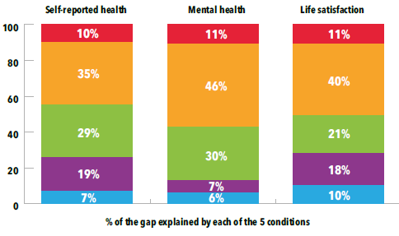









Becoming a Population Health Focused Organisation
Becoming a Population Health focussed, and competent organisation requires visible leadership, foundations that enable engagement and align of the whole the organisation to challenge existing ways of thinking, working and delivery across all aspects of our business. Population health is integral to the delivery of our high-quality organisational vision as reflected in our Strategic Objective 1: People of Swansea Bay live healthier more equal and prosperous lives. We understand the challenges of delivering this agenda given the current external context in which health and care is being delivered especially in achieving the shift organisational towards preventing ill-health as opposed to treating ill-health. The foundations developed to date since inception of the Population Health Strategy.
We will continue with our engagement led approach to build leadership, literacy, capability and capacity needed to implement strategy at scale. Utilising governance, systems and processes to create alignment to enable consistent application of population health approaches through existing work and development of new opportunities. Core to this is strengthening our use of data to promote the role and impact of prevention to ensure we understand, recognise and act to tackle the 5 conditions that contribute towards health inequalities. One size will not fit all and so we need to be adaptive and ensure all aspects of our business & ways of working, embed and demonstrate action.
The 5 conditions contributions to inequities in health
There is a big gap in the difference in health between the most and least deprived communities in Swansea Bay. Not all of this can be solved by health care services alone – in fact on about 10% of the gap (health inequity) is thought to be down to inequalities in healthcare service provision. The rest is caused by income security social support (35% of the gap in self-reported health), living conditions (29%), social and human capital (19%), and employment and working conditions (7%).

Slide 33
Our Population Health Strategy requires action to challenge the status quo and change behaviour to enable us to move from responding to increasing demands on our services to prioritising equity across all that we do to address the differential health needs of our population leading to a better, fairer Swansea Bay for all. Developing understanding and action in line with our role as an anchor institution and productive partnerships as the foundation for joined up action to reduce the gap between our least and most deprived communities, addressing poverty and the impact this has on the overall health and wellbeing of our local population.
There is a lot we already know about what action is needed to reduce inequalities and improve the health and wellbeing of the whole of our population. The healthcare we provide has the potential to improve health inequalities by only 10%. The remaining 90% requires us to take bold and considered action in line with the evidence base. Working with and through partners and partnerships to improve overall health and wellbeing of our local population and reduce the gap between our least and most deprived communities.
Sustainable development, our impact on our environment, and our voice as an anchor institution to improve the socio-economic status and placemaking agendas for the communities we serve must be part of the value we create.
Our work in Health Protection, Vaccination and Diabetes management working across clusters strengthens the focus for prevention. Developing our regional ambition to focus on equity-driven healthcare further supports the direction set by WG.
Maximising our impact as an Anchor Institution
The Foundational Economy in Health & Social Services (2021-22) Programme set out towards “Maximising the impact to Wales from its biggest Network of Anchor Institutions, Health and Social Services”. Programme focuses around the 3 Ps:
Procurement – leveraging spend to benefit Welsh businesses and communities.
People – how recruitment can employ people from the communities served, especially those further away from the labour market.
Place – how the health and social care ‘footprint’ and estate can be managed to provide better access to services as well as benefit local communities, businesses and the third sector.
As a £1.5bn anchor institution that employs over 14,000 the Health Board has significant assets and spending power and can consciously use these resources to improve the health of the population of Swansea Bay and create a better future for all.
Our Population Health Strategy articulates the role we can and need to take through the four pillars, one of which is anchor. It calls for us to mobilise and repurpose our resources to ensure greater and longer lasting impact.

Slide 34
Population Health Priority Areas for 2025/26
Alongside delivery against our ambitions outlined in the Population Health Strategy, the 2025/26 NHS planning guidance also draws attention to specific priority areas which include:
Diabetes management
Improved compliance with completion of 8 care processes for patients within primary and secondary care services
Monitoring of requirements of the DSS specifications
Education and communication programme for all staff and patients
Digital improvements to increase data capture
Participation in the Welsh Government home urine albumin testing pilot
Allocation of a diabetes consultant to each cluster for early/timely advice and expertise
Health Protection & Immunisation
National Immunisation Framework for Wales
  Evaluate performance to learn from practice and improve on uptake in all target population
  Providing data to key local partners involved in the delivery of vaccines to adopt good practice and improve efficiency
  Vaccine Equity Strategic Plan Implementation
  Re-focus services to address inequalities in vaccine uptake rates across ethnicity and deprivation through the leadership of an established Vaccine Equity Group
  Enable easy access for all services to information on vaccination to promote understanding and uptake
  Health Protection Framework for Wales
  Swansea Bay UHB will provide leadership in developing a sustainable regional Health Protection Partnership that focusses on multi-agency action to prevent and respond to health protection challenges
  The Health Board, working with partners, will continue work towards Welsh Government elimination targets for hepatitis B&C, HIV and Tuberculosis
Tobacco Control
  Help Me Quit smoking cessation services continue to be operational in Swansea Bay, providing support to smokers in the community, hospital and maternity
  Help Me Quit in Hospital and Maternal Smoking Cessation pilot programmes are operational in the Health Board, with continued funding through Prevention and Early Years funding in 2025/26
Whole System Approach to Healthy Weight
  Access to food, including availability and affordability, has been agreed by the PSBs as a regional priority
  Work will commence to map this in detail and agree the area of focus for collaborative work, aligning with the Well-being Plans and Health Board priorities
  A regional Learning Network aimed at building capacity and capability for systems working will be established
Weight Management
  Develop a comprehensive and sustainable weight management pathway in line with the All Wales Weight Management Pathway, including a focus on Level 2 and Level 3 adult Weight Management Services

Slide 35
Quality, Safety and Patient Experience
Swansea Bay University Health Board (SBUHB) has a Duty of Quality –Health and Care Quality Standards, as set out in the Quality and Engagement Act (Welsh Government, Health and Social Care (Quality and Engagement) (Wales) Act 2020). In line with our responsibilities under this duty, Quality and Safety remain fundamental to our Annual Plan and the plans of our Service Groups and Systems. We aim to do this by: Putting quality at the heart of all of our decisions; Having an effective quality management system in place; Communicating with our communities about the quality of our care. In addition to this, SBUHB has a duty to ensure that we are open and transparent when care goes wrong under the Duty of Candour
Our Quality Strategy is clear that “quality is everybody’s business”. The strategy sets out our vision for quality, namely “to reignite our intrinsic commitment to delivery of high-quality care that exceeds patients and carer expectations”.
Implementing Our Duty of Quality
We will provide regular information to our communities on the quality and safety of our care
Our quality dashboard will be completed and launched across the organisation
AMaT will be rolled out across nursing assurance audits
We will develop opportunities for our patients to support our assurance activities
Will support the work of our Mental Health QI and Assurance Board
We will continue to learn from internal and external reviews, including those from Llais and HIW
Our Patient Safety Congress events are well established with over 2150 attending in 2024, we will build on this in the coming year to increase the opportunities for learning across the organisation
We will embed of Quality Impact Assessment process at Board level
We will finalise and launch our Learning from Events Framework
Our QI Improvement Forums will continue to provide opportunities for sharing improvement ideas
We will increase opportunities for patient to be involved in quality improvement
We will work with partners as part of the Safe Care Collaborative

Slide 36
Quality Priority Areas for 2025/26
We recognise the harm that deconditioning can cause, both to individual patients and across our systems. We are developing specific roles across our services to support prevention of deconditioning and will also be undertaking health board wide work in the following areas:
End of Life Care
We will continue to make improvements in our End-of-Life (EoL) Care in line with professional standards, clinical guidance and the quality attributes set out in the quality statement. We will do this with our Regional Partnership Board, Local Authorities, Hospices, Third Sector and other appropriate Stakeholders to ensure that people facing a life shortening illness at whatever stage of their lives are supported by a workforce who are upskilled in Advanced Care Planning, Future Care Planning and EoL Care.
Infection Prevention & Control
We will continue to work collaboratively across the organisation in order to achieve the Antimicrobial Resistance and Health Care Associated Infection Improvement goals that have been set for 2024-2025. To ensure that we are always striving to improve outcomes for our service users we are working with our digital development team to create an application that will support the central analysis of HCAI case reviews. This will provide us with a better understanding of what may be contributing to our service users acquiring infections and guide us towards where we can make improvements.
Bereavement
We have achieved full implementation of the ‘Care After Death’ service and will continue to work collaboratively across the organisation and our partners to further develop the portfolio, service provision, relevant policies and outreach services. We have also adopted the Charter for the Bereaved Families.
Reducing harm through pressure damage and continuing our downward trajectory of number of pressure damage incidents reported through
Improving the information we give to patients about the importance of movement in order to maintain skin health
Working to improve the quality of reporting of pressure damage so we can provide the appropriate care
Nutrition & Hydration
We will build on the enthusiasm for improving the nutrition and hydration of our patients.
Deliver quality improvement projects to increase the availability of snacks for patients, engage with patients in developing and tasting menus as well as ensuring that we identify patients who require referral for specialist support.
Preventing Harm from Falls
Implementing the recommendations from the national audit for inpatient falls
Falls prevention work within the community through Clusters
Recognising and Responding to Deterioration
Rolling out the new national early warning systems (NEWS 2, PEWS, NEWTT2) as part of a national implementation programme

Slide 37
Quality , Safety and Improvement Plan
Delivery Action
Quality Improvement We are designing a training package to provide quality improvement skills for our patients To reduce harm from pressure damage we will work with communities to increase their understanding about skin health Building on the success of our previous intergenerational work, we will reduce harm from falls within the community Rolling out the new national early warning systems Delivering quality improvement projects as part of the national Safe Care Partnership
Quality Planning Developing a new model of patient stories so that we can increase the opportunities for patients to share their experiences Contributing to a national study on the impact of the arts-based Sharing Hope project on staff wellbeing Publishing our framework for Learning from Events Development of our Dementia Steering Group to inform improvements in our care
Quality Control Further development of our quality and safety dashboard to provide information at ward and service level Increased use of AMaT to manage our external inspections On going commitment to compliance with Welsh Language Standards
Quality Assurance Strengthening our quality assurance systems within service groups Re-launching our programme of independent member visits to services, to provide a further layer of assurance Creating opportunities for patients to be involved in our quality assurance activities Strengthening our systems of assurance for cross-cutting themes through our Patient and Stakeholder Experience Group Further development of how we communicate with our communities about the quality of our care through ‘Always on ‘ reporting

Slide 38
Commissioning Quality and Outcomes-Driven Care
We have a duty to commission services that meet the needs of our population through assessing needs, planning and prioritising services and purchasing and monitoring the effectiveness of services in delivering the best health outcomes possible for our communities.
Our key achievement for 2024/25 was the Voluntary Sector Recommissioning Programme which was an example of how we effectively used the principles of the Commissioning Cycle to procure services from the Voluntary Sector that complement our services to meet the needs of our population
Priority areas for 2025/26
Strengthening processes and infrastructure:
  Refresh of our Commissioning Framework to ensure that it is an effective tool for the Health Board in delivering the Annual Plan priorities and key strategies such as the Population Health Strategy.
  Continued update on Commissioning Process related to Health Services (Provider Selection Regime) (Wales) Regulations 20256 which commenced in February 2025.
  Improved performance and quality management of contracting arrangements with neighbouring Health Boards.
  Ensuring that correct contractual arrangements are in place for regional commissioning, e.g. joint delivery models with Hywel Dda University Health Board.
  Delivering key programmes of work, including:
    Completion of the final phase of the Voluntary Sector Recommissioning Programme in Q2 25/26 which will be underpinned by robust co-produced service specifications. Implementation of the Performance & Quality Assurance Framework for Voluntary Sector contracts including annual visits and scrutiny of monitoring information to assure the Health Board on the performance and quality of the services being commissioned.
    Development of commissioning model for Emotional and Mental Wellbeing Strategy working with the Regional Partnership Board (RPB) to jointly commission mental health support services from Voluntary Sector organisations
    Implementation of an Alliance commissioning model for Drug and Alcohol Services in partnership with the Area Planning Board (APB).
    Commissioning of a sustainable non-drug allergy service in collaboration with South Wales Health Boards.
    Securing additional elective activity from Independent Providers to aid the Health Board in achieving waiting times targets. Delivery against contracts to be monitored via Quality and Delivery meetings.

Slide 39
Continuing Healthcare (CHC)
    Demand for CHC is increasing in line with population demographics. Alongside the strategic challenges, there is a need for more focussed operational management of services to mitigate against the service and financial pressures being experienced. The former National Collaborative Commissioning Unit (NCCU) undertook a review of the Health Board’s commissioning approach to CHC and recommended a centralised function. Work has commenced over the last 18 months to localise the recommended model, and we will be undertaking a specific programme of work in 2025/26 to strengthen the commissioning of Continuing Healthcare and Complex Care. through a standardised commissioning approach and by working in partnership with Social Services. This programme will focus on the opportunities to streamline and standardise processes; more efficiently manage contractual arrangements, support the wider development of the sector, improve partnership relationships as well as the potential to enhance negotiating leverage with providers.
Working on An All Wales Basis
Health organisations across Wales have come together over the last few months to consider the challenges facing the NHS in Wales and how we can collectively address these over the coming years. The aim is to build a service delivery blueprint which will describe what the NHS in Wales will look like in 10 years’ time, and which will deliver improvements in health outcomes and performance and reduce inequalities. This will be a collaborative effort, bringing together the thinking from within NHS organisations in Wales and utilising external expertise and international insights, and will support and enhance the Welsh Government’s work on a National Plan. This will be a blueprint that describes an integrated primary and community care system focused on prevention and early intervention, a future model for hospitals, technology enabled care and a future-focused and enabled workforce. It will also set out a plan for how these changes will be delivered.
Engagement and involvement of communities
Collaboration with Welsh Government policy leads
Engagement and involvement of NHS staff in shaping future models
Clear roadmap for digital transformation
Delivery model which is based on clarity of responsibility at a National Regional and Local level
As this national work develops, Swansea Bay UHB will commit to aligning the thinking into our plans for service change and improvement.

Slide 40





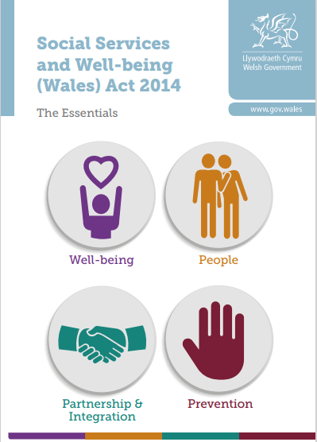
Working in Partnership
We have a strong record of partnership working and, wherever possible and beneficial, we will continue to deliver regional and integrated solutions. To achieve this, we are working with our statutory and no-statutory partners directly and through the Regional Partnership Board (RPB), Public Services Board (PSB), and other NHS & External Partnerships. We have developed the following Health Board Principles for Collaboration. Details of our regional working priorities can be found from page 58.
Principles for Collaboration
v
Recognise the value of partners and develop trust and mutual respect
v
Demonstrate commitment to develop and agree shared goals and values
v
Practice open and transparent communication
v
Collaborate when there is a clear advantage for the population
v
Effective representation of the views and interests of Service Groups and Corporate Departments
v
Strong focus on transformation and innovation
Regional Partnership Board
Public Service Boards
The West Glamorgan RPB Area Plan sets out how the West Glamorgan Regional Partnership Board will respond to the findings of the West Glamorgan Population Needs Assessment published on the 1st April 2022, which captured the health and social care needs of people living region.
The Wellbeing Plans developed by the Public Service Boards in Swansea & Neath Port Talbot are primarily driven by matters raised in the Assessment of Local Well-being undertaken in 2022. The Plans take into account recommendations made by the Future Generations Report, and Welsh Government’s Future Trends Report.
Through the Regional Partnership Board (RPB), we collaborate to design and deliver integrated services. We work in collaboration to identify shared priorities for service transformation and align the utilisation of the Regional Integration Funds (RIF) and Regional Capital Funds money.
The West Glamorgan Area Plan guides our work, focusing on the principles of person-centred care, prevention, early intervention, and seamless integration across services. This aligns with the vision set out in A Healthier Wales, which emphasises the importance of long-term, integrated services that support individuals to live healthier lives, with a focus on collaboration and shared responsibility in delivering health and care outcomes."
Third Sector
The Health Board's collaborative approach with the Third Sector Providers continues to make an invaluable contribution to service provision and improvements towards patient care. A full recommissioning programme is underway. Also in collaboration, the Health Board and the RPB are at the early stages of engagement to implement the Emotional and Mental Wellbeing Strategy

Slide 41



Primary Care Clusters
The Health Board works as part of the Pan Cluster Planning Group in both planning and delivering local health care services. Working as a cluster ensures care is better co-ordinated to promote the wellbeing of individuals and communities. Details of the Pan Cluster Planning Group and the Cluster’s priorities are set out in this plan on page 79-81. Clusters aim to:
Have safe & effective systems to direct people to the right person at the first point of contact
Provide care closer to or at home, by the right person, when it’s most needed
Deliver high quality integrated primary, community health, social care & third sector services
Understand & respond to the health and care needs of their population
Plan to prevent ill health and promote well-being
Swansea Bay UHB and Hywel Dda UHB Joint Committee
The newly established Regional Joint Committee between Hywel Dda and Swansea Bay University Health Boards will provide an opportunity to build upon the joint aspirations, ambitions, ideas, and commitment to drive regional delivery. A Regional Joint Committee’s work programme is being developed. Both Health Boards are keen to make the most of the opportunities presented through the establishment of the Joint Committee for the benefit of the respective patient populations.
Regional Specialised Partnerships
Collaboration between Cardiff and Vale and Swansea Bay University Health Boards to ensure shared delivery of sustainable specialised services across the two tertiary centres with a focus on:
  Hepatobiliary and pancreatic (HPB) Network will focus on several key milestones to enhance service delivery and coordination, and will address significant gaps in service provision for patients with Severe Acute Pancreatitis​
  The development of an interim Gynae Oncology arrangement to support SBUHB with a regional MDT whilst establishing a long-term regional model for complex gynae oncology
Joint Commissioning Committee
Working with the new Joint Commissioning Committee (JCC) For Wales on priorities including Paediatric Services, Cardiac Surgery, Nephrology and Specialist Mental Health. We will continue working with the JCC on the implications of their Foundational Plan. As a Provider, we host a number of Specialised services with sustainability or financial risks that have not been prioritised for investment in year, we need to fully understand the impact on what we can deliver in 2025/26 and work with JCC to minimise financial risk in year. The JCC foundational plan assumes an additional funding requirement of £6.3m from SBUHB as a commissioner. This liability has been included in full in financial plan for 2025/26.

Slide 42
Service Delivery and Improvement

Slide 43
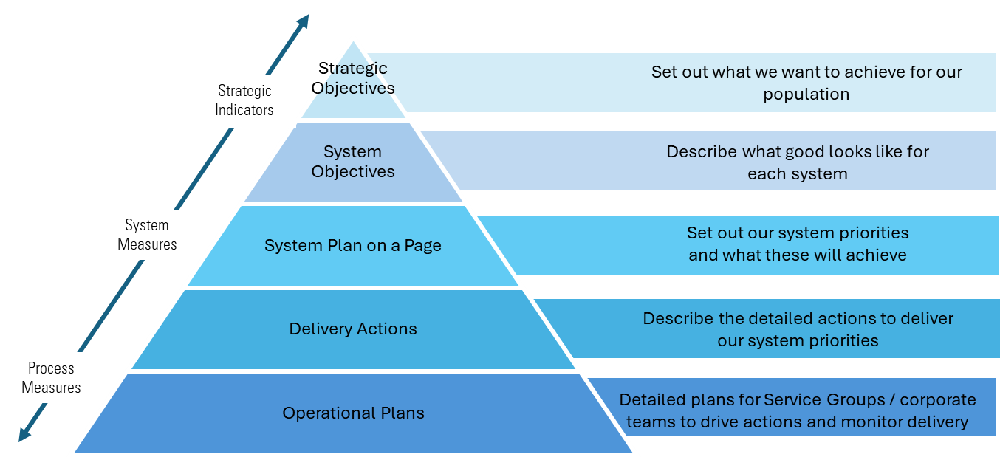
Planning Approach
This Annual Plan for 2025/26 is set in a three-year context that enables us to develop our strategic direction while focussing on our immediate priorities that will establish the foundations for success.
Our framework for planning and delivery is described in the diagram below. It aims to ensure that the actions we take culminate to deliver our strategic objectives.
This section of the Plan is divided into 'system areas'; Primary and Community Care, Unscheduled Care, Planned Care, Cancer, Mental Health, Learning Disabilities, Women’s Health, Maternity and Neonatal, and Children and Young people. Our objectives for each system are set out aligned to six of the core domains of quality and our 2nd strategic objectives. These objectives describe what good looks like for patients and the public. Aligned to these objectives are how we will measure delivery and where our actions will get us in terms of improved performance. We also include System 'Plans on a Page' which describe the critical priorities that will be delivered in 2025/26 and things we need to do to deliver them. Delivery Actions are then presented which describe in more detail the specific actions we will undertake in 2025/26 across Service groups and corporate teams. These Delivery Actions have been through a thorough scrutiny process conducted with broad senior engagement and are fully aligned to our Financial, Workforce Digital and Capital plans .
43

Slide 44
We have identified our immediate priorities for 2025-26 as:​
  Ensuring the delivery of safe and sustainable services​​
  Strengthening financial control to ensure that we can commission and deliver services within the resources available to us​​
  Improving performance in those areas of Welsh Government escalation as part of our continuous improvement journey
To deliver these priorities for 25/26, this plan was developed through, in the first instance, identifying and understanding our gaps in delivery and performance, and our areas of risk. Delivery Actions were then developed to address these gaps within the financial and performance parameters set by the Executive Team. Action were aligned to the three categories of Expenditure Control Short-term service change and ensuring safe services , and Medium-term to Long-term sustainability. Through this process they key priorities set out on page 19 were identified for immediate and concentrated action:
Our Urgent and Emergency Care and Planned Care Systems including key conditions: Diabetes, Cardiovascular, Respiratory, and Frailty.
Special Programmes to address key risk areas: Maternity and Neo Natal, Cancer Mental Health, Emergency Department, Children, and Regional Pathology.
Baseline Assessment of service and delivery
Identification of gaps and risks
Development of Delivery Actions to address risk and gaps
Our Annual Plan consists of the following key components:
Annual Plan 2025/26
Strategic Context
Responding to National Guidance
Delivery Action by System
Special Programmes: Mat-Neo, Cancer, Mental Health, ED, Regional Path, Children
Responding to Enabling Actions
(adopt or justify)
Recovery and Sustainability Actions
Organising for Delivery
All actions in the plan have been aligned to the Welsh Government Enabling Actions and Delivery Expectations. These have been indicated in each Delivery Action table:
Enabling Action | EA1
Delivery Expectation | DE1
Significant delivery milestones are indicated in the plan and more detailed milestones are described in the Ministerial templates in Annexes 2a-e. ​Our key proposals and changes will be impact assessed, and engagement requirements will be identified prior to implementation.

Slide 45
Priorities and Special Programmes
Through our Planning we have identified particular areas for delivery and transformation to address key risks and fragility of services. In 2025/26, we will direct particular focus on these areas.
Ares of Focus
Special Programmes
Urgent and Emergency Care
Frailty
Mental Health
Regional Pathology
Children & young People
Diabetes
Planned Care
Respiratory
Emergency Department
Cancer
Maternity & Neonatal
Cardiovascular
Urgent and Emergency Care
As part of a whole system approach, our ambition is to create ‘one urgent and emergency care system’ which clearly supports patients and communities in knowing where and when they can get the care they need in an emergency. This will be achieved through consistent and integrated delivery of the Six Goals to help achieve the best possible clinical outcomes, value and experience for patients and staff involved in the delivery of care. Strengthening joint planning and accountability with our Regional Partnership Board partners is a key enabler and focus for 2025-28.
Planned Care
We recognise that a fundamental change is needed within planned care services that will deliver sustainability though service redesign. Our over-arching ambition for Planned Care is to deliver and improve access to advice, diagnostics, therapy and interventions for patients through maximising new ways of working, pathway redesign, innovation and digital innovation. This will include core activity, transformation initiatives and re-modelling of services in sustainable way.
Frailty
Through the One Bay Way frailty alliance we have established a local pathway for elective general surgical patients encompassing screening for frailty at point of referral and yearly whilst on elective waiting lists. This is performed digitally where possible and via telephone where patients are unable to complete digitally ensuring equality of access for people who have less familiarity or access to digital technology. The screening questionnaires are reviewed, and patients are streamed into appropriate services which include two perioperative medicine clinics. The successful introduction of this service has resulted in reduction of general surgical waiting lists and optimisation of those who wish to go ahead with surgery. It ensures the right patient is treated at the right time in the right place.

Slide 46
We have demonstrated an improvement in availability of shared decision making in line with 3P’s and national guidance. There is also evidence nationally of a decrease in ‘one the day’ cancellations and decision regret associated with surgery which should replicated in Swansea Bay with establishment of this service. Further to this there has been a significant number of new diagnoses made and optimisation of medication including reduced costs through rationalisation following introduction of this service.
Diabetes
Currently 8.13% (26,000) of the Swansea Bay population have diabetes. Approximately 10% of the national NHS budget is spent on people with diabetes and it is estimated that over the next ten years, one in 11 adults in Wales will have Type 2 diabetes; Public Health Wales estimates that by 2035/36 there will be a 56% increase in patients living with diabetes. This rising prevalence will incur significant cost to the NHS and therefore to SBUHB. Over 10% of hospital admissions are attributed to people with diabetes. People with diabetes admitted to hospital, have an 8% chance of mortality within the year. This number rises to 13% if they have had an amputation; SBUHB has the highest rate of amputations, certainly in Wales, and one of the highest in the UK. SBUHB has signed up to the Tackling Diabetes Together Programme [TDT] and has formulated a plan to improve the Health Board’s position in relation to the Diabetes 8 Care Standards.
Respiratory
COPD is the most common respiratory disease and a COPD exacerbation is the second most common reason for an emergency admission. SBUHB and WAST have redesigned the COPD pathway to focus on the elements of Diagnostic, Preventative and Early intervention stages, addressing key issues which will contribute to the overall betterment of the Whole System pathway – Enhancing the professional community model and community of practice which aligns and educates on the resources within Primary and Secondary care. Future work will include Respiratory Ward and Community NIV redesign.
Cardiovascular Disease
Cardiovascular disease is another major cause of morbidity in our population. To date we have implemented community pathways for Atrial Fibrillation and Heart Failure, these are now operational with initial benefit realization submitted to WG/NHS Execs. These community services will be continued using ongoing VBHC monies for the next 12 months.
Lengths of stay following Vascular surgery are on average 1.5 days higher than the health board average, with 80% of procedures being carried out via emergency or unplanned care. In September 2024, the health board initiated the creation of the South-West Wales Vascular Network and, as part of that process a programme of work has been initiated through an agreed Vascular Services Plan. The priorities of the Vascular Plan include the stabilising and growth of Vascular Interventional Radiology (VIR), plus the development of a Hybrid Theatre (the business case for which is currently with Welsh Government). Support of these developments will facilitate a significant change in the reliance on emergency care and move towards a more planned care approach, enabling the establishment of a critical limb pathway. These developments will significantly reduce lengths of stay, improve the flow of patients and surgical outcomes and have a positive impact on amputation rates, currently some of the worst in the UK.

Slide 47



Special Programmes
Emergency Department
Work will focus on delivering modern and appropriate physical environment in the emergency department at Morriston Hospital to ensure safe services, dignity of care for patients and patients treated the right place by the right person.
Mental Health
Work will focus on modernising models of care and estate infrastructure across mental health services including inpatient and community settings.
Children & Young People
Work will focus on improving sustainability of services with greater focus on early intervention and prevention through development of an integrated CYP strategy.
Cancer
Work will focus on developing a comprehensive strategy for Cancer care and prevention linking community, secondary and tertiary services.
Maternity-Neonatal
Work will focus on ensuring high quality safe maternal and neo natal services and deliver the recommendations of the HIW report in full.
Regional Pathology
Work will focus on providing stability and sustainability to services across the region by developing critical mass, joint training and quality management systems, single digital information systems, collective recruitment and capital solution

Slide 48
Primary Care and Community Services
We will seek to ensure equitable access to admission avoidance services and health education, empowering individuals to maintain their independence, health and wellbeing, regardless of their circumstances or needs. We must also provide timely and effective first contact care by ensuring patients are seen by the appropriate healthcare professional, including social care and third sector colleagues, where appropriate. Care must occur in the right setting, supported by accurate and up-to-date digital information for enhanced health outcomes and prevention of harm; always delivering safe and efficient treatment and pre-surgery care and support, tailored to individual needs, ensuring optimal preparation for patients. Ensure effective pathways, in and out of hospital and offering support for prompt, person-centred discharge and post-discharge care, ensuring continuity and support that maximises health outcomes and addresses what matters most to the patient.
Measuring Delivery
% GP practices achieving all National Access Standards for In-hours GMS:
Number accessing Pharmacists Independent Prescribing Service for acute minor conditions and routine contraception services where the patient reports they would have otherwise visited their GP:
% of adult/child population accessing NHS Dental care over 24-month period: .
Capacity at the weekend of community nursing and specialist palliative care nursing to at least the required levels previously set for 2024/25 and greater where possible
Capacity of Enhanced Community Care to at least the required levels previously set for 2024/25 and greater where possible.
EQUITABLE
Primary and community care is available to people based on need, reducing inequity in outcomes and access.
EFFICIENT
People receive care that is supported by data and digital technology, ensuring relevant information is accurate, complete, up to date and shared between everyone responsible for that person’s care.
People receive care from the appropriate professional in the correct setting. They encounter services that are adequately staffed, well-trained and experienced, ensuring safety and preventing harm.
SAFE
TIMELY
People receive timely, integrated primary and community care, delivered locally to minimise health outcomes.
People are informed, supported and empowered to maximise their health and wellbeing and when necessary receive appropriate evidence-based care that maximises outcomes.
EFFECTIVE
PERSON CENTERED
People receive optimal, evidence based, primary care across all providers based on clinical need and what matters most to them.

Slide 49
Primary Care and Community Services Plan on a Page
2025/26
2026-2028
System Priorities
Areas to Deliver
Outputs
Develop sustainable plan for Hearing Aids
Delivery of Tobacco Control Priorities
Ensure GMS access and sustainability
Improvement of GMS Estates
Implementation of Dental Access Portal
Implementation of Optometry Contract
Review access to Special Care Dentistry/ Specialist Dentistry/Generalist Dentistry
Maintain services of Paediatric Dentistry general anaesthetic
Implementation of Pan Cluster Priorities
Implement Local Cluster Plans (208 key actions)
Implementation of Electronic Prescribing
Maximise number of Pharmacies offering the Independent Prescribing Service
Continue with implementing Community Psychology Model
Review all high CHC placements
Delivery of GMS Planned Care Programme
We will maintain national target of 100% GP practices achieving all National Access Standards for In-hours GMS
Improve Prevention and Wellbeing
Sustainable Diabetes Prevention Programme
Community by Design
We will increase the numbers accessing Pharmacist Independent Prescribing Services
Implementation of the full primary care model at cluster level
We will maintain our delivery of NHS dental services for adults and children
Care to be delivered locally and integrated to ensure primary care is consistent on a 24/7 and geographic basis
Sustainable Weight Management Pathway
We will increase weekend capacity for community nursing and specialist palliative care
Data and digital technology is a key enabler of transformational change
We will increase capacity of Enhanced Community Care
Interdependent Workstreams
Primary & Community Estates Strategy
PCPG Priorities
Contract Reform
Strategic Programme for Primary Care
Workforce Strategy
Digital

Slide 50
Primary and Community Care Delivery Actions
Ref | Delivery Action
PCT_02 | Develop sustainable plan for Adult and Paediatric Hearing Aids [also included in Planned Care System]
PCT_09 | Focussed implementation of Pan Cluster Planning Group (PCPG) Priorities and Cross Cluster projects in support of the National ‘Accelerated Cluster Development’ (ACD) Programme Development and delivery of a Pan Cluster Planning Group (PCPG) plan. x8 Clusters working independently and where needed in unified manner to develop and deliver on IMTPs that support the local population |  | EA.1
MHLD_25 | Continue implementation of Community Psychology Model [Requires additional funding for roll out in 4 remaining clusters- in dialogue with RPB, APB and stakeholders to establish funding source]
PCT_11 | Develop and implement plan to support the roll out of WGOS 4 and 5 and manage/mitigate the impact on capacity / demand and finance
PCT_12 | Review access to General Dentistry Service (GDS) Highlight financial risks to the General Dental contract position Assess impact of introduction of Dental Access Portal (DAP) Assess 25/26 contract changes impact (to in-hours access) | DE.12
PCT_13 | Review access to Specialist Dentistry including: Paediatric General anaesthetics in Parkway Clinic and Access to Oral Surgery. | DE.12
PCT_14 | Actions to reduce risks to GMS access, capacity & Sustainability | DE.10
PCT_15 | Delivery of GMS Planned Care Programme including the extension of minor surgery in Primary Care and the Ring Pessary Service (subject to continuation of Planned Care monies in 25/26) [Also included in Planned Care System] | DE.10 DE.3
PCT_16 | GMS Estates Development Programme Brunswick, Croeserw, Cymmer Health Centre Rent Review Programme Management of Primary Care Estates maintenance backlog workload | DE.10 | EA.24
PCT_17 | Deliver Tobacco Control Priorities: [cross cutting on all Systems] National HMQ Digital system implementation in 2025/26 Planning for 26-27/27-28 Secure ongoing funding or cease smoking cessation services established in 24/25 via Prevention and Early Years funding

Slide 51
Ref | Delivery Action
PCT_21 | Continued progress against actions/recommendations from HMP Swansea HIW inspection reports alongside further progress of Health, Care and Wellbeing Delivery Plan (HCWDP) 2023-25.
PCT_23 | Review of all CHC high-cost placements to ensure patients are appropriately placed [linked to overall Health Board led work on CHC Programme] |  | EA.23
PCT_26 | Community Continence Service Progress retendering process with Procurement. Review impact of service redesign actioned in Q2 24/25 to increase preventative measures and reduce continence product costs. |  | EA.21
PCT_03 | Planning for 26-27/27-28 Secure ongoing funding for provision of the All-Wales Diabetes Prevention Programme (AWDPP) [cross cutting on all Systems] | DE.6 | EA.27
PCT_06 | Planning for 26-27/27-28 Develop plan to meet the minimum standards of the All-Wales Weight Management Pathway [cross cutting on all Systems]

Slide 52

Unscheduled Care
SBUHB recognises that at a national level ‘Six Goals’ policy focuses on a whole system solution to the provision of UEC. As part of this whole system approach, our ambition is to create ‘one urgent and emergency care system’ which clearly supports patients and communities in knowing where and when they can get the care they need in an emergency. This will be achieved through consistent and integrated delivery of the Six Goals to help achieve the best possible clinical outcomes, value and experience for patients and staff involved in the delivery of care. Strengthening joint planning and accountability with our Regional Partnership Board partners is a key enabler and focus for 2025-28.
Measuring Delivery
Timely Access to Care
Number of ambulance patient handovers over one hour:
Number of patients who spend 12 hours or more in all hospital major and minor emergency care facilities from arrival until admission, transfer, or discharge compared to the same month the previous year:
Number of people who are delayed in hospital as measured by the Delayed Pathways of Care Dashboard
EQUITABLE
People who need to access urgent care can do so based on need, reducing inequity in outcome and access.
EFFICIENT
People with urgent or emergency care needs access appropriate care with admission to an acute hospital bed if clinically necessary.
People in need of urgent care receive it from the right person in the right place, first time by services that are appropriately staffed, trained and experienced so that further harm is prevented.
SAFE
TIMELY
People who need to access urgent care can do so 24/7 and they receive appropriate treatment or intervention in line with clinical need.
Linked to West Glamorgan RPB Older Persons work programme
People receive optimal, evidence- based, responsive care based on clinical need and are transferred to appropriate services according to need.
EFFECTIVE
We will be driving required change in the Emergency Department infrastructure through a special programme to ensure effective progress and results
PERSON CENTERED
People are informed and able to be involved in shared-decision making wherever appropriate

Slide 53
Unscheduled Care Plan on a Page
2025/2
2026-2028
System Priorities
Areas to Deliver
Outputs
Revise the Acute staffing rotas / SPOA / Triage / Streaming / Expand SDEC and OPAS Cover
Assess Clinical Support Service provision
Review non-clinical support
Expand UEC Care Co-ordination Hub
Review all AHP / Pharmacy / Advanced Prac
We will reduce ambulance patient handovers >1 hr
Implement 7 Day Service
D2RA
Further implement Front Door Flow Model
Development of the Integrated Discharge Hub
Joint development of D2RA
Redesign and refine Silver and Gold On-call
Improve Emergency theatre flow
Improve flow across Singleton and NPT Hospitals
Review bed base – Gorseinon and Bonymaen
Undertake robust Community Nursing Services D&C planning
We will reduce ED waits >12 hrs
Mental Health ED
Improve Management of Flow
Older People's Mental Health
We will deliver a 12-month reduction trend. in the Number of people who are delayed in hospital
Stroke Improvement Plan
Reshape Virtual Wards and ACT
Remodel Inpatient Rehabilitation
Respiratory Service Improvement Plan
Deliver Peri-operative Service for frailty
Review Ty Olwen Palliative Care beds
Pathway Redesign
We will reduce admissions
Develop secondary care diabetes and endocrine service
Interdependent Workstreams
Community Model Review
Mental Health ED and Older People's Mental Health
Regional
Digital

Slide 54
Unscheduled Care Delivery Actions See also detailed UEC 6 Goals Plan 25/26 submitted to National 6 Goals Prog 31st March 25
Ref | Delivery Action
MGH_01, PCT_35, MGH_32, | UEC 6 Goals – 7 Day Services for UEC: Revise the Acute Medicine rota to provide improved continuity of care and increase the sessional input into front door services over the 7-day period. GP workforce to deliver 7-day SDEC, linked to acute medical rota provision Assess nurse staffing requirements to deliver 7-day single point of access, triage and streaming. Nursing uplift will be required to extend OPAU and SDEC services. Consult with existing advanced practitioners in OPAU to deliver 7-day service cover. Assess current AHP workforce in both front door and community teams to assess the gap in provision to deliver 7-day services Review all administrative provision with a view to pooling resource to provide 7 day service cover. Assess baseline Clinical Support Services such as radiology and pathology cover. Review domestic and portering provision to deliver the 7-day service model Expand the current UEC Care Co-ordination Hub to provide 7-day service cover to include all relevant hub disciplines - WAST, therapies, GP cover, H@H. | DE.1 DE.2 | EA.1 EA.2 EA.3 EA.4 EA.5 EA.6
MGH_02, PCT_22, NPTS_43 | UEC 6 Goals- Management of Flow: Centralised flow model to serve HB wide flow, Hub and spoke working across all sites based at Morriston Hospital. Development of the IDH as a key platform in the delivery of centralised flow and implementation of D2RA. Joint development of a robust D2RA model delivered in partnership with NPT CC and Swansea City CC. Linked to the centralised flow model, revise the roles and responsibilities of the Bronze tier and redesign the Silver on call rota to promote system management that mirrors the Flow operating Model. | DE.1 DE.2 | EA.1 EA.2 EA.3 EA.4 EA.5 EA.6
MGH_03, NPTS_44 | UEC 6 Goals - UEC Pathway Redesign: Reshape Virtual Wards and ACT to deliver a Hospital at Home service to support admission avoidance in the community and from front door, conveyance of ambulances and early discharge. Model the inpatient rehabilitation demand and designate capacity to deliver rehabilitation services with a fixed length of stay - align to D2RA. Implement revised pathways for patients with respiratory conditions that span both acute and community services. Maximise the role and function of the UEC Care Co-ordination Hub in managing the respiratory demand to alternative, more appropriate pathways of care. Redefine the frailty pathways of care, aligned to the front door redesign and 7-day services provision. Maximise the role and function of the UEC Care Co-ordination Hub in managing frail older persons demand to alternative, more appropriate pathways of care, linked to the Hospital at Home model of care. Review the acute stroke pathway in respect of the UEC front door redesign programme. Consider the role of the UEC Care co-ordination Hub and same day emergency care services for unknown onset stroke presentations to avoid ED attendance. | DE.1 DE.2 | EA.1 EA.2 EA.3 EA.4 EA.5 EA.6

Slide 55
Unscheduled Care Delivery Actions
Ref | Delivery Action
PCT_18 | Review of bed base position across Gorseinon Hospital & Bonymaen House as part of Health Board wide review of bed-based provision. Current assumption as per financial plan- Gorseinon 30 beds (funded levels) and Bonymaen House (7 beds, joint funding provision with RPB) | DE.9 | EA.5 EA.6
D_08 | Signal enabling USC priorities Support new ways of working through the Integrated Discharge Hub. Prepare for working with the Electronic Patient Record (EPR). | DE.1 DE.2 | EA.1, EA.2 EA.3, EA.4 EA.5, EA.6
MGH_05 | Deliver Peri-Operative Service for Frailty: Continuation of Phase 1 and 2 of the One Bay Way Frailty project upscaled peri-operative services screening and referral clinics for frailty across selected elective waiting lists focussed on high range/ high risk patients [Subject to availability of Planned Care monies TBC] | DE.3 DE.9
MGH_07 | Design sustainable collaborative chronic kidney disease community service model and undertake pilot [subject to external funding being received, e.g. exploring opportunities with WG and the pharmaceutical industry]
MGH_08 | Respiratory Services Improvement Plan – Improve access to acute and chronic clinical conditions in all care settings [Also involved in Planned Care and Cancer Systems] | DE.1,DE.2 DE.3,,DE.4 | EA.5,,EA.7,EA.9, EA.10
PCT_19 | Ty Olwen Palliative Care Beds (14 beds): Reduce sickness less from current 15.57%. Amend rota to be more efficient / reduce handover | DE.13 | EA.6, EA.17 EA.18, EA.20
PCT_20 | Undertake robust Demand and Capacity planning across Nursing services including District Nursing, Sexual Health, Complex Wound Care, Lymphoedema and Community Cardiology | DE.9 DE.13 | EA.6, EA.17 EA.18, EA.20
MGH_06 | Deliver the Stroke Service Improvement Plan that aims to transform stroke pathways, expand clinical roles and support early discharge. Planning for 26/27-27/28: Scope Community Integrated Stroke Service using benchmarking from peers.DE.2 Establish Comprehensive Regional Stroke Centre incorporating HDUHB demand for 26/27 [Regional Priority with HDd]
MGH_10 | Develop and implement a sustainable secondary care diabetes and endocrine service by remodelling the Diabetes pathway. [Also involved in Planned Care System] Planning for 26/27-27/28: Implementation of the NICE Diabetes Closed Loop System. [subject to funding TBC – as per business case submitted to WG March 2025] | DE.6 | EA.27

Slide 56
Planned Care
SBUHB recognises that a fundamental change is needed within planned care services that will deliver sustainability though service redesign. Our over-arching ambition for Planned Care is to deliver and improve access to advice, diagnostics, therapy and interventions for patients through maximising new ways of working, pathway redesign, innovation and digital innovation. This will include core activity, transformation initiatives and re-modelling of services in sustainable way. We want to ensure that we capture lower health care needs earlier, so that we can enable patients with a higher need to receive effective and efficient interventions.
Provision of services and wellbeing activities which are based on population need and reduce inequity in outcomes and access.
Measuring Delivery
Timely Access to Care
We will maintain zero 104 week waits for treatment, as achieved by 31st March 2025 – subject to additional monies from WG
We will maintain our ‘best in Wales’ position on 0 patients waiting over 52 weeks for a first outpatients' appointment
We will work towards reducing the number of patients waiting over 8 weeks for a diagnostic endoscopy, and continue to maintain our current position of no patients waiting over 8 weeks for all other diagnostics (80% TI target)
EQUITABLE
Diagnostic and intervention pathways are integrated, seamless and well organised to ensure best outcomes. Records and information are shared, as appropriate, facilitating effective decision making and eliminating duplication.
EFFICIENT
SAFE
People with the greatest clinical need are prioritised for interventions in the most appropriate setting for their care.
TIMELY
People receive timely access to diagnostic services and interventions, undertaken in local settings, wherever possible.
EFFECTIVE
People have access to evidence –based interventions from multidisciplinary teams using modern and innovative technology
PERSON CENTERED
People have access to personalised help and information to support them to make informed decisions about the interventions they receive and their health and wellbeing.

Slide 57
Planned Care Plan on a Page
2025/2
2026-2028
System Priorities
Areas to Deliver
Outputs
Improve NDD and EYND Services | Review Administrative processes
Implement CIN Guidelines | Outpatients Transformation
Monitor CAN/DNA | Clinical Clerical Validation
Implement Community & Health Pathways
We will maintain zero 104 week waits for treatment (subject to additional monies/ WG allocations)
Referral Advice & Guidance
Theatre Developments
Diagnostics
Establish Hysteroscopy and Minor Ops | Maintain 8-week diagnostic target
Implement National Diagnostic systems | D&C pathology linked to regional service
We will maintain 0 patients waiting over 52 weeks for a first outpatients' appointment
IR Sustainability
Right size theatres and anaesthetics | Convert to Day case in line with BADs
Increase HVLC lists linked to OR1 | Develop the surgical footprint
Implement regional ortho and opthalmology | Interventional Radiology Transformation
Ring Fence surgical bed footprint | Maximise Robotic strategy
Establish Hybrid Theatre linked to vascular
Treatment Times and Outcomes
Critical Care / Burns Expansion
We will work towards reducing the number of patients waiting over 8 weeks for a diagnostic endoscopy
Critical Care
Building Resilient Cell Pathology
Improve 24 hr outreach
Expand Vascular Access Service
We will maintain our current position of no patients waiting over 8 weeks for all other diagnostics
Community by Design
Deliver Therapies 14wk RTT | Service improvements in: Continence Integrated Sexual Health, Looked After Children, HMP Swansea, Audiology
Deliver GMS Planned Care Programme
Laboratory Medicine Improvement Plan
JCC
Develop Maternity/Neonates/Perinatal workforce strategy
Develop Nephrology Strategy
Interdependent Workstreams
Pre Asessment & Pre-hab
D&C Planning
Pharmacy & Medicines Management
Regional
Digital

Slide 58
Planned Care - Delivery Actions
Ref | Delivery Action
NPTS_41, OP_14-16, | Maintain Outpatients 52 week 0 breach target across all specialities To be delivered within core capacity TBC Supported by validation in place, and Service level Performance Scrutiny reporting into Outpatients Redesign Group, reporting to Planned Care Board. Aligned to Outpatients Programme as below. |  | EA.7 EA..9 EA.15
OP_1 – 13, NPTS_42, | Deliver Outpatients Transformation Programme, aligning national and local priorities for 25/26 including: Implement Health Pathways - 35 Regional Pathways (lift & shift) implemented, published and available for SB Community HealthPathways users by Q4 25/26. Effective Referrals - Implementation of referral redesign, delivered in line with the Digital, Operational and Measurement Recommendations identified through the Map, Measure and Model stages of the Effective Referral project Modernise outpatient redesign (new to follow-up care)- including role of SoS and PIFU, and active discharge, virtual reviews, exploring use of high-volume clinic model. Centralise pre-registration and NPTSSG booking teams into the Patient Access Directorate by Q1 25/26. Deliver Education and Training to support services delivering Outpatients activity in accordance with National guidelines and Health Board protocols. Deliver 3Ps Programme - Roll out SPOC wellbeing services & Waiting Well Assessments (digital and non-digital) across services on roadmap in Q1 25/26. Maximise the opportunities of pathway redesign and joint working between primary and secondary care. [See PCT_15 in Primary Care System] |  | EA.7 EA..9 EA.10 EA.15 EA.25 EA.35
D_05,07,09,10,19 | Digital Transformation Priorities for Planned Care/ Outpatients: Implementation of the NHS App in parallel with the Swansea Bay Patient Portal. Increase the spread and scale of adoption of the Hybrid Mail - Support a reduction in run rate pressures through reduced postage costs while contributing to the long-term sustainability of clinical services. Complete the implementation of HIR (Hospital Initiated Referrals) across all specialities – improved quality and safety due to more timely receipt and prioritisation of referrals. Implementation of PROMPTLY - Continue to implement PROMS and digital health assessments, replacing Doctor Doctor and any other current systems. supporting individually scoped benefits for each service to improve patient and service management. In-Touch - Go live with 'In Touch' outcome form and write back to WPAS - Real time clinic outcomes, reducing the number of patients without an 'outcome' in WPAS. |  | EA.30 EA.31
MGH, NPTS | Maintain Planned Care 104 weeks 0 breach target across all specialities– subject to additional monies to be received from WG. Deliver within core capacity as much as possible, with additional activity provided by WLIs, outsourcing as per speciality level D&C plans TBC on basis of planned care allocation/ additional WG monies Supported by validation in place, and Service level Performance Scrutiny reporting to Planned Care Board. Aligned to Theatres Board and other work programmes as below. | DE.3 DE.4 | EA.11 EA.12 EA.13 EA.14 EA.15

Slide 59
Planned Care - Delivery Actions
Ref | Delivery Action
NGH_26c/d , MGH, NPTS | Sustainable Surgical Pathways Redesign: Implement sustainable OG pathway (RSSPPP Priority with Cardiff) Implement plans for HPB centralisation (RSSPPP Priority with Cardiff) Planning for 26/27-27/28: Whole system review of surgical specialities – opportunities for efficiency, productivity and sustainable services, e.g CIN, GIRFT recommendations, non pay rationalisation, estate utilisation, and working with JCC to right size services aligned to D&C and funded levels. Develop Strategy for Robotics Establish OR1 in theatres 4 & 5 at NPTH; [Major Capital Prioritised with WG] | DE.3 DE.4 | EA.11 EA.12 EA.13 EA.14 EA.21 EA.24 EA.25
NPTS_20 | Deliver Theatres Board Programme- embed improvement changes across x 7 workstreams: Theatre Scheduling - embed 642 compliance Resources - aligning Theatre Environment, Equipment and Workforce Finance - implement Value Based accounting approach to surgical pathways Digital - embed Theatre Dashboard view of surgical pathway Quality and Safety - embedding the Theatres Q&S framework Service Development and Improvements - implementing any service development associated with workstreams above | DE.3 DE.4 | EA.11, EA.12 EA.13, EA.14 EA.15, EA.16 EA.17, EA.19 EA.20, EA.21 EA.24 ,EA.25
NPTS_17 | Implement Theatre refurbishment programme Phase 1 (Theatres 1 and 2 in Singleton) of the refurbishment programme from Q1 25/26. Planned reduction in capacity managed by Theatres Board and considered in 104 weeks performance delivery. HSDU Refurb in Singleton also planned for 25/26 – timelines TBC to be aligned with above. | DE.3 DE.4 | EA.11 EA.12 EA.13 EA.14 EA.24
NPTS_19 | Right sizing Theatres and Anaesthetic capacity To align Anaesthetic and theatre workforce capacity with the required Health Board theatre template | DE.3 DE.4 | EA.11, EA.12 EA.13, EA.14 EA.15, EA.16 EA.17, EA.19 EA.20,, EA.21 EA.24,, EA.2,,
NPTS_22 | Deliver Regional Orthopaedic Programme [Regional Priority with HDdUHB – see Regional Chapter for details] | DE.3 | EA.11, EA.12 EA.13, EA.14

Slide 60
Planned Care - Delivery Actions
Ref | Delivery Action
NPTS_23 | Deliver Regional Ophthalmology Programme [Regional Priority with HDdUHB – see Regional Chapter for details] | DE.3 | EA.8, EA.11 EA.12, EA.13 EA.14
PCT_32-34 | Delivery of Prehabilitation Programmes [subject to recurrent VBHC monies]: For patients within Surgical inclusion criteria. Delivered through a tiered approach, encompassing a digital self-management platform plus a supervised Therapy led Prehabilitation service for identified patients with higher health needs suitable for intervention. Continued delivery of an MSK Prehabilitation programme for surgical Orthopaedic patients matching agreed inclusion criteria. Expansion of MSK Prehabilitation service for SB High volume low complexity (HVLC) general surgery patients matching agreed inclusion criteria | DE.3 DE.4 | EA.25, EA.28 EA.29
PCT_01 | Deliver 14 weeks Therapies and Audiology waiting list target in all areas Implement improvement plans and internal recovery plans in services as required |  | EA.7, EA.9
MGH_09, MGH-32, MGH_12e | Deliver improvements in Diagnostics 8 week waiting times in line with agreed trajectories: Deliver Endoscopy Sustainability Plan to phase endoscopy capacity up to meet total demand. [Additional recurrent monies as agreed in January 2025]. Progress regional opportunities with HDd [Regional Priority – see Regional Section] Maintain 8 weeks in Neurophysiology [subject to planned care monies] Maintain 8 weeks target in Cardiac CT and MRI [subject to planned care monies] Radiology Service Improvement Programme Support 8 weeks target delivery in MRI by continuing to fund mobile MRI via planned care monies this capacity with equivalent service in a diagnostic centre Planning for 26/27-27/28: Invest in expansion of substantive workforce to reduce reliance on outsourcing, insourcing and WLI sessions. Develop business case to WG for permanent funding of a second CT gantry at Singleton [subject to capital – National Imaging Programme] Progress replacement/ upgrade of Second MRI scanner in Morriston[subject to capital - National Imaging Programme] | DE.5 | EA.16, EA.17 EA.19, EA.25 EA.26

Slide 61
Planned Care - Delivery Actions
Ref | Delivery Action
MGH_34 | Deliver Cellular Pathology Sustainability Plan to support Pathology specimen turnaround times, particularly for urgent suspected cancer pathways and planned care Maintain core services by utilising agency support whilst undertaking training and recruitment in pursuit of a resilient and sustainable service model. Reduce use of WLIs covering capacity gap by recruitment to Substantive and Locum posts, [subject to Planned Care monies] Establish Business/Management Structure/Function – Regional working with HDd Planning for 26/27-27/28: Building Resilience - Succession Planning and future service support – scoping additional requirements, review mortuary provision to ensure capacity is available utilising all sites across the HB, development of Advanced practice team | DE.4 DE.5
MGH_32k, MGH_34g/h, D_02, D_03, D_17, D)34, | Digital Supporting Planned Care / Diagnostics Pathology digital system replacement (LIMS 2.0) - Implement the new Laboratory Information Management System Radiology digital systems replacement (RISP) – Implement the new Radiology Information System (RIS) and Picture Archiving and Communication System (PACS). Support maintaining quality and safety in radiology diagnostic services across the Health Board. Expand the use of Electronic Test Requesting and Reporting - Improve quality and safety through the digitisation of diagnostic services. Digitise cellular pathology services – Implement Digital Cellular Pathology System business case submitted to WG/DHCW in March 2025. | DE.5 | EA.25 EA.26
MGH_35 | Laboratory Medicine Improvement Plan: Planning for 26/27-27/28 Invest in the expansion of substantive Biomedical Scientist workforce

Slide 62
Cancer
Our aim is to deliver cancer care and services that improve patient survival, outcomes and experience. Swansea Bay UHB hosts the South West Wales Cancer Centre (SWWCC) which provides non-surgical oncology treatment for the population of South West Wales (including patients from Hywel Dda UHB). Swansea Bay is the only Health Board which delivers the entire pathway of care for cancer for the region, apart from a small proportion of very specialist services (SBUHB’s commissioner share of Velindre Cancer Centre equates to 0.64%). Delivering our vision will require a ‘one cancer system’, which provides timely access to ‘the right care, by the right person at the right time’ and working ‘better together’ with patients, their families, primary and secondary care and third sector partners. Our vision is aligned to and locally delivers the Cancer Quality Statement (2021) and Cancer Improvement Plan for Wales (2023).
People living in the SWWCC boundary have access to cancer services based on their need, reducing inequity in access and outcomes. These may need to be provided on a regional or national level to maintain quality and standards of care.
Measuring Delivery
Radiotherapy wait times: We will reduce wait times across the following pathways
Scheduled - % within 21 days, % within 28 days
Urgent SC - % within 7 days, % within 14 days
Emergency - % within 1 day, % within 2 days
Elective delay - % within 21 days, % within 28 days
Systemic Anti-Cancer Therapy (SACT) wait times: We will reduce wait times across the following pathways
Priority 1 (Emergency -within 48 hours)
Urgent/Priority 2 - within 14 days (for Curative, Palliative/Disease Control, Haematology remission and Neoadjuvant intent)
Routine/Priority 3 - within 21 days (for adjuvant intent)
Timely Access to Care
% patients starting first definitive cancer treatment within 62 days from point of suspicion (regardless of the referral route): We will deliver a 12-month improvement trend, building toward achieving the national target of 80% by 31 March 2026.
EQUITABLE
EFFICIENT
People receive cancer investigations and treatment that exceed the standards in the National Optimal Pathways.
Harm is minimised as a result of delays or treatment. People receive care delivered by the appropriate professionals within a skilled multidisciplinary team
SAFE
TIMELY
People with cancer start treatment as soon as possible, at least within 62 days of when cancer is suspected.
People have access to high quality, timely diagnostic services, allowing cancer to be detected earlier at more treatable stages. People are supported to be better prepared for diagnostics and treatment and receive excellent evidence-based treatment to maximise outcomes.
EFFECTIVE
People are empowered to reduce their risk of developing cancer via support to address known risk factors such. People are properly informed and supported to co-produce their care and those living with cancer who cannot be cured, or are nearing end of life are supported with personalised care, including support for families and loved ones.
PERSON CENTERED

Slide 63
Cancer Plan on a Page
2025/26
2026-2028
System Priorities
Areas to Deliver
Outputs
We will reduce waiting times across Radiotherapy pathways
Operationalise 2nd CT SIM
Develop business case for 5th Linac +/- spare bunker
Reset and Redesign Acute Oncology and Haematology Unit (including developing IO Toxicity Service)
Develop sustainable Regional Oncology OPD hub and spoke model
Increase SACT capacity
Develop 3-year plan for TrAMs programme
Cancer Specialist Service with JCC
Deliver tumour site action plans
Develop plan for lung cancer health checks/screening
Review Swansea Uni Pilot re MRSIM
We will reduce wait times across SACT pathways
Non-Surgical Oncology
Scope potential additional linacs in SWW
We will deliver a 12month improvement trend for patients starting first definitive treatment within 62 days building to 80% by 03.2026
Develop D&C plan across Allied Health Professionals
Interdependent Workstreams
Cancer Strategy
Prehabilitation
Prevention
Digital
To be noted: The Cancer System is impacted by a number of Planned Care System Delivery Actions, due to the nature of services/ pathways that are intrinsically linked, e.g. surgery, diagnostics. See Planned Care System section.
We will be driving required change in the Cancer services through a comprehensive strategy for Cancer care and prevention through a special programme to ensure effective progress and results

Slide 64
Cancer - Delivery Actions
Ref | Delivery Action
NPTS_04-09 | SWWCC Radiotherapy Developments: [Also included in Regional priorities with HDdUHB] Operationalise 2nd CT SIM at SWWCC as approved by WG Capital funding, in place by Q2/3 25/26 Development of a WG Capital BC and joint HB revenue for the 5th Linac (+ spare Bunker TBC) – to be developed for WG submission by Q2/3 25/26 | DE.4 | EA..25
NPTS_02, 10-13 | Oncology and Haematology Redesign and Clinical Strategy: Reset and redesign current Acute Oncology & Haematology Assessment Unit (AOHAU) service incorporating the development of an IO Toxicity Service Sustainable regional Oncology Outpatients hub and spoke model service across 3-year Wales, including prov3-yearncology outpatient rehab services; Support Development of 3 year Road Map for Bronglais Also included in Regional priorities with HDdUHB] Increase capacity for SACT to meet demand - Short term/ immediate solution implemented asap- additional x 4 chairs through increasing workforce in pharmacy, nursing and chemo schedulers. Develop 3-year plan for SACT - to include development and implementation of National TrAMS Programme | DE.4 | EA..25
NPTS_07,08, 14,15 | Cancer Specialist Services with JCC Operationalise PET CT at SWWCC -approved by JCC & WG Capital Progress JCC Leukaemia Business Case -further scoping and aligning with Cardiff & Vale UHB and Hywel Dda UHB to take place Planning for local implementation of molecular radiotherapy as directed by JCC/ National work Provide Contact Radiotherapy from South-West Wales Cancer Centre [subject to capital funding TBC in addition to JCC revenue] | DE.4 | EA..25
NPTS and MGH | Deliver tumour site action plans agreed for 25/26 – aligned to HB Targeted Intervention Cancer priorities | DE.4 | EA..25
PCT_31 | Continued implementation of a prehabilitation programme for those with cancer including continuation of Rapid Diagnostic Centre and the development of USC pathway videos and delivery of interactive webinars [subject to recurrent VBHC national monies] | DE.4 | EA..25
NPTS & MGH | Planning for implementation of Lung Cancer Health Checks/ screening, as advised by outcome of national scoping work led by PHW, outcomes from WG expected Q3 25/26. SBUHB has fed into scoping on potential impacts on demand and capacity on key specialities in 24/25. | DE.4 | EA..25
NPTS_04-09 | Planning for 26/27-27/28 Scoping potential for 6th/7th Bunker +/-Additional Linacs in HDdUHB footprint – decision to proceed by Q1 25/26. MR SIM: Pilot currently ongoing with Swansea University, undertake scoping feasibility and planning for MRSIM | DE.4 | EA..25
PCT_05 | Planning for 26/27-27/28: Demand & Capacity plan across Allied Health Professionals to understand population need across cancer pathway | DE.4 | EA..25

Slide 65
Mental Health
Our aim is that people have easy access to tools and support to maintain and improve their mental wellbeing. We will do more to improve the quality of life for people who have been diagnosed with and treated for mental illness and Learning disabilities. Pathways within Mental Health and Learning Disabilities are complex and often delivered within different parts of the overall model of services, so we need to streamline these. We have made significant progress in moving from a predominantly inpatient model to a more community focused service, and moreover, we need to centralise our adult acute mental health inpatient service into a modern facility. This will provide a better patient and staff experience, improve outcomes and enable more sustainable staffing.
Measuring Delivery
% mental health assessments undertaken within (up to and including) 28 days from the date of receipt of referral
% of therapeutic interventions started within (up to and including) 28 days following an assessment by LPMHSS
EQUITABLE
People receive support in accessing mental health services based on need, reducing inequity in outcomes and access
People receive care that is well documented, co-ordinated and seamless, supported by technology, ensuring relevant information is accurate, complete and shared between appropriate stakeholders.
EFFICIENT
People who need access to services are seen by the right person, in the right place, first time and are seen by appropriate staff who are trained and experienced to prevent further harm.
Linked to West Glamorgan RPB Emotional Wellbeing and Dementia work
SAFE
People receive integrated, seamless care that is delivered locally, wherever possible. Reduced waiting times and timely discharges are delivered by effective management of people through the system
TIMELY
People are supported by a multi-disciplinary team, providing optimal, evidence based and responsive care. Treatment is on the basis of clinical need, with transfer to appropriate services as required.
EFFECTIVE
We will be driving change in Mental Health through a special programme to ensure approach to ensure safety of service delivery and environment of care
People are empowered to maximise their health and wellbeing and have assistance to support them in deciding which treatment is the most appropriate for them. Families and carers are also appropriately informed, supported an equipped with the tools and skills to support the heath and care of their family member.
PERSON CENTERED

Slide 66
Learning Disabilities
Our aim is to modernise learning disability services across Swansea Bay through implementing and embedding a Regional Learning Disabilities Strategy. We will work to reduce the health inequalities faced by people with learning disabilities by working with mainstream healthcare services to support them to make reasonable adjustments in order to improve access to services for all people with a learning disability. We will support service users directly to ensure they access the healthcare services they require where reasonable adjustments made by mainstream health services are insufficient. We will also ensure we are undertaking assessments and preparing care and positive behaviour support plans for the commissioning and monitoring of packages of care funded either jointly or solely by the NHS to meet a person’s learning disability needs. Ensuring that service users who require out-of-area placements are actively supported and monitored, and, repatriated closer to home as soon as is appropriate will remain a priority and we will improve the provision of short term acute inpatient care for people with a learning disability with co morbid severe mental illness and challenging behaviour due to vulnerability and learning disability specific needs as well as providing specialist rehabilitation services as part of a pathway to community support for people with the most complex challenging behaviour, health issues and forensic needs.
EQUITABLE
People are able to access care based on need, reducing inequity in outcomes and access
Measuring Delivery
Progress against the priority areas to improve the lives of people with learning disabilities (Qualitative report)
People receive care that is well documented, co-ordinated and seamless, supported by technology, ensuring relevant information is accurate, complete and shared between appropriate stakeholders.
EFFICIENT
People who need access to services are seen by the right person, in the right place, first time and appropriately triaged and risk assessed to prevent further harm. People access services in an environment that is fit for purpose.
Linked to West Glamorgan PB Wellbeing Learning Disabilities work programme
SAFE
TIMELY
People can access and receive appropriate treatment and intervention in line with national standards at the right time to support their health & wellbeing.
People have access to a multi-disciplinary team and receive evidence based, responsive and optimal care based on clinical need. People receive proactive care and support for their physical, emotional, mental wellbeing and health in addition to evidence based specialist treatment as required.
EFFECTIVE
PERSON CENTERED
People, their families and carers are provided with the necessary support, information and tools to manage their health and wellbeing effectively.

Slide 67
Mental Health and Learning Disabilities Plan on Page
2025/26
2026-2028
System Priorities
Areas to Deliver
Outputs
L2 escalation support NHS Exec/Independent Consultant
Medical workforce review/service demand
Outpatient Pathways /Single Point of Access
Develop OPMHS enhanced assessment and Therapy Hub
Review OPMHS bed model
Continue to implement Community Psychology model
We will deliver Progress against the priority areas to improve the lives of people with learning disabilities
Adult Inpatient and Community Modernisation
LD Inpatient service model and estate
CAMHS
Deliver RPB CYP Plan: No wrong door / Appropriate Placements / Transition Principles
We will maintain the 80% target of mental health assessments undertaken within 28 days from receipt of referral
Mental Health ED
Specialist Mental Health
Progress implementation of JCC MH Specialist Strategy
Develop HDU Facilities
Mental Health Estate
Relocation of CDAT base
Refurbishment of Ward F Seclusion Facility
Progress Capital BC modernisation of Adult Inpatient
Co-locate Community OPMHS
Older People's Mental Health Service
We will maintain 80% target of therapeutic interventions started within 28 days following assessment by LPMHSS
LD Modernisation
Reconfigure Dan Y Deri/submission of BC to RPB
Develop seclusion facilities LD acute assessment unit /submission of BC to RPB
Interdependent Workstreams
UEC 6 Goals and D2RA
Mental Health ED /Older People's Mental Health
CHC
Digital

Slide 68
Mental Health and Learning Disabilities Delivery Actions
Ref | Delivery Action
MHLD_13 | Adult Inpatient & Community Model Modernisation Level 2 intervention support from NHS Executive & Welsh Government to support HB by undertaking joint initial assurance of pathways. Supported by work from Independent Consultant awaiting outcome of Level 2 NHS executive review. | DE14 DE15
MHLD_14 | Review Mental Health medical workforce: Planning for 26/27-27/28: Comparing workforce capacity and skills against service demand to identify gaps; workforce redesign to develop new roles | DE14 DE15 | EA.16EA.17
MHLD_12 | New Build Adult Mental Health – Progress Capital Business Case for Modernising Adult Mental Health Inpatient Services [Subject to Capital TBC, not in Major Capital Prioritisation]
MHLD_15 | Modernise Outpatients Pathways and Access [also part of Planned Care System] Improving access to >18 Outpatient Services by reviewing and developing robust outpatient pathways with a SPOA function to cover all geographical areas | DE14 DE15 | EA7 EA9 EA10
MHLD_20 | Manage Psychological Therapies demand mitigate risks within existing resource associated with increased waiting times
MHLD_06,07, | Redesign Older Peoples Mental Health Inpatient Services: Develop Enhanced Assessment and Therapy Hub CST group and living well with Dementia groups – in place by Q4 25/26
MHLD_04-05 | Progress implementation of JCC MH Specialist Strategy: Implement recommendations - impact on Caswell Clinic (MSU) and Taith Newydd (LSU) – complete building works in Q1 25/26 Develop HDU facilities on Tenby and Cardigan Ward [Capital dependent - WG Targeted Estates Fund 25/26 & 26/27 for alarm systems; Design costs for seclusion suites confirmed and will be submitted to WG with JCC supported]
MHLD_10, 11 | MH Estate and Safety Improvements: Community Drug and Alcohol Team modernisation and relocation – team to move to new base by Q4 25/26

Slide 69
Mental Health and Learning Disabilities Delivery Actions
Ref | Delivery Action
MHL03 | Modernisation of LD Inpatient Facilities: · Develop Dan Y Deri Challenging Behaviour inpatient facility –submit business case for RPB Capital in Q1 25/26 Develop seclusion facilities for LD Acute assessment unit - submit business case for RPB capital by Q4 25/26 Planning for 26/27-27/28- Develop business case for new inpatient service model and buildings on behalf of three Health Boards
MHLD_19 | CHC Effectiveness: Develop actions to improve clinical and financial effectiveness associated with packages of care. Review of all CHC high cost MH & LD placements to ensure patients are appropriately placed[linked to overall Health Board led work on CHC Programme] |  | EEA.23
MHLD_06,07 | Planning for 26/27-27/28 - Explore potential OPMHS beds reduction (currently split sites) Develop co located Older Adult Mental Health Team for Area 1&2 in central Swansea for Swansea residents (Westfa/Phillips Parade) [Capital dependent TBC]
MHLD_10, 11 | Planning for 26/27-27/28 Refurbishment of Ward F Seclusion Facility

Slide 70
Women’s Health
The Women’s Health Plan for Wales will be delivered over ten years, through a series of short, medium and long–term actions. It will follow a life course approach, with a focus on delivery of services from 16 years age, often an important time of transition within health services. The Women’s Health Network will work with the Maternity, Neonatal, and Children’s Health Networks to ensure that the health of girls in the early-years and adolescent period are prioritised.
The Plan outlines the key health inequalities experienced by women in Wales at a population level, and highlights some of the disparities in health, which are emerging. However, it will also highlight opportunities for closing the gender gap, improving health across our NHS services and bringing to our attention areas of innovation and best practice delivered by our motivated and committed NHS staff.
Women and girls will receive treatment based on needs, reducing inequity in outcomes and access. This means we will: listen to them about their symptoms, treatment, and other factors involved in their care, before suggesting an appropriate course of treatment.
Measuring Delivery
Establishment of one Women’s Health Hub in each health board area by March 2026 (aligned to the Women’s Health Plan)
EQUITABLE
Women and girls will receive high standards of care whenever they are cared for within our services. This means we will: ensure our staff have the necessary skills, knowledge and confidence to understand what support is needed
EFFICIENT
Women and girls will receive safe and effective care; with risk, intervention and variation reduced wherever possible. This means that: we will work in partnership with women and our partners to keep them safe from harm
SAFE
Priority Areas for Women's Health:
  Preconception and Postnatal Health
  Menopause
  Ageing Well
  Menstrual Health
  Endometriosis
  Violence against Women and Girls
  Contraception and Abortion Care
Women and girls will receive care and treatment when they need it. This means we will: ensure our waiting times and referral times are managed appropriately in order to meet the needs of the women and girls using our service.
TIMELY
EFFECTIVE
Women and girls will receive the right care, at the right time; with access to specialist services when needed, and access to ongoing treatment and support as appropriate.
PERSON CENTERED
Women and girls will receive personalised care, which they are involved in planning; reflecting their choices and health needs. This means that: women and girls will be involved in decisions about their care, and the available options for their care.

Slide 71
Maternity and Neonatal Care
The foundations of health and wellbeing start with pregnancy, birth and the early days of childhood. Person-centred, safe and high-quality care for mothers and babies throughout pregnancy, birth and following birth can have a positive impact on the health and life chances of women and babies and on the healthy development of children throughout their life. This can help to reduce the impact of inequalities which can have longer-term health consequences for families, securing the best possible outcomes for mothers, babies and communities. Our long-term vision for Maternity Services in Swansea Bay, including Midwifery and Neonatal Services, is that women, and their families in Swansea Bay, are equipped with the knowledge, skills and confidence to make informed decisions about their care, and the care of their children.
Care and treatment are determined by clinical priority, understanding of additional care needs, language of choice, respecting the individuals cultural background to avoid variation and intervention.
Measuring Delivery
Implementation of and adherence to the All-Wales Perinatal Engagement Framework: Leadership, Culture and Workforce, Equality, Diversity and Inclusion
Listening (the capacity and capability to listen to women, parents, families and communities)
Maternity and Neonatal Voice Partnership arrangements
Analysis and triangulation
Using people’s experiences and feedback to drive quality improvement, service development and ongoing learning
‘Closing the loop’, governance, reporting and publication
EQUITABLE
Available resources are used efficiently and sustainably with a view to minimising environmental impact, whilst maintaining a clear focus on delivering person-centred care to maximise outcomes and experience
EFFICIENT
Consistent use of person-centred and evidence- based pathways of care delivered by a skilled MDT underpinned by clinical governance, robust demand and capacity information, risk management and escalation protocols in line with national standards
SAFE
Systems and process are embedded to ensure multi professional, multiagency communication and evidence-based assessments, decision-making and clinical prioritisation are undertaken across perinatal services to deliver care in the most appropriate place and time.
TIMELY
Continuity of care, universal pathways with additionality as required. Supported by standardised reporting, investigation of adverse events and continuous learning. Focus on population health, wellbeing and prevention.
EFFECTIVE
PERSON CENTERED
Appropriate and timely information is provided in multiple languages and formats and women are supported to make informed decisions through their pregnancy in a range of settings.
We will be driving required change Maternity and Neonatal services through a special programme to ensure effective progress and results

Slide 72
Women’s Health , Maternity and Neonatal- Delivery Actions
Ref | Delivery Action
NPTS_40 | Implement the WG Women's Health 10 Year Plan in SBUHB, including development of Women's Hub Produce a Women’s health strategic framework and direction for all specialities who deliver services for women within Swansea Bay UHB, incorporating the final version of the Welsh Government Women services plan (published 10th Dec) | DE.8
NPTS_29 | Ensure Sustainable Fertility and Andrology service: Maintain de -escalated status Develop new contractual arrangements with JCC Develop fee paying services further and deliver key financial targets (savings in 2025/26 and improved service delivery)
NPTS_30 | Development of a SBUHB Maternity and Neonatal and Perinatal Workforce Strategy Implementation of national workforce standards from BAPM, RCOG & RCM to deliver optimal care [subject to external funding, e.g. JCC as this becomes available] Six key service priorities: 1. Developing the maternity support workforce 2. Maximising productivity through technological solutions 3. Staffing at times of peak acuity 4. Redesigning the community midwifery staffing model 5. Strengthening clinical leadership and supporting career progression 6. Listening to the workforce and nurturing positive culture
NPTS_31 | Matneo Safety Programme Strengthen and improve Culture, Exec leadership, Matneo leadership, Matneo teamwork
NPTS_32 | Establish and deliver education, training and a maternity and neonatal and perinatal research strategy
NPTS_33-37 | Embed the All-Wales Midwifery Led Care Guidance, Perinatal Engagement Framework and standards of care into practice - to ensure high quality care is provided in all Midwifery led Settings, includes: Family initiated care in Neonatal Units Optimise breastfeeding – Breastfeeding lead appointed in 24/25 Seamless links to community maternity mental health services as appropriate - Further develop transitional care unit in line with National Standards, subject to availability of national funding
NPTS_38 | In-Utero Transfers and Neonatal Transport Service [working with JCC] Demonstrate safe and sustainable services through completion of actions outlined as a result of the action plan formulated from the proposal to reconfigure neonatal services Interim model to stay in place 25-26 & 26-27 as no further funding is included in the JCC Planning process
NPTS_39, D_12 | Development of a digital maternity plan - in line with Digital Maternity Cymru national timelines Business case for local implementation of Digital Maternity Cymru System submitted to WG 31st March 2025 as per national directive. TBC implementation costs from WG and HB agreement to fund ongoing revenue costs |  | EA.30

Slide 73
Children and Young People
Our ambition is to promote and support a healthy start in life for children, young people and their families as they grow and develop. We want to ensure that all children and young people are able to reach their full potential and be emotionally and physically healthy; giving them the best start in life. Our team of multi-skilled professionals work alongside children, young people and their families to support their needs and provide effective and safe care, working in a suitable child-friendly environment. Working in partnership with other organisations, children, young people and their families, we aim to safeguard the health and wellbeing of children and young people within the Swansea Bay University Health Board area. We strongly believe that by working in conjunction with the goals of the Healthy Child Wales Programme, we will support a positive impact to children’s health, social and educational development; optimising their longer-term potential.
Measuring Delivery
Neurodivergence
Plans should reflect active engagement with the Neurodivergence Improvement Programme and integrated working with partners in Regional Partnerships Boards, including education.
Health Boards should consider the requirements of the Statutory Code of Practice on the Delivery of Autism Services, which is being expanded to include other ND conditions. There should be an emphasis on delivering early help and support, reducing assessment waiting times for children and young people in particular.
EQUITABLE
Children and Young people’s services are based on population need and reduce inequity in outcomes and access.
Children and Young People’s care and treatment is well documented, coordinated and seamless, supported by technology, ensuring relevant information is accurate, complete and shared between appropriate stakeholders.
EFFICIENT
Children and Young people are appropriately safeguarded including in transition to adult services. They are treated in a way that supports them to feel mentally and emotionally strong, in suitable locatiosn and with as much continuity as possible.
SAFE
Children and Young people receive the appropriate care, treatment and interventions at the right time and is focussed on prevention to get the best start in life.
TIMELY
Linked to West Glamorgan RPB Emotional Health and Wellbeing and Autism, NDD and Children and Young People work
EFFECTIVE
Children and Young People have access to support, diagnostics, treatment and care that achieve optimal healthcare outcomes.
Health professionals collaborate with Children, Young People and their advocates to inform, support and empower them to maximise their health and wellbeing. Families and carers are informed and equipped to support the health and care of their children.
We will be driving required change Children and Young People's services through a special programme to ensure effective progress and results
PERSON CENTERED

Slide 74
Children and Young People - Delivery Actions
Ref | Delivery Action
NPTS_25 | Revise the current CYP strategic framework with focus on the agreed actions from the 2024 CYP Summits
NPTS_26 | Develop plans to relocate Paediatric Footprint at Morriston, to ensure this is fit for purpose for CYP and their families/carers
NPTS_27 | Develop and expand sustainable Neurodevelopmental and Early Years Neurodevelopmental service (0-17.9 years) Sustained improvements in NDD waiting times TBC awaiting confirmation of additional WG monies - national ask for urgent mapping in Q4 24/25 to demonstrate impact of not undertaking additional activity and what waiting times would look like if reverted back to only core capacity EYNDD - Invest in workforce to meet population needs in line with NICE guidance [subject to availability of external funding] Progress partnership working with local authority and education, locally and through regional partnership board work, in addition to participation in WG Redesign programme
NPTS_28 | Develop an agreed recovery plan across all Paediatric surgical specialities to reduce the waiting times of children and young people waiting over 26 weeks for surgery over next 12 months [subject to planned care monies TBC] [Also included in Planned Care System] |  | EA.11- 14
MHLD_09 | Deliver RPB CYP Programme Board Delivery Plan and Workstreams including: Phased operational approach to the regional 'No Wrong Door' project to develop a multi-agency access point for mental health and emotional wellbeing Safer accommodation group to consider appropriate placements which meet the needs of young people in the region. Complex transition principles (cross-agency).
MHD_21 | Establish and embed Hillside Secure Children's Home In-Reach service - Directed by Welsh Government and as per Service Specification agreed between SBU HB and NPT LA. Establish full team Q2 25/26
MHLD_22 | Review CYP psychology service models to support increased demand and improved outcomes in: Child health services (Paediatric, Specialist Surgical, and Child Development) Paediatrics inpatients Children's Centre model - currently only half funded by MHSIF. [Implementation of any additional resource requirements would be subject to securing WG / external funding]
PCT_24 | Review of assessment/funding criteria of Looked after Children across Swansea Bay footprint so that SBUHB funding aligns with actual health needs [aligned to corporate led CHC programme]

Slide 75
Women's Health Children and Young People and Maternity Neonatal Plan on a Page
2025/26
2026-2028
System Priorities
Areas to Deliver
Outputs
Women's Health
Women's Health Plan – Development of a Women's Health Hub
Sustainable Fertility Services – Maintain de-escalated status and review JCC contracted arrangements
We will establish a Women's Health Hub by March 202
Delivery of 8 Women's Health Priority Areas
Develop an agreed paediatric surgical plan
Develop plans to redesign Morriston Paediatric footprint
Partnership working with RPB – NDD Service improvements
CYP Strategy – Agreed actions from CYP Summit
Community Children's Services
Children & Young People
Sustained improvement in NDD waiting times
Delivery of CYP Strategy
Workforce strategy
Maternity-Neonatal safety programme
Perinatal research strategy
Deliver Perinatal Engagement Framework
Neo Natal Transfers
Mat Neo Digital Plan
Maternity & Neonatal
We will deliver EPR for Maternity Services
Deliver the recommendations of the HIW report
Interdependent Workstreams
Community Model Review
CHC
Digital

Slide 76
Cross System and Specialised Delivery Actions
There are a number of additional Delivery Actions which cut across systems or stand alone as specialist services such as Pharmacy and Medicines Management or the work of the Vascular Network. These Delivery Actions don't sit neatly into our system plans and are described here.
Ref | Delivery Action
NPTS_01 | Develop a comprehensive health board strategy for Pharmacy and Medicines Management. The strategy will focus on several key areas to optimise the use of medicines, support patient outcomes, and manage resources effectively. |  | EA.22
NPTS_03 | Deliver Pharmacy & Medicines Management Decarbonisation Initiative: Actions aligned to the Health board's Climate Action Plan to reduce the supply of high global warming potential inhalers, reduce overprescribing to reduce waste. |  | EA.22
MGH_23a-g-, MGH_32h-I,MGH_15h=G | Deliver Vascular Services Improvements, working with the Vascular Network to: Develop a baseline D&C plan for alongside a financial analysis, explore need for additional staff (e.g. Clinical Nurse Specialists and Vascular Lab to support this fragile service), explore digital solutions for outdated and soon to be unsupported platforms Agree and implement a robust vascular repatriation policy Planning for 26/27-27/28 - Progress with development of Hybrid Theatre business case, as prioritised in WG Major Capital prioritisation. Continue to progress with Vascular Interventional Radiology by implementing plans put in place with support from NHS England Transformation Unit | DE.3 DE.4
MGH_12 | Develop sustainable neurological service strategy, to include Develop a Neurology Outpatient referral Advice and Guidance Service Fragile Dystonia Service Fragility of the Neuromuscular Disease Service Long waiting times for Non-epileptic Attack Service & Functional Neurological Disorders potential patient harm Neurology patients waiting in excess of 26-week waiting list target, potential patient harm Neurophysiology Risk of capacity to conduct Diagnostics Testing Parkinsons Centre/Jill Rowe Unit - unfit for patient care potential risk to patient and staff Poor patient experience and care due to access challenges for patients with Acute Neurological Problems Risk of not meeting national standards resulting in failure of Open Access Epilepsy Service &possible detrimental patient impact | DE.3 DE.4

Slide 77
Ref | Delivery Action
MGH_13a-d | Deliver Nephrology Strategy in line with agreements with JCC Complete expansion of the Renal Dialysis Units in NPT and Bridgend Develop Interventional Nephrology Service to assist with line insertion for patients requiring vascular access for dialysis or other renal treatments in 3 phase Install a water plant for Cardigan Ward to reduce the risk of infection and to meet water testing standards
MGH_15 | Critical Care Improvements, including: Develop medium-term plan for sustainable PACU service and Planned Surgical Care Pathway to support post-anaesthetic care and Level 2 care of patients Develop and implement Workforce plan to include retention & recruitment of clinical staff, ICU and post-ICU therapy and rehabilitation Allied Health Professional workforce plan (including clinical psychology and/or psychiatric nursing support) in line with GPICS when released in 25/26, 24/7 outreach service
MGH_17,18 | Sustainable Burns & ICU Complete Integration of Burns ICU within General ICU (Burns Phase 2 Planning for 26/27-27/28 - Phase 2 re-expansion of ICU Review space options to realign and support capacity
MGH_19, 20 | Sustainable Cardiology and Cardiothoracic service including: Development of a sustainable TAVI,DCCV, TOE, Pacing Service to meet demands Progress regional conversations including with JCC, e.g. cardiac surgery, mitral clip, TAVI, Non-femoral TAVI service, developing work up protocols and repat pathways | DE.3 DE.4
MGH_20 | Replacement or alternative for Omnicell systems (storage cabinets for hc drugs) in ICU, Cardiac ITU and ED, which are end of life and cannot be supported beyond October 2025

Slide 78
Enabling Delivery

Slide 79








Pan Cluster Plan: Priority Areas for 2025/26 Summary
Following the success of the 2024/25 Plan Cluster Plan our new plan has taken a more refined approach, considering the predominating areas of activity put forward within the Local Cluster Collaboratives which align with the Health Board and Regional Partnership Board priorities. This year there are two agreed Pan Cluster Priority areas. The Pan Cluster Plan is included at Annex 4.
Emotional Mental Health and Wellbeing
Introducing and embedding in Community based Psychology provision to develop an optimum model, planning Third Sector commissioning, Mapping Cluster activity (considering equity)
USING A POPULATION HEALTH LENS & CONSIDERING EQUITY, CO-PRODUCTION
Improving Care for Frailty and Older People
Reducing Falls- supporting the development of a system wide single approach to responding to falls; Setting out and developing the role of primary care in admission avoidance –prevention and early intervention; Wider roll out across Clusters of the Community Clinician role (providing care for frail patients in the community)
In addition, the following key enablers have been recognised as being required in order to take forward both the Cluster IMTPs and Pan Cluster Plan, to be woven into respective work areas: Primary Care access and sustainability (estates, workforce development and equity of provision). Individual plans for each of the 8 clusters are included within the Pan Cluster Plan (Annex 4) and contain a wide range of actions at cluster level to improve health and well-being and deliver excellent services close to home.
Afan
City
Bay
Upper Valleys
Cwmtawe
Llwchwr
Penderi
Neath

Slide 80
Local Primary Care Cluster Plan Priorities 2025/26
The health board is committed to working with the Clusters to improve the health and wellbeing of our population and to improve the services available to people in the community. Primary Care services make up around 90% of all health service contacts and form part of most pathways of care. It is therefore vital to our future transformation ambitions to plan and deliver services in conjunction and in partnership with primary care colleagues. This year following close working and recognition of the impact on the whole health system, all eight Clusters and the health board have prioritised actions to tackle and manage diabetes. The below table of cluster actions demonstrates how they link to and support the health board system plans.
There are a total of 208 delivery actions planned for 2025/26 across all 8 clusters.
KEY
Ca | CYP | LD | MHW | PC | PH | Pr | QS | UC
Cancer | Children & Young People | Learning Disability | Mental health & Wellbeing | Planned Care | Population health | Prevention | Quality & Safety | Unscheduled Care
Delivery Action | Nu. Clusters | System Links
Mental health & emotional wellbeing - develop and deliver accessible and timely models of care supporting people, including psychological therapies and social prescriber referral pathways | 8 | MHW,CYP,PC,PH,PR,QS
Population health, wellbeing and resilience - promoting healthy behaviours and lifestyle choices | 8 | PH, CYP, MHW, Pr, QS
Antimicrobial stewardship – improve management including reduction in 4C prescribing | 8 | QS, UC, PC, PH, Pr, UC
Access, pathways & RTT - accelerate pathways and improve access to primary care services, reduce RTT times including audiology, physiotherapy, OT, persistent pain, heart failure & respiratory services, reduce demand on outpatients | 8 | PC, QS, UC
Green agenda – promote across clusters including inhaler management and Greener Dentistry | 8 | QS, PH
Unpaid carers - early identification and support | 8 | QS, UC, CYP, MHW, PC, PH, Pr
Cancer - promoting screening, early diagnosis & early treatment | 8 | Ca, Pr
56-day prescribing – implement across all cluster practices | 8 | QS, PC
Flu vaccination - deliver annual programme | 8 | PC, Pr, PH
Type 2 diabetes management – enhance use 8 essential care processes / education program | 8 | PC, Pr, QS

Slide 81
Delivery Actions | Nu. Clusters | System Links
Children & Young people - increase uptake in immunisation, improve health outcomes, reduce obesity, promote healthy behaviours | 7 | CYP, PH, MH&W, Pr, Q&S
Optometric independent prescribers - train, promote and utilise to improve patient access | 6 | QS, UC, PC
End of life care (EOL) – improve for patients and their families including EOL audit | 6 | QS, UC, PC
Safeguarding - identify, support patients experiencing issues including domestic violence, suicide ideation, substance misuse, complex needs, frailty, social isolation, long term-health conditions | 5 | QS, UC, CYP, LD, MHW, PC, PH, Pr
Oral and dental care pathways – enhance/ implement OPG / Endodontic | 5 | PC, Pr, QS, UC
Consultant Connect – optimise use | 5 | PC, QS, UC
Common Ailments Scheme – raise awareness / signpost | 5 | PC, QS, UC
Improved wound care management | 4 | PC, Pr, QS
Chronic conditions, hypertension, cardiovascular morbidity and mortality – improved assessment, review, care, prevention | 4 | PC, Pr, QS, UC
People with a learning disability - improve health outcomes and provide support in accessing annual health checks/ access to routine care | 4 | LD, PC, Pr, QS, UC
Making Every Contact Count (MECC) – deliver staff training and awareness | 3 | QS, PH, Pr
Care at home – timely, responsive routine and acute care at home | 2 | PC, QS, UC
Eye care – increased accessibility to specialised eye care in primary care | 1 | PC, QS
Estates – increase available space to delivery cluster services | 1 | QS, PC
Catheter Clinic – scope requirements for a pan cluster catheter clinic | 1 | PC, QS

Slide 82



Working with Hywel Dda University Health Board (HDdUHB)
We are committed to working with Hywel Dda UHB to design and deliver a stronger more sustainable West Wales Regional Health Economy. We continue to work on a regional basis both in collaboration with Swansea University and bi-laterally between the two Health Boards. Our approach is to consider regional partnerships and regional solutions as core principles of a whole system approach to the planning and delivery of services.
As part of the development our approach to regional working, the two Health Boards have formally constituted a Joint Committee in order to provide joint leadership for the regional planning, commissioning, and delivery of services for both University Health Boards taking into account the service challenges, financial challenges and population health needs of both organisations and the work previously undertaken through ARCH.
During 2025/26 we will:
  Transition from current regional working arrangement to the new Joint Committee, whilst retaining current good practice and focus on performance and delivery.
  Set out the ambition of the ‘future state’ for the Region and the implications for the health and the health and care services for the future population.
Clinical Service Priorities for 2025/26
The key priority areas for 2025/26 will centre on:
Orthopaedics including hand, ankle and arthroplasty
Eye care including Glaucoma Paediatric Cataracts and Medical Retina
​​Diagnostics including radiology and endoscopy
Cancer including oncology outpatients and radiotherapy
Pathology including a Pathology Operational Delivery Network (To be taken forward as part of special programme to ensure effective delivery)

Slide 83

Data and Digital
To explore how we can digitally enable better healthcare at a regional level by working collaboratively to share solutions, resources, expertise, experience and ideas:
  Remove digital friction – allowing seamless access systems across the region
  Explore the transition towards what an Electronic Health Record (EHR) Model would require to provide the right information at the point of care regardless of organisational boundaries
  Empower the regional population with consistent access to digital information and toolsBuilding on our respective strengths including:
    Leveraging the Strategic Partner Model in Hywel Dda – how can we do this on a regional basis
    Leveraging the data for (Data Science / Advanced Analytics / Research / Innovation)
Research, Innovation, and Excellence
Both Health Boards have strong approaches to research and innovation, with many examples of partnering together, and with industry and academia, to support the advancement of clinical trials and evaluations of new and novel approaches to improving care and health outcomes. The new Southwest Wales Joint Committee is committed to building on these foundations and will oversee a work programme over the next nine months to deliver options for strengthening the regional approach. The options will vary in scope from concentrating on those areas where there is a current or planned regional pattern of service delivery, through to a wider and deeper collaboration around all areas of research and innovation activity.
Wellbeing Economy
We build on regional partnerships and assets to develop plans for a regional Wellbeing Economy that will prioritise human, social, planetary and economic wellbeing, which constitute the well-being “capitals”. This will include important assets such as trust, social cohesion, participation, environmental sustainability and quality employment, which are crucial for developing healthy, fairer and prosperous societies where people can thrive.
Working with Cwm Taf Morgannwg UHB
We continue to work closely with our colleagues in Cwm Taf Morgannwg university Health Board (CTMUHB) to agree joint areas of working to best utilise our contract agreements. Priority areas for out 2025/26 workplan include reviewing and undertaking Benefit Impac Assessments across a number of SLAs and LTAs to best determine patient pathway implications , undertake necessary engagement exercises and undertake change programmes as agreed.

Slide 84





Working with Cardiff and Vale UHB (C&VUHB)
Regional and Specialised Services Provider Planning Partnership
Swansea Bay UHB has an extensive track record in providing high quality specialised services and is the second largest provider of these services in NHS Wales. Its services form a crucial part of the care pathway for patients across the West Wales, South Wales and in some instances the whole of Wales. These services cannot be delivered in isolation, and it is important to recognise the interdependencies and co-dependencies with other services provided within the Health Board and other organisations, to ensure that all patients in Wales have timely and equitable access to safe, effective and sustainable services.
The establishment of the Regional and Specialised Services Provider Planning Forum with Cardiff and Vale University Health Board (CVUHB), the largest provider of specialised services, exemplifies this collaborative approach. This forum enables shared view on delivering sustainable specialised services across the two tertiary centres in South Wales. By maintaining a collaborative relationship, the forum seeks to deliver the best quality and outcomes of care possible to patients, ensuring the sustainability of specialised services within South Wales into the future.
Key Priorities for 2025/26
  Hepatobiliary and Pancreatic Board Network (HPB)
  The HPB Network will focus on several key milestones to enhance service delivery and coordination and will address significant gaps in service provision for patients with Severe Acute Pancreatitis. The network will also act as a precursor for the Shared Delivery Network, and ultimately the fully integrated HPB centre.
  Gynae Oncology
  The development of an interim arrangement to support SBUHB with a regional MDT will be a priority. Additionally, a project will be established to develop a long-term regional model for complex gynae oncology.
  Cardiac Surgery Services
  We will support the JCC review of Cardiac Surgery services to ensure the delivery of high-quality care and the development of sustainable service models. Key priorities for 2025/26 are yet to be determined, as the appointment of a project team is dependent on JCC agreement to include as priority within their IMTP.
  Specialised Services Partnership Strategy
  We will continue work on developing a partnership strategy for specialised services, focusing on enhancing collaboration, improving patient outcomes, and ensuring the efficient use of resources.
  Tertiary Service Oversight Group (TSOG)
  The Tertiary Service Development Group (TSDG) plays a crucial role in monitoring and supporting the development of tertiary services. The TSOG is responsible for identifying and addressing gaps in service provision, ensuring alignment with strategic priorities, and facilitating collaboration between Health Boards and other stakeholders.

Slide 85



West Glamorgan Regional Partnership Board: Area Plan 2023-2027 – 2025 /26 Priorities
The West Glamorgan Area Plan guides our work, focusing on the principles of person-centred care, prevention, early intervention, and seamless integration across services. This aligns with the vision set out in A Healthier Wales, which emphasises the importance of long-term, integrated services that support individuals to live healthier lives, with a focus on collaboration and shared responsibility in delivering health and care outcomes."
Older Persons
To support people to remain living well within their own homes and communities
Five work streams have been established to drive transformation focussed on building community capacity and developing a resilient integrated Health and Social Care model. Focus for 2025/26 will be on for Aging Well Prevention and Early Intervention, Intermediate Care Services Review and Falls Prevention
Wellbeing Learning Disabilities
People with a learning disability have the right support to make their own choices to achieve a happy, healthy life that is meaningful to them. They have opportunities to learn, work and actively contribute to their community.
The Regional Learning Disabilities Strategy continues to be implemented using co-production principles to work in partnership, listen, respect and properly support individuals with learning disability. Priorities include: Transport Getting the Right Care and Support, enhanced community care support.
Carers
Unpaid carers are identified, recognised and supported to care. They have a life alongside caring and have a feeling of well-being throughout their care journey
The priority for the Carers programme will be the implementation of the Carers Strategy, which aspires to build upon previous successes and make changes where needed to transform services. Priorities 2025/26: Access to services Information advice and assistance; young carers carer’s hub developments.

Slide 86




Children and Young People
To support children and young people to be safe, healthy and prosperous
To support children and young people to be safe, healthy and prosperous, the work programme will include the development of the following priorities : accommodation solutions, transition from child to adult services, improved access to emotional wellbeing and mental health support children’s services review.
Autism and NDD
Ensure that people with neurodevelopmental disorders have access to the service and support they need to participate fully within their communities and lived fulfilled lives
This programme will ensure that people with neurodevelopmental conditions have access to the services and support they need to participate fully within their communities and live fulfilled lives regardless of an assessment or diagnosis.
Emotional Well-Being and Mental Health
To take a more preventative approach to the service- emphasising earlier intervention, emotional well-being and reducing the risk of MH difficulties escalating across West Glamorgan. Delivery focus for 202526 include:
Delivery focus in 2025/26 will include developing a new joint commissioning model to bring together people with lived experience, partners and organisations across the region. The model will support a co-produced approach to identifying needs, designing solutions and commissioning existing and innovative approaches in a joined-up way. We will simplify access to services by developing integrated, multi-agency front doors that provide clearer more streamlined pathways for people seeking support. We will enhance and refine our approach to empowering communities to generate their own solutions, and explore ways to make better use of evidence and data in decision making – ensuring services address current unmet needs and help prevent future problems.
Dementia
People with Dementia and their carers can access the services and support when, where and how they need it across health, social care and Voluntary services.
Our priorities include implementation of the 20 All Wales Dementia Standards and development of a co-produced 5-year Regional Dementia Strategy. We will adopt the Dementia Friendly Hospital charter across all sites: To create hospital environments that are safe, supportive and responsive to the needs of people with dementia. To ensure that individuals receive comprehensive , coordinated care that addresses their cognitive, physical and emotional needs we will deliver Memory Assessment Services and we will see capital development including Dementia Hwbs and supported independence living.

Slide 87

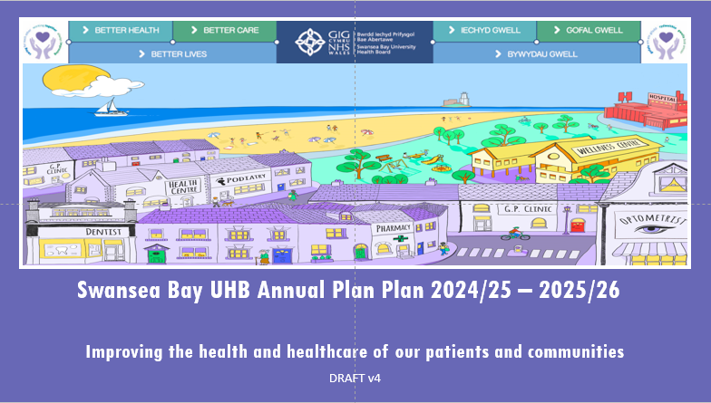

Working with Our Public Service Boards:
Neath Port Talbot PSB Objectives
Swansea Bay UHB Wellbeing Objectives
Swansea PSB Objectives
Every child has the best start in life
All children, young people and adults are enabled to maximise their capabilities and have control over their lives
Best Start in Life
Early Years
Good work and fair employment is created for all
A healthy standard of living is ensured for all
The role and impact of ill-health prevention is strengthened
Secure, green and well-paid jobs and improved skills
Live Well, Age Well
Healthy and sustainable places are created through placemaking
Racism, discrimination and their outcomes are tackled
Thriving and Sustainable Communities
Strong Communities
Environment, Culture and Heritage
Environmental sustainability and health equity are pursued together
Climate Change and Nature
The Health Board are working with Swansea and Neath Port Talbot PSBs to support the transformation of Early Year’s services, with a focus on developing a strategic approach to integration of services. Early Years Priniciples for Collaboration have been agreed by partners and multi-agency pathways are included within the priorities for 2025/26.
Both PSBs are tackling the economy, and the Health Board must consider its role as anchor institution and play an active role in this area. In 2025/26 the Health Board will continue to play a key role in supporting the Swansea PSB with the developments at TATA Steel.
Community Safety Partnerships are visible within the governance of the PSBs. SBUHB Safeguarding are supporting this area of work. The Healthy Relationships Strategy, is a joint 3-year Strategy between NPT Council and Swansea Bay University Health Board.
Developing a Strategic approach to climate adaptation is a priority for both PSBs, to understand climate related impacts on communities and existing inequalities, whilst understanding what actions need to be undertaken by the region.

Slide 88
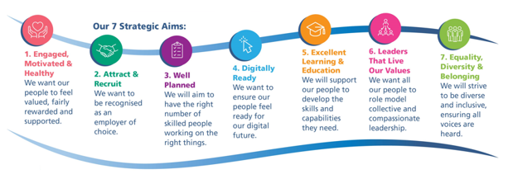
Workforce
Our 5-year People Strategy 2024-2029 sets out our Health Board’s long-term ambitions for our workforce. The strategy is aligned to the national “Healthier Wales: Health and Social Care Workforce Strategy” and the Health Board’s 10 year “One Bay Way” vision document. The strategy outlines 7 strategic workforce themes: Engaged, Motivated and Healthy; Attract and Recruit; Well Planned; Digitally Ready; Excellent Learning and Education; Leaders that Live Our Values; and Equality, Diversity and Belonging. Each theme has a number of high-level actions.
Approach to Planning the Workforce
In addition to launching our 5-year People Strategy in 2024 to articulate our Health Board’s vision and strategic aims for our workforce, service areas have been encouraged to develop robust workforce plans when designing and developing the workforce they need to deliver their services now, and in the future, with consideration given to how they might re-design their existing workforce, use new roles to fill gaps and how they might grow their own workforce, particularly for hard to recruit roles.

Slide 89




Workforce Priorities ​
Engaged, Motivated and Healthy: We want our people to feel valued, fairly rewarded and supported
Year 1 Priorities:
Continue our best practice review of HR policies and processes to improve staff experience and reduce employee harm​​​
Deliver the Speaking Up Safely audit recommendations specific to Workforce & OD, to improve psychological safety ​​​
Embed the retention plan across service groups (e.g. flexible working opportunities) to improve staff experience and ​
reduce turnover​​
Provide timely Occupational Health advice to support our people to be healthy at work/enable a timely return to work after sickness absence ​​​
Improve our Attendance at Work metrics by supporting our people with their health, which will also help to reduce expenditure on variable staff (e.g. bank and agency) to cover absences​​
Years 2/3:​
Continue to listen to our people and ensure we take action when they speak up (e.g. annual staff survey results and action plans)​
Preventative wellbeing initiatives (e.g. continue staff health checks, creating the right culture)​
Assess our cultural baseline and create the right culture to facilitate workforce transformation and re-design​
Attract and Recruit: We want to be recognised as an employer of choice
Year 1 Priority:
Develop a “widening access to careers in healthcare” programme to support local communities to access healthcare careers and to increase diversity
Years 2/3:
Continue to promote our Health Board as a great place to work/ volunteer
Improve the recruitment experience of our candidates
Digitally Ready: We want to ensure our people feel ready for our digital future ​
    Year 1 priority:
    Implement training and education for Workforce Digital Systems users
    Years 2/3:
    Champion the role of digital information/ technology in supporting workforce redesign and delivering greater workforce efficiencies/productivity

Slide 90




Well-Planned: We will aim to have the right number of skilled people working on the right things ​​
Year 1 priorities:
Build on the Workforce Metrics Dashboard to increase insights and support managers to make informed decisions about their workforce ​​
Work with Finance to embed Establishment Control best practice to improve data accuracy ​​
Support the effective implementation of our job planning policy so that > 90% of all Consultants have an agreed job plan in place at all times by 30 September 2025 ​​
Implement workforce-related programmes of work to achieve the ministerial priorities of reducing agency spend
Years 2/3:
Continue to support organisation - wide workforce transformation and re-design to build sustainable health care services
Develop great teams, in less hierarchical structures and across multi-disciplinary boundaries, focussing on patient/service user outcomes
Design our workforce and roles to support the decarbonisation/ climate change agenda
Excellent education and training: We will strive to develop the skills and capabilities our people need
Year 1 priority:
Implement training and education for Workforce Digital Systems users (also links with digital theme)
Years 2/3:
Transform our coaching and mentoring opportunities to increase accessibility for all our people
Review and evaluate the content of our education and learning programmes to ensure they meet our people’s needs and remain aligned to our vision
Leaders that Live our Values: We want all our people to role model collective and compassionate leadership
Year 1 priority:
Refresh our suite of leadership development programmes to support our leaders to act as role models and advocates for our Health Board
Years 2/3:
Continue our Talent Management and Succession planning work and expand it to align with our appraisal processes
Golden Thread: Equality, Diversity and Belonging: We will strive to be diverse and inclusive, ensuring all voices are heard (in everything we do)

Slide 91

NHS Wales Staff Survey 2024
‘We Said, We’re Delivering Together’
Almost 2,000 voices of Swansea Bay staff were heard during 2024’s national survey. Those voices helped shape and inform our top 3 priorities to work together to deliver during 2025-2026.
Action |  | Progress to Date
Leadership Management
Empowerment: We involve staff early in changes and decision making Visibility and Communication: We reconnect with the front-line for better two-way communication What will success look like? Better feedback on consultation policies and leadership | Best practice Review set up for policy improvements Launched ‘Brilliant Basics’ management platform with digital toolkits Started Quality Improvement Coaching Monthly Ask Abi Sessions and regular updates from the CEO and Team Briefings Launched Planned Care Academy | Best practice Review set up for policy improvements Launched ‘Brilliant Basics’ management platform with digital toolkits Started Quality Improvement Coaching Monthly Ask Abi Sessions and regular updates from the CEO and Team Briefings Launched Planned Care Academy
Speaking Up Safely / Raising Concerns
Feedback: We provide ongoing updates and take action when concerns are raised Listening into Action: We work with those who speak up showing action and honestly about what we can and can’t do What will success look like? Better data on Speaking Up Safely fewer escalated concerns more resolved issues | October 2024’s Speak UP Month engaged 1,183 staff Developed a Raising Concerns hub on the intranet Draft action plan for audit recommendations Set up Speaking Up Safely Working Group Started training on the speak up safely cycle – listening acting feedback | October 2024’s Speak UP Month engaged 1,183 staff Developed a Raising Concerns hub on the intranet Draft action plan for audit recommendations Set up Speaking Up Safely Working Group Started training on the speak up safely cycle – listening acting feedback
Values and Behaviours
Compassion Inclusivity and Belonging: We improve how we support and respect individual differences Bullying Harassment and Abuse: We have zero tolerance and improve support for those affected What will success look like? Better staff experience and perception fewer reports of bullying and harassment | Healthier working relationships and compassionate leadership resources promoted CEO and Chair signed Compassionate Leadership Pledge Integrating compassionate leadership into revised leadership development offering Created easy to read digital toolkits Finalising and publishing the ‘WE All Belong’ Strategic Equality Plan | Healthier working relationships and compassionate leadership resources promoted CEO and Chair signed Compassionate Leadership Pledge Integrating compassionate leadership into revised leadership development offering Created easy to read digital toolkits Finalising and publishing the ‘WE All Belong’ Strategic Equality Plan

Slide 92
Workforce Delivery Actions
Ref | Delivery Action
WF_01 | Support line managers with timely Occupational Health advice to support health at work/enable timely return to work after sickness absence |  | EA20
WF_02 | Improve Attendance at Work |  | EA20
WF_03 | Best Practice Review of HR policies and processes
WF_04 | Deliver Speaking Up Safely audit recommendations specific to Workforce & OD, in collaboration with key stakeholders
WF_05 | Embed the retention plan across service groups
WF_06 | In collaboration with stakeholders, design, embed and evaluate a suite of management and leadership development initiatives for all levels of clinical and non-clinical leaders that supports us to embed our values, behaviours and deliver our One Bay Way 10 year vision
WF_07 | Develop a Swansea Bay ‘Widening Access to Careers in Healthcare’ (WATCH) Programme
WF_08 | Implement Training and Education for systems users across all workforce Digital teams
WF_09 | Build on workforce Metrics Dashboard to increase insights
WF_10 | Work with Finance to embed Establishment Control best practice
WF_11 | Ensure effective implementation of job planning policy, to include ensuring that > 90% of all Consultants have an agreed job plan in place at all times by 30 September 2025 |  | EA19
WF_12 | Implement workforce-related programmes of work to achieve the ministerial priorities of reducing agency spend |  | EA17 – EA18

Slide 93
Digital
Our refreshed Digital Strategy, outlines our ambitions for making SBUHB an inclusive, ‘digital first’ organisation, using the most appropriate digital tools intelligently and selectively to support service-led transformation and deliver tangible benefits for the workforce, our patients and our population. ​
The Health Boards' vision is to improve health and well-being of the population of Swansea Bay by harnessing the power of digital technology and digital transformation.
The SBUHB digital landscape needs to be simplified, rationalising current systems and developing a central Electronic Patient Record (EPR) model and Care Data Repository (CDR). This approach will enable ‘true integration’, where information about a patient can be entered once and will automatically populate across all relevant systems thus feeding a rich data repository that is capable of supporting advanced business intelligence and analytics. Alongside this, the EPR model will make it possible for all clinicians to access the patient information they need to make the highest quality clinical decisions regardless of where they sit in the system, reducing the need for patients to repeat their stories and ensuring clinicians and care professionals understand a person’s full medical history and circumstances when engaging in their care.
Given the national approach to digital in NHS Wales, effective collaboration at a national level will be vitally important to the success of the Health Board’s digital journey. The recent review of NHS Wales digital governance identified 16 recommendations to strengthen the approach, controls and assurance mechanisms for digital delivery. It is imperative that SBUHB leaders are able to support and influence the implementation of these recommendations, which will have a significant impact on digital advancement across the Health Board.
Digital Priorities for 25/26
The following slides provide the digital enablers for 25/26 aligned to the IMTP Framework. To highlight, the strategic and early priorities identified in our strategic roadmap are:
  A single electronic patient record (EPR) for secondary care - Fundamental to its success will be the establishment of a strategic partnership with a preferred supplier who will work flexibly with the Health Board on both existing and emerging priorities. Our intention is to develop a business case for a first phase EPR solution to support improvements across Unscheduled and Emergency Care (UEC).
  Digital solution for Community, Mental Health, and Learning Disabilities - A key requirement from this solution will be alignment and integration with regional partners, such that that digital solution can enable delivery of the ambitions of Connecting Care aligned to “A Healthier Wales”. In 25/26 we will deliver phase 1 across our Swansea MH and Community integrated teams to de-risk the end of life WCCIS system.
  Departmental and Specialists service solutions - This will include services in pathology (National LIMS) , radiology (National RISP) and Maternity.

Slide 94
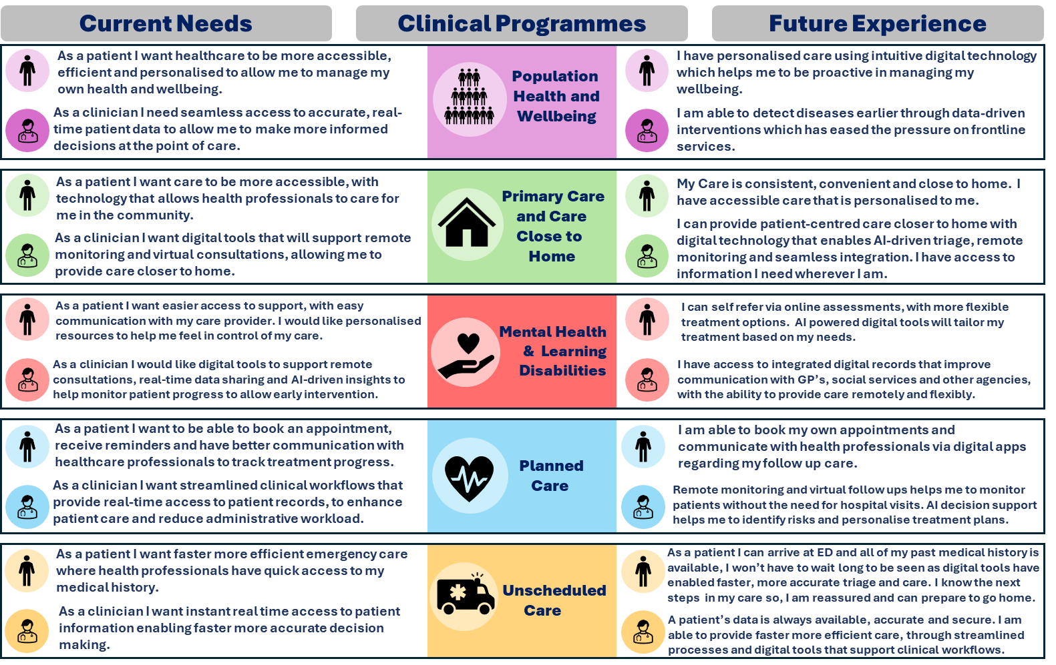
Digitally Enabling our Clinical Services
The Digital Strategy’s vision is “to improve the health and well-being of the population of Swansea Bay by harnessing the power of digital technology and digital transformation”. The strategy recognises the need for further advances in the way we use digital, data and technology to enable service-led transformation and deliver tangible benefits to our patients, population and workforce.

Slide 95
Digital Delivery Actions
Ref | Delivery Action
D_01 | Electronic Health Record (EHR) - Digital Strategy [Relates to all Systems, but particular reference to UEC in 25/26] Procure module 1 of an Electronic Health Record (EHR) with a focus on Urgent and Emergency Care including Epma. Undertake procurement activities by Q3 as Contract for Minor Injuries Unit digital system ends September 2026. [Subject to a Business Case and ongoing discussions with the 6 Goals Programme, Digital Medicines Transformation Portfolio and Welsh Government] | DE.1 DE.2 DE.9 | EA.1, EA.2 EA.3, EA.4 EA.5, EA.6
D_08 | Signal [Relates to all Systems, but particular reference to UEC in 25/26] Support new ways of working through the Integrated Discharge Hub. Prepare for working with the Electronic Health Record (EHR). | DE.1, DE.2 DE.9
D_02 | Pathology digital system replacement (LIMS 2.0) [Relates to all Systems but particularly Planned Care and Cancer System] Implement the new Laboratory Information Management System (LIMS 2.0) – go live and reaching ‘stable operations’ in Q2 25/26. [Ongoing revenue costs for 25/26 and are in the draft financial plan as national programme pressures. | DE.4 DE.5 | EA.25 EA.30
D_03 | Radiology digital systems replacement (RISP) [Relates to all Systems but particularly Planned Care and Cancer System] Implement the new Radiology Information System (RIS) and Picture Archiving and Communication System (PACS) – GO live and have reached 'stable operations’ by Q4 25/26 Ongoing revenue costs for 25/26 and are in the draft financial plan as national programme pressures. Some funding for digital resources for 25/26, enhanced with existing resources from digital transformation team. | DE.4 DE.5 | EA.25 EA.30
D_35 | Digitise cellular pathology services [Relates to all Systems but particularly Planned Care and Cancer System] Ability to scan histology samples for diagnosis and to support the use of AI. This is important for attracting and retaining suitably skilled professionals given the ability to work remotely elsewhere National BC assumes implementation will be managed by DHCW and the pathology service . Resources for DHCW and pathology are described in the case. Potential capital requirements should additional infrastructure be required. £0.1m noted in Underlying Health Board Deficit. | DE,4 DE.5 | EA.25 EA.30
D_05 | Implementation of the NHS App in parallel with the Swansea Bay Patient Portal [Relates to all Systems but particularly Planned Care System] Increase the spread and scale of adoption of the Patient Portal. New functionality available within the NHS App will support Planned Care through enabling patients to view and cancel appointments. Ensure implementation of national digital priorities and contribute to the long-term sustainability of clinical services through empowering patients. | DE.3 | EA.7, EA.9 EA.10, EA.21 EA.30, EA.31
D_07 | Increase the spread and scale of adoption of the Hybrid Mail [Relates to all Systems but particularly Planned Care System] | DE.3 | EA.7, EA.9 EA.10, EA.21 EA.30, EA.31

Slide 96
Digital Delivery Actions
Ref | Delivery Action
D_09 | Complete the implementation of HIR (Hospital Initiated Referrals) across all specialities [Relates to all Systems but particularly Planned Care] Live across all specialities, roll out completed in line with plan approved by Outpatients Redesign Group, enabling a consistent approach to dealing with referrals and a mechanism to monitor and analyse to inform service change | DE.3 | EA.7, EA.9 EA.10, EA.21 EA.30, EA.31
D_17 | Expand the use of Electronic Test Requesting and Reporting [Relates to all Systems but particularly Planned Care, Cancer and Primary Care System] Pilot extended Electronic Test Requesting functionality in Q4 | DE.3 DE.4 DE.5 | EA.7 EA.10
D_18 | Engage with the National Programme on the replacement of the Systemic Anti-Cancer Therapy SACT e-prescribing system [Also in Cancer System] Continue to engage with national programme in the context of the extended current system and integration to the SMR (current system contract ends Sept 2025) | DE.5 | EA.25 EA.30
D_19 | Go live with 'In Touch' outcome form and write back to WPAS [Relates to Planned Care System] Roll out plan as agreed by Outpatients Redesign Group | DE.3 | EA7 EA.10
D_10 | Implementation of PROMPTLY Continue to implement PROMS and digital health assessments, replacing Doctor Doctor and any other current systems. supporting individually scoped benefits for each service to improve patient and service management.
D_11 | Implementation of WNCR in Paediatrics [Also in CYP System[ Digitisation of paediatric wards across SBUHB, improving compliance in terms of assessment completion, saving time in completion of the full suite of documents, improving quality and safety. View to rollout in Morriston in Q3 25/26 in line with the nationally agreed plan (to be confirmed) |  | EA.30
D_!2 | Digital Maternity Cymru - Digitisation of maternity records - in line with National Programme [Also in MatNeo System] Subject to a Business Case submitted 31st March 2025 and WG funding to support the implementation. Ongoing revenue costs will need to be absorbed by the health board |  | EA.30
D_13 | ePMA - Integrate HEPMA with National solutions such as the Shared Medicines Record (SMR) Go live with Version 9 to enable successful integration with National Shared Medicines Record - Testing/go live of API if requirements agreed and signed off in Q3
D_15 | Implement Open Eyes aligned to the pathways as prioritised by the Ophthalmology Service including regional working with Hywel Dda UHB Awaiting on a directive from Welsh Government on the future direction of the programme in Q1 | DE.3 | EA.30
D_16 | Implement WICIS in line with national implementation plan TBC timelines as Currently on hold nationally |  | EA.30

Slide 97
Digital Delivery Actions
Ref | Delivery Action
D_04 | Work with the national programme to deliver a technical solution for the WECDS data set Planning for 26/27-27/28 Standards Implementation: Implementation of a digital solution to support the adoption of the WECDS dataset, planning in place by Q4 25/26 to go live of solution for capturing the WECDS data set.
D_06 | Connecting Care [Relates to Mental Health, Learning Disabilities and Primary Care Systems] Identify and procure an alternative system for WCCIS and migrate existing 750+ Health Board users who are using WCCIS on the Swansea Council contract, aligned with Swansea Council timelines - Business Case approved. Subject to funding being made available. Implementation cost of £250k to support development of system. Go live with Rio for 750 Users in Q4 25/26. Planning for 26/27-27/28 Decide on the future direction of the Health Board and whether a National or Regional approach to a solution will be followed |  | EA.30
D_19 | WPAS Roll out across Mental Health, Learning Disabilities and Primary Care and Therapies
D-22-29 | Deliver Digital Infrastructure Priorities: Cyber Secure Back Ups NPT Wireless Equipment Replacement Replace ageing hardware Additional server equipment including storage Complete rollout of Imprivata card login system to all acute hospital wards Implement new core network at Morriston & Singleton Hospital Upgrade to Windows 11 operating system and remove Windows 10 as Microsoft are ceasing support by in October 2025 Undertake an options appraisal to assess a Call Manager Upgrade to Cloud Voice |  | EA.32
D_31-34 | Deliver Digital Intelligence Priorities: Delivery of a suite of Quality & Safety dashboards Re-banding of Coding Staff and development of auto-coding software to improve coding completeness in accordance with Clinical Coding Audit Action Plan. Centralisation of Health Records function to Ty Samlet - supporting releasing space on our hospital sites to support service redesign. – Complete by Q1 25/26 Delivery of Data Literacy and Value Programme Help support the creation of the NDR across NHS Wales

Slide 98
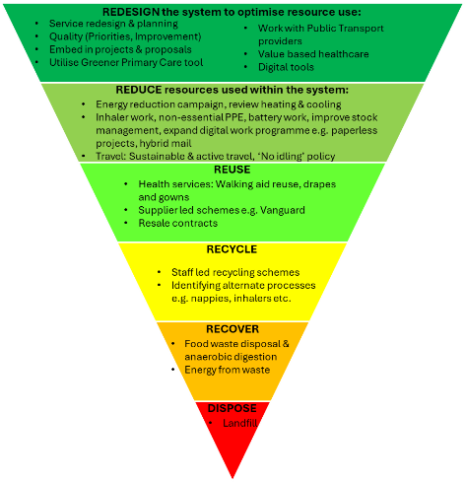
Sustainability
Sustainability is about ensuring our impact today will not inhibit future generations living as good, if not better, lives. This is viewed through consideration of the triple bottom line of social, environmental and economic with a 4th area introduced through the Well-Being of Future Generations Act (WBFGA) related to Culture and Welsh language. Whilst climate action is a key area, it represents one form of sustainability, recognising that human health and the health of our planet are inextricably linked. Ways in which sustainability is supported through the Health Board is shown in the below diagram with the WBFGA at the heart of everything.
Climate Action Plan 2024 - 2026
Our aim is to reduce emissions from SBUHB activities, whilst maximising support of the Well-Being of Future Generations Act​
Climate Adaptation:
Responding to the ‘Climate Adaptation Strategy for Wales’ the HB is developing a multi-faceted adaptation approach thorough:
Internal development of an adaptation plan that is proactive working to ensure climate risks and opportunities are understood and addressed, where appropriate, to reduce negative impacts on the population
Collaboration with Public Service Boards to develop regional approaches to climate adaptation and sharing experiences, response mechanism and best practice
Sharing best practice and linking with wider NHS Wales and public sector partners
98

Slide 99





Delivery Actions
 | Our Culture & Ways of Working Embed sustainability, decarbonisation and adaptation in revised mechanisms of how Health Board develops and agrees proposals / projects across the HB
 | Our Travel Improve travel information for staff, patients and visitors to the Health Board incl. facility locations, travel planning etc. Develop and implement a 'No idling policy' to improve onsite air quality Work with Public Transport providers on improving connectivity between population and health services incl. ticketing, access etc. Support active travel through better access, closer partnerships in the Health Travel Charter, maintaining paths for walking and wheeling, include improved facilities during new projects/major refurbishments
 | Our Buildings & Estates Develop and implement an energy reduction campaign Review of existing heating and cooling and implement changes to reduce energy use, where possible. To include: Air-conditioning systems and comfort cooling Heating reductions Procurement routes for purchasing additional heating/cooling
 | Our Procurement Work with those purchasing to make more sustainable purchasing decisions Sharing resources with purchasers Guidance for evaluating social value questions Continue to implement stock management processes across the Health Board, including: Scan 4 Safety Ward level inventory management review programme
 | Our Sustainable Healthcare Work with Green Group to identify existing and potential projects that can be spread and scaled/embed across the Health Board Utilise 'Greener Primary Care' tool across Primary Care Cluster Planning Expansion of digital workflow to improve admin and clinical processes, reducing waste and removing duplication Deliver outpatient letters electronically and move to paperless outpatient clinics Reduce prescribing of inhalers with high GWP. Investigate feasibility of moving to risk-based approach to replacing batteries in medical devices

Slide 100
Research, Development & Innovation
A thriving culture of Research, Development and Innovation is a critical factor in the provision of safe, high quality care and aligns with health boards' Duty of Quality to continually improve the quality of the services they provide.
SBUHB has a two-pronged approach to RD&I for 2025-26:
  Development of a Regional RD&I strategy with Hywel Dda UHB under the Joint Committee arrangements, recognising the strengths both organisations bring, along with opportunities for wider academic partnerships and a larger population
  Development of a Bridging RD&I Strategy for SBUHB pending the establishment of the regional RD&I plan with Hywel Dda UHB to ensure SBUHB's
The Research, Development and Innovation Strategy has been developed to align to the pillars of the NHS Research & Development Framework and the four national projects being taking forward via the national Embedding Research in the NHS programme.
Underneath each pillar are associated objectives which are supported by a delivery plan, including:
  Ensure visibility of research, development and innovation at board level​
  Effective Use of research delivery staff​
  Maintain recruit to time and target performance​
Introduce modern facilities and equipment
Introduce pump-prime schemes​
increase the number of Chief and Principal Investigators​
Introduce research, development and innovation showcase events
Building on successes of 2024/25:​
Improved governance and reporting through the Digital, Data, Research and Innovation Committee.​
Continue to raise the profile of RD&I in the health board following the first Swansea Bay R&D Day among all healthcare professionals.​
Work with Swansea University to promote early career interest in RD&I among undergraduate nursing and medical students.​
Strengthen the commercial clinical research environment through the development of Commercial Research Delivery Wales (CRDW), with particular opportunities in SBUHB to increase commercial trials within oncology, aligned to the ambitions of ‘Tackling Cancer through Research’ to increase the number of patients accessing cancer studies.​
Seek funding through the Voluntary Scheme for Branded Medicines, Pricing, Access and Growth (VPAG) scheme to support RD&I.​
A new joint clinical academic appointment in SAIL (a joint appointment of a consultant oncologist between SBUHB, Swansea University and the Wales Cancer Research Centre) to explore the potential of the SAIL data to assist in developing cancer treatments and improving outcomes - potentially the first in the UK.​
The interface and strong partnership working with Swansea University and plans to revisit the Memorandum of Understanding with Swansea University to ensure the Health Board has sound financial controls in place.​
The development of a policy for undertaking advanced therapies within the Health Board for genetic advanced therapies, which is being considered as part of the infrastructure development on the Morriston site.​
​

Slide 101
Financial Assessment
A detailed financial assessment has been made of the three main components of the financial plan for 2025/26: -
• Run rate pressures into 2025/26 from 2024/25
• Impact of additional forecast cost increase for growth, inflation and demand changes in 2024/25 in light of the Welsh Government allocation of 1.77%
• Savings framework
The combination of increased operational expenditure seen in 2024/25 and the use of non-recurrent options to mitigate in year pressures has led the organisation to a significant underlying run rate carrying from 2024/25 into 2025/26. This has been assessed as £92.5m following “bottom up” analysis from individual budget holders correlated with a “top down” assessment exercise.
In 2025/26 the Health Board has assessed the new costs in year of £36.9m offset by Welsh Government allocation increase of £15.2m (1.77%).
The Cost-Up assessment building in national and local growth, alongside inflation and changes to the commissioning contracts has been undertaken through a combination of:
• Collaborative work with other Health Boards to test and challenge the assumptions;
• Nationally agreed rates for inflation;
• Directed changes to areas like the Welsh Risk Pool;
• LTA discussions with all commissioners;
• Detailed clinical assessment of areas such as NICE.
The Health Board welcomes the planning assumption that additional funding will be provided by WG for the impact of the 2025/26 Pay Award and for the changes in Employers National Insurance Contributions from April 2025.
This overall presents a net pressure in-year for 2025/26 of £21.7m.
The organisation has set an ambitious savings delivery target of 5% for 2025/26 recognising that the starting position for the year is not acceptable. 5% is considered to be the maximum deliverable savings level in a financial year.
After inclusion of the 5% (£55.4m) savings requirement, the closing assessed Plan for 2025/26 of £58.7m deficit remains in excess of the forecast closing position from 2024/25; this is also in excess of the Health Board’s Target Control Total of £17m. The Health Board clearly recognises that this financial profile is not acceptable or supportable, but at this stage represents the health Board’s considered position. The Health Board fully agrees that it must go further and at pace in 2025/26

Slide 102
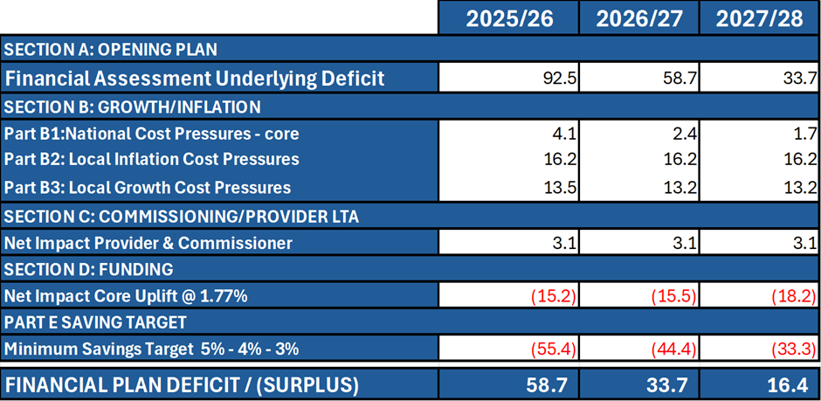
In terms of a three-year outlook, a summary of the financial outlook for Years 2025/26 – 2027/28 is provided in the table below:
This outlook assumes allocations and wage award funding are broadly the same as 2025/26 and that cost pressures and service growth are also broadly stable.
Savings delivery is adjusted to 4% and 3% for future years to account for deliverability after 5% in year 1.
A significant amount of work has been carried out by budget holders across Service Groups and Corporate Directorates in 2024/25 to enable line of sight to the forecast outturn of £43.7m for 2024/25.
From a savings perspective this represents a major challenge for 2025/26; however, there is significant opportunity across the Health Board to deliver savings at scale:
• A first wave of savings of circa £14m has been identified for 2025/26
• 29 further schemes have been identified and are currently being costed
• £28.9m of benchmarked opportunities for further savings will be issued to budget holders for action.
Whilst this action is welcome and positive this does not give delivery confidence yet on the £58.7m deficit plan or assurance on further identification of savings at pace and scale. The Health Board would benefit from external support to help with this acceleration and testing of existing schemes to increase delivery confidence in the plan and for it to be taken further. Discussions are ongoing with Welsh Government in this regard.

Slide 103
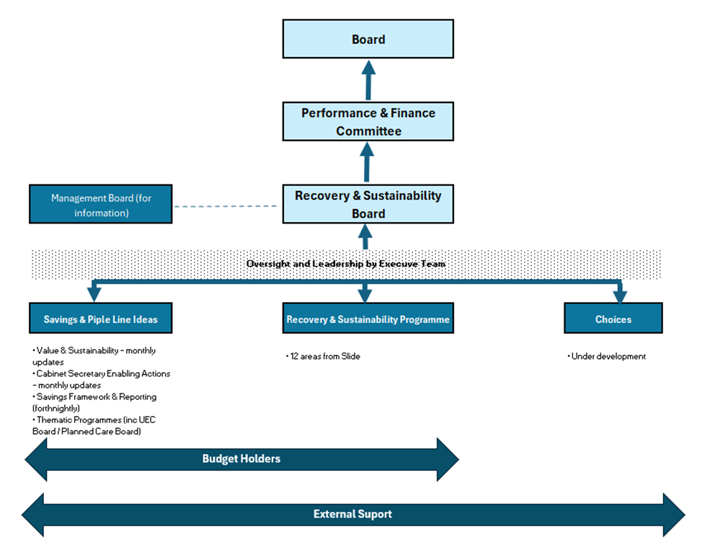
Internal governance arrangements have been strengthened and clarified with clear executive leadership and regular twice monthly reporting and monitoring regime in place. The Recovery and Sustainability Programme has been refreshed for 2025/26, reflecting on the learning from 2025/26 and further team resource has been allocated to strengthen it. Oversight of the plan and its delivery remain a primary matter for the Performance and Finance Committee (PFC) which is a direct sub-committee of the Full Board. Sufficient time will be given at these meetings with PFC meeting twice a month at present to scrutinise, challenge and support delivery plans.
A test as to the efficacy of this would also be welcome through the external support under discussion. The diagram below illustrates the clear framework for plan delivery.
​
On the basis of the current financial profile the Health Board is maintaining its control system from 2024/25 into 2025/26 in terms of vacancy freeze and variable pay controls.
The Health Board has further strengthened its governance arrangements and has clear Executive leadership through the Recovery and Sustainability Programme.
There is absolute clarity that more is needed to reduce risk in this base plan, improve upon it and support is necessary to achieve the scale and pace required.
It is acknowledged at this point that the plan cannot be approved and needs to be further worked through following submission, assessment and scrutiny by Welsh Government.​

Slide 104
Capital & Estates
The Health Board’s Estates Strategy approved by the Board in 2023, identified the need for significant capital investment to support the CSP and a programme of backlog maintenance works identified by Condition Surveys. Following feedback on the NHS - All Wales Capital Prioritisation (Scheme Specific Elements), a new Estates Task Force under the leadership of our vice-chair was established in January, to provide the board with strategic oversight of the implementation of the Estates Strategy. Whilst the main elements of the prioritised 10-year plan remain intact, the Task Force recommended an urgent focus on four schemes which will require urgent short-term capital funding support from WG (in addition to long term strategic support) to ensure Operational Resilience and Safety & Clinical Suitability
Adult Acute Mental Health Unit Cefn Coed
ED Morriston
Regional Cellular Pathology
Taith Older Persons Ward, Glanrhyd (Fire)
Morriston Hospital - Hybrid Planning Application is due for submission in June 2025 for the development of the current site plus additional 55 acres (Outline Planning) and the provision of a new access route to J46 of the M4 (Full Planning).
The development of alternative funding models, estates utilisation, disposals and decarbonisation from part of the 10-year programme.
During 2025-26 we will focus on developing our plans to provide modern estate to support our Community and Mental Health services in Swansea City Centre, looking at partnership models with Swansea Council and their development partners.
The plan reflects the new Core Requirements funding allocations for TEF, Equipment & Diagnostic and Digital. Our discretionary capital programme will focus on maintaining the highest risks in our equipment & digital asset base, along with maintenance of our building estate alongside a contribution to the new TEF programme and the PFI contractual commitments at NPT hospital.
Approved Schemes
Two schemes in the West Wales Cancer Centre have recently been approved. These schemes to provide a permanent PET-CT and 2nd CT-Sim will complete in 2025-26.
New - Urgent Risks
The Board has requested urgent capital support on three capital schemes in the 10- Year programme to progress with short-term plans to mitigate the risks associated with delays with the main schemes to manage Operational Resilience and Safety & Clinical Suitability
Adult Acute Mental Health Unit, Cefn Coed
ED Improvements, Morriston
Regional Pathology – Cellular Pathology
In addition, support will also be required to re-provide the Taith Older Persons Ward which was badly damaged following a fire.
C. WG Endorsement to produce Business Cases
Three schemes received WG endorsement to progress with the development of business cases.
Emergency Department, Morriston. This scheme is linked to the provision of a new Access Route into Morriston Hospital and the City Deal Campuses Business Case. A business case scoping meeting for the provision of a new ED department is taking place with WG in April
Develop a HVLC Centre of Excellence for Urology, NPT. The relocation of high-volume low complexity Urology activity from Morriston to NPT will create increased capacity for planned care procedures and improve performance on the cancer pathway at Morriston. The Board is considering scrutiny comments from WG following submission of the business case.
Hybrid Vascular Theatre, Morriston. Provide a dedicated hybrid theatre for more complex cases to allow vascular surgeons to combine conventional surgical techniques with interventional techniques in a hybrid theatre without interruption. The Board is considering scrutiny comments from WG following submission of the business case.

Slide 105
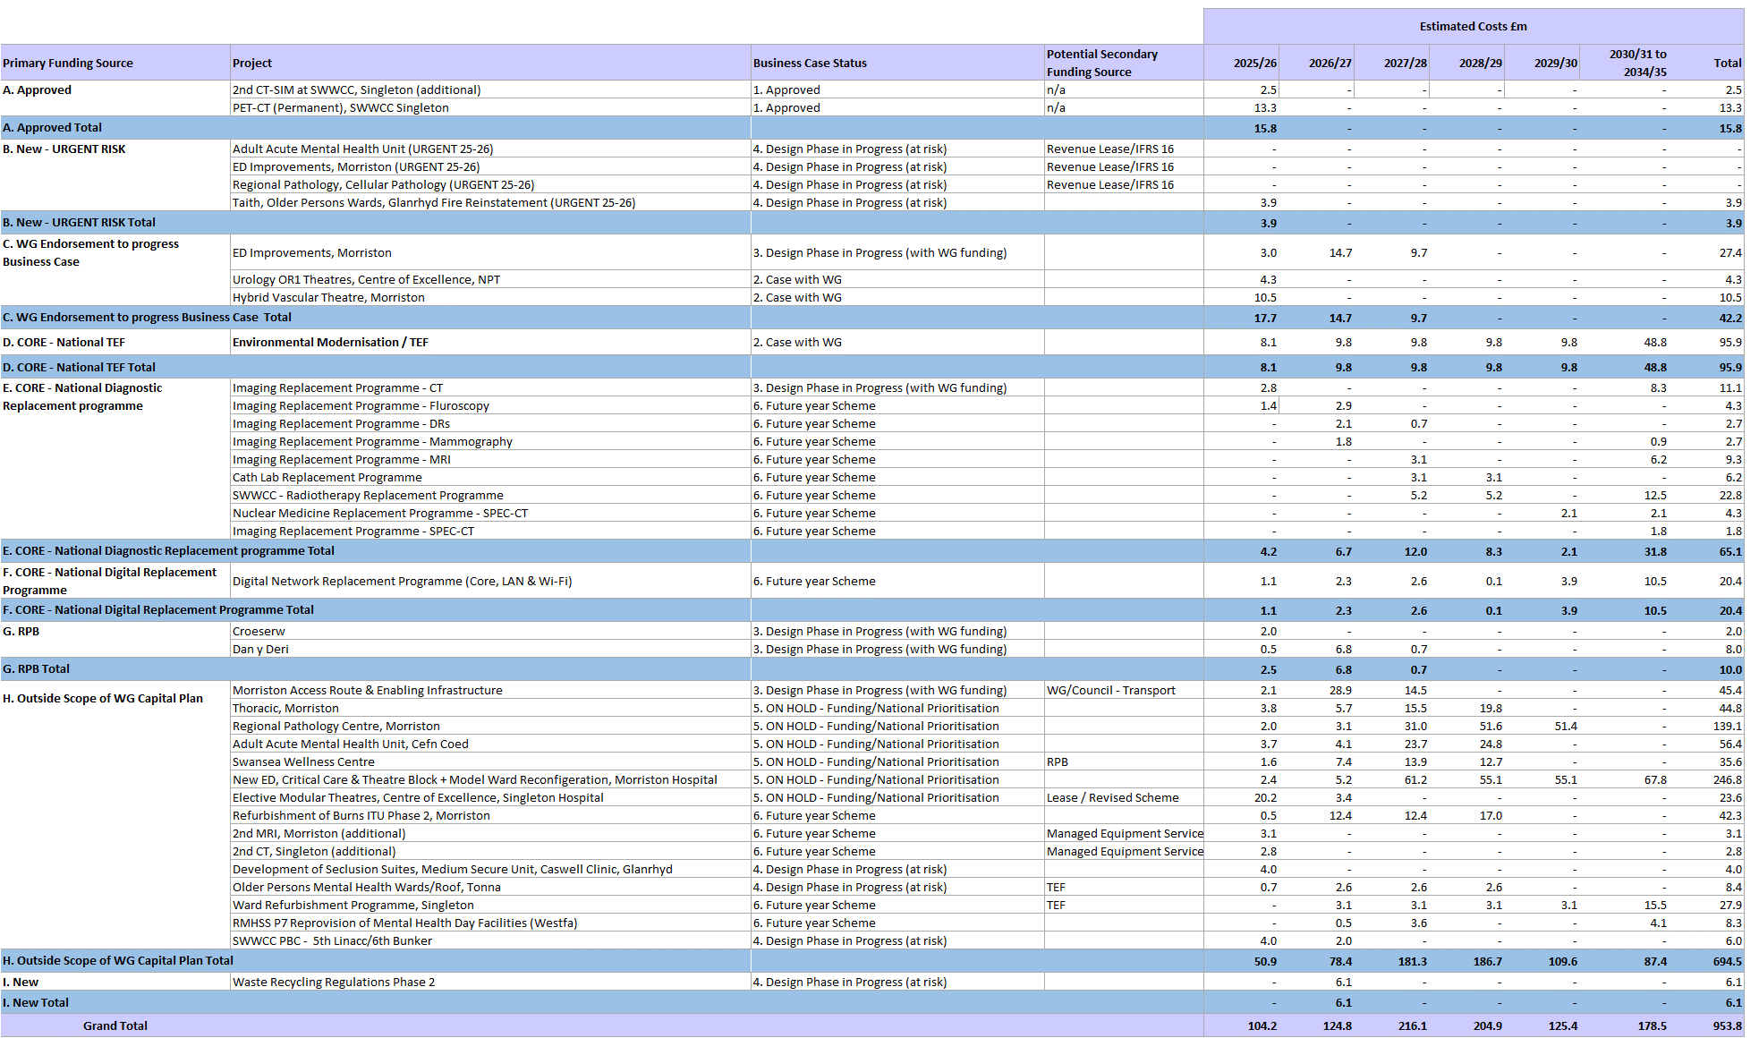
Capital & Estates – 10 Year Outline Capital Programme

Slide 106
Capital & Estates – Enabling Actions
Estates Rationalisation
Following the submission of our Estates Rationalisation of Non-Clinical Space submission in 2023, we are continuing to continuing to develop our disposal strategy. During 2024-25 we completed two disposals at Cymmer Health Centre and Phillips Parade. Our disposal strategy has identified two further disposals in 2025-26 and further potential disposals in the medium term which will require detailed investigation.
We will continue to develop our disposal strategy for the remaining surplus areas of the Cefn Coed site, although this work will need to be linked to the provision of new accommodation for the current Mental Health Acute Adult accommodation on the site.
We are also actively investigating the potential to provide surplus land adjacent to the Health Board HQ in Baglan to support the recent request from WG for the identification of sites that may be suitable for ‘meanwhile’ temporary alternative residential use (using Modern Methods of Construction and by implementing Permitted Development Rights).
We are working closely with our partners at Swansea University on their City Deal Campuses Business Case, which may provide additional funding and land disposal opportunities.
Alternative Financing Models
The newly formed Estates Task Force group will consider the commercial opportunities to deliver capital solutions using public and private partnerships to assist in developing the estate strategy and the implications.
We are continuing to benefit from funding from the Swansea Bay City Deal, with the hybrid planning application for the development of the Morriston Hospital site and new Access Route from the M4 due for submission in June 2025.
Working with the West Glamorgan Regional Partnership Board, we secured design funding in 2024-25 to produce business cases for a new Learning Disabilities home in Dan-y-Deri (HCF) and a replacement for Cymmer Health Centre (IRCF). Both business cases will be completed in 2025-26. Further work on
Some of our schemes also have revenue funded options which require IFRS 16 technical capital support. In 2024/25 we were able to capitalise through Right of Use Capital around £12m.
We will be continuing to work with our Energy Service partner and the WG Energy Services and Health & Social Care Finance teams to explore how we can access alternative financing to de-steam and decarbonise the estate. These schemes are more about reducing carbon rather that also cost reduction.
We have established a new PFI Exit Board to oversee the hand back of the NPT hospital to NHS ownership in May 2030. The Project Board will be responsible for the overall direction and management of the project from development of the Exit plan through to hand back and commissioning in line with Estates condition B and FM staff TUPE. The initial 7-Year pre PFI Expiry Health Check report from the UK Infrastructure Projects Authority (IPA) in 2023 has formed the basis of our work programme and a 5-Year pre PFI Exit Expiry Health Check will be taking place in mid 2025. The Board is currently considering several external specialist advisor appointments to support the exit, including commercial, legal and financial support.

Slide 107
Governance and Delivery
To enable delivery, we will be clarifying our Organisational Strategy to ensure we are all working to achieve the same ambitions. We will set out clear milestones and ensure our annual operational plans are integrated with and aligned to our longer-term vision and goals. We will also work to develop the culture in the Health Board through building out leadership and management capacity and capability, embed out values and behaviours and demonstrate consistent delivery to reinforce our role as a trusted partner and anchor institution. We will invest in our people so that are engaged and empowered, working in effective teams. We must also improve and streamline our systems and processes through the development of a clear operating framework with reliable data and intelligence that provides insights to facilitate improvement and transformation. Finally, we must also ensure we have the right organisational structures in place so that we are organised for success.
Mitigating Risks to Delivery
All risks have mitigating actions and are continually reviewed through the Health Board Risk Register. The Plan is a dynamic document and risks to delivery are constantly assessed and acted upon. Key risks to delivery include:
Capacity to Deliver: System pressures significantly challenge our ability to dedicate capacity and resources to delivering projects, programmes and service changes. Our governance arrangement will ensure a clear focus on delivering our priorities. We will also ensure robust plans are in place to manage seasonal pressures.
Workforce: Our robust prioritisation approach to planning has identified the workforce required to deliver our priorities and we are confident that we can attract the workforce required and we have put a number of steps to mitigate any risk such as embedding clinicians in the planning; refreshed recruitment strategies, branding and attraction campaign; recruitment team; international recruitment; internal recruitment trackers; and health, wellbeing and pastoral support.
Digital: The Health Board is committed to Digital transformation as a critical enabler to the sustainable delivery of clinical services, as set out in the refreshed Digital Strategy, with actions aligned to this Plan.
Capital: The Health Board has an ambitious capital programme to maintain its existing asset base and implement major service change to ensure future sustainability of our services. We will continue to take a prioritised approach to our capital schemes based on agreed principles.
Emergency Preparedness, Resilience and Response
Our emergency preparedness, resilience and response (EPRR) processes not only help the Health Board to comply with legal requirements but also reinforce the delivery of high-quality, safe, and equitable services, as well as supports the long-term sustainability and resilience of the organisation. Our work enhances resilience, ensures we maintain care quality during crises, ensures staff well-being, and supports financial sustainability. Our goal is to embed EPRR principles into the organisation's strategic work programme, improving emergency response, and ensuring continuity of care, especially for vulnerable populations.

Slide 108
Framework for Governance and Delivery
RSSPP
PSB
Health Board
Pan Cluster Planning Group
West Glamorgan RPB
RJC
Board Committees
Local Cluster Collaborative
Steering and Advisory Board
Management Board
Afan
Bay
Llwchwr
Penderi
Board 1
Board 2
Board 3
Unscheduled Care Board
Planned Care Board
Recovery & Sustainability Programme
Special Programmes:
Maternity-Neonatal, Mental Health, ED, Regional Pathology Children
Cancer
Communities and Older People Programme
Wellbeing & LD Programme
Children & Young People Programme
City
Cwmtawe
Neath
Upper Valleys
Emotional Wellbeing and MH Programme
Cancer Board
Professional Collaboratives
Carers Partnership
Neurodiverse Programme
GMS
Dental
Nursing
AHP & Health Sciences
Regional Commissioning Programme
CYP Board
Dementia Programme
Women’s Health Board
Pharmacy
Optometry
3rd Sector
Supporting Programmes:
Capital
Digital & Data Transformation
Workforce
Section 16 (Social Value & Social Enterprise)
  Mental Health
We have Programme Boards in place for Planned Cure and Unscheduled Care and for the Recovery and Sustainability Programme. These will drive performance and grip and control. A separate portfolio is being established to ensure we have a special focus on key programmes that will oversee the scoping planning and scrutiny of these particular service and infrastructure schemes with heightened focus on sustainability. They will ensure a standardised approach to programme oversight and governance in the Health Board

Slide 109
Glossary
Electronic Prescribing & Medicines Administration EPMA
Electronic Patient Record EPR
Equality Impact Assessment EQIA
Early Years Neurodevelopment Disorder EYND
General Dentistry Service GDS
Get It Right First Time Programme GIRFT
General Medical Services GMS
General Practitioner GP
Guidelines for the Provision of Intensive Care Services GPICS
Global Warming Potential GWP
Health Board HB
Health Care Acquired Infections HCAI
Health, Care and Wellbeing Delivery Plan HCWDP
Hywel Dda University Health Board HDdUHB
Hospital Electronic Prescribing & Medicines Administration HEPMA
Hospital Initiated Referrals HIR
Healthcare Inspectorate Wales HIW
Hepatobiliary and pancreatic Board HPB
Health Solutions Business Unit HSDU
High Volume, Low Complexity HVLC
Intensive Care Units ICU
Integrated Discharge Hub IDH
Integrated Medium Term Plan IMTP
Immuno-Oncology IO
Intensive Therapy Unit ITU
Joint Commissioning Committee JCC
Laboratory Information Management System 2.0 LIMS 2.0
Local Primary Mental Health Support Service LPMHSS
Long Term Agreements LTAs
Multidisciplinary Team MDT
Making Every Contact Count MECC
Mental Health & Learning Disabilities MH & LD
Mental Health & Wellbeing MHW
Magnetic Resonance Imaging MRI
Magnetic Resonance Simulation MRISM
Musculoskeletal MSK
Neurodevelopment Delay NDD
National Early Warning Score 2 NEWS 2
Promote, Prevent and Prepare for Planned Care 3Ps
Care Coordination, First Contact of Care, Continuity of Care & Comprehensive Care 4Cs
Accelerated Cluster Development ACD
Acute Clinical Team ACT
Allied Health Professionals AHP
Artificial Intelligence AI
Audit Management and Tracking AMaT
Acute Oncology & Haematology Assessment Unit AOHAU
Area Planning Board APB
A Regional Collaborative for Health ARCH
All Wales Diabetes Prevention Plan AWDPP
British Association of Perinatal Medicine BAPM
Business Case BC
Child & Adolescent Mental Health Service CAMHS
Could Not Attend CNA
City Council CC
Community Drug & Alcohol Team CDAT
Care Data Repository CDR
Continuing Health Care CHC
Clinical Implementation Network CIN
Chronic Obstructive Pulmonary Disease COPD
Commercial Research Delivery Wales CRDW
Clinical Services Plan CSP
Computed Tomography CT
Computed Tomography Simulator CT SIM
Cwm Taf Morgannwg University Health Board CTMUHB
Cardiff and Value University Health Board CVUHB
Children & Young People CYP
Demand & Capacity D&C
Discharge to Recover then Assess D2RA
Dental Access Portal DAP
Direct Current Cardioversion DCCV
Digital Health Care Wales DHCW
Did Not Attend DNA
Emergency Department ED
Electronic Health Record EHR
End of Life EoL

Slide 110
Glossary
Referral To Treatment RTT
Systemic Anti-Cancer Therapy SACT
Swansea Bay University Health Board SBUHB
Suspected Cancer SC
Same Day Emergency Care SDEC
Service Level Agreements SLAs
Shared Medicines Record SMR
See on Symptom SoS
Single Point of Access SPOA
Mat Neo Safety Support Programme SSP
South West Wales Cancer Centre SWWCC
Transcatheter Aortic Valve Implantation TAVI
To Be Confirmed TBC
Tackling Diabetes Together Programme TDT
Targeted Intervention TI
Transoesophageal Echocardiogram TOE
Transforming Access to Medicines TRAMS
Tertiary Service Development Group TSDG
Tertiary Service Oversight Group TSOG
Unscheduled Emergency Care UEC
Urgent Suspected Cancer USC
Value Based Health Care VBHC
Vascular Interventional Radiology VIR
Voluntary Scheme for Branded Medicines, Pricing, Access & Growth VPAG
Welsh Ambulance Service Trust WAST
Widening Access to Careers in Healthcare WATCH
Well Being of Future Generations Act WBFGA
Welsh Emergency Care Data Set WECDS
Welsh Government WG
Welsh General Ophthalmic Services WGOS
Welsh Intensive Care Information System WICIS
Waiting List Initiatives WLI
Wales Nursing Care Record WNCR
Welsh Patient Administration System WPAS
Newborn Early Warning Track and Trigger NEWTT 2
National Health Service NHS
National Institute for Health and Care Excellence NICE
Non-Invasive Ventilation NIV
Neath Port Talbot & Singleton Service Groups NPT SSG
Neath Port Talbot Hospital NPTH
Organisational Development OD
Older People’s Assessment Service OPAS
Older Persons Admission Unit OPAU
Outpatients Department OPD
Outpatients Group OPG
Older People’s Mental Health Service OPMHS
Picture Archiving & Communication System PACS
Post Anaesthesia Care Unit PACU
Pan Cluster Planning Group PCPG
Primary Care & Therapies PCT
Positron Emission Tomography & Computed Tomography PET CT
Paediatric Early Warning System PEWS
Public Health Wales PHW
Patient Initiated Follow Up PIFU
Patient Reported Outcomes Measures PROMS
Public Services Board PSB
Quality & Safety Q&S
Quarter (1,2,3,4) Q (1,2,3,4)
Quality Improvement QI
Royal College of Midwives RCM
Royal College of Obstetricians and Gynaecologists RCOG
Research, Development & Innovation RD & I
Regional Integration Funds RIF
Radiology Information System RIS
Radiology Informatics System Procurement RISP
Regional Joint Committee RJC
Regional Partnerships Board RPB
Regional & Specialised Services Provider Planning Partnerships RSSPPP

