Slide 1
Vaccinations & Immunisations
Jennifer Davies
Acting Executive Director of Public Health
November 2024

Slide 2
Immunisations and vaccinations – overview
Three broad schedules to be delivered across the population:
  Routine immunisations – from 8 weeks to 75 years
  Selective immunisation programmes e.g. Hepatitis B, TB, Influenza, Pertussis, RSV
  Additional vaccines for individuals with underlying medical conditions e.g. chronic respiratory and heart conditions, diabetes, chronic liver conditions etc.
Providers:
  All GPs in Swansea Bay UHB are commissioned to provide routine childhood and adult vaccinations.
  Community Pharmacies commissioned to provide some vaccine.
  School nursing services deliver vaccination programmes in educational settings where applicable.
  Immunisation team support the immunisation system for all vaccination programmes.

Slide 3
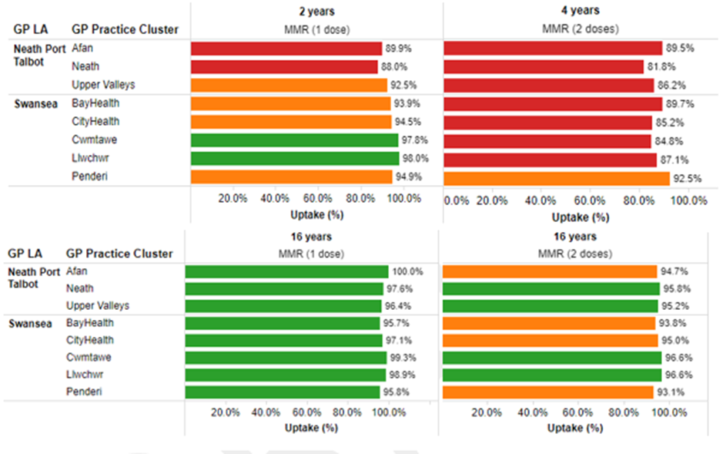
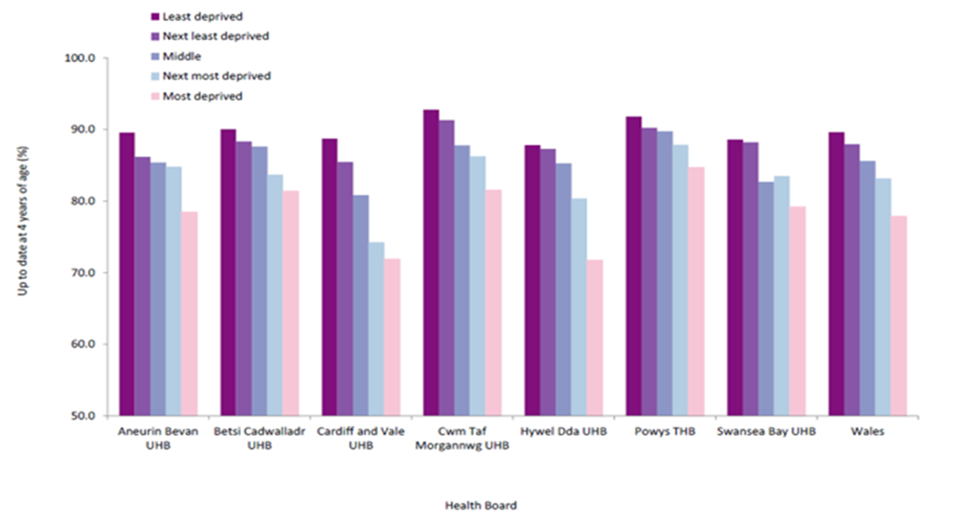
Measles, Mumps & Rubella (MMR)
Uptake by GP cluster:
  Significantly lower uptake rate in early years and in 4-year-olds – none reaching 95% coverage.
  Uptake improved by 16 years predominantly through effective school nursing vaccination campaigns.
Poorer uptake in most deprived areas compared to least deprived areas and is consistent across each Health Board. SBUH ranked 6th highest uptake of 7 health boards in least deprived and 4th highest in most deprived areas – 9% difference in uptake.
Source: PHW (June, 2024)
Notes:
National comparator position for SBUHB
Data cleansing so we know our figures are accurate and known risks

Slide 4
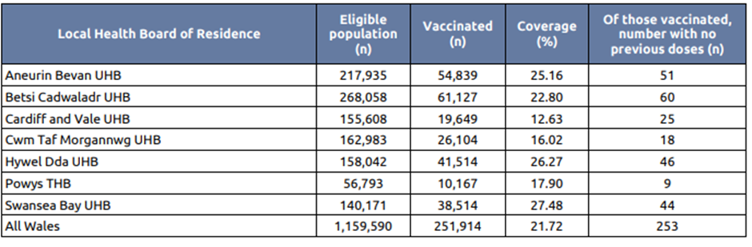
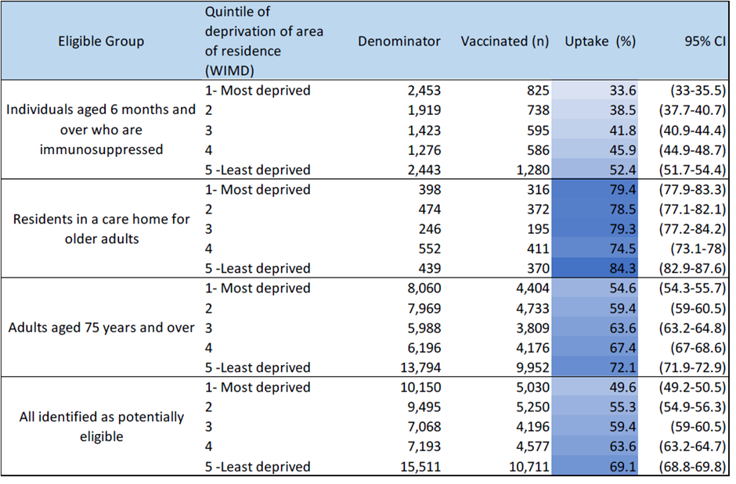
COVID-19 vaccination
Vaccination response is via GPs (34 commissioned), Community Pharmacies (20 commissioned) and Immunisation team.
Winter booster commenced October 2024 in line with national guidance
SBUHB is ranked 1st across Wales (as at 31.10.24)
Source: PHW (October 2024)
From a deprivation perspective, the table shows uptake rates reported from the Spring COVID-19 Enhanced Surveillance Report (2024).
18.8% greater uptake in least deprived areas.
Source: PHW (August 2024)

Slide 5
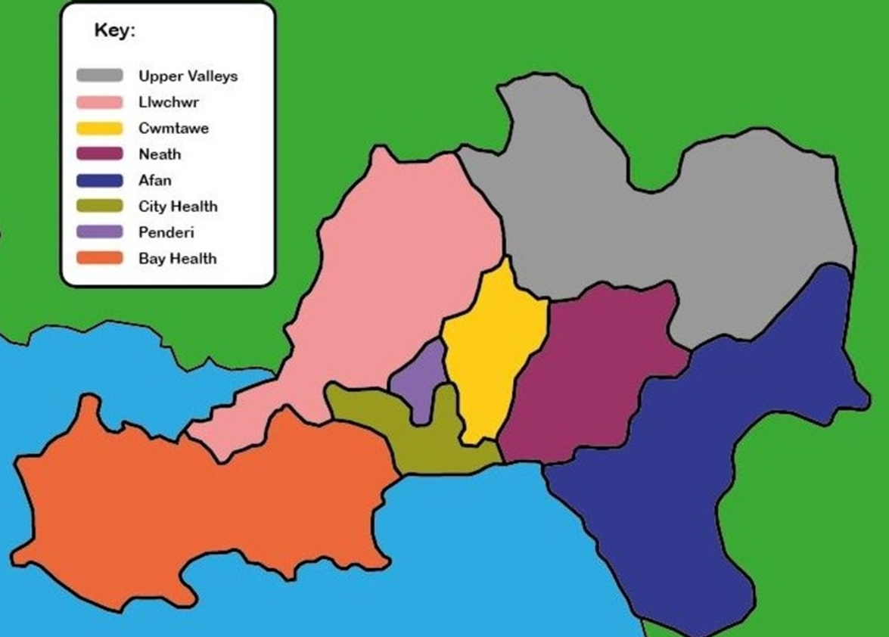
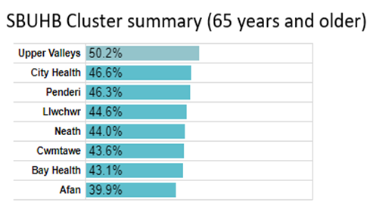
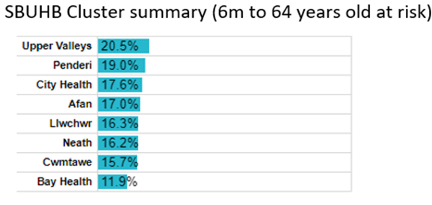
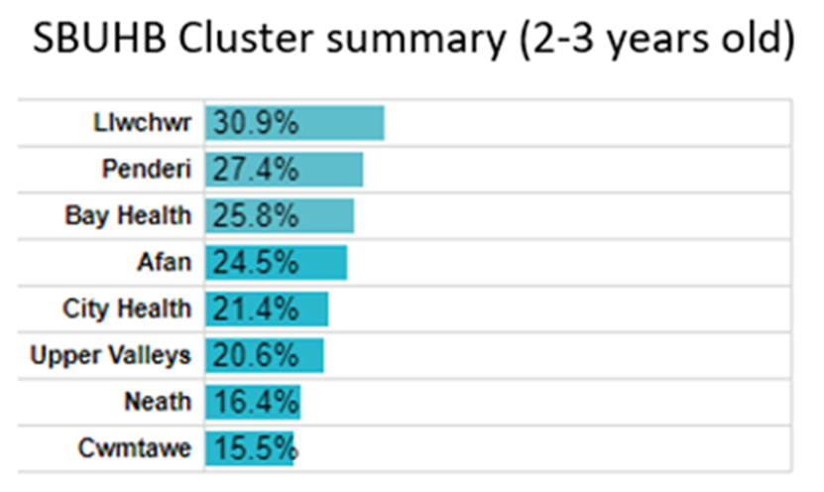
Influenza (Flu) vaccination – by GP cluster
Commissioned service with all GPs across HB with support from Immunisation team. Due to complete by December 2024.
Uptake rates by primary care clusters shown below – higher rates overall for over 65yrs with significant variation between highest and lowest uptake rates
Source: PHW (October 2024)

Slide 6
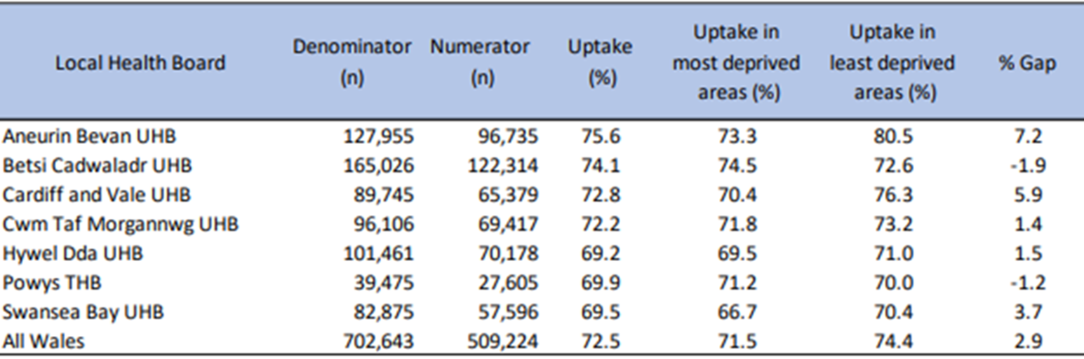
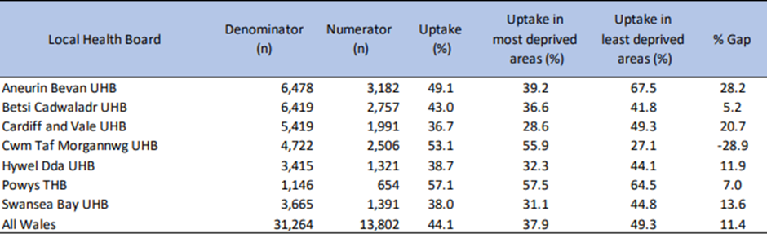
Influenza (Flu) vaccination – by deprivation
Data is available for 2023-24 campaign only at this stage.
Data and insight from last year’s campaign is being used to inform this year’s action plan especially with regards to increasing equity of uptake
Uptake of Influenza vaccine in 65+year old in Wales for the 2023-2024 season by health board, comparing patients registered with GP practices in most deprived and least deprived areas
Uptake of Fluenz vaccine amongst 2-year-olds in Wales for the 2023-2024 season by health board, comparing patients registered with GP practices in most deprived and least deprived areas
Source: PHW (September 2024)

Slide 7
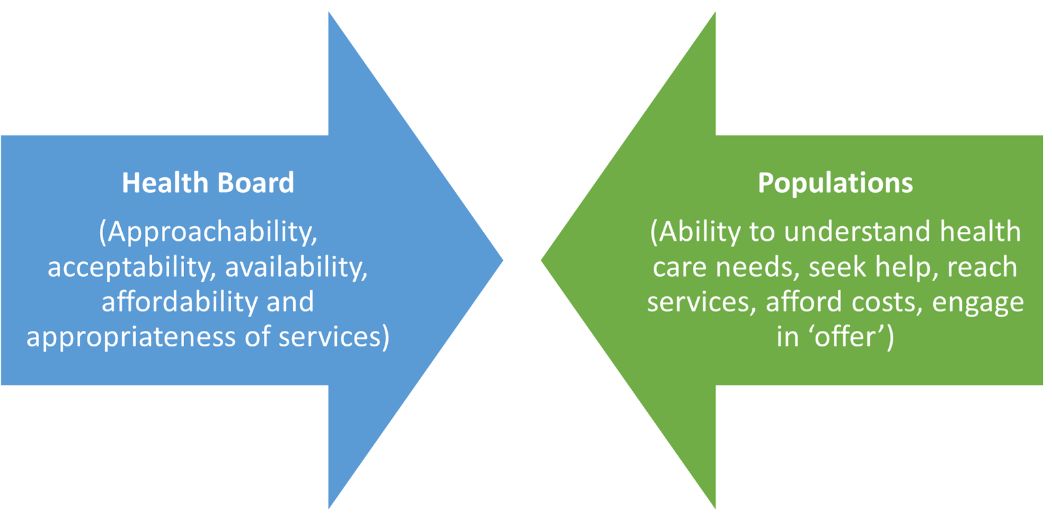
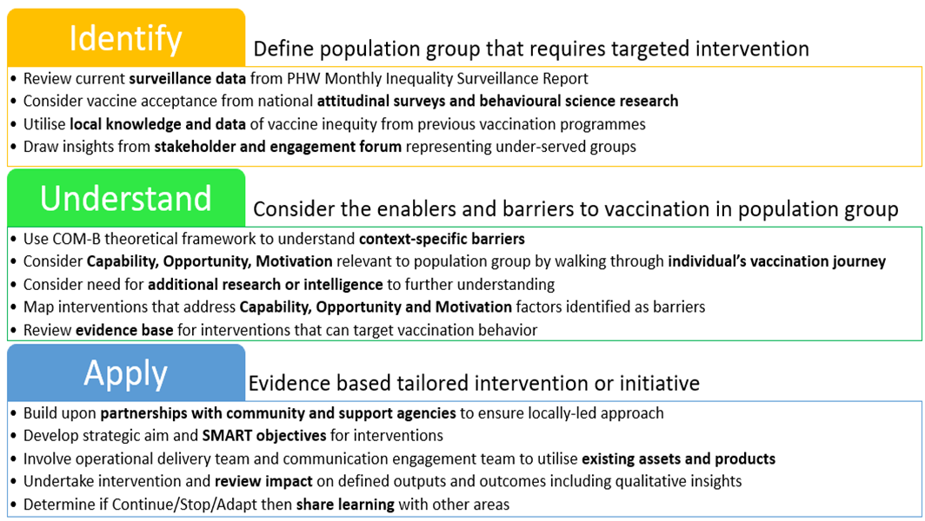
SBUHB Vaccine Equity Strategic Plan
Developed and approved by the Health Board – focuses on addressing inequity in engagement and uptake
At the core of access:
  If services are available and there is an adequate supply, then the opportunity to obtain health care exists and a population may 'have access' to services.
  Extent to which a population 'gains access' depends on more than proximity but includes financial, organisational and social or cultural barriers that limit the utilisation of services.
Source: SBUHB Vaccine Equity Action Plan

Slide 8
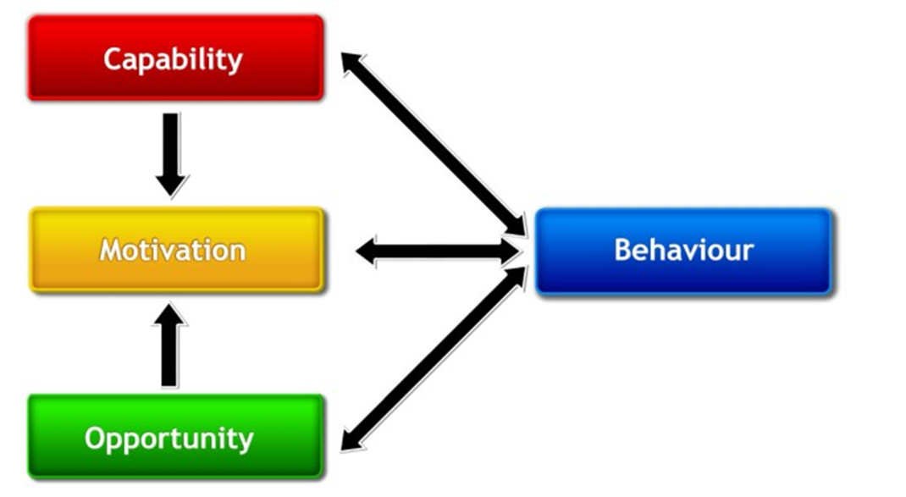
Examples of insights gathered into drivers of inequity
Individuals / Households / Communities / Populations
Organisations / Providers / Systems
Knowledge of what individuals are eligible for (esp high risk groups) & how to access
Understanding of what vaccines are, safety, importance (literacy) – especially for different population groups
Ability to get to appointment offered / engage in process
Digital / data issues e.g. delays/lack of sharing information between providers/health databases making it difficult to identify those under-vaccinated, subsequently delaying scheduling of any outstanding vaccination appointments.
Limitations of settings e.g. schools having poor/no internet connection connections in settings preventing e-consent process.
Lack of appropriate resources adapted to address literacy levels for population.
Hesitancy & reluctance within certain population groups, driven by mis-information; social norms/media and messaging; vaccine fatigue
Low prevalence of diseases - risks posed by infection is underestimated by the public and healthcare professionals when it is rarely encountered.
Proactive vs reactive approach adopted differentially across provider landscape – based on range of key factors including contractual requirements/expectations; prioritisation; skills/capacity.
Heterogeneity of population requiring differential approach/offer – costs/resource requirements
Poor transportation links esp if where lack of local provider of certain vaccines (e.g. COVID-19)
Limited flexibility in terms of access to vaccinations outside of traditional working / school day hours
Mixed provider landscape and operating model – creating variation for physical access & ‘messenger’ branding e.g. who is delivering, degree of flexibility of appointment scheduling.
Significant reduction in peer vaccinators.
Shorter window for delivery (e.g. October start).
Notes:
Prioritisation of vaccine schedule e.g. older adults or delaying of delivery within capacity/practical issues e.g. RSV.

Slide 9
Actions to address these potential barriers to engagement
Short term / immediate
Lived experience / insight:
Medium to longer term
Use existing governance mechanisms at an operational and tactical level to address barriers in a timely way across the provider landscape
Immunisation Feedback Form for those delivering and/or supporting immunisation and vaccination – helping to identify alternative methods to improve uptake rates; reduce hesitancy and complacency.
Improved communication & messaging - creation and promotion of key messages and materials, tailored and specific to our local audience with an equity lens.
Targeted / tailored provision:
Improved data / intelligence – work to build a more co-ordinated and responsive system including the sharing of primary care data to inform targeted provision
Review and consider the differential contractual obligations / expectations between providers
Vaccine Equity Group – involving wide representation from across Health Board and those from undeserved and hard to reach communities.
Shared learning with other Health Boards – to see what we can adapted & adopted
Provider landscape – scope the potential for how different models of delivery can help to drive up overall uptake and drive down the inequality gap
Engagement with voluntary sector organisations – to understand challenges and barriers faced and support partnership working to increase confidence, convenience and reduce complacency.
Attendance at events across the health board such as Mosques; Chai and Chat sessions; and school festivals, to further understand barriers and challenges.
Implementation of domiciliary immunisation service for those where vaccination in their own home is the best approach.
Collaboration with local authority colleagues to ensure children who are electively home educated are given equal opportunities to receive their vaccinations.
Providing tailored vaccinations / sessions on request and opportunistically
Long term conditions – consider options for proactive approach to those services / areas interfacing / serving eligible & high-risk groups with particular medical conditions
Provider management as part of co-ordinating different provider contributions to delivery

Slide 10
Next steps
Board is asked to note:
Nature and diversity of the immunisation and vaccination programme, including provider landscape
Differential uptake and factors that drive this based on emergent and ongoing insight gathering
Implications this has in terms of the type of actions needed to increase overall uptake and reduce the variation across under-served groups
Board is asked to support:
Actions already being progressed in the short term to resolve the practical challenges emerging from the above
Future actions and options to explore based on findings to date

Slide 11
Diolch
Thank you

