Slide 1
West Glamorgan Partnership
Seasonal Planning
2024-2025

Slide 2
Approach to Winter 2024/2025
The Winter Plan sets out actions that the Regional Partnership, including Swansea Bay University Health Board, Swansea Council, Neath Port Talbot County Borough Council and Third Sector organisations will take to maintain key services and ensure that the delivery of Health and Social Care services during the winter of 2024/25 is sustainable.
The priorities and actions outlined in Welsh Government communications are covered in detail within the SBUHB, Local Authority and Regional Partnership annual plans. These describe our ambitions of driving a quality focused effort for the benefit of our patients, our staff and our finances.
The backdrop to this winter remains challenging, both from a financial point of view and the pressures within the system, aligned to flow and capacity. This is impacted by a continued high demand of our services and workforce challenges.
Maximising planned developments and delivery across the 6 Goals for Emergency Care and Care Action Committee priorities is a critical focus of our winter approach. This approach will support the system to remain resilient and sustainable over winter.
The majority of initiatives developed over previous winters remain operational and have continued to support flow all year around. Effective monitoring enables an understanding of system pressures and required mitigation.
The region aims to deliver the plan within current resources whilst seeking opportunities, through whole-system approach, to improve efficiencies, utilise capacity effectively and flexing resources as required.

Slide 3
Keeping Well this Winter
Regional priorities:
Community Wellbeing
The Wellbeing of our Workforce
Winter Respiratory Vaccination Approach
Infection, Prevention and Control

Slide 4
Community Wellbeing
Person Centred
Primary Care
IAA
Community Multi-Disciplinary Team
Falls Response
Community Support
Tidy Minds
Sorted / Supported
Carers Support
Hubs
Assistive Technology
Local Cluster Collaborative
West Glamorgan aims to promote wellbeing and independence. The region uses the following approaches
Enhance Community Inclusion and Resilience
Improve Access to Early Intervention Services
Empower Individuals and Communities
Promote Sustainable and Long-term Benefits
Facilitate Integrated and Collaborative Working

Slide 5
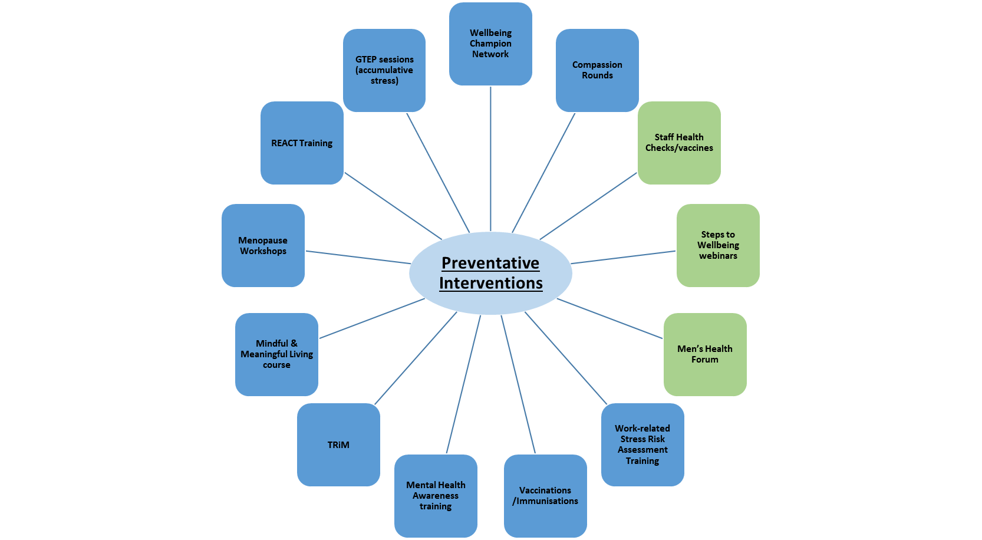
The Wellbeing of our Workforce
Maintaining the wellbeing of our workforce continues to be a priority across the Region.
The Occupational Health and Staff Wellbeing Team provide a range of services to support our workforce.
Monthly updates of support and wellbeing services are communicated to staff via the intranet and team brief sessions.

Slide 6
Regional Respiratory Vaccination Programme
Influenza vaccinations: commissioned service with all GPs across the Health Board with support from the Immunisation team. Due to complete by December 2024.
Covid-19 vaccination: collaborative effort - GPs (34 commissioned), Community Pharmacies (20 commissioned) and Immunisation team Winter booster (commenced October 2024) . The Health Board is ranked 1st across Wales (as of 31.10.24)
Fluenz Vaccine – Commissioned service by primary care for 2-3 year olds. School Nursing delivering across educational settings for 4-15 year olds.
Staff Flu and COVID-19 Vaccines: Occupation Health has led the initial response for Flu. Immunisation Team supporting and delivering Flu and Covid-19 vaccinations
Primary focus is on equity elements - SBUHB Vaccination Equality Strategic Plan is being implemented to address the inequity in engagement and uptake
Priorities
Barriers to vaccinations removed for flu and COVID vaccinations
Continued promotion of the new RSV vaccination
Maximise vaccination uptake in patient facing staff
Maximise vaccine update of pregnant women
Ambitions
To protect those at greatest risk from these respiratory viruses;
To reduce the circulation of respiratory viruses in our communities;
To support the resilience of the NHS and care system through the winter period Target update is 75%

Slide 7
Respiratory Vaccination Programme Delivery
Barriers to vaccinations removed for flu and COVID vaccinations | Continued promotion of the new RSV vaccine | Maximise flu vaccine uptake in patient facing staff | Maximise vaccine uptake of pregnant women
Primary care led via GP’s and Community Pharmacies with support from Immunisation team to eligible groups Aberafan Vaccination Centre & Immbulance utilised to support COVID vaccinations to eligible individuals registered with non-engaged practices School nursing team administering vaccine to primary and secondary school aged children. Provisional plans to offer mop up sessions to maximise uptake with support from immunisation team. Sexual Health Department offering to HIV+ patients Immunisation team are primarily vaccinating care home residents with COVID vaccinations. Offer made to care home staff during vaccination sessions Vaccination of housebound individuals are via immunisation GPs or CP Inpatient vaccination plan in place Immunisation team are scoping development of resources in alternative languages that is also in accessible formats following feedback from service users Continuous engagement with key stakeholders across the HB, especially with groups/organisations that support individuals/communities that have protected characteristics or undeserved population | 34 commissioned GPs for older adult vaccination campaign, with 31 commissioned to provide vaccination to pregnant women Immunisation team vaccinating in Neath Port Talbot and Singleton Hospital ANC with RSV vaccine Communication plan will follow National communications PHW RSV resources (in accessible formats) circulated to midwives and immunisation staff Immunisation team are scoping development of resources in alternative languages that is also in accessible formats following feedback from service users | Collaborative approach between Occupational Health; Immunisation team and peer vaccinators Site based clinics /Drop in model / Mobilisation to wards / Night shift offerings planned for November ‘Live’ Staff flu/COVID vaccination uptake dashboard will inform teams to adopt targeted approach Communication plan to support messaging/myth busting PHW resources (in accessible formats) sent to occupational health to promote and circulate across hospital sites and to support Peer Vaccinators in conversations with staff | Immunisation team offering RSV vaccine in Neath Port Talbot and Singleton Hospital ANC. MS Form and bookings link to be utilised for pregnant ladies to book and appointment for an ANC offering, and also to request an alternative offering (Home visit / pop ups etc.) Opportunity to advise on all other vaccinations in these settings is well received Education plan in place for Midwives to further support conversations with pregnant women Digital Immunisation Feedback form developed to provide information to the Immunisation Team on any barriers/challenges and also highlight any opportunities for us to improve deliver and uptake rates of RSV. Targeted offerings for RSV for those practices who have not expressed an interest in delivering the programme. Cluster based offerings under development

Slide 8
Respiratory Vaccination Programme Additional Focus Winter 2024/25
Support the Community to Prepare for Winter
1
Maintaining LA capacity to provide advice to prevent COVID and other respiratory virus outbreaks in care homes, domiciliary care, early years settings and schools. An ongoing, programmed offer of support has been developed, including training and audits
2
Prison Healthcare Team offering vaccinations to residents and maintain capacity to test for COVID and other respiratory viruses to support outbreak control measures
3
Have in place a system to deliver COVID testing in the community for vulnerable people and care homes
4
Capacity to manage COVID outbreaks in care homes and special schools
5
Workplan linked to Immunisation Team activity on vaccinations
6
IP&C specialist Nurse support provided to care homes

Slide 9
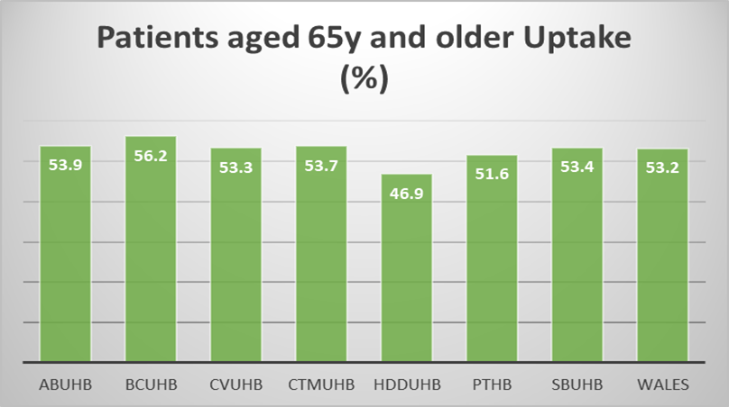
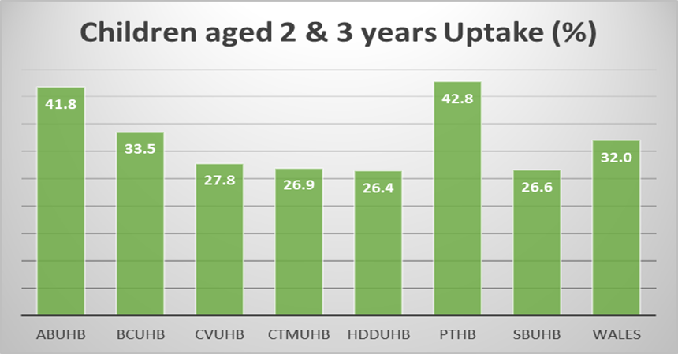
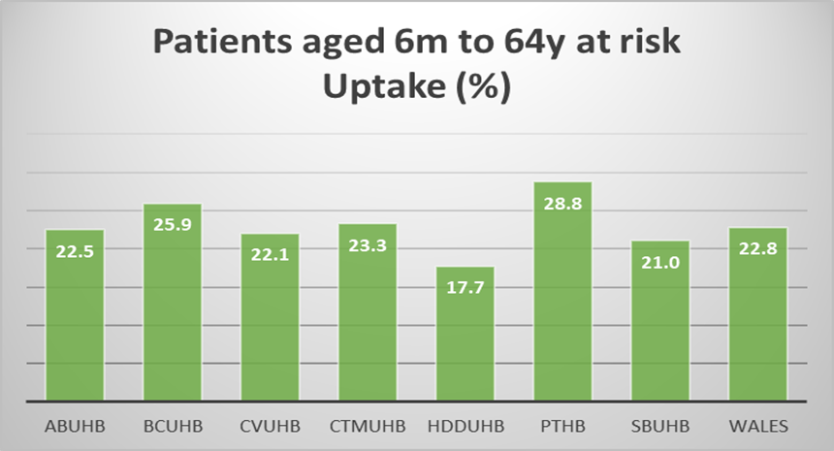
Regional Vaccination uptake 2024/2025 (as of 5/11/24)
Actions to increase Vaccination uptake:
Work with GP Practices on plans to improve uptake
Fortnightly data quality meetings in place
Engagement with Primary Care to understand the challenges / barriers and risk based on equity of uptake to ensure universal offer
Targeted support to reduce the gap we see between uptake across the clusters
Internal and external communications to drive up staff uptake rates

Slide 10


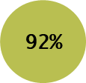



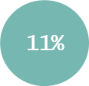
Health Care Acquired Infections
The HB remains in targeted intervention, with particular challenges in C. difficile rates. Priority remains on reducing the incidence of HCAI and improving antimicrobial stewardship continues. Current YTD position (year-on-year comparison):
  HCAI Bacteraemia - Staph. aureus , E. coli , Pseudomonas - continuing decreasing trends.
  HCAI C. difficile and Klebsiella bacteraemia - continuing increasing trends.
  AMS 72-hour review compliance . 72-hour review outcome: Change: ; Continue: ; IV to Oral Switch: ; Stop:
Clear leadership: Continued strong commitment essential to improve and maintaining our standards at all levels and within all multi-disciplinary groups. Executive and Service Group Director leadership is driving forward the consistent IPC messaging.
Revised governance structure: targeted and supportive scrutiny for specific hot spot areas. Gold command response for unacceptably high incidence of C. difficile.
Whole system communication and having a shared responsibility. All staff are expected to hold themselves and other responsible in maintaining standards reduce harm to our patients.
Focus on doing the basics well in areas like hand hygiene, cleanliness, antimicrobial prescribing, correct sampling, bare below elbows and complying with dress code.
Cleaning and decontamination priorities – Remove clutter, keep all surfaces, desk, storage areas, and frequent touch points clean. Have pride in our workplaces. Major programme of enhanced cleaning and enhanced technology disinfection drawing to a conclusion in Morriston.
Notes:
10

Slide 11
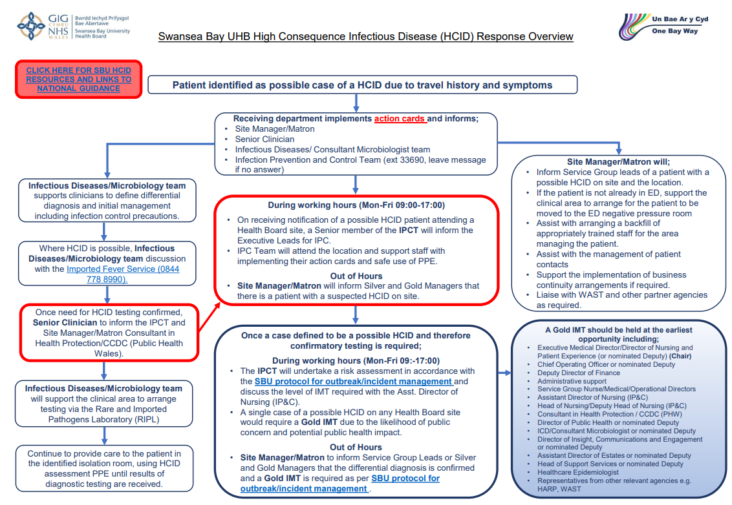
Infection, Prevention and Control: HCID
Notes:
11

Slide 12
Maintaining Flow Across the System:
Building Primary and Community Resilience
Urgent and Emergency Care

Slide 13
What’s Important?
Ensure individuals can live safely and comfortably at home. If hospitalisation is necessary, facilitate a timely, smooth and secure discharge process.
Why?
What?
Quality of Life: Staying at home often provides a more comfortable and familiar environment, which can significantly enhance a person’s well-being and happiness.
Independence: Living at home allows individuals to maintain their independence and continue their daily routines, which is important for their mental and emotional health.
Cost-Effective: Home care is generally more cost-effective than long-term hospital stays or residential care facilities.
Reduced Hospital Strain: Keeping people safe at home can reduce the strain on hospitals, allowing them to focus resources on those who need acute care.
Prolonged Stays: Prolonged hospital stays can lead to patient deconditioning along with increased risk of acquiring hospital-associated infections.
When hospitalisation is necessary, a smooth and secure discharge process essential to ensure:
Continuity of Care: Proper discharge planning ensures that individuals receive the necessary follow-up care and support, reducing the risk of readmission.
Safety: Ensuring a safe discharge process helps prevent complications or accidents that could occur if someone is sent home without adequate preparation.
Peace of Mind: A well-managed discharge process provides peace of mind for both the patient and their family, knowing that all necessary arrangements have been made for their care at home.
Home Adaptations: Install safety features like grab bars, ramps, and non-slip mats to prevent falls and accidents.
Assistive Devices: Provide tools such as walkers, wheelchairs, and medical alert systems to enhance mobility and safety.
In-Home Care Services: Arrange for professional caregivers to assist with daily activities, medication management, and personal care.
Community Support: Connect individuals with local resources and support groups to reduce isolation and provide social interaction.
Monitoring: Use technology like telehealth services and remote monitoring devices to keep track of health conditions and provide timely interventions.
During Hospital Discharge:
Discharge Planning: Work with healthcare providers to create a detailed discharge plan that includes follow-up appointments, medication schedules, and care instructions. Our Home First team identifies individuals on wards and supports their discharge once they are clinically optimised.
Engage Unpaid Carers and Individuals in decision-making processes. Our Integrated Discharge Hub communicates with partner organisations, families, and unpaid carers to ensure timely discharges to the appropriate setting for everyone.
Education: Ensure that patients and their families understand the discharge plan and know how to manage care at home.
Home Assessment: Conduct a home safety assessment before discharge to identify and address any potential hazards.
Transportation: Arrange for safe and reliable transportation from the hospital to home.
Follow-Up Care: Schedule follow-up visits from healthcare professionals to monitor recovery and address any issues that arise.

Slide 14
Factors and Challenges: for the Winter Period
Key Challenges
Financial Challenge
Capacity Issues
Increased demand on Emergency Department
Infrastructure Challenges
Increased demand on Community Care Systems
Increased call volumes to services
Key Factors
Seasonal Illnesses
Workforce Capacity
Planned Care
Public Expectation
Exacerbation of Chronic Conditions
Vulnerable Populations eg Homelessness

Slide 15
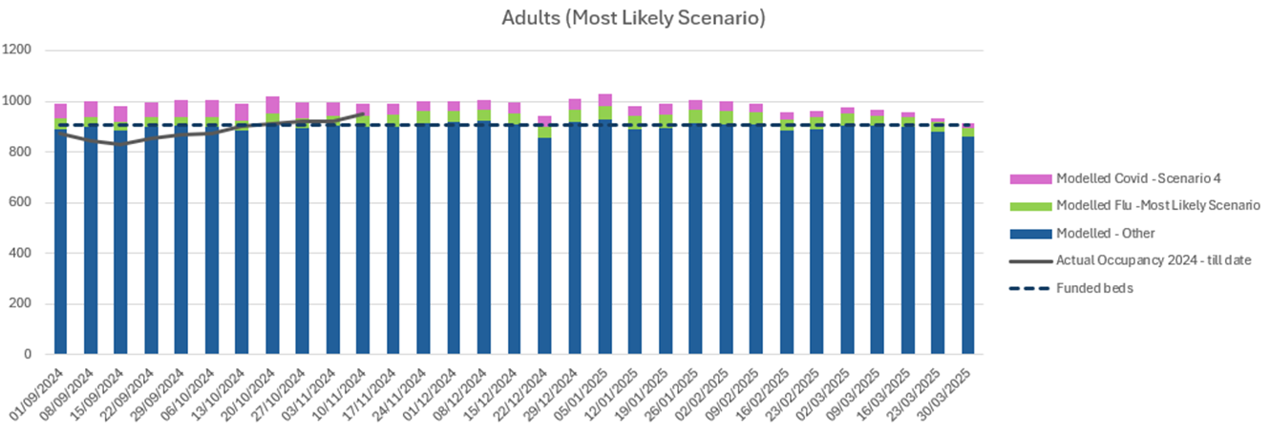
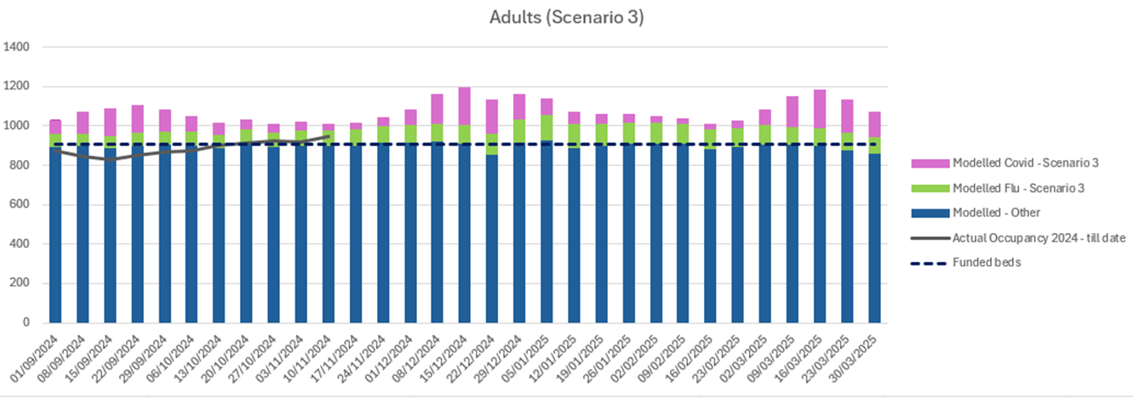
Respiratory Illness - Swansea Bay Modelling Scenarios: Adults
Adults: Most Likely Scenario Modelling:
Occupancy peaks in the week between the 5th and 11th January 2025
Average bed Deficit: 117 beds.
Adults Worst Case Scenario Modelling:
Occupancy peaks in the weeks between the 8th December and 11th January 2025 and 9th and 29th of March 2025
Average bed deficit: 248 and 245 beds, respectively

Slide 16
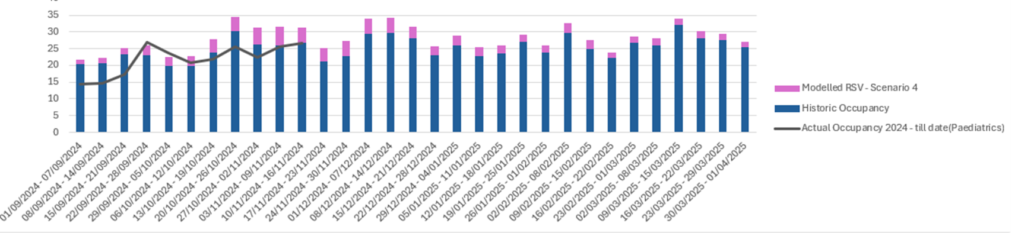
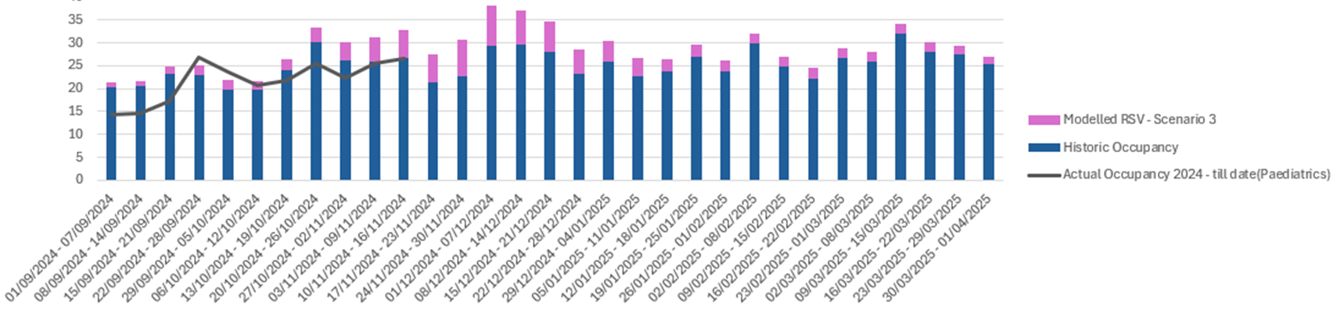
RSV Illness - WG Scenarios: Paediatrics
RSV Paediatrics: Most Likely Scenario Modelling:
Occupancy peaks in the first 2 weeks of December
RSV Paediatrics: Worst Case Scenario Modelling:
Occupancy peaks in the first 2 weeks of December

Slide 17
What We've Delivered Since Winter 2023/24
Increased number of patients attending OPAU, with reduced number of admissions and a reduced length of stay for admitted patients
Increased number of patients are attending our same day emergency care (SDEC) service a month
Reduction in ambulance hours lost per day due to flow
Reduced number of 12 hour Ambulance handover breaches in the Emergency Department
Delivered a reshaped acute medicine model of care to treat patients in the right place and support flow
Reduced the number of patients waiting over 2 years for planned treatment (0 patients)
Reduced the number of patients waiting over 52 weeks for first outpatient appointment (0 patients)
Launched ‘Sorted/Supported’ and ‘Tidy Minds’ website to support Emotional Wellbeing and reduce pressures on primary care
Community Psychology Team –
live in 3 clusters
Strengthened Community Services e.g. Local Area Coordination, community wellbeing services to support people within their communities
Delivered 40,776 Common Aliment Scheme consultations during 2023/24
Development and roll out of an Intergrated Discharge Hub to streamline processes and improve flow
Our Virtual Wards supported over 3,000 patients and 1,282 avoided admissions
15,143 Mental Health ‘111 press 2’ calls handled

Slide 18
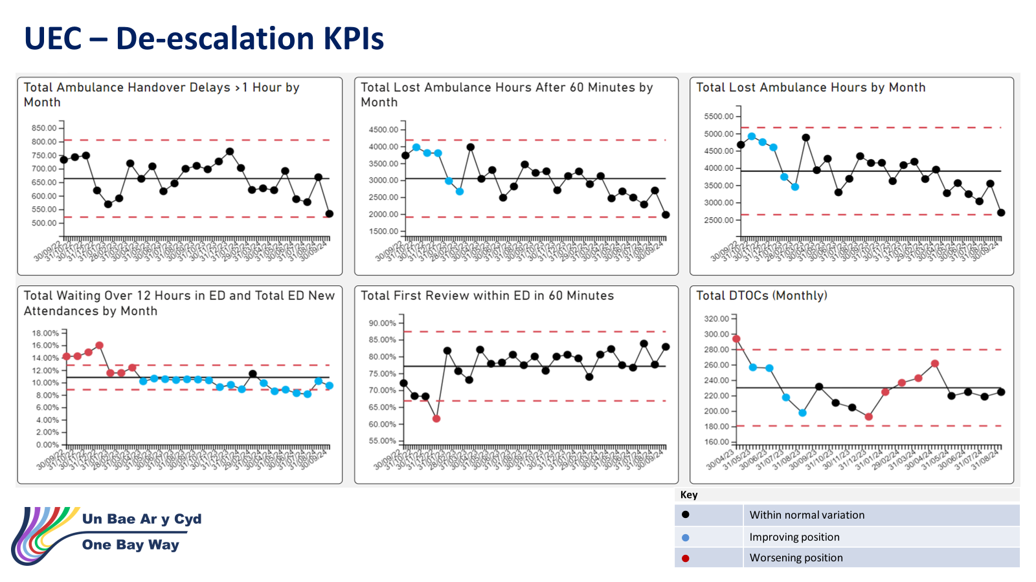

Slide 19
Seasonal Planning Priorities to Address the Challenge 2024/25
Integrated Care
Business as Usual Activity (to avoid hospital admission and support discharge from hospital )
Realign Domiciliary Care and reablement capacity to support flow
Home First Pathways
Data dashboards to monitor flow
Utilise community services to prevent admission to hospital to support timely discharge
Commissioners to discuss with the external services so continues service levels though the Christmas holidays
Implementation of Frailty Strategy : Frailty Hub, OPAU, Virtual Wards, ACT moving towards an Acute Care at Home model
Communication - Clear communication about new initiatives is essential. The development of documents explaining the approach to manage staff and patient / carers’ expectations
Pathways of Care Delays (POCD) - Focus on the delivery of actions to reduce Pathways of Care Delays (PoCD), COP deep dives and the recording of D2RA pathways on our SIGNAL digital system to enable increased understanding of bottlenecks within the system. Escalation to COO / Directors of Social Servicing on a weekly basis.
Rollout of the Integrated Discharge Hub (IDH) - assisting in facilitating timely discharge.
7 Day Working - A range of services to support flow currently operate across a 7-day working week, where resources and contractual arrangements permit. For example: ACT, District nursing, Domiciliary Care, Community Reablement Teams.
Continue the 50/50 funding arrangements for individuals while a DST (Decision Support Tool) is undertaken at the individual’s home

Slide 20
Seasonal Planning Priorities to Address the Challenge 2024/25
Integrated Community Services and Primary Care
GMS sustainability through cluster investment (pharmacy, nursing, physio, paramedic)
Frailty register in GP practices - enabling the identification of 2% most frail patients
Delivery of Consultant Connect technology to all Care Homes to prevent unnecessary conveyancing
Community pharmacy provision to support demand and capacity – including common ailments scheme, out of hours provision, UTI services, Sore Throat , Test and Treat, Flu programme (89 practices)
Pre-hospital pathways development for COPD for winter
Development and Implementation of the Falls Level 1 and Level 2 service (plan being developed)
Continued delivery of the National supplementary services for Care Home and increasing community services for care homes
Commissioning in and out of hours dental services
Emotional Wellbeing and Mental Health Programme: Enhanced Communications, Resilience for existing support services
Wellbeing and Learning Disabilities Programme: Grant funding to support local community groups
Carers Programme: Enhanced communication on services and support available, short breaks and respite for carers including young carers
Children and Young People: Improved access to Emotional Health and Well-Being support services, Enhanced Communications additional funding to support therapeutic support for children and young people
Neurodiversity: Myth-busting animation, parent drop ins and social communication booklet developed

Slide 21
Seasonal Planning Priorities to Address the Challenge 2024/25
Hospital Care
Robust business continuity management for all services, including the support services, estates and digital to ensure there is a full understanding of the risks that may impact on our premises, staff, services, utilities and supplies. This includes BCPs and contingency plans for Mortuary services over winter
Operational delivery plans and arrangements developed across all service groups (attached) with a focus on maintaining flow and effective utilisation of capacity. Plans
Pre-Hospital and Front Door:
  Implementation of Frailty Strategy :Phase 2 came online in September with a focus on Frailty hub, OPAU, Virtual Wards, ACT moving towards an Acute Care at Home model
  Direct Access provided to our vulnerable patients through SDEC / 24/7 integrated UPCC including direct access for Care Homes, APP at scene, and 111. Working towards a 7-day UEC Care Coordination hub
  Senior decision makers at front door services especially ED, AMU, SDEC. Focus to support flow across the system
  Mental Health Support Services: The Sanctuary service, 111 press 2 service, Mental Health SPOA, Crisis response
  Delivery of the front door trauma pathway redesign to reduce time spent in ED for #NOF patients
Flow
  Revised flow operating model: A consistent tactical command at Level 4 and introduction of revised escalation processes
  Ambulance: Reduced conveyance as a result of UEC care coordination hub and streaming to alternative pathways of care
  Improved ambulance performance: reinforcement of zero tolerance to 10+ hour waits policy and continuous flow model
  Contingency planning for surge capacity including SGH Ward 8/OPSS/Ward S/ Anglesey AMU : Model to support LOS, discharge and flow.
  Paediatric surge plans developed to reflect Welsh Government modelling and likely RSV peak admissions
Discharge
  Continued focus on reducing COPs through established processes e.g SAFER, D2RA, criteria led discharge
  Singleton and Morriston COP capacity under redesign
  Roll out of Integrated Discharge Hub across SBUHB sites

Slide 22
Governance and Assurance:
Finance
Risks
Monitoring

Slide 23
Additional requirements to support Winter Pressures 1
Opportunity | Priority for | Resources | Impact
Re-purpose Ward 8 SGH to a Ready to Go Unit to support COP | Regional | £954k (exc pharmacy and therapies) | Support surge capacity; Reduced CoPs
Re-commission 4 beds at Bonymaen - bringing the total commissioned beds at BYM to 8 | Regional | £120,000 for the winter period | Increased Step up/ down provision; Discharge planning/ Admission avoidance
To increase acute bed pool in Morriston in Acute Medicine (15 beds), frailty (12 beds) and surgical services (5 beds) by beds | SBUHB | Frailty 12 beds: £550k Surgical bed pool: £285k Acute Medicine: £750k | Support surge capacity; Increased flow through surgical and frailty pathways
To open 25 medical beds on Anglesey Ward – ward model to be confirmed , ? P1 bed pool with in-reach from IDH. | SBUHB | £954k (exc pharmacy and therapies) | Support surge capacity
To open the ED Clinical Decision Unit to support ED managed patients for 8–12-hour period to avoid admission. | SBUHB | 2 x Band 5 RN 24/7 = £44k per mth substantive/ £64k per month agency | Admission avoidance – circa 12 pts/24 hr period
To provide navigation and quality improvement support to the Emergency Department | SBUHB | 3 x 8a on rotational shifts over 24 hr period = £22k per month | Improved patient navigation and quality of care in the ED; Leadership support to the ED operational team
Transitional Beds scheme | Regional | TBC dependent on number of beds Approx £20,000 based on last year's figures | Increased Step up/ down provision; Discharge planning/ Admission avoidance
GMS Winter 2024 Additional Capacity Funding | SBUHB | £100,000 (supporting paper drafted) | Mitigate risk to workforce and increases in demand; Support practices not to trigger L5 escalation (practice closures)
Increase inhaler review scheme uptake in community pharmacy | SBUHB | £9,300 | Reduced respiratory admissions

Slide 24
Additional requirements to support Winter Pressures 2
Opportunity | Priority for | Resources | Impact
Pre-Hospital pathways – COPD / Falls L1 and L2 model | SBUHB | TBC – workforce | Reduced admissions due to falls/ respiratory reasons
Pooled Fund - To support individuals in exceptional circumstances to be discharged from hospital and supporting people to stay in their own homes | Regional | £50,000 for Winter Period | Discharge planning/ Admission avoidance
Development of the Integrated Discharge Hub to support surge through winter | Regional | £180,000 to March 2025 | Support surge capacity; Discharge Planning
Increase social work hours though surge periods (funding required) | LA’s | £20,000 to March 2025
Fy Mywyd Transitional Support project | Regional | £14,390.00 | Reduce wait time for support, developing increased independence, increased personal resilience and improving self-reliance
Dementia Hwbs | Regional | £26,316.00
NPT Technology Enabled Care | NPT | £20,000.00 | Support hospital discharge via NPT reablement / hospital teams.
CYP - Additional resources for RIF CYP schemes providing therapeutic support which currently have waiting lists. | Regional | £60,000.00 | Reduce witing lists to third sector support schemes. 341 Children and Young People and their Families currently on Waiting lists
EWMH - 4th Community Psychologist for the Afan Cluster from December 24 to March 25 | Regional | £20,000.00 | Reduce the impact the redundancies are having on people's mental health: domestic abuse, substance use and depression are increasing as result of the redundancies
CYP - Improving access to Emotional Health and Well-Being support services Bridging support | Regional | Costs not yet provided | Improved access to Emotional Health and Well-Being support services
CYP - Coverage of Fluenz vaccination | Regional | Costs not yet provided | Increased coverage of Fluenz Vaccinations through the winter - want to highlight the importance of getting vaccinated to protect others from serious illness this winter, particularly for those most at risk
EWMH - Provide support to agencies working with communities affected by the recent redundancies at TATA as there are serious concerns linked to peoples mental health | Regional | Costs not yet provided | By increasing funding into agencies working directly with those who are affected by the redundancies in TATA, there is a likelihood that people will avoid crisis. Trade Unions in the area are running a community drop in where affected people can go for support and advice and they are experiencing people attending in mental distress.

Slide 25
Additional requirements to support Winter Pressures 3
Opportunity | Priority for | Resources | Impact
Magic Notes software presents an opportunity to enhance the efficiency of hospital social work teams by enabling a faster turnaround of assessments. | Regional | £36,000 | Reduce delays in social work assessments, speed up the completion of joint assessments, and lessen the administrative load on teams.
Additional Dental cover for Christmas/ New Year period | SBUHB | £5,000 | Reduce demand ED/ OOH over the Christmas period
Additional Dental appointments from the Dental access portal | SBUHB | £5,000 | Reduce demand ED/ OOH over the Christmas period
Additional Pharmacy cover for the Christmas/ New Year period | SBUHB | £7,800 per pharmacy for 3 days | Reduce demand on GPs /OOH services over the Christmas period.
Bring forward community psychology post to start earlier | Regional | £18,000 (to fund until 31/3/2024)) | Community support provision – reduce demand on GPs/ OOH.
Funding to practices to provide care homes support over and above the current DSS or to enhance buddy arrangements for practices that do not participate currently. | SBUHB | £108,000 | System flow, reduced hospital admissions, improved pathways of care
EWMH - Provide support to agencies working with communities affected by the recent redundancies at TATA as there are serious concerns linked to people's mental health | Regional | Costs not yet provided | By increasing funding into agencies working directly with those who are affected by the redundancies in TATA, there is a likelihood that people will avoid crisis. Trade Unions in the area are running a community drop in where affected people can go for support and advice and they are experiencing people attending in mental distress.
EWMH - 111 press 2 provides 24/7 mental health support and signposting for the public and professionals. Increasing funding over the winter months will enable the service to increase the number of staff working during busier time periods reducing call waiting lists. | Regional | Costs not yet provided | Reduce the number of people who reach crisis over the period, or prevent people from being admitted into statutory services.

Slide 26
Risks and Mitigation
What are the highest risk areas in delivering this winter what mitigating actions are in place?
Risk | Mitigation
Maintaining System Resilience over winter | Business Continuity planning arrangements in place. Regionally developed Winter plan – outlines the integrated approach to system planning and maintaining flow across the UEC and community interface. Local bed modelling undertaken to understand peaks in demand over the winter period. Governance and Monitoring arrangements in place. Surge plans developed where applicable.
Workforce- sustainability of the workforce over the winter period. | Challenges with the recruitment and retention of care staff across all settings. Sickness levels remain high and there are extremely high pressures and demands across health and social care services, which will be compounded by the winter period. Business Continuity planning arrangement in place.
Financial Constraints | Will require difficult choices to be made – balancing the range of options to increase system capacity and reduce risk across all partner organisations.
Potential Industrial Action (HCSW) | Robust Business Continuity arrangements and governance in place, including escalation processes and activation for a declared BCI/ Critical incident.
Impact of Princess of Wales service closures due to critical state of estate | Robust Business Continuity arrangements and governance in place, including escalation processes and activation for a declared BCI/ Critical incident
Increased waiting times in ED/ delayed hand overs and Increased pathways of care delays | Seasonal planning embedded, regional plan developed – outlines approach to managing UEC and Community pressures. Utilisation of SDEC/ UPCC. CAC priorities, 50-day challenge action plan
Low uptake of Vaccinations and Immunisations | Work with GP Practices on plans to improve uptake Fortnightly Data Quality Meetings in place Engagement with primary Care to understand the challenges/barriers and the risk based on equity of uptake to ensure universal offer Targeted support to reduce the gap we see between uptake across the clusters Internal and external communications to drive up staff uptake rates

Slide 27
Risks and Mitigation
What are the highest risk areas in delivering this winter what mitigating actions are in place?
Risk | Mitigation
Impact of mass unemployment events from Tata Steel on service demand over winter | Work is being driven through the PSBs . Steering group in place. Discussion on-going with central government regarding support package for the local community. Third sector business case in developed to increase third sector support provisions specifically around food banks, domestic abuse charities and cost of living/ employment support.
Unpaid Carers | Health Issues: Physical and mental health can worsen due to caregiving demands; Financial Strain: Rising costs, especially for heating, add financial pressure; Isolation: Winter can increase feelings of loneliness and depression; Lack of Support: Insufficient social care services can lead to burnout; Higher Care Demands: Winter illnesses can increase the need for care.
Well-being and Mental Health | Isolation: Increased loneliness and less social interaction; Financial Stress: Higher heating bills and holiday costs; Health Issues: Cold weather can worsen health conditions and increase illness; Seasonal Affective Disorder (SAD): Depression due to less sunlight; Less Physical Activity: Reduced exercise and outdoor time
Learning Disabilities | Health Issues: Higher risk of respiratory illnesses; Isolation: Increased loneliness and mental health challenges; Service Access: Difficulty accessing healthcare and support; Financial Strain: Higher heating and winter costs; Safety: Greater risk of falls and injuries.
Dementia | Health Issues: They may not recognize or communicate that they are cold, increasing the risk of hypothermia; Isolation: Cold weather can limit social interactions, leading to increased loneliness and anxiety; Access to Services: Winter weather can make it harder to access healthcare and support services; Worsening Symptoms: Shorter days and less sunlight can exacerbate symptoms like sundowning and Seasonal Affective Disorder (SAD); Safety Concerns: There is a higher risk of falls and injuries due to icy condition
Children and Young People | Health Issues: Increased risk of respiratory infections and skin conditions like eczema due to cold weather; Mental Health: Shorter days and less outdoor activity can lead to anxiety and depression; Isolation: Cold weather can limit social interactions and outdoor play, impacting their social development; Safety Concerns: Higher risk of falls and injuries due to icy conditions; Financial Strain: Families may struggle with higher heating costs, affecting overall wellbeing.

Slide 28
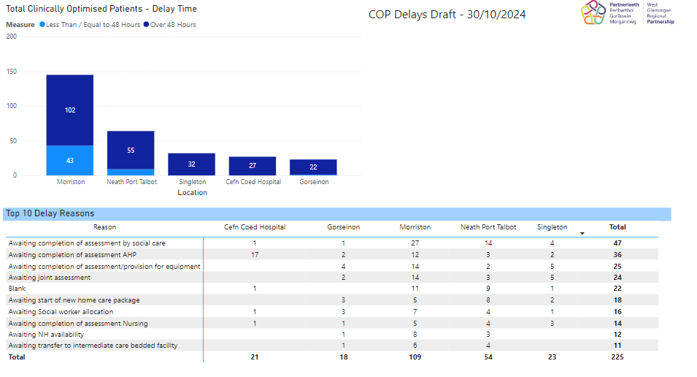
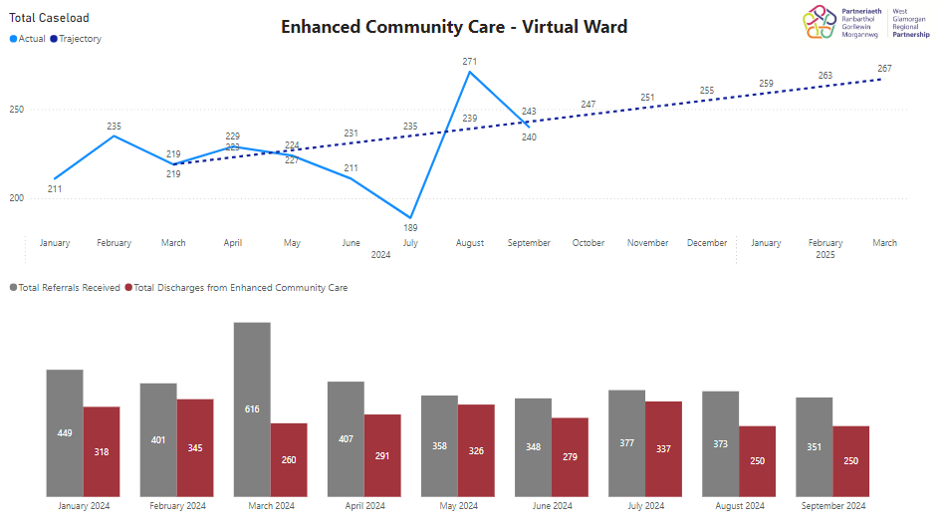
Season Plan Monitoring
A daily huddle takes place with both Health and Care Staff to review the position and risks across the region. A Regional Operational Assurance Group also meets weekly to review activity and performance this include the review of the and Pathway Of Care Delays Action Plan. Reports are submitted to both the Community and Older Peoples Programme within the Regional Partnership Board and the HB’s Urgent and Emergency Care Board. In addition, there is local partner monitoring
Regional Dashboard
Enhanced Community Care – Acute Clinical Team
Enhanced Community Care – Virtual Ward
Enhanced Community Care – Speciality Palliative Care
28 Day Emergency Readmission Rate (Age 65+)
District Nursing Hours Weekday vs Weekend
District Nursing Hours – Weekend Trajectory
Emergency Medical Admissions (Length of Stay over 21 Days)
Admission Rates 75+
Signal Clinically Optimised Delays (:Live)
Total Pathway of Care Delays
Long Term Package of Care Waiting Lists – Community and Hospital
Days Delayed
Pathway of Care Delays – Assessment Delays Only
Adults Receiving Reablement

