Slide 1
Welsh Centre for Burns
A Patient journey
Louise Limbert

Slide 2
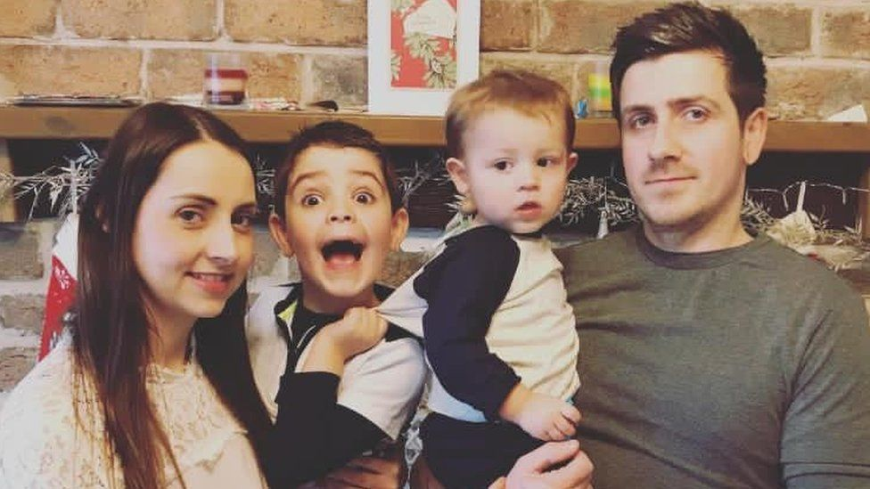
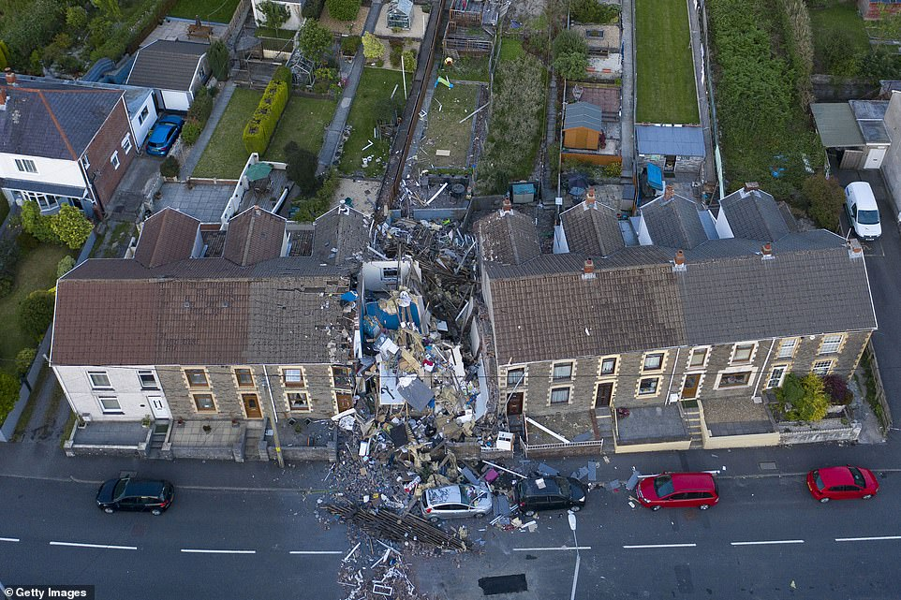
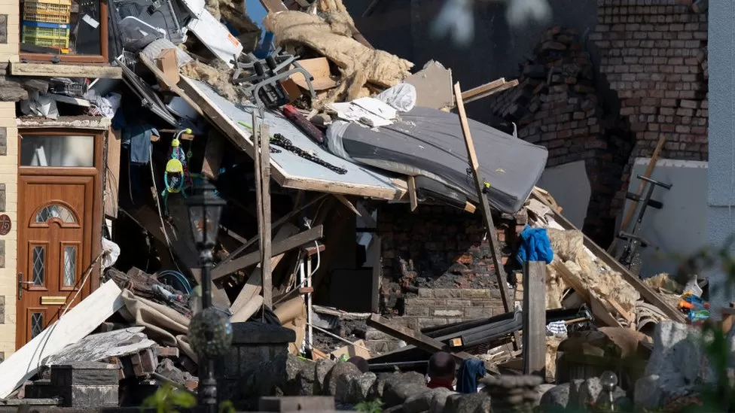
Image: Wales Online/ Matthew Horwood
Image: BBC News/ Getty Images
Notes:
I’m going to present a patient journey through the Regional Burns Centre. We are currently waiting for a patient story to be completed so that we can add her experiences and thoughts.
On the 4th of June 2020 our patients, a 31 year old mother and her two sons aged 5 and 2 had enjoyed a morning at the beach in the middle of the summer heatwave. When they arrived home mum thought she could smell gas, so she put the children down on the sofa at the front of the house and went to the kitchen at the back of the house to investigate. Shortly afterwards, a huge explosion reduced the house to rubble with the three of them inside. Mum was blown across the kitchen and ended up under the large fridge and although this caused her to sustain a pneumothorax it protected her from falling debri and more serious injury, amazingly , all three were rescued from the rubble by neighbours, and they all survived. Both the boys sustained around 25% burns, and were airlifted Bristol Children’s Hospital accompanied by their dad and his family. Their mum, our patient, was brought to us as the Centre for adult major burns, accompanied by her parents. Having to separate the families at a time of such high distress was extremely upsetting for all involved, as you can imagine.
This was also a time of COVID and we were getting to grips with all of that and what it meant for families visiting.

Slide 3
Patient Journey through our unit
24/06/2020 - admitted to Burns ITU following a blast injury from a gas explosion
21/08/2020 – Transferred to Burns Rehab ward
05/10/2020 – Discharged Home with outpatient service follow-up.
(Burns out-patient department, Burns Outreach service, Laser Clinic, Physio and OT)
Burns Psychology supported patient and family throughout

Slide 4
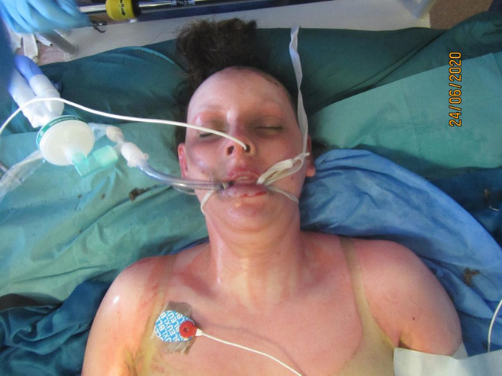
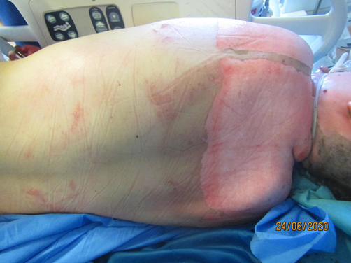
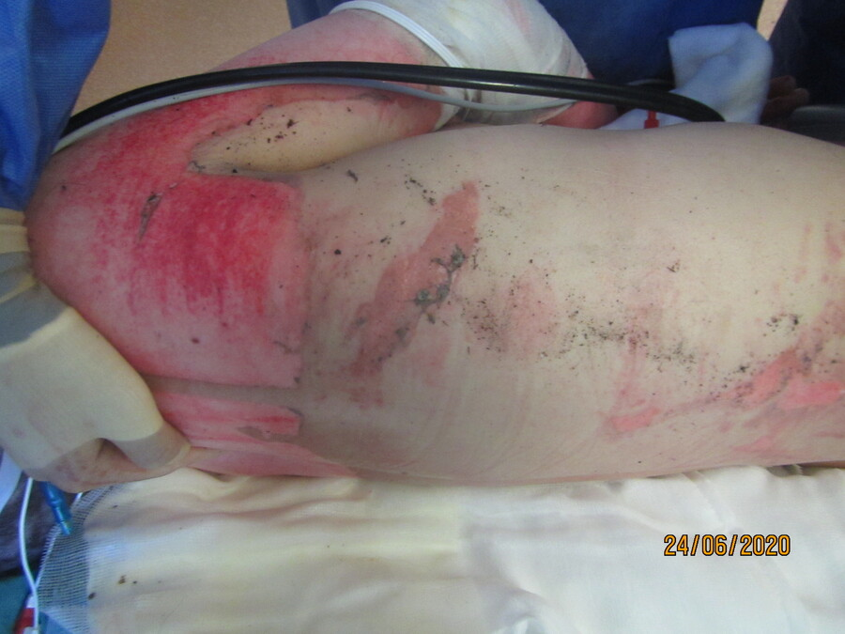
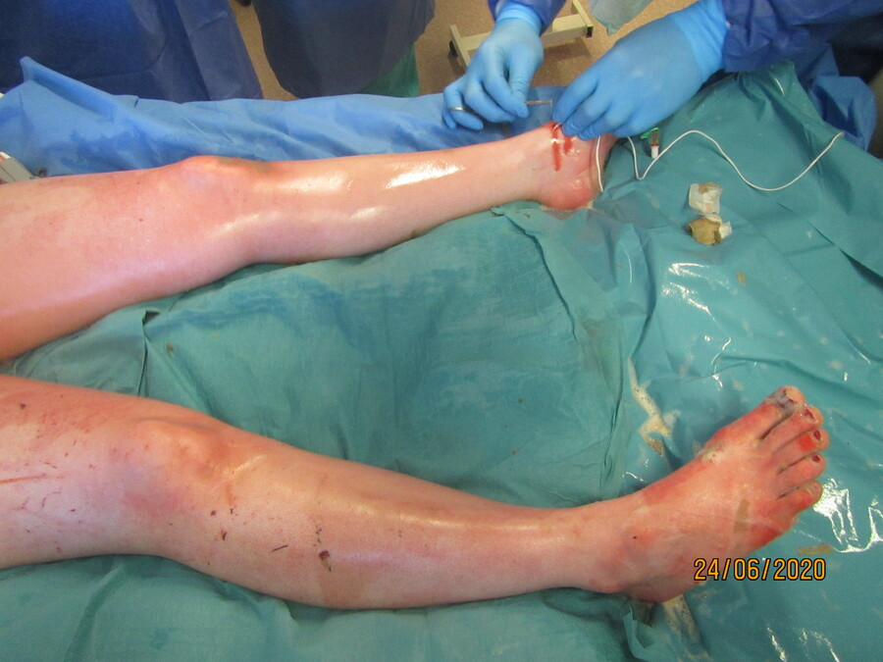
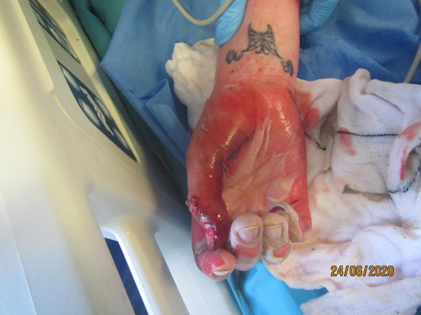
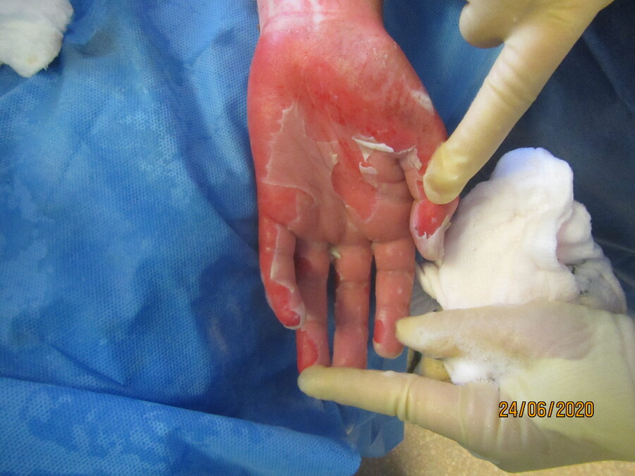
Notes:
She sustained a 72% burn injury, which was initially assessed to be largely partial thickness and it was thought that the wounds would mostly heal with conservative management. During explosion, she also sustained fractured ribs, a haemo-pneumothorax, and perforated eardrums.
Unfortunately, due to the nature of the blast injury, over the following few days she developed burn wound infection and multi organ failure, and it was feared that she may not survive her injuries. Her family were called in to say their farewells the same day that the children went to theatre in Bristol for skin grafting, so again, the family being split was highly distressing. The patient’s partner had to be blue-lighted by police from Bristol to see her, but fortunately, she stabilised and he was able to return to Bristol to be with the children. The psychological impact of this on the entire family was enormous.
Due to the wound infection and the criticality of her condition, the depth of the burn deepened and 60% of the area needed to be grafted.
There wasn’t enough donor site available to allow cropping for the skin grafting to take place in one sitting, so we needed to wait about 3 weeks between each grafting episode, which delays weaning from the ventilator as daily dressing changes are painful and exhausting. As areas were grafted they needed to be immobilised for 5 days, further hindering rehab. Due to the length of time she spent on ITU and the level of sedation she was on, she developed critical illness neuropathy to both upper and lower limbs. This resulted in a slower weaning progress from the ventilator.
Delirium Management:
The risk of delirium in Burns ITU is high. One of the first things we do as a team to try and minimise this is to communicate effectively with the patient, using short sentences and asking single questions. This was very difficult to achieve effectively due to pt’s perforated eardrums and the fact that covid restrictions meant all staff had to wear mask and visor making our voices more muffled. Covid restrictions also meant that family were unable to be present with her in her room, so we were unable to involve them in her care as we usually would.

Slide 5
Burns ITU
initially thought for conservative treatment but Burns deepened and required 60% TBSA debriding and skin grafting. Had acute sepsis episodes, required Tracheostomy.
Intensive wound care management. Undergoing daily painful showers and dressings changes with anaesthetic support
Physiotherapy working on respiratory strength, reduction of contractures and improving mobility.
OT providing splinting for hands.
Psychology providing patient and family support.
Complex wound microbiology – multiple organisms including MDRO requiring complex infection control precautions.
Using digital format to keep family updated during COVID restrictions with complex outer family dynamics. Keeping Jess up to date on her children's progress.

Slide 6
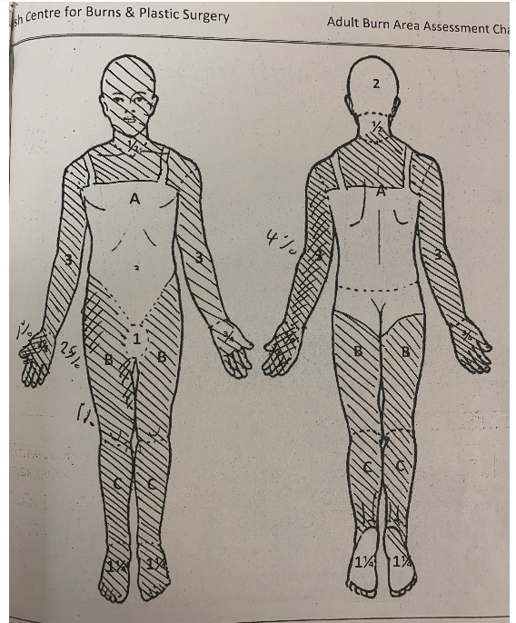
Lund & Browder chart

Slide 7
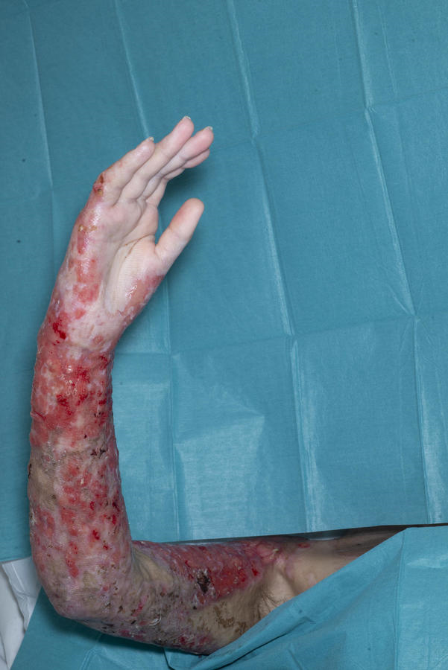
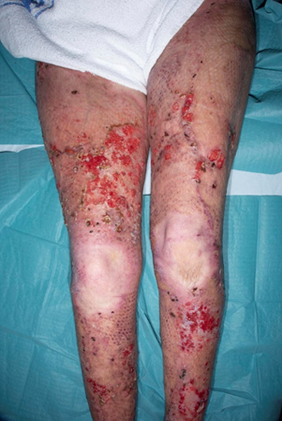
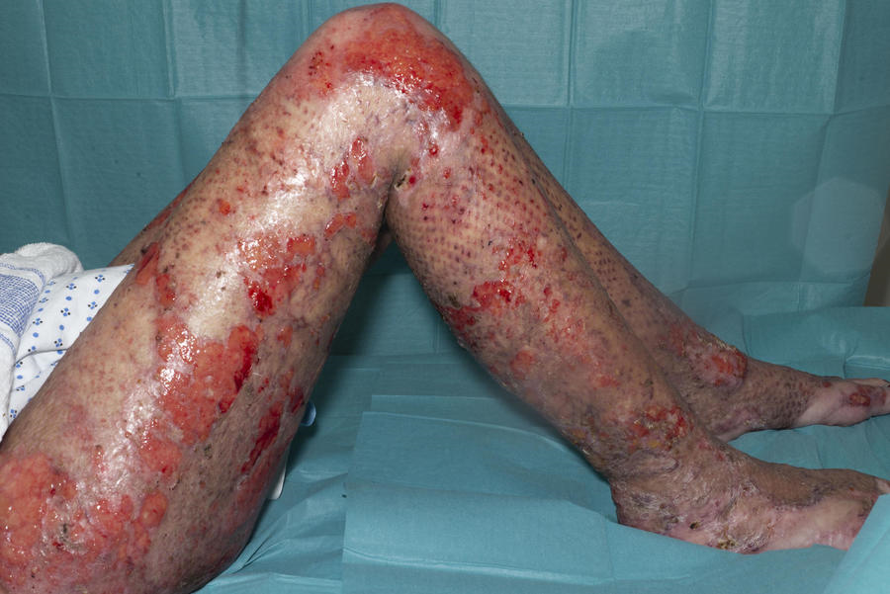
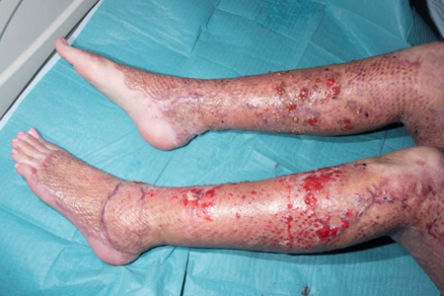
Notes:
So by 10 weeks post-injury she was ready to be transferred to the rehab ward
The children and her partner were living locally with his parents, but were still unable to visit regularly due to covid restrictions and the fact that she had developed a multi-resistant organism. This also delayed wound healing, causing further pain and wound breakdown, prolonging her stay in hospital and limiting where we could conduct her rehabilitation. She was, however, highly motivated for rehab as she was so desperate to return home to her family. The intensity of rehab needed to increase to facilitate this, and also to reduce the risk of contracture as her wounds healed and scar tissue developed.

Slide 8
Burns Ward (Powys ward)
Transferred to Powys ward 21/08/2020 for on-going complex wound care, rehabilitation, psychological support and discharge planning.
Complex infection control issues.
Visiting for children arranged within a closed bay on Dyfed ward, allowing psychology, physio and OT support for the whole family in a single area.

Slide 9
Physiotherapy – Rehab Ward Phase
Mobility progression: Pat slide/hoist, stedy/sara stedy, pulpit frame, zimmer frame, crutches/walking stick, independent
Unable to attend gym due to MDRO status – created single patient use area with access to limited equipment to build strength and cardiovascular ability
Ongoing range of movement exercises for all joints
Active exercises encouraged, with passive stretching to achieve end range
Psychology – Ward Phase
Individual work- ongoing use of stabilization techniques, engagement with rehabilitation and early adjustment to injuries
Discussions regarding coping with the separation from her sons and ways of remaining involving in their care
Weekly goal planning sessions with all MDT members
OT – Ward Phase
Pressure garment measuring / Starting scar management / Re-adapting splints
Notes:
Problem 1
Reduced mobility
Treatment plan:
Sitting out for longer periods
Sit to stand transfer practice
Walking
Balance exercises
Problem 2
Reduced strength
Treatment plan:
Continue active and resisted movement, weighted exercises
All joints through full available range of motion passively to ensure end range achieved
Problem 3
Reduced stamina and cardiovascular ability
Treatment plan:
Build up length of sessions
Pacing and ensuring adequate rest between sessions

Slide 10
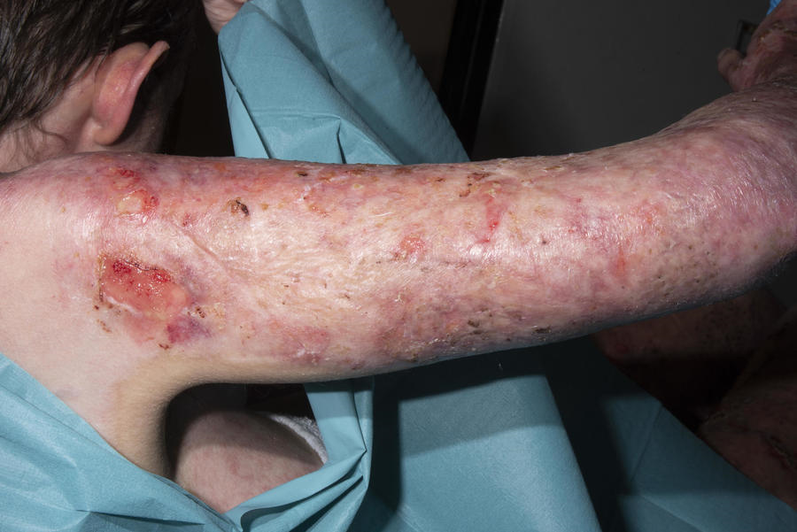
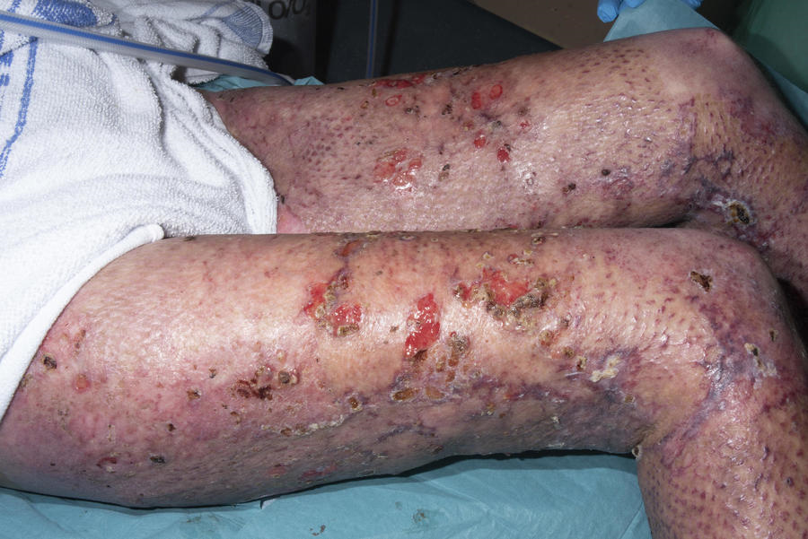
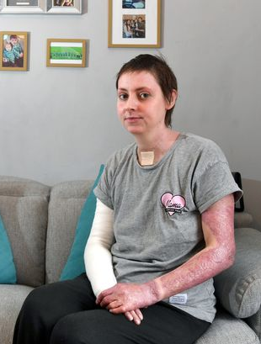
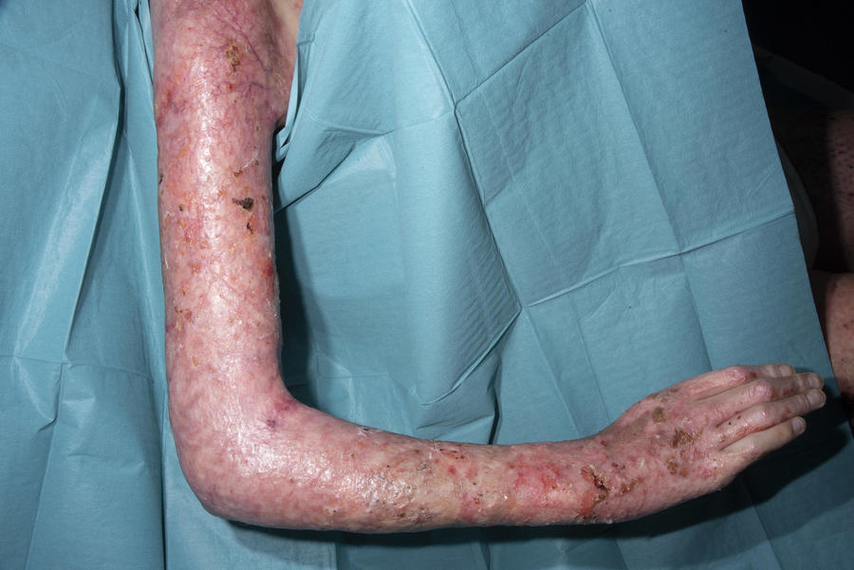
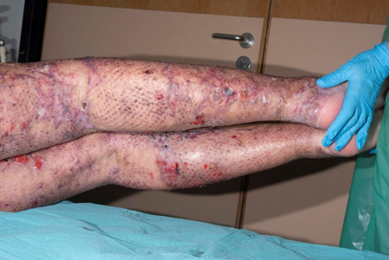
Image: Wales Online/ Gayle Marsh
Notes:
Four months post-injury she was ready for discharge home, with only small scattered areas left to heal.

Slide 11

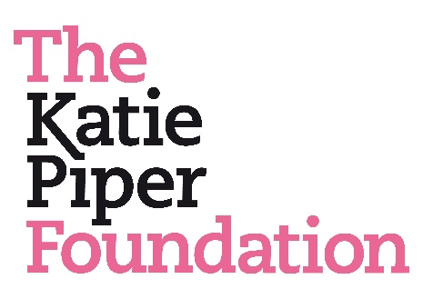
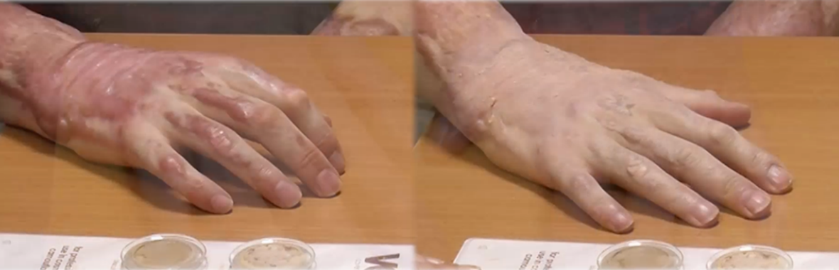
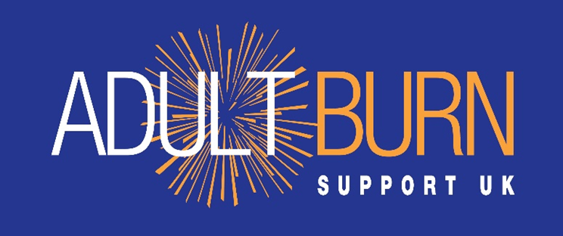
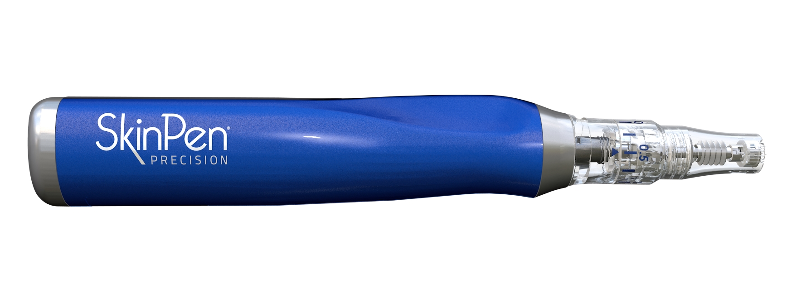
Occupational Therapy – Out-Patient Phase
Notes:
Scar management
Elbow splint, anti-claw splints, night splint, scar massage, compression garments, itch management, skin camouflage, micro-needling
Referral to Dan’s Fund for Burns
Grant for home exercise equipment
Private audiology appointment and provision of hearing aids – work reintegration
DFFB Adult Burn Support Network
Signposted to Katie Piper Foundation
Micro-needling at point of scar maturation

Slide 12
Out-patient journey
Discharged to a new home
Follow-up care arranged with Burns out-patients department, with Physio, psychology and OT supporting during her visits.
Discharged to her grandfathers empty property which was an adapted bungalow whilst she was waiting for her house to be re-built. Did not have any house insurance but the community raised money to help with the rebuild.
When discharged from Burns OPD, Jess was referred to Burns Outreach service which follow-up wound care in the community. Physio, Psychology and OT continued to be involved in her care for helping her to maintain function, scar management and trauma response.
Further Laser treatment has taken place and also small day surgery cases for release of Burns contractures to fingers.

Slide 13
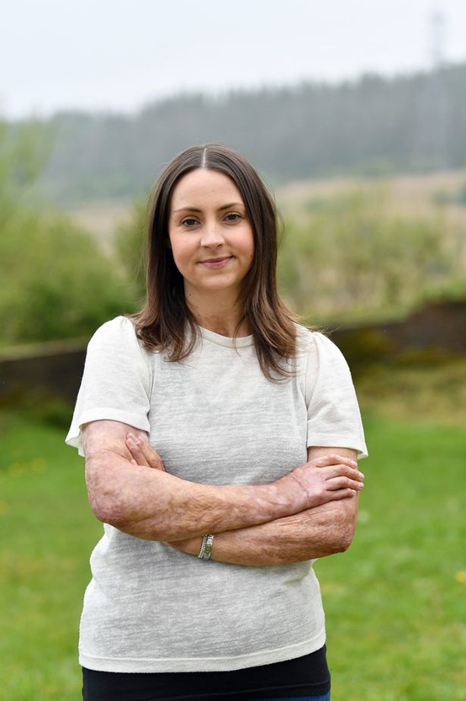
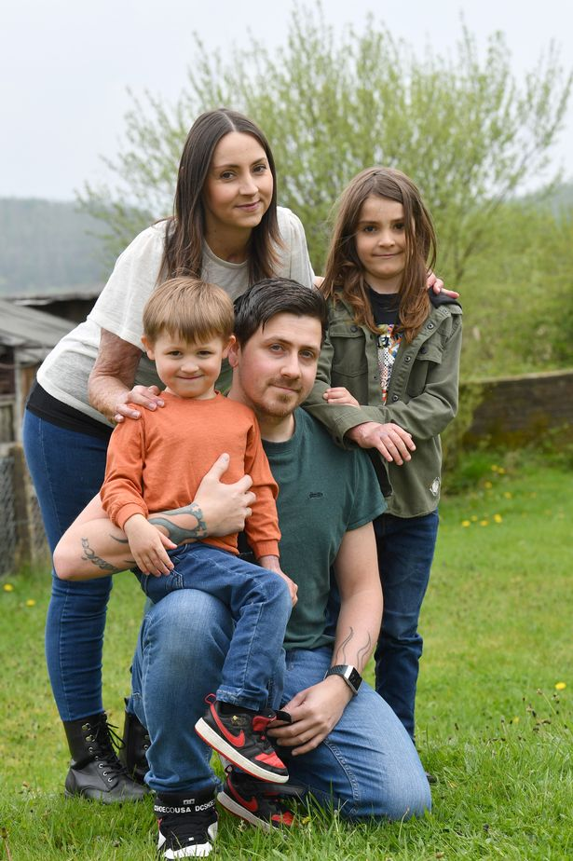
Notes:
Re-building their home, and their lives. Both back in work and boys in school. Burns rehab will be ongoing for many years – several surgical procedures still to come.

