Slide 1
Staff Incidents
Morriston Service Group
Desk-top Review:
Incidents Reported 01/04/2023 to 31/03/2024

Slide 2
Scope & Source Data
The following report is based on a data extracted from the Once for Wales (Datix) system on 18/06/2024. The following criteria was used:
Incident Type, Who Affected? = Staff/Contractor
Reported Date = 01/04/2023 to 31/03/2024
The query was reported using Report Template 1 – General Listing Report (Large)
A total of 578 records were included; or which 503 occurred at Morriston Hospital, 23 at Singleton Hospital and 39 at NPT Hospital and 13 at locations outside of main hospital sites but involving staff managed by Morriston Service.
Please note that this extract only relates to staff managed by Morriston Service Group. It includes services managed by the Group but located on sites outside of Morriston, such as Radiology Services. The extract does not include incidents occurring at Morriston Hospital Site which may have involved staff linked to other HB Groups such as Estates and Facilities.

Slide 3
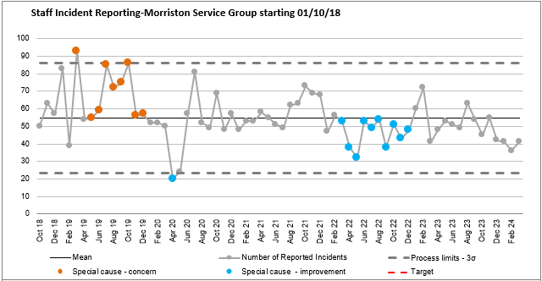
Prevalence: Staff Incidents Morriston Service Group
Continued observed reduction in number of staff incidents reported – starting from Feb 22. This step-down has then plateaued, setting into a new lower outcome process
There is no indication that this reduction in reporting is linked to the transfer from DatixWeb to Once for Wales however it should be acknowledged that there have been significant service changes since Dec22 which potentially could have an impact on
Notes:
The important thing to remember on this slide is that Staff Incident are relatively steady with a very slight decline. This would suggest that they are predictable and therefore preventable.
An example of the potential change in staff incidents due to Service Change would be the transfer of Theatres. We historically would have seen a certain number of needlestick/sharps injuries in Theatre. They are now moved out of the trend which could be the reason for the first indication of a reduction in numbers from November 23.

Slide 4
Day of the Week: Staff Incidents based on Date of Incident
 | 2023/2024 |  | 2022/2023
Day | Number | % | %
Monday | 74 | 13% | 15%
Tuesday | 91 | 16% | 14%
Wednesday | 92 | 16% | 16%
Thursday | 99 | 17% | 20%
Friday | 89 | 15% | 17%
Saturday | 74 | 13% | 8%
Sunday | 59 | 10% | 13%
Equal distribution would be 14%
The pattern of Staff incidents (occurring) continues to be consistent across the day of the week
Thursday continues to be the most likely day for a Staff Incident to occur
There is a significant variance between the number (%) of incidents which happen on a Saturday compared to a Sunday – despite having equivalent staffing numbers

Slide 5
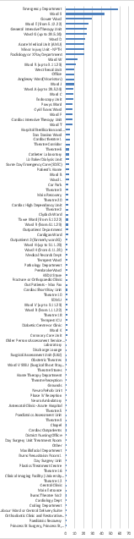
Location of Reported Staff Incidents
104 wards/departments who have reported staff incidents (compared to 81 in 22/23) – 28 have reported 5 or more incidents over the review period (27 in 22/23)
The Top 5 locations:
Top5 locations account for 36% of reported incidents
Top12 locations account for 54% of reported incidents
All other wards/departments reported 10 or less incidents within the 12mth period
Ward/Dept | 2023/2024
 | Number | %
Emergency Department | 58 | 10%
Ward S | 43 | 7%
Gowers | 29 | 5%
Ward E | 25 | 4%
Ward G (Joint) | 24 | 4%
ITU (Joint) | 24 | 4%
Notes:
Again this supports that Staff Incidents are predictable. The majority of the incidents occur in a relatively small number of locations across the hospital site.

Slide 6
Staff Incident Type:
Staff Accident related to Behaviour by Cause
Aggressive/threatening behaviour | 143 | 46%
Physical assault (physical contact) | 86 | 28%
Inappropriate behaviour / attitude | 40 | 13%
Anti social behaviour | 8 | 3%
Verbal assault (racial abuse) | 8 | 3%
Patient clinically challenging behaviour | 8 | 3%
Verbal assault (swearing etc.) | 7 | 2%
Harassment | 7 | 2%
Inappropriate use of social media | 2 | 1%
Verbal assault (gender/sexual orientation) | 1 | 0%
Sexual (inappropriate) behaviour | 1 | 0%
Equality and diversity policy / guidelines | 1 | 0%
Grand Total | 312
Behaviour (including violence and aggression) | 312
Accident, Injury | 159
Infrastructure (including staffing, facilities, environment) | 30
Equipment, Devices | 26
Communication | 23
Records, Information | 5
Information Governance, Confidentiality | 4
Medication, IV Fluids | 3
Ill health (work related) | 3
Access, Admission | 3
Information Technology | 2
Safeguarding | 2
Treatment, Procedure | 2
Infection Prevention and Control | 2
Consent, Mental Capacity Act (including DoLS) | 1
Transfer, Discharge | 1
Grand Total | 578
Staff Accident related to Accident/Fall by Cause
Contact with needles or medical sharps | 48 | 30%
Slip, trip or fall | 32 | 20%
Manual Handling - Patient/service user handling | 19 | 12%
Contact with object or animal | 14 | 9%
Contact with or exposure to hazardous substance | 13 | 8%
Burns or scalds | 11 | 7%
Struck against or by an object | 11 | 7%
Manual Handling - Non patient/service user handling | 8 | 5%
Contact or exposure to electricity (electric shock) | 2 | 1%
Road traffic collision | 1 | 1%
Grand Total | 159
Over 80% of Staff Incidents occur as a result of either Behaviour or an Accident
Notes:
This again reinforces the predictability of Staff Incidents. The vast majority of Staff Incidents are as a result of two primary causes.

Slide 7
Case Study: Personal Injury following an Accident at Work
SITUATION
The staff member fell whilst on duty within a clinical area
The fall was as a result of a trip event caused by a trailing electric lead. The electrical lead was attached to a piece of healthcare equipment being used at the bedside, which was connected to a wall power source
The electrical lead was black. The floor underneath the lead was dark grey and there were no visual precautions in place to clearly identify the trailing lead
OUTCOME
The staff member sustained a fractured foot and was unable to work for a period of 6weeks
The personal injury claim was made as a result of the inability to undertake additional agency work due to the injury
ISSUE/PROBLEM
The Health Board were unable to provide sufficient evidence of a robust system of work for managing the risk associated with trailing machine leads.
LEARNING
Update a Matron’s Meeting to ensure that monthly Matron Audit process fully addresses “Does the environment appear clean and free from clutter, high and low dust and potential risk such as trip hazards? “
Outcome Update to Health Board H&S Team – request that pre-existing Local Safety Notice relating to trailing electrical leads from inpatient bed equipment, be updated to include ALL bedside clinical equipment which requires connection to a power source
Share learning within Health & Safety Meetings, across the Health Board
Consideration of placing permanent precautionary colours on healthcare equipment leads to ensure they a visible against all surfaces

Slide 8
Observations/Conclusions:
Reported staff incidents started to reduce in Sept2021 and have subsequently found a lower level of reporting that has been consistent from Feb2022 and which has continued through 2023
The daily rate of staff incidents remains at a crude level of 1.5 incidents per day, within services managed by Morriston Service Group
This equates to a rate of around 0.4 incidents for every 1000 members of staff (based on 3600 staff population)
The greatest risk of harm to staff is from adverse patient behaviour
More than 50% of staff accidents could be mitigated through improved training compliance

Slide 9
What Next?

