Slide 1
Summary Financial Position
Month 9 FY 2024/25
8th January 2025
Notes:
This slide can be used for presentations which are from a health board-wide perspective or for a whole HB audience as the graphic device to the right of the slide includes all four service group colours and red for the corporate team.

Slide 2

Financial Performance Month 9
On the 2nd December the Health Board were notified that WG will issue £6.4m of funding to reduce our planned deficit to £43.7m, noting that the control total for 2025/26 set by Welsh Government remains £17.1m.
In Month 9 there is an in-month overspend of £1.5m.
YTD at Month 9 is an overspend of £47.5m. This is in excess of the £43.7m 2024/25 revised plan.
Overall, the Health Board YTD position is £14.7m off the delivery of the revised plan deficit figure of £43.7m.
In the graph above the orange bars illustrate the potential financial change required to be able to deliver the revised plan deficit of £43.7m.
The yellow line depicts the level required if the HB were to achieve the £17.1m 2025/26 control total.
To hit the £43.7m revised Plan the HB needs to underspend in Q4 by a total of £3.8m
Notes:
This is a generic copy slide.

Slide 3

Summary Month 9 & Movement In Month
Notes:
This is a generic copy slide.

Slide 4
Summary of the Mth 9 & YTD Position
Notes:
This is a generic copy slide.

Slide 5
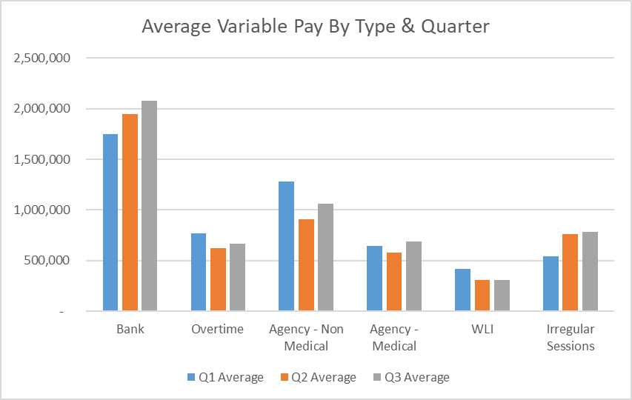
Summary Variable Pay
Variable Pay Target - the HB set a target for variable pay to be reduced by 25% versus the average spend in Q1 by the end of Q2, with a further 25% reduction at the end of Q3. To meet this target would require variable pay spend to reduce to £4.0m at Q2 and to be down to £3m by month 9. The actual variable pay spend at Month 9 was £5.1m, £2.1m short of the target set.
Notes:
This is a generic copy slide.

Slide 6
Summary of Savings Position @ Mth 9
Notes:
This is a generic copy slide.

Slide 7
Actions Underway and WG meeting feedback
Actions Summary
Agency “ban” in place with Quality Impact Assessment process in place to aid decision making.
Executive Director sign off in working hours (relevant to professional area) Gold on call out of hours
Vacancy freeze in place
CHC approach under development
Investment review underway
Morriston and Mental Health and Learning Disabilities escalated with recovery plan meeting scheduled with CEO for 8th January 2025
Recovery and Sustainability Board Friday 10th January 2025
WG meeting feedback
Meeting 6th January 2025 to discuss Health Board forecast
4 HBs having these discussions (where WG deems a risk to target delivery)
Presentation given which highlighted key points from presentation to Board and discussion at Board
WG line of enquiry specifically on delivery confidence of £43.7m control total
Limited confidence given on impact of actions set out on this page as no ledger impact assessed yet
HB asked to profile the recovery through Monthly Monitoring Returns (MMR)
Next meeting 16th January 2025 (with NHS Executive Finance Planning and Delivery Team) to review month 9 and profiling of monitoring return
Clear messaging that HB is doing all it can with full transparency on the numbers and the component parts of the plan
Clear messaging that planned care cessation not an option in this plan
WG acknowledged understanding of the position, but Health Board must deliver significant improvement in financial position to achieve £43.7m deficit total.
Notes:
This is a generic copy slide.

