Slide 1
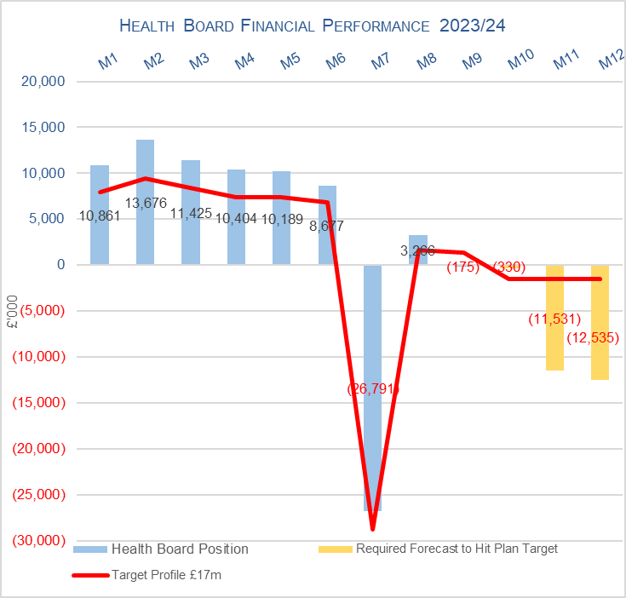

Health Board Reported Position @ Mth 9 2023/24

Slide 2
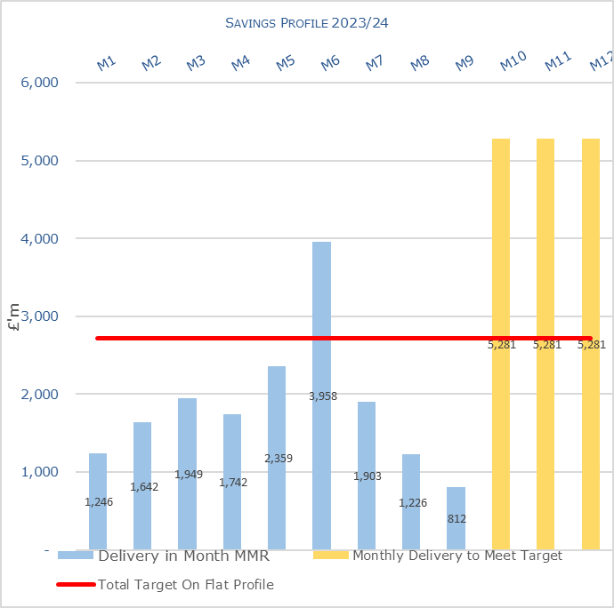
Health Board Savings @ Mth 9 2023/24

Slide 3
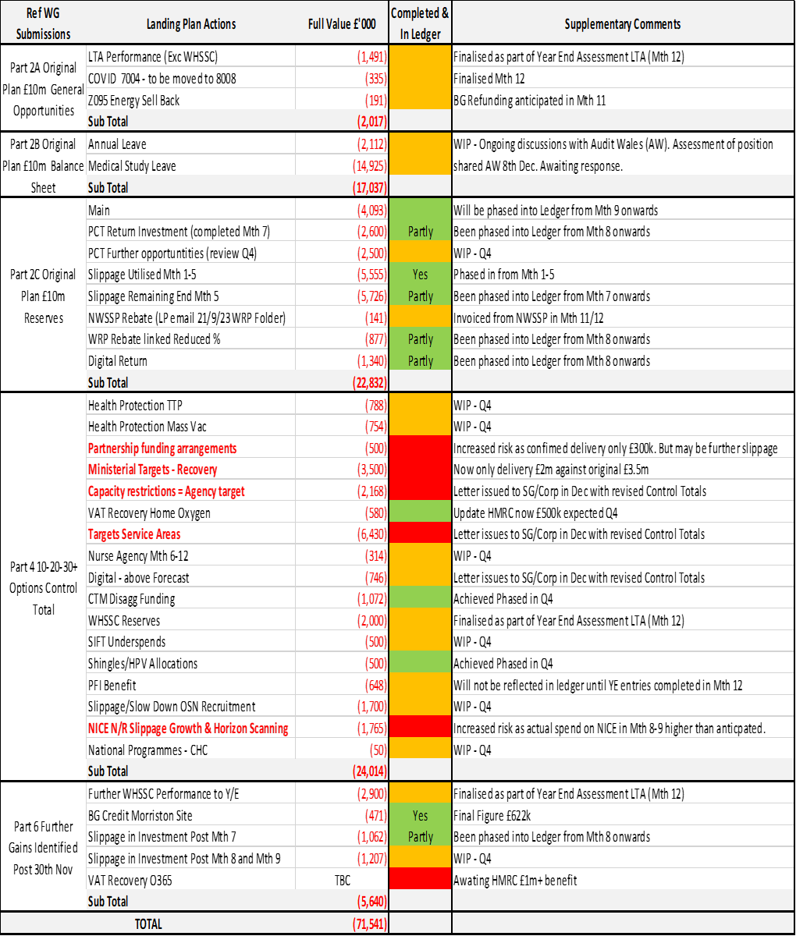
2023/24 Landing Plan

Slide 4
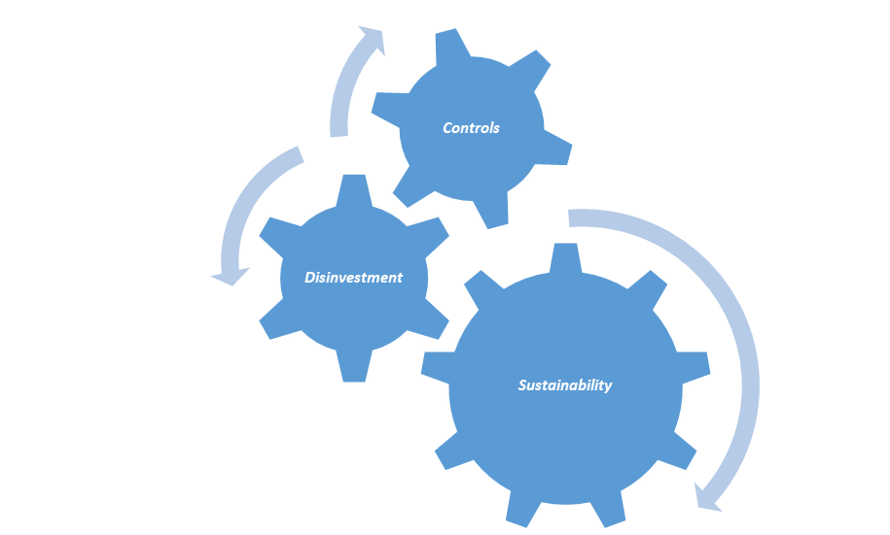
2024/25 Financial Plan
21st December 2023 WG published 2024/25 Allocation Letter. Key points of note in the letter:
  Funding for the NHS Pay Awards in 2024/25 will be held centrally and allocated to employers once the Awards are agreed during the Financial Year.
  Funding for the national COVID responses including Mass Vaccinations, Test, Trace and Protect (TTP) and PPE has been included in the 2024/25 baseline based on 80% of the Month 8 2023/24 forecast level of expenditure (£9.3m) with the full value of existing Long COVID funding also included in the baseline (£1.0m).
  Discretionary Allocations (Table A) – HB allocations have been increased by £96.0m, which includes:
    £43.3m, as confirmed in 2023/24, to reduce the original planned deficit (therefore not available to issue to budget holders);
    £31.5m for core costs, which equates to approximately a 3.67% uplift. This compares to 1.5% in 2023/24;
    £8.1m for Energy (£7.8m received in 2023/24) based on the Month 8 2023/24 forecast level of expenditure.
  Planned & Unscheduled Care Sustainability funding (COVID Recovery) was previously split, with £120m allocated as core and £50m held centrally to support regional approaches across Wales. The regional £50m has now been allocated to HBs based on the 2023/24 share of the allocation. For Swansea Bay this is £19.5m.
Financial Plan – work is underway on assessment of the 2024/25 plan. Underlying principles of plan:
  Clear message from WG is this is a plan for sustainability
  Expectation of strong cost controls and requirement to operate within the allocations provided
  Plan need to focus on choices and disinvestments to meet expectations from WG

