Slide 1
Finance Update M9 – 25/26
Audit Committee
15th January 2026
Notes:
This slide can be used for presentations which are from a health board-wide perspective or for a whole HB audience as the graphic device to the right of the slide includes all four service group colours and red for the corporate team.

Slide 2
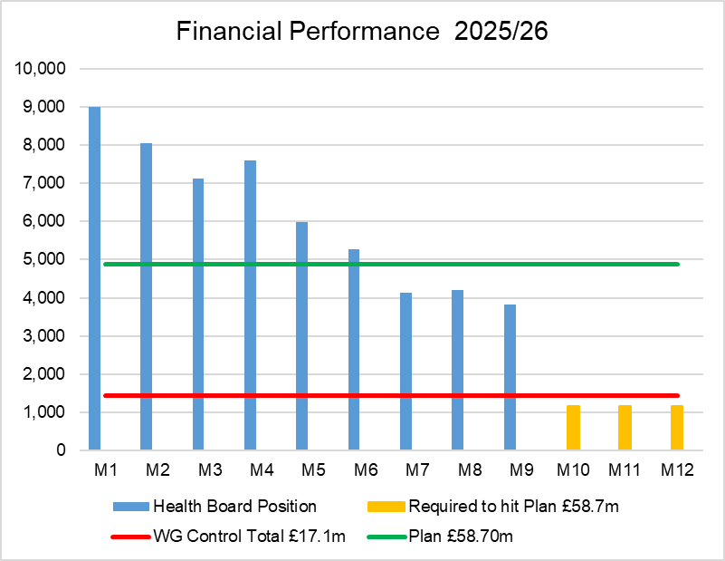
Financial Performance Month 09
The Plan submitted at the end of March, which has not been approved, reported a £58.7m deficit with a requirement to deliver £55.4m of savings. The Control Total for the Health Board set by Welsh Government remains £17.1m.
The table below provides the Variance and the Performance against the £58.7m Deficit Plan for 2025/26:
In Month 09 there is an in-month overspend of £3.8m. This is £1.1m below the planned deficit of £4.9m (1/12th of the £58.7m).
At Month 09 the YTD overspend is £55.2m. This is £11.2m above the planned deficit of £44m (9/12th of the £58.7m).
Notes:
This is a generic copy slide.

Slide 3
In Month Reconciliation of Variance by Area & Expenditure Type
Notes:
This is a generic copy slide.

Slide 4
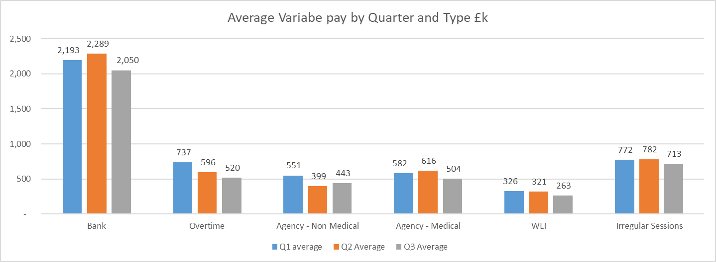
Summary Variable Pay
The actual variable pay spend at Month 9 was £4.2m. A detailed breakdown of variable pay by month, type and job family can be found in Appendix 1.
Notes:
This is a generic copy slide.

Slide 5
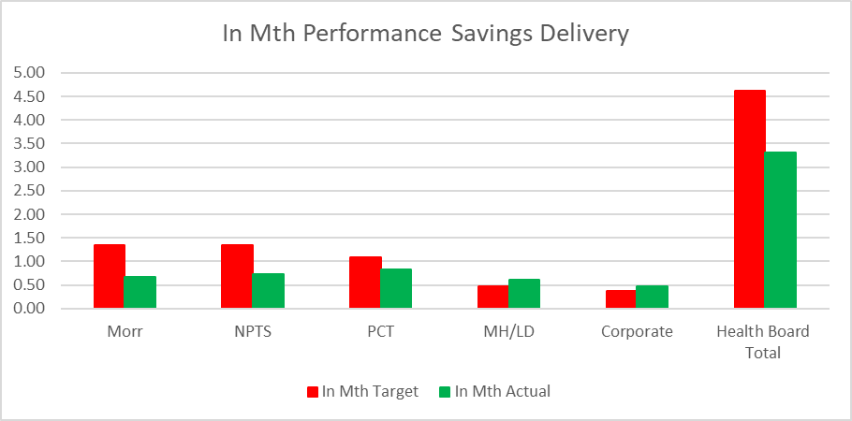
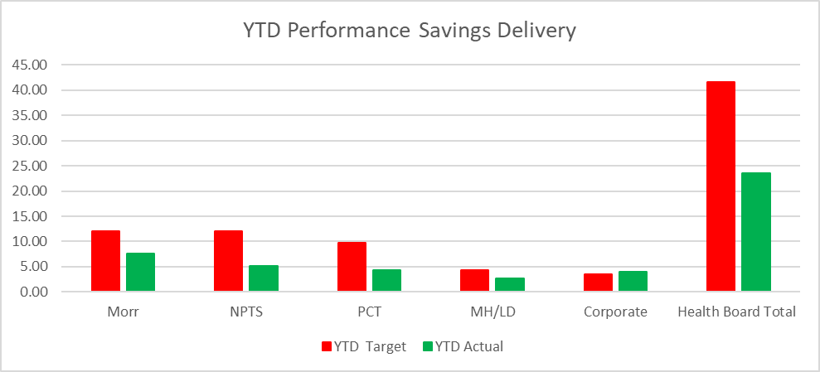
Summary of Savings £55.4m Savings Delivery @ Month 09
The two graphs above demonstrate the performance by Service Group, Corporate Directorates and the combined overall Health Board Total for the Savings Position for Month 9 and the Year-To Date, with red bars reflecting the target required and the green bars the actual delivery.
In summary the £58.7m plan required the Health Board to deliver £55.4m of savings. In month 9 there was an underachievement of savings totalling £1.3m. YTD there remains a shortfall of £18.0m. This is one of the key issue in the delivery of the 2025/26 financial position.
Notes:
This is a generic copy slide.

Slide 6
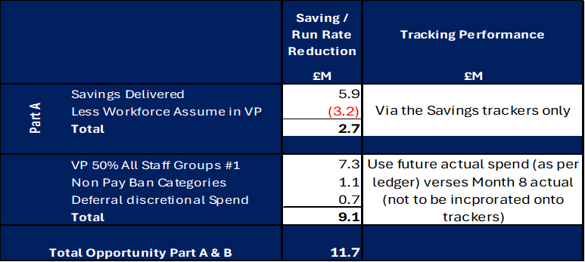
Performance Against 11th September £55.4m Savings Plan @ Mth 9
Plan v Forecast Delivery
Forecast Delivery Mth 8 v Mth 9
Reminder – Board approved Plan
Notes:
This is a generic copy slide.

Slide 7
Initial Outlook 2026/27
Notes:
This slide can be used for presentations which are from a health board-wide perspective or for a whole HB audience as the graphic device to the right of the slide includes all four service group colours and red for the corporate team.

Slide 8
2026/27 Initial Outlook – Overview
 | £M
Opening Plan 26/27 | 58.7
Non-Delivery of Savings 25/26 | 35.0
SG In-year changes | 15.6
Additional SG In-year changes | 2.2
HB-wide changes | 7.0
WRP R Pressure | 5.4
Financial Assessment 2025/26 into 2026/27 | 124.0
National Pressures | 13.8
Local Inflation | 20.3
Local Growth | 20.7
Commissioning LTA | 2.9
Provider LTA | 2.7
SLA | 0.2
WG Funding Allocation | (12.5)
Savings Target | (44.4)
Plan version 1 | 127.7
Orange figures – Health Board direct influence and control Green – fixed Blue – further scrutiny and challenge The overall plan figure of £127.7m is predicated largely on the £124.0m 2025/26 assessment. This consists of building on the opening plan of £58.7m as follows: A1: Non-delivery of 25/26 savings (£35.0m) A2: Service Group in-year changes (£15.6m) A3: Additional Service Group in-year changes (£2.2m) A4: HB-wide changes (£7.0m) A5: WRP R Pressure (£5.4m) This shows that the shortfall in Savings delivery in 25/26 has the largest impact on the formulation of the plan. It also has implications on the achievability of the £44.4m savings target for 26/27. Additional known and forecasted pressures are then added on: National Pressures Local inflation Local Growth Commissioning LTA Provider LTA SLA The WG funding allocation and savings targets are subsequently included to improve the deficit plan. WG funding allocation Savings Target – based on 4% as per previous plan – 1% approximately equal to £12m

Slide 9
Appendices
Notes:
This slide can be used for presentations which are from a health board-wide perspective or for a whole HB audience as the graphic device to the right of the slide includes all four service group colours and red for the corporate team.

Slide 10

Appendix 1 - Variable Pay Breakdown
Notes:
This is a generic copy slide.

