Slide 1
Summary Financial Position
Month 01 FY 2025/26
Audit Committee 21 May 2025
Notes:
This slide can be used for presentations which are from a health board-wide perspective or for a whole HB audience as the graphic device to the right of the slide includes all four service group colours and red for the corporate team.

Slide 2
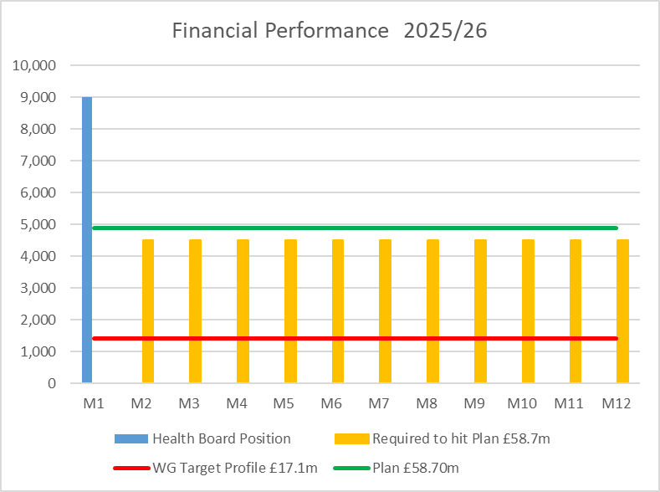

Financial Performance Month 01
 | In Mth |  | YTD
 | £'m | RAG | £'m | RAG
Performance Against RRL | 9.0 |  | 9.0
Perfomance Against £58.7m Plan | 4.1 |  | 4.1
The Plan submitted at the end of March, which has not been approved reported a £58.7m deficit with a requirement to deliver £55.4m of savings.
The control total for 2025/26 set by Welsh Government remains £17.1m.
In Month 01 there is an in-month overspend of £9.0m. This is £4.1m above the planned deficit of £4.9m (1/12th of the £58.7m)
In order to maintain the £58.7m planned deficit, the HB needs to recover the month 1 overspend of £4.1m in future months.
Notes:
This is a generic copy slide.

Slide 3

In Month reconciliation of variance by Area & spend type
Notes:
This is a generic copy slide.

Slide 4
Month 01 variance by Area
Notes:
This is a generic copy slide.

Slide 5
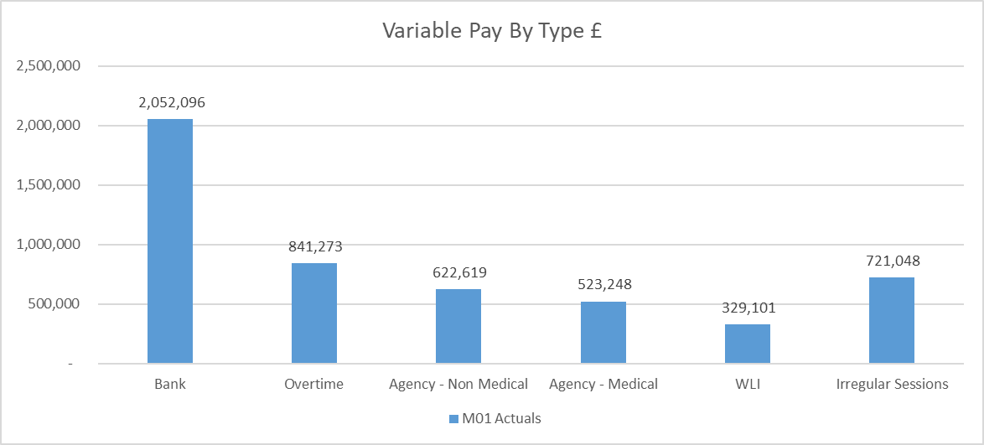
Summary Variable Pay
The actual variable pay spend at Month 1 was £5.1m. A detailed breakdown of variable pay by month, type and job family can be found in Appendix 1.
Notes:
This is a generic copy slide.

Slide 6
Summary of Savings Position @ Mth 01
Notes:
This is a generic copy slide.

Slide 7
Appendices
Notes:
This slide can be used for presentations which are from a health board-wide perspective or for a whole HB audience as the graphic device to the right of the slide includes all four service group colours and red for the corporate team.

Slide 8
Appendix 1 - Variable Pay Breakdown
Notes:
This is a generic copy slide.

