Slide 1




Charitable Funds Finance Update Report
Alison McLennan
Assistant Director of Finance & Performance
Agenda Item 5.1
18th March 2025

Slide 2

FINANCIAL POSITION OVERVIEW
Page 2
 | 1st April 2023 to 31st January 2024 £ | 1st April 2024 to 31st January 2025 £
Donations | (307,801) | (508,298)
Legacies | (45,298) | (337,207)
Dividends & Interest | (101,659) | (109,536)
Grants | (75,445) | (11,045)
Fundraising Income | (51,821) | (40,306)
Sponsorship Income | - | (1,100)
Total Income | (582,024) | (1,007,491)
Expenditure | 876,622 | 1,020,350
Net expenditure before other gains/losses | 294,598 | 12,859
Realised (Gains)/Losses | 4,230 | (66,900)
Unrealised (Gains)/Losses | (184,084) | (34,321)
Net Movement Year to Date | 114,744 | (88,363)
There has been a net increase in funds of £88k for the first ten months of this financial year compared to a net reduction of £115k in the same period last year. Net expenditure was £282k lower (total income is £425k higher and total expenditure is higher by £144k so far in year). Also, total net investment gains are £79k lower.

Slide 3
INVESTMENT PORTFOLIO POSITION
Page 3
 | 31st March 2023 £ | 31st March 2024 £ | 30th June 2024 £ | 30th Sept 2024 £ | 31st Dec 2024 £ | Unrealised Gain / (Loss) in 2024/25 £
Book Value | 4,418,409 | 4,211,523 | 4,228,123 | 4,183,322 | 4,204,811
Market Value | 4,730,732 | 4,817,251 | 4,799,884 | 4,840,188 | 4,844,860
Unrealised Gain / (Loss) | 312,323 | 605,728 | 571,761 | 656,866 | 640,049 | 34,321
Cumulative unrealised gains have increased overall by £34k during the 2024-25 financial year when compared to the year- end value. The portfolio value is updated quarterly.

Slide 4
FUND BALANCES
Page 4
Overall fund balances have increased by £0.088m this financial year to date. The main movements are an increase in the total cash held locally offset by an increase in creditors and a decrease in debtors.
 | 31/03/24 | 31/01/2025 | Movement
 | £ | £ | £
Investments (Stocks & Shares) | 4,817,251 | 4,841,200 | 23,949
Investments – Cash | 65,308 | 30,833 | (34,475)
Investment | 62,500 | 62,500 | 0
Property
Total Investment Portfolio | 4,945,059 | 4,934,533 | (10,526)
Cash Held Locally | 122,389 | 330,503 | 208,114
Debtors | 144,252 | 73,532 | (70,720)
Creditors | (69,474) | (107,978) | (38,505)
Total Value of Funds | 5,142,226 | 5,230,589 | 88,363

Slide 5
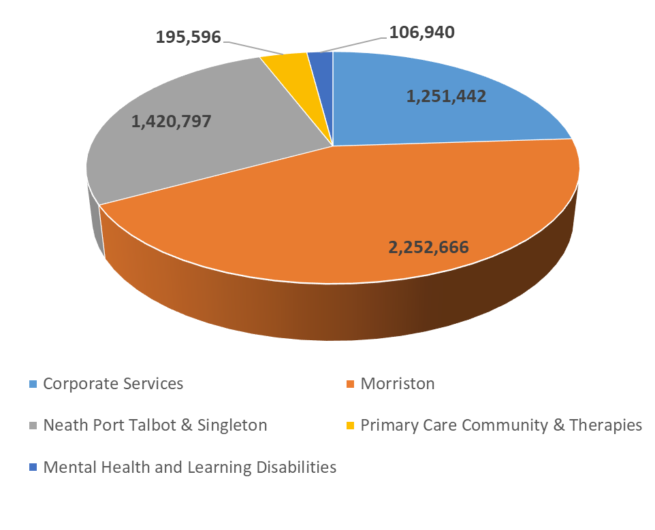
FUND BALANCES BY SERVICE GROUP
Page 5
The Corporate Services balance includes the Finance Admin Fund which holds the gains and losses on the investment portfolio.

Slide 6
INCOME AND EXPENDITURE BY SERVICE GROUP
Page 6
Income is higher by £344k and expenditure is higher by £144k for the ten months to date of 2024/25 as compared to the same period in 2023/24. Most of this movement is in the Morriston service group. Income in corporate services includes the investment portfolio gains and losses, note there were higher net gains last year within this income (by £82k).
 | Income April 2023 to January 2024 £ | Income April 2024 to January 2025 £ | Expenditure April 2023 to January 2024 £ | Expenditure April 2024 to January 2025 £
Corporate Services | 376,053 | 223,839 | 380,081 | 373,786
Morriston | 175,220 | 592,074 | 174,225 | 281,350
Neath Port Talbot & Singleton | 188,805 | 277,105 | 301,550 | 334,279
Primary Care & Community Services | 12,099 | 10,285 | 14,889 | 20,550
Mental Health & LD | 9,578 | 2,262 | 5,877 | 10,384
Total | 761,755 | 1,105,566 | 876,622 | 1,020,350

Slide 7
TOP 10 FUNDS BY VALUE
Page 7

Slide 8
TOP 10 FUNDS BY DONATIONS
Page 8
Top 10 funds by donations account for 70% of all donations received to date.

Slide 9
Highest spending funds
Page 9
The 10 highest spending funds account for 80% of expenditure to date.

Slide 10
FUND USAGE
Page 10
Dormant funds number 126 and account for 47% of the funds covering 15% of the total fund value. There were 104 dormant funds in the same period last year (Jan 2024).

Slide 11


AGE OF DORMANT FUNDS
Page 11
2024/25 Dormant Funds also of those dormant funds, which were also in Previous Financial Years
List of Funds Dormant since 2019/20
Year | Number of Funds | Value
2024/25 | 126 | 796,034
2023/24 | 71 | 255,371
2022/23 | 51 | 217,441
2021/22 | 31 | 77,923
2020/21 | 23 | 47,205
2019/20 | 8 | 12,663
Fund Name | Fund Balance £
YF16-West Endocrine Research | 909
YG07-West Trauma Unit | 232
YJ02-West Histo/Cytopathology | 828
YK09-West ENT Respiratory Symposium | 2,519
YK28-West Ophthalmic Education | 3,995
YK29-West Childrens Eye | 2,969
YK31-West Eye T | 990
YR11-Ty Einon | 220
Total | 12,663
* As at 31.01.25
Update on funds dormant since 2019/20. One fund has closed since last update. All fund managers have been contacted again in February 2025, following the new escalation process agreed previously by CFC. The Charitable funds Finance Manager to also review.

Slide 12
FUND CHANGES FROM LAST REPORT TO DATE
Page 12
1 New Fund requested, 1 has been reopened, and 1 has been closed from last report to 31.01.25
New Funds Opened | Fund Number | Reason | Date
Fund Name
Head and Neck Oncology Charity (HANOC) | YB56 | For Education, equipment, resources and social/support groups to enhance patient care, experience and recovery | 01.11.24
Reopened Funds | Fund Number | Reason | Date
Singleton Acute Medical Day Unit | YN17 | Fund was requested a few years ago but not donations had been received and was closed in 2020. Now donations have been received in the form of cheques so requesting the fund is reopened. | 16.12.24
Closed Funds | Fund Number | Reason | Date
West Shickle Fund | YN70 | Transfer of fund balace to Health Centre the Shickle Fund relates to as no longer a managed service by the Heath Board | 28.10.24

Slide 13
CASH POSITION
Page 13
The locally held cash balance as at the end of January 2025 was £0.331m. Despite the increase in recent months, the cash balance has decreased from the normal level of cash held in previous periods.

Slide 14
Legacies received
Page 14
Nine legacies have been received in the first 10 months of the current financial year as detailed below.
(1st April 2024 to 31st January 2025). There are 19 open legacies in total.
Service Group | Benefactor | Fund Name | Legacy Received 01.04.24 - 31.01.25 £
NPTS | GJ | South West Wales Cancer Centre | 500
Morriston | GJ | West Stoma Care | 500
NPTS | HDT | South West Wales Cancer Centre | 1,801
Morriston | ER | Morriston General Patients & Staff | 240,906
Health Board | NM | Helping Hand Fund | 1,500
Morriston | EMH | West Neurology | 50,000
NPTS | GRL | South West Wales Cancer Centre | 2,000
Morriston | JDLM | West Cardiac Centre | 1,000
Morriston | KR | Sarcoma Fund | 39,000
Morriston | ER | Morriston General Patients & Staff | 138,000
 |  | Total | 475,207

Slide 15
RESERVES PERFORMANCE
Page 15
The Reserves Policy states that the level of reserves held should be within 1 and 4 years average annual expenditure comprising the total fund balance less unrealised gains. This policy used to be between 1 and 3 years before this change was agreed in the December 2022 Charitable Funds Committee. This target has therefore consistently been achieved, although it peaked at 3.73 years in August 2023.

Slide 16
FINANCE ADMIN FUND FINANCIAL HIGHLIGHTS
Page 16
Opening Balance as at 1st April 2024 | 1,064,036
Dividends and Interest | 108,529
Gains and Losses | 98,074
Governance Costs | (81,689)
Charity Team Staff Costs | (141,163)
Fundraising costs | (21,502)
Investment Management Fees | (12,829)
Current Balance | 1,013,456
Ongoing Commitments and anticipated income 2024/25
Dividends and Interest | 33,663
Gains and Losses | 0
Governance Costs | (11,785)
Charity Team Staff Costs | (48,795)
Fundraising costs | (1,090)
Investment Management Fees | (12,171)
Total | -40,178
Forecast Year End Balance | 973,278
Notes
- Governance Costs include bank charges, external audit fees, the dedicated finance analyst supporting charitable funds and the overhead charge from the health board for procurement, accounts payable, accounts receivable etc.
Fundraising costs include non pay costs associated with fundraising including items purchased for fundraising events and the cost of donation platforms such as Just Giving and Enthuse.

Slide 17
FINANCE ADMIN FUND FORECAST
Page 17
Forecast Full year Movement | £
Dividends and Interest | 142,191
Gains and Losses | 98,074
Governance Costs | (93,474)
Fundraising Staff Costs | (189,958)
Fundraising Non-Staff Costs | (22,592)
Investment Management Fees | (25,000)
Forecast In Year Movement | 90,759
Notes
The forecast fundraising staff costs are taken from the 5-year Financial Plan.

Slide 18
Fundraising income and expenditure comparison
Page 18
Fundraising Income 2024-25 (up to 31.01.2025) | £
Y653-Singleton General Purpose | 299 |  | Raffle
Y664-Helping Hand Fund | 118 |  | CHOOSE2REUSE
Y667-Africa Health Links | 5792 |  | Raffle & fundriaser
YB34-South West Wales Cancer Fund | 6550 |  | Raffles and tea bars
YB39-West Traumatic Brain Injury Service | 97 |  | Fundraising
YB49-20th Anniversary Cancer Support Fund | 735 |  | Raffle
YB50-SeaRAD (SBU Radiotherapy Research Fellow Fund) | 22728 |  | Jiffy Ride
YD06-Pharmacy Fund | 115 |  | Raffle
YF35-West MS Specialist Team | 402 |  | Raffle
YH20-NICU Accommodation Fund | 428 |  | Raffles and tea bars
YK02-West Mastectomy | 675 |  | Funraising awarnes day
YN21-NPTH Neuro Rehab Patients & Staff Fund | 350 |  | Raffle
YN34-West Physiotherapy Fund | 583 |  | 12 Hour Cycle-A-Thon Physio Team
YN35-NPT Children’s Centre Therpay Fund | 300 |  | Raffle
YP21-Arts in Health | 1144 |  | Sale of Artworks
YR50-CAMHS Charitable Fund | -10 |  | Raffle (coding error)
Total | 40306
Fundraising expenditure 2024-25 (up to 31.01.2025)
Fundraising Staff Costs | 141184
Fundraising Non Staff Costs | 56942
Total | 198126
Shortfall** | -157820
** This is an element but overall performance of the charity will be accounted for by the financial plan and the performance against it

Slide 19
12 months breakdown of income and expenditure
Page 19
Income relates to Donations, Legacies, Grants and Fundraising Income only and does not include Dividend Interest or Investment Gains or Losses. High grants value in February relates to Arts in Health grants. High value of legacies in August 2024 relates to one large legacy for the Morriston Service Group. High value of fundraising income in January 2025 relates to Jiffy Ride monies
High governance costs in March relates to audit fee accrual which reversed in April, and high cost in January relates to audit fee invoice being paid. High expenditure in February 24 due to £85k scanner purchased.

Slide 20
GENERAL CHARITY RISKS/ISSUES
Page 20
Issues
Finalisation of the charity plan to enable continuous monitoring of plan vs actual.
Whilst the staffing budget for the Charity Team has been approved by the CFC, there is currently no approved non pay budget until the financial plan is approved
Agreement of the proposed overhead to support the finance admin fund and fixed costs of the charity to be agreed.
Risks
It has been discussed previously that the fixed costs of the charity need to be covered either through realising gains on the investment portfolio, increased income, applying a fundraising administration fee charged on fundraising events supported by the team, or by applying an administration fee across all funds.
The CFC previously agreed that the investment policy should be amended to request that Brewin Dolphin generate £220k of income per annum. Raising £220k per annum has meant reducing the portfolio value by selling investments and so was only sustainable in the short term. Therefore from 24-25, alternative sources of funding will be required to support the administration costs of the charity and the cash withdrawal requirements from Brewin Dolphin adjusted accordingly.

Slide 21
CHARITY DECISION POINTS
Page 21
Short Term Considerations
Investment Strategy - £220k per annum withdrawal from the portfolio is unsustainable – consider reducing to £130k per annum for year 1 and 2 of the financial plan, allowing growth in the investment portfolio
Consider an increased risk in the portfolio to risk factor 7 (currently 6) to allow for potential increased growth at a higher risk
Alternatively consider continuation of the £220k pa withdrawal and portfolio reduces steadily
Consider introduction of an overhead charge across majority of funds – between 8 and 10% is required to bolster finance admin fund and cover charity team and administration costs.
Preferred investment strategy, helping hand and overhead charge recommendations to be proposed to HB Chair.
Long Term
Continue helpful discussions simplifying the administration of the charity
Review the proposed overhead - should it be more realistic given other benchmarked charities?
Consider options to shift balance of funds held in restricted funds to unrestricted funds via admin charge and increased charitable income activities

Slide 22
FINANCIAL CONTROLS AND GOVERNANCE
Page 22
Audit Wales update (Accounts have been approved and Charity Commission Website updated by 31st January deadline)
Annual Report for 2023/24 was completed and submitted to Audit Wales during audit
Review of FCP20 & Charitable Expenditure Guidance (Agenda item)
Legacies – review of full will requirement with Audit Wales for review
Financial Controls requiring review and update in:
  Use of Charitable Funds Credit Card

