Slide 1

Charitable Funds Committee
June 2026
Patient / Staff Story
Charity Team:
Lewis Bradley: Interim Charity Manager
Cathy Stevens: Community Support Charity Officer
Catrin Jones: Digital fundraising & Engagement Officer

Slide 2
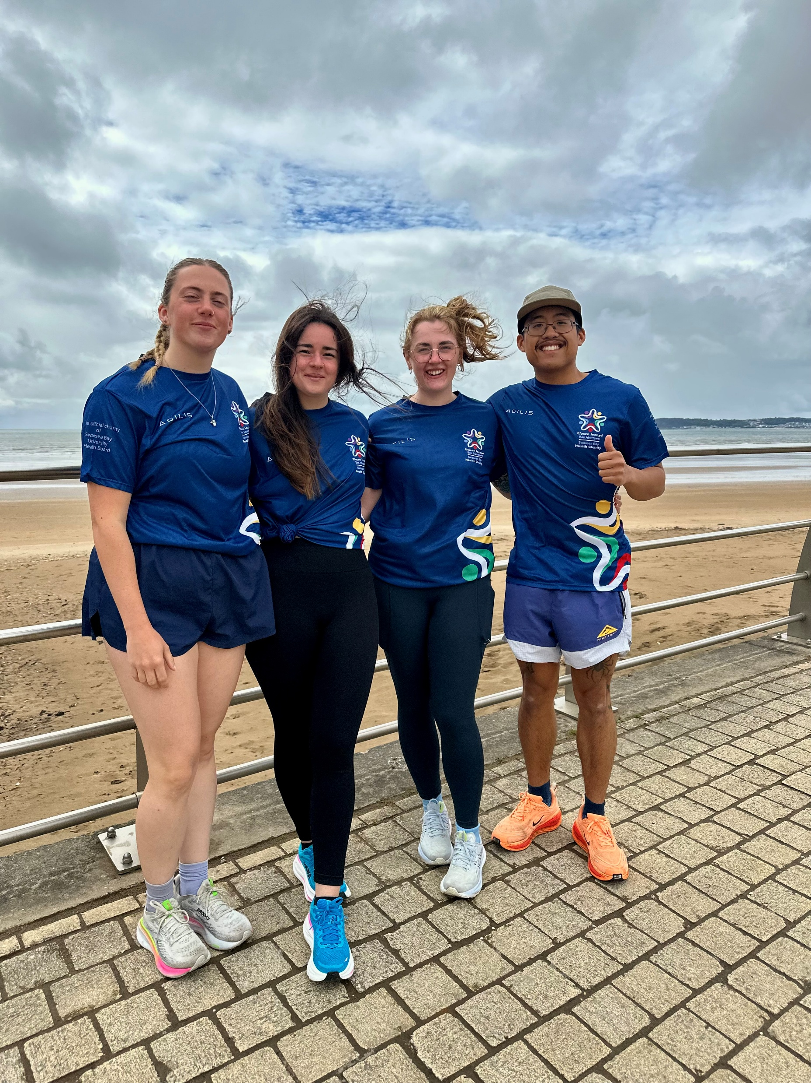
Staff Story
Team
Paediatric Pacers
Take on Swansea Half Marathon
Seven dedicated members of our paediatrics team will be taking on the challenge of running the Swansea Half Marathon, coming together with one shared goal: To improve the inpatient experience of the children in our care. Every step they take is in support of creating a more comfortable, supportive, and compassionate environment within the unit.
Why did you think about fundraising?
Family centred care is really important to us in paediatrics, and we want to facilitate a ‘home from home’ environment for patients and there families. Working on the wards, we can see first hand where we lack resources for these families and fundraising could help to improve this.
How do you think it will benefit your patients?
When children are in hospital, it can be a very stressful time for families. Providing them with essential items can help to alleviate the worries, so that they can focus on the child’s health.
How does it bring you closer together as a team?
We have been able to arrange multiple meet ups and practice runs (of course with a coffee stop afterwards!) supporting each other and motivating each other along the way. As nursing staff you spend long hours with colleagues and develop great working relationships. We have grown to gain great friendships, and we feel so lucky to have this team behind us

