Slide 1

Charitable Funds Committee
June 2026
Charity Team:
Lewis Bradley: Interim Charity Manager
Cathy Stevens: Community Support Charity Officer
Catrin Jones: Digital fundraising & Engagement Officer

Slide 2
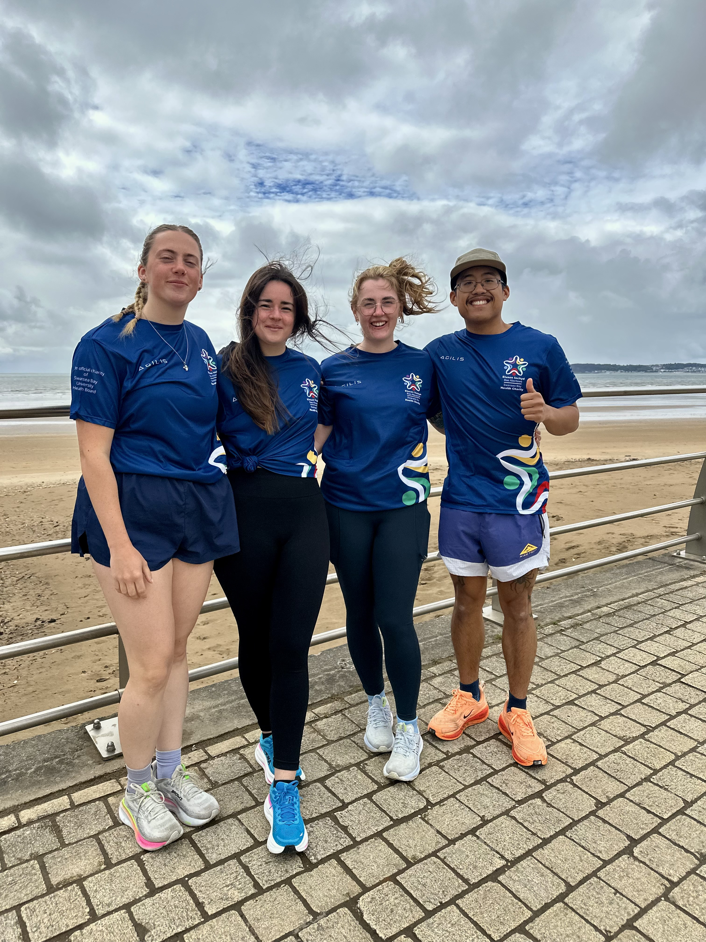
Staff Story
Team
Paediatric Pacers
Take on Swansea Half Marathon
Seven dedicated members of our paediatrics team will be taking on the challenge of running the Swansea Half Marathon, coming together with one shared goal: To improve the inpatient experience of the children in our care. Every step they take is in support of creating a more comfortable, supportive, and compassionate environment within the unit.
Why did you think about fundraising?
Family centred care is really important to us in paediatrics, and we want to facilitate a ‘home from home’ environment for patients and there families. Working on the wards, we can see first hand where we lack resources for these families and fundraising could help to improve this.
How do you think it will benefit your patients?
When children are in hospital, it can be a very stressful time for families. Providing them with essential items can help to alleviate the worries, so that they can focus on the child’s health.
How does it bring you closer together as a team?
We have been able to arrange multiple meet ups and practice runs (of course with a coffee stop afterwards!) supporting each other and motivating each other along the way. As nursing staff you spend long hours with colleagues and develop great working relationships. We have grown to gain great friendships, and we feel so lucky to have this team behind us

Slide 3



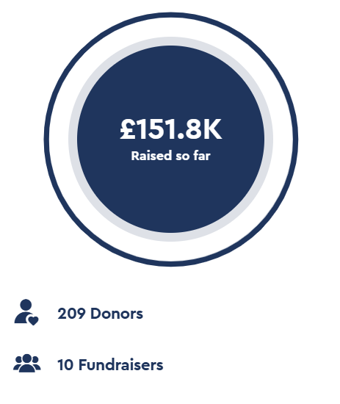
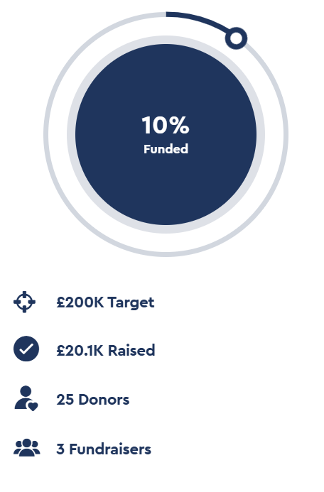
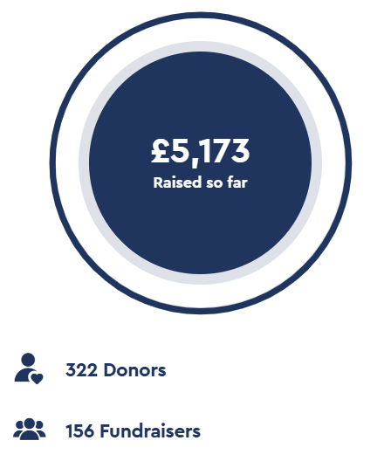
Appeals
To be included

Slide 4
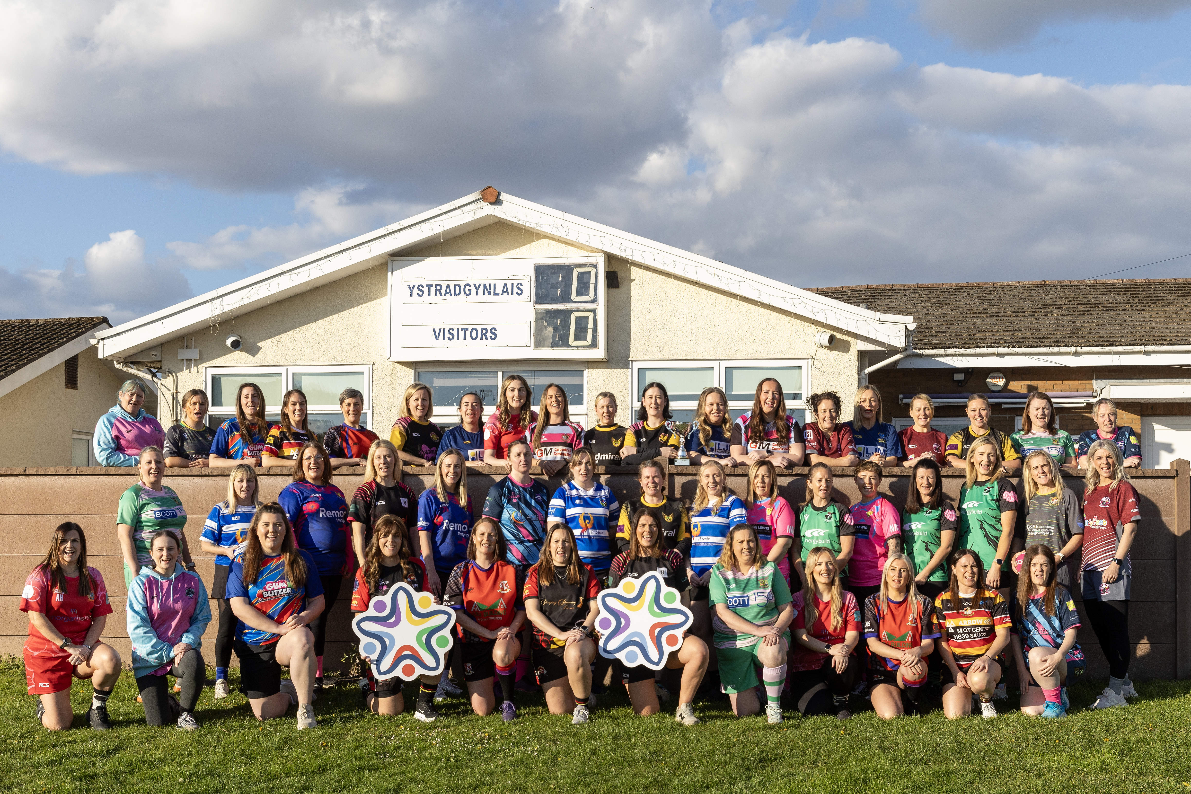

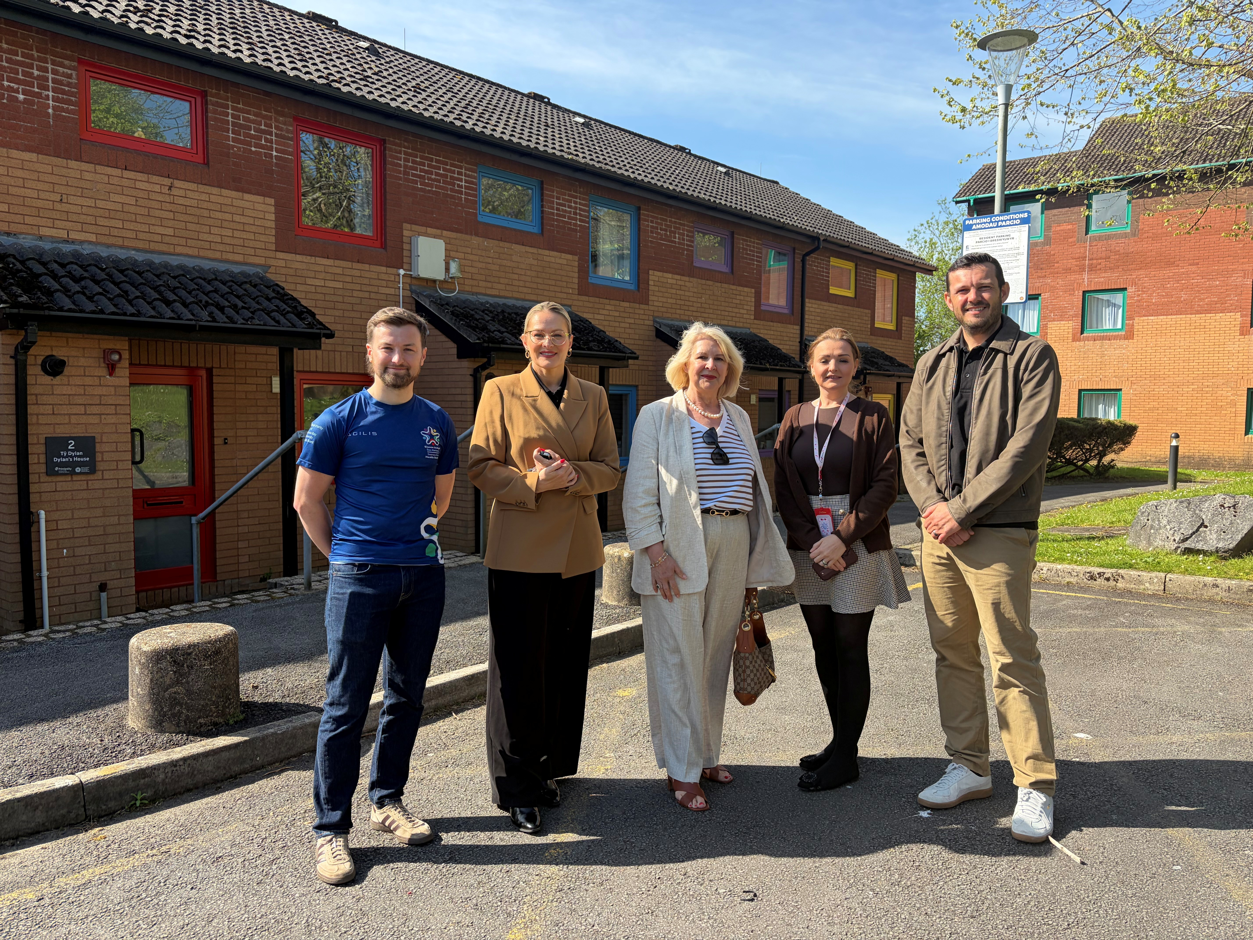
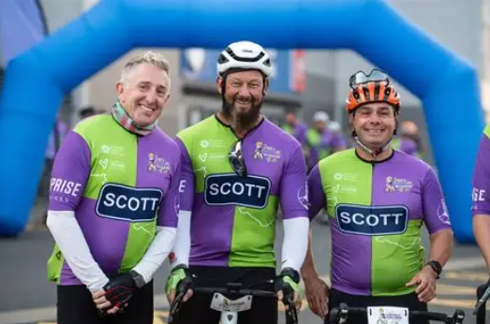

Corporate Partnerships
Supporting ‘Cwtsh Natur’ for 26-27 with income and events.
90% of ‘Touched By Cancer’ women's rugby tournament sponsorship places confirmed
Cwtsh Clos to benefit from 3 Years of Support from
John Pye Auctions & DVLA Partnership
(With a 2 year extension possibility)
A new ‘Charity of the Year’ partnership that will support the general fund
(2 years)
New sponsor agreement with Andrew Scott LTD including additional income and support for Jiffy’s Cancer 50 Challenge
(3 year deal)

Slide 5
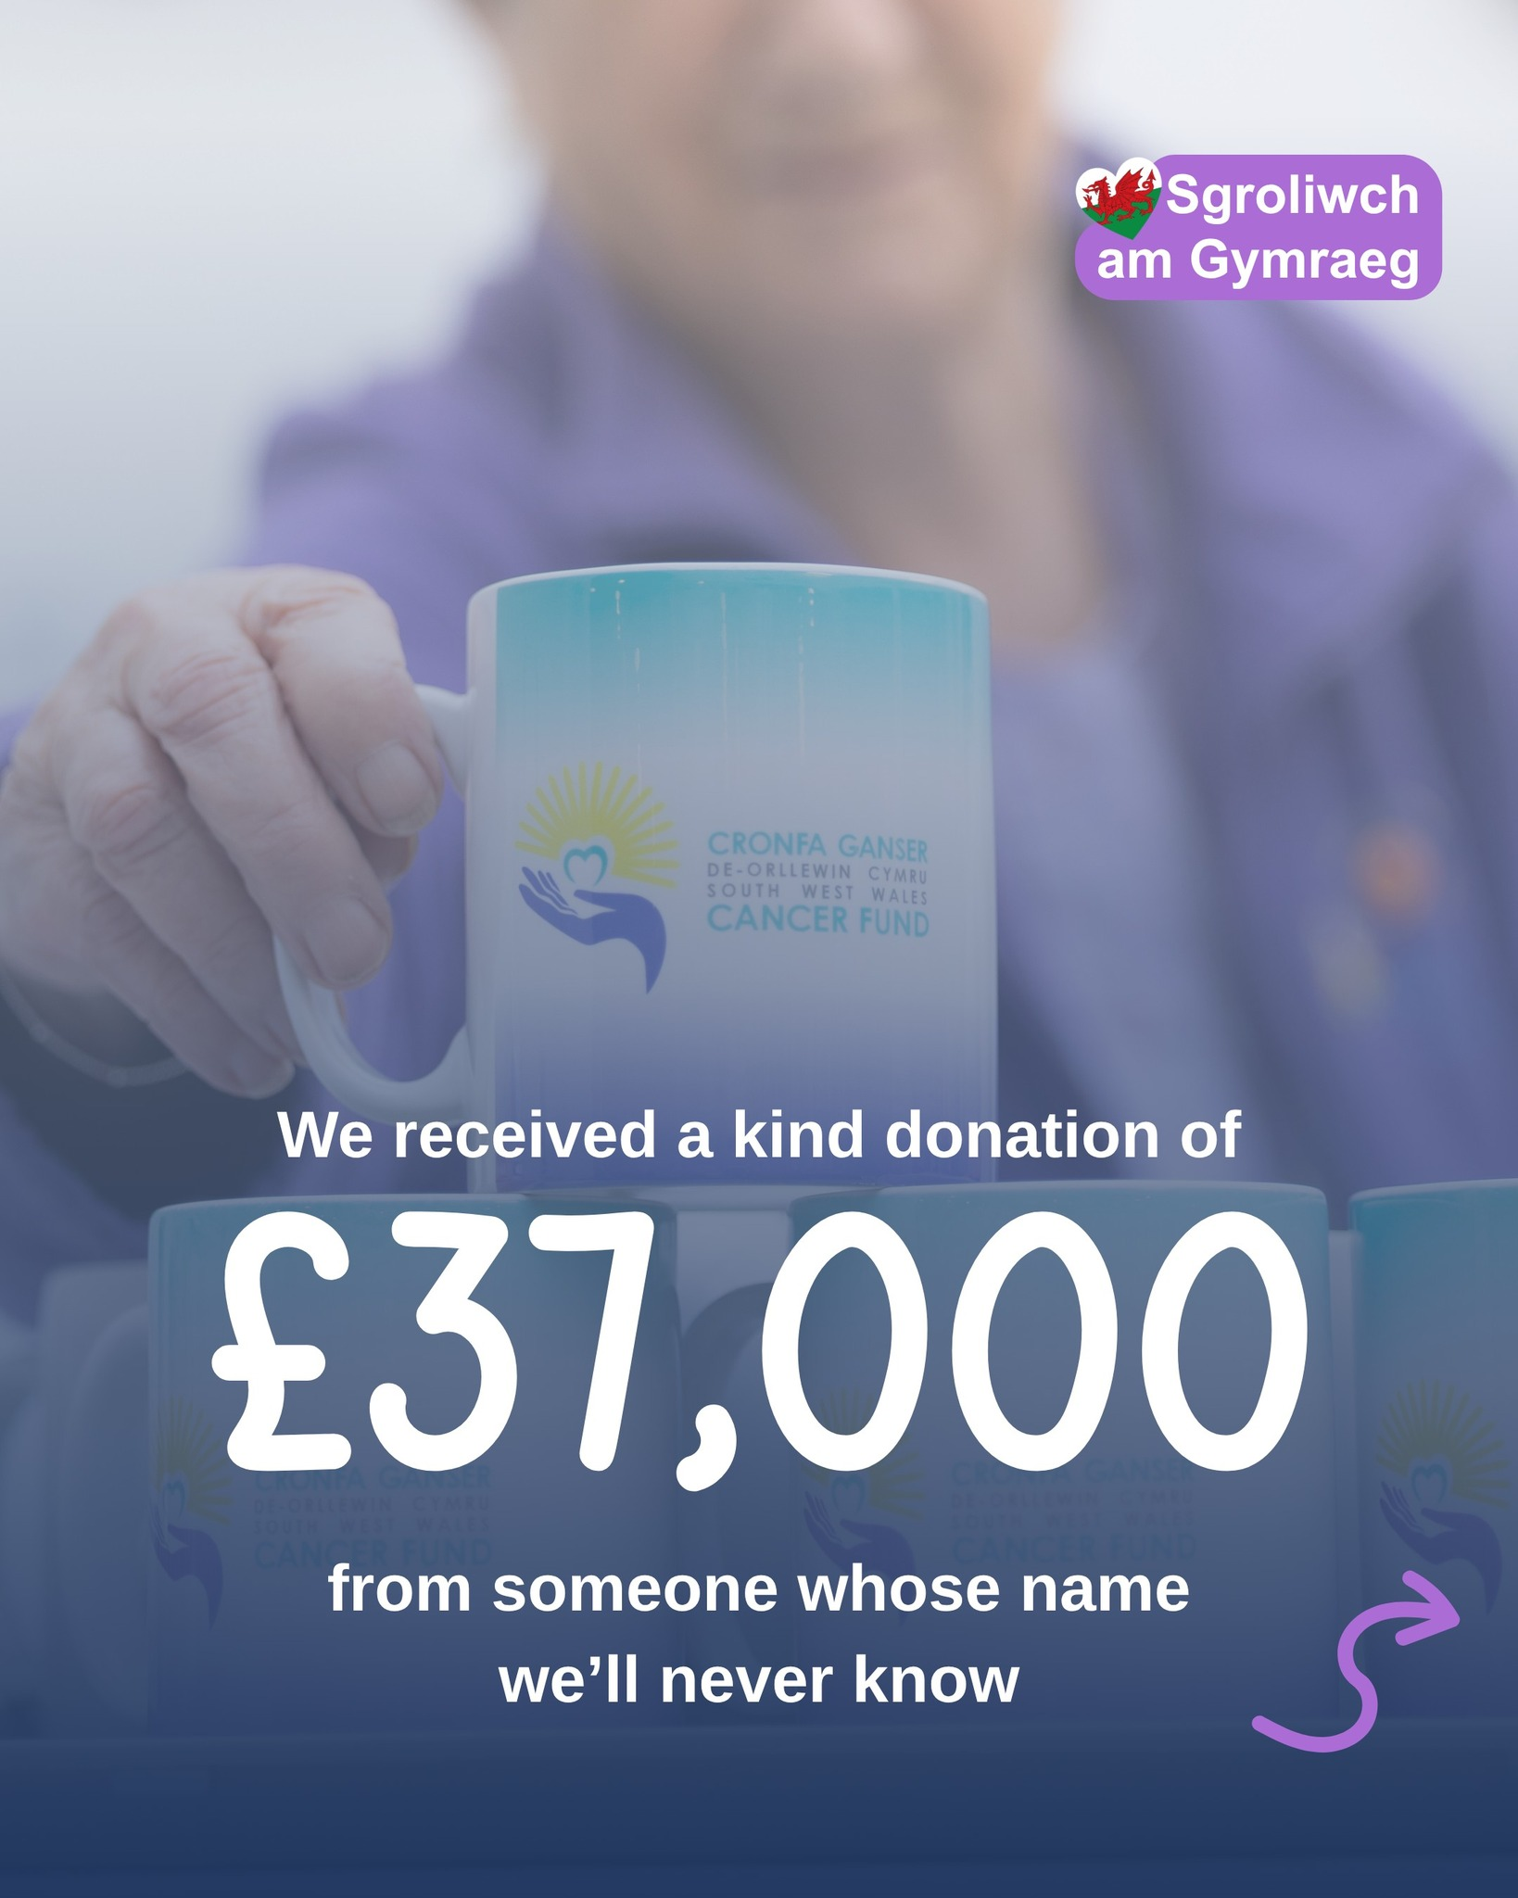
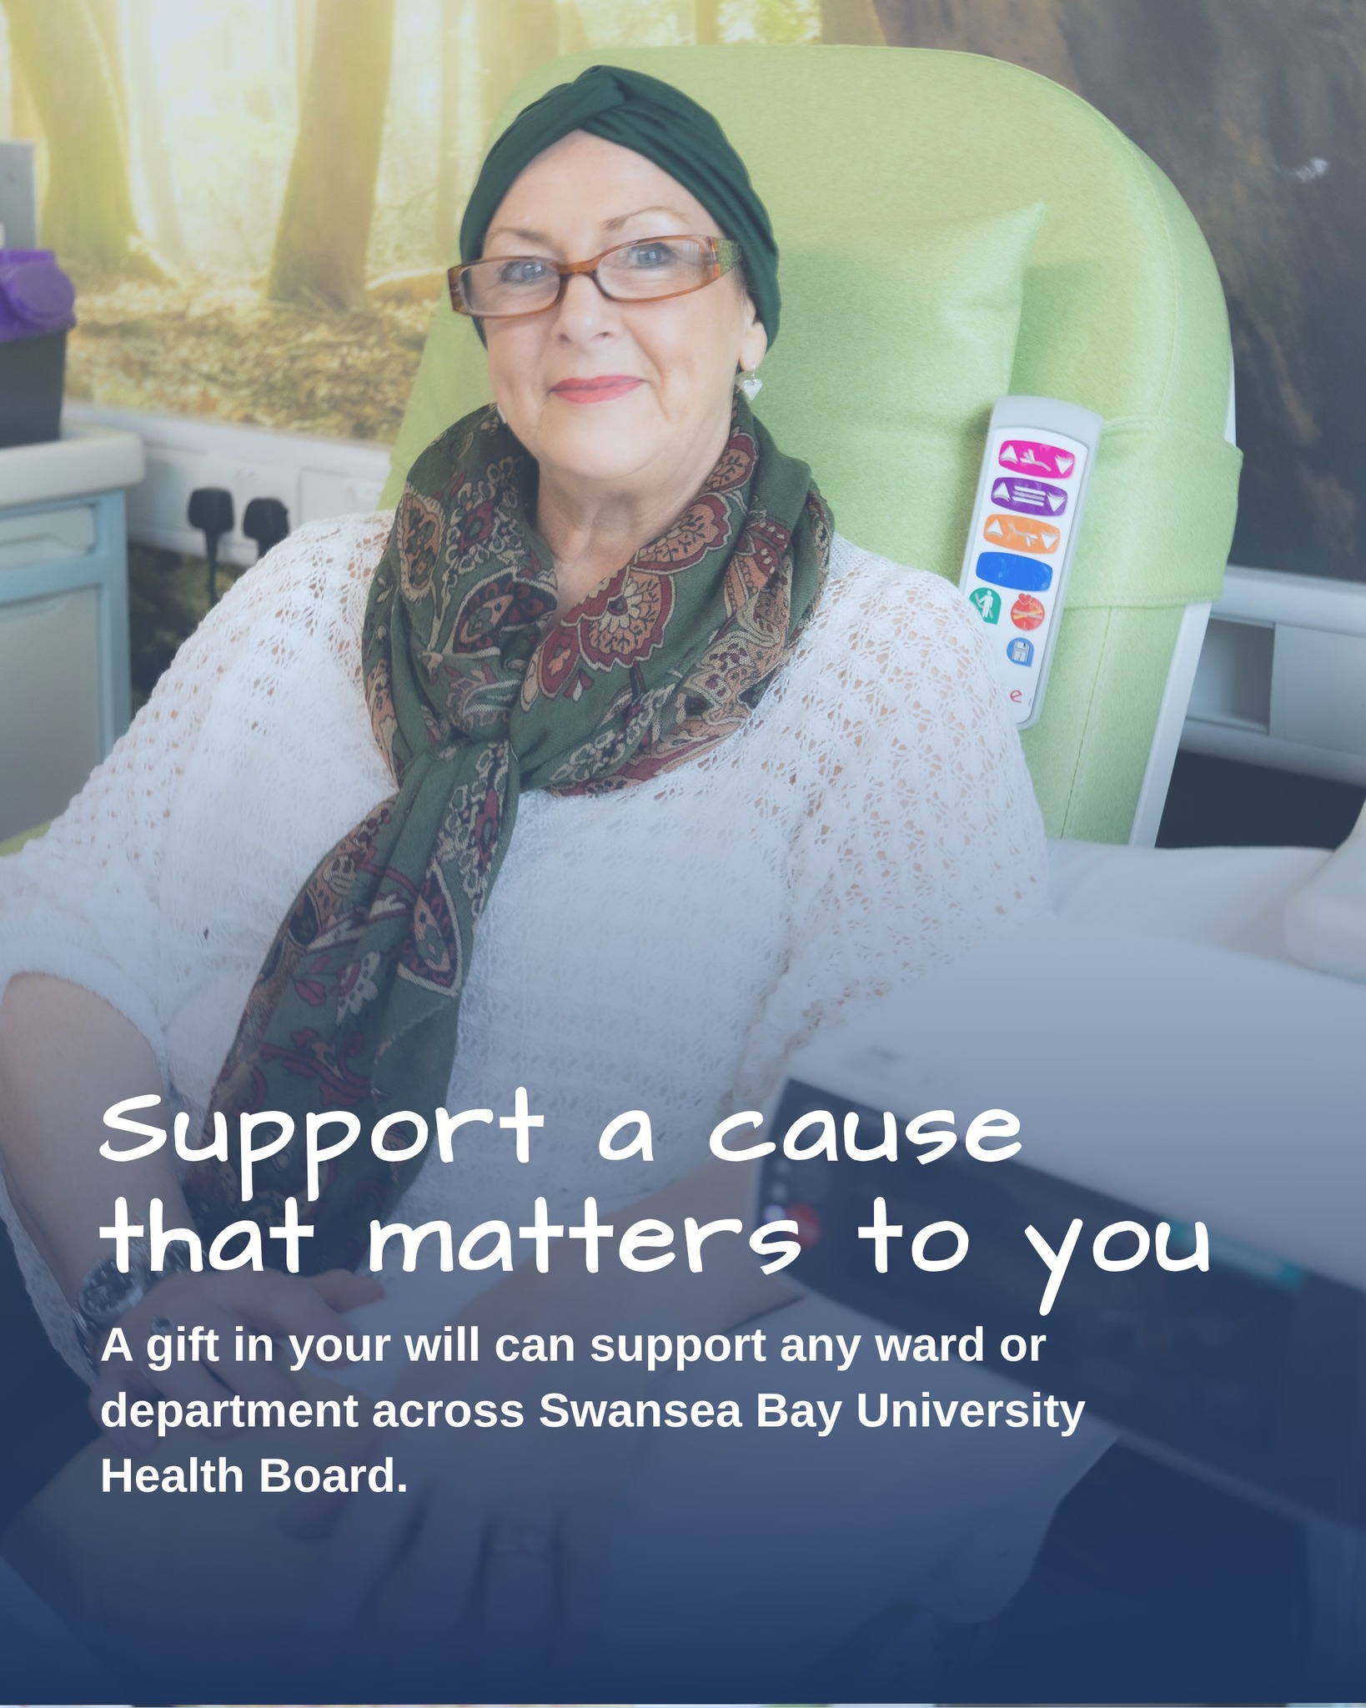
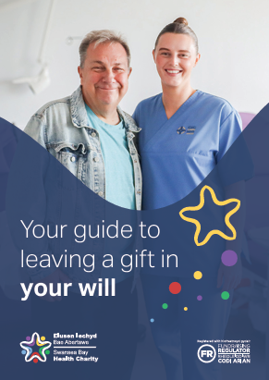
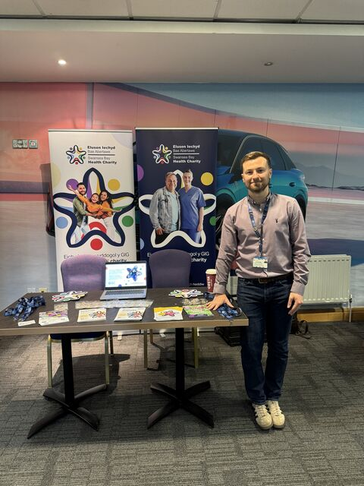
Wills & Legacy Plan
We have now released our ‘Wills Booklet’ for grateful patients to give back to SBUHB.
Staff training, education and distribution is currently being supported by ‘End of Life Team’ with an opportunity to further the opportunity with other areas of SBUHB in the future with drop-in sessions / team sessions so our staff can be aware that patients can give back with a ‘Forever Thank You’ donation through their will.

Slide 6
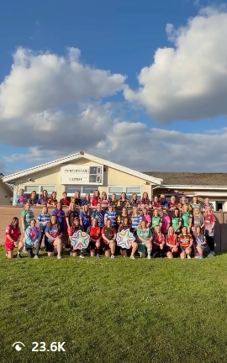
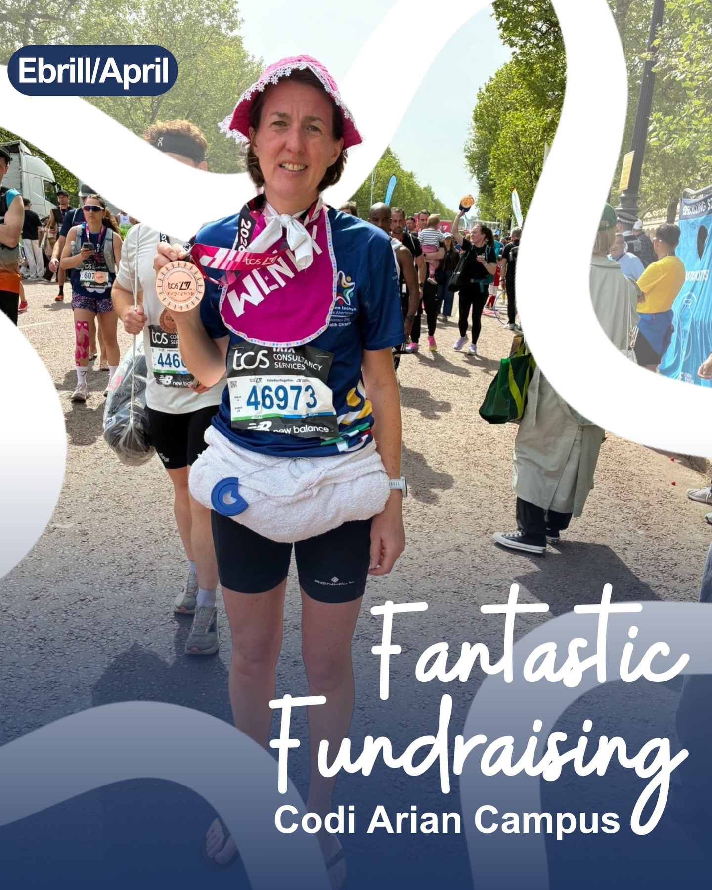

Marketing and exposure
Analytics:
Engagement (+13.6%)
Followers (+207%)
Post reactions (+1200%)
Click through rate (+500%) since beginning in January 2025*.
(*Stats compare Jan 2025-Apr 2026 to Jan-Dec 2024 using Hootsuite Analytics)
Social Media (Video)
High footfall traffic on Instagram
Reels & Video performing extremely well
Highest Video: 23,000 views
Averaging 2,800 per video
Website Traffic
Driving traffic to website by adding email round-ups with a range of fundraising stories.
Website evaluation currently ongoing, relevant and exciting updates will be made throughout 2026

Slide 7
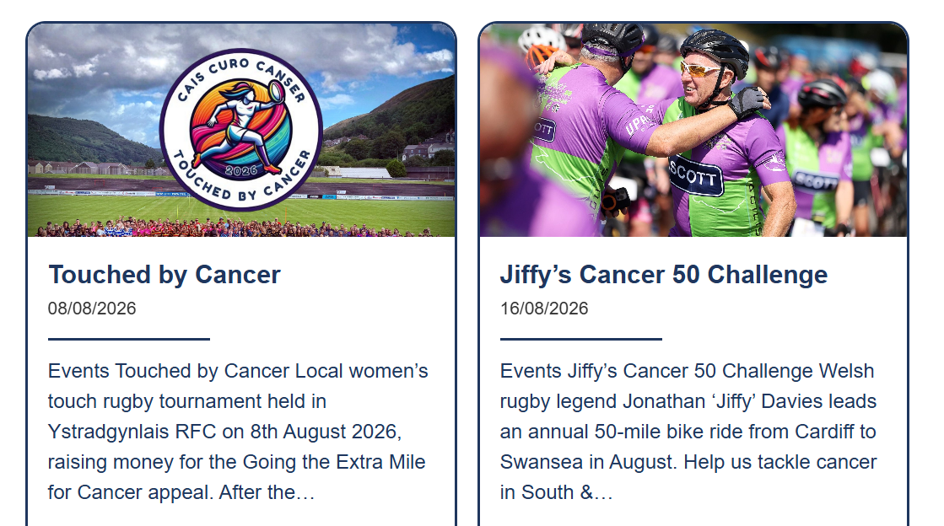
Events

Slide 8
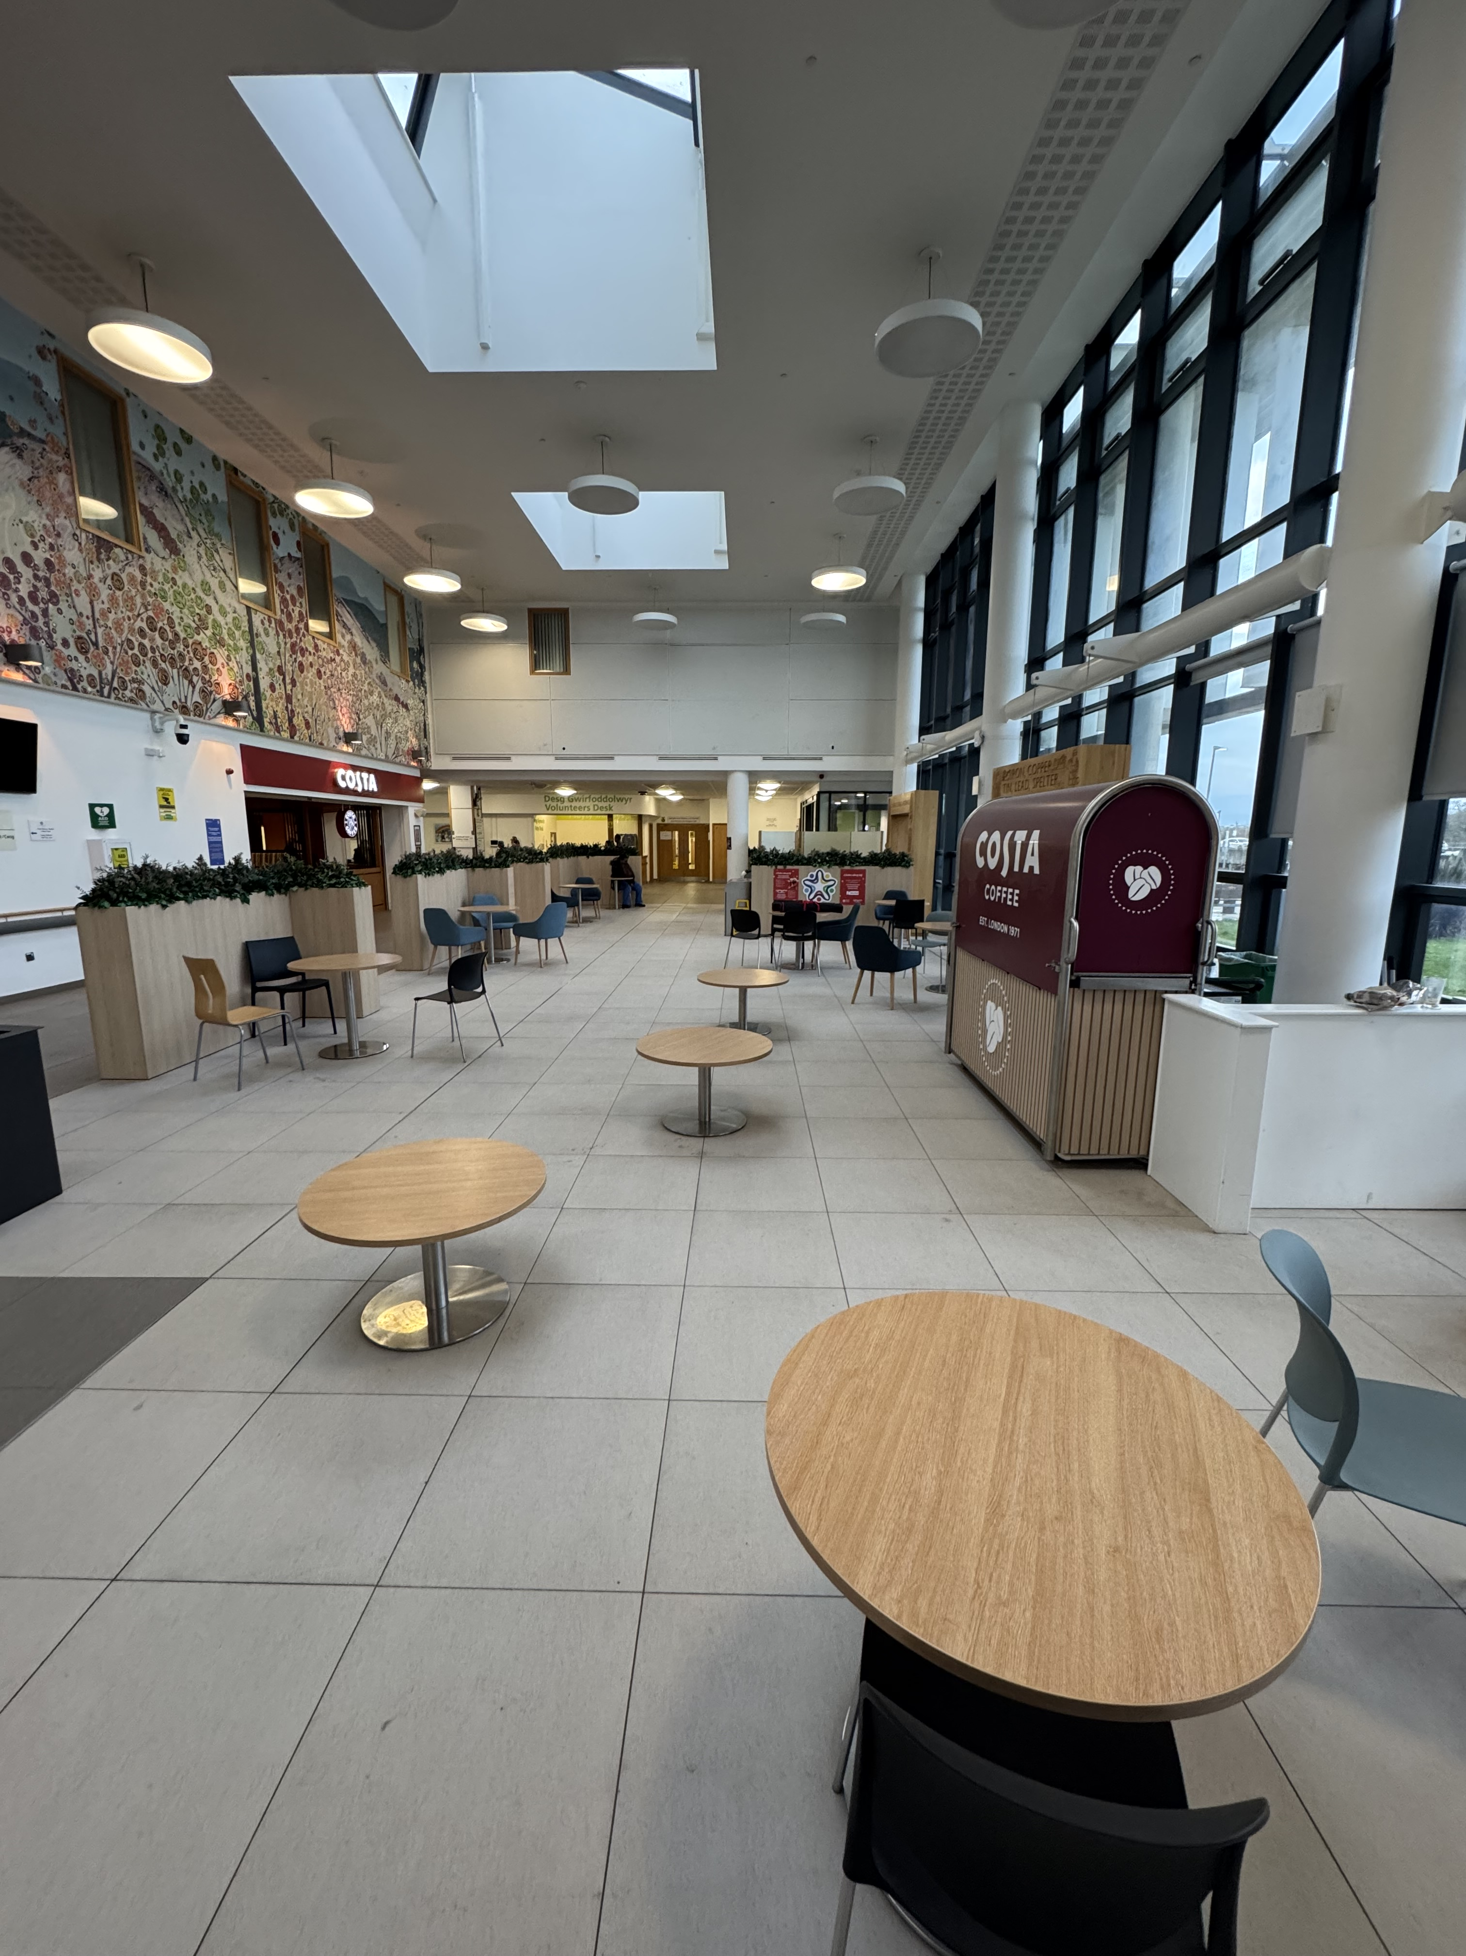
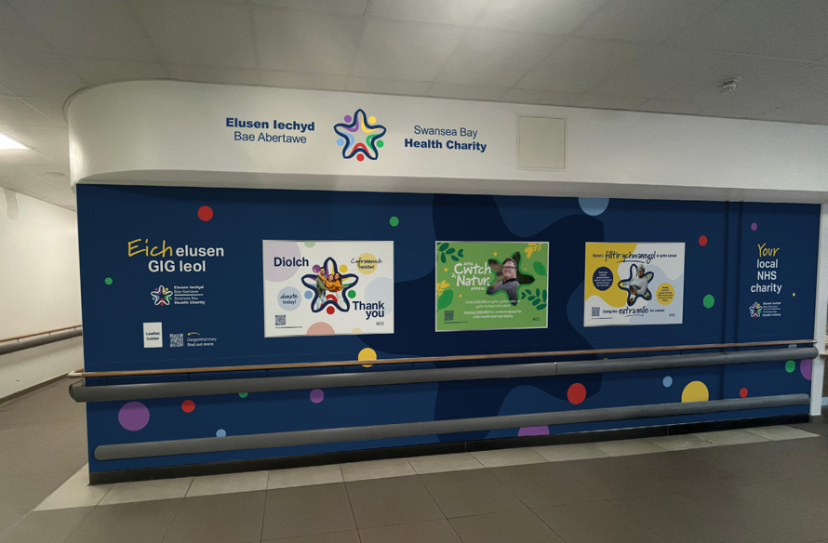
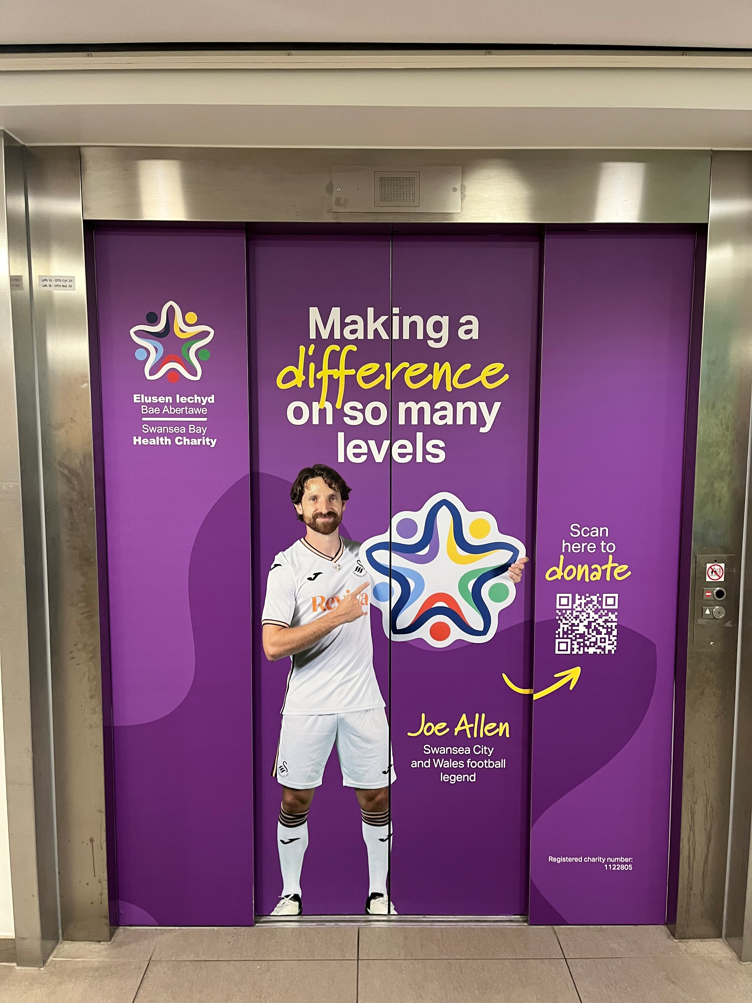
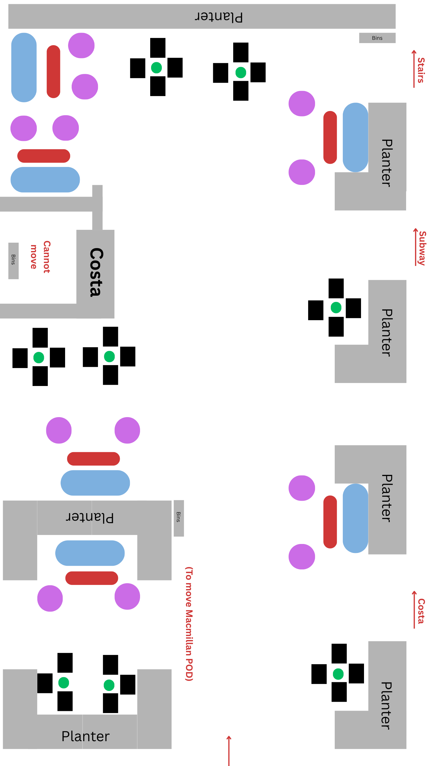
Morriston Refurbishment
Wellbeing / Waiting area
New Sofas
New Coffee Tables
Softer Seating
Additional standard seating
To give a theme / rebrand
Working with Morriston Team for opinions
New Charity Branding
Currently, charity brand within the hospital is non-existent
Plan to strengthen the awareness, the option to give and the ask for support

Slide 9
Thank You
Swanseabay.Healthcharity@wales.nhs.uk

