Slide 1



Charitable Funds Financial Update
Alison McLennan
Assistant Director of Finance
Agenda Item 3.2 Appendix A
18th June 2026

Slide 2

THE PLAN – SUMMARY Movement in fund balance 2025-26
Page 1
£ | Year 2 YTD Plan | Year 2 YTD Actual | Year 2 YTD Variance
Income | 755,000 | 1,581,300 | 826,300
Fixed Costs of Running the Charity | (381,474) | (274,407)​ | 114,800​
Contribution to Expenditure on Charitable Causes | 373,526 | 1,301,042 | 927,516
 | ​ | ​ | ​
Expenditure on Charitable Causes (funds & Small grants) | 801,426 | 882,196 | 80,770
 | ​ | ​ | ​
Movement in Fund Balance | (427,900) | 418,847 | 846,746
Plan expenditure is based on total fund expenditure in 2023-24, less fixed costs of running the charity.
CFC agreed not to release any funds from the Swansea Bay General Fund to support small grants in the community for 2024-25 – this was agreed for 25-26 and paid.

Slide 3
THE PLAN – SUMMARY Movement in fund balance 2026-27 Page 2
£ | Year 3 YTD Plan | Year 3 YTD Actual | Year 3 YTD Variance
Income | 191,667 | 532,676 | 341,009
Fixed Costs of Running the Charity | (81,948) | (37,363) | 44,585
Contribution to Expenditure on Charitable Causes | 109,719 | 502,863 | 393,144
 | ​ | ​ | ​
Expenditure on Charitable Causes (funds & Small grants) | 133,571 | 171,636 | 38,065
 | ​ | ​ | ​
Movement in Fund Balance | (23,852) | 331,227 | 355,079
The plan is phased in equal 1/12ths. YTD incorporates income and expenditure from 1st April to 31st May 2026 – i.e. 2 months.
Plan expenditure is based on total fund expenditure in 2026-27, less fixed costs of running the charity.

Slide 4
FINANCIAL PLAN Narrative
Page 4
The Plan translates and costs the 5-year Strategic Plan for the Charity, Developed by the Charity Team, and approved by the Charitable Funds Committee (CFC).
The Plan start date was agreed by the CFC to be the financial year 2024-25, therefore we are at the beginning of Year 3 of the Plan.
The Plan is all-encompassing, covering income, fixed costs of running the charity, individual fund expenditure and the reserves position.
Year 1 performance to plan has been shared previously with the CFC – this report has detailed the final position on Year 2 of the plan and the first 2 months of Year 3.

Slide 5
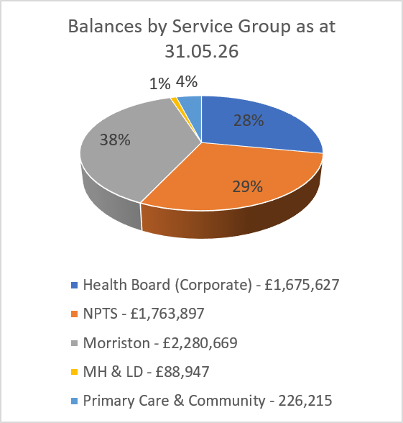
FUND BALANCES BY SERVICE GROUP
Page 5
Top 5 Funds (excluding Core Costs Fund)
Y646 – Morriston General Patients & Staff - £373,712
YN04 – MN Stroke - £334,858
YB34 – South West Wales Cancer Centre - £234,795
YF33 – West Parkinson’s Disease - £133,628
YF31 – West Neurology - £123,371

Slide 6
Administration/overhead charge
Page 6
As agreed by the CFC in its special May meeting, the administration/overhead charge to be levied across funds was reduced from 10% to 6%.
There have been 3 funds excluded – the MR Morgan fund, core costs fund and the Swansea Bay General Fund.
The basis of the charge was calculated as the closing balance on each fund as at 31st March 2026 but the charge will not be enacted until month 3 (June 2026).
All fund managers have been sent a letter to update them of the change in advance of the charges being applied from the Director of Finance on behalf of the CFC.
The Swansea Bay General Fund will receive a benefit of approximately £268k as a result.
It is proposed to administer the charge on an annual basis using the closing balance at the end of the financial year to be enacted in the first month of the following financial year. This will benefit departments across the Health Board.

Slide 7
DORMANT FUNDS
Page 7
As requested by members, below are tabled 66 funds dormant over 2 years as at 31st March 2026, detailing fund balance, primary fund manager, directorate & brief narrative on progress
Fund | Fund Name | Rest | Closing Bal | Primary Fund Manager | Direct | Fund Purpose | Narrative
YR37 | Ward F (Adult) Mental Health NPTH | N | -8.14 | David West | MH & LDS | General | Closed P02-27
YT12 | Hafod Y Wennol Fund | N | -60.01 | Gareth Bartley | MH & LDS | Enhancing the patient experience of being in hospital | Initial meeting held to discuss suitable expenditure on all funds within LDS. Next meeting 03.06.26
YN59 | Swansea Bay Health Visiting Fund | N | -73.93 | Joanne Lamb | PCC | General | Active P01-27
YT11 | Laurels and Briary Patient Fund | N | -81.03 | Gareth Bartley | MH & LDS | Patients Activities & Welfare | Initial meeting held to discuss suitable expenditure on all funds within LDS. Next meeting 03.06.26
YP20 | West Catering | N | -131.97 | Rob Daniel | HB | Equipment and Training | Expenditure requestes approved, awaiting processing
YG03 | West Orthopaedic | N | -141.98 | Mark Mullins | NPTS | General | Met new CD 14.04.26 - awiting expenditure requests
YN31 | West Dept of Nutrition & Dietetics | N | -165.72 | Sioned Quirke | PCC | Training | No response to date from FM
YB05 | Ty Olwen Education | N | -200.91 | Gwenllian Mair Davies | PCC | Training | Plans to utilise fund & close, awaiting paperwork
YR08 | West All Wales Eating Dis Sp Int Gr | N | -218.84 | David West | MH & LDS | Research and Training | Met with DW -working through MH funds to rationalise where possible. On going paperwork
YR11 | Ty Einon | N | -219.74 | David West | MH & LDS | Patient Care and Training | Met with DW -working through MH funds to rationalise where possible. On going paperwork
YG07 | West Trauma Unit | N | -231.91 | Claire Williams | Morriston | Equipment, Patient Care, Training and Staff Benefit | Met new CD 14.04.26 - awiting expenditure requests
YH43 | Swansea Bay Gynaecology Services | N | -273.75 | Abigail Morris | NPTS | General | Active P01-27
YA22 | West Theatre Services | N | -350.00 | Jonathan Gates | NPTS | Equipment, Patient Care and Training | Plans to send staff to conference in Aug 26
YN50 | Neath Dietetic Fund | N | -360.68 | Sioned Quirke | PCC | General | No response to date from FM
YA10 | Neath Port Talbot Day Surgery Unit | N | -454.96 | Will Windsor | NPTS | General | Plans to purchase TVs for waiting area - awaiting paperwork
YT13 | Rowan House A.A.U | N | -516.02 | Gareth Bartley | MH & LDS | General | Initial meeting held to discuss suitable expenditure on all funds within LDS. Next meeting 03.06.26

Slide 8
DORMANT FUNDS – continued
Page 8
Fund | Fund Name | Rest | Closing Bal | Primary Fund Manager | Direct | Fund Purpose | Narrative
YH33 | Scott McCrorie Nurses Study | N | -594.63 | Sue Kotrzuba | NPTS | Training | Expenditure approved - awiting processing
YK06 | West ENT Book | N | -681.10 | Heikki Whittet | Morriston | Training | Met HW plans to merge funds - awaiting return of paperwork
YN12 | Care of the Elderly Wards in Morriston (rest) | Y | -754.17 | Natalie Dark-Harry | Morriston | Patient Activites and Patient Garden | In process of changing FM
YF25 | Singleton Medical Assessment Unit | N | -807.49 | Melanie Collins | NPTS | Equipment, Patient Care and Training | No response to date from FM
YJ02 | West Histo/Cytopathology | N | -828.04 | Christopher Bowden | NPTS | Research and Training | No response to date from FM
YF16 | West Endocrine Research | N | -909.17 | Stephen Bain | NPTS | Equipment, Research and Training | No response to date from FM
YK31 | West Eye T | N | -990.42 | Garry Shuttleworth | NPTS | Equipment and Training | to discuss expenditure plan with colleagues
YK59 | East Stroke & Vascular | N | -1,012.27 | Tina Taylor-Wood | NPTS | General | To be merged with YF60 - awaiting paperwork
YA13 | West Anaesthetics Education & Research | N | -1,069.42 | Anthony Murphy | NPTS | Training | No response to date from FM
YN20 | West Ward W | N | -1,120.89 | Karen Allcock | Morriston | Patient Care and Training | In process of changing FM
YR46 | Taith Newydd Rehab Services | N | -1,250.00 | Gareth Barbour | MH & LDS | General | Further to request FM sent deails on who to approve expendiute from fund
YT08 | East Llwyneryr Unit | N | -1,527.20 | Gareth Bartley | MH & LDS | General | Initial meeting held to discuss suitable expenditure on all funds within LDS. Next meeting 03.06.26
YA17 | Chronic Pain Fund | N | -1,598.47 | Steven Young | PCC | Equipment, Patient Care and Training | Looking for suitable courses for staff - awaiting paperwork
YF14 | SBU Dermatology | N | -1,629.70 | Dr Avad Mughal | Morriston | General | Change of FM reqired - awaiting paperwork
YR01 | West Neuropsychology Fund | N | -1,687.91 | Tanya Edmonds | Morriston | Equipment and Training | FM to discuss with staff and submit paperwork
YE22 | West Higher Surgical Trainees (CLOSED) | N | -1,707.59 | Simon Hodder | Morriston | Patient Care and Training | Closed P01-27
YN16 | Rehab Day Unit (RDU) | N | -1,726.06 | Karen Gronert | PCC | Equipment, Patient Care, Training and Staff Benefit | Change of FM reqired - awaiting paperwork

Slide 9
DORMANT FUNDS- continued
Page 9
Fund | Fund Name | Rest | Closing Bal | Primary Fund Manager | Direct | Fund Purpose | Narrative
YH33 | Scott McCrorie Nurses Study | N | -594.63 | Sue Kotrzuba | NPTS | Training | Expenditure approved - awiting processing
YK06 | West ENT Book | N | -681.10 | Heikki Whittet | Morriston | Training | Met HW plans to merge funds - awaiting return of paperwork
YN12 | Care of the Elderly Wards in Morriston (rest) | Y | -754.17 | Natalie Dark-Harry | Morriston | Patient Activites and Patient Garden | In process of changing FM
YF25 | Singleton Medical Assessment Unit | N | -807.49 | Melanie Collins | NPTS | Equipment, Patient Care and Training | No response to date from FM
YJ02 | West Histo/Cytopathology | N | -828.04 | Christopher Bowden | NPTS | Research and Training | No response to date from FM
YF16 | West Endocrine Research | N | -909.17 | Stephen Bain | NPTS | Equipment, Research and Training | No response to date from FM
YK31 | West Eye T | N | -990.42 | Garry Shuttleworth | NPTS | Equipment and Training | to discuss expenditure plan with colleagues
YK59 | East Stroke & Vascular | N | -1,012.27 | Tina Taylor-Wood | NPTS | General | To be merged with YF60 - awaiting paperwork
YA13 | West Anaesthetics Education & Research | N | -1,069.42 | Anthony Murphy | NPTS | Training | No response to date from FM
YN20 | West Ward W | N | -1,120.89 | Karen Allcock | Morriston | Patient Care and Training | In process of changing FM
YR46 | Taith Newydd Rehab Services | N | -1,250.00 | Gareth Barbour | MH & LDS | General | Further to request FM sent deails on who to approve expendiute from fund
YT08 | East Llwyneryr Unit | N | -1,527.20 | Gareth Bartley | MH & LDS | General | Initial meeting held to discuss suitable expenditure on all funds within LDS. Next meeting 03.06.26
YA17 | Chronic Pain Fund | N | -1,598.47 | Steven Young | PCC | Equipment, Patient Care and Training | Looking for suitable courses for staff - awaiting paperwork
YF14 | SBU Dermatology | N | -1,629.70 | Dr Avad Mughal | Morriston | General | Change of FM reqired - awaiting paperwork
YR01 | West Neuropsychology Fund | N | -1,687.91 | Tanya Edmonds | Morriston | Equipment and Training | FM to discuss with staff and submit paperwork
YE22 | West Higher Surgical Trainees (CLOSED) | N | -1,707.59 | Simon Hodder | Morriston | Patient Care and Training | Closed P01-27
YN16 | Rehab Day Unit (RDU) | N | -1,726.06 | Karen Gronert | PCC | Equipment, Patient Care, Training and Staff Benefit | Change of FM reqired - awaiting paperwork
YR40 | Glanrhyd Caswell Clinic | N | -1,831.72 | Gareth Barbour | MH & LDS | General | Plans to purchase digital equip for pats - awaiting paperwork
YN03 | West Elderly Care Functions | N | -2,015.19 | Dr Manju Krishnan | Morriston | Training, study leave, medical & office equipment, improving patient care, expenses | Plans for expenditure - awaiting paperwork
Y670 | Ward E Neath Port Talbot | N | -2,110.06 | Tina Taylor-Wood | NPTS | Patient Care | Plans to be merged with YF60 - awaiting paperwork
YR03 | Cefn Coed Rehab Servs | N | -2,156.82 | Gareth Barbour | MH & LDS | Patient Care | Further to request FM sent deails on who to approve expendiute from fund

Slide 10
DORMANT FUNDS- continued
Page 10
Fund | Fund Name | Rest | Closing Bal | Primary Fund Manager | Direct | Fund Purpose | Narrative
YP23 | Morriston Ward T | N | -2,363.76 | Niamh Parry | Morriston | Equipment, Patient Care and Training | Getting quotes for purchases - awaiting paperwork
YF38 | Neath Port Talbot MIU Fund | N | -2,588.12 | Rebecca Clarke | Morriston | General | Expenditure requestes approved, awaiting processing
YR47 | Tawe Clinic (Clyne & Fendrod Garden) | N | -2,702.51 | David West | MH & LDS | Patient care - gardens only | Awaiting completion of Tawe Capital project before purchasing plants etc for garden
YG09 | Morriston Ward B Trauma & Ortho Surgery | N | -2,753.41 | Ceri James | Morriston | Equipment and Staff Benefit | Plans to purchase scales - awaiting paperwork
YA24 | Macs Childrens | N | -2,797.20 | Sue Kotrzuba | NPTS | Patient Care | Plans to utilse - discussing with staff
YE16 | West UK Surgical Fund | N | -2,860.03 | Umesh Khot | Morriston | Equipment, Staff Benefit and Training | Plans to utilise on staff training - awaiting paperwork
YK29 | West Childrens Eye | N | -2,968.99 | Garry Shuttleworth | NPTS | Equipment, Research and Training | 3 expenditure requests approved-awaiting processing
YB46 | Jill Rowe Neuro Ambulatory Unit Fund | N | -2,971.38 | Gillian Ingram | Morriston | Equipment, Patient Care and Training | Active P02-27
YK08 | West ENT OPD | N | -3,199.56 | Christine Roberts | Morriston | Patient Care, Equipment and Training | 2 new FMs in place - awaiting ependiture requests
YE02 | Ward K Morriston (Surgery – Colorectal) | N | -3,304.39 | Julie Andrews | Morriston | General | Investigating ward changes and paperwork required
YG05 | Morriston Ward A | N | -3,507.85 | Eliza Guinto | Morriston | Equipment | Plans to merge funds and purchase scales - awaiting paperwork
YK05 | West ENT Fund | N | -3,789.44 | Heikki Whittet | Morriston | Patient Care | Met HW plans to merge funds - awaiting return of paperwork
YN44 | Neath Port Talbot Care of the Elderly | N | -3,810.55 | Sreedhar Kolli | NPTS | General | New FM in place, need to arrange meeting
YE03 | Stuart Winsey Surgical Travel | N | -4,157.62 | Mark Davies | Morriston | Research and Training | To be used for training - requested more details
YG08 | West Paediatric Ortho Develop | N | -4,872.50 | Matthew Horner | NPTS | Equipment and Training | New FM in place, need to arrange meeting
YE24 | West Stoma Care | N | -5,319.35 | Glynis Morris | Morriston | General | To be used for training - requested more details
YH35 | West Childrens Continuing Care | N | -5,574.03 | Sue Kotrzuba | NPTS | Patient Care | 2 expenditure requests currenlty being processed
YF22 | West Endocrine Specialist Nurse | N | -6,084.23 | Stephen Bain | NPTS | Patient Care and Training | No response to date from FM
YF69 | GP Out of Hours Fund | N | -6,208.80 | Joanne Warriss | PCC | General | Active P01-27
YR21 | Tonna David Blight Legacy (rest) | Y | -7,780.71 | David West | MH & LDS | Equipment and Research | Expenditure requestes approved, awaiting processing
YR22 | Tonna Resource Centre (rest) | Y | -8,126.00 | David West | MH & LDS | General | Further details on restrictions requested
YE27 | Neath Port Talbot General Surgery Fund | N | -8,438.89 | Will Windsor | NPTS | General | Plans to purchase equip - awaiting paperwork
Y668 | West Gastroenterology/Nutrition Fund | N | -8,825.96 | Linzi Thomas | Morriston | General | Palns course fee for Sept 26 intake
YN10 | West Elderly Care Research | N | -8,834.70 | Rhodri Edwards | Morriston | Research and Training | Staff training planned - awaiting paperwork
Y688 | Bernice D Stephen NPT Legacy Fund (rest) | Y | -10,000.00 | Melanie Collins | NPTS | Purchase of equipment for NPT Hospital | plans to purchase wheelchairs - awaiting paperwork
YK17 | West Max Facial Research No 2 | N | -16,468.03 | Madhav Kittur | Morriston | Research, training & Equipment | Closed P01-27
YN24 | West Spice Development | N | -20,568.71 | Catherine Davies | PCC | Patient Care | Plans to merge - awaiting paperwork
YE20 | West Prostate Cancer Research | N | -44,930.24 | Neil Fenn | Morriston | Research and Training | Project immient - awiting paperwork for expenditure
YF70 | Bevan Legacy Fund | N | -103,242.02 | Melanie Collins | NPTS | Training | FM requested details on legacy - wishes to use on non training items
Total |  |  | -340,546.89

Slide 11
NEW/CLOSED FUNDS
Page 11
No New Fund requested and 12 funds have been closed from last report to 21st May 2026
Closed Funds
Fund Name | Number | Reason | Date
West ECG | YC16 | As part of fund rationalisation, the balance of YC16 was transferred to YC14 so that it could be closed | 23.02.26
Singleton Ward 8 Patients & Staff | YF19 | Ward 8 no longer exists, balance transferred to Y653 – Singleton General in order to close | 25.02.26
LPMHSS - Swansea | YR49 | As part of fund rationalisation and utilisation of dormant funds, small balance has been transferred to YR17 in order to close | 16.03.26
West Post Grad Dental | Y620 | As part of fund rationalistion and utilisation of dormant funds, the balance has been transferred to Y621 in order to make a purchase and close Y620 | 16.03.26
EMRTS & ACCTS Charitable Fund | Y634 | Fund set up in October 2024 but has had no activity. Service has no current plans to fundraise, agreed to close for now and re-opened should donations be received | 23.03.26
Ken Holbrook Thomas Legacy (Rest) | YB55 | Transferred the balance of YB55 to YB50 - SeaRAD (SBU Radiotherapy Research Fellow Fund) to spend on Research fellow as approved by CFC, and then close YB55 | 23.03.26
West Mr Emery Gynaecology | YH04 | As part of fund rationalisation, the balance of YH04 was transferred to YH07 in order for the fund to be closed | 09.04.26
NHS Charities Together Stage 3 (rest) | Y662 | Fund was created for stage 3 NHSCT monies received. Fund have been fully utilised and is no longer required | 13.04.26
West Gynaecology | YH07 | As part of fund rationalisation within the service, the balance of the fund was transferred to YH43 in order to close | 28.04.26
West Higher Surgical Trainees | YE22 | As part of fund rationalisation, the balance of the fund was transferred to YK17 in order to close | 28.04.26
West Post Grad Hospitality | Y621 | Fund has been utilised and is no longer required | 07.05.26
Ward F (Adult) Mental Health NPTH | YR37 | As part of fund rationalisation, the very small balance was transferred to YR18 – Patients Council in order to close | 21.05.26

Slide 12
FUND BALANCES
Page 12
Overall fund balances have increased by £0.331m this financial year to date. The main movements are an increase in the investments, fixed term deposits and a decrease in debtors. There was also a decrease in cash held and creditors.
Investment vs Cash: Strategic Balance

Slide 13
CHARITABLE FUNDS CASH & LIQUIDITY OVERVIEW
Page 13
• Cash balances held to support monthly payment runs.
• Consistent surplus cash above operational requirements of £0.4-£0.8m.
• Surplus funds placed into short-term 1-month deposits with c. 4% interest.
• Remaining surplus funds held in regular accounts (1.25% interest).
Cash balances are sufficient to meet operational needs, with surplus creating the need to optimise the funds currently held outside the investment portfolio.

Slide 14
INVESTMENT VS CASH: STRATEGIC BALANCE
Page 14
Maintain / Increase Cash & Deposits
✅ High liquidity for payment runs
✅ Stable, predictable returns (deposits)
❌ Lower returns vs investments
❌ Opportunity cost of holding excess cash
Retain Funds in Investment Portfolio
✅ Potential for higher long-term returns
✅ Supports capital growth
❌ Reduced liquidity
❌ Exposure to market volatility
• £55k quarterly drawdown from investment portfolio (capital + income) reducing long-term fund value.
• Surplus cash suggests scope to reduce drawdowns.
• Trade-off between liquidity certainty and maximising investment returns.
• Neither investment returns nor deposit rates are guaranteed.
• Note previous sensitivity analysis on drawdown sustainability performed by Brewin Dolphin (paper 2.1 June 2025 CFC Meeting).
• Recent reduction in overheads charge to 6% to cover actual not budgeted costs means investment drawdowns may be utilised to cover any shortfall (through the core costs fund).
The Committee is asked to consider whether the current level of cash drawdown and reserves represents an appropriate balance between short-term liquidity needs and preserving long-term value.

Slide 15
INVESTMENT PORTFOLIO POSITION
Page 15
 | 31st March 2024 £ | 31st March 2025 £ | 31st March 2026 £ | 31st May 2026 £ | Unrealised Gain / (Loss) in 2026/27 £
Book Value | 4,211,523 | 4,243,424 | 4,279,330 | 4,279,322
Market Value | 4,817,251 | 4,727,652 | 4,977,109 | 5,406,756
Unrealised Gain / (Loss) | 605,728 | 484,228 | 697,779 | 1,127,434 | 429,655
Cumulative unrealised gains increased overall by £214k during the 2025-26 financial year and £430k in the 2 months to 31st May 2026 when compared to the year-end value.

Slide 16
RESERVES PERFORMANCE
Page 16
The Reserves Policy states that the level of reserves held should be within 1 and 4 years average annual expenditure comprising the total fund balance less unrealised gains.

Slide 17
Notes
Page 17
The tendering process for the Investment management will take place in accordance with the original contract start date.
The Strategic Plan needs to be refreshed to consider income streams, Dormant Funds, Rationalisation of Funds and Future processes around new fund requests.
Future overhead percentage calculations for 2027/28.

Slide 18
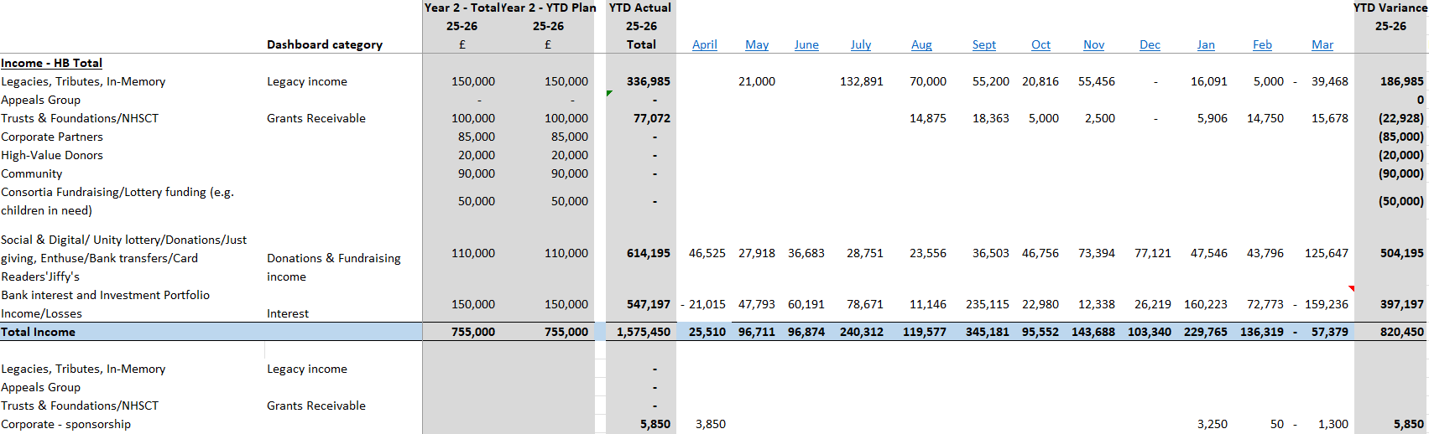
Appendix 1- THE PLAN – Income Performance 2025-26
Page 18

Slide 19
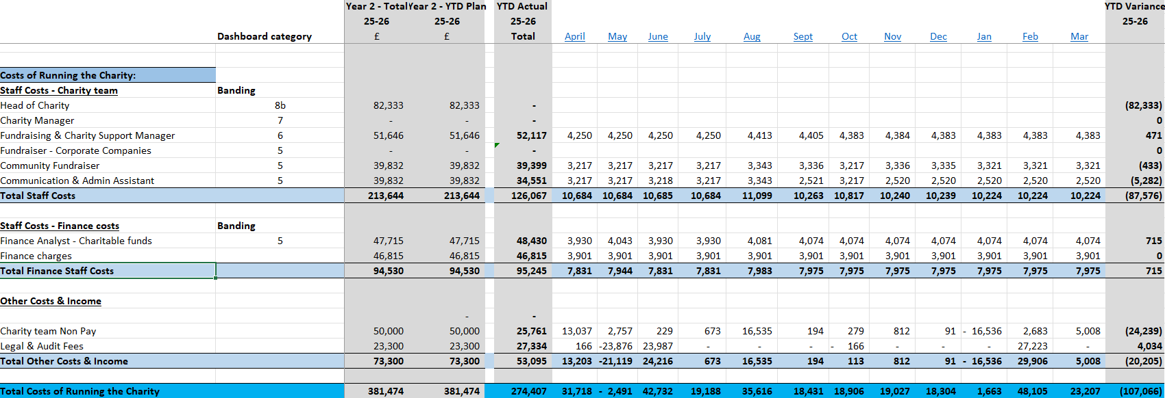
appendix 2 - THE PLAN – FIXED COSTS OF RUNNING THE CHARITY 2025-26
Page 19

Slide 20
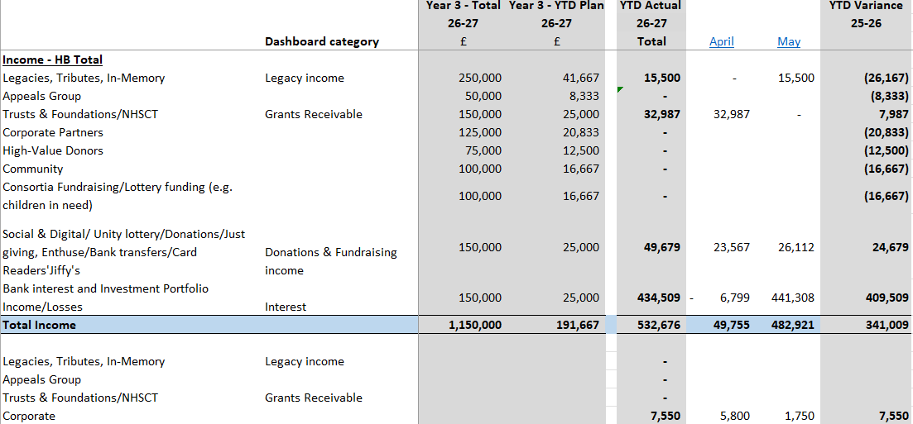
Appendix 3- THE PLAN – Income Performance 2026-27
Page 20

Slide 21
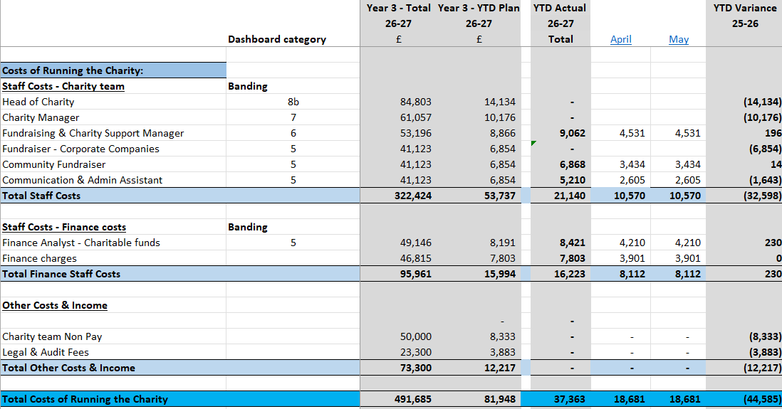
appendix 4 - THE PLAN – FIXED COSTS OF RUNNING THE CHARITY 2026-27
Page 21

