Slide 1

Charitable Funds Committee June 2025
Charity Team:
Lewis Bradley: Charity Support Manager
Cathy Stevens: Community Support Charity Officer
Catrin Frame: Digital fundraising & Engagement Officer

Slide 2
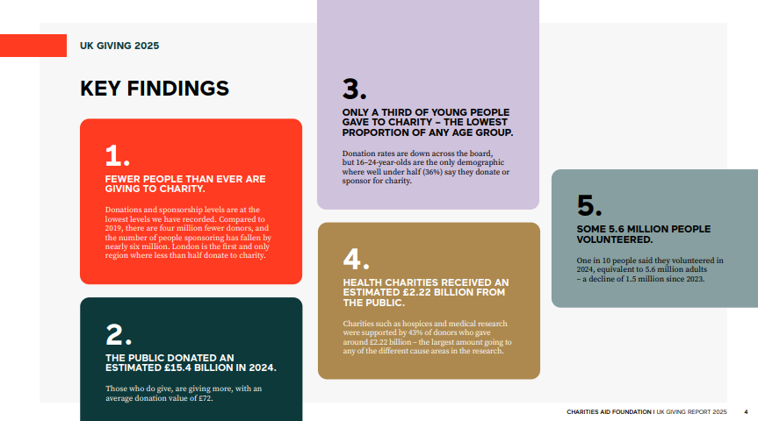

Slide 3
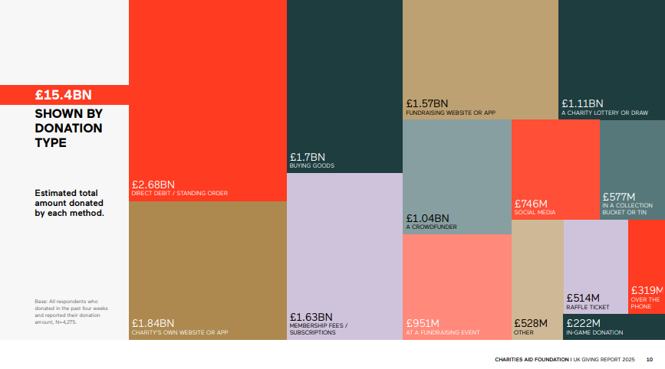
AROUND 3.9 MILLION PEOPLE CANCELLED A REGULAR PAYMENT TO CHARITY LAST YEAR.

Slide 4
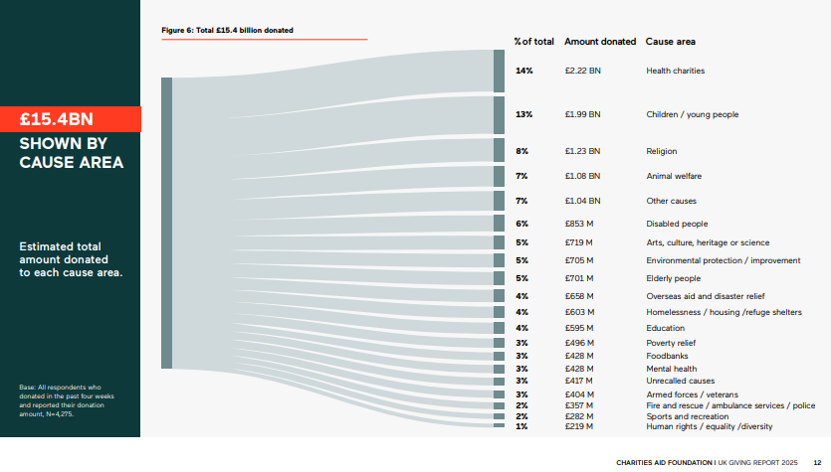
AROUND A THIRD OF DONORS SUPPORTED AN EMERGENCY APPEAL IN THE LAST 12 MONTHS
REASONS FOR NOT DONATING INCLUDE AFFORDABILITY, LACK OF TRUST, AND A LACK OF INTEREST.

Slide 5
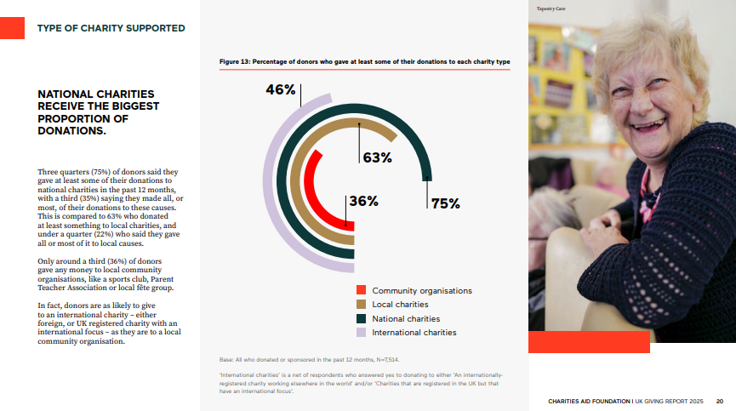

Slide 6

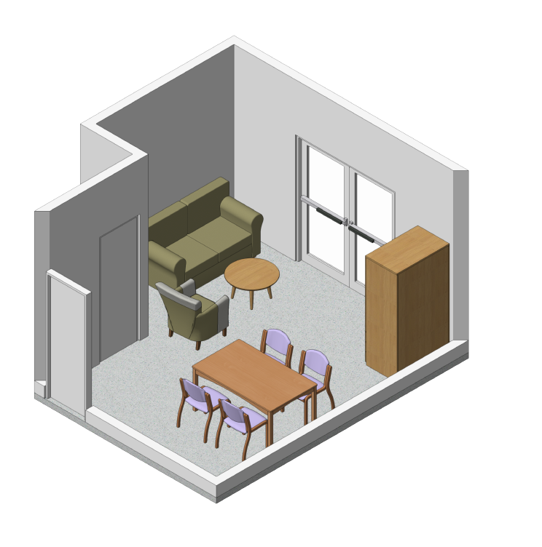
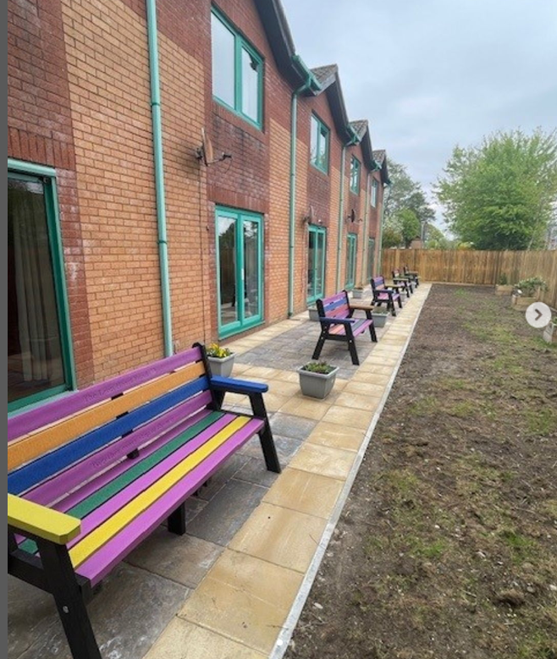
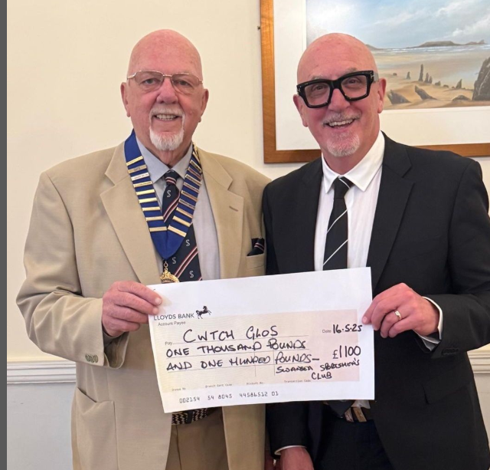
Progress
Join Us – TBC July 2025
To celebrate the unveiling of the newly refurbished Cwtsh Clos houses.
To open the Swansea City AFC house (Name TBC)
&
Principality Building Society’s house ‘Ty Dylan’
To invite everyone who has supported the renovation (internally & externally)
Food & drinks in the community centre opposite Cwtsh Clos.

Slide 7

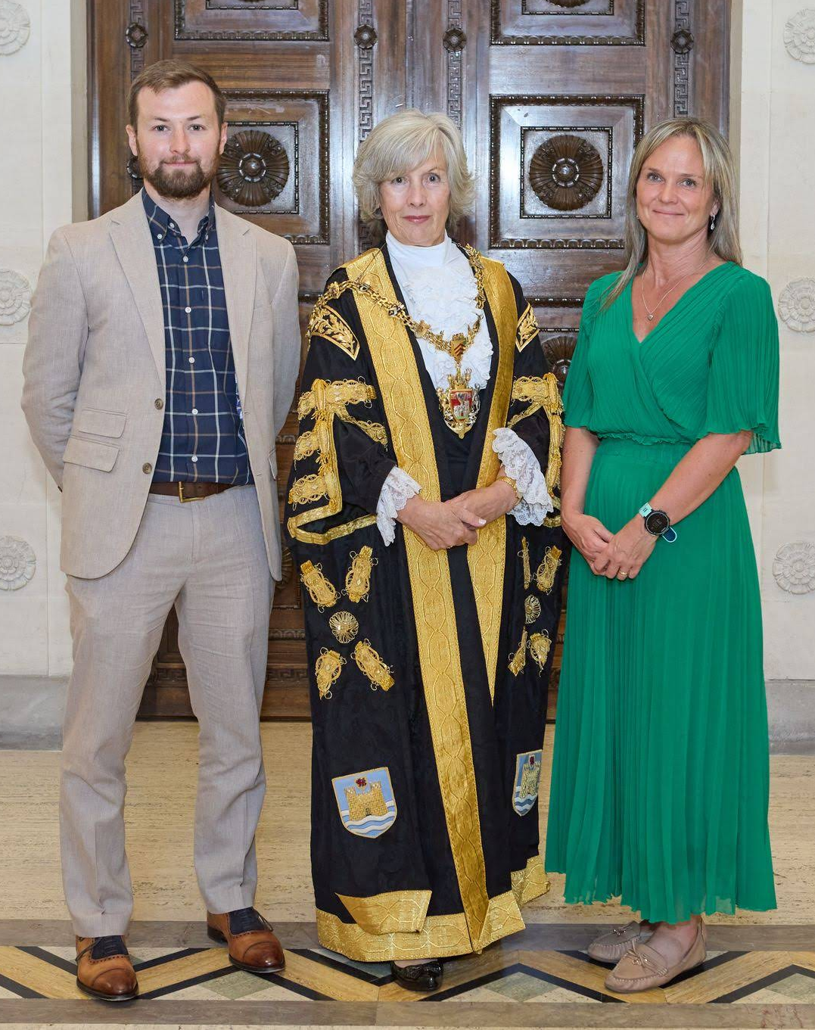
The Right Worshipful The Lord Mayor of the City and County of Swansea Councillor Cheryl Philpott, for the municipal year 2025/26.
Cheryl and Steve have chosen to support Swansea Bay Health Charities ‘Going the Extra Mile for Cancer' appeal, situated at the South West Wales Cancer Centre at Singleton Hospital.
Cheryl has visited the Cancer Centre departments at Singleton Hospital with Lewis Bradley & Kate Ashton.
Plans are being arranged for visits with distinguished guest, including events throughout the year to raise the profile and income of the appeal.

Slide 8
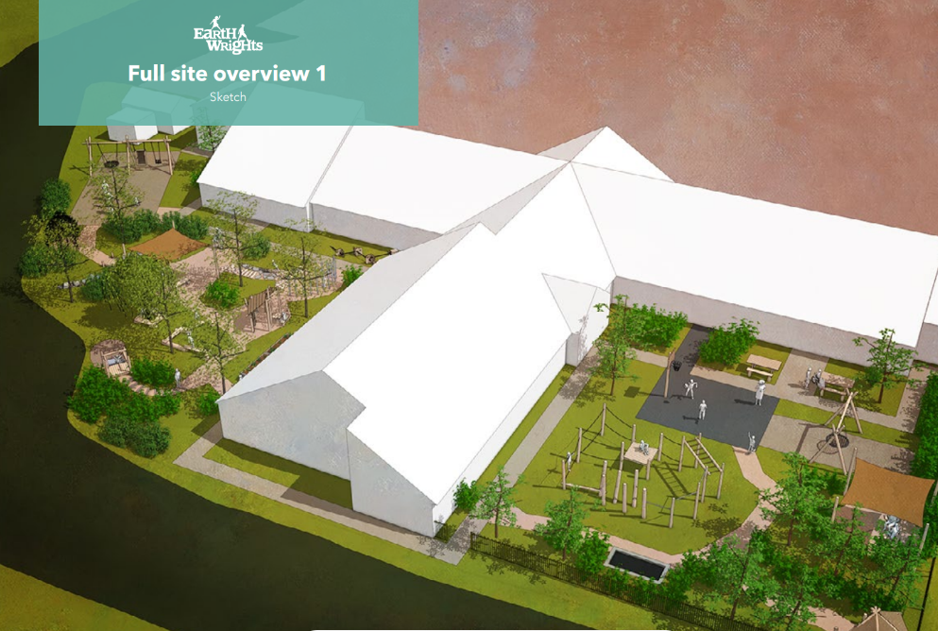
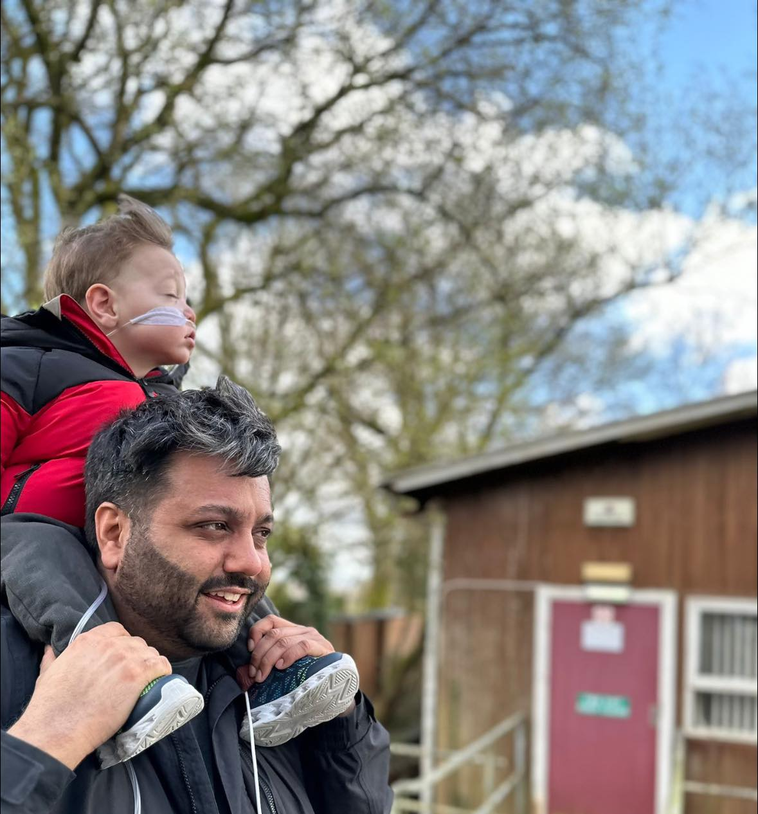
2025 Proposal:
Childrens & CAMHS Garden Appeal
Appeal Name: Cwtsh Natur
Tagline: The nature space for child wellbeing
Aim: We are raising £200,000 to create Cwtsh Natur—a dedicated outdoor therapy space where children and young people can find peace, safety, and healing in the embrace of nature.
How the Outdoor Space Will Help Our Patients:
Enhanced Physical Development: Improves motor skills, agility, balance, and coordination through activities like climbing and running.
Improved Mental Health: Reduces stress, anxiety, and depression, providing a calming effect and improving overall mental well-being.
Sensory Stimulation: Offers a variety of sensory experiences that aid in sensory integration and regulation.
Social Interaction and Play: Encourages social skills development through group activities and cooperative play.
Cognitive and Emotional Benefits: Enhances creativity, problem-solving skills, and resilience, boosting confidence and coping abilities.
Therapeutic Benefits: Serves as an extension of therapy, making sessions more enjoyable and less intimidating.

Slide 9

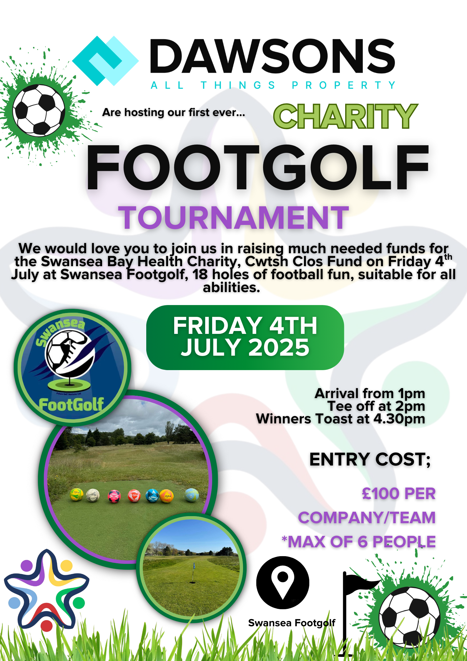
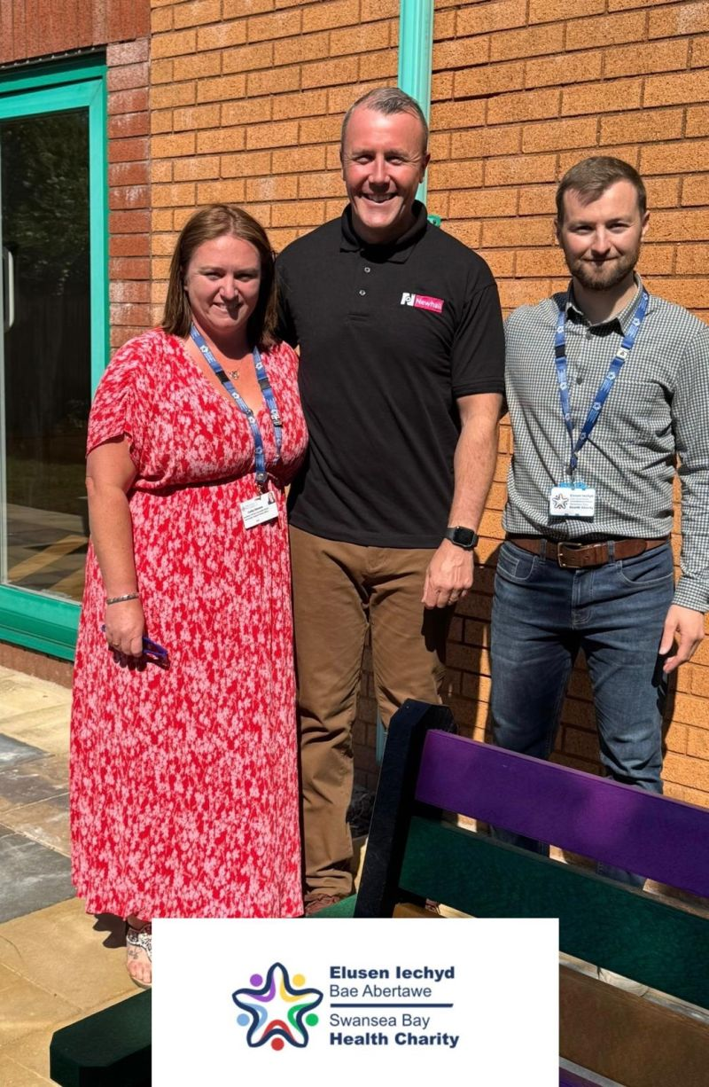
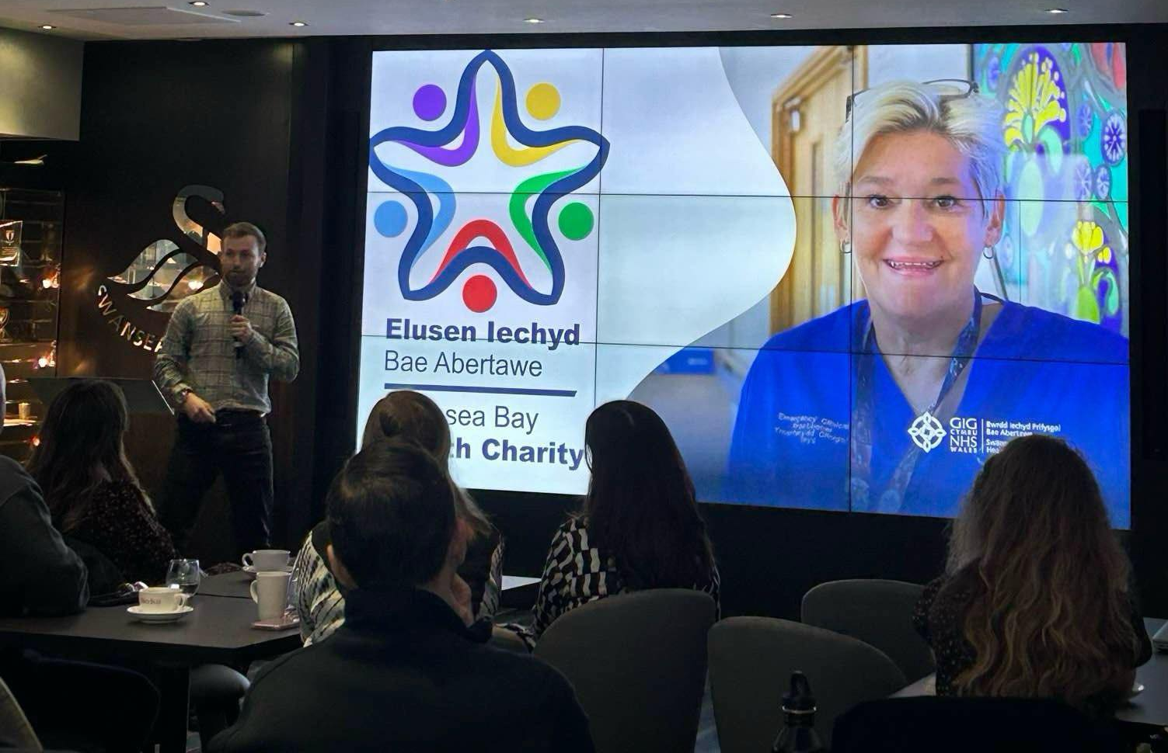

New Corporate Partnerships
To sign up to the City Business Network (CBN) for 25-26 after the success of developing relationships with Swansea City AFC & other corporate partners.
Thanks to Mal Pope & Kev Johns, as well as the charity team for cultivating a donation from a colleague at Nation Radio.
We are the chosen charity of the ‘Pride of Wales Awards’ for 2025. A fantastic networking opportunity for future appeals, as well as supporting Cwtsh Clos.
Charity of the year partnership with Dawsons Group. Starting with a Footgolf tournament in Swansea, the start of hopefully a long-term opportunity (Event 80% sold out)
Created a long term partnership with Newhall. To help provide cleaning solutions for estates and families at Cwtsh Clos.
Including New TV’s purchased & approx. donation of £5,000 in 2025

Slide 10





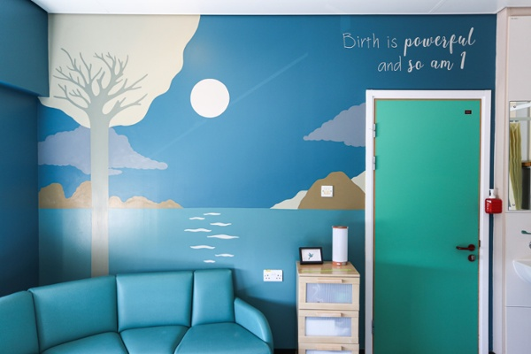
Charity Collaboration
£6,592.08 Gift In Kind received for a Purchased a Finger pressure monitor and V-scan Air CL
(Story to be released)
To jointly target West Wales with specific messages around the collaboration of SWWCCF and Maggie’s. Elevating the profile & income.
Successful funding bid with the Arts in Health team (And some internal funding) allowed us to successfully gain a grant to decorate the new NPT Birthing Unit (£15,000 Project).
Discussion underway to look at a possible collaboration that benefits both charities, our patients and staff. Potential event in Bridgend due to the new dialysis unit.
Discussions started to look into support for Morriston Paediatric Department, where Joseph spent most of his time. Possible collaboration of events and support mechanisms.

Slide 11
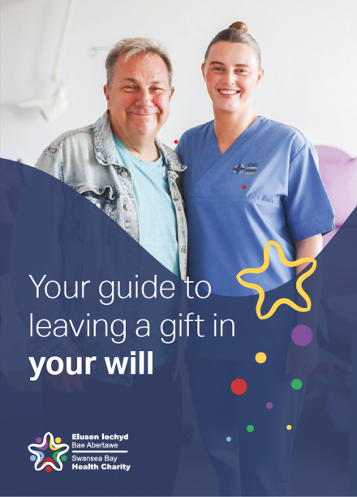
Legacy Income Development
Strategy:
Gifts In Wills & Legacies was one third of our Swansea Bay Health Charities income in 24/25.
Phase 1 (Completed)
To add the digital version of the ‘Gift in your Will’ document to Swansea Bay Health Charity website, with a dedicated landing page where supporters can download, gain insight and find the correct information.
Phase 2 (Underway)
QR code on the posters will link through to the digital page, meaning a more efficient and cheaper way to distribute the booklet to more stakeholders. As well as purchase ‘Smee & Ford’ membership to look at the success of the development.
Phase 3
Contact Funeral Directors / Will Writers / solicitors where they may speak to patients and staff about Gifts In Wills & Legacies. The booklet can be a reminder but also an educational booklet that can allow parties to know about the charities, what we spend charitable income and the benefits of giving to Swansea Bay Health Charity.
Phase 4
To work directly with departments where there is scope to implement the legacy strategy such as ‘End of life care’, Primary Care, Cancer Centre’s, Renal, Burns, Theatres, NICU and A&E where there is footfall or life-changing emergencies’ where we have saved lives while still being considerate.

Slide 12
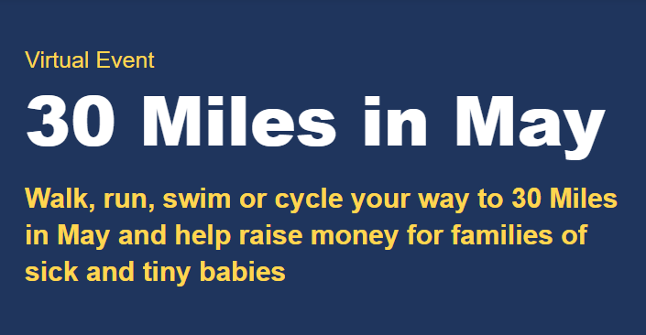
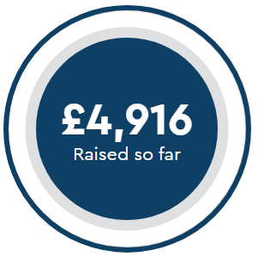
Social & Digital Development
New website landing pages: Focused Funds (In development)
Aim: To give funds that are not large enough to be an appeal dedicated space to promote their charitable activity, or ‘the ask’ so people can choose to help fundraise for a purpose.
21 funds identified that need support across various areas of the health board.
New website landing pages: Fundraising Packs (In development)
Aim: To aim to give fundraisers assets to assist them with their fundraising goals. Allowing the team to assist more potential funders more easier and effectively, as well as giving confidence to the fundraiser that we want to support them reach their targets.
In future, we can develop this in-line with specific appeals.

Slide 13

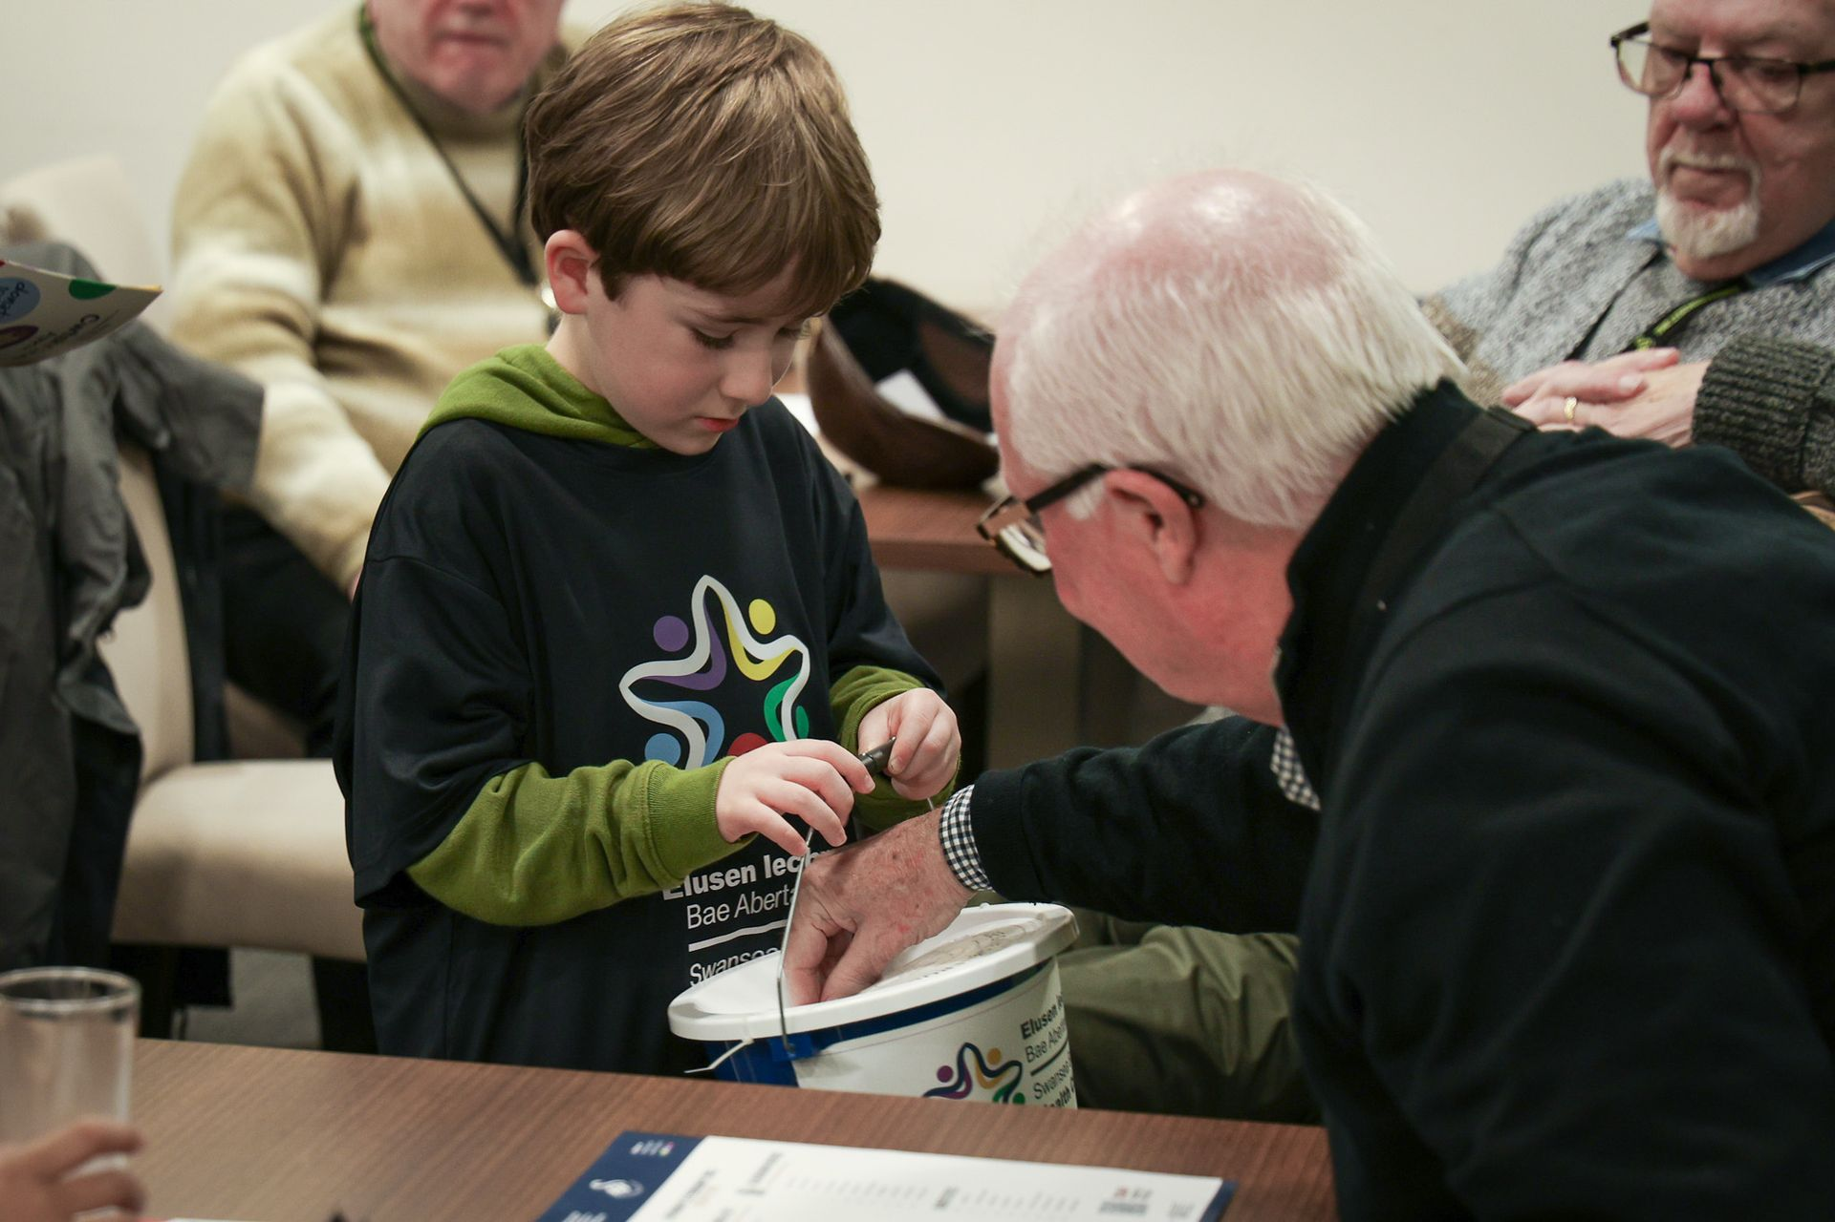
Fund Managers Day
Whilst Swansea Bay University Health Board benefits by having a dedicated charity team, there are many occasions and circumstances that mean the relationship between the fund manager and team is critical for efficiency, income and expenditure.
To explore new creative ways of looking for income as well as ideas for expenditure. Led by the charity team and successful fund managers that have made a difference.
It’s an opportunity to take fundraising assets away to promote their service as well as developing fund managers as ‘Charity Champions’.
Taking a more interest in their role.
Volunteers Strategy
Currently, we a focussing on volunteers on an event by event basis. In future, we shall be changing our messaging and focus. Maximising opportunity and volunteers for the charity as a whole so we can manage any opportunities / events with their support.

Slide 14
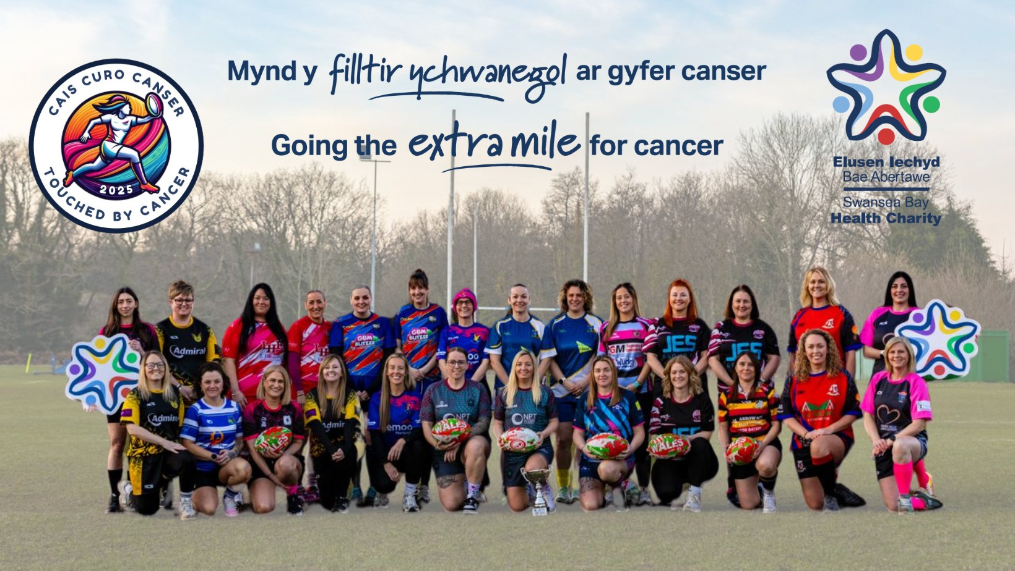
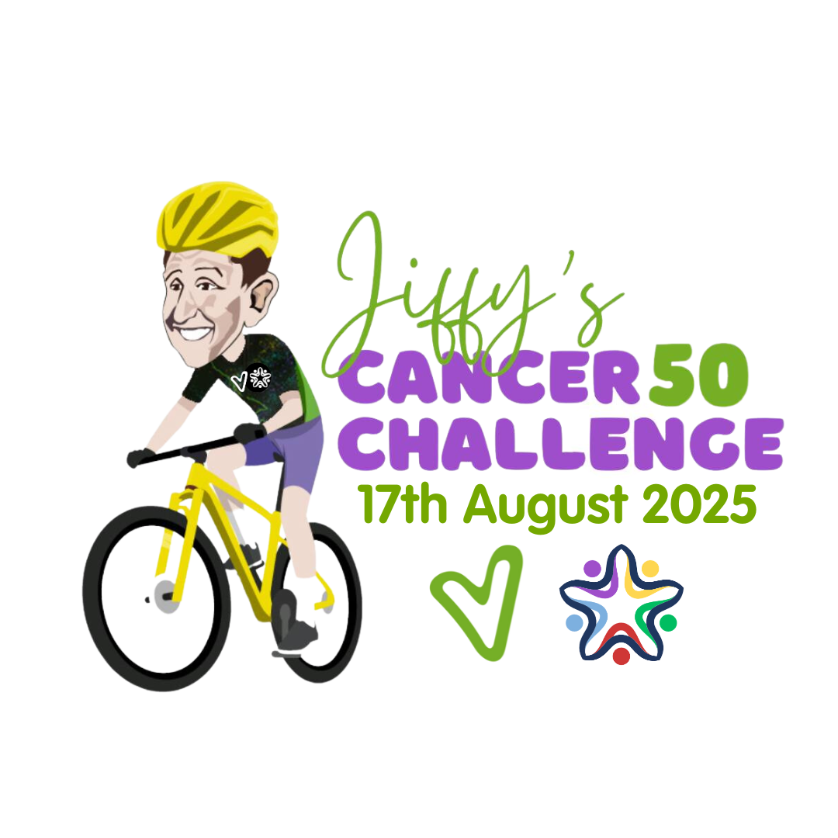
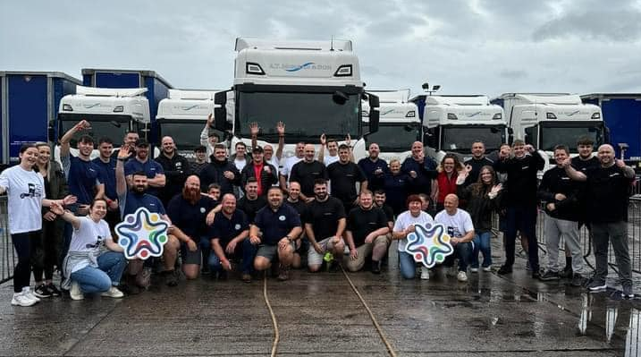

2025 Events Planning
Touched By Cancer, Women’s Touch Rugby Tournament – 9th August
The 5th edition of the Jiffy’s Cancer 50 Challenge – 17TH August
The 2nd edition of AT Morgan’s ‘Charity Truck pull’ – 7TH September
Principality Building Society Walk ‘Cwtsh By The Coast’
(2025 Date TBC)

Slide 15
Diolch / Thank You

