Slide 1



Charitable Funds Financial Update
Alison McLennan
Assistant Director of Finance
Agenda Item 3.2 Appendix A
17th March 2026

Slide 2

THE PLAN – SUMMARY Movement in fund balance
Page 1
£ | Year 2 YTD Plan | Year 2 YTD Actual | Year 2 YTD Variance
Income | 629,167 | 1,518,935 | 889,768
Fixed Costs of Running the Charity | (317,895) | (203,095)​ | 114,800​
Contribution to Expenditure on Charitable Causes | 311,272 | 1,322,940 | 1,011,668
 | ​ | ​ | ​
Expenditure on Charitable Causes (funds & Small grants) | 667,855 | 625,740 | (42,115)​
 | ​ | ​ | ​
Movement in Fund Balance | (356,583) | 697,201 | 1,053,784
The plan is phased in equal 1/12ths. YTD incorporates income and expenditure from 1st April to 30th January 2026 – i.e. 10 months.
Plan expenditure is based on total fund expenditure in 2023-24, less fixed costs of running the charity.
CFC agreed not to release any funds from the Swansea Bay General Fund to support small grants in the community for 2024-25 – this has now been agreed for 25-26 and paid.

Slide 3
FINANCIAL PLAN Narrative
Page 2
The Plan translates and costs the 5-year Strategic Plan for the Charity, Developed by the Charity Team, and approved by the Charitable Funds Committee (CFC).
The Plan start date was agreed by the CFC to be the financial year 2024-25, therefore we are now in Year 2 of the Plan.
The Plan is all-encompassing, covering income, fixed costs of running the charity, individual fund expenditure and the reserves position.
Year 1 performance to plan has been shared previously with the CFC – this report will focus on Year 2 of the plan.

Slide 4
FUND BALANCES BY SERVICE GROUP
Page 3
Top 5 Funds (excluding Core Costs Fund)
Y646 – Morriston General Patients & Staff - £373,187
YN04 – MN Stroke - £335,083
YB34 – South West Wales Cancer Centre - £247,111
YF33 – West Parkinson’s Disease - £133,328
YF31 – West Neurology - £124,671

Slide 5
Administration/overhead charge
Page 4
As agreed by the CFC, an administration/overhead charge of 10% is to be levied across funds.
There have been 3 funds excluded – the MR Morgan fund, core costs fund and the Swansea Bay General Fund.
The basis of the charge was calculated as the closing balance on each fund as at 31st March 2025 but the charge has not yet been enacted.
All fund managers will be sent a letter in advance of the charges being applied from the Director of Finance on behalf of the CFC. Given the change in Director of Finance it is now proposed to enact this charge in 2026-27.
The Swansea Bay General Fund will receive a benefit of approximately £420k as a result.
It is proposed to administer the charge on an annual basis using the closing balance at the end of the financial year to be enacted in the first month of the following financial year. This will benefit departments across the Health Board.

Slide 6
DORMANT FUNDS
Page 5
Dormant funds by Service Group
A blanket email has been sent to all dormant fund managers reminding them of the dormant fund process and escalation. The finance team will request the support of the Charity team where applicable to target high value dormant funds in the first instance
 | Financial Year 2025/26
Directorate | YE 24/25 | Q1 | Q2 | Q3 | Q4
Health Board | 6 | 7 | 6 | 5
NPTS | 43 | 41 | 36 | 35
Morriston | 43 | 48 | 52 | 49
MH & LDS | 15 | 16 | 16 | 14
PCC | 12 | 14 | 10 | 14
Total | 119 | 126 | 120 | 117
Each quarter’s figures are based on a rolling 12 months

Slide 7
NEW/CLOSED FUNDS
Page 6
One New Fund requested, one new fund to be ratified and no funds have been closed from last report to date
New Funds Opened | Fund Number | Reason | Date
Fund Name
Plastic Trauma Clinic Support Fund | TBC | No existing fund dedicated to Plastic trauma clinic
Community Wound clinic | YN77 | Currently no fund in place, monies goes into District Nursing fund and we are not sure what monies are for wound care. One of Mayor's designated charities for 2025 | 15.01.26
Closed Funds | Fund Number | Reason | Date

Slide 8
FUND BALANCES
Page 7
Overall fund balances have increased by £0.697m this financial year to date. The main movements are an increase in the investments, creditors and a new fixed term deposit. There was also a decrease in cash held and debtors.

Slide 9
INVESTMENT PORTFOLIO POSITION
Page 8
 | 31st March 2024 £ | 31st March 2025 £ | 30th June 2025 £ | 30th Sept 2025 £ | 31st Dec 2025 £ | Unrealised Gain / (Loss) in 2025/26 £
Book Value | 4,211,523 | 4,243,424 | 4,242,617 | 4,246,969 | 4,263,802
Market Value | 4,817,251 | 4,727,652 | 4,802,201 | 5,026,935 | 5,156,382
Unrealised Gain / (Loss) | 605,728 | 484,228 | 559,584 | 779,966 | 892,580 | 408,352
Cumulative unrealised gains have increased overall by £408k during the 2025-26 financial year when compared to the year-end value. The portfolio value is updated quarterly.

Slide 10
RESERVES PERFORMANCE
Page 9
The Reserves Policy states that the level of reserves held should be within 1 and 4 years average annual expenditure comprising the total fund balance less unrealised gains.

Slide 11
Notes
Page 10
Wales Audit Office finalised the audit of the 2024/25 annual accounts and the accounts were formally signed and submitted to the Charities Commission.
Additional investment of surplus cash on fixed term deposit rates have continued with Lloyds Bank as approved by the Director of Finance & Performance. Since the process began at the end of September 2025, a total of £7824 has been generated in interest on the fixed term investments.
The tendering process for the Investment management will take place in accordance with the original contract start date

Slide 12
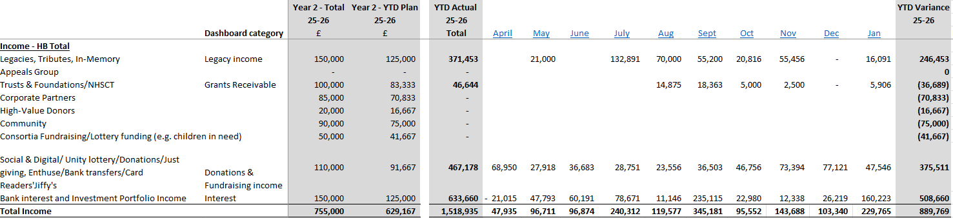
Appendix 1- THE PLAN – Income Performance
Page 11

Slide 13
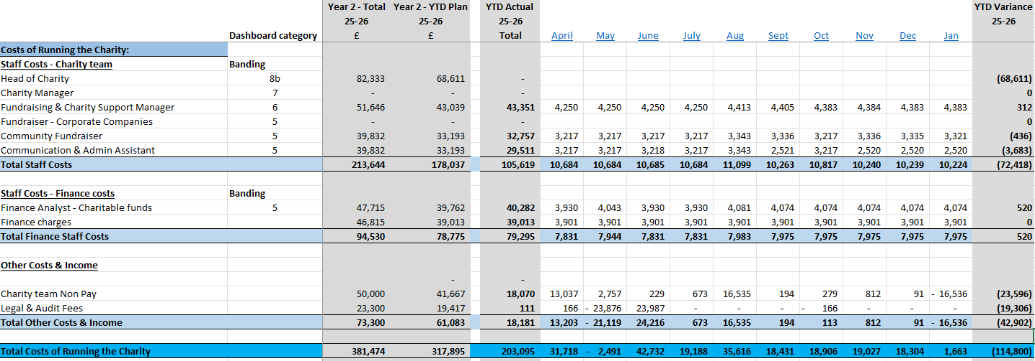
appendix 2 - THE PLAN – FIXED COSTS OF RUNNING THE CHARITY
Page 12

