Slide 1



Charitable Funds Financial Update
Alison McLennan
Assistant Director of Finance
Agenda Item 3.2 Appendix A
16th October 2025

Slide 2

THE PLAN – SUMMARY Movement in fund balance
Page 1
£ | Year 2 YTD Plan | Year 2 YTD Actual | Year 2 YTD Variance
Income | 251,667 | 950,440 | 698,773
Fixed Costs of Running the Charity | (127,158) | (145,195) | (18,037)
Contribution to Expenditure on Charitable Causes | 124,509 | 805,245 | 680,736
Expenditure on Charitable Causes (funds & Small grants) | 267,142 | 308,019 | 40,877
Movement in Fund Balance | (142,633) | 497,226 | 639,859
The plan is phased in equal 1/12ths. YTD incorporates income and expenditure from 1st April to 30th September 2025 – i.e. 6 months.
Plan expenditure is based on total fund expenditure in 2023-24, less fixed costs of running the charity.
CFC agreed not to release any funds from the Swansea Bay General Fund to support small grants in the community for 2024-25 – this is to be discussed for 25-26.

Slide 3
FINANCIAL PLAN Narrative
Page 2
The Plan translates and costs the 5-year Strategic Plan for the Charity, Developed by the Charity Team, and approved by the Charitable Funds Committee (CFC).
The Plan start date was agreed by the CFC to be the financial year 2024-25, therefore we are now in Year 2 of the Plan.
The Plan is all-encompassing, covering income, fixed costs of running the charity, individual fund expenditure and the reserves position.
Year 1 performance to plan has been shared previously with the CFC – this report will focus on Year 2 of the plan.

Slide 4
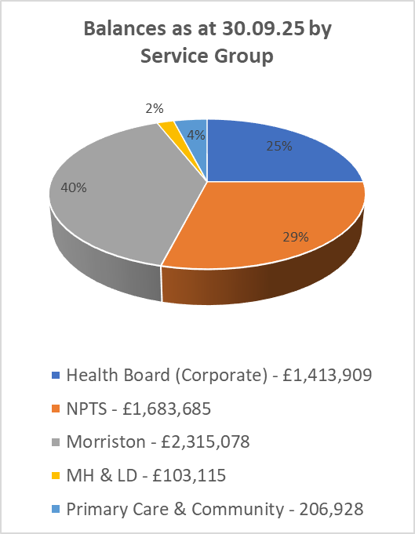
FUND BALANCES BY SERVICE GROUP
Page 3
Top 5 Funds (excluding Core Costs Fund)
Y646 – Morriston General Patients & Staff - £429,060
YN04 – MN Stroke - £335,123
YB34 – South West Wales Cancer Centre - £250,539
YF33 – West Parkinson’s Disease - £133,328
YF31 – West Neurology - £124,587

Slide 5
Administration/overhead charge
Page 4
As agreed by the CFC, an administration/overhead charge of 10% is to be levied across funds.
There have been 3 funds excluded – the MR Morgan fund, core costs fund and the Swansea Bay General Fund.
The basis of the charge was calculated as the closing balance on each fund as at 31st March 2025 and the charge will be enacted in October 2025 (in month 7 position).
All fund managers will be sent a letter in advance of the charges being applied from the Director of Finance, Darren Griffiths, on behalf of the CFC.
The Swansea Bay General Fund will receive a benefit of approximately £420k as a result.
It is proposed to administer the charge on an annual basis using the closing balance at the end of the financial year to be enacted in the first month of the following financial year. This will benefit departments across the Health Board.

Slide 6
DORMANT FUNDS
Page 5
Dormant funds by Service Group
Financial Year 2025/26
Directorate | YE 24/25 | Q1 | Q2 | Q3 | Q4
Health Board | 6 | 7 | 6
NPTS | 43 | 41 | 36
Morriston | 43 | 48 | 52
MH & LDS | 15 | 16 | 16
PCC | 12 | 14 | 10
Total | 119 | 126 | 120
Each quarter’s figures are based on a rolling 12 months

Slide 7
NEW/CLOSED FUNDS
Page 6
New Funds Opened | Fund Number | Reason | Date
Fund Name
None opened
Closed Funds | Fund Number | Reason | Date
Singleton Ward 1 Obs & Opthal | YH58 | Fund requested but never used – due to changes in services/wards this is no longer require | 01.08.25
West CCU Patients & Staff | YC01 | As part of fund rationalisation within Cardiac Services the balance of YC01 was transferred to YC06 in order amalgamate the funds; YC01 is therefore no longer required | 05.08.25

Slide 8
FUND BALANCES
Page 7
Overall fund balances have increased by £0.497m this financial year to date. The main movements are an increase in the investments, creditors and a new fixed term deposit. There was also a decrease in cash held and debtors.

Slide 9
INVESTMENT PORTFOLIO POSITION
Page 8
 | 31st March 2024 £ | 31st March 2025 £ | 30th June 2025 £ | 30th Sept 2025 £ | Unrealised Gain / (Loss) in 2025/26 £
Book Value | 4,211,523 | 4,243,424 | 4,242,617 | 4,246,969
Market Value | 4,817,251 | 4,727,652 | 4,802,201 | 5,020,266
Unrealised Gain / (Loss) | 605,728 | 484,228 | 559,584 | 773,297 | 289,069
Cumulative unrealised gains have increased overall by £289k during the 2025-26 financial year when compared to the year-end value. The portfolio value is updated quarterly. (September 2025 figures are based on Brewin Dolphin online rather than formal portfolio report (expected early October)).

Slide 10
RESERVES PERFORMANCE
Page 9
The Reserves Policy states that the level of reserves held should be within 1 and 4 years average annual expenditure comprising the total fund balance less unrealised gains.

Slide 11
INVESTMENT PORTFOLIO POSITION
Page 8
 | 31st March 2024 £ | 31st March 2025 £ | 30th June 2025 £ | Unrealised Gain / (Loss) in 2025/26 £
Book Value | 4,211,523 | 4,243,424 | 4,242,617
Market Value | 4,817,251 | 4,727,652 | 4,802,201
Unrealised Gain / (Loss) | 605,728 | 484,228 | 559,584 | 75,356
Cumulative unrealised gains have increased overall by £75k during the 2025-26 financial year when compared to the year-end value. The portfolio value is updated quarterly. (September 2025 figures are based on Brewin Dolphin online rather than formal portfolio report (expected mid October)).

Slide 12
Notes
Page 10
At the end of August 2025 Wales Audit Office commenced some early interim audit work for their audit of the 2024/25 annual accounts.
This is ahead of their main audit which is due to start on 27th October 2025 and will continue into November 2025.
Additional investment of surplus cash on fixed term deposit rates have begun with Lloyds Bank as approved by the Director of Finance & Performance – further detail will be shared in future committee meetings.

Slide 13
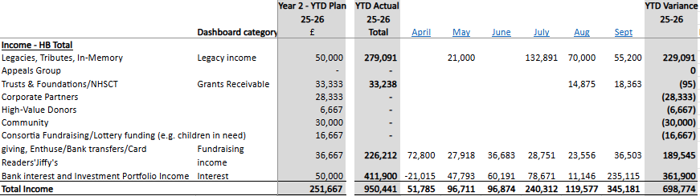
Appendix 1- THE PLAN – Income Performance
Page 11

Slide 14
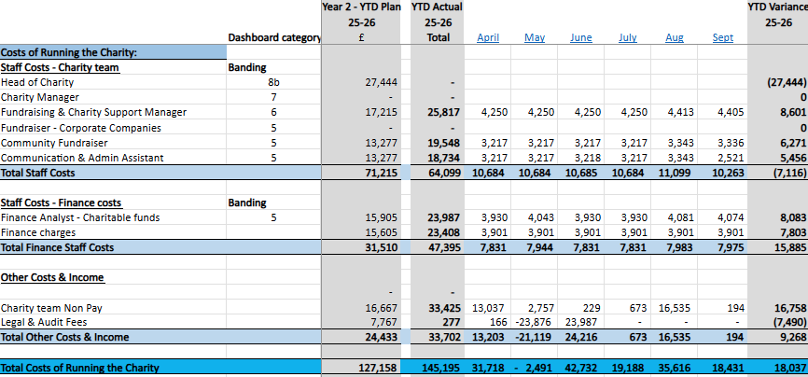
appendix 2 - THE PLAN – FIXED COSTS OF RUNNING THE CHARITY
Page 12

