Slide 1




Fundraising for Swansea Bay Health Charity
Ailish McGrail
Therapeutic Radiographer
Making a meaningful difference and going beyond my clinical role
Wanting to contribute to cancer care and support outside of my job
Personal fulfillment knowing that my efforts can make a difference
Enjoyment in organising and planning events

Slide 2






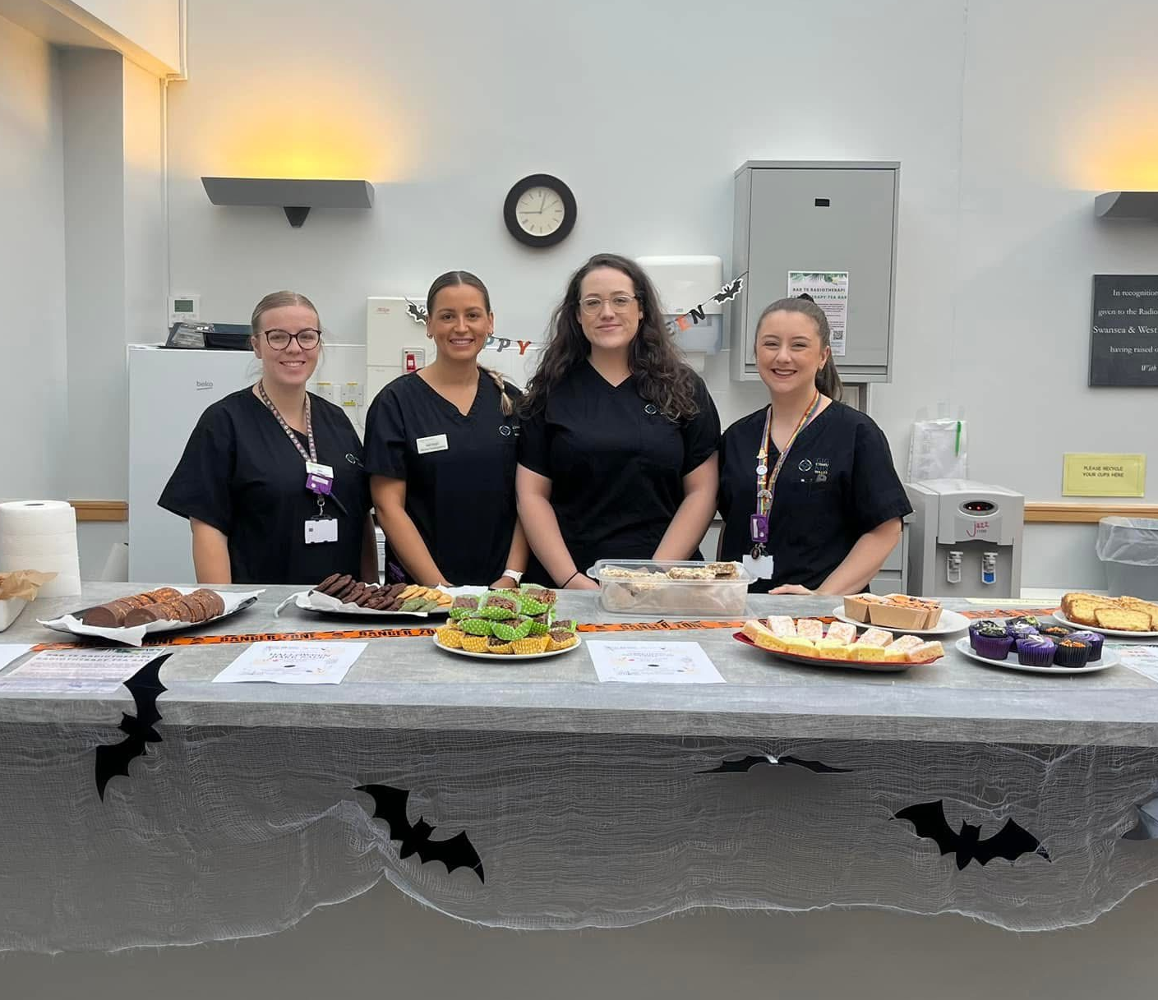


Fundraising since 2023
Raffles
Bake Sales

Slide 3
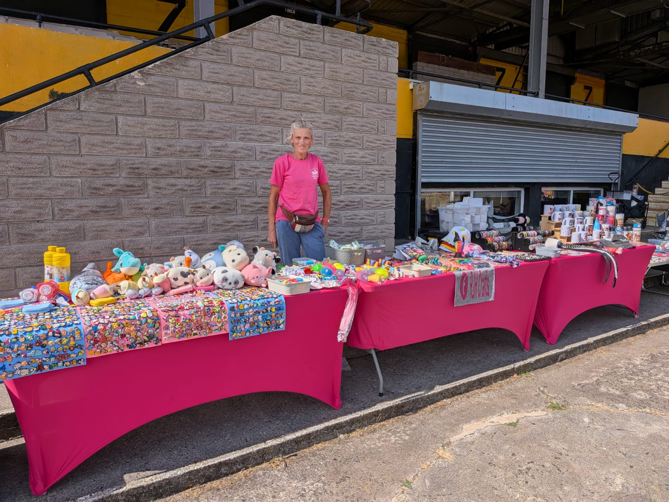
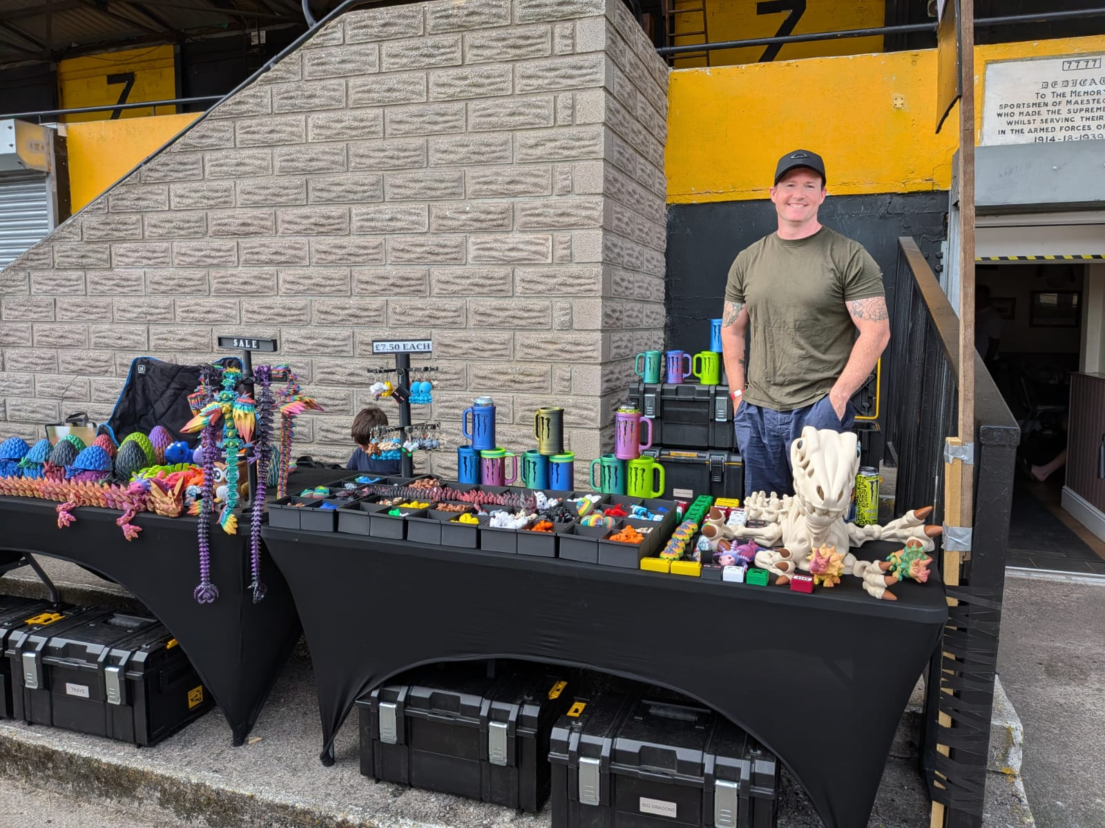
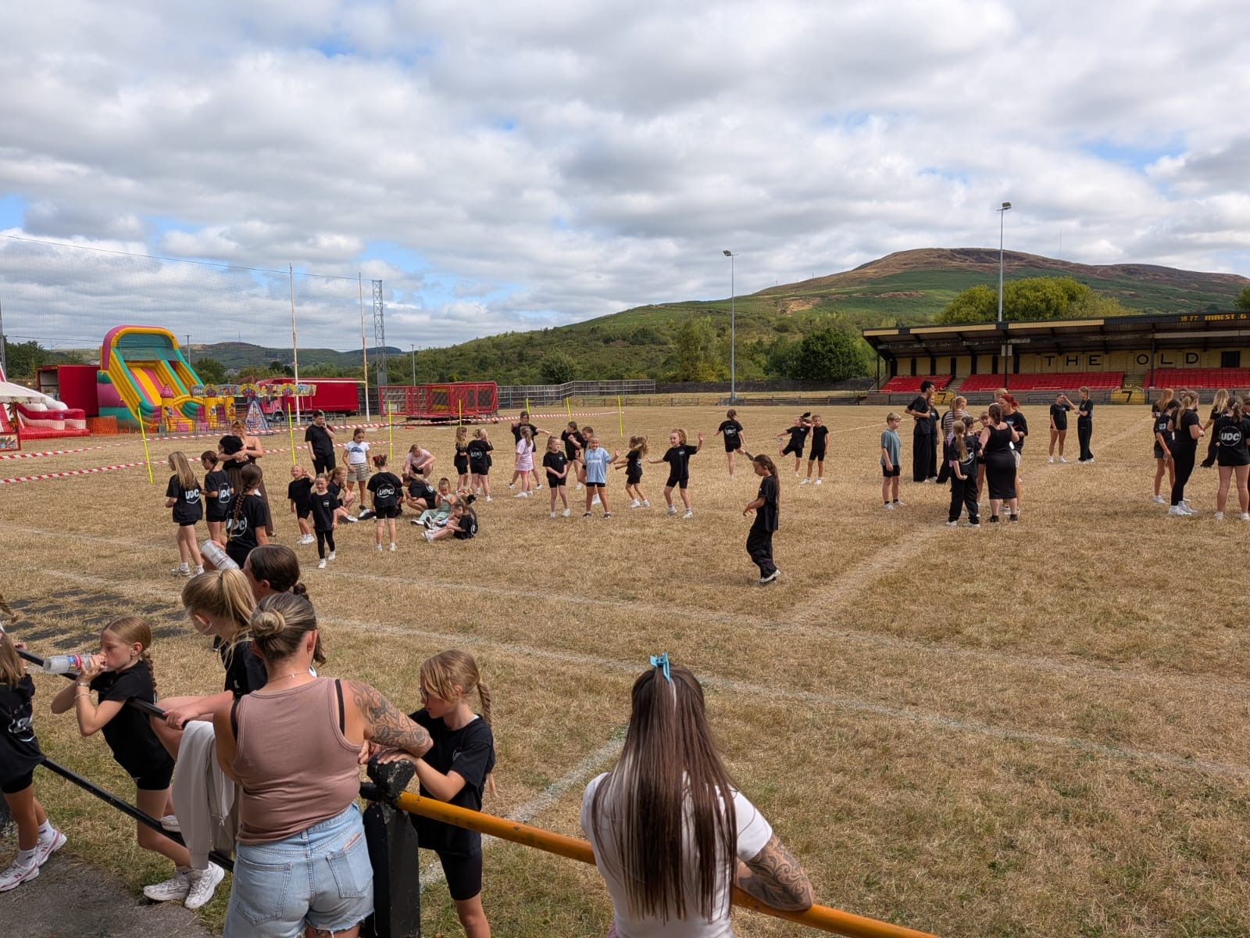
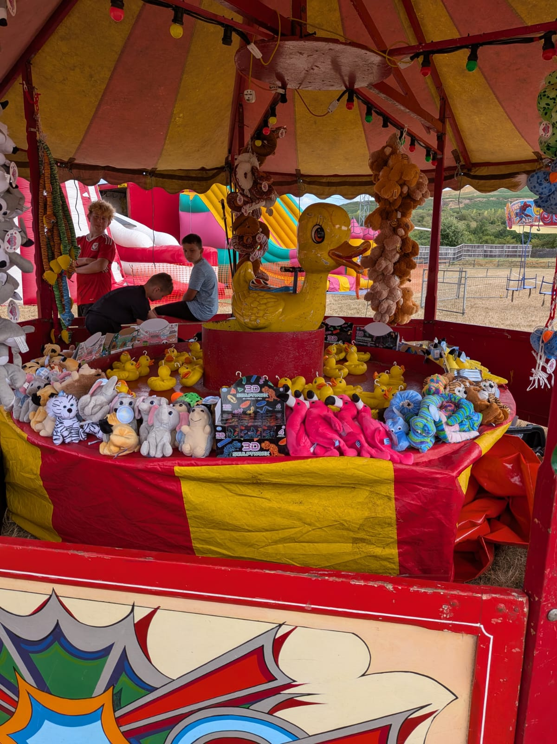

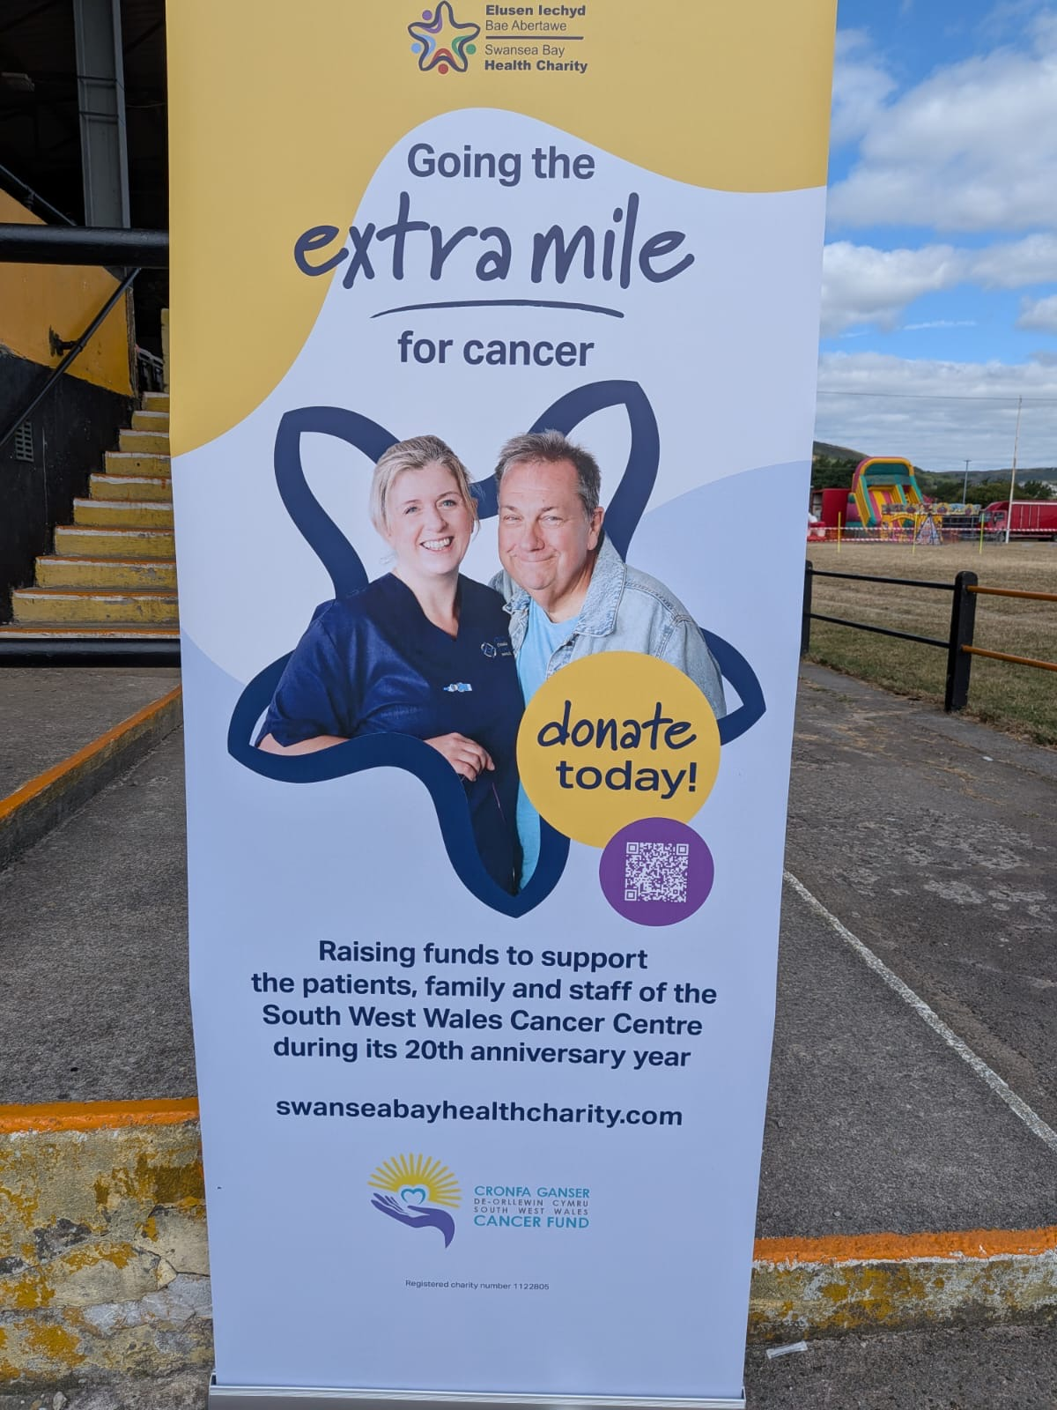
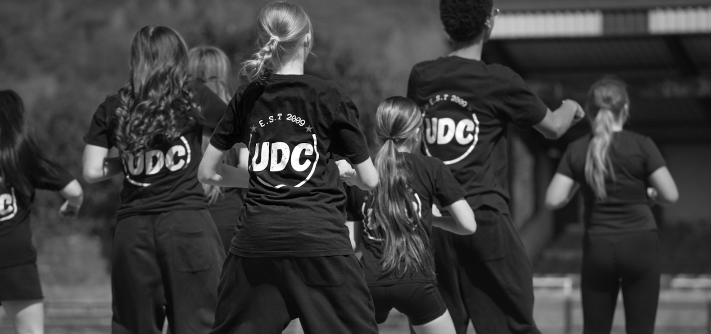
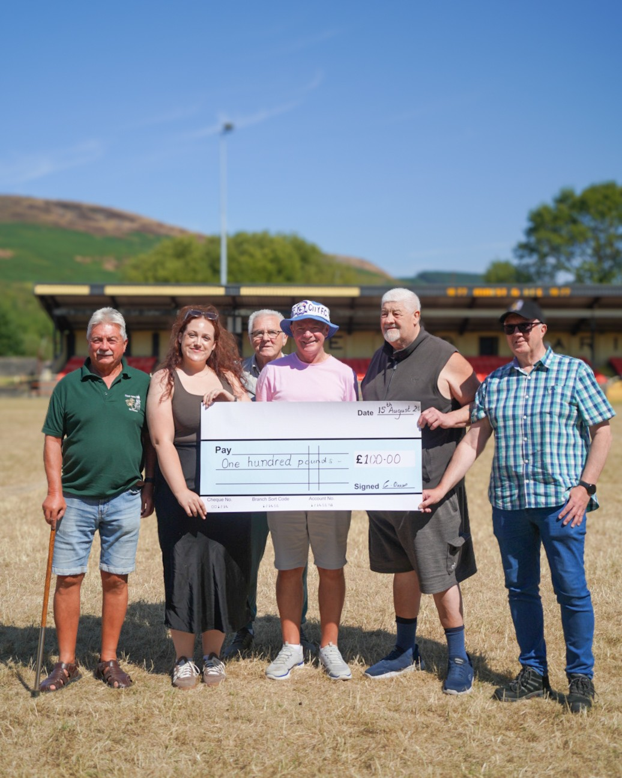
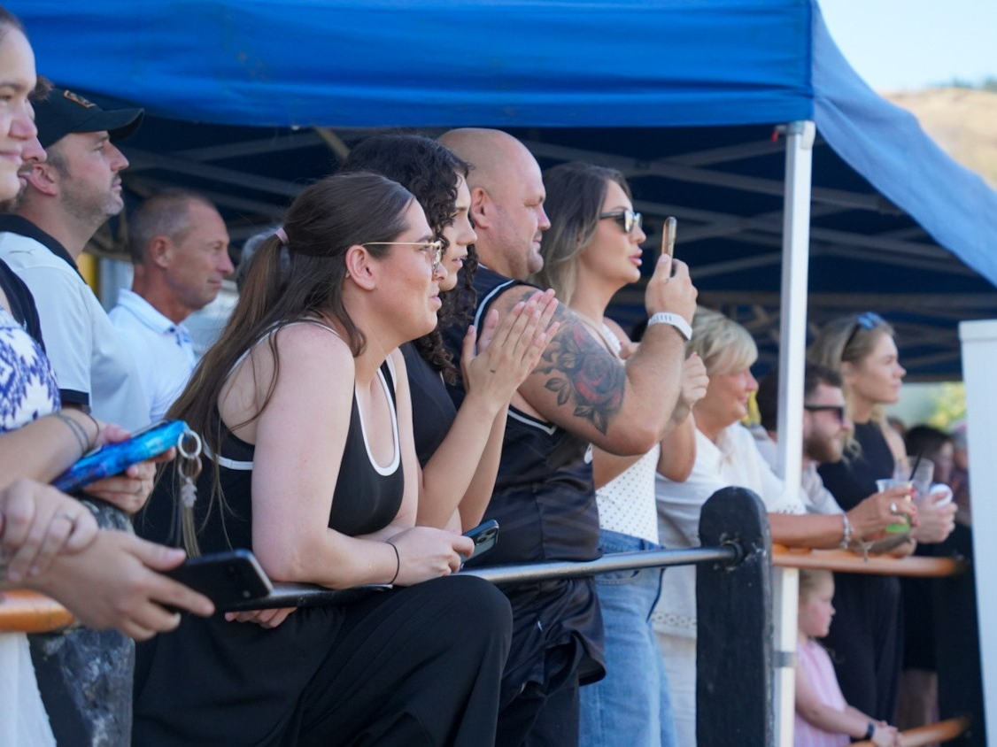
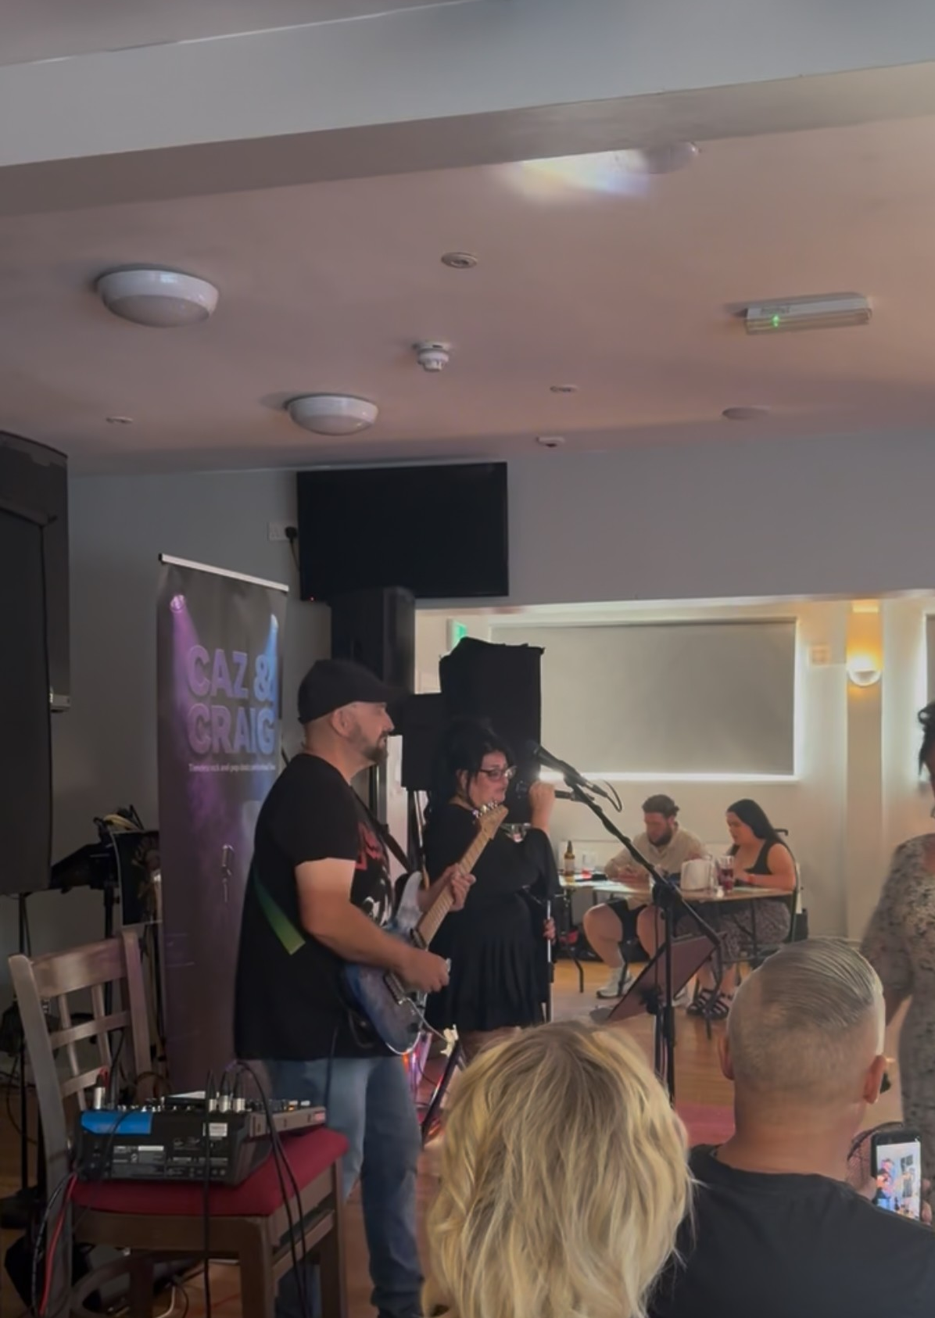
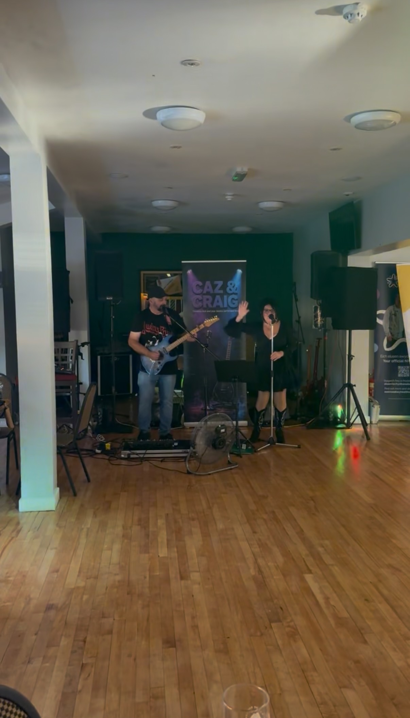

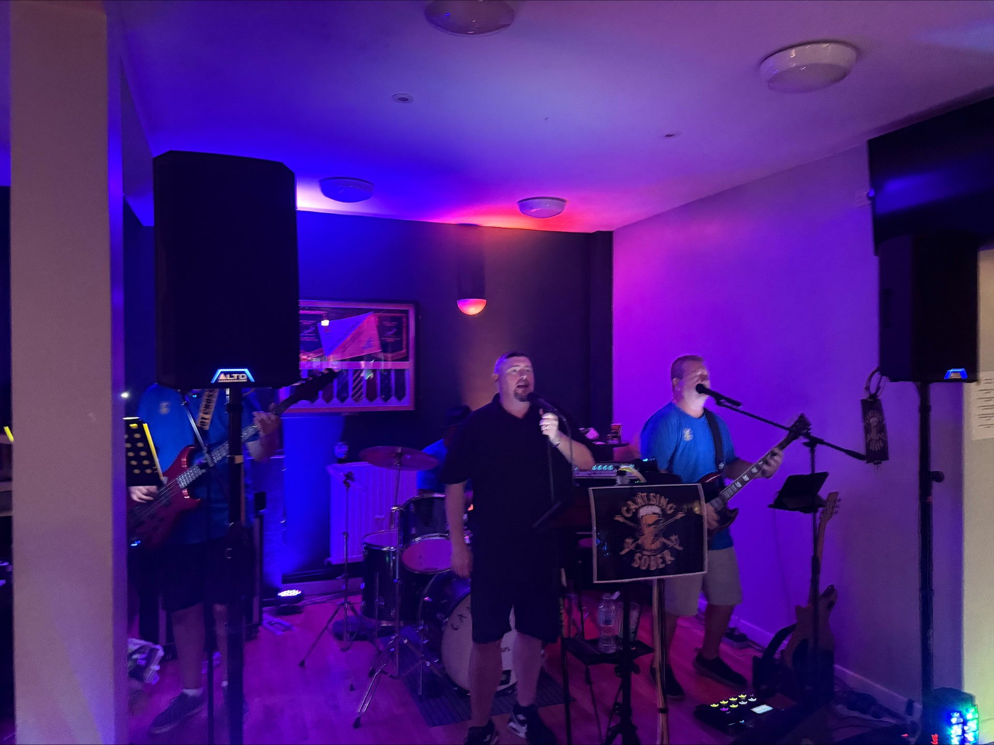
Back to back fundraising day
August 2026
- £1,540.10 raised
Total raised in 3 years
- £6,134.52

