Slide 1




Charitable Funds Financial Update
Alison McLennan
Assistant Director of Finance
Agenda Item 3.2 Appendix A
15th October 2026

Slide 2

THE PLAN – SUMMARY Movement in fund balance 2026-27 Page 2
£ | Year 3 YTD Plan | Year 3 YTD Actual | Year 3 YTD Variance
Income | 479,167 | 804,806 | 325,639
Fixed Costs of Running the Charity | (204,869) | (122,431) | 82,438
Contribution to Expenditure on Charitable Causes | 274,298 | 689,925 | 415,627
 | ​ | ​ | ​
Expenditure on Charitable Causes (funds & Small grants) | 333,928 | 409,468 | 75,540
 | ​ | ​ | ​
Movement in Fund Balance | (59,630) | 280,457 | 340,087
The plan is phased in equal 1/12ths. YTD incorporates income and expenditure from 1st April to 31st August 2026 – i.e. 5 months.
Plan expenditure is based on total fund expenditure in 2026-27, less fixed costs of running the charity.

Slide 3
FINANCIAL PLAN Narrative
Page 3
The Plan translates and costs the 5-year Strategic Plan for the Charity, Developed by the Charity Team, and approved by the Charitable Funds Committee (CFC).
The Plan start date was agreed by the CFC to be the financial year 2024-25, therefore we are in Year 3 of the Plan.
The Plan is all-encompassing, covering income, fixed costs of running the charity, individual fund expenditure and the reserves position.
Year 2 performance to plan has been shared previously with the CFC – this report has detailed the first 5 months of Year 3.

Slide 4
FUND BALANCES BY SERVICE GROUP
Page 4
Top 5 Funds (excluding Core Costs Fund)
Y646 – Morriston General Patients & Staff - £381,872
YN04 – MN Stroke - £314,860
YB34 – South West Wales Cancer Centre - £182,198
YB49 – 20th Anniversary Cancer Support Fund - £137,331
YF33 – West Parkinson’s Disease - £127,711

Slide 5
Administration/overhead charge
Page 5
As agreed by the CFC in its special May meeting, the administration/overhead charge to be levied across funds was reduced from 10% to 6%.
There have been 3 funds excluded – the MR Morgan fund, core costs fund and the Swansea Bay General Fund.
The basis of the charge was calculated as the closing balance on each fund as at 31st March 2026 and the charge was applied in month 3 (June 2026).
The Swansea Bay General Fund received a benefit of £267,829 as a result.
It is proposed to administer the charge on an annual basis using the closing balance at the end of the financial year to be enacted in the first month of the following financial year. This will benefit departments across the Health Board.

Slide 6
DORMANT FUNDS
Page 6
As reported at the previous meeting, there were 66 dormant funds (inactive for more than two years) as at 31st March 2026.
As at 31st August 2026, this number has reduced (by 15) to 51 dormant funds, with a combined balance of £274,163.
Of these 51 dormant funds, 11 have recently had expenditure request forms approved and associated expenditure is currently in progress.
Finance continues to engage with fund managers through emails and meetings to encourage fund activity, in line with the Dormant Fund Escalation Policy approved by the Charitable Funds Committee last year.
The total number of charitable funds currently held is 242.
Breakdown of Funds | Balances <£1k | Balances £1k - £5k | Balances >£5k | Total
Number of Funds | 42 | 75 | 125 | 242

Slide 7
NEW/CLOSED FUNDS
Page 7
No New Fund requested and 5 funds have been closed from last report to 18th September 2026
Closed Funds
Fund Name | Number | Reason | Date
Bernice D Stephens Morriston Legacy Fund (rest) | Y648 | Legacy has been utilised and the fund is no longer required | 16.07.26
Beryl Margaret Clothier Legacy (rest) | Y652 | Opened as a restricted fund for legacy which has now been utilised, so fund is no longer required | 13.07.26
Ty Olwen Education | YB05 | As part of fund rationalisation, to transfer the balance of YB05 to YB42 - Y Rhosyn Palliative care. Ty Olwen Trust now pay for all training for Ty Olwen Staff but some joint training for Ty Olwen & Y Rhosyn staff is paid for from YB42. The monies transferred will be ringfenced for this. | 21.08.26
Singleton Medical Assessment Unit | YF25 | As part of fund rationalisation, to transfer the balance of YF25 to YN17 - Singleton Acute Medical Day Unit in order to close | 21.08.26
Tawe Clinic (Clyne & Fendrod Garden) | YR47 | Balance of fund transferred to YR18 for purchase of 3 benches for garden as insufficient balance in YR47. YR47 no longer required | 12.08.26

Slide 8
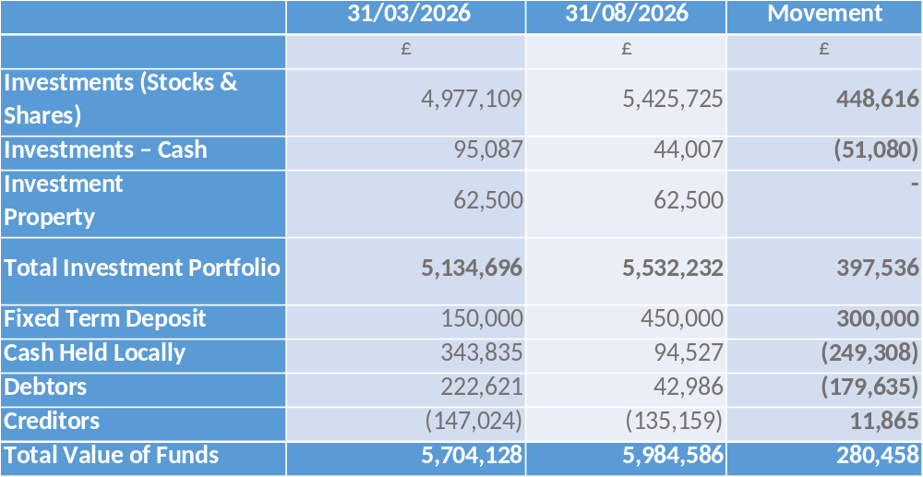
FUND BALANCES
Page 8
Overall fund balances have increased by £0.280m this financial year to date. The main movements are an increase in the investments, fixed term deposits and a decrease in cash and debtors. There was also a smaller decrease in creditors.
Investment vs Cash: Strategic Balance

Slide 9
INVESTMENT PORTFOLIO POSITION
Page 9
 | 31st March 2024 £ | 31st March 2025 £ | 31st March 2026 £ | 30th June 2026 £ | Unrealised Gain / (Loss) in 2026/27 £
Book Value | 4,211,523 | 4,243,424 | 4,279,330 | 4,370,072
Market Value | 4,817,251 | 4,727,652 | 4,977,109 | 5,414,192
Unrealised Gain / (Loss) | 605,728 | 484,228 | 697,779 | 1,044,120 | 346,345
Cumulative unrealised gains increased overall by £346k in the 3 months to 30th June 2026 when compared to the year-end value. The latest quarterly valuation was in June.

Slide 10
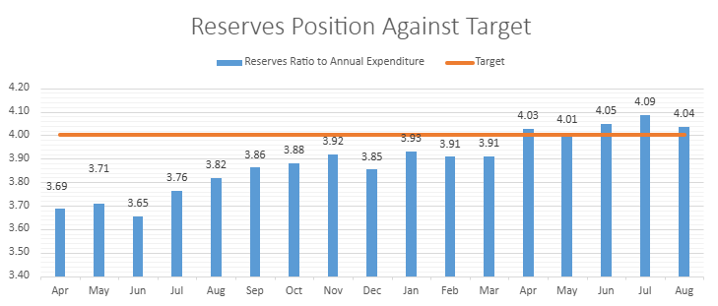
RESERVES PERFORMANCE
Page 10
The Reserves Policy states that the level of reserves held should be within 1 and 4 years average annual expenditure comprising the total fund balance less unrealised gains. The higher fund balance and lower average spend mean the reserves position has been slightly outside of this target range.

Slide 11
Notes
Page 11
The tendering process for the Investment management will take place in accordance with the original contract start date.
The Strategic Plan needs to be refreshed to consider income streams, Dormant Funds, Rationalisation of Funds and Future processes around new fund requests.
Future overhead percentage calculations for 2027/28.

Slide 12
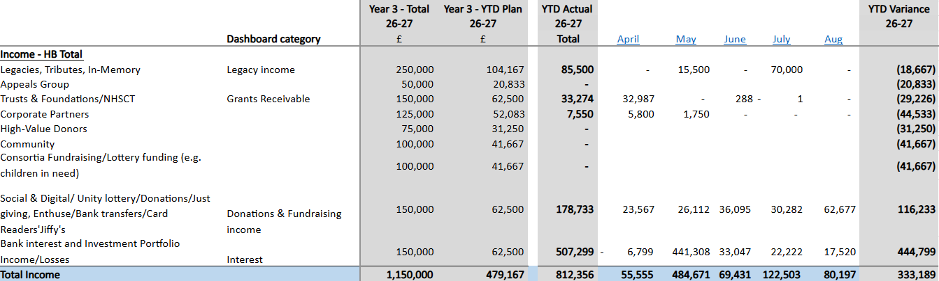
Appendix 3- THE PLAN – Income Performance 2026-27
Page 12

Slide 13
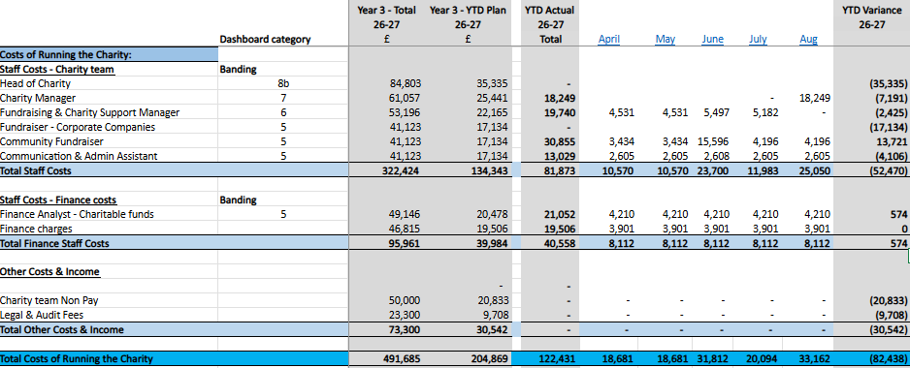
appendix 4 - THE PLAN – FIXED COSTS OF RUNNING THE CHARITY 2026-27
Page 13

