Slide 1
Swansea Bay
Research and Development Annual Review
Notes:
This slide can be used for presentations which are from a health board-wide perspective or for a whole HB audience as the graphic device to the right of the slide includes all four service group colours and red for the corporate team.

Slide 2
Actions from October 2023 Annual Review
Action | Progress
Development of research and development strategy | Underway. Previous strategy has been updated to meet current priorities as a 12-month bridging strategy.
Reporting to board | To be undertaken via the Digital Data, Research and Innovation Committee.
Joint Committee or Forum with Swansea University | Currently managed through JSRC (Joint Study Review Committee) and ARCH (A Regional Collaboration for Health)
Oversight of JCRF (Joint Clinical Research Facility) | JCRF Board is place to provide an overview of performance and finance. This attended by health board, university and JCRF staff.
Workforce research capacity | Tariff included in the job planning guidance and potential for future clinical academics under consideration in the context of the financial challenges faced by both the health board and university.
Alignment of public involvement and UK national standards | An R&D team member attends the HCRW (Health and Care Research Wales) Public Involvement Alliance group and is available as a point of advice for local teams at the research design stage in ensuring public involvement appropriately considered.

Slide 3
General Reflections: Embedding NHS R&D Framework
Self-assesment undertaken in October 2023;
Framework and self-assessment shared with Digital, Data, Research and Innovation Committee in January 2025;
Key areas of focus to begin with are strategy and governance;
Afterwhich there will be an opportunity to refresh the self-assessment to take into account the priorities and plans within the strategy;
Any not covered will be delivered through specific implementation plans;
Progress will be reported to the Digital, Data, Research and Innovation Committee.
Notes:
This is a generic copy slide.

Slide 4
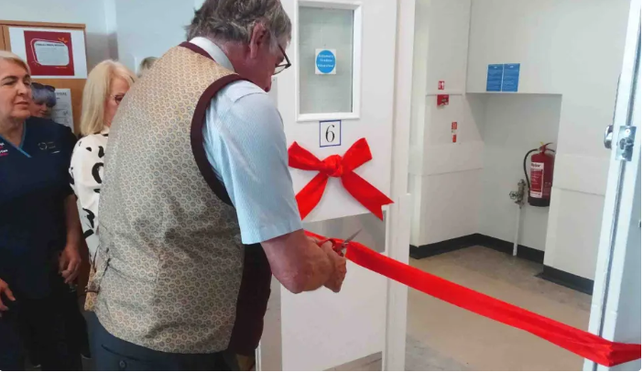
Progress and Achievements
Maintained time to recruit performance - including first patient to be screened in the UK in a commercial epilepsy study.
New and ongoing grants include individual Fellowship and Research Time awards (for a Consultant, AHP (allied health professional) and Healthcare Scientist) alongside two new Health and Care Research Wales study specific grants awarded within Ophthalmology and Physiotherapy.
Swansea Bay UHB also was proud to receive two national awards – MediWales Innovation Award for Technology and Digital Impact (Orthopaedic Prehabilitation and Pre-assessment Team) and an NHS Wales Award for Learning and Research – Lymphoedema team for their ‘On the ground’ community learning scheme.
Successful R&D Day in September 2024;
Cohorts of nursing and medical students undertaking shadowing;
Oncology and haematology clinical space at Singleton;
Appointment of part-time clinical trials pharmacist at Singleton and radiographer now under portfolio of R&D;

Slide 5
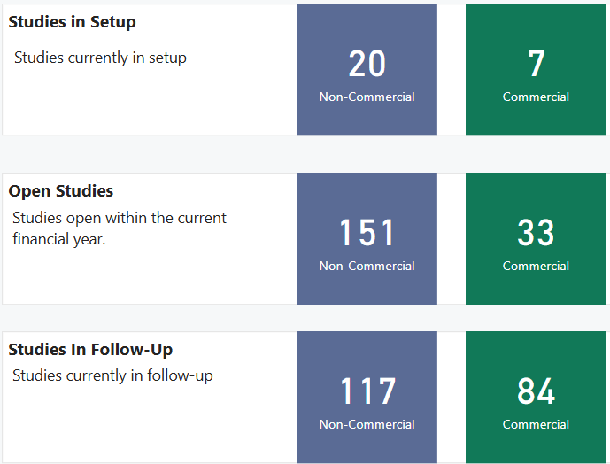
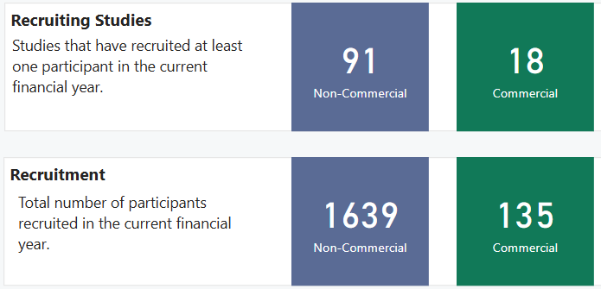
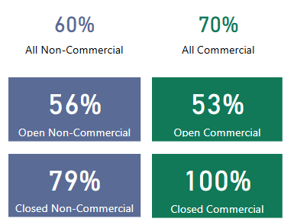
2024-25 in Numbers
Time and Target to Recruitment:
Number of non-portfolio studies: 92

Slide 6
Challenges
Pharmacy
  More capacity needed in Singleton;
  Transparency around pharmacy income and funding streams;
Financial Environment
  Challenges for health and university sectors;
Research facilities
  Space limited for delivery team to see patients;
Advanced therapies
  Policy in process of being developed.

Slide 7
Priorities and Next Steps
Strategy
  Bridging strategy to be taken through governance structures in March 2025;
  Regional arrangements with Hywel Dda University Health Board;
Governance arrangements
  Part of the board-level Digital, Data, Research and Innovation Committee;
  Operational arrangements to be established;
  MoU (memorandum of understanding) with Swansea University to be revisited;
  Co-sponsorship agreement with Swansea University;
VPAG (Voluntary Scheme for Branded Medicines, Pricing, Access and Growth)
  Potential for cancer link with Hywel Dda University Health Board, starting with pharmacy arrangements;
New clinical academic appointment in SAIL (Secure Anonymised Information Linkage Database)
  Joint appointment Swansea Bay/Swansea University and Wales Cancer Research Centre;
  Potentially the first in UK.

Slide 8
Thank you.

