Slide 1


Swansea Bay University Health Board
Performance & Finance Committee
Financial Plan 2024/25 – Next Steps to Board Meeting on 23rd May 2024
23rd April 2024

Slide 2
PART 1: Recap Revenue Financial Plan Submission 2024/25

Slide 3
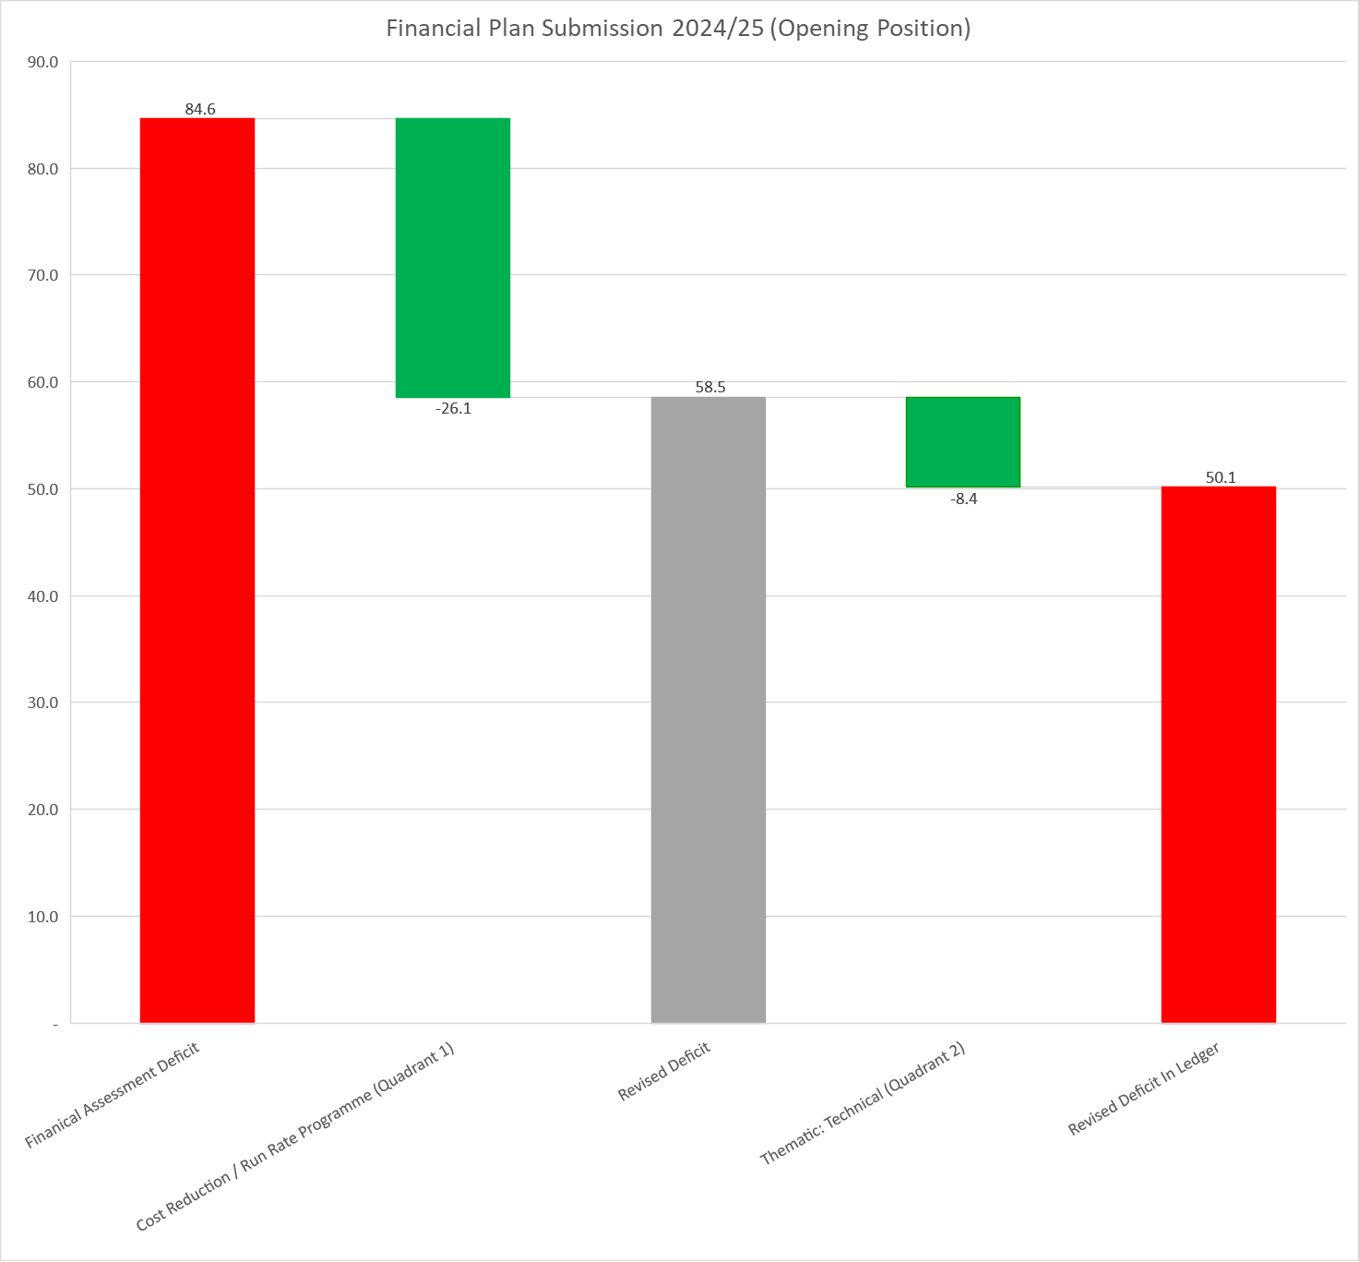
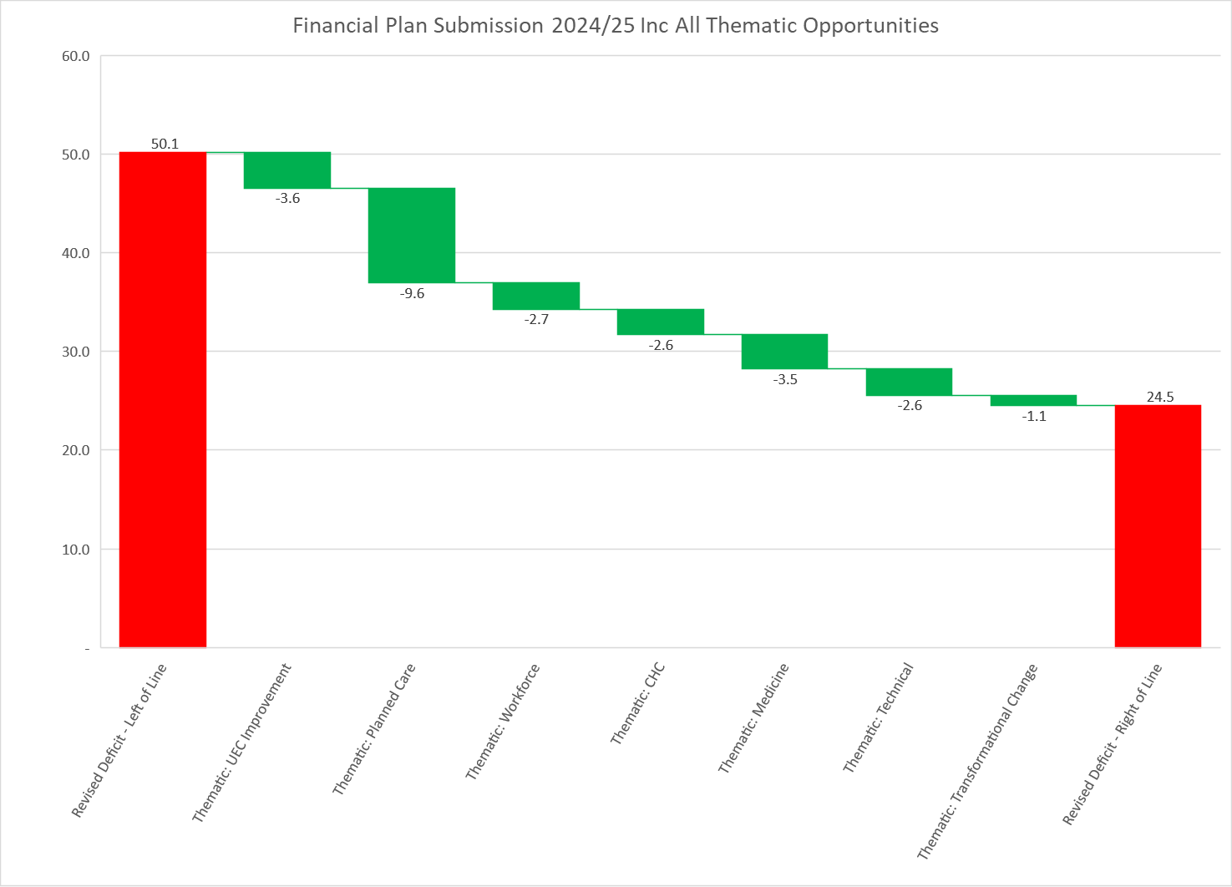

Financial Plan 2024/25 (Waterfalls)
Part 1 Plan Submitted 28th March 2024: Including Quadrant 1 and Part of Technical Themes from Quadrant 2
ANCHOR POINT
Part 2 Plan: Including delivery of the remaining balance of Quadrant 2 Opportunities £25.6m
V&S
Part 2 Plan requires Executive leadership and granular plans to provide the confidence to the Board and thus allowing the plan to be moved In-Year from £50.1m to the £24.5m

Slide 4
Thematic Summary & SRO
At the Board Briefing on the 29th February members were presented with a list of ‘OPTIONS’ to mitigate the assessed deficit position. A list of the options is provided in the next slide (including the ‘greens’ items of £26.1m + £8.4m which are on the right of the anchor point). A high level summary of the options grouped into thematic areas is provided below as a recap excluding the green items.
The Board were informed in March that a named SRO would be allocated to allow the programmes to commencement in early April 2024.
Underpinned by

Slide 5
Full List Options Grouped By Theme From 29th February 2024 Board Brief
Key:
Green = Already in £50.1m
Amber = choices Board to do in Q1
Yellow = granular plans and SRO lead actions required
Only when there is a high level confidence in delivery of yellow and amber schemes would a proposal be presented to the Board to amend the Board supported Anchor point of £50.1m .

Slide 6
Years 1 - 3
The MDS (Minimum Data Set) required by WG alongside the main plan submission requires the submission of Year 2 and Year 3 indicative plan.
The two lines highlighted in yellow will need to be updated to reflect the outcomes of the Quadrant 2/Thematic Programmes. At point of completing the MDS for submission on 28th March 2024 the value is held at nil, for updating through 2024/25.

Slide 7
PART 2: Update Financial Plan 2024/25 Post Board Approval 28th March 2024

Slide 8
Update Thematic Programmes & Financial Plan
Executive Team agreed the nominated SRO for each Programme on 3rd April;
Finance PMO developing reporting mechanism for each programme ensuring there is no duplication of schemes that will support the delivery of the £26.1m allocated to Budget Holders;
Initial meetings held with each SRO by the Finance PMO to support set up of programmes;
Updates from each programme required by end April to support recommendation to the Board on any potential changes to the plan. Governance route for agreement will be:
Management Board 15th May 2024
PFC In-Committee
21st May 2024
Board Meeting
23rd May 2024
Further Accountability Letter submitted WG end May 2024
Thematic Programme | SRO
UEC Improvement | Chief Operating Officer
Planned Care | Chief Operating Officer
Workforce | Interim Director of Workforce & OD
CHC | Interim Director of Strategy
Medicines | Interim Medical Director
Technical | Director of Finance & Performance
Transformational | Director of Finance & Performance
Underpinned by

Slide 9
Update KPMG Work Programme
Programme Areas | Allocation Time
1. Independently assess the scale and drivers of the underlying deficit | 10%
2. Review opportunities to further strengthen existing financial controls | 5%
3. Review the detail of the in-year financial plans our Service Groups will return to us at the end of May 2024 for deliverability | 20%
4. Refresh pipeline of savings previously determined by KPMG and align this with our Health Board internally developed repository of opportunities to maximise immediate and medium term options to achieve balance as soon as possible. We discussed that the look back may be less valuable given the significant progress in implementing the Health Board’s Clinical Services Plan (CSP) which is due to commence a refresh in 2024 and that a prospective piece of work on future opportunities in year would be key | 55%
5. Set out for the Health Board the opportunities to deliver the requirement of financial balance as soon as possible within this three-year planning cycle. Essentially this is an extension of point 4 above into future years but I wanted to draw the distinction from the drive to improve significantly in year with my Board’s ambition to get a sustainable position of balance as soon as possible within the 3 year planning cycle | 10%
Underpinned by

