Slide 1


Performance & Finance Committee
Neath Port Talbot & Singleton Service Group
26th August 2025

Slide 2

Agenda Detail
Health Board & Service Group Financial Summary
In-Month Revenue Position
Savings Performance
Key Drivers
Risks, Next Steps & Mitigating Actions
Appendices

Slide 3

Dashboard

Slide 4
Summary Health Financial Plan & Service Group Element
FINANCIAL PLAN 2025/26
SERVICE GROUP ELEMENT PLAN
OPENING BUDGET

Slide 5

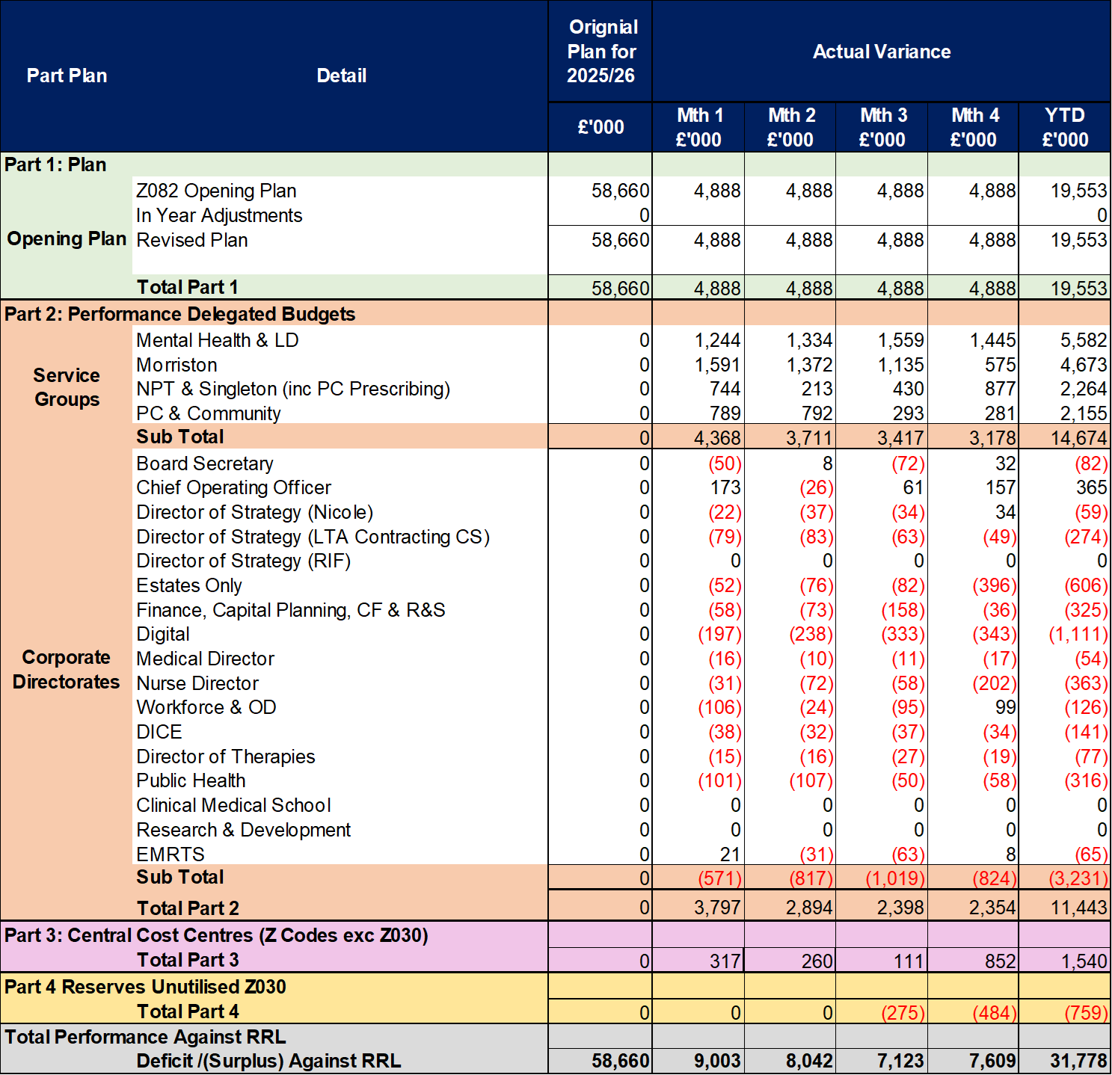
2025/6 In Year Health Board Position & Service Group Element

Slide 6
Service Group Position By Month & Divisions
KEY MESSAGES
Neath Port Talbot & Singleton Service Group (NPTSSG) has an assessed opening 2025/26 underlying deficit of £16.4m excluding new year growth and inflation but assumes that long standing underspends continue and all 2024/25 savings plans listed as green/ amber deliver a full year effect. This assessed deficit has been funded via the Health Boards financial plan. In addition, funding for assessed growth of Primary Care Prescribing and Systematic Anti-Cancer Therapy (SACT) has been issued. All other growth, demand and service pressures are expected to be managed, and the Service Group deliver a break-even position.
The Service Group has been set a savings target for the year of £16.1m
In Month 4 NPTS is reporting an overspend of £0.878m and a Year to Date overspend of £2.266m.
It is worth noting that the M1-3 position has been restated in M4 to reflect the transfer of the Patient Access service from Morriston to NPTS. This improved the M3 Year-to-date position by £0.157m
£0.179m of the deterioration from M3 to M4 relates to the transfer of this service, accompanied by it’s share of the Morriston Service Group (MSG) Savings Target (£0.040m), as well as an Underlying Surplus adjustment to reflect the level of underspend (£0.139m) assumed for this service within the MSG Underlying Deficit.
£0.100m of the in-month deterioration is because of drug costs, with primary care prescribing variance deteriorating by £0.060m and pharmacy drug fridge failure resulting in a £0.040m drug write-off.
The remaining deterioration was seen in Cancer Services with non-recurrent pressures for items such as the retrieval of notes from external storage (£0.035m) as a part of a plan to cease external storage and related costs, purchase of batteries (£0.035m) within the Medical Equipment Management Service.
The position excluding cost improvement targets is largely within the underlying position assessment utilised in planning for 2025/26. However, there are both areas of improvement and those where pressures have been worse than expected. Whilst they are netting off at this point, close monitoring is being undertaken to ensure that the benefits can be maintained as far as possible and that the pressures are being actively managed.

Slide 7
Year-To-Date Service Group Position By Division & Type Expenditure/Income
Excluding the impact of unidentified savings vs target, the YTD financial position is better than the Underlying Deficit assessment.
Income is improved because of continued non-recurrent contribution from the provision of radiopharmacy services to Southeast Wales – this over delivery offsets increased associated cost on both the pay and non-pay lines.
Despite this, areas of concern when compared to the underlying assessment at this stage include Establishment Expenses (£106k overspend YTD) and Premises & Fixed Plant (£227k overspent YTD). Establishments Expenses overspends are driven by Postage (£61k) and Travel & Subsistence (£20k overspent).
The following areas of Clinical Services & Supplies cost pressures are offset by underspends in Surgery, namely Theatres: IMM vaccines £115k overspent; Women’s Health overspend (£226k) consisting of £84k Neonatal Medical & Surgical Equipment which is materially driven by activity; Welsh Fertility Institute overspend of £59k.
There is a risk that those spends currently lower than the assessed Underlying Deficit, and now therefore funded, increase and therefore expose the areas that are currently spending above Underlying Deficit assessed levels.
The pay expenditure YTD is lower than funding and therefore assessed underlying deficit although there is risk inherent within this position. Significant contributors to this underspend include Community Paediatrics and Welsh Fertility Institute (WFI), accounting for over half of the underspend. It is worth noting that no ULD adjustments were made to WFI budgets due to being a JCC commissioned service with budgets maintained to reflect historic funding levels.

Slide 8

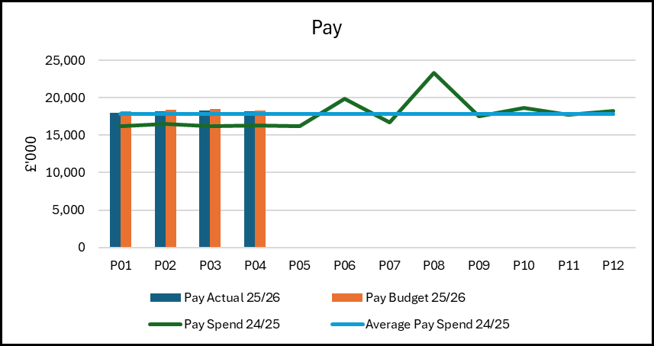
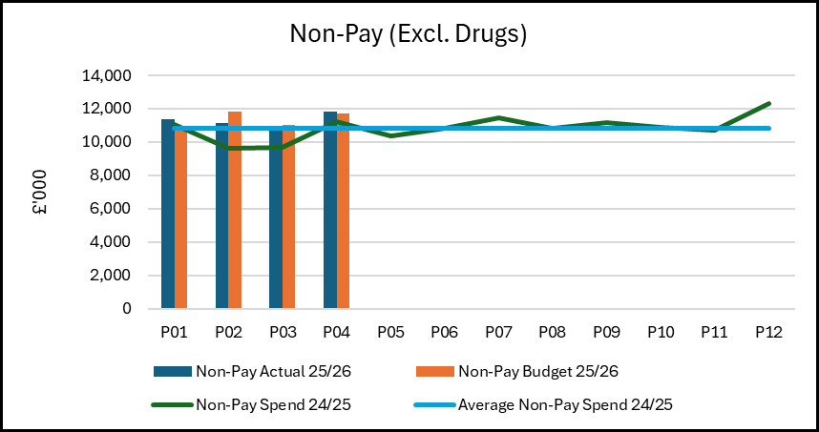
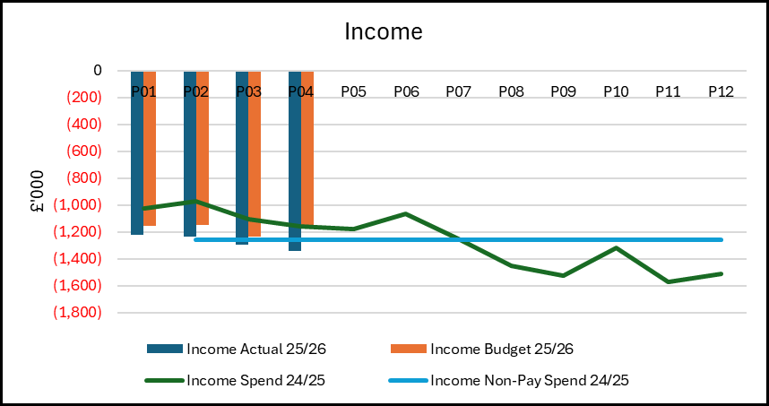
Drivers of Position (Actual)
Pay: Actual expenditure trend across the first third of the year is averaging £0.363m higher per month than the 24/25 average. 25/26 Pay award, including arrears, is expected to be paid in August. The medical staff increase equates for £0.035m of this average monthly increase – although this has trended upwards for each of the 4 months to date, while nursing (both registered and unregistered) equates for £0.202m of this increase, with Children’s services accounting for £0.087m of that, driven in part by higher nursing to patient ratio, including patient with needs for 3:1 care and 5:1 care. Pharmacy Scientific and Technical staff contributes to £0.078m of this monthly average increase.
Monthly variable pay for the first quarter of the year is lower than the monthly average for 24/25, with M4 spend reaching the average level of 24/25. Improvements in registered nursing variable pay is largely offset by increases in unregistered nursing. Decreased registered nursing variable pay also coincides with an increase in nursing substantive costs.
Non-Pay: Excluding Drugs (includes Blood Products) the actual monthly average cost of the first third is running at £0.458m higher than the average for 24/25, of which £0.115m relates to outsourcing/insourcing costs; £0.239m is primary care prescribing where the former is funded from Welsh Government Recovery monies and the latter currently cumulatively underspent. Monthly drugs costs, which consists primarily of NICE drugs, is on average £0.407m higher per month this year vs last year.
Income: Income continues to deliver above target levels, in large part due to the non-recurrent income associated with the temporary provision of radiopharmacy services to Southeast Wales. Income levels are currently at the average monthly level seen in 24/25.

Slide 9
Drivers: Pay Summary
Medical staffing pay trend, on average, is relatively static to the average of last year. However, following a lower cost month in month 1, the month-on-month trend is increasing. This, in the main, has been driven by the month-on-month increase in variable pay – notably agency.
Monthly nursing costs were higher in the first third of the year compared to the prior year monthly average with half of the increase driven by 2 areas: Theatres and General Paediatrics. Theatre increases (£57k monthly on average) are linked to Recovery funded additional activity whilst the paediatric increase (£51k monthly on average) is driven by patient need for increased nurse to patient ratio. This need subsided in month 4 and saw a significant decrease in spend.
25/26 Pay Awards are expected to be applied in August, accompanied by the related funding.
Paid Whole Time Equivalent numbers (which doesn’t include agency) are marginally lower in the first third than the monthly average of the last financial year. This is expected given the slowing of recruitment due to enhanced scrutiny.

Slide 10
Drivers: Variable Pay & Performance Against 30% Reduction (Actual)
Key messages:
The Health Board has been set targets to reduce agency expenditure as part of the NHS Wales Planning Framework. The target is to reduce all agency expenditure by 30% based on the 2024-25 outturn and to cease the use of all ancillary, A&C, and HCSW agency staffing by the end of September 2025. The Service Group’s net agency spend target was bettered in month although with some staff group improvements offsetting others that are not currently meeting the target. Notably, nursing agency reducing to £64k below target following spikes in spend in M1 and 2 resulting from up to 5:1 nursing : patient requirement. This in Month 4 offset medical agency which was £54k above the 30% reduction target. Medical agency continues to be used in Haematology and Oncology to cover long term vacancies with additional usage in Oncology due to sickness; General Paediatrics due to a combination of consultant restricted duties and junior doctor Less Than Full Time (LTFT) gaps, restricted duties and sickness. In addition to these, both Breast Services and Spinal have this month started incurring medical agency spend due to new vacancies and long-term vacancies, respectively. Continuation of agency spend in Breast and Spinal is a risk with its continuation at best offsetting any potential reductions made elsewhere.
Waiting list initiatives continue to be used to support the delivery of surgical capacity, in particular planned care additional work. Anaesthetics continues to be the biggest consumer of WLI/ADH (£311k in month) because of core activity vacancies, additional emergency activity and planned care recovery.
Month 4 overtime spend was in line with the monthly average spend for 24/25. Of that overtime, Overtime Planned Additional Activity Rate (PAAR) spend currently averages £63k per month and is mainly associated with Theatres activity supporting Planned Care Recovery programme which is a little higher than the average for 24/25..
As above, this target is only now breached within medical staffing and Scientific and Technical but is being offset by registered nursing and Allied Health Professionals in M4.
.

Slide 11
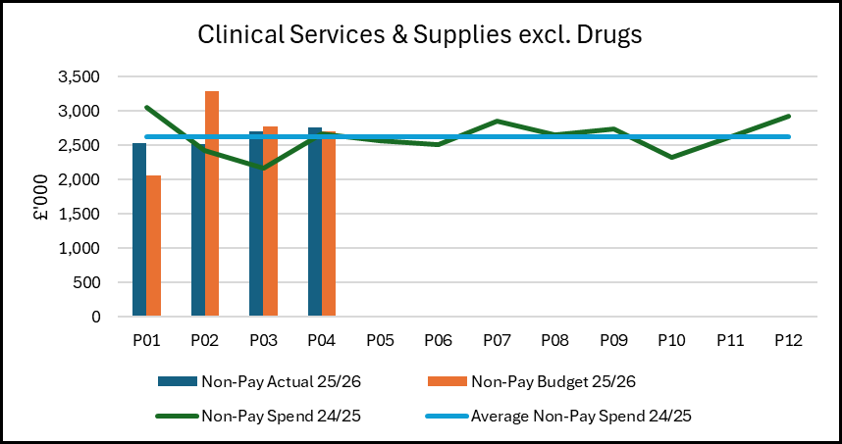
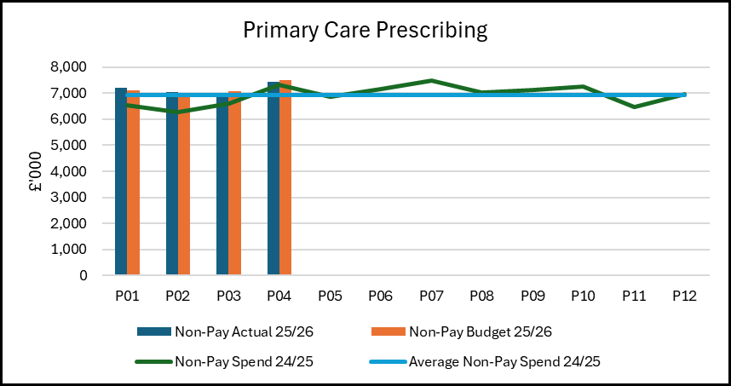
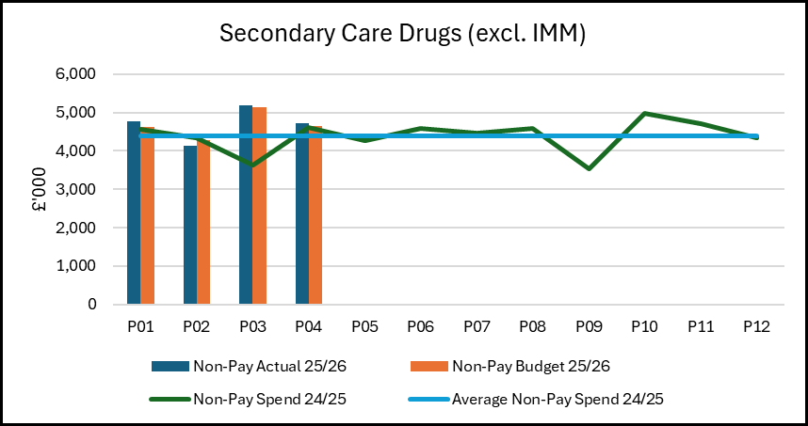
Drivers: Non-Pay (Actual)
On average, Clinical Services & Supplies spend is in line with last year’s monthly trend whilst underspending on budget YTD by £311k – with Theatres contributing £325k towards that underspend.
Primary Care prescribing costs for the YTD are on average £239k per month higher than in 24/25 but currently remains within the funded levels due to a combination of savings delivery and 25/26 growth funding. Continued close monitoring of growth required vs funding assumption.
Monthly Secondary Care drug costs, which consists primarily of NICE drugs, is on average £0.407m higher per month this year vs last year. This increase is largely seen in the following areas: £96k increase on average per month in Haematology vs prior year average; £103k increase on average per month in Oncology; £125k increase on average per month in Rheumatology.

Slide 12

Savings Summary

Slide 13

Identification Opportunities & Risk
Further Opportunities for 25/26:
Further progress of savings schemes for inclusion in the savings plan, including but not limited to
  Additional commissioning income
  Investment in digital technology and process e.g. Self check-in
  Service modernisation & efficiencies
  Theatre efficiencies
  Accounting gains
Recovery of costs for additional work undertaken in recovery space to ensure complete cost recovery.
Variable pay reduction following the local implementation of new Health Board wide capped expenditure.
Review of use of nursing headroom and associated rostering
Further Risks:
Recovery work impact on clinical support service spends, flows of recovery funds.
Waiting List Initiative Pay Award/ Pay Disputes
Operational Pressures
Implementation timescales/ managerial capacity for a number of work programmes including recovery
Challenge of staff engagement against perceived deliverability
Inter group consequences of recovery plan options
Additional costs of band 2 to 3 Support worker agreement
Lower vacancy rate than assumed in Health Board financial plan
Primary Care Prescribing volume and price growth greater than growth funding

Slide 14
Actions & Next Steps To Be Taken By Service Group
The Service Group needs to manage new emerging pressures to ensure spend does not breach the underlying assessment.
The Service Group needs to continue to develop and deliver its cost improvement plans to meet the full £16.1m target recurrently and utilise non recurrent means to bridge the timing gaps that are now inevitable through the 2025/26 financial year.
All Amber Schemes to be reviewed and any outstanding issues address so the scheme can turn Green
All Red Schemes to be reviewed and one of two actions to be taken:
    where the scheme remains valid all work required to allow them to turn to Amber to be completed
    where the scheme is no longer valid, they need to be removed as a viable scheme on the tracker
Further work is required to understand the impact of changing demand profiles and those driven by recovery work in supporting clinical services and clinical support services to ensure no adverse impact on the financial position.
Additional Budget Manager training sessions are planned to ensure the management teams supporting Divisions have the core budget management skills require

Slide 15
Appendices

Slide 16

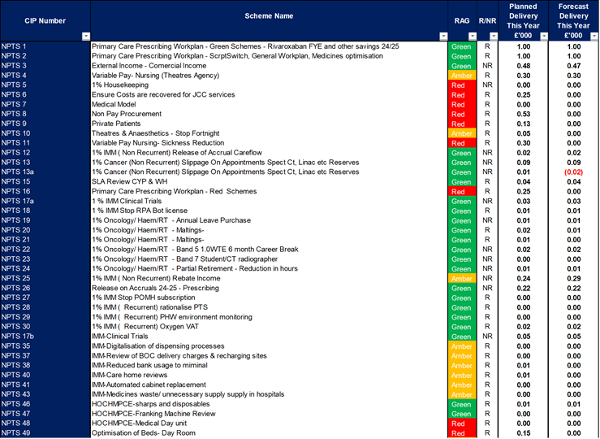
Appendix 1: Schedule Savings Schemes

Slide 17
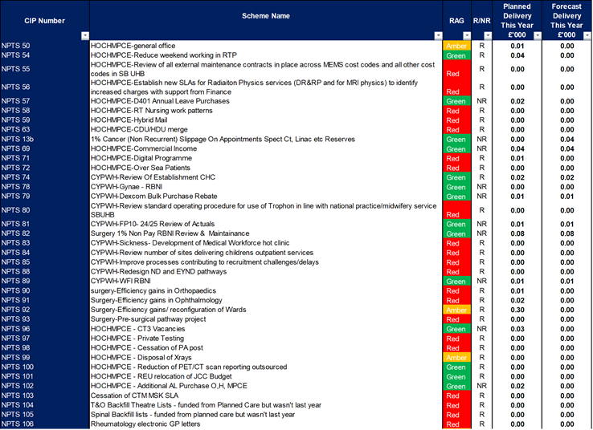
Appendix 1: Schedule Savings Schemes

Slide 18
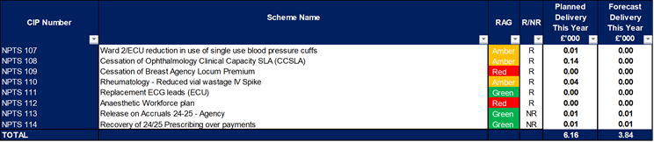
Appendix 1: Schedule Savings Schemes

