Slide 1


Performance & Finance Committee
Primary Care, Communities and Therapies Service Group
17th December 2024

Slide 2

High Level Summary
Top 3 Actions to address position:
PCT SG has identified a further £1.9m of non recurrent savings in month which will support the achievement of the £1.8m control total.
The increase of the Gorseinon beds to 48 at the end of November is adding a further cost pressure of c£30k per month so further mitigations will need to be identified in order to achieve the £1.8m.

Slide 3
Agenda Detail
Health Board & Service Group Financial Summary
In-Month Revenue Position
Savings Performance
Key Drivers
Risks, Next Steps & Mitigating Actions
Appendices

Slide 4

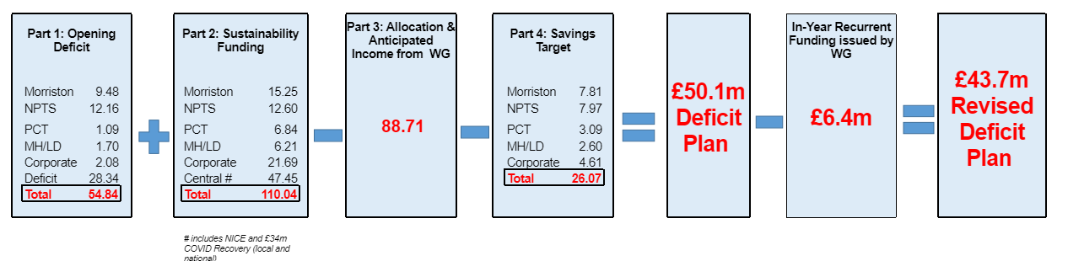
Health Board Summary Elements of Financial Plan
Note: Specific elements from Part 1, 2 and 4 of the plan that relate to this service area are summarised on the next slide.

Slide 5

Service Group Element of Financial Plan

Slide 6

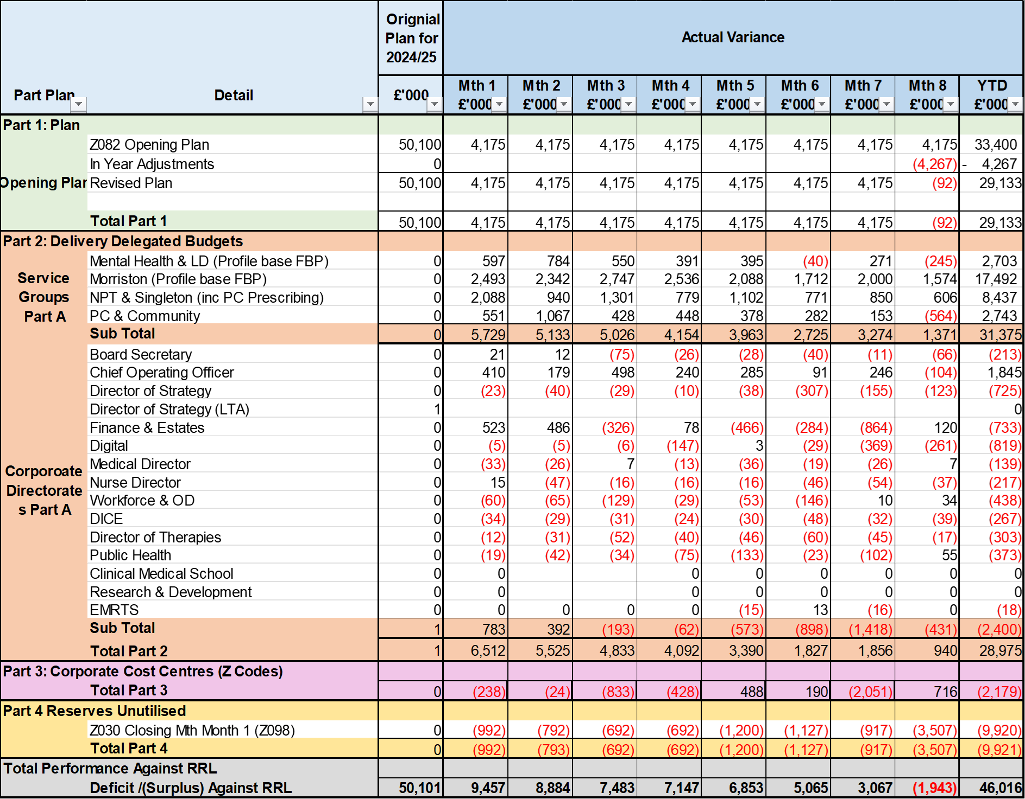
2024/25 In Year Health Board Position

Slide 7
Service Group Position By Month & Divisions
Key messages:
There have been improvements month on month largely through non recurrent benefits.
The majority of the year to date overspend is related to:
  continuing care home spend (£3.9m)
  Shortfall in dental patient charge revenue £800k
  higher Looked After Children contributions to the local authorities (£643k)
  additional beds in Gorseinon above funding (£529k)
  District Nursing £400k .
Offset by vacancies and non recurrent benefits.

Slide 8
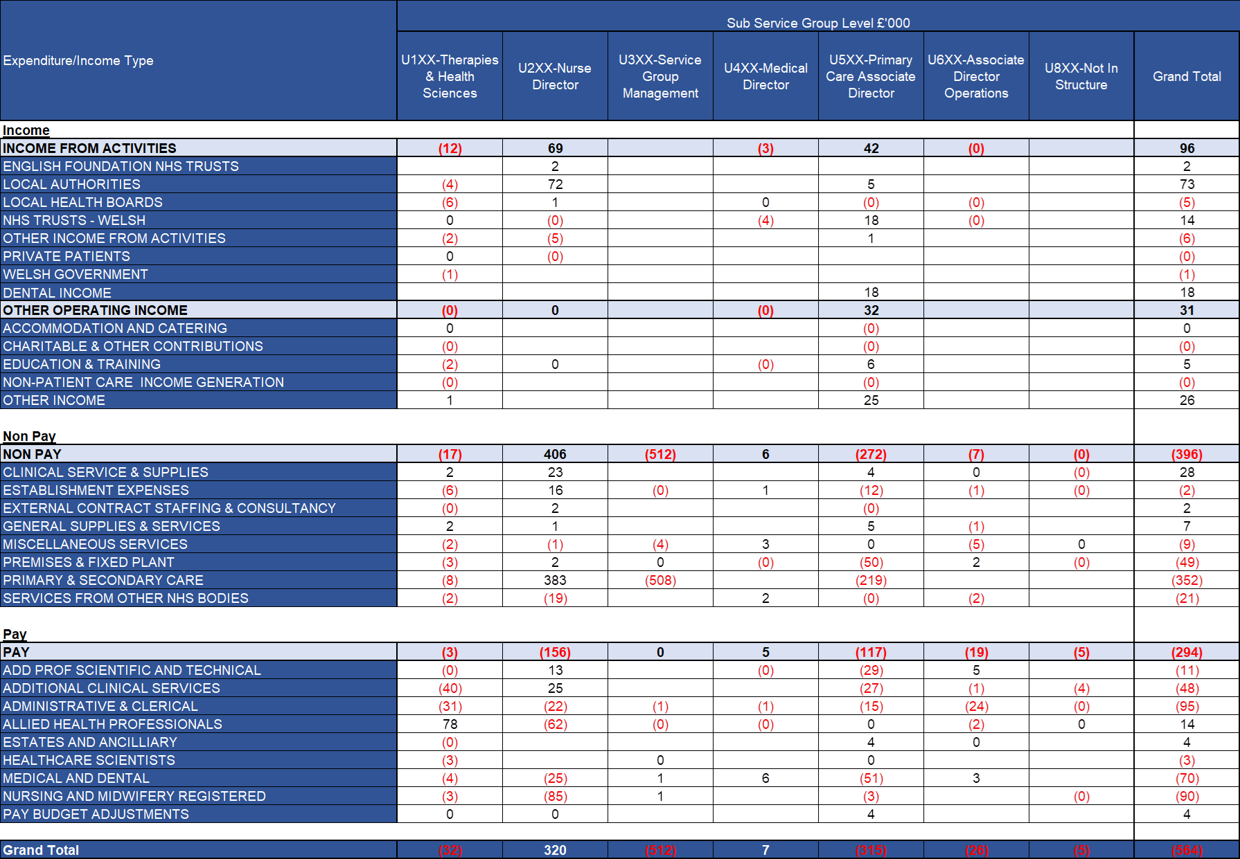
In Month Service Group Position By Division & Type Expenditure/Income
Key Drivers:
Income
Main pressures are dental income. The local authorities pressure is offset by a pay saving due to vacant posts.
Non Pay
The impact of the non recurrent benefit release and non investment of 23/24 dental under-achievement is creating the underspend.
Pay
Underspends in pay are the result of vacancies across all the main staff groups.

Slide 9

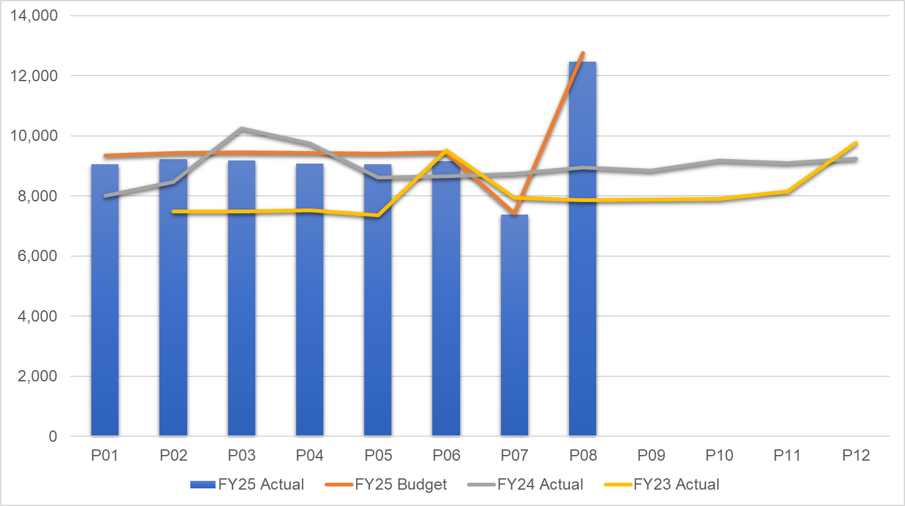
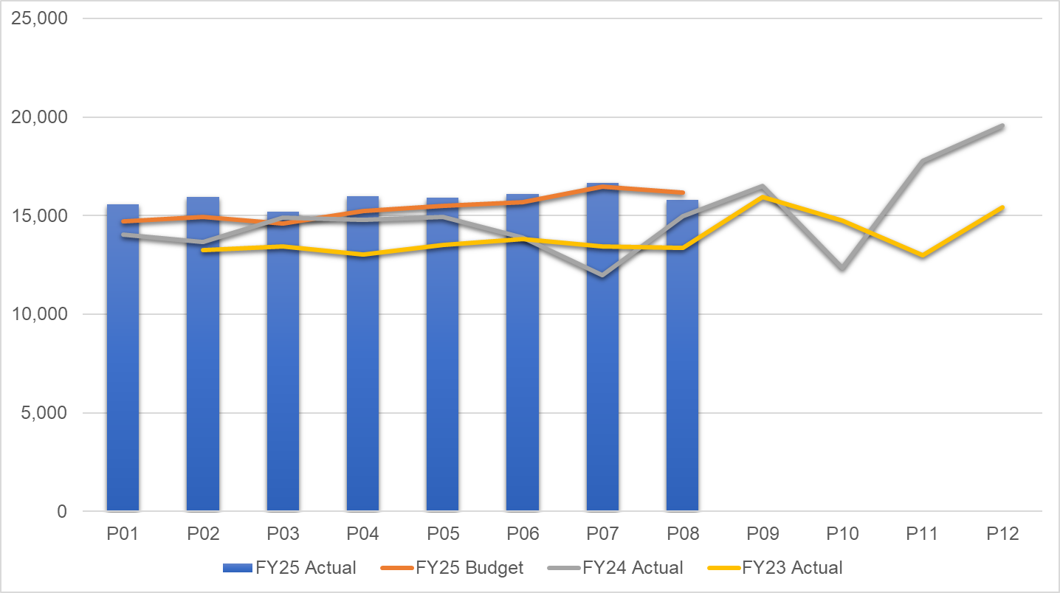
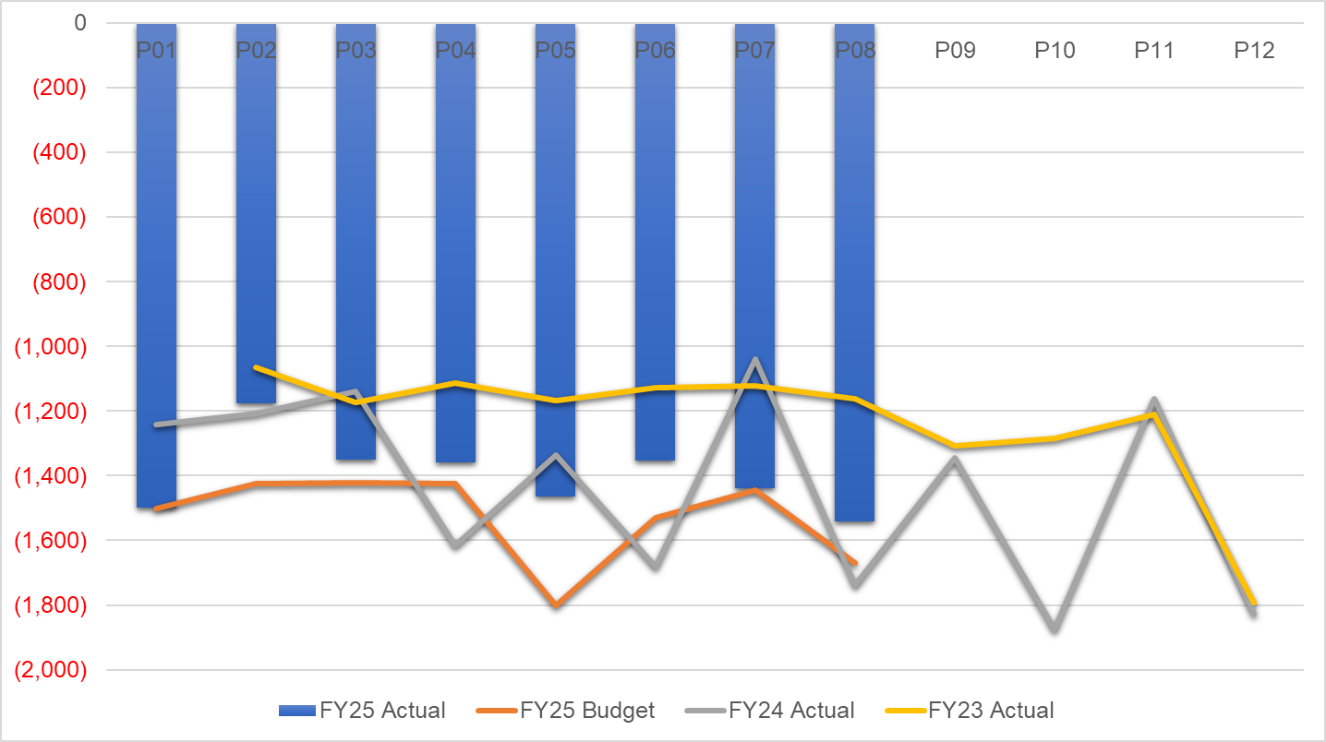
financial performance: Overall trends
Pay by Month £000s
Non Pay by Month £000s
Income by Month £000s
Key Messages:
PAY: Trends have been affected by the transfer of Acute Clinical Team in month 7 and the pay award in month 8.
NON PAY:
  Continuing Health Care (Care Homes and Looked After Children packages costs) account for 28% of non pay spend. The spike in month 7 is due to 24/25 inflationary uplifts being applied.
  Primary Care contracts account for 67% of non pay spend.
INCOME: Dental Contract Patient Charge Revenue is 28% less than budgeted levels as a result of contract reform and accounts for the Income shortfall vs budget, though it has increased vs. 23/24 due to the national fee increases.
Notes:
PAY M3 23-24 spike relates to 23-24 Recovery Pay award payment. Last year’s increasing trend is investment related (Virtual Wards, Therapies, Smoking Cessation etc).

Slide 10
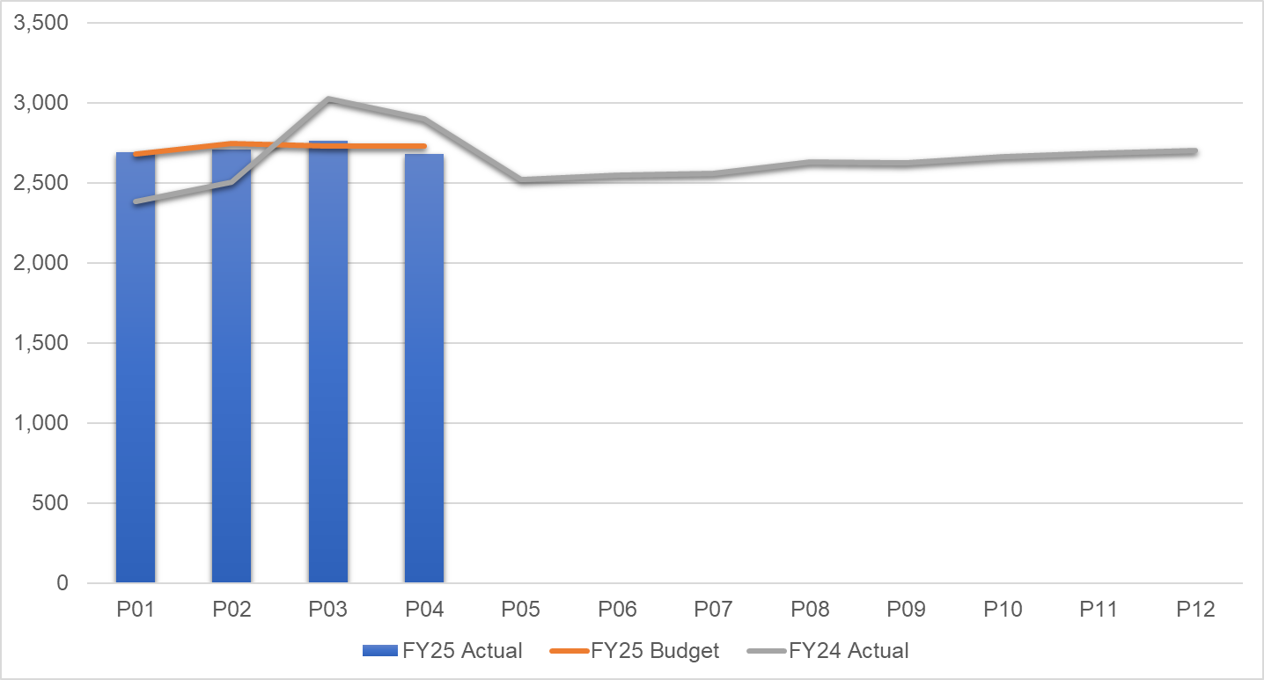
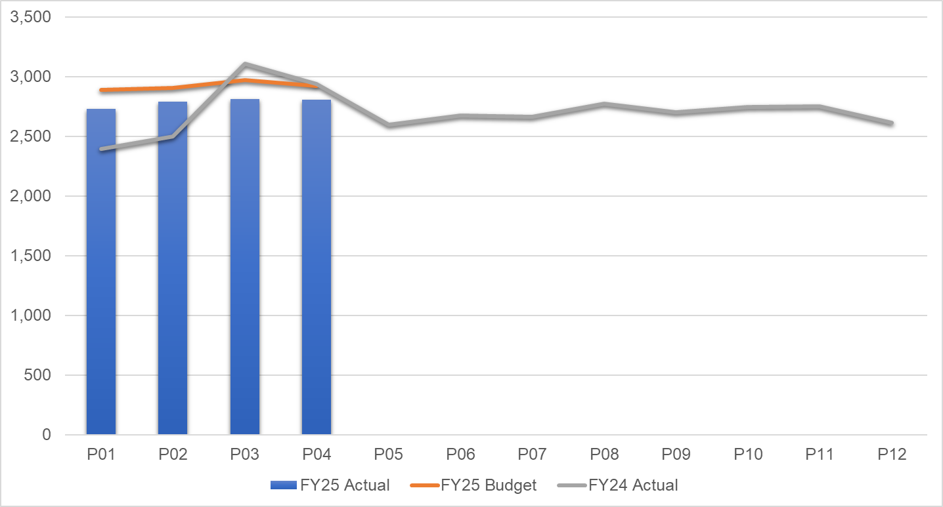
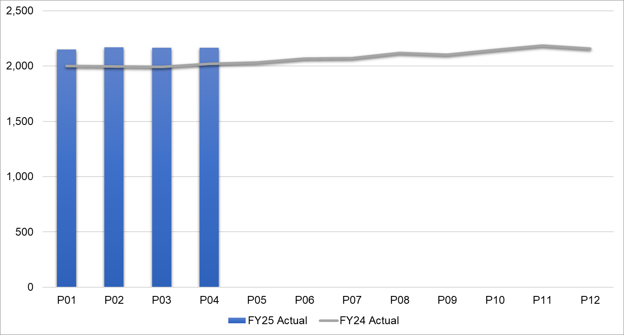
Pay Summary
Registered Nursing by Month
Allied Health Professionals by Month
WTEs by Month
Key Messages:
Nursing pay spend is in line with budget and last year’s spend.
Allied Health Professionals’ pay spend consistently below budgeted levels
WTEs are showing an increase on last year in line with investments and recruitment to vacancies.

Slide 11
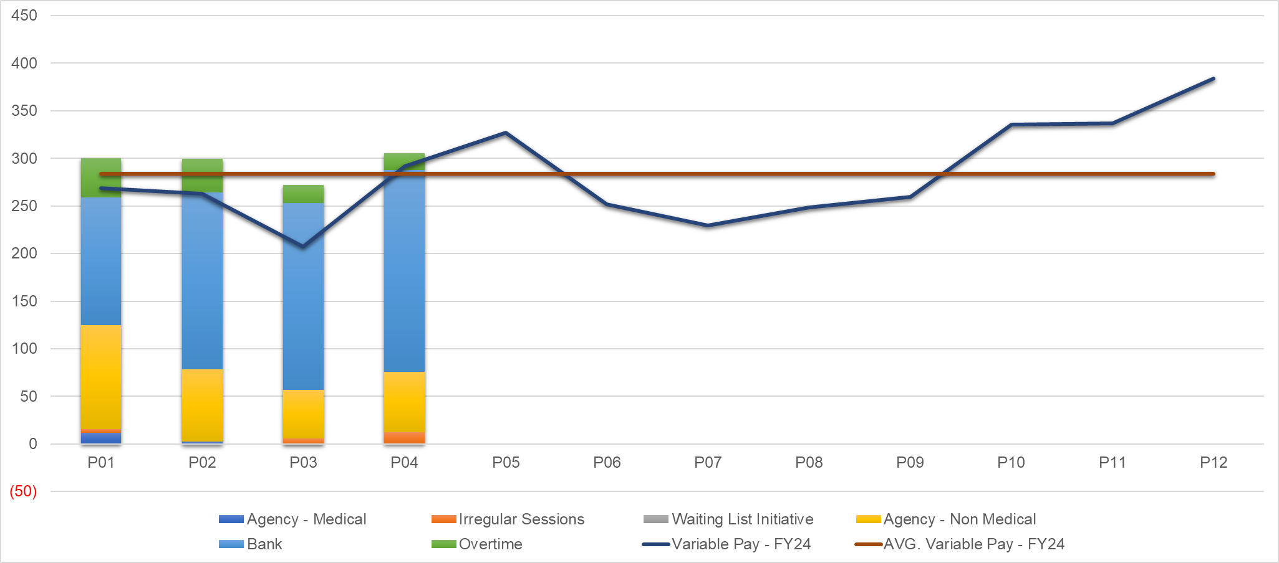
Pay : Variable pay
Variable Pay Trends £000s
Key messages:
Variable pay is largely linked to surge beds in Gorseinon, higher activity in District Nursing and high sickness / vacancies in Ty Olwen plus the opening of 4 additional beds in Q4 23-24. These three areas account for almost two thirds of the variable pay. This also explains the increase versus 23-24.

Slide 12
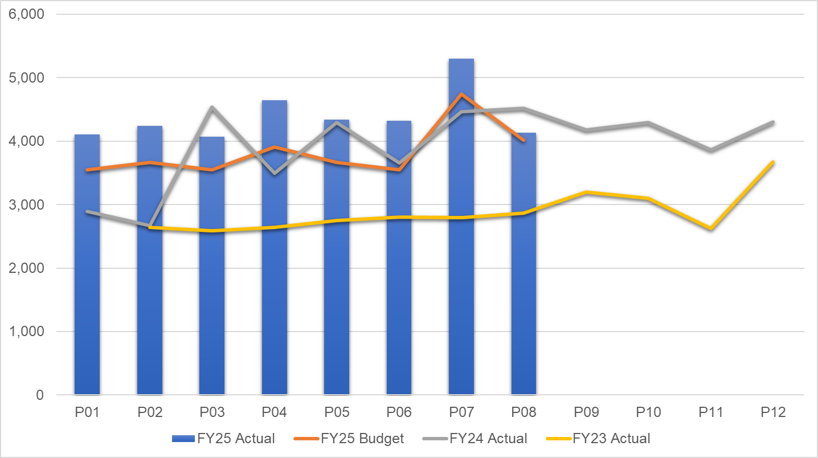
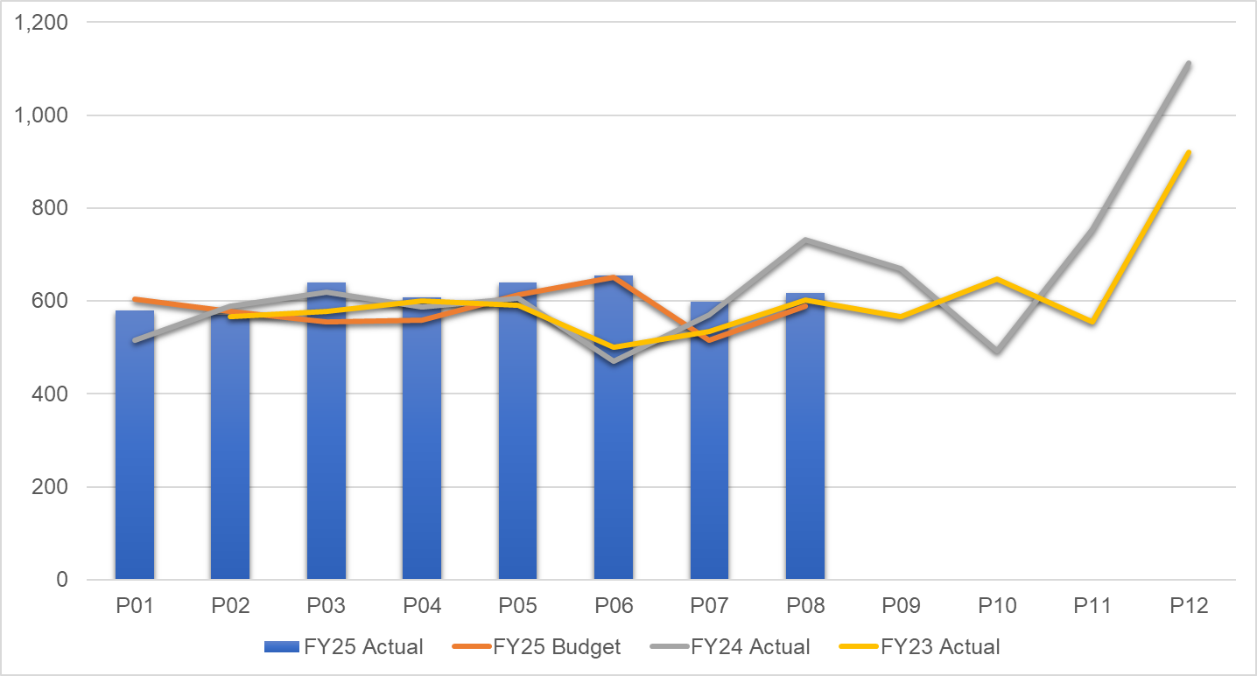
Non Pay: key drivers
Continuing Health Care / Funded Nursing Care by Month
Clinical Supplies incl. Drugs by Month
Key Messages:
Continuing Health Care and Funded Nursing Care continue to be the largest cost pressure due to a growth in volumes of patients and higher acuity, resulting in an increased average weekly cost per package.
Clinical Supplies spend is tracking 5% above budget due to higher sexual health costs linked to higher external tests linked to HIV care and Gender service and HIV drugs. District Nursing costs have also significantly increased year on year due to the higher number of end of life patients being looked after by the team. Community Continence’s cost pressure is caused by contract increases including a delivery charge per patient.

Slide 13

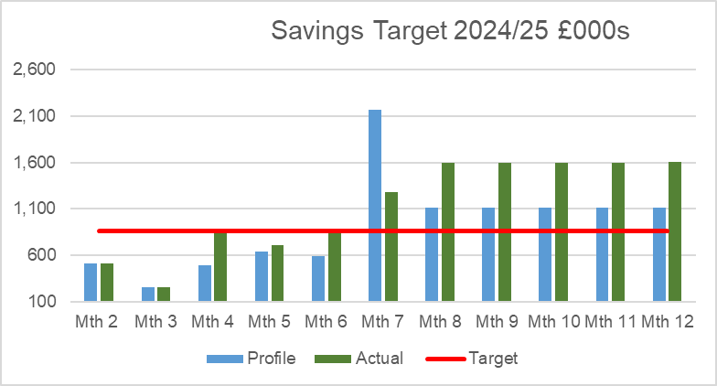
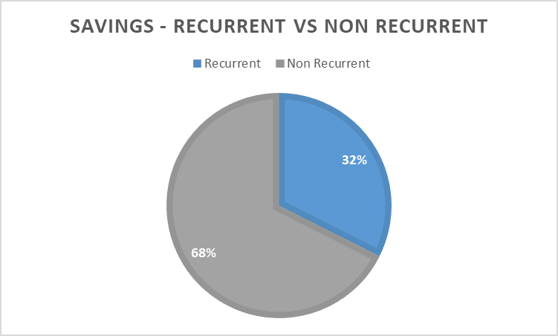
Savings Summary (Proportion HB Target £26.1m)
Identification of Opportunities & Profile
The Service Group have a target of £3.171m, £9.5m including run rate reduction requirements. PCT Group has identified £12.5m of savings and run rate reductions, though this is largely non recurrent so the priority is resolving the recurrent pressure.

Slide 14
Savings Detail – Green Schemes

Slide 15
Savings Detail – Amber & Red Schemes

Slide 16

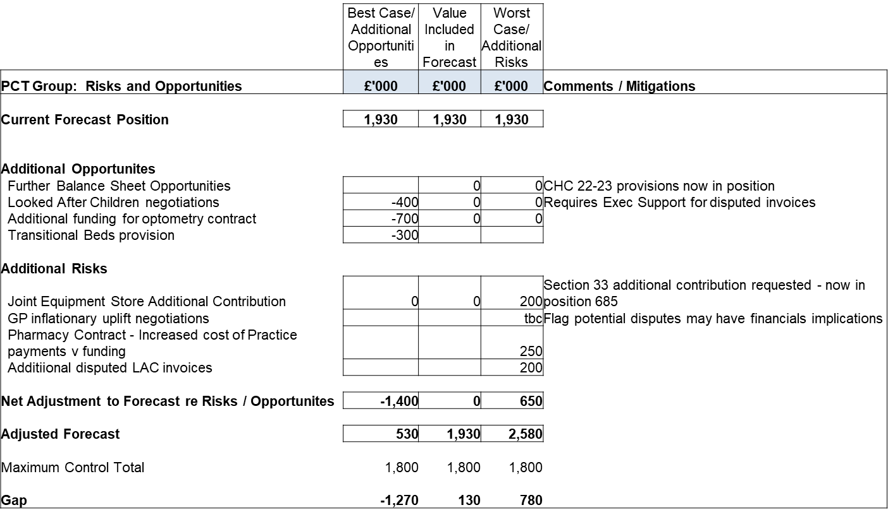
Identification Opportunities & Risk (Including Hot Spots)

Slide 17
Action & Next Steps To Be Taken By Service Group
Actions and Next Steps:
Service Group to review options around staffing of Gorseinon beds with Executive colleagues.
Pursue opportunities in terms of Looked After Children disputed invoices, transitional beds provision and optometry funding required.
Work to minimise identified risks
Pursue 25/26 cost reductions as part of IMTP planning.

