Slide 1
Capital Plan 2025/26 – Financial Context
Financial context:
We are aiming for breakeven in 2024-25. The pressure to retain a balanced capital position remains fragile as there is limited remaining flexibility in the programme to manage emerging service and infrastructure risk. However recent in-year allocations of £9.1m from WG for equipment and digital replacements have significantly eased the in-year pressure and will allow the 2025-26 plan to start from a more stable base.
The 2025-26 discretionary plan reflects initial WG advice on the NHS All Wales Capital Prioritisation and initial core funding allocations. Further work is required to finalise scheme specific proposal outside of the core allocation changes as WG are working through a number of scenarios as part of the 2025-26 WG budget.
Our prioritised 10-year forecast for the All-Wales Capital Programme (AWCP) remains in place, with work continuing on those cases where design fee funding is available. Others remain on-hold pending the outcome of the national prioritisation work.
Key financial challenges:
Significant national capital funding constraints remain. The level of discretionary funding has continued to be eroded against inflation and continued growth in the fixed asset base in medical equipment and digital devices, with no national uplift to discretionary allocations since 2010. Following the 2022/23 national reduction in core capital funding 24%/£100m, the local reduction of £2.7m was fully reinstated in 2024/25 (following a 50% reinstatement in 2023/24). A national uplift to discretionary allocations from £83.7m to £100m an increase of £16.2m/19.3% has been notified for 2025/26. The impact for SBUHB is an uplift of £2.7m/24%.
Additional national funding allocations are also to be made for a) TEF (Targeted Estates Fund) £40m, b) Diagnostic Equipment Replacement Programme £15m and c) Digital Replacement Programme £10m
Continuing upward price inflation across the market for all aspects of capital spend, including building schemes, medical and digital equipment, albeit at a lower level than the last 2 years.
The PFI contract for Neath Port Talbot hospital has a fixed £1.389m contribution to the lifecycle replacement programme [note: starts to reduce significantly from 2025/26 and ends in 2027/28.027/28 leading up to PFI exit 2030]
The combination of significant backlog maintenance (estates, equipment and digital) means investment from the discretionary programme for service change/recovery projects is likely to be limited and difficult choices will be required to achieve a balanced opening 2025/26 capital resource plan.
This initial draft plan provides an outline to achieve an opening balanced plan. Further work is required to assess,
a) Service Group priorities following the Executive review.
b) Implementation of new national waste regulations from April 2026.

Slide 2
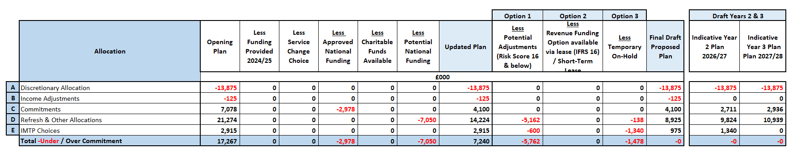
Capital plan –Initial 2025/26 Discretionary (Summary)
Section A. Discretionary allocation uplifted by £2.77m/24% to £13.875. This is the first uplift to discretionary capital baseline allocations since 2010, to recognise age and risks across the estate. Overall national uplift 19.3%.
Section B. Income adjustments, include Board approved disposal. No account taken for recovery of expended business case fees from the AWCP due to ongoing national prioritisation exercise
Section C. Commitments including AWCP schemes (spend & income), City Deal and NPT PFI contract £1.4m.
Section D. Refresh allocations for the existing fixed asset base include risk assessed bids provided by the services units and corporate departments with oversight provided by the Capital Prioritisation Group. Also refresh programmes for major programmes (digital services infrastructure & devices and estates backlog maintenance). Potential adjustments £5.3m include £2.5m medical equipment risk scored at 16.
Section E. IMTP choices.
Overall draft position without any adjustments £7.240m over allocated resources. Potential adjustments for risk score 15s and 16s and other funding sources could reduce over commitment to £1.478m. Applying a temporary hold of £1.478m would produce a balance position but with significant risk of the plan moving to an unbalanced position during the year without additional WG funding. Leaves a small programme contingency of £364k.

Slide 3
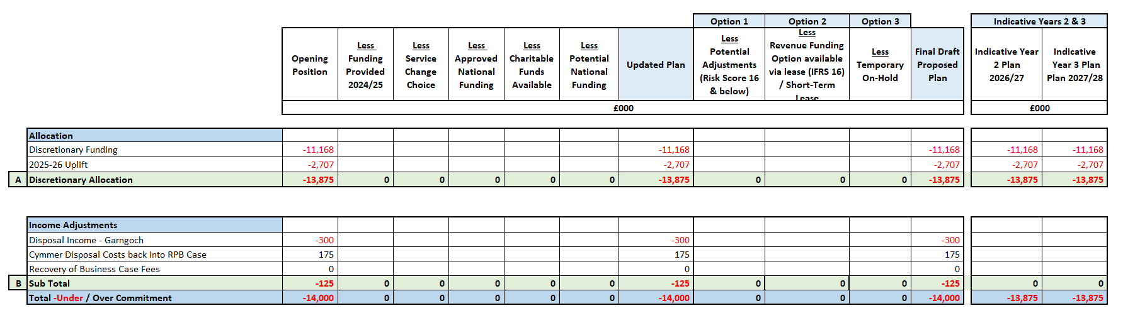
Capital plan – 2025/26 Discretionary (Detailed headings ‘A/B’)
Section A National funding allocation £13.975m.
Discretionary allocation uplifted by £2.77m/24% to £13.875. This is the first uplift to discretionary capital baseline allocations since 2010 to recognise age and risks across the NHS Wales estate.
Overall national uplift 19.3%.
SBU uplift in recognition of significant PFI fixed contractual commitments.
Section B. Income Adjustments £0.125m
Potential disposal income £300k, for Board approved part disposal of Garngoch hospital.
No account taken for recovery of expended business case fees from the AWCP due to ongoing national prioritisation exercise. Subsequent approval of business cases could lead to a benefit of £1.277m.

Slide 4
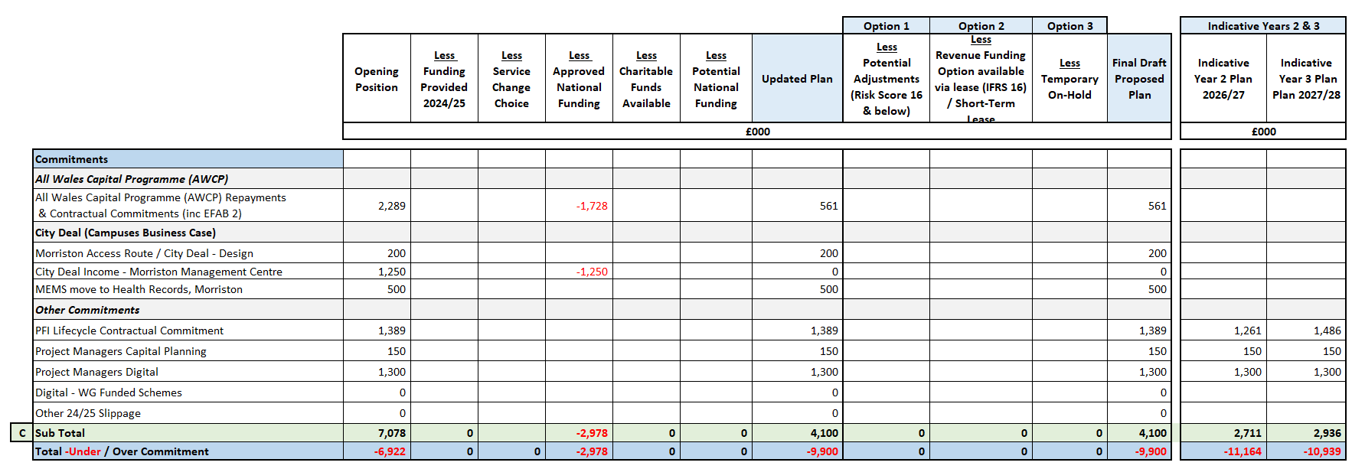
Capital plan –2025/26 Discretionary (Detailed headings ‘C’)
Section C Commitments £4.1m
AWCP repayments include 2024/25 slippage which need to be repaid from discretionary £0.561m.
City Deal, includes completion of Hybrid Planning Application for the Morriston Access Route, Management Centre and MEMS move to the vacated Health Records building.
NPT PFI fixed contractual element for lifecycle replacement £1.389m [note: commencement of gradual reduction in contractual commitment for lifecycle which ends in 2027/28 in advance of hand back in May 2030].

Slide 5
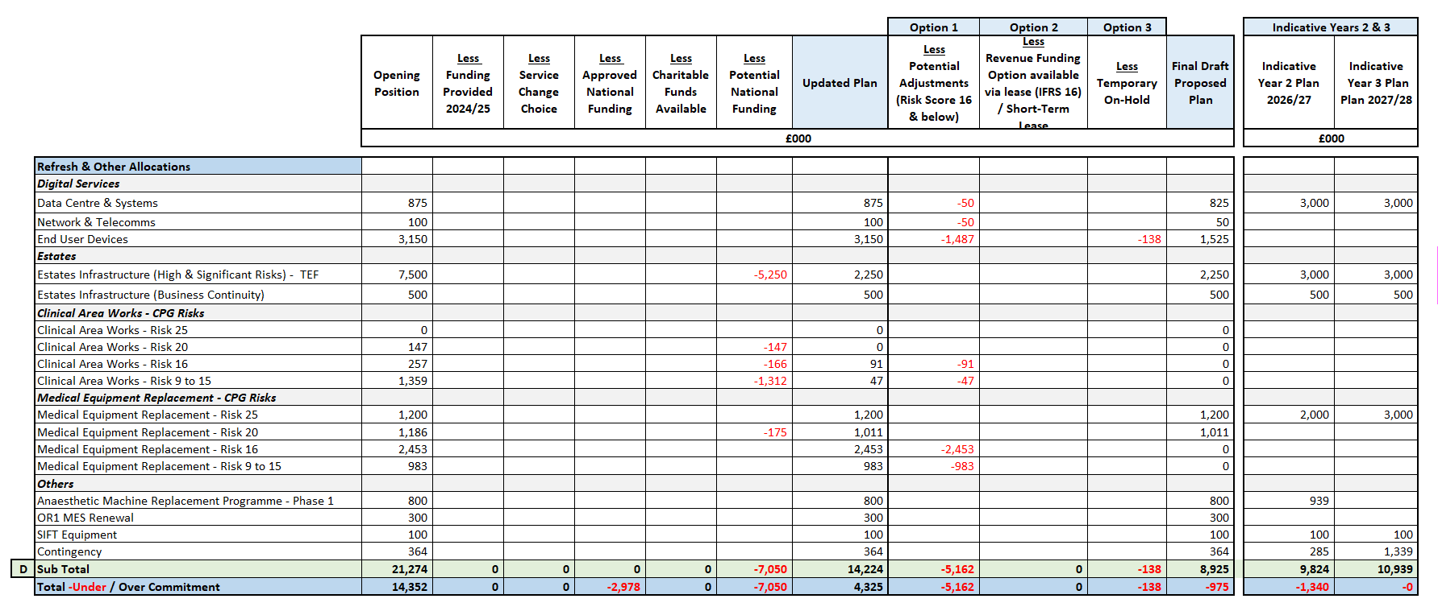
Capital plan – 2025/26 Discretionary (Detailed headings ‘D’)
Section D. Refresh Allocations, £8.925m
Refresh programme for digital services infrastructure & devices. A new national £10m equipment replacement programme to be launched by WG in 2025/26.
Estates Infrastructure for high and significant risks assumes a £5.250m funding allocation from the newly released national (TEF) Targeted Estates Fund - £40m a year funding in each of 2025/26 and 2026/27, requires a 30% contribution from discretionary (like EFAB). Bid process to launch in Q4 with allocations for a) Infrastructure £18m, b) Fire Safety £5m, c) Mental Health £5m d) Decarbonisation £6m e) Infection Prevention Control £3m and f) Decontamination £3m.
Refresh allocations for the existing fixed asset base for equipment and minor estates work include risk assessed bids provided by the services units and corporate departments with oversight provided by the Capital Prioritisation Group (CPG).
Phase 1 £800k for a 3 phased programme to replace all of the Anaesthetic Machines in Morriston. Phases 2 and 3 would need to take place by 2026/27
As in previous years, options to adjusting for risk score 16 and 15 reduces requirement from £14.224m to £8.925m, which contributes to an overall balanced position.

Slide 6
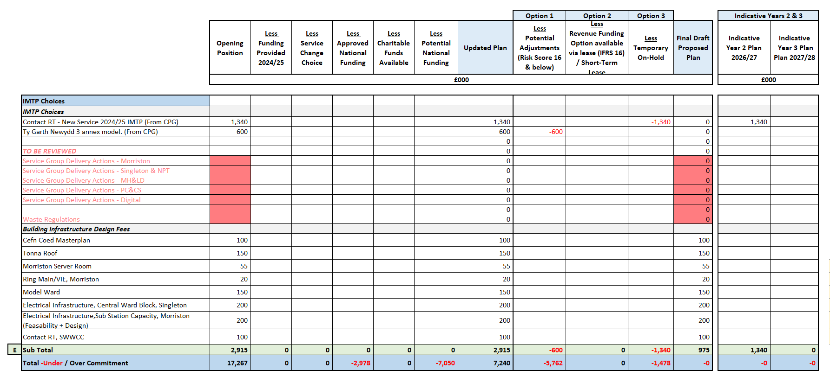
Capital plan –Initial 2025/26 Discretionary (Detailed headings ‘E’)
Section E. GMO Choices £0.975m
Contact RT was included in 2024/25 IMTP but now likely to require £1.3m capital for building infrastructure work and equipment. Suggest a £100k design fee allocation in 2025-26 subject to the service business case being approved from a revenue/JCC perspective.
Includes choices on design fees linked to building infrastructure priorities. Unclear at this stage if national funding will be available in 2025-26. There may be an opportunity to recover fees in 2026-27 through the TEF allocation.
Further work required to assess,
a) Service Group priorities following the Executive review.
b) Implementation of new national waste regulations from April 2026.

