Slide 1


Performance & Finance Committee
Neath Port Talbot Singleton Service Group
23rd July 2024

Slide 2

High Level Summary
NPTS SG @ Mth 3 | Service Group | Health Board
Target Variance Annual | 0.0 | 50.1
Target Variance YTD | 0.0 | 12.5
YTD Variance | 4.5 | 25.8
YTD from Target Variance | 4.5 | 13.3
Variance % HB YTD Value | 18%
Top 3 Actions to address position:
Follow up on feedback to 28th June Opportunities submission
Present revenue reduction options at Star Chamber for consideration and decision
Continue to identify revenue reduction options and associated impacts for assessment
Notes:
Service Group to follow up on 28th June submission of potential opportunities for feedback
Present revenue reduction options at Star Chamber for consideration and subsequently decision
Continue to identify revenue reduction options and associated impacts for assessment

Slide 3
Agenda Detail
Health Board & Service Group Financial Summary
In-Month Revenue Position
Savings Performance
Key Drivers
Risks, Next Steps & Mitigating Actions
Appendices

Slide 4

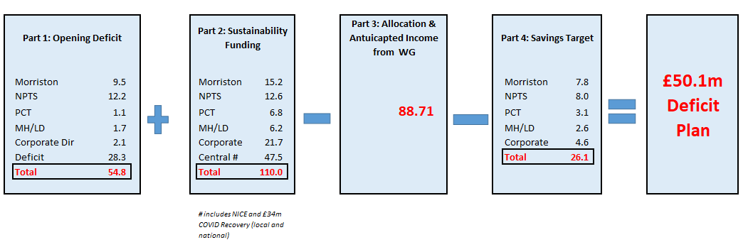
Health Board Summary Elements of Financial Plan
Note: Specific elements from Part 1, 2 and 4 of the plan that relate to this service area are summarised on the next slide.

Slide 5

Service Group Element of Financial Plan

Slide 6

2024/25 In Year Health Board Position

Slide 7
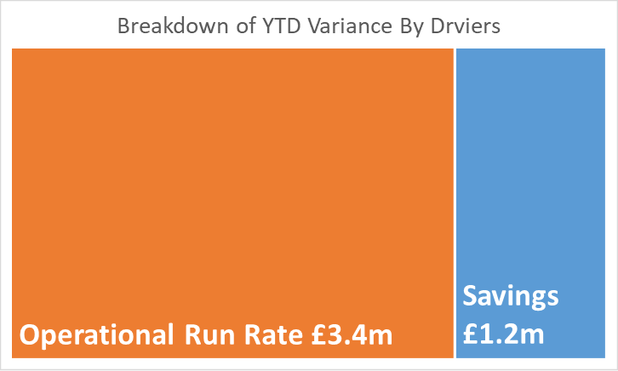
Service Group Position By Month & Divisions
Period | In Month Budget £'000 | In Month Actual £'000 | In Month Variance £'000
Mth 01 | 30,773 | 32,966 | 2,194
Mth 02 | 30,638 | 31,881 | 1,243
Mth 03 | 29,792 | 30,885 | 1,093
Mth 04
Mth 05
Mth 06
Mth 07
Mth 08
Mth 09
Mth 10
Mth 11
Mth 12
Total YTD | 91,203 | 95,733 | 4,530
Centrally held reserves (Group Management) devolved to relevant budgets in following areas in Month 3, correcting the Year To Date (YTD) position across Divisions
  Primary Care Prescribing (Integrated Medicines Management (IMM)
  Private Finance Initiative (PFI) Unitary Charge Inflation (Hospital Operations & Site)
Surgical Services’ in-month overspend primarily driven by spends in activity driven services:
  Anaesthetics Medical & Dental £315k
  Trauma & Orthopaedics (T&O) – Clinical Service & Supplies £175k
  Theatres – Clinical Service & Supplies £77k
  Private Patient Income £42k
Women’s & Children’s in-month overspend primarily driven by:
  Gynaecology Medical staffing £72k
  Paediatrics Medical staffing (incl. Neonatal) £66k
  Midwifery Nursing £75k
Cancer Services’ in-month overspend primarily driven by:
  Nursing £64k
  Clinical Service & Supplies £76k

Slide 8
In month Service Group Position By Division & Type Expenditure/Income
Key Drivers:
£1.09m In-month driven evenly across both Pay and Non-Pay expenditure
£567k Clinical Services & Supplies
  £131k Cancer Services Drugs
  £182k vaccines – of which subsequent analysis shows a significant element can be recovered
  £220k Theatres and Trauma & Orthopaedics
£623k Medical staffing spend
  £315k Anaesthetics incl. £205k Waiting List Initiatives (WLI) and £50k additional sessions
  £72k Gynaecology
  £66k Paediatrics (incl. Neonatal)

Slide 9

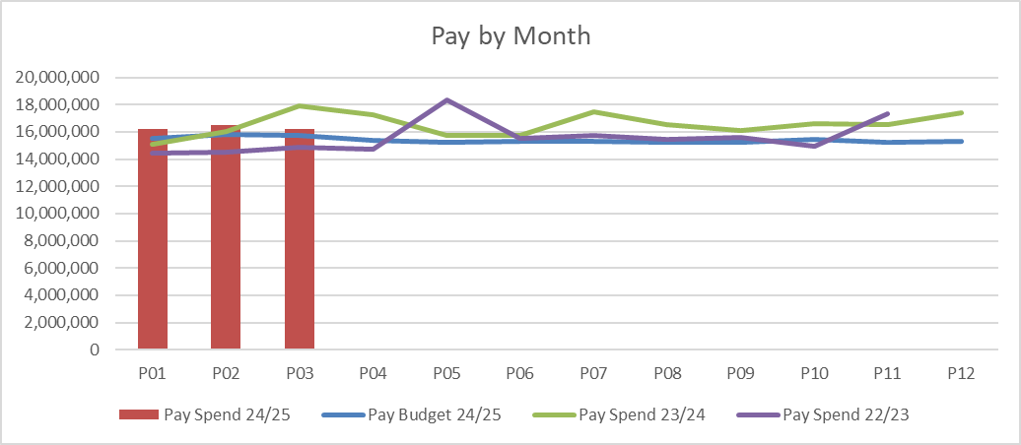
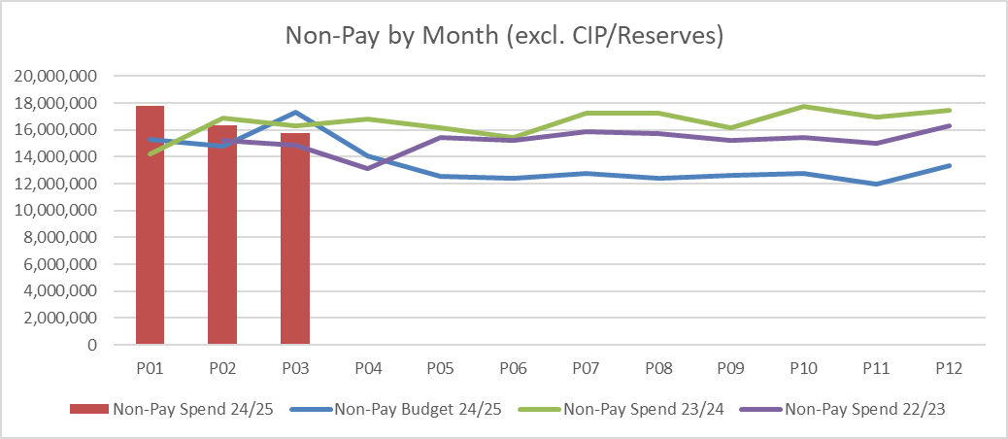
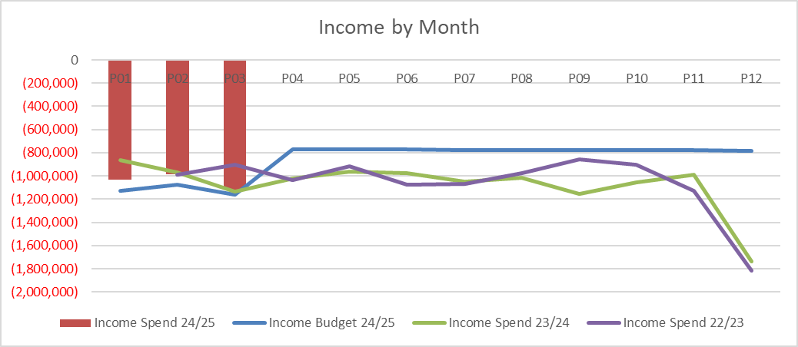
financial performance: Overall trends
Key Messages:
YTD non-pay trending downwards:
  In part due to natural monthly variation of National Institute for Health and Care Excellence (NICE) approved high cost drugs spend, where funding is also issued non-recurrently on an usage basis per month
  In part due to decrease in other Clinical Service and Supplies Costs, particularly in activity driven areas such as Theatres, where stock levels and activity plays a part in monthly variation
YTD Pay consistent month-on-month, with variability largely driven by Enhancements and Variable pay
Income largely consistent month on month with M3 levels benefitting from income for Out of Area (OOA) neonatal babies; Pharmacy pre-packaging sales; Joint Commissioning Committee (JCC) Positron Emission Tomography (PET) performance

Slide 10
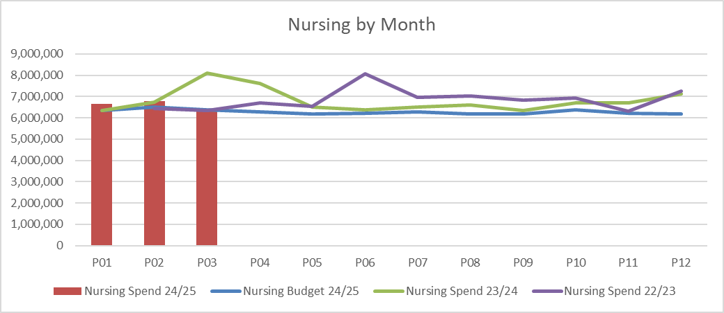
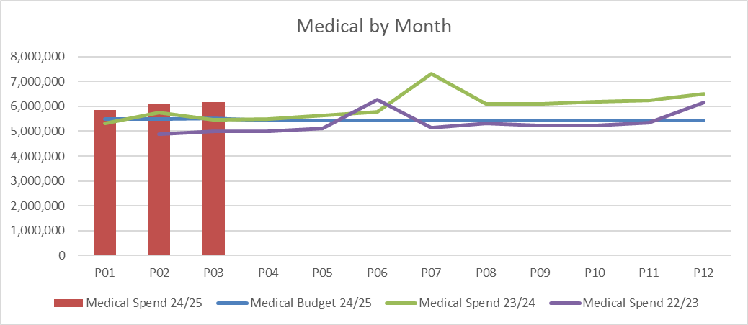
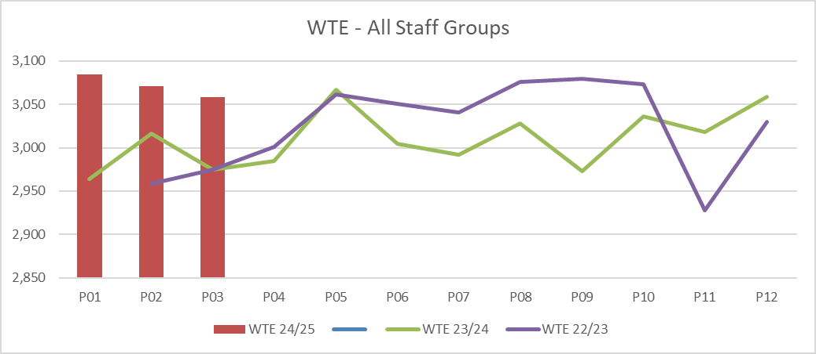
Pay Summary
Key Messages:
Variable Pay key driver for increase in Medical spend – particularly agency, seen in the following areas: Oncology; Paediatrics; General Medicine; Rheumatology
Month 3 nursing spend decreased on trend, driven by reductions across Neath and Singleton wards: Singleton Ward 8; Neath Ward C
Reduction in WTE is driven by a reduction of Health Care Support Workers (HCSW) from 480 whole-time equivalents (wte) in M1 to 451 wte in month 2.

Slide 11
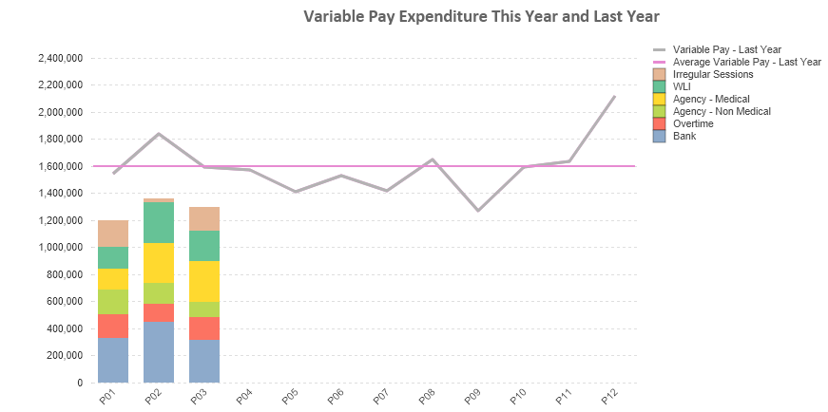
Pay : Variable pay
Extract from Reportinhg Dashboard
Key messages:
£1.8m YTD Medical variable spend primarily driven by: £648k Anaesthetics; £350k Neath General Medicine; £249k Gynaecology; £132k; Paediatrics; £162k Haematology
£1.15m YTD Nursing & Midwifery variable spend primarily driven by: Midwifery £230k; Cancer services £214k; Theatres £193k; £250k Neath & Singleton Wards
£704k YTD Additional Clinical Services (predominantly includes HCSWs) variable spend primarily driven by: £388k Neath & Singleton Wards; £114k Cancer Services

Slide 12
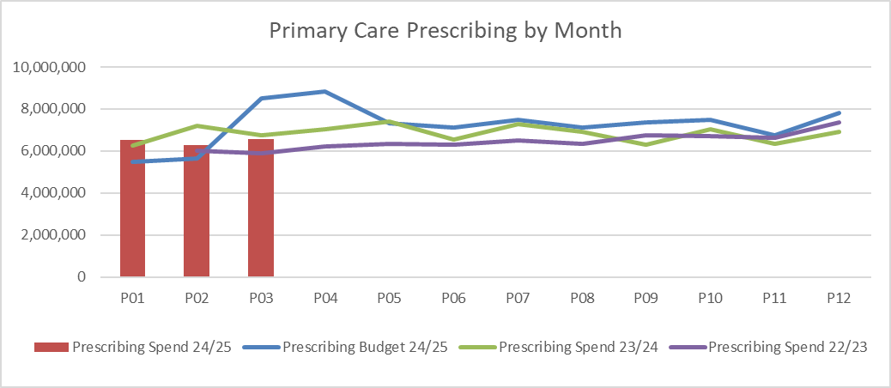
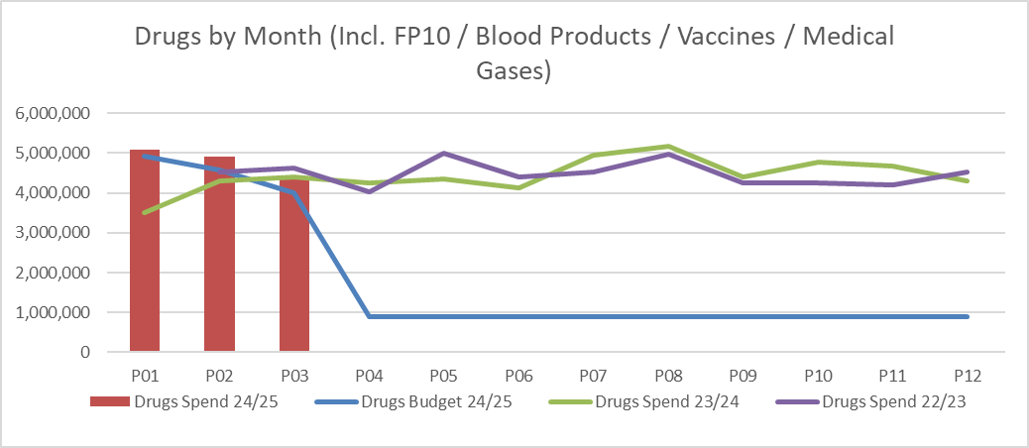
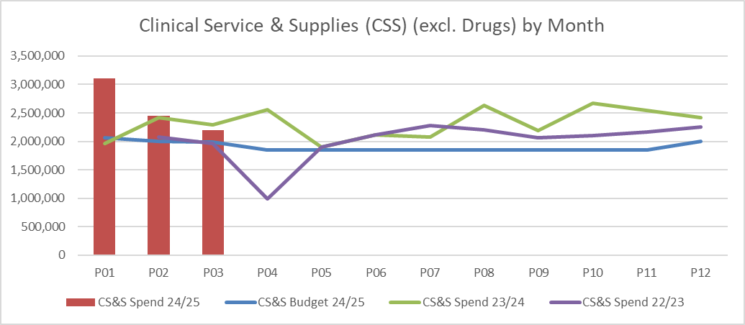
Non Pay: key drivers
Key Messages:
Primary Care Prescribing underspent £240k YTD due to delivery of additional savings above plan
High natural monthly variation in drug spend, particularly for National Institute for Health and Care Excellence (NICE) approved high cost drugs, where funding is also issued non-recurrently on an usage basis per month
  Both in-month and YTD overspends driven by: Vaccinations (£243k YTD) and both Oncology (£134k YTD) and Haematology Drugs (£116k YTD). Subsequent analysis shows that funding can be recovered for a significant element of the vaccination overspend
Clinical Service & Supplies (excl. Drugs) YTD overspends from activity driven services: Trauma & Orthopaedics (T&O) Implants £468k; T&O Hire of Medical & Surgical Equipment (M&SE) £134k; Theatres M&SE £568k; Theatres Appliances (incl. Implants and Prosthesis) £258k

Slide 13

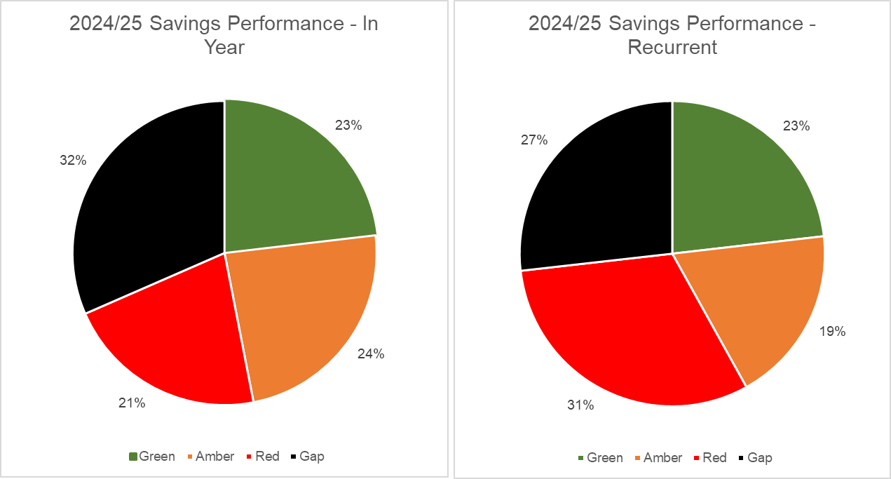
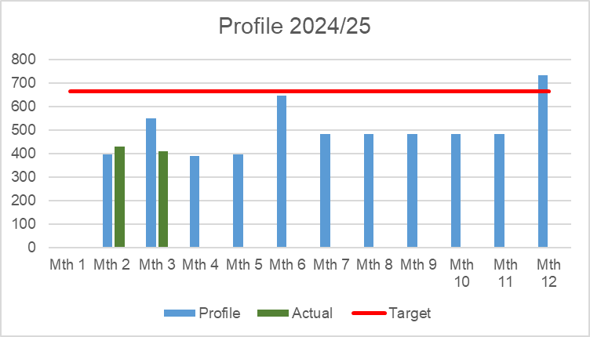
Savings Summary (Proportion HB Target £26.1m)
Identification of Opportunities & Profile
The Service Group have a target of £7.965m. Both charts below show there remains a significant gap in plans against the target, and a further risk that remain at red 21% in year and 31% non-recurrently. Service Group actively reviewing opportunities to close gap and to move ideas forward to improve deliverability RAG rating

Slide 14
Savings Detail

Slide 15

Identification Opportunities & Risk (Including Hot Spots)
Further Opportunities:
Activity related decreases in expenditure:
  Theatres
  Trauma & Orthopaedics
Further Risks:
Public Health Wales (PHW) funding risk for Colposcopy SLA
Cwm Taf Morgannwg (CTM) SLA Disaggregation + Sustainability

Slide 16
Action & Next Steps To Be Taken By Service Group
Actions and Next Steps:
Service Group to follow up on 28th June submission of potential opportunities for feedback
Present revenue reduction options at Star Chamber for consideration and subsequently decision
Continue to identify revenue reduction options and associated impacts for assessment

