Slide 1


Targeted Intervention Update
July 2024

Slide 2

Planned Care

Slide 3
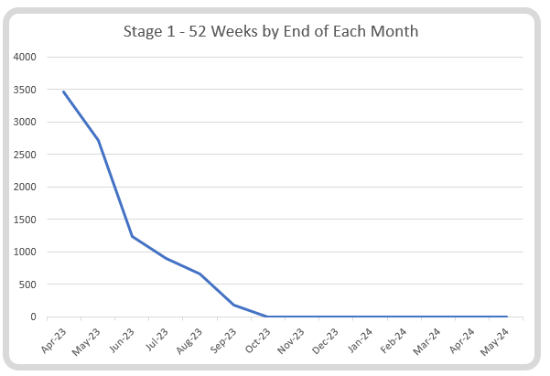
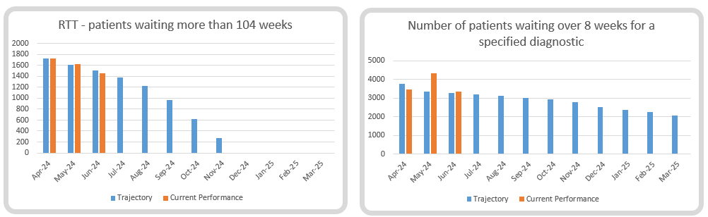
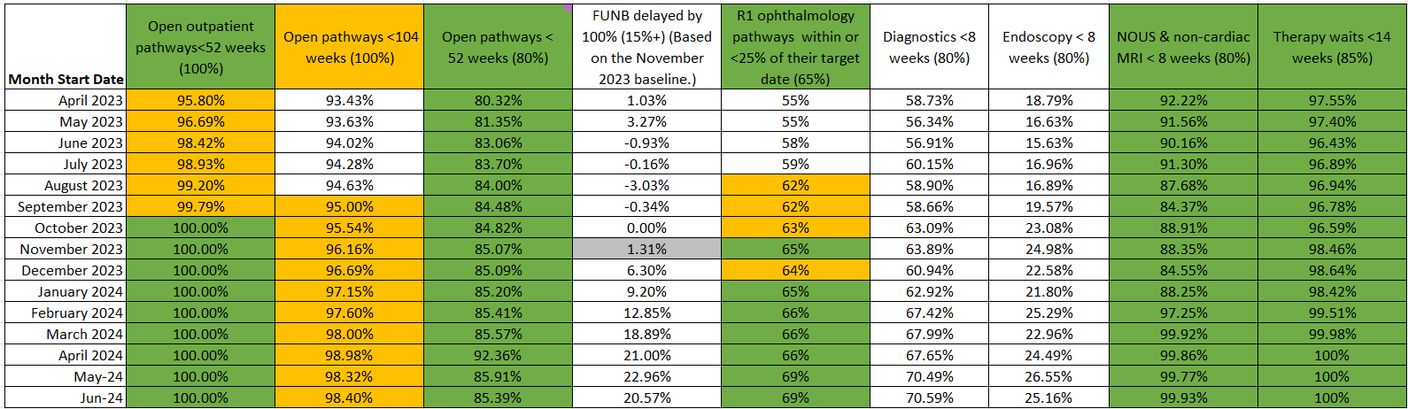
Planned Care Performance

Slide 4
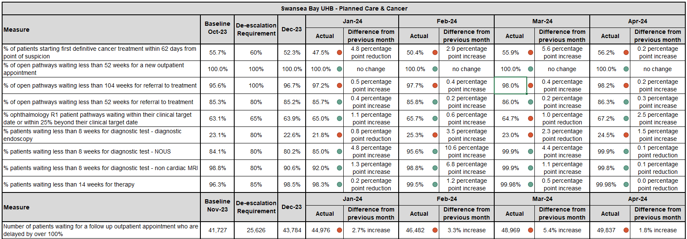
WG Data presented to June TI Review

Slide 5
Urgent & Emergency Care

Slide 6
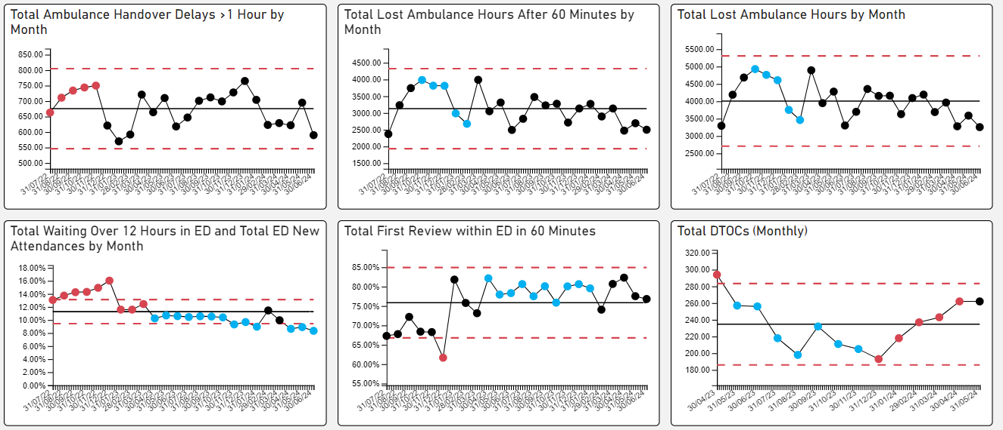
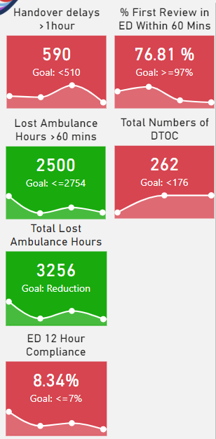
UEC – De-escalation KPIs

Slide 7
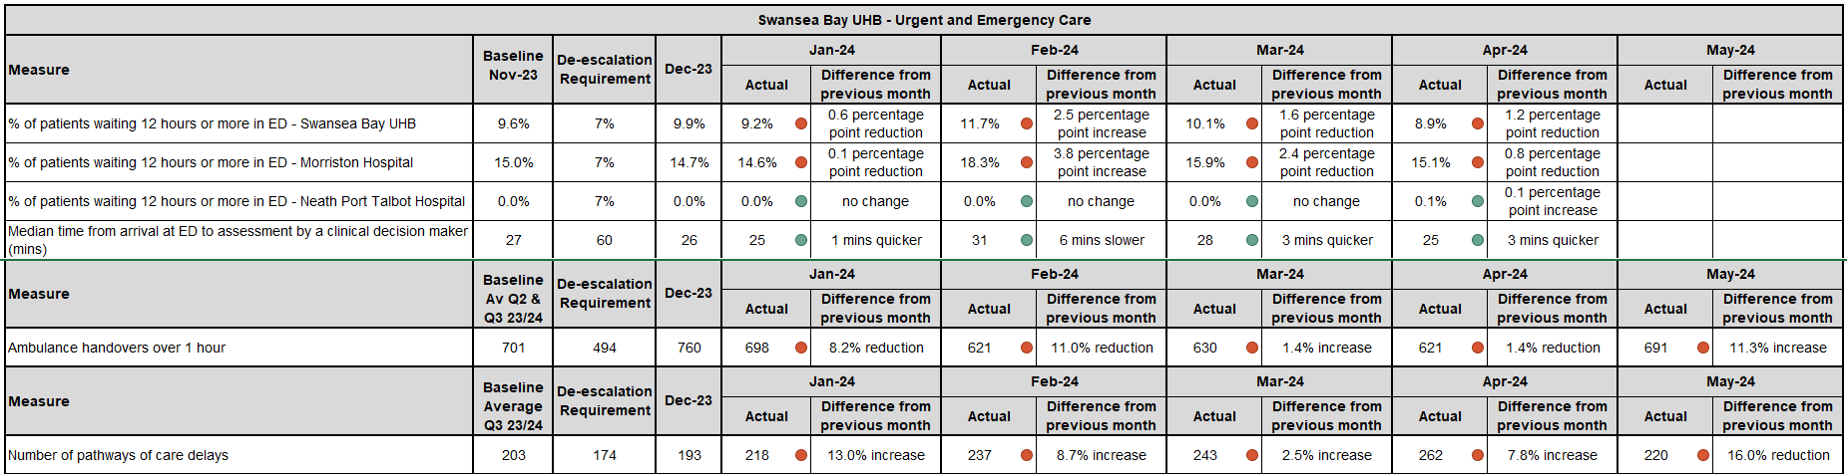
WG Data presented to June TI Review (most recent at time of submission)

Slide 8
UEC – Plan for TI Response
Five main areas of work:
  Frailty strategy – approved via Management Board – phase one brought forward from Sept to June due to continued UEC pressure.
  Grip & control operational management – new appointment to commence 16th July to support
  Senior decision makers at front door services – more progress required
  Pathway of care delays (PoCD) – transfer of leadership from Morriston SG to PCT SG (Helen St John)
    Virtual Wards & ACT now under to leadership of Morriston Frailty Unit (Dr Liz Davies)
    Home First
    Interface with local authority
  Reconfiguration of Emergency Dept – funding received to develop reconfiguration plans – lead by Capital Planning (Simon Davies)

Slide 9


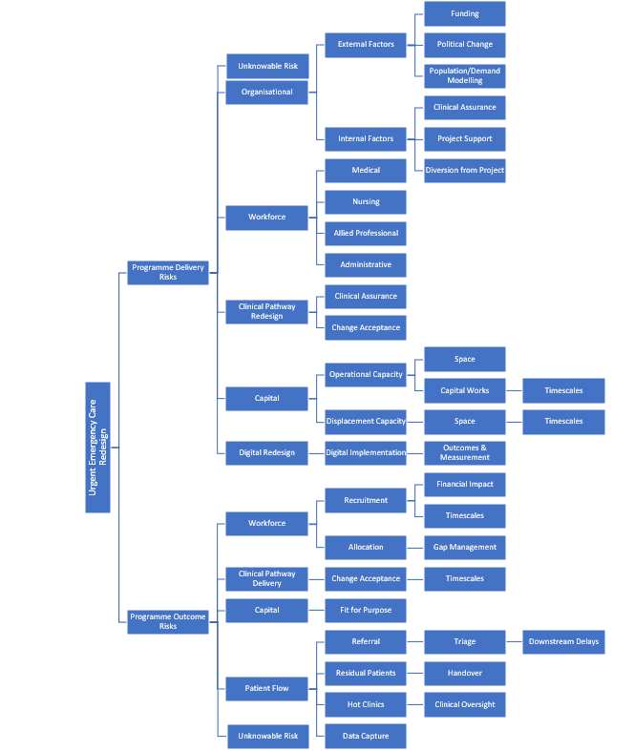
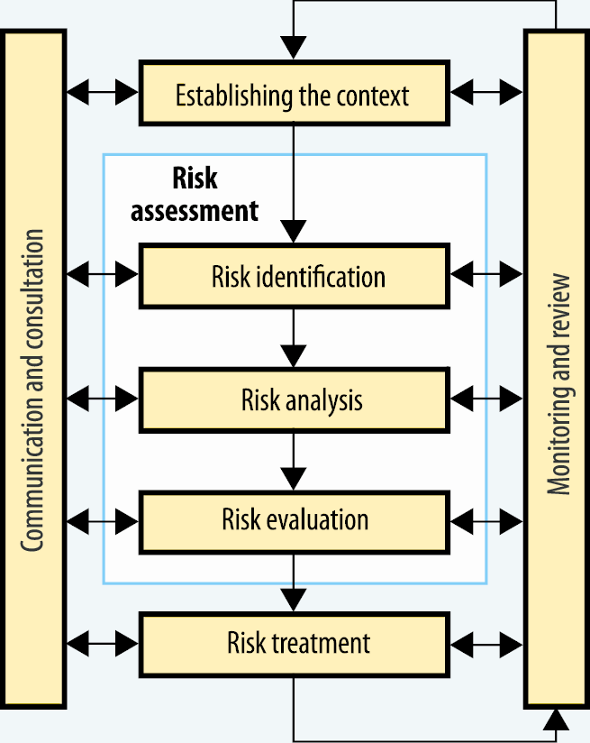
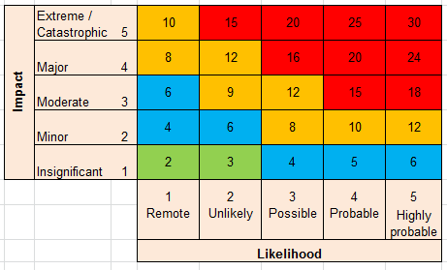
RISK MANAGEMENT PLAN
Project:
Urgent & Emergency Care Redesign, Morriston Service Group
Project Description
Risk Influencer Diagram
The Morriston Urgent & Emergency Care (UEC) Programme 2024/ 2025, is an amalgamation of multiple UEC GMOs/ projects and covers work on:
Acute Medical Rotas
Same Day Emergency Care
Frailty Service Provision
Emergency Medicine
Site Co-ordination
COP/ POCD (linkages to wider health-board wide POCD action plan/ activity).
The aim of the Programme is drive forward sustainable change and improvement in urgent and emergency care provision, across the MGH space.
Risk Plan: Aims and objectives
To clearly identify what “hazards” are present within the project and within each workstream
To identify and describe risks at both a programme delivery and programme outcomes level
To describe how risks are evaluated and assigned severity
To describe action and mitigation taken to address/resolve risk
To establish process for monitoring accepted risks
Risk Management Methodology
Risk Scoring
Risk Tolerance
Risk Assignment
Risk Tolerance refers to the amount of risk that the organisation is willing to accept in pursuit of its long-term goals
Current Risk Tolerance = TBC
Each Programme Workstream will have a Risk Register
Each identified risk will be assigned to and owned by a team member
Each Workstream Risk Register will record the named risk owner

Slide 10
UEC - Summary
Concentrating efforts on where evidence shows constraints in the system and where greatest improvement is needed for patient outcomes and experience
Undertaken via a formal programme of work with clear workstreams and leads
A whole-system approach, clinically led, supported by Digital and data
Programme being worked up with key milestones, deliverables and timescales.

Slide 11
Cancer TI Update

Slide 12
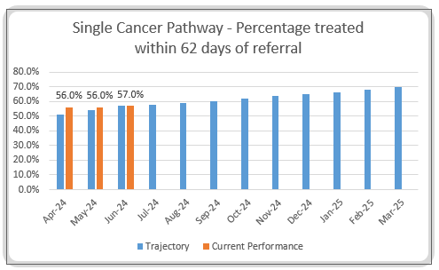
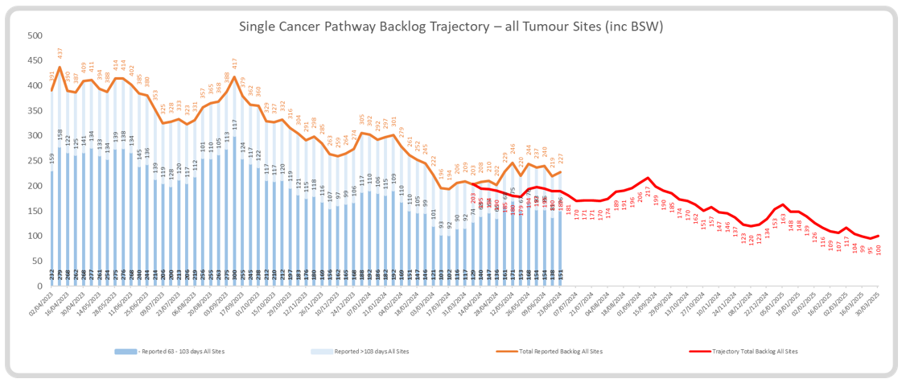
Single Cancer Pathway Performance

Slide 13
Single Cancer Pathway – Decision to Treat within 31 days
The chart demonstrates the median wait days to Decision to Treat for treated patients along with the percentage meeting 31 days.
Overall the median wait days and percentage attained is improving.

Slide 14
Pathology Turnaround Times (information as at 29/05/24)

Slide 15
Priorities/Focus Next Month
Continue to focus on front end of pathway for all specialties
Review impact of pilot of daily meetings for USC outpatient capacity in breast and gynaecology
Review impact of introduction of RALP on performance in urology – clearance of backlog may reduce performance
Business case for further investment in breast service – BCAG
Continued focus on cellular pathology
Review impact of accelerated diagnostics initiative for lower GI

Slide 16
HCAI TI Position to 31.05.24

Slide 17
Progress against TI goals: May 2024

Slide 18
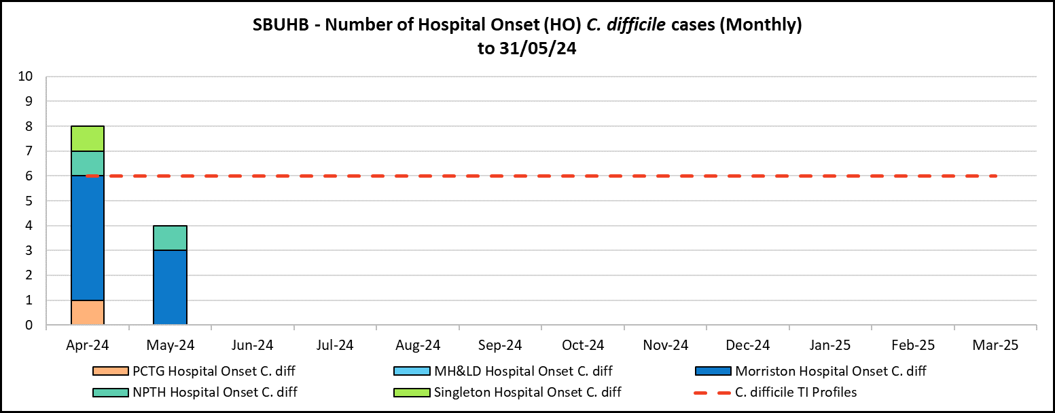
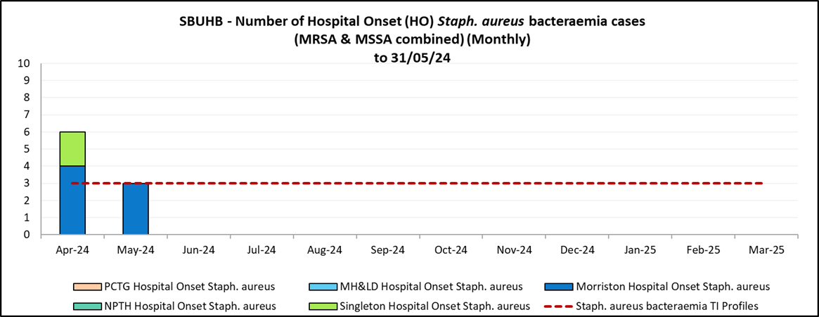
Hospital Onset HCAI TI Criteria, C. difficile and Staph. aureus to 31/05/24
Actions:
Antimicrobial stewardship
  Prescribing – audit, education, restriction.
  Preventing colonisation, reducing exposure and reservoir of risk.
Actions:
Prevention programme.
  Targeted screening high risk patient groups
  Skin decolonisation programme
  Invasive device management.
  ANTT.

Slide 19
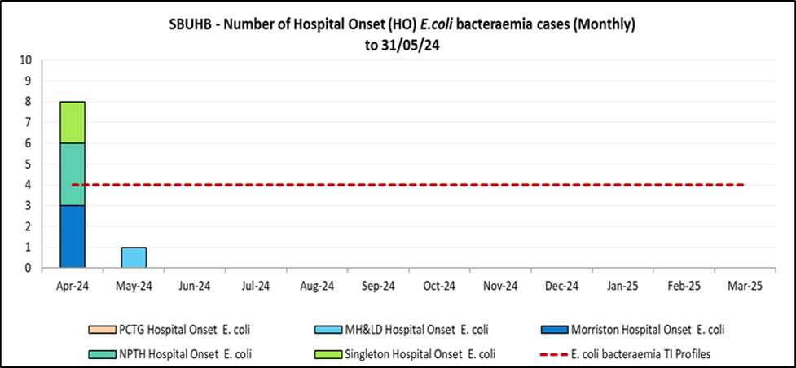
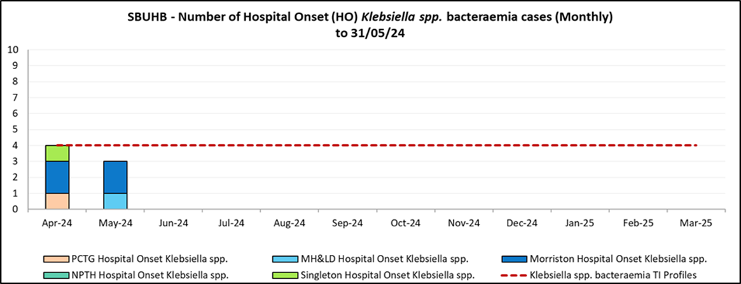
Hospital Onset HCAI TI Criteria, E. coli and Klebsiella spp. bacteraemia to 31/05/24
Actions:
Hydration campaign
Prevention & treatment of Urinary tract infection
Diagnosis & sampling
Invasive device management
Example Title Text

Slide 20
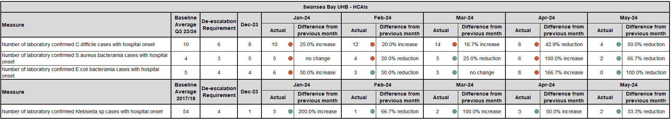
WG Data presented to June TI Review

Slide 21
CAMHS

Slide 23
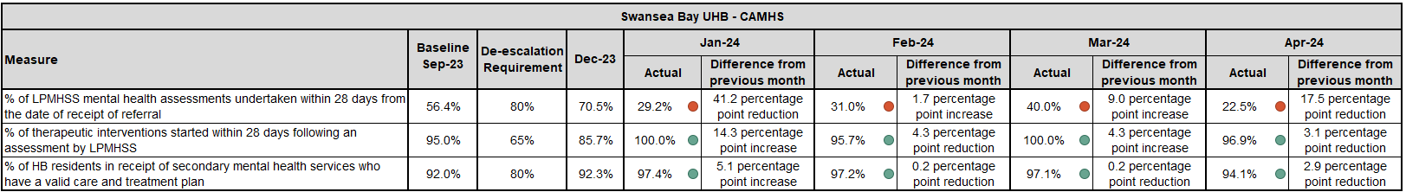
WG Data presented to June TI Review

