Slide 1


Performance & Finance Committee
Neath Port Talbot Service Group
25/03/2025

Slide 2

High Level Summary
Original Target
Revised Target
Top 3 Actions to address position:
Divisional leads continue to work on their individual savings and recovery plans, with a focus on delivering a sustainable plan for 25/26 as well as recovery in 24/25
Reduce variable/ premium cost pay
Progress recovery plan actions aligned with latest organisation approval.
NPTS SG @ Mth 11 | Service Group | Health Board |  | NPTS SG @ Mth 11 | Service Group Control Total | Health Board
Target Variance Annual | 0.0 | 43.7 |  | Target Variance Annual | 11.8 | 43.7
Target Variance YTD | 0.0 | 40.1 |  | Target Variance YTD | 10.8 | 40.1
YTD Variance | 9.4 | 47.0 |  | YTD Variance | 9.4 | 47.0
YTD from Target Variance | 9.4 | 6.9 |  | YTD from Control Total | -1.4 | 6.9
Variance % HB YTD Value | 20% |  |  | Variance % HB YTD Value | 20%

Slide 3
Agenda Detail
Health Board & Service Group Financial Summary
In-Month Revenue Position
Savings Performance
Key Drivers
Risks, Next Steps & Mitigating Actions
Appendices

Slide 4

Health Board Summary Elements of Financial Plan
Note: Specific elements from Part 1, 2 and 4 of the plan that relate to this service area are summarised on the next slide.

Slide 5

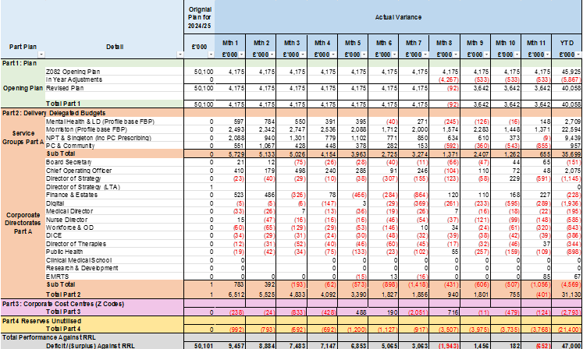
2024/25 In Year Health Board Position
Notes:
Corporate Reports

Slide 6

Service Group Element of Financial Plan
The end of year control total target for Neath Port Talbot & Singleton Service Group (NPTSSG) is £11.8m.
Forecast outturn is £9.9m (Re-assessed for Recovery & Sustainability Board 12th March).
There remain both risks and opportunities within the forecast for 24/25 outturn. The service is committed to delivering the best possible outturn whilst maintaining patient care.

Slide 7
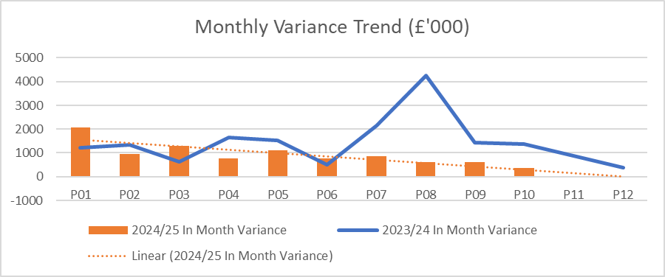
Service Group Position By Month & Divisions
Key Messages:
At month 11, NPTSSG is £9.4m overspent year-to-date (YTD). This consists of net £11m overspends across Divisions, which is partly offset by net Group Management underspend of £1.6m consisting of non-recurrent accounting opportunities and reserves held centrally in year.
Integrated Medicines Management’s (IMM) underspend of £2.3m, driven by vacancies, limits the Division’s overspend position – a future financial risk as vacancies are appointed to.
The improvement in variance run rate seen in M11 is as a result of a lower than forecasted prescribing spend, with the impact of winter yet to materialising as forecasted ~£480k.
Year-To-Date (YTD) variance is largely driven by overspends in the Surgical Division, particularly so in the support services and Trauma & Orthopaedics (T&O):
Theatres (£4.5m) is driven by a combination of both Pay (£0.4m) and Non-Pay (£4.1m) where the capacity is not financially sustainable within existing budgets.
Anaesthetics (£2.8m) is driven entirely by Pay (£2.9m) and is due to: volume of additional work needed to maintain current Theatres timetable; number of vacancies required backfilling by Additional Duty Hours (ADH) – all of which come at a premium rate, where the local agreement is similar in value to Waiting List Initiative (WLI).
The cost of covering additional unfunded capacity is also driving the overspend (£1.6m). This is in addition to staffing costs incurred by Morriston Service Group for the temporary redeployment of Ward K staff to Ward 8/3
T&O (£1.6m) is predominantly driven by non-pay overspends linked to the volume of Implants and Appliances which is not financially sustainable within current budget.
Divisional leads continue to work on their individual savings and recovery plans, with a focus on delivering a sustainable plan for 25/26 as well as ongoing recovery in 24/25.
Notes:
Local Reports

Slide 8
In month Service Group Position By Division & Type Expenditure/Income
Key Drivers:
Pay – Medical Staff
Anaesthetics (£292k) continues the overspending trend, for the reasons referenced on the prior slide, with £280k resulting from ADHs paid at near WLI rate.
T&O (£89k) continues to overspend in line with run rate and results from an establishment unsustainable under current budgets, as well as incurring premium variable costs from the backfilling of gaps
Obs & Gynae (£38k) continues to overspend but at has improved on trend of £53k per month to date. This is predominantly due to the use of ADH shifts for sickness; vacancies, and; additional capacity/other.
Haematology (£35k) The trending overspend is as a result of 1x post (equivalence in sessions) above funded establishment and 2 consultant posts being at premium agency rate, with further supervisory on call payments also contributing.
Non Pay
Miscellaneous is the net budgetary CIP requirement offset with any unallocated reserves (slippage/ accounting support).
Clinical Supplies & Services continues to see significant pressures in both Theatres and T&O as referenced in the previous slide.
In addition, Haematology Blood Products are £32k overspent in month, where actual spend has increased on average by ~£30k per month.
In month prescribing underspend of £750k, with the impact of winter yet to materialise.
Notes:
DoF Matrix – local reports

Slide 9

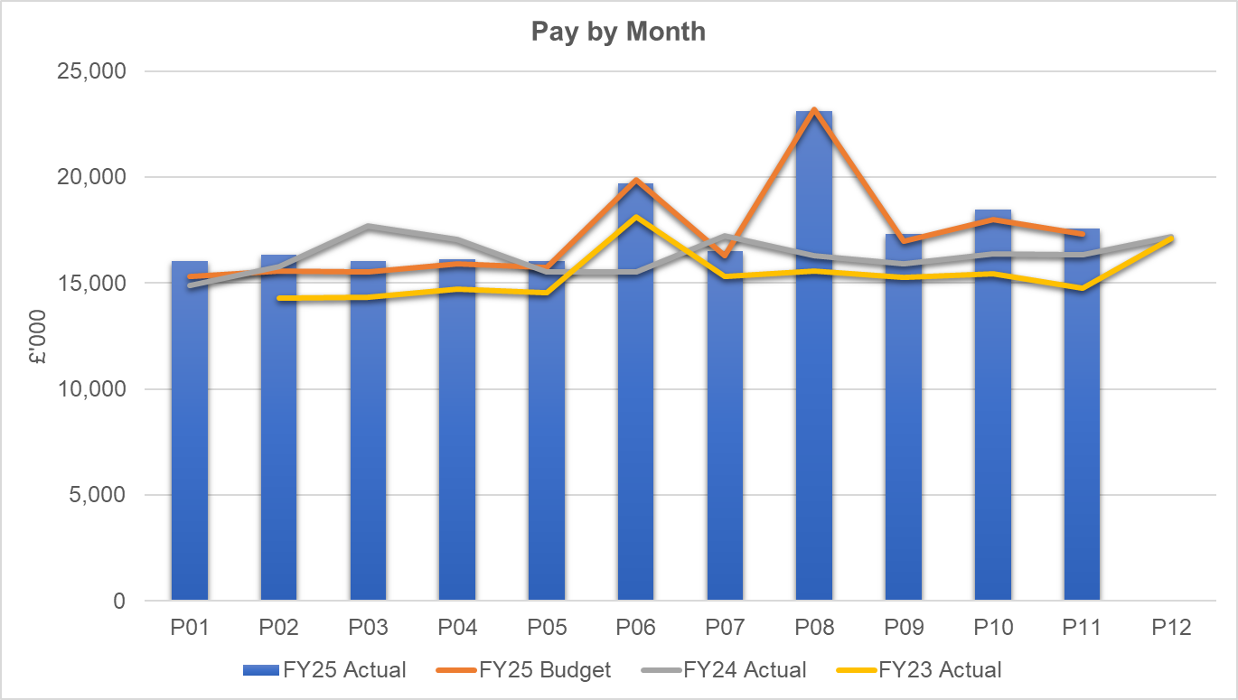
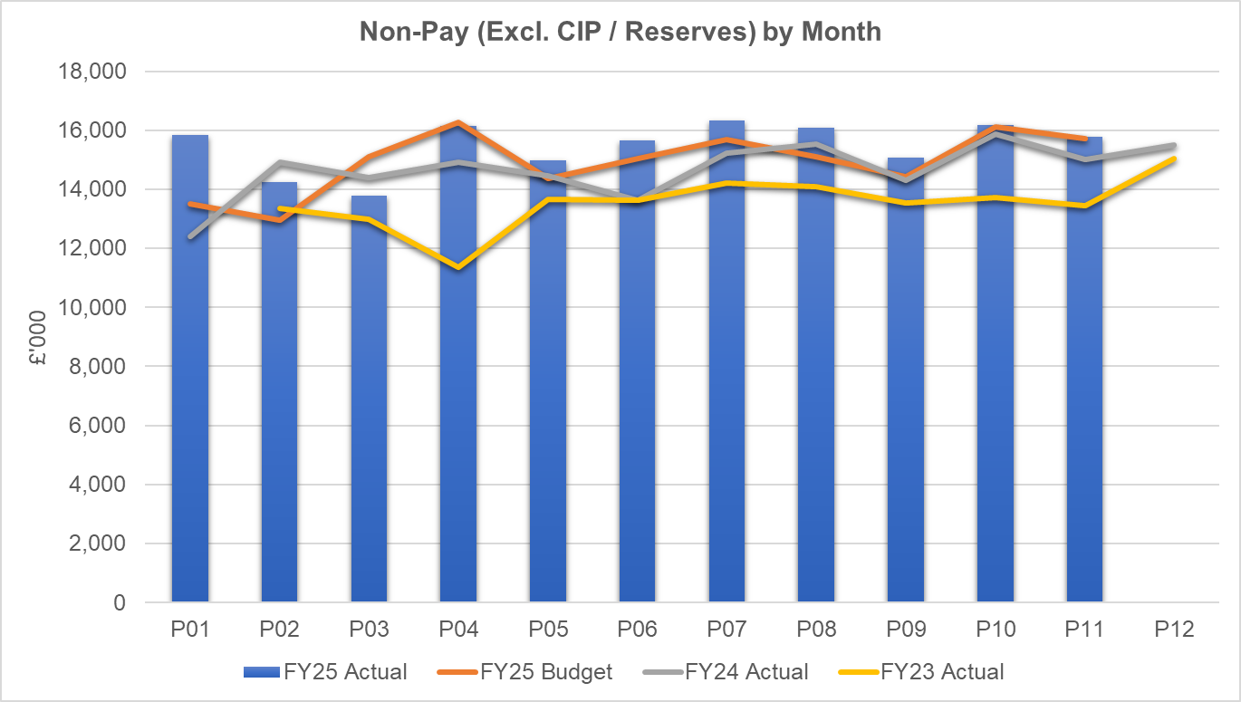
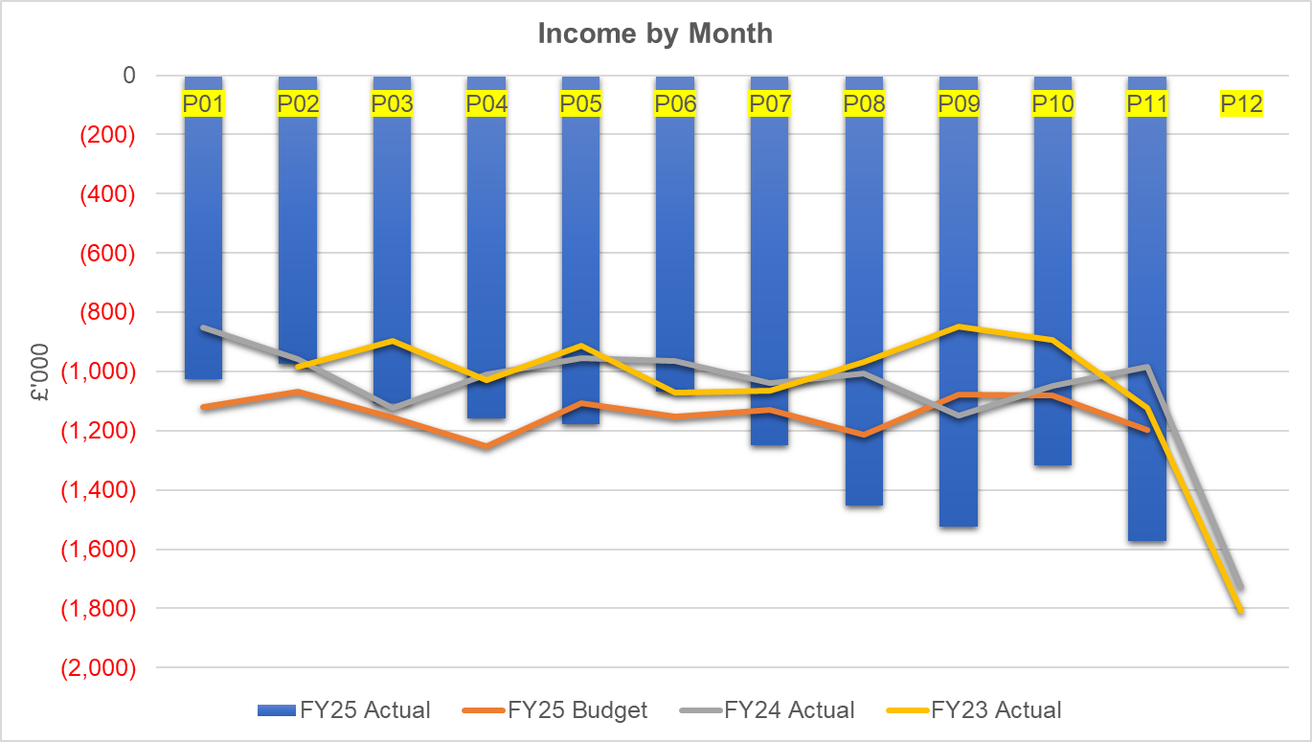
financial performance: Overall trends
Pay
A medical and dental pay award (2023/24 and 2024/25) with back pay was applied in month 06 and 08, respectively (and funded) which skews the high-cost trend data. If the impact of this was excluded the overall trend of expenditure is largely stable, elements of variable pay is reducing but there has been some increase in substantive costs following planned recruitment to deliver services. The impact of Student Streamlining to Theatres in particular is expected to see substantive cost increase without initially seeing a corresponding decrease in variable pay. It is worth noting that WLI pay arrears have not yet been paid as work is undertaken to differentiate true WLI from ADH undertaken at WLI rates. Significant vacancy related YTD pay underspends in IMM (£2.1m), Medical Equipment Management Service (MEMS) (£0.25m), Community Paediatrics (£0.6m) and CHC (£0.25m) are contributing to limiting the overspend and risks deteriorating if and when posts are appointed to. £100k FYE MEMS vacancies already appointed to.
Non Pay
Month on month variations are largely attributable to the variation in NICE approved high cost drugs, where funding is issued from centrally to Service Groups on a usage basis each month. Other large variations in Clinical Service and Supplies Costs are largely seen in activity driven areas such as Theatres, where stock levels and activity levels play a part in monthly variation.
Income
Recent income improvements have been significantly driven by: retrospective tariff negotiation and agreements for the interim provision of Radiopharmacy services to South East Wales organisations, and; retrospective re-alignment of Oncology SLA charges to current service provision to Hywel Dda. These improvements have been partially offset by deterioration in private patient income improvements seen in M07, M08 and M10.

Slide 10
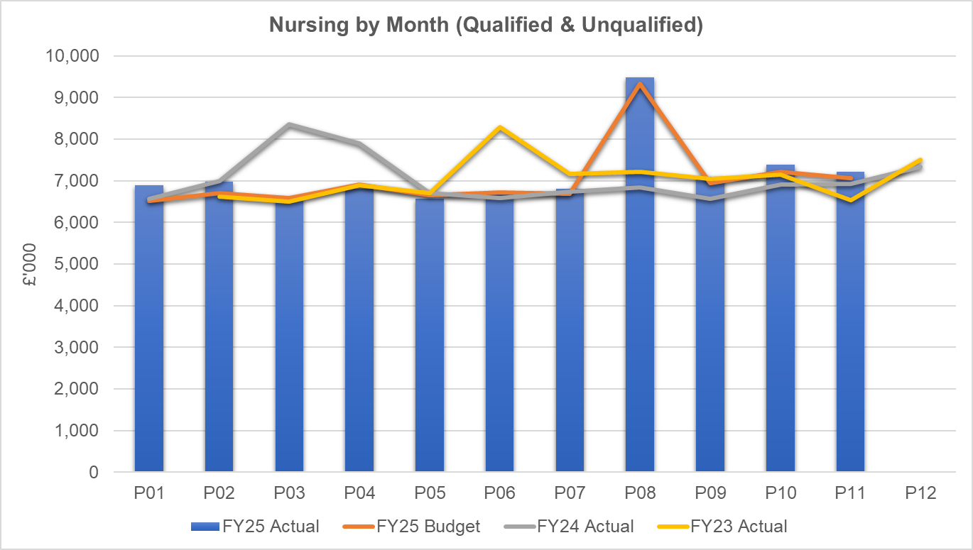
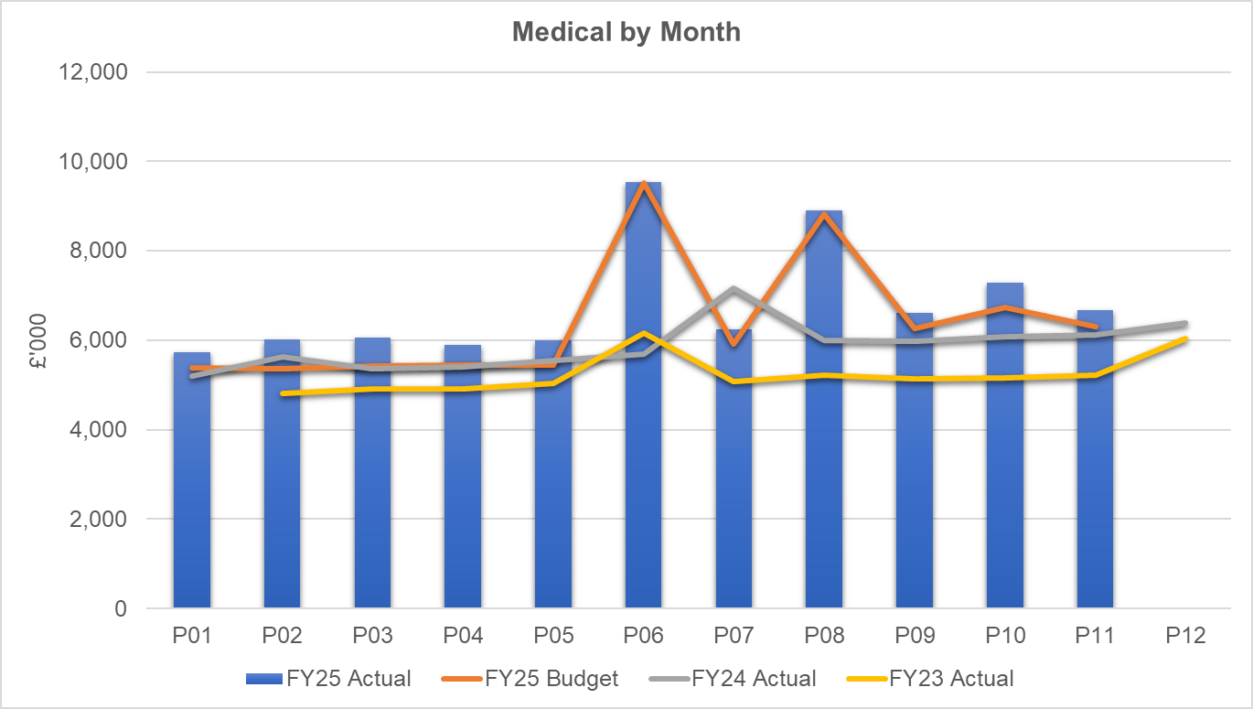
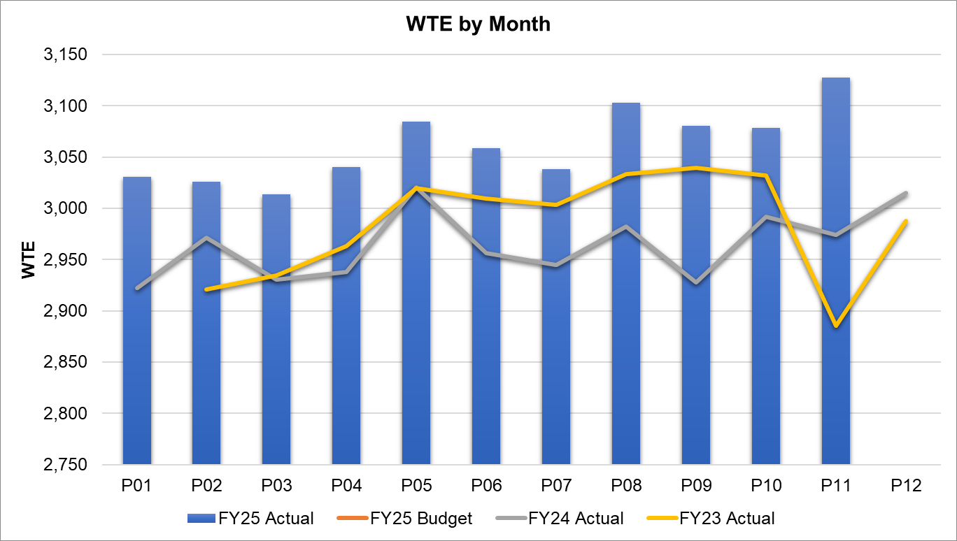
Pay Summary
Total nurse expenditure shows an increasing trend and can largely be attributable to the increasing levels of additional (outlier) capacity open on the Singleton site. The A4C pay award (2024/25) with back pay was applied in month 08, respectively (and funded) which skews the month on month trend data.
A medical and dental pay award (2023/24 and 2024/25) with back pay was applied in month 06 and 08, respectively (and funded) which skews the month on month trend data. The spike in WTE reported in M5 and M11 was as a result of the rotation of training grades between organisations and being incorrectly charged through Single Lead Employer (SLE) – the financial value was adjusted to reflect this whilst corrected by Shared Services.

Slide 11
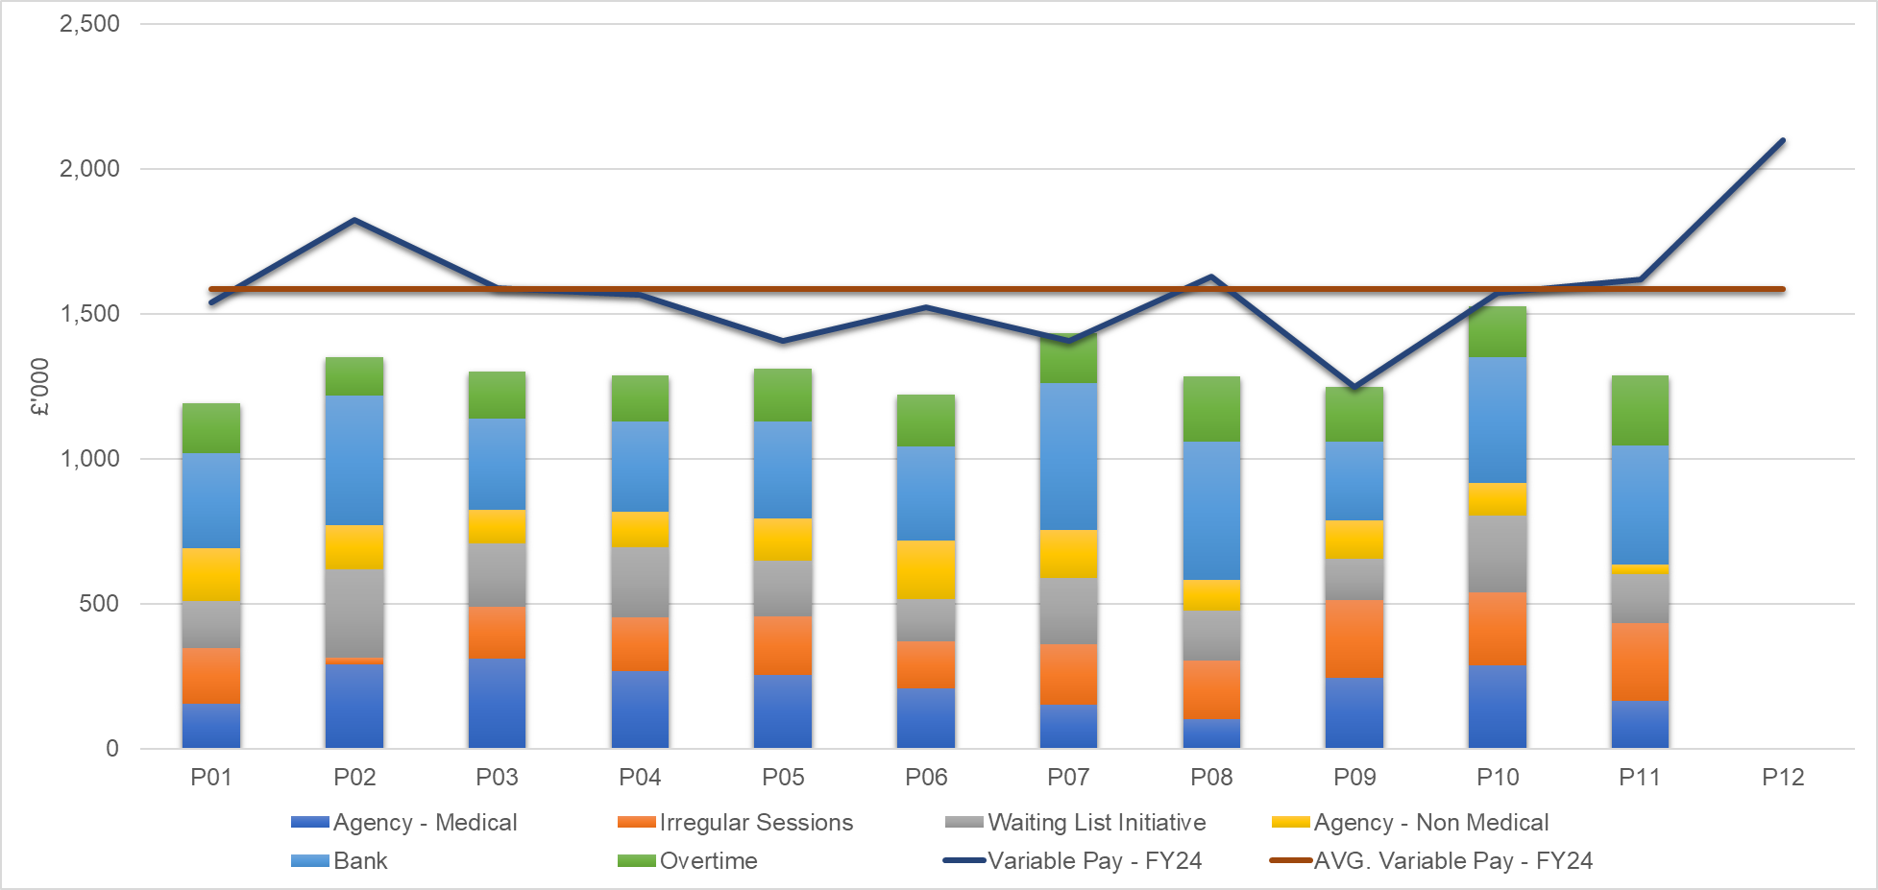
Pay : Variable pay
Anaesthetics ADH/WLI accounts for 16% of the variable pay expenditure to date.
Additional bed capacity bank & agency spend accounts for a further 12% of the total variable pay expenditure to date.
Funded Planned Additional Activity Rate (PAAR) totalled £74k in month 11, accounting for 6% of the in month variable pay.
Haematology Medical agency spend totalling £511k YTD accounts for 3.5% of the YTD variable pay with Gynaecology accounting for another 3.5%
Theatres overtime (excl. PAAR) at £749k accounts for 5% of the YTD variable pay
Notes:
Variable pay report needs updating because qlkiview no longer exists

Slide 12
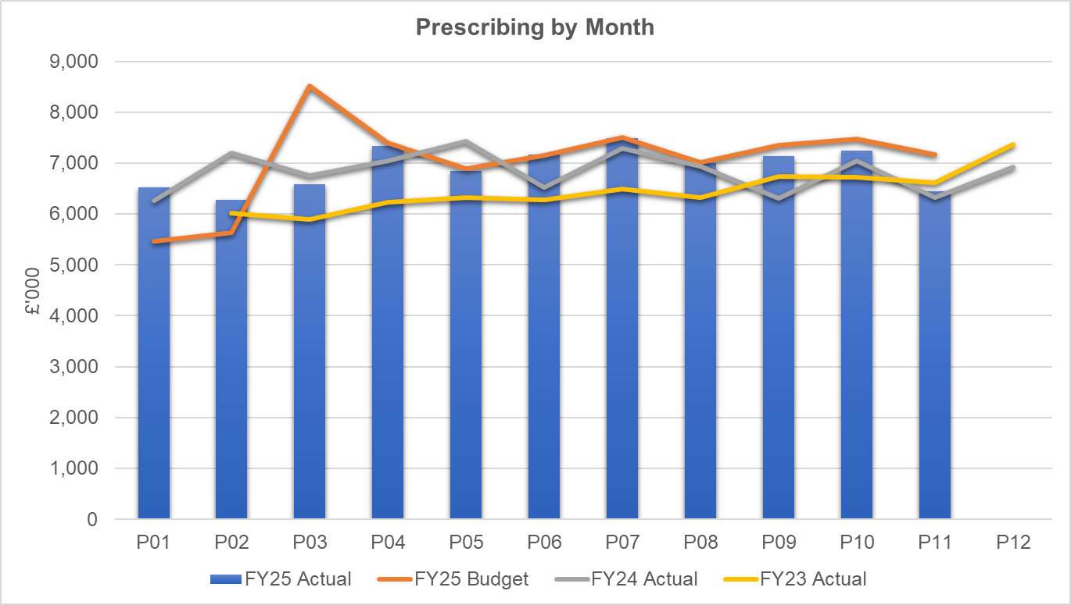
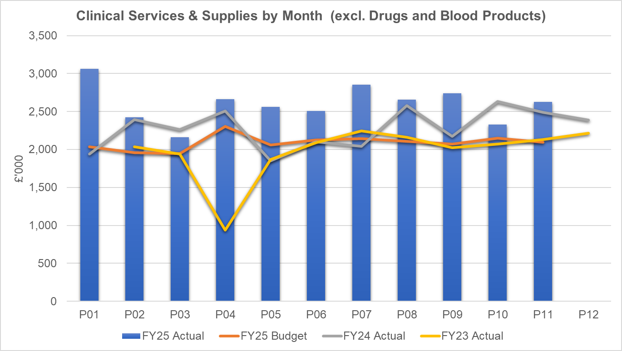
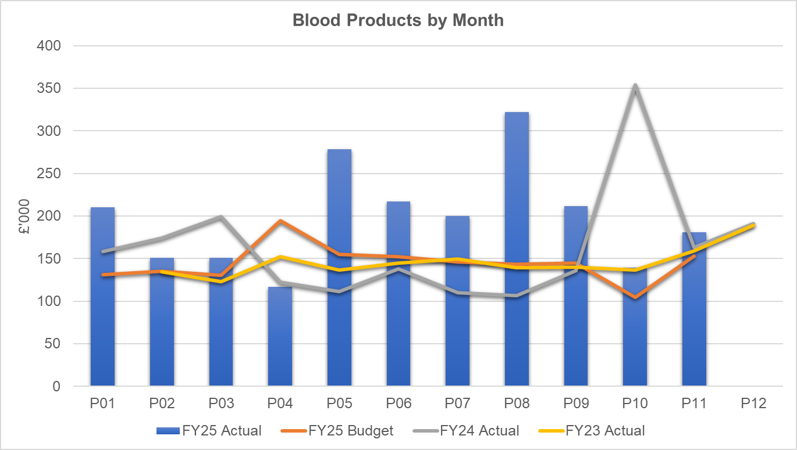
Non Pay: key drivers
69% of Clinical Services & Supplies (excl. Drugs and Blood Products) expenditure is seen in the Surgical Division with Theatres and T&O accounting for 41% and 22%, respectively - both activity driven services. As a support service, Theatres is integral to the delivery of other services’ performance targets, where any efficiency gains are utilised to deliver further performance gains.
These expenditure areas are also contributing to the increased spend levels in 24/25 vs 23/24 due to the following reasons: Increased activity; Inflationary Pressures; Non-recurrent benefits taken in 2023/24.
Haematology Blood Products - which along with Rheumatology to a lesser extent is the biggest consumer of blood products - is a current cause for concern. Expenditure levels have clearly increased vs 2023/24 with further investigation underway to understand the drivers of this spend. There is often natural monthly variation in spend but this year’s Haematology expenditure has averaged £30k per month higher than last year, which in turn was ~£30k per month higher than the year prior to that.
Prescribing - is providing a £0.7m underspend in-month following receipt of the latest datasets and there is a YTD underspend of £1.4m. We have at this point received 9 months of PAR data. The YTD data is below the anticipated levels at this point in the year and therefore a larger element of this anticipated benefit has been recognised in-month. The Pharmacy team are expecting potential further reductions linked to Cat M later in the year; there is the possibility of further opportunities. The position will remain under close review pending further PAR data in the final month of the year.

Slide 13

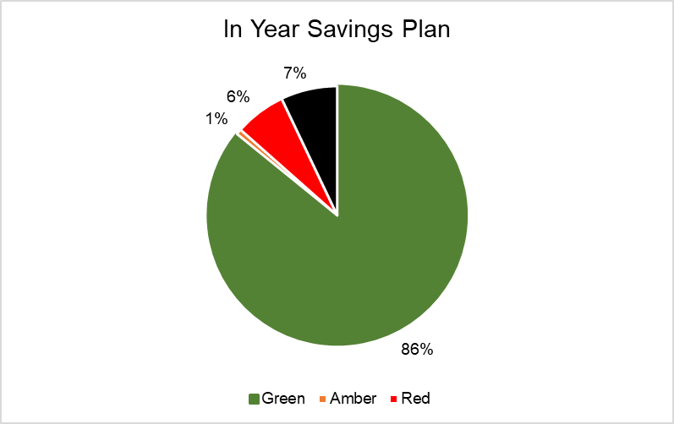
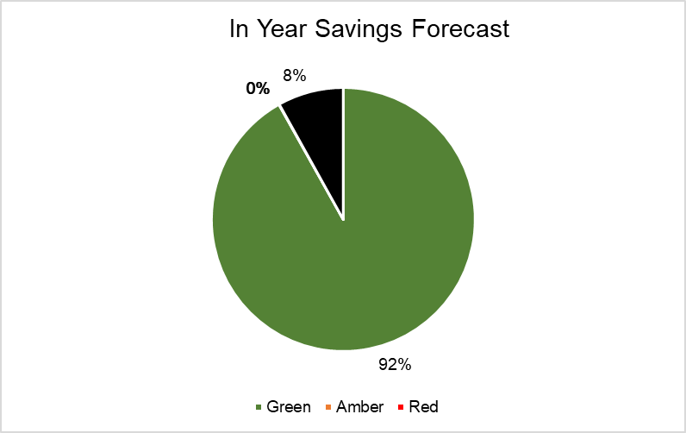
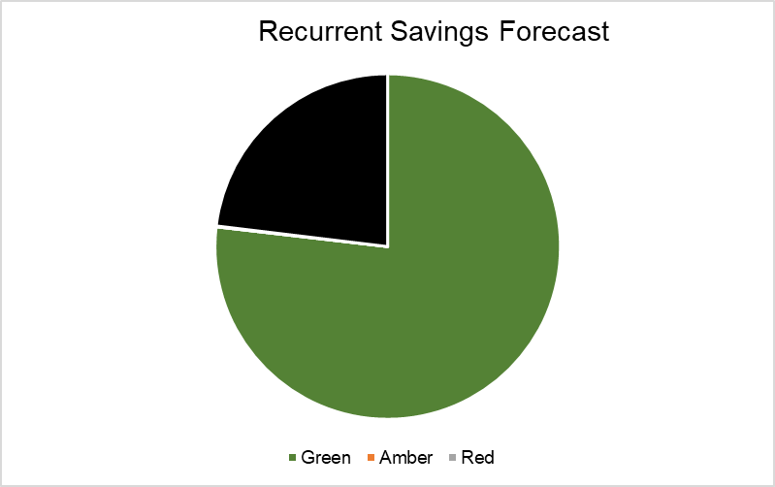
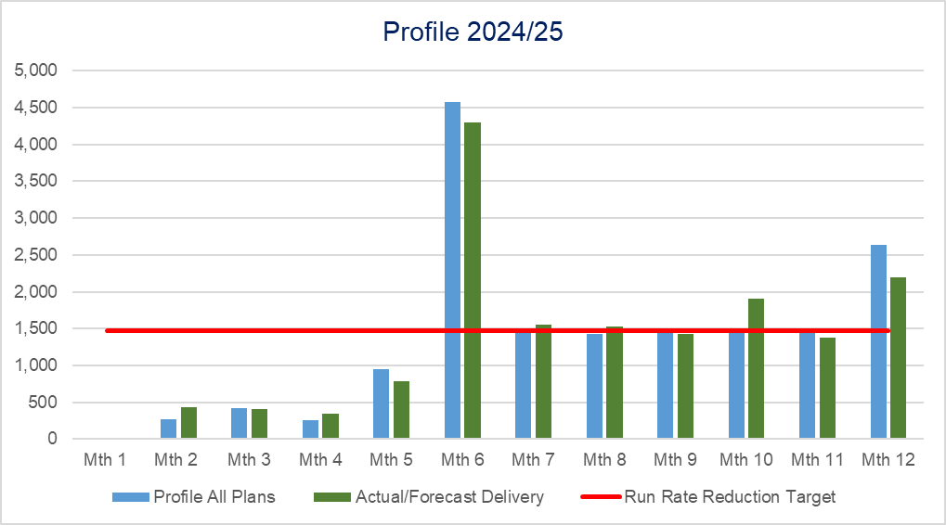
Savings Summary From Financial Assessment
Notes:
CIP

Slide 14
Savings Detail (Green)
Detail of Green Schemes | £'000 | Status | Next Steps - Work in Progress
Rivaroxaban | 350 | On Target to be delivered
Primary Care WorkPlan | 1,390 | On Target to be delivered | Anticipated to Over Achieve but needs further review
Ticaglaor | 170 | Off Target
Contract for Sugammadex | 200 | Delivered
Liquid Meds in Childrens | 33 | Delivering / Off Target | • SBAR for switch to Ceyesto brand of Melatonin liquid written by MM and approved by Community Paeds in September 2024 • Singleton, Neath and Morriston hospital sites all using Ceyesto since September/October 2024. • First month savings (October 24) around £3.5k • Forecasts need to be altered down (21k this year, 42k full year saving) – slight reduction due to bottle size/expiry date of new preparation.
Primary Care Rebates Review | 350 | Delivered
Service Review | 294 | Delivered
10% Reduction in Variable Pay | 1,419 | Partial Delivery
Procurement | 1,000 | Partial Delivery
Non Reccurrent Opportunities | 500 | Over delivered
VAT Oxygen | 150 | Over delivered
Storage | 3 | Delivered
IMM-Spend to Save ( Drugs Transformation HCD) | 25 | Delivered | In Corporate Position
Hywel Dda SLA Alignment of Commissioning Arrangements | 200 | Delivered
Tattoo less Treatment-Savings on medical grade | 1 | Delivered
MEMS maintenance contract Review | 360 | On Target to be delivered
Radio pharmacy Pricing-price tariff | 157 | Delivered
Paeds-Efficiencies in Community & ND: move to Paperlite, cessation of off-site secure storage & use of external venues | 2 | On Target to be delivered
Gynaecology-Intensity Banding: | 5 | Delayed
WFI-Generate income from medication sales | 22
WFI-Increase in fee-paying patient activity | 94 | Delayed / Slipped | Progressing but delayed – Marketing campaign being reviewed but issues raised by Dice team around compliant website so further work taking place to market WFI. More fee-paying patients planned for treatment.
WFI-Price increase in fee-paying fees | 29
WFI-commisioning Arrangments - Part1 | 35 | Delayed / Slipped | Awaiting meeting to be scheduled with JCC/SBUHB. Benchmarking work and proposal document completed.
WFI-Realignment of Required Facilities | 25 | Delivered
WFI-Travel Expenses | 5 | Delivered
WFI-Reduction in anaesthetic sessions from reduction in theatre sessions | 48 | On Target to be delivered
WFI-Reduction in Consultant Intensity Bandings | 2 | On Target to be delivered
WFI-Self Funding medical Arrangements | 9 | On Target to be delivered
Reserves Allignment | 1,365 | Delivered
Purchase of Annual Leave | 41 | On Target to be delivered
Reserves Slippage | 1,349 | Delivered
Reassessment of Run Rates | 430 | Delivered
Reassessment of Run Rates | 1,789 | Delivered
Reduction Of Surge Beds | 846 | Delivered
Run Rate Vacancies | 1,800 | Delivered
Run Rate Vacancies | 127 | Delivered
Other Procurment | 180 | Delivered
Recovery Scheme Adjusment to Balance to Plan | 302 | Delivered
Do not replace current over establishment of junior and senior clinical fellow posts - 4 leaving and don’t replace | 76 | Delivered
 | 15,183
Notes:
CIP

Slide 15
Savings Detail (Amber)
Detail of Amber Schemes | £'000 | Status | Next Steps - Work in Progress
RT Immobilisation Research-Work with Suppliers to provide research using free/discounted equipment | 4 | Delayed / Slipped
Electronic Reception-Change the current model to patients self booking in with volunteer support | 10 | Delayed / Slipped
WFI-commisioning Arrangments - Part2 | 107 | At Risk | Unlikely to deliver in year, recurrently still on track
 | 121
Notes:
CIP

Slide 16

Identification Opportunities & Risk
Further Risks:
Implementation timescales/ managerial capacity for any recovery schemes
Challenge of staff engagement against perceived deliverability
Ongoing pressures linked to Surge and UEC demand
Inter group consequences of recovery plan options pursued such as Therapies vacancies impact on Length Of Stay/ Bed Plan
Additional inflationary and demand pressures (organisation agreements, maintenance, blood products)
Delivery of contract activity and prioritisation of limited theatre capacity
Funding for pay award reflecting true cost/ risk of reporting capability diluted due to pay award and service realignment
Further Opportunities for 25/26:
Service Review (& South Wales Response to Issues)
  Gynae Oncology
  Spinal
  Medical/Bed Model Neath- Rehab and Stroke
Activity
  Demand management
  Clinical Variation
  Commissioning clarity

Slide 17
Action & Next Steps To Be Taken By Service Group
Continued focus on delivering best closing position for 24/25
Action cost control measures as per Health Board Recovery & Sustainability Programme
Demand and Capacity reviews
Pursuing schemes to deliver recurrently into 25/26 (review of current schemes and new ideas)
Work with Recovery & Sustainability team to identify new opportunities using benchmark data sets
Continue to reduce variable pay
Continue close monitoring of position and progress against plans

