Slide 1


Performance & Finance Committee
MHLD Service Group
Date: For June 2026 Committee Meeting

Slide 2
Part A: Priority Areas & Key Actions

Slide 3
Summary Actions
PRIORITY AREAS FOCUS | Nurse staffing variable pay and sickness absence Medical staffing variable pay New year CHC growth and growth mitigation Adult MH cases commissioned in the private sector Savings delivery
5 TOP ACTIONS FOR NEXT 4 WEEKS | Reduction of sickness absence and management of sickness absence to policy Continued scrutiny on new CHC cases Continuation of review, rightsizing and repatriation to mitigate the cost of growth Approval of investment into Home Treatment Team in order to reduce the commissioning of the adult MH cases in the private sector Development of plans to meet housekeeping savings target Contribution to the medical and nursing workforce savings workstreams
5 TOPS ACTIONS LAST 4 WEEKS & UPDATE ON OUTCOME | Reduction of A&C agency expenditure to target Completion of A&C turnover savings PID Identification of secondary care drugs savings opportunity Reduction of variable pay at start of June compared to May average Reduction of high sickness absence in Gwelfor and in Ward F

Slide 4
Part B: Look Forward

Slide 5
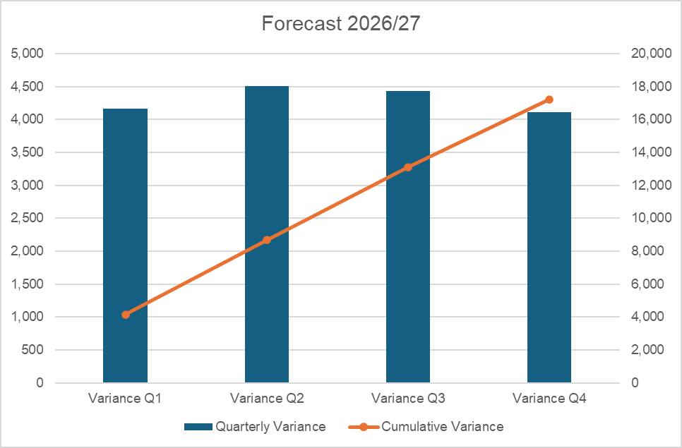
Forecast
Key Assumptions:
Excludes the impact of the 2026-27 Medical & Dental Pay Award and the amendment to the A4C Band 3 pay scale.
Any active recruitment offset by turnover or displacement of temporary staffing, pending detailed analysis
Variable pay based on level of temporary staffing at the start of June 2026
Investment in clinical staffing for Home Treatment Team to reduce the cost of the adult MH cases
CHC growth in future months at rate of growth in months 01 and 02
CHC growth mitigation in future months at rate of growth in months 01 and 02
Reduction in the cost of the adult MH cases in line with business case for investment in the Home Treatment Team
Delivery of all green and amber RAG rated saving schemes

Slide 6
Part C: Look Back

Slide 7
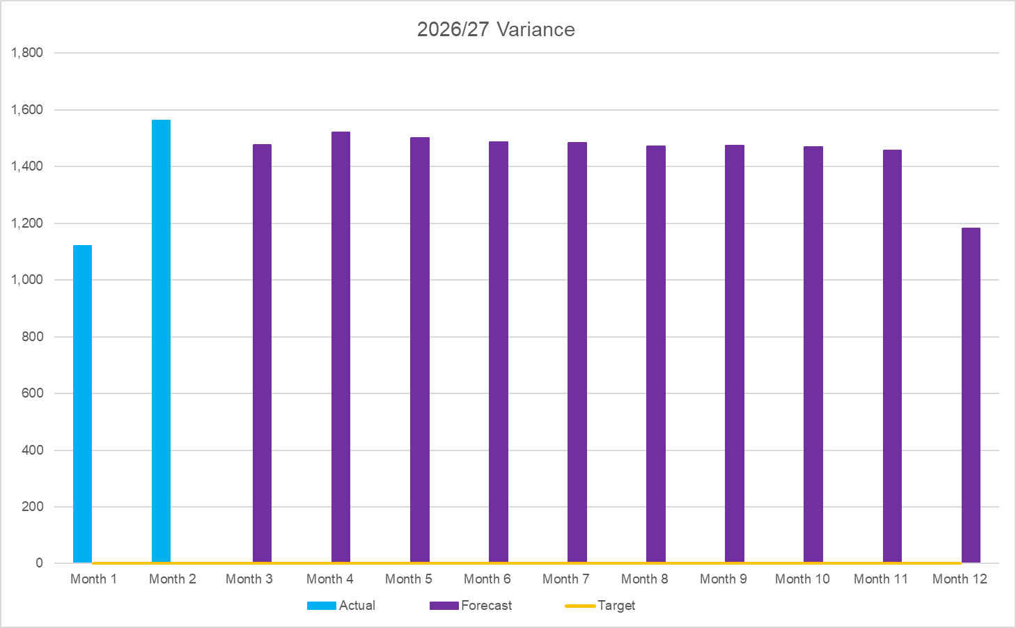

2026/27 Health Board Position By Service Area
OPENING BUDGETARY POSITION | IN YEAR PERFORMANCE
ACTUAL & FORECAST VARIANCE TREND

Slide 8
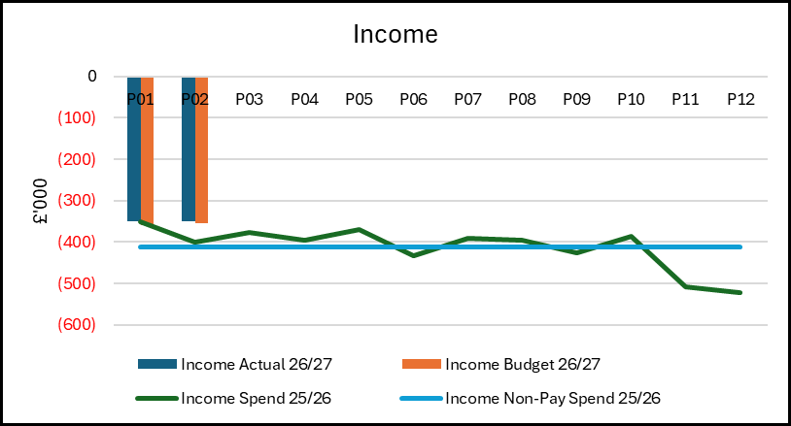
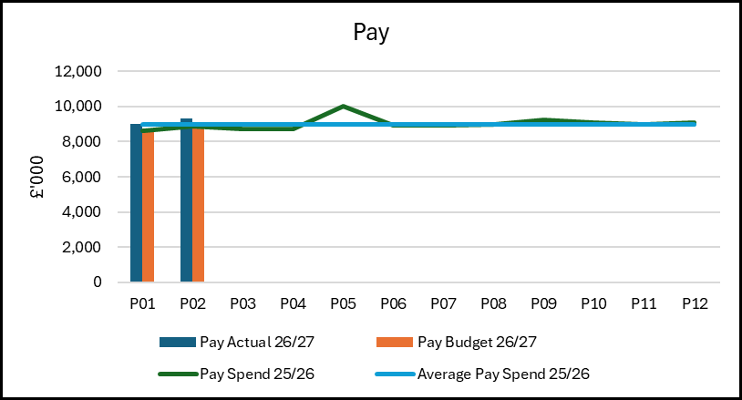
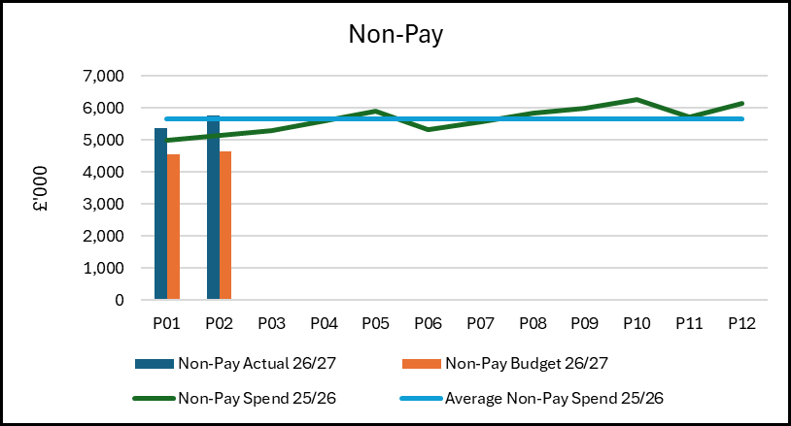
Summary: Income, Pay, Non-Pay
Key Points:
Income - £31,248 overspent to date
• There is cost pressure from the ending of an SLA where it has not yet been possible to take down the cost base, action is being progressed, and there is reduced training income.
Pay - £0.736m overspent to date
• The majority of the overspending is against nursing budgets due to the continued high variable pay. The position is then helped by underspending against Psychology and A&C budget due to turnover/vacancy.
• In medical staffing there is a small overall increase in variable pay month-on month. The agency is up, there had been some accrual benefit in m01, and the ADHs are down. There has been some movement across other pay lines.
• In nursing there is a large increase in the nursing variable pay, this is in line with the weekly reporting into the Service Group. The variable pay has increased by £165,432 from £676,341 in month 01 to £841,773 in month 02.
Non-Pay - £1.918m overspent to date
• The overspending from the adult MH Cases, CHC and savings shortfall against target.
• There has been an increase in the cost of the adult MH cases from £0.444m in m01 to £0.520m in m02 and £0.968m to date.
• The CHC overspend is now £57,094 to date, there had been large non-recurrent benefit in m01.
• And there is a charge in the position of £0.833m for the shortfall in savings delivery against target. At month 02 the Service Group has only been able to identify green and amber schemes to a value of £834,446 against the £5.577m target.

Slide 9
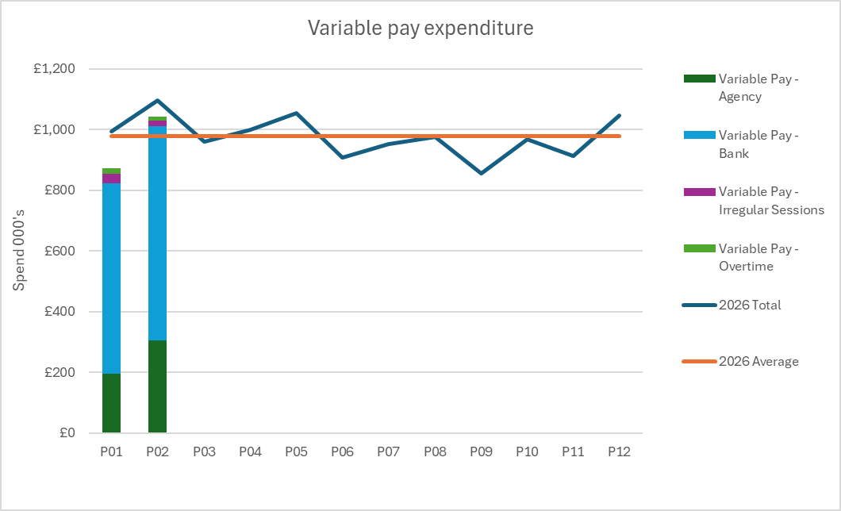
Pay Summary
Key Points
There is continued high variable pay in the new financial year, both medical and nursing
In medical staffing there is agency cover across a number of specialties for vacancy and sickness absence and some additionality for adult MH cases. And there is the cost of ADHs largely for rota gaps.
In nursing there is cover across registered nursing and HCSWs for vacancy acuity and sickness absence. There is a stepping up for staffing levels above funded levels, mainly from HCSWs, to manage acuity. And there is cover from RNs and HCSWs for high levels of sickness absence.
There is also some small expenditure for A&C and ancillary agency staffing

Slide 10
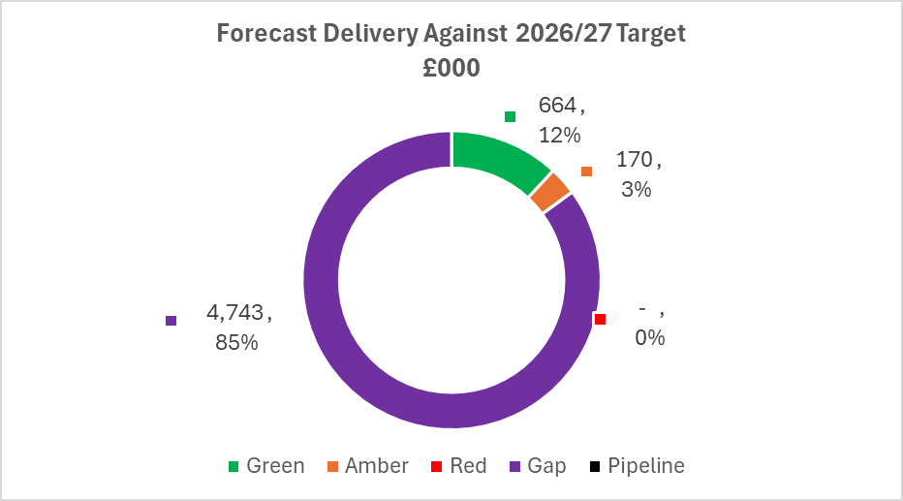
Savings

Slide 11
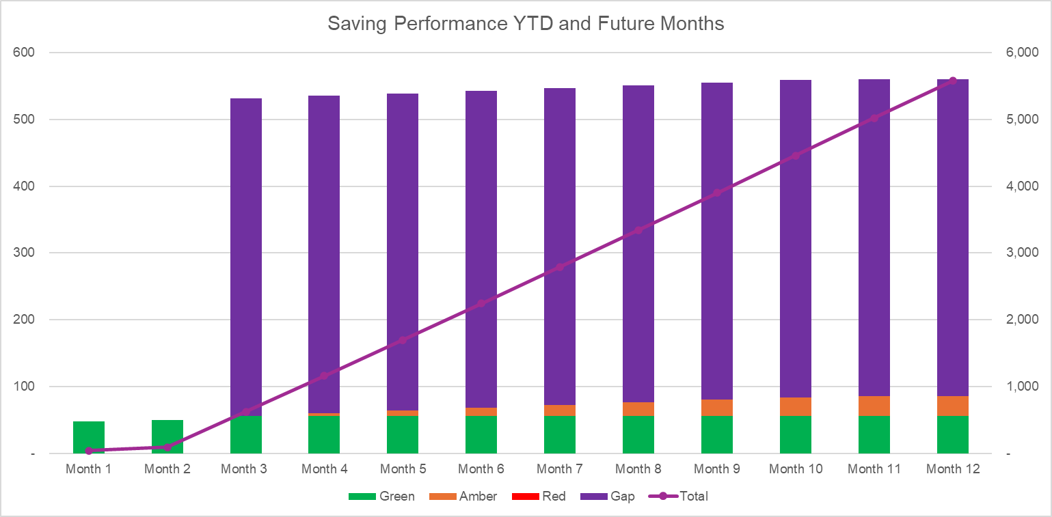
Savings
Note: All figures in £000s, the monthly profiling against the Y-axis on the LHS and the cumulative totalling against the axis on the RHS

Slide 12
Identification Opportunities & Risk
Further Opportunities Above £65m |  | Further Notes / Comments The opportunities are opportunities to improve the level of the forecast and do include some cost reduction against existing savings target, being the nursing variable pay and the housekeeping savings. The improvement in the cost of the adult MH cases is the management of an existing pressure. This would be an improvement to the operational position.
Risks (Top 5)

Slide 13
Part D: Budget Holder Performance

Slide 14
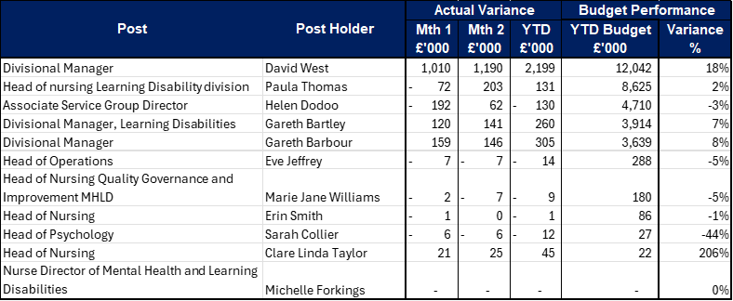
Accountability Letters: Variance By Budget Holder

Slide 15
Accountability Letters: Replies @ 12 June 2026

Slide 16
Accountability Letters: Training Record
Summary:
Of 12 Budget Holders only 1 BH has yet to complete the training due to being unavialable in May.

Slide 17
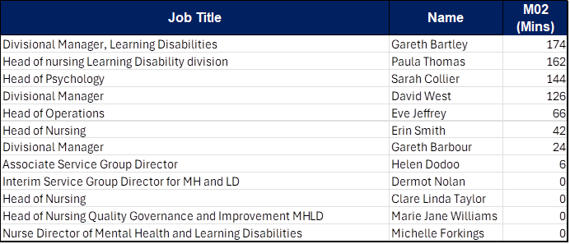
Accountability Letters: Qliksense Usage Stats

