Slide 1
Annex 1
Detail Financial Position
Month 2 FY 2026/27

Slide 2

Financial Summary
In-Month Variance
£7.656m
Variance to Plan £1.3m
YTD Variance
£16.174m
Variance to Plan £3.4m
Executive Summary
Income and Expenditure Insights
Operational and Financial Performance
Appendices

Slide 3
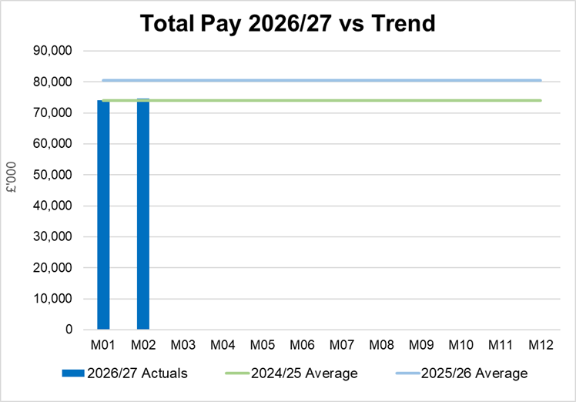
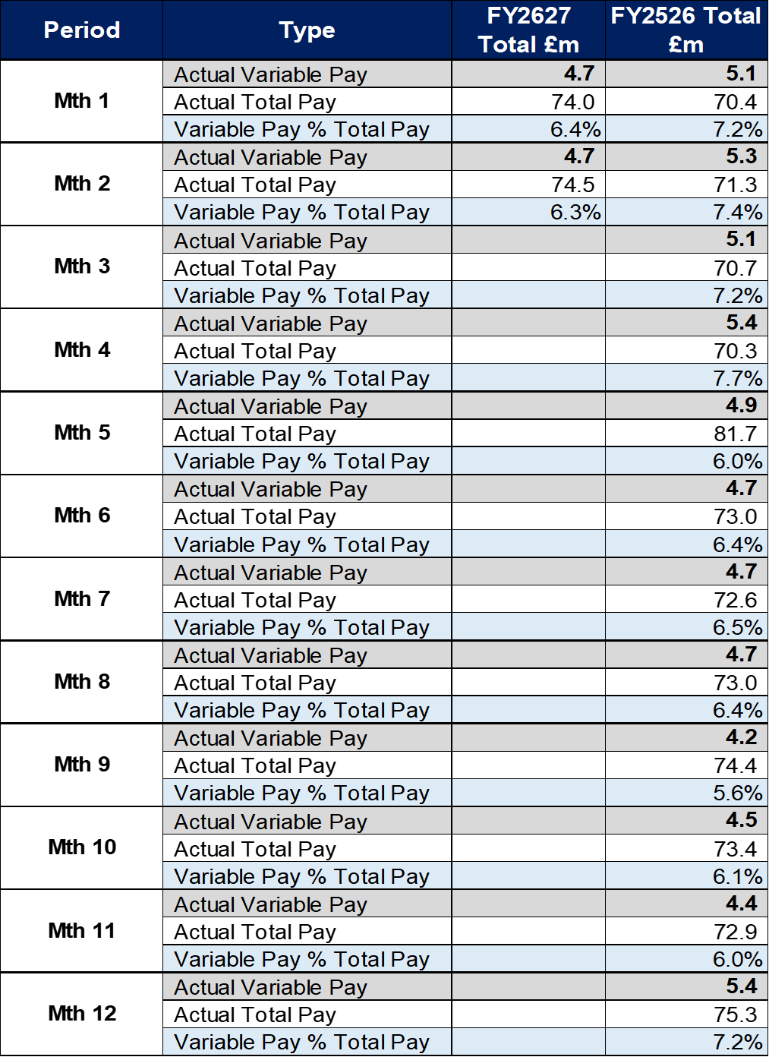
Total Pay Insights
In-Month Actual
£74.545m
Variance to Ledger £0.89m
YTD Actual
£148.544m
Variance to Ledger £1.11m
Executive Summary
Income and Expenditure Insights
Operational and Financial Performance
Appendices
Key Information
Month 2 Pay was broadly in line with Month 1, with vacancies more than offsetting the pressures in Medical and Dental and Nursing linked to high levels of sickness absence and a continuation of staffing surge bed capacity. This is linked to the increased Grip & Control in place to oversee recruitment, this has not been treated as a savings at this point as further work is required to assess the TRACs status of posts.

Slide 4
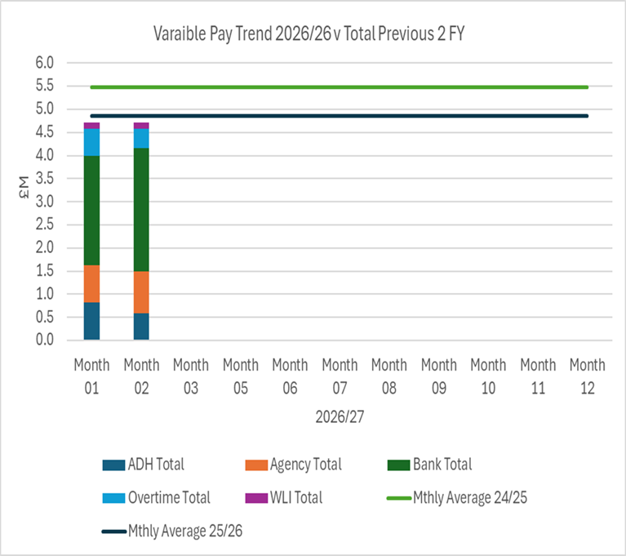
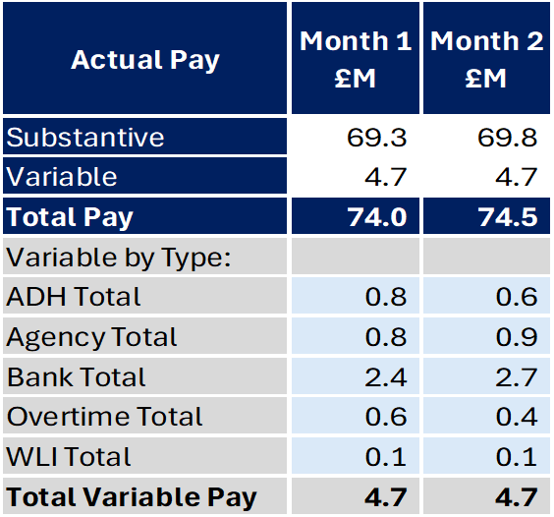
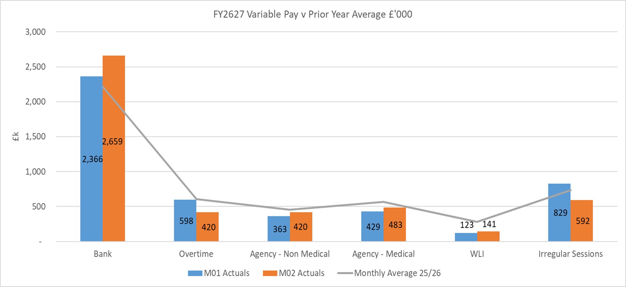
Variable Pay Insights
In-Month Actual
£4.716m
YTD Actual
£9.423m
Executive Summary
Income and Expenditure Insights
Operational and Financial Performance
Appendices
Key Information
The actual variable pay spend at Month 02 was £4.7m. Bank and agency are the key driver for this continued high spend, with other areas showing some improvement in Month 2.

Slide 5
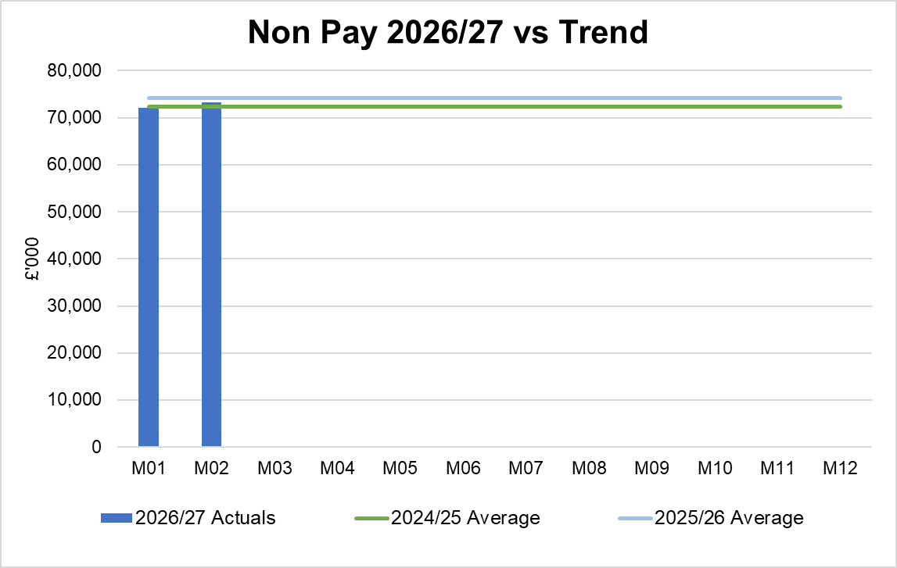
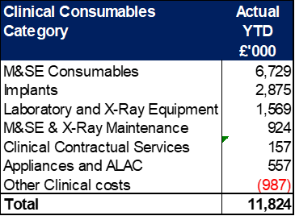
Non-Pay Insights
In-Month Actual
£73.327m
Variance to Ledger £6.7m#
YTD Actual
£145.403m
Variance to Ledger £13.7m#
Executive Summary
Income and Expenditure Insights
Operational and Financial Performance
Appendices
# includes saving non-delivery
Key Information
This area overall has an in-month position of breakeven. Within the ledger the gross JCC income is reflected within the income lines and not netted off against expenditure and so overall the Health Board position is not adversely affected. If JCC activity increases the gross level of expenditure and income will increase. The main drivers within this category of clinical consumable expenditure include heart valves & pacemakers, linked to some JCC activity. Non Pay also includes secondary care drugs, a breakdown of the categories of Clinical Consumables based on actual spend is provided in the table on the right. Prescribing is providing a breakeven position in-month following receipt of the latest datasets (March 2026; PAR data is received 2 months in arrears).

Slide 6
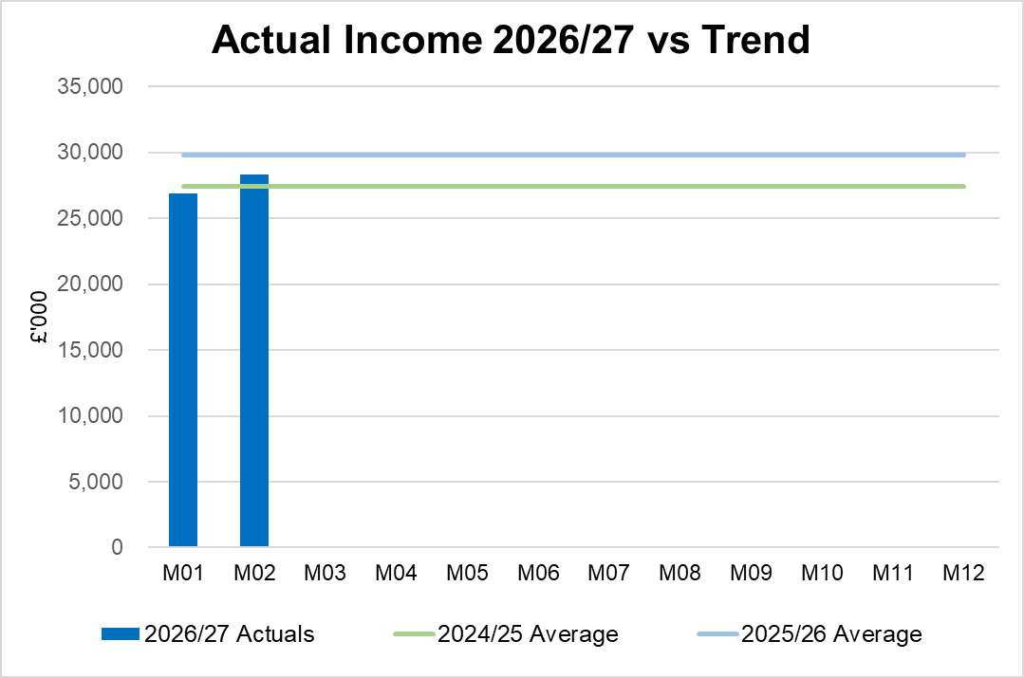
Income Insights
In-Month Actual
£28.324m
Variance to Ledger £0.066m
YTD Actual
£55.196m
Variance to Ledger £1.3m
Executive Summary
Income and Expenditure Insights
Operational and Financial Performance
Appendices
Key Information
There was an increase in income for Month 02, primarily due to an increase in rebates relating to Mounjaro along with an increase during the month in commercial R&D income. The Joint Commissioning Committee (JCC) Income as a provider reported a slight underperformance in Month 2, with summary assessed performance by area in table opposite. Dental Contract Income underperformed in-month by £0.1m.

Slide 7
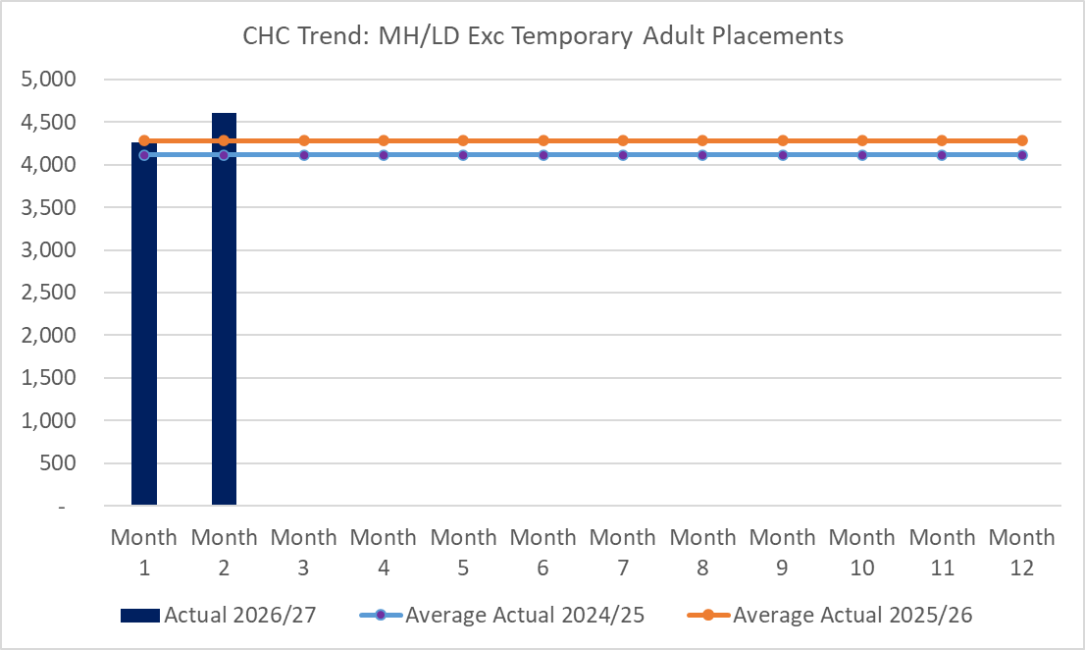
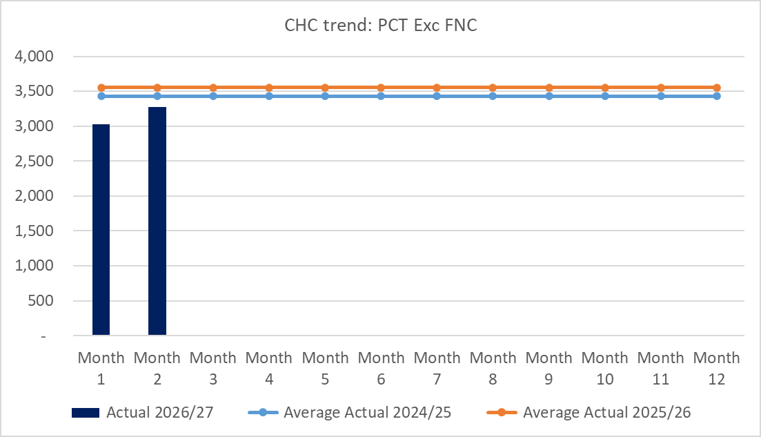
CHC Insights
In-Month Actual
£7.879m
Variance to Ledger £0.38m
YTD Actual
£15.170m
Variance to Ledger £0.29m
Executive Summary
Income and Expenditure Insights
Operational and Financial Performance
Appendices
Key Information
In Month 2 CHC was overspent by £0.3m due to higher patient numbers within PCT than planned in addition to a small growth pressure in MHLD. An analysis of actual expenditure and patient numbers for 2026/27, along with the average values from 2025/26 is provided in table below. The table also includes the Temporary Adult Mental Health Placements for transparency. The graphs on the left reflect average expenditure in the last two financial years, compared to the in month position. MH/LD excludes the temporary placements and PCT excludes Free Nursing Care/Self Funders.

Slide 8
LTA Performance Insight
In-Moth Actual
YTD Actual
Executive Summary
Income and Expenditure Insights
Operational and Financial Performance
Appendices
This will be reported quarterly with the first data being published in the Month 3 report.

Slide 9
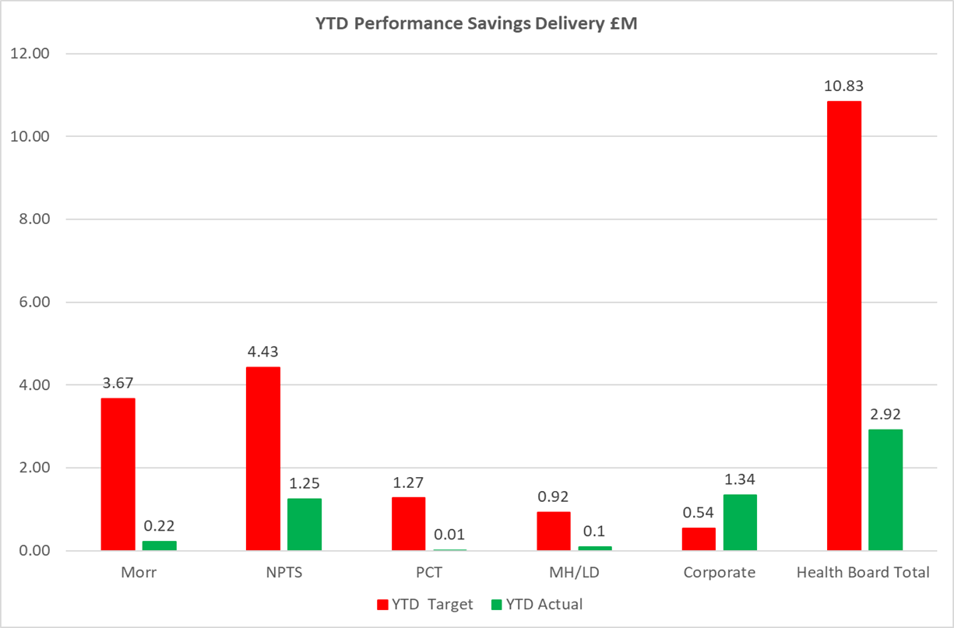
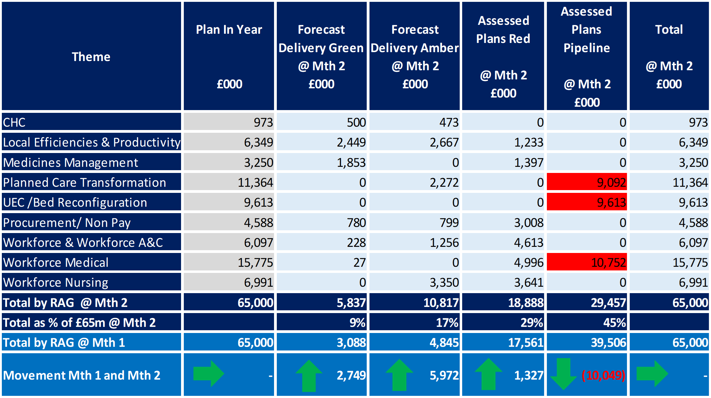
Savings Insights
Executive Summary
Income and Expenditure Insights
Operational and Financial Performance
Appendices
Savings
In Year Savings
Target = £65m
Green & Amber = £16.7m
25%
Recurrent Savings
Target = £65m
Green & Amber = £15.8m
24%
In Month Delivery
Target = £5.4m
Achieved = £1.9m
Gap = £3.5m
YTD Delivery
Target = £10.8m
Achieved = £2.9m
Gap = 7.9m

Slide 10
Reserves Insights
Executive Summary
Income and Expenditure Insights
Operational and Financial Performance
Appendices
Key Information
For 2026/27, the Health Board will hold two central reserves and the purpose of these reserves are below: Main – this holds funding from Welsh Government or the plan that has yet to be issued to Budget Holders. These items are not surplus but either due to timing have not been issued or is an area where funding is issued based on actual values consumed in future month. NICE – this holds the total Health Board funding for all NICE costs (drugs and infrastructure) and is issued to the service each month based on the actual costs consumed as reported through the Pharmacy system.

Slide 11
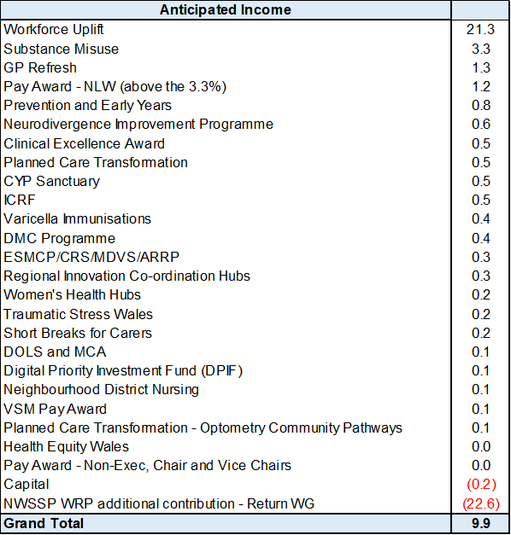
Anticipated Allocation
Executive Summary
Income and Expenditure Insights
Operational and Financial Performance
Appendices
Key Information
The current deficit plan of £76.6m is predicated on receipt of the Welsh Government funding at the levels anticipated in the table opposite.

Slide 12
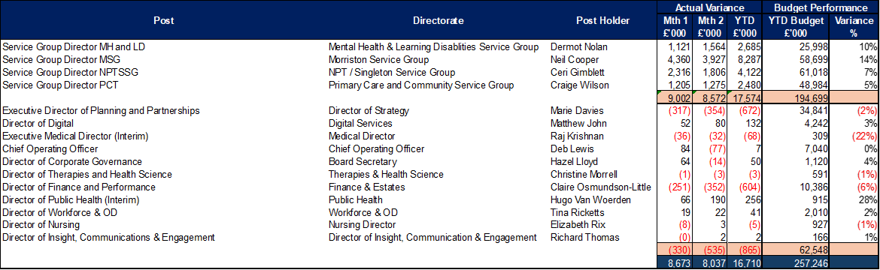
Appendix 1 – Variance by Budget Holder (Directors)
Executive Summary
Income and Expenditure Insights
Operational and Financial Performance
Appendices
Appendices

Slide 13
Appendix 2 – Variance by Budget Holder
Executive Summary
Income and Expenditure Insights
Operational and Financial Performance
Appendices
Appendices
Morriston Service Group
PCC Service Group
MH & LD Service Group
NPTS Service Group

Slide 14
Appendix 3 – Accountability Letters (1)
Executive Summary
Income and Expenditure Insights
Operational and Financial Performance
Appendices
Appendices

Slide 15
Appendix 3 – Accountability Letters (2)
Executive Summary
Income and Expenditure Insights
Operational and Financial Performance
Appendices
Appendices

Slide 16
Appendix 3 Qliksense – Finance Dashboard Usage
Executive Summary
Income and Expenditure Insights
Operational and Financial Performance
Appendices
Appendices
These tables monitor the Qliksense Dashboard usage for Month 02 for all 67 budget holders reporting usage in minutes.

Slide 17
Appendix 3 Qliksense – Finance Dashboard Usage
Executive Summary
Income and Expenditure Insights
Operational and Financial Performance
Appendices
Appendices
These tables monitor the Qliksense Dashboard usage for Month 02 for all 67 budget holders reporting usage in minutes.

Slide 18
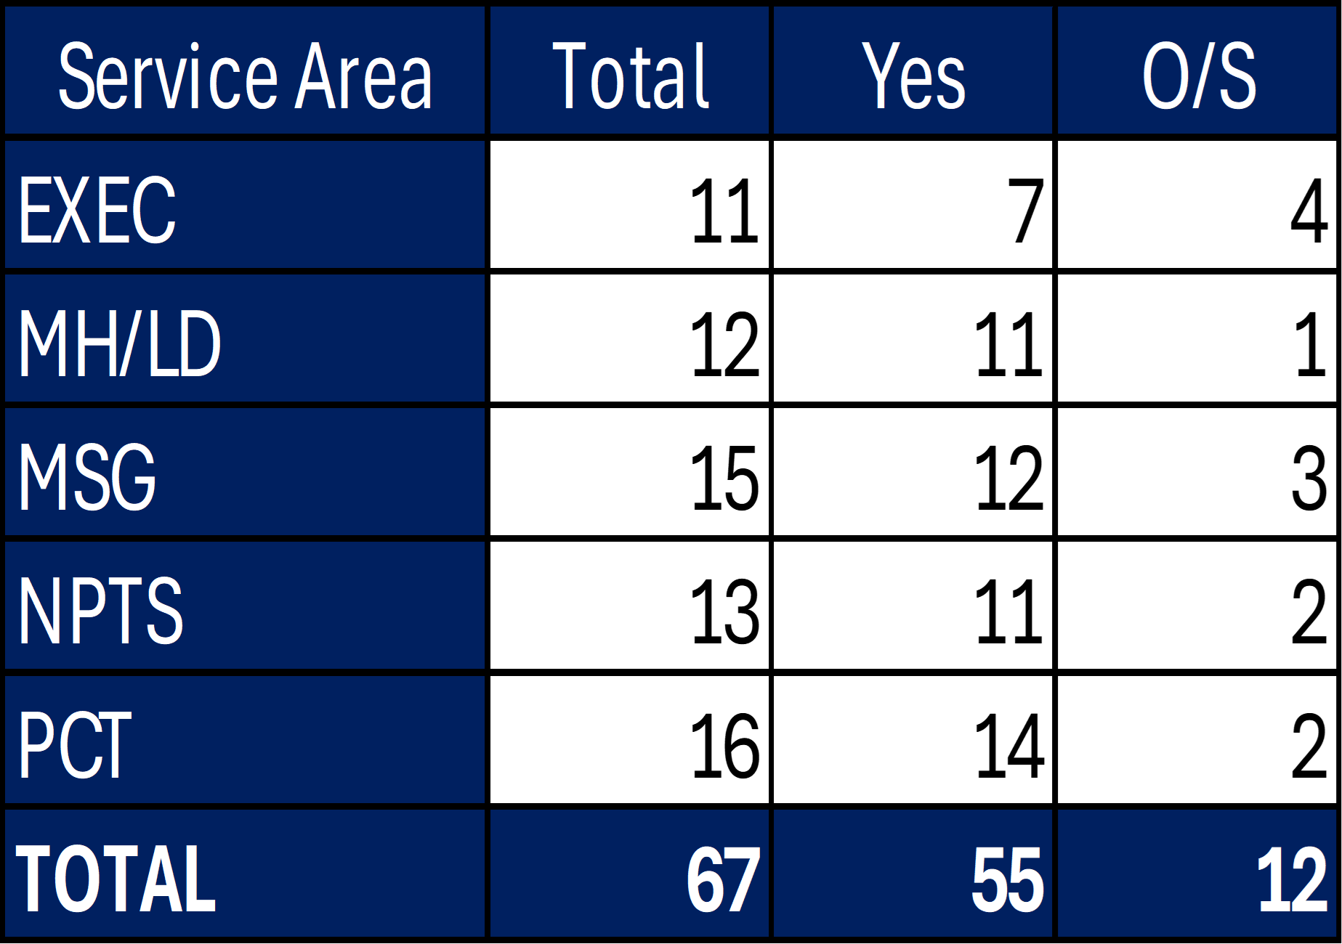
Appendix 4 Summary Budget Holder Training
Executive Summary
Income and Expenditure Insights
Operational and Financial Performance
Appendices
Appendices
Status @ 15 June 2026
Key Information Outstanding Training
4 Executives 1 retiring 3 delivered through 1:1 – dates to be set 8 Service Groups 1 on Maternity Leave # 1 changed roles post letters published # 1 retiring # 1 commenced post 1 June 4 Unavailable at time training Actions: # review whether additional letters need to be issued 4 unavailable given 1:1 by FBP’s

Slide 19
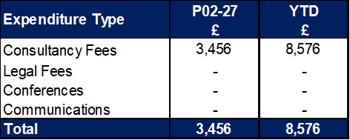
Appendix 5 Summary Other Data
Executive Summary
Income and Expenditure Insights
Operational and Financial Performance
Appendices
Appendices
Maternity Review
The total costs for this are allocated to a dedicated Cost Centre (6F34).
Key Information Central Z Codes
Contracting: SLA /LTA performance: JCC (previously WHSSC), LTA and SLA contract income and expenditure are transacted within this area and financial performance reported. NICE approved high-cost drugs and associated LTAs are also transacted and monitored against targets set. In addition to this, non-contracted activity income in relation to English foundation trusts invoiced on a quarterly basis are reported. Capital: The Finance Capital Team manage a number of cost centres covering the PFI, IFRS16 and Depreciation charges for assets both owned and donated are transacted here. RRL and Central Reserves: The Welsh Government funding received at the start of the year is tracked within this area. Any anticipated allocations in year are also transacted through these codes. Other HB wide funding received from HEIW and SIFT is also captured in here. All central reserves remain within the Z cost centres and details of these are provided in Appendix 2. Corporate income and expenditure. Any income and expenditure that is not service group specific is transacted and reported through a number of corporate Z cost centres, examples include, payroll and pension costs, VAT recovery, losses and receipts in relation to funding from Welsh Risk Pool, overseas visitors’ income and Road Traffic Accident income.

