Slide 1
Q4 Integrated Planning & Performance
24th April 2026

Slide 2
Q4 Integrated Planning & Performance Workshop, 24th April 2026
Purpose:
To provide structured time to look back on delivery in 25/26 and understand what has gone well, what has been difficult and what learning we need to carry forward.
To identify opportunities, positives and challenges, and consider how this learning should shape our approach in 26/27.
To ensure we have a shared view of priorities, risks and expectations for the year ahead, and a collective understanding of delivery across R&S, Performance and BAU, and System Transformation.
Agenda:
Time | Item | Description | Lead | Resources
9.00- 9.10 | Introduction | Introduction to the day | CEO
9.10- 10.30 | Look Back 25/26 | 10min System Overview of: Achievements Challenges Learning (What could have been done differently) Risks and Learning taking into 26/27 and mitigation | System Leads to present | Overview slide per System area provided by System Lead Supported by Q4 data pack completed by Planning and Performance - March Performance Data and delivery against POAP (Appendix 1)
10.30-11.15 | Performance Review Reflections | DoPP to present structure and process and support we're putting in place for 26/27. Plenary on reflections to inform and strengthen this structure/process | DoPP | Slides on governance structure
11.15 – 11.30 | 15 mins Break
11.30 – 13.00 | Look Forward 26/27 | 10min System Overview of: Plan Priorities Trajectories Risks and mitigations | System Leads to present | Annual Plan 26/27 Plan on a Page/ Delivery Plans Overview slide per System area provided by System Lead
13.00-13.30 | Plenary | Reflections and actions required | DOPP

Slide 3
WG feedback on Plan 26/27 - CEO
Annual Plan 26/27 submitted to Welsh Government 31st March 2026, following approval by Board to do so, while acknowledging the plan does not meet the statutory duties of financial balance.
Letter received from Welsh Government Director General to CEO, 17th April.
The Health board is required to consider and address the feedback and provide a response to the specific actions required by 29th May. Response must demonstrate tangible improvements to the Plan in relation to performance and finance.
Exec Led Action Plan in development to provide our response to the feedback, being clear on the actions we will or will not undertake.
Key themes as follows:
Overall Plan Quality and Strategic Coherence WG feedback: The plan is considered unacceptable and unsupportable, overly descriptive, lacking delivery focus, and reads as a “plan for a plan”.
Performance Delivery WG feedback: Performance trajectories are unambitious or unacceptable, breakthrough objectives are mis-specified, and there is insufficient evidence of grip and credible delivery.
Finance and Financial Recovery WG feedback: The financial section lacks depth and assurance. The projected £76.6m deficit is unacceptable, with insufficient detail on drivers, savings delivery, risks, and opportunities.
MDS Alignment and Technical Corrections WG feedback: Material inconsistencies between MDS tables, performance trajectories, and the narrative plan.
MAG Recommendations WG feedback: Insufficient clarity on baseline position and lack of quantified opportunities linked to MAG recommendations.
Delivery Unit and Assurance WG feedback: Insufficient clarity on how the proposed delivery unit will ensure pace, grip, and confidence in delivery.

Slide 4
1. Look Back 25/26

Slide 5
Population Health
Primary & Community Care

Slide 6
2025/26 Look Back
Primary Care and Community System - Craige Wilson
Achievements: Maintained compliance for 14-week RTT for Therapies and Health Science Successful recommissioning of PSALT ( circa 300 patients) Reduction in CMAT waiting times Weight management (level 3) partnership with Roczen delivery Year end (draft) finance position underspend Maintained reduced Variable pay compared to Q1&2 DSS for 0.5% Complex Frailty population – improved uptake compared to 2024/25 (impact tbc) Success delivery across the 8 Cluster IMTPs (66% green and 22% amber) Progress across the 3 priorities in the Pan Cluster Plan eg extending Community Psychology to four clusters and attracting RPB budget for a 5th post. Integrated T&F Falls Pathway group across Primary, Secondary and RPB. Launch of joint injections and minor surgery DSS Launch of revised sexual health LSS Primary Care training and education programme for women’s health Dental Access Portal – reduced total numbers waiting access in Q4. Successful recommissioning of dental activity ( new dental practice) WGOS 4&5 continued roll out Increased Independent Prescribers in Optometry and Comm Pharmacy Community By Design Programme initiated | Learning: Complexity across Service Group/ System reporting and processes
Risks going into 26/27: Significant programmes of work requiring capacity building in the community including the transfer of resources/staff into the community Limitations in Primary Care Estates Access to diagnostics in Primary Care Significant contract reform being undertaken simultaneously

Slide 7
Population Health
UEC

Slide 8
2025/26 Look Back
UEC - Alison Gallagher
Achievements: Implemented concurrent improvement PDSAs which resulted in significant periods of improvement during parts of 25/ 26. Improved metrics at Q2 included: Ambulance Handover Delays <45 mins (155% improvement) Average time to handover (82.2% improvement) Hours lost due to Ambulance Handover (77% improvement) ED Turnaround time (23% improvement) Total no. of patients awaiting admission at 9am (38.7% improvement) Reduction in Clinically Optimised Patients in beds and bed-days consumed National Escalation Status Reporting reduction (Shift from SL4 as a constant, to SL3, with frequent SL2 reported) Reduction of Deaths in ED (31 pre-test(s) of change to 13 at end of Q2) Although significant improvements were witnessed within Q2 moving into Q3 and Q4 has become more challenging with performance metrics dipping (significantly on occasions) and periods of entering Business Continuity (BCI). Trialled community falls response (Level 1 & Level 2) coupled with admission avoidance activity with care hones & domiciliary care Trialled a UEC SPOA with a ‘clinical conversation before conveyance/ dispatch’ to aid in system navigation and admission avoidance (where appropriate) Ongoing to works to improve acute frailty offer subject to challenging conditions (e.g. bedding of front door assessment spaces and capacity challenges) Ongoing works to improve flow and discharge subject to challenges in relation to capacity/ staffing deficits | Challenges: Significant numbers Clinically Optimised Patients (COP) in emergency beds reducing overall bed-pool and flow (and linked Pathway of Care Delays) Overcrowding in front door services (ED, AMU, SDEC, OPAU) limiting throughput and flow Long ambulance waits in Q3 & Q4 (due to above challenges) Limited resources to implement sustainable change across the UEC pathway Challenge regarding implementing sustainable service models due to limited capacity
Learning: Whole system solutions required to mitigate UEC challenges Systems priorities for UEC noted as: Pre-hospital pathways & front door Management of flow Discharge Sustainable change from an ‘as is’ to a ‘to be’ and the ‘final state’ model requires end-to-end support to achieve all benefits | Risks going into 26/27: Risk that we fail to significantly reduce the number of Clinically Optimised Patients in hospital beds (and linked POCD) Risk that patient safety concerns related to lengthy Chair & Trolley waits at our front door(s) (ED, AMU, SDEC, OPAU) are not mitigated and these negatively impact patient outcomes/ experience (and health board performance measures) Risk that we fail to improve ambulance handovers (hrs lost) and ED 4/ 12 hrs performance Risk of limited resources impacting delivery of actions Risk related to an inability to sustain new operating model changes due to workforce capacity (e.g. IDH/ front door/ therapies) Risk of reduced capacity and flow within acute services due to delay in implementation of the Community Services Review

Slide 9
Population Health
Women’s Health, CYP & Perinatal

Slide 10
2025/26 Look Back
Women’s Health, CYP & Perinatal – Ceri Gimblett
Achievements: Women's Health Plan Successful Ministerial visit to Women's Health Pathfinder Hub January 2026 and Women's Pathfinder hub established CYP and Workforce strategies Opening of Paediatric SARC Swansea in July 2025. Appointment of two key Consultant roles - General paediatrician with eating disorder interest post-first in south Wales and visionary change and General paediatric led sleep service- breaking silos and working pan CYP Developing a sustainable model for Gynae Oncology across Wales. Successful development of Project Board and operational groups Service Specification agreed following consultation Plan in place to merge MDT across Wales, key meetings in diary to operationalise Develop sustainable Fertility Services Realigned WJCC contract and value Successful outcome of two Regulatory (HFEA) inspections and renewal of licenses for 4 years Neurodevelopment service improvements Outsourcing service for ND service successful delivery – nil patients waiting over 156 weeks and reduced number waiting over 104 weeks CYP Strategic Actions aligned to new WHCYP PN Programme First Programme Board planned for 27/4/26 following successful workshop delivered in December 2025 Perinatal service improvements Establishment of robust governance and meetings structures Strengthened leadership team in place Perinatal natal improvement programme established and progressing on target Perinatal safety manager now in post | Challenges- Risks: Paediatric ward footprint Interim arrangement of ward environment continues to be an issue Neonatal transport Interim model maintained Fertility services Uncertainty of agreed activity levels until half-way through the year. Workforce significant risk – recruitment plan in progress recruitment restrictions inhibited service in delivering increased activity Neurodevelopment service Workforce challenges – small team through removal of underlying deficit funding- unavailability etc. Perinatal services Inspection and ongoing scrutiny with WG and HIW Workforce – unavailability due to Mat leave in NICU and Band 2/ Band 3 vacancies in Maternity. Badgernet implementation Workforce modelling assumptions do not currently allow sufficient protected time to release neonatal staff for mandatory MoNET training without compromising service delivery Womens health Nature of short-term funding General risks going into 26/27 Significant challenge to get Children higher on our agenda – but can use breakthrough objectives to help with this and relaunch of CYP Steering Board Programme of work within perinatal programme is going to requires some level of investment (which based on current environment is challenging) Women’s health services remain complex and multi‑sector spanning whole systems, requires ongoing coordination and clinical leadership to avoid fragmentation
Challenges

Slide 11
Population Health
CHC

Slide 12
2025/26 Look Back
CHC– Hannah Roan
Achievements: £1.399m delivered by MHLD through rightsizing and reviews Transformation Programme: Improved governance through CHC/ Complex Care Programme Board Establishment of Transformation Complex Care Programme Board (formerly called Regional Commissioning Programme Board) and workstreams: Joint working arrangements Accommodation Strategy Market Stability Report Establishment of centralised commissioning team Creation of performance dashboard | Challenges Relationships Conflicting priorities Limited capacity Provider led market Data- availability and sharing Lack of local service provision
Learning: Jumping in with solutions before quantifying the problem Prioritisation is key Focus on money leads to perception about cost shifting There are opportunities to improve processes and standardisation across the region Pace can be slow if want to get partnership working right Partners face similar challenges in relation to demand, gaps in service provision, rising costs | Risks: Limited capacity- same people being called on to deliver Relationships remain fragile To do things right often means that due diligence and time is needed- not everything can be done at pace Direct Payments- unknown costings which would offset savings High-cost cases- unexpected high-cost cases would offset savings
Challenges

Slide 13
Population Health
Workforce

Slide 14
Workforce– Emma Owen
2025/26 Look Back
Key Achievements in Delivering Annual Plan Actions Aligned to the SBUHB people Strategy: Engaged, Motivated & Healthy Staff turnover reduced across all professions Occupational Health performance sustained despite demand growth: ~69% seen within 4 weeks, with measurable improvements in report quality (audit against national standards) Attract & Recruit (Employer of Choice) 100% of Graduate Gateway Cohort 6 secured employment in SBUHB ahead of programme end Apprenticeship routes expanded, including new pathways (e.g. Electrical; Legal Services) Well Planned Workforce Business Partners aligned to retention principles and embedded within service groups Structured reporting of workforce concerns, themes and learning established via Workforce & OD governance Digitally Ready Digital learning and engagement strengthened through the Learning Lab, supporting real‑time access to leadership and improvement resources Excellent Learning & Education 41 staff completed Level 3 Coaching & Mentoring (MEDR funding), strengthening internal capability Ongoing uptake of Welsh Government–funded education and training routes Leaders That Live Our Values LEAD multidisciplinary leadership programme launched (124 applications in first month), with service‑based improvement projects embedded Equality, Diversity & Belonging Speaking Up Safely action plan delivered with audit assurance and local service group reporting in place Joint workforce–staff side guidance developed to strengthen fair, consistent people management
Challenges Conflicting priorities Limited capacity Finance Changing priorities
Risks: Limited capacity to support existing and unplanned demand. Increase in sickness absence requiring increased support Increase in ER cases Increased scrutiny

Slide 15
Population Health
Digital

Slide 16
Digital– Matt John
2025/26 Look Back
Achievements Rio – Paper based teams in Mental Health and Learning Disabilities (MH&LD) Successful go-live of the Rio electronic patient record on 24 March 2026 across the Mental Health and Learning Disabilities services with strong early usage of the system. Over 500 users have migrated from paper based systems to an electronic solution to support patient care. Key enabler to the Mental Health Transformation Programme working in tandem with the Q&S workstream supporting service redesign. Digital Technology The total capital allocation for essential digital infrastructure in 25/26 was £8.68m, of which £5.153m was funding secured from Welsh Government. This is enabling the modernisation of services provided: Replacement of a significant number of desktop, laptop and ipad computers Network equipment to replace and modernise the network at Morriston Hospital Fibre optic cabling for the acute Hospitals for increased resilience and speed to run modern digital systems Laptops and infrastructure for Mental Health to implement the new digital system (Rio) Additional devices and mobile carts for the new Maternity system Additional storage capacity for digital systems New hardware for the Health Board wide telephony system Cardiology system upgrade Equipment for the new dialysis unit opening in Neath Port Talbot this month
Digital Maternity System – Badgernet Key enabler for the Health Board maternity transformation programme A revised incremental approach to delivery is underway, with rollout across two phases Successful Phase 1 Go-Live on 31 March 2026 (for all new antenatal bookings) Phase 2 (implementation across all maternity services) is on schedule and due to commence 18 May 2026 Radiology Information System Procurement (RISP) The new Radiology systems (RIS and PACS) successfully went live on 30th March across Morriston, Singleton and Neath Port Talbot. Provides a foundation to implement new ways of working including capabilities such as electronic vetting and electronic requesting of images. Digital Eyecare Open Eyes Electronic Patient Record (EPR) successfully implemented across all Ophthalmology sub-specialities on 08 September 2025. OPERAi Electronic Referral Solution (ERS) testing commenced in Q4 in readiness for implementation across primary and secondary care during May 2026 Enabler to regional working with Hywel Dda.

Slide 17
Digital– Matt John
Achievements Network Transformation In February NPT Hospital became the first site in SBU to implement the new secure network, part of a wider three‑year £8.68m digital infrastructure modernisation programme. The digital network doesn’t just connect computers — it connects telephones, X‑ray machines, security cameras, medical devices, and many other systems that rely on fast, reliable, and secure connectivity to function safely. The new network gives the health board a more secure, and more resilient network that improves system performance for clinicians, protects against cyber threats, and ensures that critical equipment and services can operate without interruption. Telephone System Upgrade The Health Board telephony system was upgraded in February. The telephone system consists of approximately 10,000 phones/extensions and is critical for the safe delivery of services. The new telephony system software will provide a supported platform and has the functionality to link with cloud-based services to improve remote working and increase resilience in the future and rollout would need to be determined by a costs/benefit exercise. More importantly the new telephone system will provide enhance cyber security protection. Clinical Coding App The Clinical Coding App has been launched for Neurology Episodes. The app collates all electronic data from numerous systems relating to an episode and allows the coder to auto-code the episode via a machine learning model. The codes are then audited before the codes are confirmed. Work has now started on creating a similar model for Rheumatology episodes.
Digital Infrastructure The total capital allocation for essential digital infrastructure in 25/26 was £8.68m.This is enabling the modernisation of services provided: •Replacement of a significant number of desktop, laptop and ipad computers •Network equipment to replace and modernise the network at Morriston Hospital •Fibre optic cabling for the acute Hospitals for increased resilience and speed to run modern digital systems •Laptops and infrastructure for Mental Health to implement the new digital system (Rio) •Additional devices and mobile carts for the new Maternity system •Additional storage capacity for digital systems •New hardware for the Health Board wide telephony system •Cardiology system upgrade •New Servers for Business Intelligence Equipment for the new dialysis unit opening in Neath Port Talbot this month Data Literacy Re-development of Data Literacy courses completed with additional modules now being offered. All digital intelligence courses are now available for staff to self-book via the Electronic Staff Record system. Over 60 staff attended a Digital Intelligence Data Literacy Course during Q4. Business Intelligence The Neonatal dashboard has been added into the Maternity and Neonatal app allowing the service to monitor a host of different operational and quality measures such as high dependency occupancy and incidents for the previous month. The dashboard also allows the data to be further drilled into to show trends of measures over time. Staff and patient experience quadrant of the Quality and Safety Dashboard has been released containing metrics across a range of areas including complaints, compliments, clinical negligence claims, personal injury claims, staff survey results. Radiology waiting list pages detailing the projected eight-week breaches at the end of the current month which can be filtered by modality have been added to the Planned Care App. These pages replicate what was already available in the app for other diagnostic waiting lists and will help the service monitor, manage and report their waiting list position.

Slide 18
CHC– Hannah Roan
Risks & Challenges LIMS The LIMS 2.0 programme faces significant challenges and risks due to delays in implementation. Progress has been constrained by prolonged User Acceptance Testing, a sustained volume of defects, and ongoing reliance on a limited pool of specialist resources. Blood Transfusion remains the highest‑risk component, reflecting the scale, age and variable quality of legacy data (spanning over 40 years), and the complexity of cleansing, validation and regulatory assurance required prior to any safe deployment. Infrastructure and cyber risks are increasing, as several nationally hosted critical components approach end‑of‑life, heightening vulnerability to outages and security threats. Continued reliance on the current LIMS therefore presents growing operational and cyber risk, alongside diminishing supplier support. Delays continue to compress the remaining delivery window, increasing pressure on Health Board capacity and financial exposure. Mitigation: Strengthened national oversight of User Acceptance Testing, further refinement of the Blood Transfusion delivery approach (including consideration of alternative go‑live models), improved defect prioritisation, and ongoing efforts to secure additional specialist and financial support through national governance arrangements. Unscheduled & Emergency Care The MIU currently use WEDS (Symphony), however the contract with the supplier expires 31st August 2026. A replacement solution is required. At the request of the national 6 goals programme for unscheduled care, DHCW have developed the UEC app (including (WECDS) as a Minimal Viable Product (MVP) to replace the functionality in WPAS ED, however there are concerns with delivery of the UEC App and that the solution will not provide the functionality to support the UEC footprint in Swansea Bay. Recent usability testing with clinicians has raised concerns due to a lack of integration with WPAS. Mitigation: The health board are working closely with DHCW to inform the development of the UEC App and are also engaging with suppliers to understand whether their systems will better meet the needs of the UEC footprint and deliver the WECDS. MIU will revert to WPAS ED as a mitigating action in September. Maternity Three of the four key integrations with the national architecture were not delivered in phase 1 of the Badgernet implementation (31st March), presenting several key risks (e.g. dual entry, administrative burden, delays in care delivery, transcription error). A clinical risk assessment was undertaken by digital midwives across Wales. Mitigation: This risk has been escalated nationally via the Technical Advisory group to agree workarounds to mitigate this risk. Health board requirements for future integrations have also been collated nationally. In the meantime, SBUHB will continue to work towards the second phase of rollout (18th May 2026) as per the agreed project plan.

Slide 19
Population Health
Planned Care

Slide 20
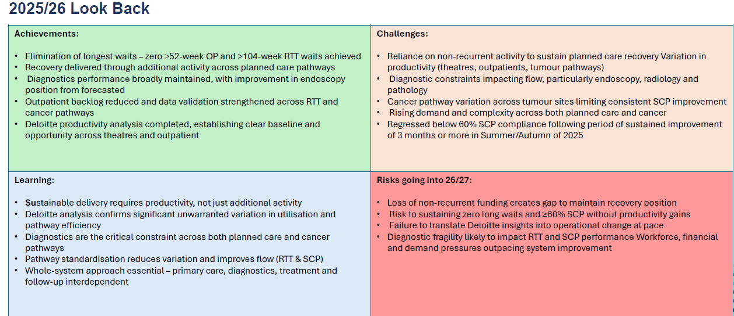
Planned Care and Cancer - Hannah Parsons

Slide 21
Population Health
MH&LD

Slide 22
2. Performance Review Reflections

Slide 23
Annual Plan 2026/27 – Monitoring and Reporting of Delivery
Tier 1
Board
Tier 2
Procurement & terms of Service Committee
Mental health Committee
Data, Digital, Innovation & Research Committee
Performance & Finance Committee
Audit Committee
Quality & Safety Committee
Workforce & OD Committee
Population Health Committee
Charitable Fund Committee
Regional Joint Committee
Tier 3
Executive Board
Tier 4
Performance and Accountability
Performance manages
SDG delivery:
Recovery & Sustainability
MHLD ImprovementProgramme Group
Planned Improvement Programme
Group
UEC Improvement Programme
Group
Perinatal Improvement Programme
Group
PH/CBD Improvement Programme
Group
Cancer Improvement Programme Group
Operational Delivery Group (COO)
Tier 5
CHC
R&S Group
Vacancy Control R&S Group
A&C Support Services & AHP R&S Group
Procurement R&S Group
Medical Workforce
R&S Group
Meds Management R&S Group
Nursing Workforce R&S Group
Morriston SDG
SNPT SDG
MHLD SDG
PCT SDG
Allocated Q&S elements
Quality, Safety Group
BAU / Performance Delivery/Financial Delivery
Allocated WOD elements
Workforce & OD Group
Allocated PH elements
CCG Operational Plan
Allocated Digital elements
Digital Group
Allocated Recovery & Sustainability Programme elements
Allocated Transformation elements
Direct Accountability and Performance management route for indicated areas
(SDG to be replaced with CCGs as appropriate)
Reporting Arrangements for oversight
Organised for Success????

Slide 24
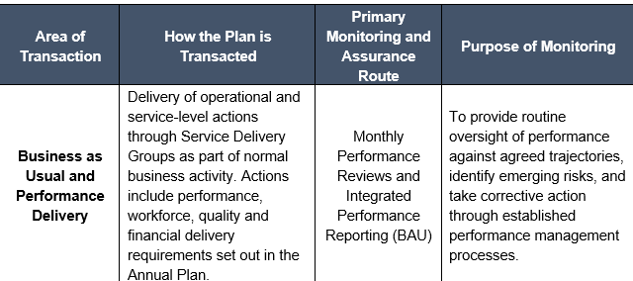
Annual Plan 2026/27 – Monitoring and Reporting of Delivery
Tier 1
Board
Tier 2
Procurement & terms of Service Committee
Mental health Committee
Data, Digital, Innovation & Research Committee
Performance & Finance Committee
Audit Committee
Quality & Safety Committee
Workforce & OD Committee
Population Health Committee
Charitable Fund Committee
Regional Joint Committee
Tier 3
Executive Board
Tier 4
Performance and Accountability
Performance manages
SDG delivery:
Recovery & Sustainability
MHLD ImprovementProgramme Group
Planned Improvement Programme
Group
UEC Improvement Programme
Group
Perinatal Improvement Programme
Group
PH/CBD Improvement Programme
Group
Cancer Improvement Programme Group
Operational Delivery Group (COO)
Tier 5
CHC
R&S Group
Vacancy Control R&S Group
A&C Support Services & AHP R&S Group
Procurement R&S Group
Medical Workforce
R&S Group
Meds Management R&S Group
Nursing Workforce R&S Group
Morriston SDG
SNPT SDG
MHLD SDG
PCT SDG
Allocated Q&S elements
Quality, Safety Group
BAU / Performance Delivery/Financial Delivery
Allocated WOD elements
Workforce & OD Group
Allocated PH elements
CCG Operational Plan
Allocated Digital elements
Digital Group
Allocated Recovery & Sustainability Programme elements
Allocated Transformation elements
Direct Accountability and Performance management route for indicated areas
(SDG to be replaced with CCGs as appropriate)
Reporting Arrangements for oversight
Organised for Success????

Slide 25
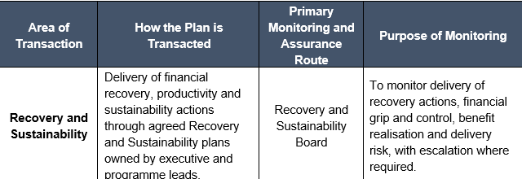
Annual Plan 2026/27 – Monitoring and Reporting of Delivery
Tier 1
Board
Tier 2
Procurement & terms of Service Committee
Mental health Committee
Data, Digital, Innovation & Research Committee
Performance & Finance Committee
Audit Committee
Quality & Safety Committee
Workforce & OD Committee
Population Health Committee
Charitable Fund Committee
Regional Joint Committee
Tier 3
Executive Board
Tier 4
Performance and Accountability
Performance manages
SDG delivery:
Recovery & Sustainability
MHLD ImprovementProgramme Group
Planned Improvement Programme
Group
UEC Improvement Programme
Group
Perinatal Improvement Programme
Group
PH/CBD Improvement Programme
Group
Cancer Improvement Programme Group
Operational Delivery Group (COO)
Tier 5
CHC
R&S Group
Vacancy Control R&S Group
A&C Support Services & AHP R&S Group
Procurement R&S Group
Medical Workforce
R&S Group
Meds Management R&S Group
Nursing Workforce R&S Group
Morriston SDG
SNPT SDG
MHLD SDG
PCT SDG
Allocated Q&S elements
Quality, Safety Group
BAU / Performance Delivery/Financial Delivery
Allocated WOD elements
Workforce & OD Group
Allocated PH elements
CCG Operational Plan
Allocated Digital elements
Digital Group
Allocated Recovery & Sustainability Programme elements
Allocated Transformation elements
Direct Accountability and Performance management route for indicated areas
(SDG to be replaced with CCGs as appropriate)
Reporting Arrangements for oversight
Organised for Success????

Slide 26
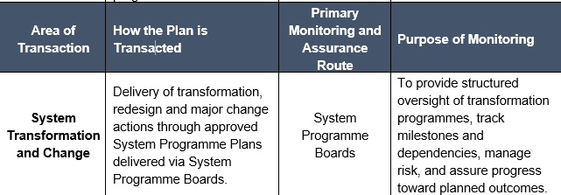
Annual Plan 2026/27 – Monitoring and Reporting of Delivery
Tier 1
Board
Tier 2
Procurement & terms of Service Committee
Mental health Committee
Data, Digital, Innovation & Research Committee
Performance & Finance Committee
Audit Committee
Quality & Safety Committee
Workforce & OD Committee
Population Health Committee
Charitable Fund Committee
Regional Joint Committee
Tier 3
Executive Board
Tier 4
Performance and Accountability
Performance manages
SDG delivery:
Recovery & Sustainability
MHLD ImprovementProgramme Group
Planned Improvement Programme
Group
UEC Improvement Programme
Group
Perinatal Improvement Programme
Group
PH/CBD Improvement Programme
Group
Cancer Improvement Programme Group
Operational Delivery Group (COO)
Tier 5
CHC
R&S Group
Vacancy Control R&S Group
A&C Support Services & AHP R&S Group
Procurement R&S Group
Medical Workforce
R&S Group
Meds Management R&S Group
Nursing Workforce R&S Group
Morriston SDG
SNPT SDG
MHLD SDG
PCT SDG
Allocated Q&S elements
Quality, Safety Group
BAU / Performance Delivery/Financial Delivery
Allocated WOD elements
Workforce & OD Group
Allocated PH elements
CCG Operational Plan
Allocated Digital elements
Digital Group
Allocated Recovery & Sustainability Programme elements
Allocated Transformation elements
Direct Accountability and Performance management route for indicated areas
(SDG to be replaced with CCGs as appropriate)
Reporting Arrangements for oversight
Organised for Success????

Slide 27
All Annual Plan actions must be tracked locally, even where corporate reporting is summary‑level.
Escalation will be through existing executive and committee routes where performance, delivery or risk thresholds are breached.
The quarterly review meetings will provide the forum for identifying opportunities, and challenges, and consider how learning should shape our ongoing delivery.
These meetings will also help ensure a shared understanding of priorities, risks and expectations and a collective understanding of delivery across R&S, Performance and BAU, and System Transformation.
The Delivery Unit will be responsible for coordinating and assuring delivery of the Annual Plan 2026/27 through existing operational performance management governance route and the Integrated Performance report in line with the updated Performance Accountability Framework.

Slide 28
Performance & Accountability Governance
Monthly Performance Reviews
Two hours long, face to face, focussing on:
          Performance against key Breakthrough Objectives, Delivery Expectations & Escalation Criteria
          Quality & Safety concerns
          Risks
          Workforce
          Digital
          Finance
    Actions & Escalation updates will be reported to the Executive Board following each round of meetings.
    Quarterly Integrated Planning & Performance Reviews
    Half a day, face to face, reviewing:
          Strategic overview of plans on a page
          System Delivery
          Risks to delivery
    Summary of discussions & updates to be included in the IPR.

Slide 29
3. Look Forward 26/27

Slide 30
ANNUAL PLAN 26/27 BREAKTHROUGH OBJECTIVES
Strategic Objective | Long Term Success | Breakthrough Objective 2026/27 | Baseline Data | Trajectories 26/27
 |  |  |  | APR | MAY | JUN | JUL | AUG | SEP | OCT | NOV | DEC | JAN | FEB | MAR
Better Health for all | People of Swansea Bay live healthier, fairer and more prosperous lives | Flu vaccine uptake improved in most deprived areas by 1% | 68.9% (65 years +) |  |  |  |  |  |  | 25% | 50% | 55% | 57% | 59% | 61%
 |  | Bowel screening rates up 10%
Improved patient safety | Care is high quality, safe, efficient and delivers the best possible outcomes for people in partnerships | No more than 2000 patients waiting more than 104 weeks for referral to treatment. | 0 | 52 | 141 | 183 | 158 | 164 | 267 | 419 | 586 | 645 | 898 | 1069 | 1317
 |  | Reduce the number of adults placed out of area for mental health inpatient treatment by 50%* | 22 | 22 | 21 | 20 | 19 | 18 | 17 | 16 | 15 | 14 | 13 | 12 | 11
 |  | 30% reduction in avoidable pressure ulcers | No Validated EOM position available for March 2026 – trajectory work taking place w/c 27/04/26
 |  | Reduce the number of patients waiting 12 hours or more in ED by 10%* | 1,356 | 1344 | 1332 | 1320 | 1308 | 1296 | 1284 | 1272 | 1260 | 1248 | 1236 | 1224 | 1212
Care is delivered in partnership | Care is delivered in partnership with our communities in safe and appropriate settings, supported by innovation | Clinically Optimised patients reduced to <100 at any one time | 223 | 210 | 200 | 190 | 180 | 170 | 160 | 150 | 140 | 130 | 120 | 110 | 100
 |  | Increase in the take up of the NHS App by 25% (from a March 2026 baseline)* | 88,842 | 90,693 | 92,544 | 94,395 | 96,246 | 98,097 | 99.948 | 101,799 | 103,650 | 105,501 | 107,352 | 109,203 | 111,054
A great place to work | The health board is a great place to work where all staff feel valued and work together towards a common goal | Improvement in staff engagement score by 5% | 70.3% |  |  |  |  |  |  |  |  |  |  |  | 75.3%
 |  | Improvement in staff health & wellbeing by 1%* | 7.04% workforce sickness absence | 6.71% | 6.42% | 6.76% | 6.98% | 6.66% | 6.59% | 6.80% | 6.81% | 7.13% | 6.92% | 6.38% | 6.04%
Use every NHS £ wisely | The health board is a resilient, sustainable and responsible organisation | Deliver savings plan of £65m of which £50m is recurrent | £55.4m delivered in year with £22.9m recurring | £5.4m | £5.4m | £5.4m | £5.4m | £5.4m | £5.4m | £5.4m | £5.4m | £5.4m | £5.4m | £5.4m | £5.4m
7

Slide 31
Population Health
Population Health

Slide 32
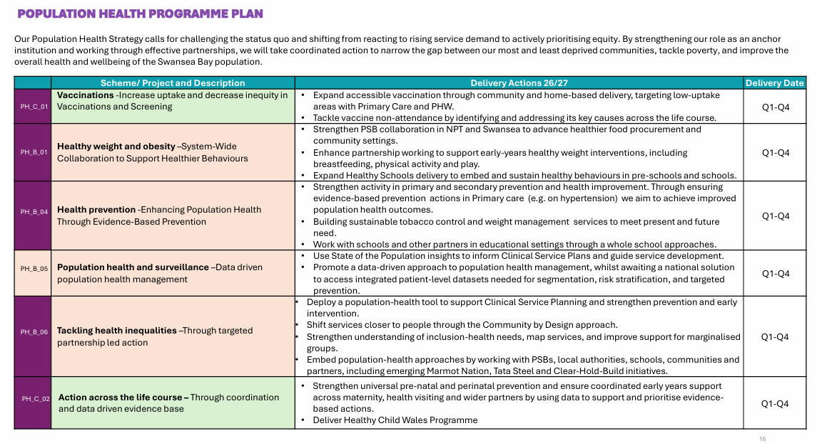
Population Health - Penelope Cresswell-Jones

Slide 33
PUBLIC HEALTH TEAM ANNUAL PLAN 2026-27
Population Health - Penelope Cresswell-Jones
The public health team annual plan reflects the breadth of our statutory responsibilities and the scale of the population health challenges facing Swansea Bay. We have considered: National and local drivers, including Health Board priorities; Population Health Committee direction; Welsh Government planning guidance and statutory duties; Core20Plus5; Designated priorities for the Public Health Team; Partnership commitments across the Public Service Boards (PSBs), the West Glamorgan Regional Partnerships Board (RPB) and the Western Bay Area Planning Board (APB); Required reporting on external funding; Broader assessments of population health need. This is underpinned by the Swansea Bay University Health Board Population Health Strategic Plan. The team works within the wider public health system, including Public Health Wales. A more detailed plan is also available.
Public Health Domains and Enablers | Public Health Areas of Focus
1. Keeping People Safe/Health Protection | Vaccinations and Immunisations Health Protection Strategy & Delivery
2. Keeping People Strong/ Healthcare Public Health | Contribution to early cancer detection (Core20Plus5- Adults) Cardiometabolic risk factors (Core20Plus5 – Adults) Reducing health service inequalities for Children and Young People (Core20Plus5- Children and Young People) Public health approach to primary and community care Inclusion health Prevention and Early Years Tobacco control leadership Healthy Weight Healthy Wales (HWHW) in healthcare Public health in Clinical transformation and Value-Based Health Care Suicide prevention and self-harm Support to women’s health and wellbeing
3. Keeping People Supported / Health Improvement/ Wider Determinants | Early Years Marmot 2 – Supporting skills, Workforce and OD Healthy Education Settings Public Health Partnerships- PSBs Whole Systems Approach to Healthy Weight Healthy Wales (WSA) Regional Health Economy (RHE) Poverty and Cost of Living Tata Health Impact Assessment Population Mental Health and Wellbeing Substance Use, Alcohol and Gambling Marmot Nation
Enablers | Health Epidemiology & Intelligence Leadership and Management Public Health Team Development Communications
Risks
Stretched epidemiology and analysis resources
Stretched consultant and senior workforce
Stretched practitioner workforce
Cost Improvement Plans may impact delivery of work programme
Recruitment delays related to staff turnover may impact delivery of work programme
Dependencies
Annual funding streams from Welsh Government
Support to delivery from PSB, RPB & joint arrangements with Hywel Dda
Wider digital, communications and engagement support for campaigns and communication initiatives
Public Health Wales engagement

Slide 34
Primary & Community Care

Slide 35
Primary Care and Community System - Craige Wilson
PCT Service Group Currently assessing 49 Annual Plan Schemes/Project areas across UEC (11) , Planned Care & Cancer (5), Women’s Health (5), Population Health (6), Diabetes (4) and Prevention and Early Years (2), Primary Care (13), Mental Health (3)
Key involvement in System Programmes -
Community Services Review– develop and implement plans based on outcomes from the Review, aligned to Clusters (UEC)
Reduced POCD within the UEC programme and across RPB partnership (UEC)
Community By Design Programme – clarity regarding focus of areas of improvement (Planned Care)
Maintain focus on 14 week targets and respond to new Audiology RTT. (Planned Care)
Digital Improvement programme will support a range of these (eg OpenEyes) and be cross cutting
New Dental Contract regulations implementation (Primary Care)
Implementation of Cluster IMTPs and Agreement and commence implementation of Pan Cluster Plan 2026/27 (Primary Care)
Support Mental Health Transformation Plan via Clusters/ Community models (Mental Health)

Slide 36
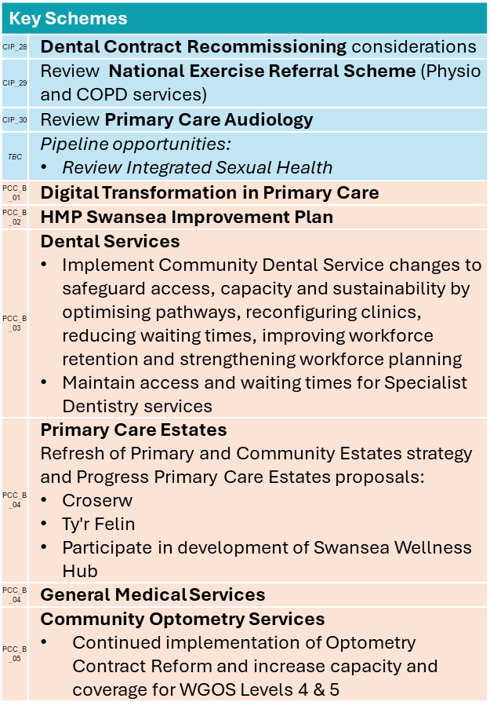
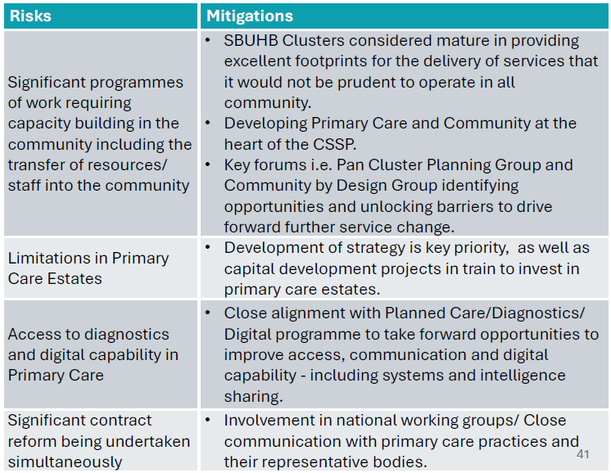
Primary Care and Community System - Craige Wilson

Slide 37
UEC

Slide 38
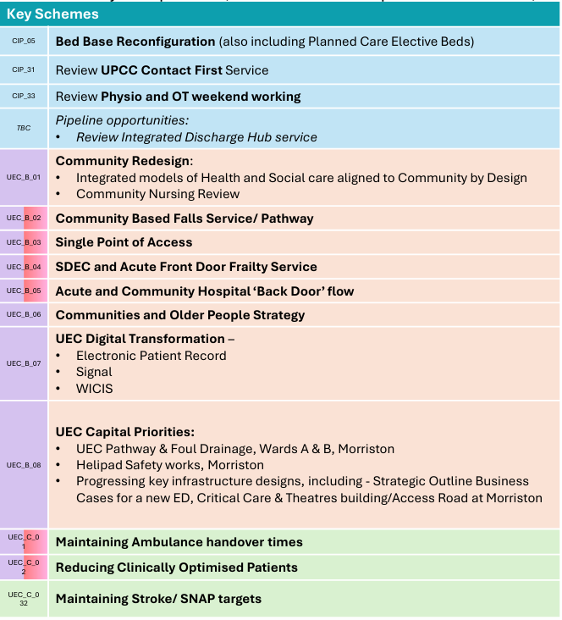
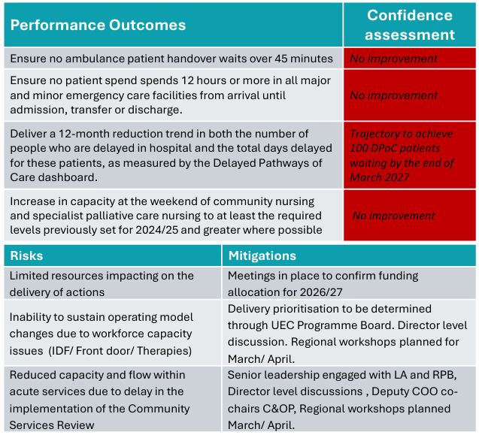
UEC – Alison Gallagher
System priorities/ programmes for 26/ 27:
Pre-hospital pathways & front door
Management of flow
Discharge
NOTE: All ‘key schemes’ aligned to a particular system priority/ programme

Slide 39
Women’s Health, CYP & Perinatal

Slide 40
Women’s Health Risks, Mitigation and Learning taking into 2026/27 - Ceri Gimblett
CYP Strategic Actions aligned to new WHCYP PN Programme
First Programme Board planned for 27/4/26 following successful workshop delivered in December 2025
Colleagues welcomed time out at workshops to start to develop strategies
Positive start to 2026/27 with establishment of programme Board will provide structure
Womens Health Plan
Women’s health services remain complex and multi‑sector spanning whole systems, requires ongoing coordination and clinical leadership to avoid fragmentation – implement primary and secondary care clinical leadership
Short-term funding does not support long term planning and sustainability – build sustainability into future pilots
Developing a sustainable model for Gynae Oncology across wales.
Finally brought together clinical leadership to work towards shared goals
Workforce will be key risk to services – service specification/model agreement key to this
Delivery is expected to be cost‑neutral ongoing review and financial management.
Develop sustainable Fertility Services
Uncertainty of agreed activity levels until half-way through the year.
Very important to have a clear plan of agreed contract at beginning of year which have been defined for 2026/27 with further work in progress for future
Workforce significant risk – recruitment plan in progress recruitment restrictions inhibited service in delivering increased activity.

Slide 41
Perinatal Risks, Mitigation and Learning taking into 2026/27 - Ceri Gimblett
Perinatal
Plans will require investment - awaiting direction from All Wales Perinatal Programme to understand true cost and/or funding opportunities
All-Wales single point of access maternity triage telephone service will require commitment from SBUHB for set up costs and staffing.
Commitment of staff to All-Wales service; rostering already in place for local service but may have greater impact.
Inability to meet demands/best practice requirements on radiology reviews by specialist provision, Recruitment or potential regional solution may be required for paediatric radiology – outsourcing mitigation currently. Neonatal/Paediatric Radiology reporting will require a long term solution
Elective Obstetrics Theatre – capital funding bid in motion. Theatre will alleviate demand on existing theatre and emergency care.
Trauma informed / psychology-led care model may require dedicated workforce with associated costs. There will also be associated training needs
Whilst women requiring care outside of maternity SOP is in place and proven to be effective, two site working for Perinatal Services will continue to be a risk for our Tertiary status and our increasing high risk population
Transitional Care will require resource to be provided in line with BAPM standards.
Resource implications for the continuation of Infant Feeding Supporters when the research funding ends in June 2026. This service has proven to be supportive to women and the continuation rates of breastfeeding at discharge.
Neonatal transport -Interim model maintained
Significant workforce issues and uncertainty of service model moving forward continues
Digital
Badger successfully launched 31/3/26, Phase 2 will launch on 19th May 2026.

Slide 42
CYP Risks, Mitigation and Learning taking into 2026/27 - Ceri Gimblett
Neurodevelopment service improvements
Workforce and removal of underlying deficit funding has been a significant risk and impact for the service during 2025/26.
Learning from utilisation of outsourcing provision from 2024/25 was used to successfully deliver a further funding of outsourced capacity.
Workforce continues to be a significant risk into 2026/27 with SBUHB having the smallest and least resources team in Wales together with staffing gaps. Service sustainability remains on risk register
Plans 2026/27 to mitigate service sustainability risks:
Liaison planned with All Wales ND Transformation Lead
ADHD Audit results anticipated Qtr1 2026/2027 to inform service development
Revised Psychoeducation model to release clinical capacity
Pilot of referral model for carers of electively home educated (EHE) CYP
With effect from April, the ND Service will initiate the planning phase for implementation of the SPOA ASD pilot
Reduction in ASD or ADHD assessment is dependant on Welsh Government funding – currently non recurrent funding received
Paediatric ward footprint
Interim arrangement of ward environment continues to be an issue and risk
There is lack of pace with this delivery priority despite Service Group efforts to progress in 2025/26
Paediatric ward environment recorded as risk level 20
Capital funding needs to be secured to develop plans to redesign Morriston Paediatric footprint
Location continues to be a risk/uncertainty - short/medium-term issues being addressed via capital planning
General Learning
Consider how we ensure we capture key strategic actions/achievements which occur through the year – examples around CYP – SARC opening, appointment to key roles

Slide 43
Population Health
CHC

Slide 44
2026/27 Look Forward
CHC - Hannah Roan
Savings Forecast:
£280 for 26/27 (MHLD SG)
£473 for 26/27 (PCTSG)
Savings have been profiled on clearing the below disputes/ outstanding reviews
Service Group | Reason | Number of cases
PCT SG | Awaiting Social Worker Allocation (Swansea) | 14
MHLD | Awaiting Social Worker Allocation- LD (Swansea) | 23
MHLD | Dispute over primary health need (Swansea) | 15
MHLD | Dispute over funding split (Swansea) | 7

Slide 45
Forward Look 2026/27
CHC - Hannah Roan
Plan priorities:
Implement jointly agreed plan to eliminate outstanding DSTs due to delay in social worker allocation
Clear backlog of disputed jointly funded packages of care based on disagreement of funding split- joint funding matrix
Clear backlog of disputed cases based on disagreement of primary health need- establishment of multi-agency peer review process
Reduce the number of out of area LD and MH placements- repatriation
Integration of Care Cubed into review process and adoption of regional approach to benchmarking
Implementation of digital case management system for CHC/ Complex Care
Implement optimum model for District Nursing, Looked After Children (LAC) and centralised commissioning team
Finalise joint working framework and agree regional disputes policy
Establish processes and structure to offer Direct Payments for CHC
Strengthened regional commissioning/ contracting arrangements- fee methodology, regional CHC contract, development of commissioning frameworks, outcome based commissioning approach, joint review meetings, accommodation solution/ market incentivisation

Slide 46
Population Health
Workforce

Slide 47
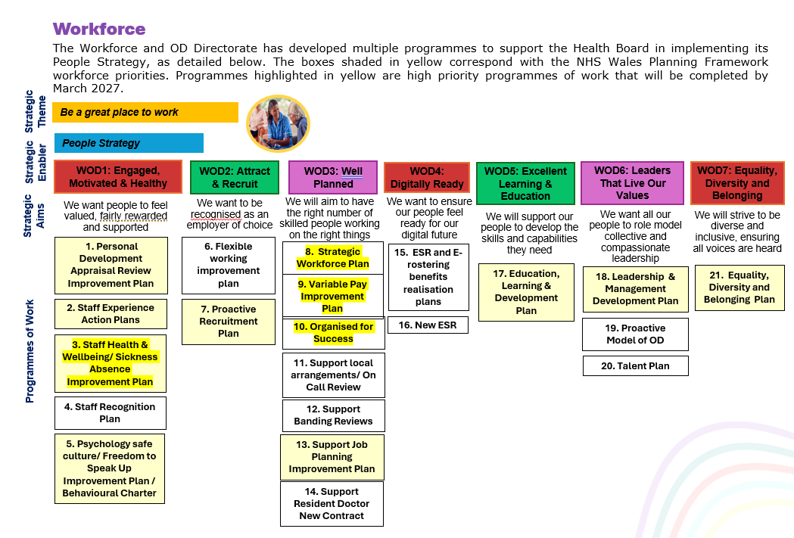
Workforce - Emma Owen

Slide 48
Digital

Slide 49
Digital - Matt John
Priorities 26/27: Microsoft 365
Microsoft 365 Enterprise Agreement renewal 2026 to 2031
SBUHB makes extensive use of M365 as a core digital platform to support collaboration, modern working, security, clinical transformation, and Health Board–wide digital maturity.
At the March Health Board meeting, SBUHB committed to continue its investment in M365 for the next 5 years.
M365 will be a significant digital enabler supporting the Organised for Success (O4S) programme to deliver the necessary efficient ways of working.
Copilot for Everyone
Copilot Chat is included in Microsoft 365 and available to all staff.
It can help with drafting, summarising, explaining and organising work and is designed for safe, everyday productivity.
Copilot for Everyone is an NHS Wales‑wide enablement campaign delivered by Microsoft with the DHCW M365 Centre of Excellence designed to help staff use Copilot Chat confidently, safely and consistently and will focus on practical use that supports our day‑to‑day work.
To register for sessions in April, use this link: You're invited to discover Microsoft 365 Copilot Chat
Further sessions will hopefully be available in May and June, but in the meantime, SBU staff can join the SBU M365 Digital Champions community for further updates on M365 generally SBU Digital Champions | Community in Viva Engage
Utilise | Drive adoption of tools included in the M365 suite | Are staff using the tools effectively?
Optimise | Standardise and improve ways of working | Are we working in the best way?
Innovate | Enable new models of work and service delivery | What can we now do differently?

Slide 50
Priorities FY26/27
Digital - Matt John
Laboratory Information Management System (LIMS 2)
Microbiology labs in Swansea Bay are scheduled to go live in May 2026, alongside other Microbiology sites across Wales.
National planning activity for Blood Sciences and Blood Transfusion modules continues, with Swansea Bay fully engaged in the process. Blood Sciences are scheduled to go live in July 2026. Blood Transfusion has a projected go-live in September 2026.
Digital Maternity; extend the Badgernet capability through additional integrations e.g. Laboratory Information Management System, Welsh Clinical Portal
Outpatients: NHS Wales App: extend the use of the App in line with ministerial priorities e.g. Cervical Smear Appointments, Swansea Bay Patient Portal: embed the use of the portal across outpatients with a focus on adoption rate of hybrid mail. Digitise administrative processes exploiting AI and existing capabilities e.g. Digital dictation.
Continuing Health Care Solution: procurement of a solution to support commissioning of care across sectors.
Welsh Intensive Care Information System: potential implementation; subject to direction from Welsh Government

Slide 51
Planned Care

Slide 52
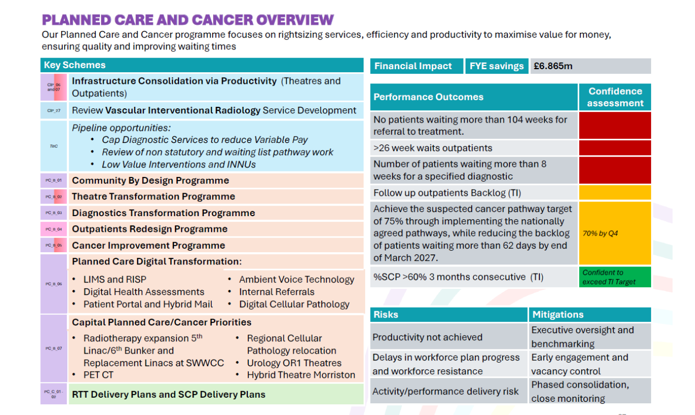

Slide 53
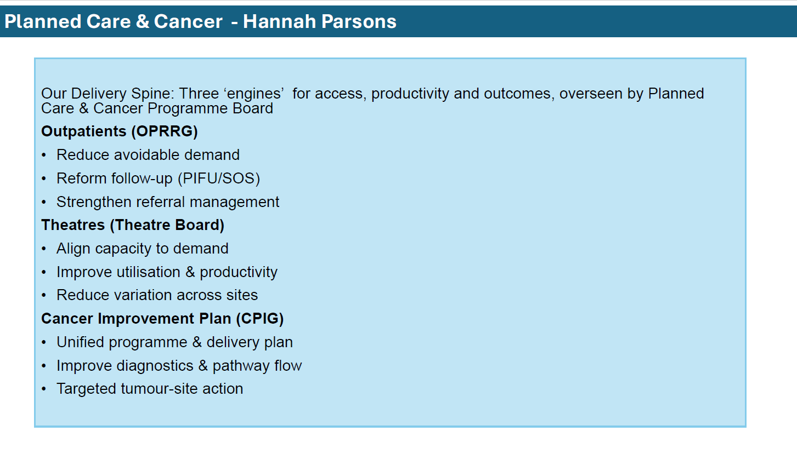

Slide 54
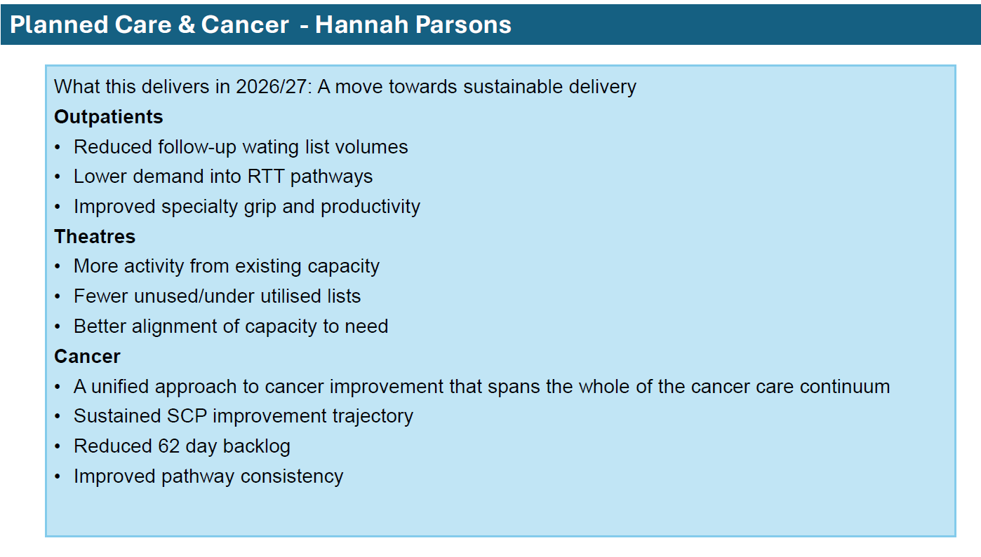

Slide 55
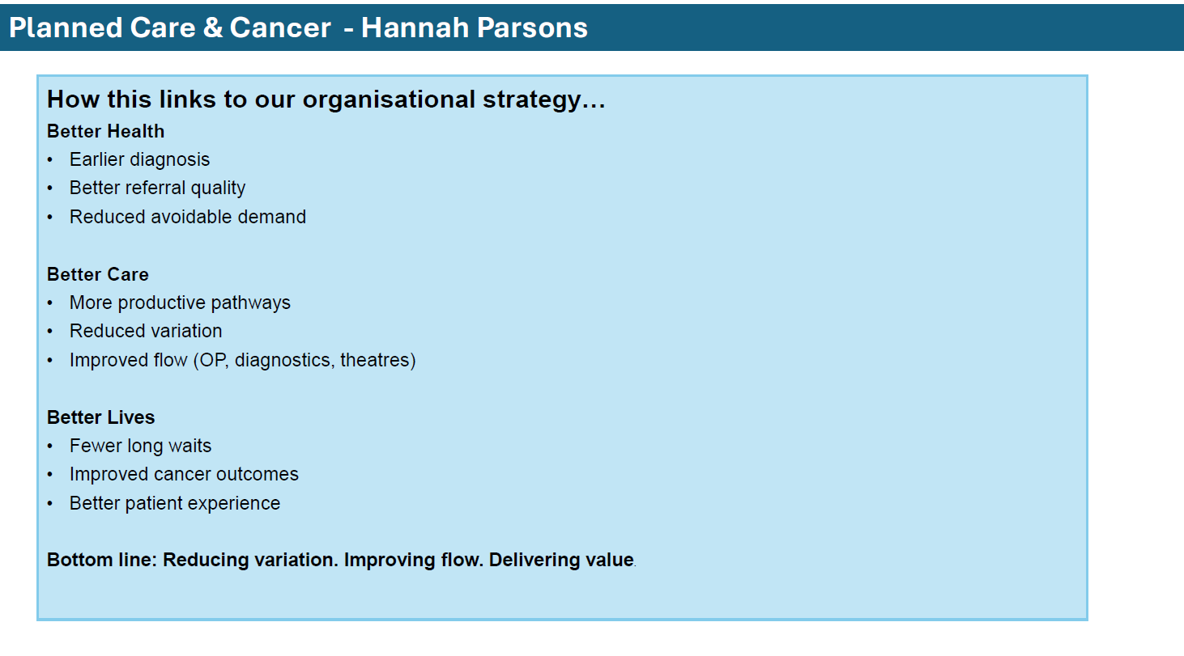

Slide 56
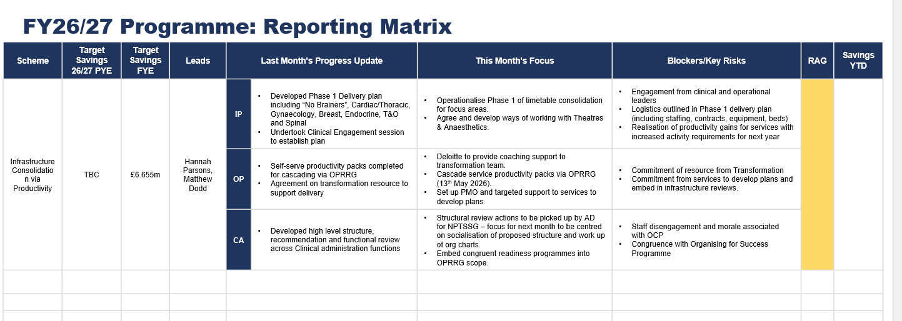

Slide 57
MH&LD

Slide 58
2026/27 Look Forward
Mental Health & Learning Disabilities – Dermot Nolan
      MENTAL HEALTH ​
      Continue with the Mental Health Transformation Program (as set out by the board)​
      Continue planned capital works on Tawe clinic to improve patient experience.​
      To begin demonstrator projects around Stepped Care 2.0 model.​
      To continue working towards a centralised booking system for Mental Health services. ​
      Continue to roll out and expand digital systems on all areas to aid in achieving digital medical records and increase digital correspondence with service users. ​
      Continue embedding new admission model whilst reviewing the role of Crisis and Home Treatment Teams. ​
      Continue work to support the reduction of private placements​
      SECURE SERVICES AND REHABILIATION​
      BJC scrutiny and capital funding approval required from Welsh Government.​
      Commence operational planning with capital planning and contractors to undertake the work in a live ward environment.​
      LEARNING DISABILITIES​
      Confirm service model with 3 HBs for future redevelopment of all inpatient units. Start process to develop case for change with ultimate aim of drafting SOC according to capital processes and timelines​
      Progress engagement for reduction of capacity within existing LD inpatient facilities​
      DIGITAL​
      Embed Rio into Phase 1 services, undertake Benefits Realisation and continue with Phase 2 preparation work, aligning with Swansea CIty Council ​
      Awaiting confirmation from Welsh Government for funding for Phase 3 of roll out of Rio

Slide 59
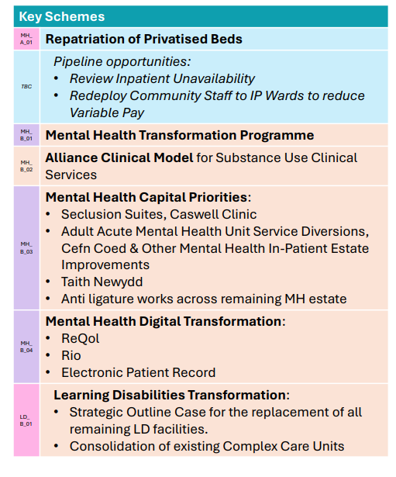
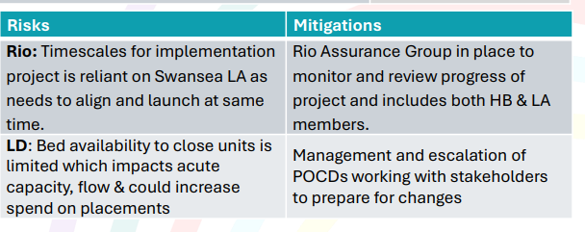
Mental Health & Learning Disabilities – Dermot Nolan

