Slide 1


Working together
Caring for each other
Always improving
Swansea Bay UHB
Annual Plan 2026/27

Slide 2
CONTENTS
Strategic Context | Pages
Introduction and About the Health Board | 4
Achievements | 5-6
Our Summary Plan | 7
Key Fact – Our population ad Services | 8-9
Strategic Overview | 10-12
Transforming for the Future | 13-14
Strategic Risks | 15-17
A Population Health Focused Organisation | 18-19
Quality & Safety | 20
Community By Design | 21
Quantifying the Challenges | 22
Our Path to Sustainability | 23-24
Organised for Success | 25
Delivery Unit | 26
Workforce Strategy | 27-28
Delivering Performance | 29
Financial Plan | 30-39
Delivery in 26/27
Planning Approach | 41
Urgent and Emergency Care | 42
Planned Care and Cancer | 43
Mental Health and Learning Disabilities | 44
CHC and Complex Care | 45
Babies, Children , Young People and Women | 46
Primary Care and Community | 47
Population Health and Prevention | 48
Workforce | 49
Non-Pay | 50
Ways of Working and Enabling Delivery
Regional Partnerships (RPB & PSB) | 52-54
Primary Care Clusters | 55
SWW Regional Joint Committee | 56-59
Tertiary Services Partnership | 60-62
Research and Development | 63
Genomics and Advanced Therapies | 64
Strategic Commissioning | 65
Digital | 66-69
Capital and Estates | 70-74
Sustainability | 75-76
Welsh language | 77
Governance and Delivery | 78

Slide 3
It We have already taken steps to improve the rigour and pace of delivery, including detailed analysis of our financial position, strengthening our savings pipeline, and taking action on the structural and operational challenges driving current pressures. This includes building a stronger pipeline of opportunities across key areas such as workforce, procurement, medicines management and service redesign
INTRODUCTION
I am pleased to introduce Swansea Bay University Health Board’s Annual Plan for 2026–2027. This year represents both a continuation of our transformation journey and a pivotal stage in strengthening the safety, sustainability, and quality of care for our population. Our Plan is informed by the Welsh Government priorities for 2026–27. These include timely access to care, Community by Design, population health and prevention, mental health access, women’s health, and quality and safety. These priorities shape the focus of our work and guide the improvements we set out for the year ahead. We are clear that this Plan is being delivered in a challenging financial context. While it does not present a financially approvable position for 2026 to 2027, it sets out a credible and structured trajectory towards financial balance over the medium term. We have strengthened our understanding of our starting position and are taking a more disciplined and transparent approach to how we close the gap, combining confirmed savings, a developing pipeline of opportunities, and further work to identify additional measures. Our ambition is to become a high‑quality, sustainable organisation aligned with A Healthier Swansea Bay (2025). Achieving this requires a strengthened operating model, clearer accountability, and consistent improvement across all levels. The Organised for Success programme is central to ensuring our structures, systems, and culture support effective delivery. This Plan is shaped by three organisational priorities for 2026/27: Safe and Effective Care – improving timely access and reducing avoidable delays. Financial Sustainability – living within our means through strengthened financial discipline and improved productivity. Transforming for the Future – developing our Clinical Services Strategic Plan, embedding a positive culture, and progressing Organised for Success. We remain focused on improving services in the areas that matter most to patients, staff, and communities, including urgent and emergency care, cancer, maternity and neonatal services, planned care, and mental health. This Plan balances immediate pressures with the longer‑term need to create a clinically robust, financially sustainable health system and reflects a clear understanding of the scale of the challenge, a strengthened approach to delivery, and a commitment to go further where required. I am grateful to colleagues across Swansea Bay for their professionalism and commitment during an exceptionally challenging period. Together, we will continue to strengthen service quality, support our workforce, and progress towards a sustainable future for our communities. Abi Harris Chief Executive Officer, Swansea Bay University Health Board

Slide 4
ACHIEVEMENTS 2025/26
Over the last 12 months our staff have consistently strived to improve services and deliver the best quality care to every patient. They have had many successes locally, regionally and nationally:
People of Swansea Bay live healthier, equitable and more equal and prosperous lives
Our prehabilitation services helped hundreds of patients improve their health while waiting, leading to better surgical outcomes and faster recovery.
Our Waiting Well Single Point of Contact team became operational, engaging with outpatients via phone or through digital health assessments.
We implemented a multi-faceted vaccination strategy to maximise uptake across staff, eligible cohorts, and vulnerable populations.
The All-Wales Diabetes Prevention Programme is active in all Clusters providing support to people with an increased risk of type 2 diabetes.
In Spring 2025, we established the Community by Design Programme Board to systematically identify services that can be delivered closer to home.
Integrated ‘Help Me Quit’ (HMQ)smoking cessation services continue to support people in the community through face-to-face, online, and telephone options.
We are working with Hywel Dda to deliver a collaborative population health approach that scales proven practices and drives sustainable change to improve health equity across the region.
Care is high quality, safe, efficient and delivers the best possible outcomes for people
We’ve delivered one of the most significant accelerations in planned care, with waiting lists falling sharply across multiple specialties.
By March 2026, we will have delivered 25,000 extra outpatient appointments, a huge achievement by our clinical teams.
We’ve reduced unnecessary appointments and given patients more control by expanding Patient Initiated Follow Up.
Demand on Unscheduled Care remains high and our teams are working under intense pressure, but we’re now delivering a better service even on our busiest days than we did before last summer’s changes.
Therapies continue to perform strongly, consistently meeting national targets
We launched a Mental Health Transformation Programme to deliver rapid improvements in quality and safety and drive short- to medium-term enhancements across services.
We are addressing national and local concerns on maternity and neonatal care following the Independent Review (July 2025); we have set-up our Perinatal Improvement Board and approved our Perinatal Improvement Plan which reflects key recommendations.
We reopened Neath Port Talbot Birth Unit and home birth services, improving staffing, training, safety monitoring, and bereavement support.
The Health Board is a resilient, financially sustainable and responsible organisation
We have strengthened governance and accountability from Board to frontline services; including our organisational strategy refresh, a comprehensive review of Board and committee governance, development of our performance and accountability framework, and enhanced financial governance and planning.
We have implemented strong vacancy control measures and improved levels of variable pay and reduced use of agency.

Slide 5
Care is delivered in safe and appropriate settings supported by innovative digital solutions
We’re proud to be the only health board in Wales with Patient Portal integration through the NHS Wales app:
  71,000 residents registered on NHS Wales App
  32,000 patients actively using SBPP for blood results, clinic letters, discharge summaries, and messaging
  23,500 repeat prescriptions ordered monthly via the app
We implemented the Rio Digital System Mental Health, with full electronic patient record integration with local authorities targeted by September 2026, making this the first such integration in Wales.
Women can now access maternity records digitally, enabling self-referral, online booking, appointment viewing, personalised care plans, and remote monitoring.
Electronic Prescribing (EPMA) has saved 5,600 hours of prescriber time annually; reduced drug rounds by 10 minutes per nurse per shift.
Nearly 90% of pathology requests are now electronic.
We launched our brand new Women’s Health Hub which is an accessible, virtual networked sustainable model of care shaped by women’s needs and experiences, giving them greater control over their health. Rather than a single building, the Hub links existing women’s health services, making care easier to access and closer to home.
CHALLENGES INTO 2026/27
We enter 2026/27 facing significant pressures across finance, performance, workforce and system flow. We must address a substantial underlying financial deficit and productivity variation. We will also continue to face on-going urgent and emergency care pressures such as high levels of clinically optimised patients, increasing Continuing Health Care / Complex Care demand, and continuing challenges in cancer, diagnostics and elective recovery. Workforce shortages, sickness levels and the need for new models of care continue to strain operational resilience. These issues are intensified by persistent health inequalities, growing service demand, and ageing infrastructure. At the heart of meeting these challenges is the need for a fundamental cultural shift towards strengthened accountability, compassion, continuous improvement and genuine co‑production with staff, patients and communities.
Despite the scale of these challenges, this Annual Plan sets a clear, disciplined and achievable path forward. It reflects an organisation determined to change, committed to improvement, and ready to take the difficult but necessary steps to build a sustainable, high‑quality future for the people of Swansea Bay.
The Health Board is a great place to work where staff feel valued and work together towards a common goal
We established Speaking Up Safely Working group, including Trade Union representation to support collective delivery of actions.
We launched LEAD behaviour-based multi-disciplinary leadership development programme in September 2025 with foundations of Quality Improvement built in. Within a month of launching 124 applications had been received and the Learning Lab was launched to support all leaders access resources and learning they need digitally in real-time, complimenting the existing Brilliant Basics platform.
Our occupational health and wellbeing service offers a broad range of early intervention/prevention support for both mental and physical health.
6

Slide 6





OUR SUMMARY PLAN
Strategic Objective | Long Term Success | By 2028 years | Breakthrough Objective 2026/27
Better Health for all | People of Swansea Bay live healthier, fairer and more prosperous lives | 90% of children are protected from communicable diseases 88% of children are protected from non-communicable disease Fewer adults are smoking: 5% of adult smokers make a quit attempt via smoking cessation services Fewer deaths from cancer: 65% of eligible adults participate in bowel screening | Flu vaccine uptake improved in most deprived areas by 1% Bowel screening rates up 10%
Improved patient safety | Care is high quality, safe, efficient and delivers the best possible outcomes for people in partnerships | Avoidable Mortality: Best in Wales European Age-standardised rate (EASR) per 100,000 Achievement of 6/9 access targets for both Emergency and Planned Care Year on year reduction in concerns | 0 patients waiting more than 104 weeks referral to treatment. ​ Reduce the number of adults placed out of area for mental health inpatient treatment by 50% ​ 30% reduction in avoidable pressure ulcers​ 0 ambulance handovers over 45min by September 2026​ 76% of patients waiting for first definitive treatment from point of suspicion of cancer less than 62 Days by end of March 2027
Care is delivered in partnership | Care is delivered in partnership with our communities in safe and appropriate settings, supported by innovation | Year on Year reduction of backlog maintenance relative to Estates risk register and strategic priority HIMSS Digital maturity assessment outcome score 3 Time to Open Studies - 75% set up within 90 days | Clinically Optimised patients reduced to <100 at any one time Increase in the take up of the NHS App by 25% (from a March 2026 baseline)
A great place to work | The health board is a great place to work where all staff feel valued and work together towards a common goal | >75 % Engagement score, reported via the NHS Wales Staff Survey >70% NHS Staff Survey respondents that feel their line manager takes effective action to help them with any problems they face >68% NHS Staff Survey respondents agreeing that the organisation respects individual differences | Improvement in staff engagement score by 5% Improvement in staff health & wellbeing by 1%
Use every NHS £ wisely | The health board is a resilient, sustainable and responsible organisation | Financial position against allocation Delivery of financial savings Reduction in Annual emissions carbon footprint | Deliver recurrent savings plan of £65m
7

Slide 7







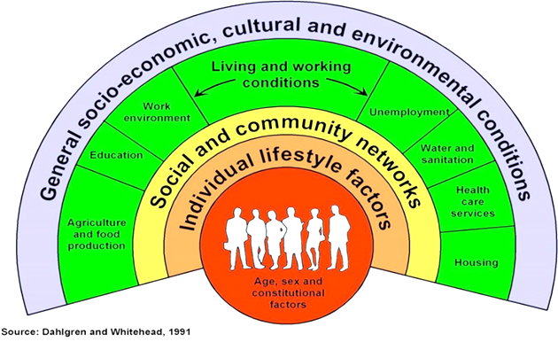


OUR POPULATION- KEY FACTS
In Swansea Bay, we serve some of the most deprived communities in Wales. We understand that deprivation increases the costs of care due to higher emergency demand and longer lengths of stay and more complex, resource-intensive interventions. We also know that health inequalities are widening, with earlier onset and greater complexity of illness and we have an ageing population with increasing multimorbidity and long-term conditions. Our plan recognises this context and demonstrates our steps to address these factors:
395,000
23%
of Children in Swansea Bay are living in poverty
1 in 6
children aged 4 years old in Swansea Bay are not fully up to date with their vaccinations.
Approx. population
Healthy Behaviours
9% of the population in Swansea and 4% of the population in NPT were born outside the UK. 5% and 1% of our population’s main language is not English.
Life Expectancy
6.4% of people in Swansea, and
4.3% of those in
NPT, are unemployed
Female
81.6 years
14% Adults currently smoke
Male
77 Years
Gap in Life Expectancy
Most deprived vs least deprived
16% Adults drink above guidelines
Health inequalities
There are persistent inequalities in Swansea Bay, linked to differing experiences of the wider determinants of health (such as education, housing and income) throughout life.
20.2
Healthy years
16.4 Healthy
years
10
years
64% Working age adults not a healthy weight
7.4
years
Female
Male
9% of the population in Swansea and 3% of the population in NPT are from a non-white ethnic group.
Over the last 20 years the proportion of the SBUHB population aged 65+ has increased from 18% to 21%, while the proportion of the population that is traditionally working age (aged 16-64) has decreased from 64% to 62%.
Data for 2024/25
8

Slide 8

















Morriston Hospital
Singleton Hospital
Neath Port Talbot Hospital
Gorseinon Hospital
Tonna (Mental health)
Cefn Coed (Mental Health)
OUR SERVICES- KEY FACTS
H1
In addition to serving our Swansea Bay population we also provide a range of specialist and tertiary services for a much larger population across South Wales, and in the case of burns and plastics services we provide service to South Wales and South-West England. We also host the Major Trauma and Spinal Networks on behalf of the South Wales Health Boards and the Emergency Medical Retrieval Service (EMRTS) on behalf of all health boards. Our joint work with Hywel Dda, formalised in our joint committee, now provides us with the opportunity to plan and deliver services together for a total population of nearly 1m people ​​​
H2
H3
H4
Neath Port Talbot
MH1
H4
MH2
MH2
H1
MH1
We also have:
44 GP practices​
91 Community Pharmacies​
58 Dental Practices ​
32 Optometry practices​
And we provide care out of other Health Board estates.
H3
Swansea
H2
In a single year across the Health Board there are:
78,157
Total new ED Attendances
(Morriston)
53,720
Total new MIU Attendances
630,991
Outpatient Appointments
138,315
Diagnostic Procedures
30,178
Inpatient and Day case
Procedures
283,416
District Nursing visits
60,746
Common Ailments Scheme Consultations
127,905
Eye Care Examinations
19,763
Calls to 111
Press 2
9,303
Referrals to Local MH services
2.17M
GMS
Consultations
786,782
GMS Consultations were urgent or acute
161,840
Referrals from Primary care
33,063
Urgent Dental Care Appointments
4,100
Psychological
Therapy Referrals
Data for Full Year 2024/25
9

Slide 9
STRATEGIC OVERVIEW
Our Organisational Strategy for ‘a Healthier Swansea Bay’ was refreshed in September 2025. It describes our commitment to building a healthier future for everyone in our communities, a future where people live well and age well, supported by high-quality care that is compassionate, equitable, and delivered close to home.
Our Mission:
Better Health, Better Care,
Better Lives
Better Health means focusing on prevention, education, and early intervention. We will work alongside our partners and communities to tackle the root causes of poor health supporting people to make informed choices, promoting mental wellbeing, and reducing health inequalities.
Better Care means putting people at the heart of everything we do. We aim to deliver safe, timely, and personalised care that reflects what matters most to each individual, designing services with patients, using feedback , lived experience and co-production at every stage. Whether at home, in the community, or in hospital, we strive to ensure every patient experience is grounded in dignity, respect, and excellence.
Better Lives reflects our wider commitment to supporting wellbeing beyond healthcare. By collaborating with social care, education, housing, and voluntary sectors, we aim to create the conditions where people can thrive physically, mentally, and socially.
Our vision is clear: a healthier Swansea Bay where individuals enjoy longer, happier, and more independent lives, with access to the care they need when they need it most.
This vision guides every decision we make and every service we design. But achieving it requires a system that prioritises prevention, early intervention and a deep understanding of the social, economic, and environmental factors that shape health. Our mission, Better Health, Better Care, Better Lives reflects this approach. We are committed not only to treating illness, but to support wellbeing throughout peoples’ lives. By working with our communities and partners, we seek to tackle health inequalities, empower people to make informed choices, and foster environments where everyone can thrive physically, mentally, and socially. This is why we have been clear about the need to maximise the four different ways we make a difference: not only as providers of care but also as a major employer, a key economic player, and a collaborative partner within the wider system.
10

Slide 10
STRATEGIC OBJECTIVES
Four ways we make a difference
Our Strategy is crystalised through five Strategic Objectives. We have aligned our delivery to these objectives including alignment to the Board Assurance Framework, Strategic Risk Register and Executive Directors’ objectives and portfolios.
We recognise that our Health Board’s influence goes well beyond the walls of our hospitals. Achieving our strategic objectives and delivering our vision and mission relies on us embracing and maximising the four ways we make a difference:
As a healthcare provider, we directly influence health outcomes by delivering safe, effective, and compassionate care.
As an employer, we play a critical role in the local economy, employing over 12,500 people.
As a major local organisation (anchor Institution), we impact economic stability, community wellbeing, and social progress through responsible stewardship of resources and active engagement in local development.
Finally, as a productive partner, we collaborate closely with a wide range of organisations, public bodies, and communities to deliver integrated, person-centred solutions.
1. People of Swansea Bay live healthier, fairer and more prosperous lives
2. Care is high quality, safe, efficient and delivers the best possible outcomes for people in partnerships
3. Care is delivered in partnership with our communities in safe and appropriate setting, supported by innovation
4. The health board is a great place to work where staff feel valued and work together towards a common goal
5. The health board is a resilient, sustainable and responsible organisation
Delivering our Vision and mission requires us to work and live our values:
    Caring for each other, where kindness and dignity shape every interaction.
    Working together, where openness, respect, and partnership guide how we engage with patients, families, staff, and communities; and
    Always improving, where safety, professionalism, and learning drive us to be the best we can be.
11

Slide 11
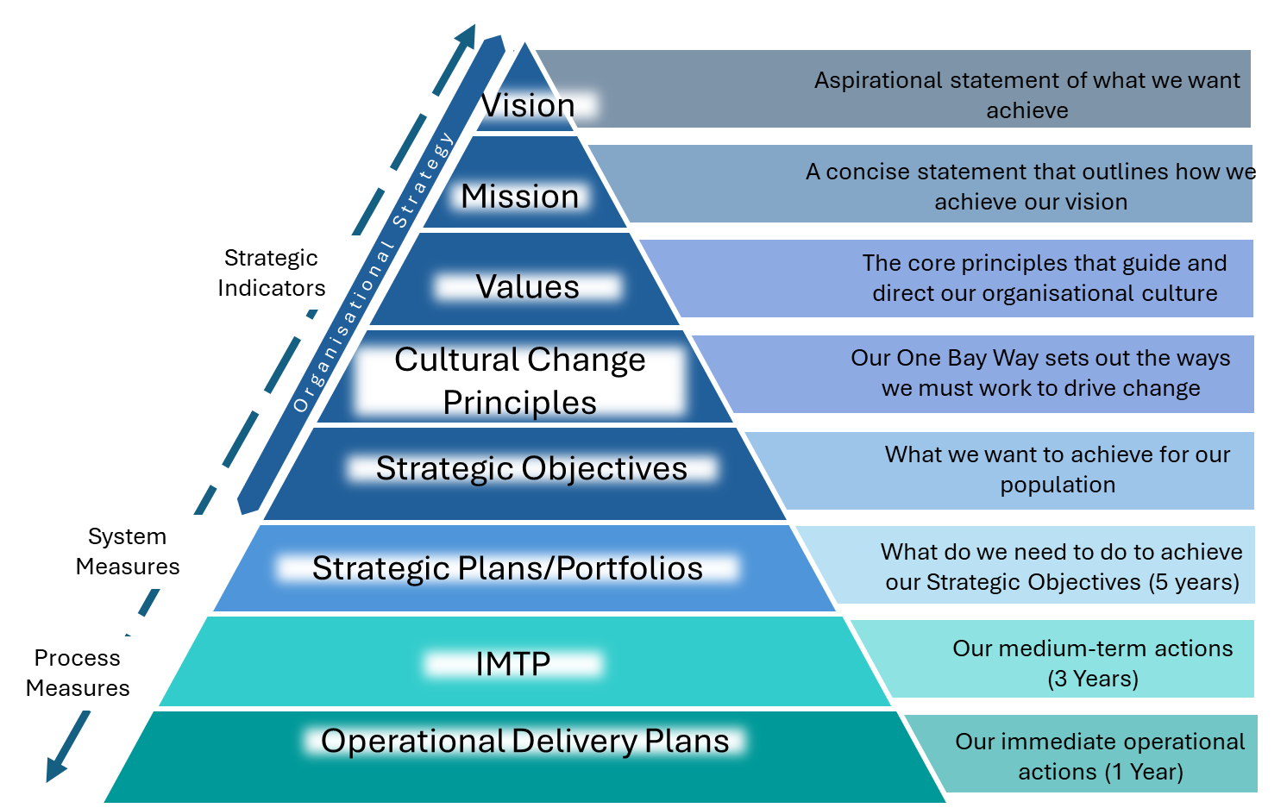
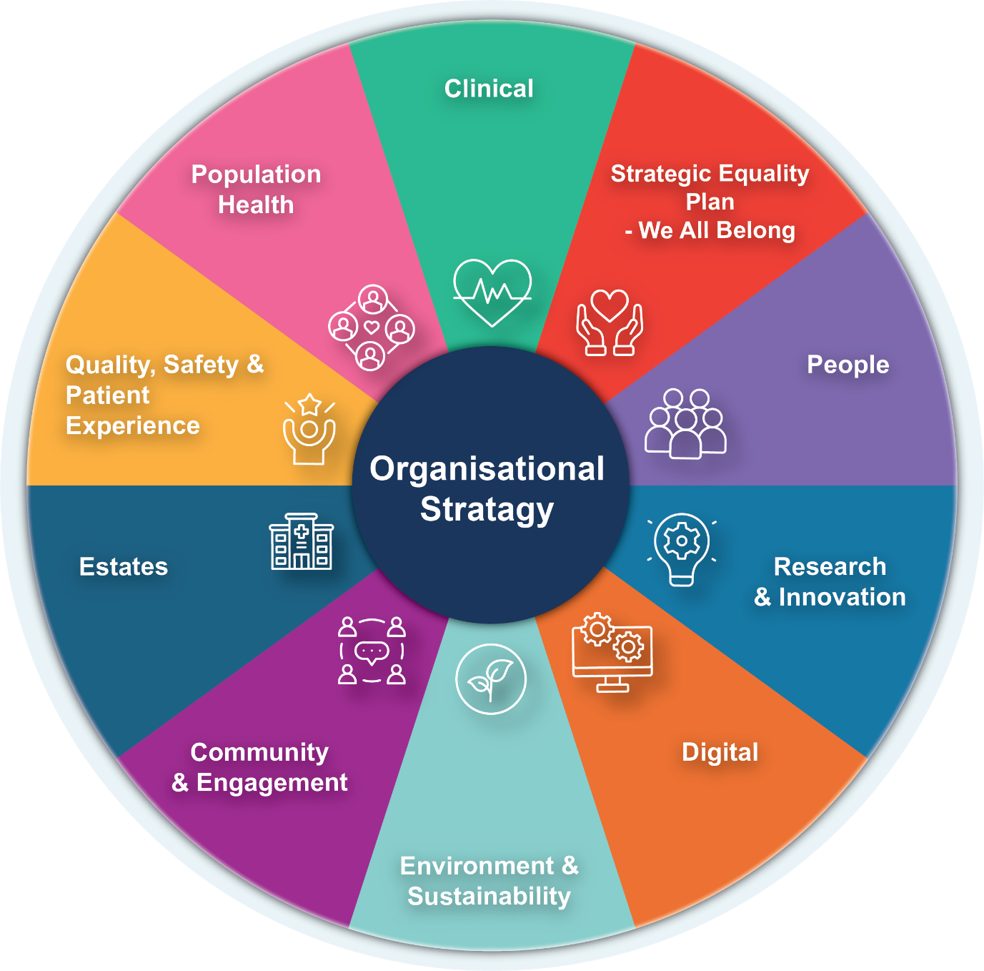
STRATEGIC FRAMEWORK – HOW IT ALL FITS TOGETHER
Strategic Plans
In 2025/26, we have worked to put in place the right that foundations will support effective delivery and transformation. Our organisational strategic framework sets out all our plans fit together from our vision right through to our operational delivery plans. Executive portfolios, our risk management approach, the Board Assurance Framework and our Integrated performance report are all aligned to this strategic framework in order that our efforts are concentrated in the same direction with the same purpose.
Our strategic Plans set out how, across all aspects of the organisation we will take forward the organisational strategy and how we will measure success
12

Slide 12

TRANSFORMING FOR THE FUTURE:
Our 10 Year Clinical Plan
Timeline
Development of the Clinical Services Strategic Plan (CSP) is underway through 2026, moving from establishing the evidence base and context in the first half of the year, into engagement, design and agreement of future models of care, and concluding with final plan approval.
Key milestones include:
  May-June2026: Engagement on principles and the public compact
  July 1st2026 : Clinical Leadership Event
  July-August: Engagement on Future Models of Care
  September 2026: agreement of strategic models of care
  October 2026: identification of priority transformation areas
  November 2026: approval of the final CSP document
The refreshed Clinical Services Strategic Plan (CSSP) ‘Transforming for the Future’ will be developed through a whole‑system, evidence‑based approach that is grounded in meaningful collaboration with the people we serve. Central to this is the creation of a public charter, shaped through engagement across the Seven Areas of Care, which will clearly outline what our communities can expect from their health service and what the health service needs from them to deliver sustainable, high‑quality care. This charter, alongside our established design principles (which will be revisited and tested through this work), will guide the development of future service models. As those models are shaped, all major pathway redesign will be co‑produced with our communities, Llais, carers, and third‑sector partners, ensuring that our future clinical system reflects lived experience, local need, and the values of those who depend on it.
Seven Areas of Care
Universal Care
Targeted Care
In-hospital planned Care
Universal access to everyday healthcare and prevention services
Complex care closer to home
Planned care that cannot be delivered safely in primary or community
settings
Timeline
Specialist Care
Apr
May
Jun
Jul
Aug
Sep
Oct
Nov
Highly specialist,
complex, or
rare-condition
care
Context
Routine Care
Clinical Model Development
Coordinated and reactive care for ongoing health needs
Enhanced Care
In-hospital Emergency Care
Short-term crisis / intensive support
Engagement
Specialist emergency care
in a hospital
Finalisation
Board
13

Slide 13
TRANSFORMING FOR THE FUTURE: OUR 10 YEAR CLINICAL PLAN
A key component of the Transforming for the Future is the work to understand the context and challenges we face now and are likely to face in the coming years so that we can plan and develop sustainable services fit for the future. The CSSP is therefore informed by the findings from these key pieces of work undertaken in 2025/26:
State of the Population | Horizon Scanning | Demand and Capacity | Infrastructure
Greater emphasis will be required on upstream interventions and community-based models to tackle the increasing chronic disease burden. An aging population and rising multimorbidity will significantly increase service complexity. There will be increased demand for diagnostics, treatment facilities, with pressures on workforce capacity for cancer, CVD, and dementia. A shrinking working-age population and skills gaps will require proactive workforce planning. Persistent health inequalities will require Services to be designed in such a way as to target inequities in rates of disease in our population’ Data-driven planning is essential for adapting to emerging needs and preparing for new interventions | Financial sustainability and policy agility are critical to maintain service resilience. Deepening health gaps require targeted, equity-focused service redesign. Workforce resilience and digital skills are essential for future-proof care and expand tech enabled care. Digital equity and interoperability must underpin technology adoption. AI readiness—data quality, ethics, and workforce training must start now. Compassionate leadership and flexible working are key to retention and quality. Climate resilience and sustainability must be embedded in all planning. Agility and research integration will define future competitiveness and outcomes. | We will need to prioritise bed base resilience, sustainable elective capacity, and improved theatre and diagnostics throughput. Urgent and emergency care must shift to a 7‑day flow model with strengthened intermediate care, virtual wards, and MDT discharge processes. Future services will need a workforce model that enables sustained capacity rather than surge‑funded short‑term activity. Diagnostics expansion, triage, and throughput improvement are essential to avoid diagnostic bottlenecks driving systemic delays. Standardising pathways will be key to restoring flow and predictable capacity. | Maintaining Capacity and Service Delivery will require high‑risk to be prioritised to protect theatre/ward throughput and urgent/emergency capacity. Sequencing capital plans will be vital in to unlocking pathway redesign benefits. There are opportunities in regional programmes to consolidate specialist services and scarce skills. It is vital to shift from reactive to lifecycle management to optimise compliance. We will need to explore mixed funding opportunities to bridge the capital gap and accelerate highest‑value schemes.
14

Slide 14
STRATEGIC RISKS ALIGNED TO THE STRATEGIC OBJECTIVES
A reset of our risk management approach was undertaken in 2024/5. This led to the creation of a strategic risk register informed by pre-existing board risks, operational service risks, and fresh top-down review against SBU objectives by Board Directors. A consolidated strategic risk register was adopted by the Board identifying the principal risks to the strategic objectives. It is supported by a refreshed corporate risk register of significant operational risks – itself informed by operational service risk registers and ongoing bi-monthly reviews of register by Executives and Board, supplemented by detailed scrutiny of Board Committees.
The below table sets out our key Strategic Risks, Corporate Risks and Operational risks aligned to our strategic objectives. Which Board Committee has oversight of the risks is also noted:
PHC: Population Health Committee
PFC: Performance and Finance Committee
QSC: Quality & Safety Committee
DDRI: Digital Data Research & Innovation Committee
WOD: Workforce and Organisational Development Committee
IC: In-Committee
Strategic Risk Register (n=17) (Ref, Risk Title, Over-seeing Committee) |  | Principle risks to the health board (at the strategic level) that could impact successful delivery of one of the organisation’s five strategic objectives |  |  |  | Horizon 2 – 3
Better Health for all | Improved patient safety |  | Care is delivered in partnership | A great place to work | Use every NHS £ wisely
Level 20 1.1 Population Health Approaches to Address Health Inequity, PHC | Level 20 2.3 Cancer Care, PFC Level 16 2.1 USC Access, PFC 2.4 Quality, Safety & Patient Outcomes, QSC 2.5 Listening to People, QSC 2.6 Maternity & Neonatal Service Transformation, QSC 2.7 Mental Health Transformation, QSC Level 12 2.2 Planned Care Access, PFC |  | Level 20 3.3 Sustainability of Digital Services DDRI 3.4 Digital Transformation Programme DDRI 3.2 Estates PFC Level 12 3.1 Partnerships and Collaboration, QSC 3.5 Research, Development & Innovation, DDRI | Level 16 4.1 Staff Health & Wellbeing and Organisational Performance, WOD Level 12 4.2 Leadership and Management, WOD 4.3 Culture, Values & Behaviours, WOD | Level 25 5.1 Recovery & Sustainability Programme, PFC
15

Slide 15
Corporate Risk Register (n=24) (Ref, Risk Title, Overseeing Committee) | A level below the Strategic Risk Register. Significant Corporate or Operational risks escalated and accepted by an Executive or Corporate Director to go on the CRR because: |  |  |  |  | System wide Horizon 1 – 2
 | The risk rating is high and the Corporate Director feels it is outside of their control The risk cannot be tolerated |  | All action has been taken to mitigate the risk The risk remains at a level above the risk tolerance level.
Better Health for all | Improved patient safety | Care is delivered in partnership |  | A great place to work | Use every NHS £ wisely
Level 12 52 Statutory Compliance: Engagement & Impact Assessment, PFC 100 A lack of a robust approach to partnerships & collaboration, PHC | Level 20 4 Healthcare Acquired Infection, QSC 66 Access to Cancer services, QSC 69 Adolescents admitted to adult MHW, QSC 80 Clinically Optimised Patients QSC Level 16 61 Paediatric GA, QSC Level 12 94 CAMHS, PFC | Level 20 60 Cyber Security and Resilience, DDRI IC 64 H&S Infrastructure, QSC 104 Clinical Coding Completeness, DDRI Level 16 36 Paper Record Storage, DDRI 105 LIMS, DDRI 108 WCCIS/Connecting Care, DDRI |  | Level 20 89 Healthcare Nursing Staff Levels (HMPS), QSC Level 16 3 Recruitment of Consultant Medical and Dental Staff, WOD | Level 25 92 Finance forecast deficit risk, PFC Level 20 85 Non-Compliance with ALN Act, QSC 90 Subject Access Request, DDRI 96 Failure to Develop an Approvable IMTP, PFC 106 Emissions Reduction, PFC 107 Emergency Preparedness, PFC Level 15 53 Welsh Language Standards, QSC Level 12 93 Finance Capital Funds, PFC
Operational Risks Current Risk Score 20+ (n=83) (Risk Type, No.) |  | A level below the Corporate Risk Register. All service group risks rated 20+ which are not on the Corporate Risk Register or the Strategic Risk Register |  |  |  | Horizon 1 – ‘Here and now’
Better Health for all | Improved patient safety |  | Care is delivered in partnership | A great place to work | Use every NHS £ wisely
 | Patient Safety (2) Medical Devices & Equipment (11) |  | Environment, Estates & Infrastructure (11) Information Governance (1) | Workforce & OD (14) Sustainable Services (32) | Compliance & Legislation (5) Financial Management (1) Governance & Assurance (4) Health & Safety (2)
16

Slide 16
Risk Areas of Focus
  Our analysis of our risks tells us that the highest scoring risks, outside of financial and estates pressures, are predominantly clustered under Strategic Objective 2, which relates to quality, safety and patient outcomes. Within this, there are multiple strategic and corporate risks relating directly to:
    Timely access to care, including planned care, cancer pathways and urgent care
    Mental health services, including both service delivery and workforce capacity
    Maternity and neonatal services, highlighted as a specific area of concern
    Avoidable harm with reference to Healthcare associated infections, which remain a high scoring corporate risk
  These themes appear repeatedly across both the Strategic Risk Register and the Corporate Risk Register, indicating that they are not isolated issues but sustained, system level risks that remain above tolerance despite mitigation. Focusing on these areas enables us to prioritise where there is both the greatest potential impact on patient outcomes and the strongest alignment with the Board’s identified risk hotspots, particularly around quality, safety and access.
Timely Access to Care | Mental Health Services | Maternity and Neonatal Services | Avoidable Harm (HCAI)
We are managing risks around access to timely care through a combination of urgent and planned care improvement programmes, delivery of strengthened performance trajectories and operational grip via the Delivery Unit to improve flow, reduce delays and increase capacity across the system | We are progressing our Mental Health Transformation Programme, focused on delivering a modern, integrated care model that strengthens prevention, improves access to psychological therapies and reduces reliance on crisis and inpatient care through improved community provision | We continues to actively manage maternity and neonatal risks through strengthened oversight, enhanced clinical governance and focused improvement actions, with particular attention to safety concerns and service sustainability. In parallel, we are reviewing all the options and mitigations to the risks associated with the current two‑site model. | We are addressing HCAI risk through strengthened quality governance, enhanced incident learning and safety systems.
15

Slide 17

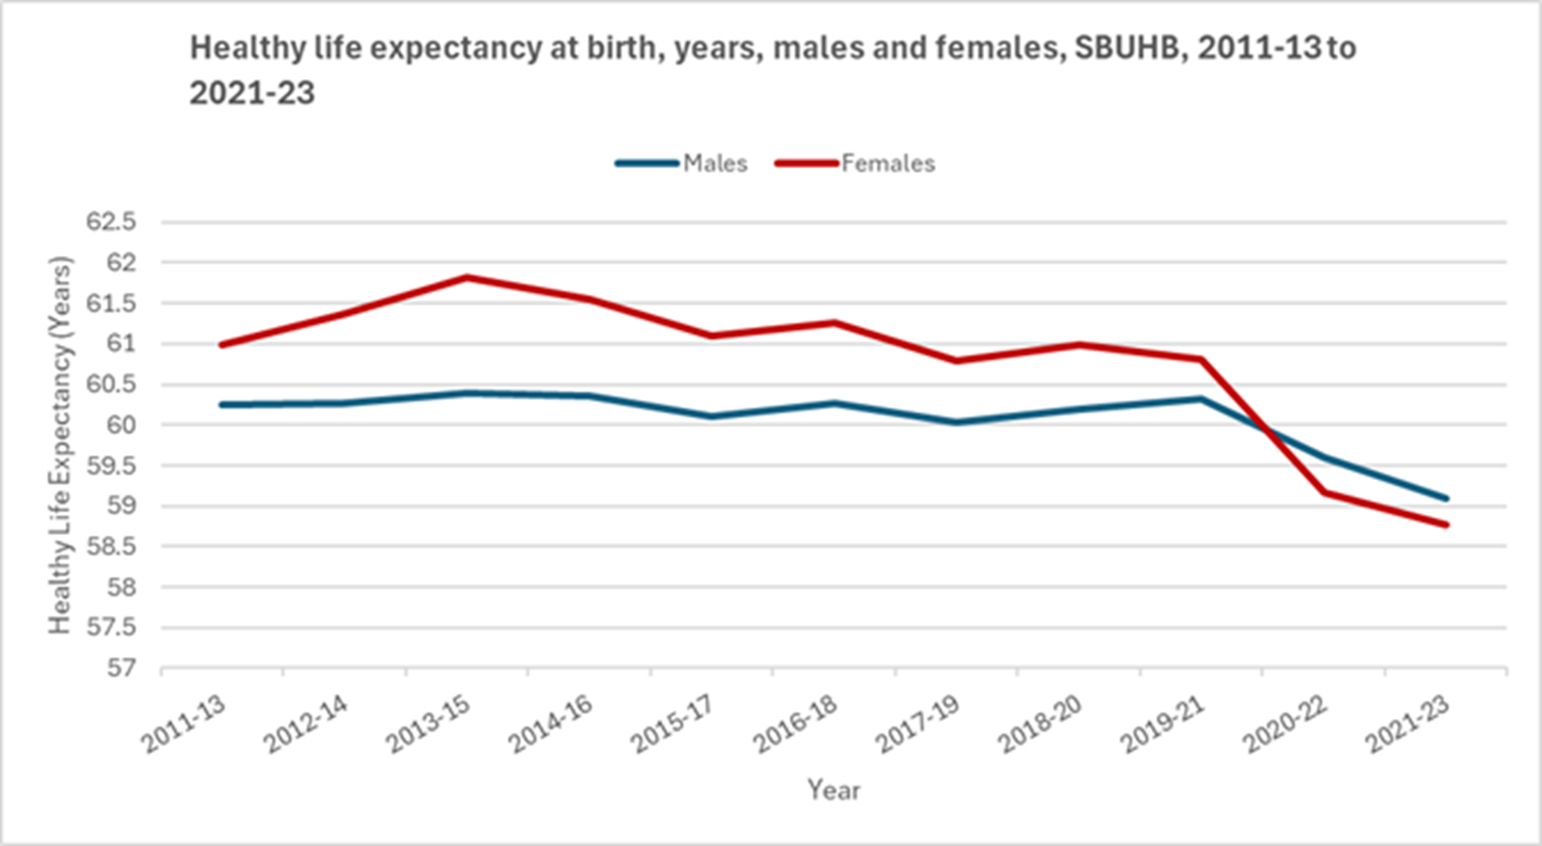








A POPULATION HEALTH FOCUSED ORGANISATION
The Swansea Bay Population Health Strategic Plan (2023) – A Better Future for All – sets out how we and our partners will improve health and wellbeing while reducing inequalities. Our focus is on prevention and tackling the ‘causes of the causes’ of ill-health through whole-system, multi-sector
action. Grounded in the Marmot principles and the five World Health Organisation policy areas, the strategic plan aligns with our A Healthier Swansea Bay: Swansea Bay UHB Organisational Strategy, mapping directly to Strategic Objective 1: People of Swansea Bay live healthier, fairer and more prosperous lives and the four pillars are embedded throughout the whole Strategy.
This strategic focus is critical given the stark health inequalities in Swansea Bay; women in the most deprived areas live nearly 20 fewer healthy years than those in the least deprived and in men this difference is nearly 15 years. Neath Port Talbot and Swansea also have among the highest rates of premature cardiovascular deaths in Wales and the UK.
The Health Board aims to add years to life, and healthy life to those years for all. We tackle our health inequities by guiding partnership whole system working on prevention and mitigation and in the health and care system through the Core20PLUS5 approach. The most deprived 20% of the population (CORE 20) as well as Priority population groups with greater health needs (PLUS) are targeted on the top five preventable health conditions affecting the population. For adults, the five (5) conditions include cardiovascular and respiratory disease, maternity services, mental illness and cancers, and for children includes asthma, diabetes, epilepsy, mental and oral health. Smoking cessation is a priority for all the adult areas as it is a risk factor in all categories.
The Population Health Committee has focused on ensuring the Strategy is implemented through priority areas by measurable actions and collaboration with directorates to embed it as a priority.
17

Slide 18




POPULATION HEALTH PRIORITY AREAS FOR 2026/27
Alongside delivery against our ambitions outlined in the Population Health Strategic Plan, the 2026/27 NHS planning guidance also draws attention to specific priority areas which include:
Increase uptake and decrease inequity in Vaccinations and Screening
  Continue to improve vaccine accessibility through community‑based vaccination venues in lower‑uptake areas, particularly during winter, alongside home immunisations. We will work with Primary care and Public Health Wales on low uptake areas for both Cancer Screening and Vaccination, targeting those at highest risk.
  Investigate and target actions to understand and address non‑attendance for vaccination across the life course.
Population Health Surveillance and Management
  Local intelligence captured through the State of the Population report will be used to inform the development of individual Clinical Service Plans.
  Continue to advocate for a data driven approach to population health improvement tracking through the All-Wales Population Health Management guidance, whilst awaiting a national solution to access integrated patient-level datasets, on which to run tools such as segmentation and risk stratification and identify population groups for targeted, preventative intervention.
Healthy weight and obesity
  Develop structures, goals and actions to progress the collaborative approach across Neath Port Talbot and Swansea Public Service Boards (PSBs) on public food procurement to support food system improvements and healthier settings/ communities.
  Strengthen collaboration with partners to support early years interventions that promote healthy weight, including breastfeeding, physical activity and activity through play.
  Further develop delivery of Healthy Schools programmes to embed and sustain healthy behaviours in education settings.
Tackling health inequalities
  Delivery of a population health focused tool to support Clinical Services Planning in addressing future need, including prevention and early intervention.
  Community by design will shift services closer to the patient.
  Working in partnership, strengthen our understanding of the health needs of inclusion health groups, map current services and set actions to enhance how services meet the needs of seldom heard/marginalised groups.
  Advocate and embed population health approaches by working with PSBs, local authorities, schools, communities and other partners, to include engaging with emerging Marmot Nation, Tata Steel, and ‘Clear Hold Build’ place initiatives.
Prevention
  Strengthen activity in primary and secondary prevention and health improvement. Through ensuring evidence-based prevention actions in Primary care (e.g. on hypertension) we aim to achieve improved population health outcomes.
  Building sustainable tobacco control and weight management services to meet present and future need.
  Work with schools and other partners in educational settings through a whole school approaches.
Action across the life course
  Strengthen universal pre-natal and perinatal prevention and ensure coordinated early years support across maternity, health visiting and wider partners by using data to support and prioritise evidence-based actions.
18

Slide 19




QUALITY AND SAFETY
Improving the quality and safety of our care remains an organisational priority as we continue delivering on our Duty of Quality and Candour. Through engagement with our communities and stakeholders, we have revised our Annual Quality report to better meet their needs.
Quality Governance & Assurance
Safety Systems & Incident Learning
Over the coming year, we will build on our work with the national Safe Care Partnership to develop our Quality Management System, including learning from Perinatal Services via the Wales-wide QMS prototype.
  Nationally reported incidents are submitted to NHS Performance and Improvement per guidance, with learning shared via quarterly Patient Safety Congress events. Over the next year, we will revise our processes to enhance learning at service and organisational levels.
  Safety alerts are managed through the Once for Wales DATIX system, and we will work with the Welsh Risk Pool to strengthen the national system.
  We continue to prevent deconditioning and have reduced inpatient falls to 3.7 per 100 bed days, well below the national average.
Patient Experience Requirements
The national Patient Experience Survey is used across services, with real-time data driving daily action on negative feedback. Over the past year, Welsh-medium feedback systems have been strengthened, with further improvements planned for 2026. Annual self-assessment against the People’s Experience Framework is underway, supported by an improvement plan.
We prioritise Welsh-language care and plan to expand Welsh-medium clinical consultations in the More Than Just Words priority areas.
Workforce, Safety & Culture
We will continue to develop Quality Improvement skills across our teams so that we can make positive changes to our care at every level.
Concerns, Complaints & Redress – “Listening to People” (from April 2026)
Concerns handling and learning will feature in the 25/26 Annual Quality Report. Compliance with the 30-day closure target has fallen to 54% as of 11.2.26. We are addressing overdue concerns, promoting early resolution, and centring the person through listening.
Looking forward, we will implement the new Listening to People framework from April 2026, focussing on early resolution and trauma informed responses.
Year‑1 Delivery Expectations (2026/27) : | From April 2026, we will implement revised concerns processes by building staff awareness and skills, reducing overdue concerns, and promoting early resolution.
19

Slide 20


COMMUNITY BY DESIGN
Community by Design (CbD) is now a core national priority for 2026–29, signalling a shift away from a hospital‑by‑default model toward integrated, community‑centred care. Rooted in A Healthier Wales, the approach strengthens prevention, supports population health management and ensures more care is delivered closer to home. A new national Transformation Programme Board, chaired by the Chief Medical Officer, is driving this work across three pillars:
Chronic Conditions
    Urgent and Same Day Care
    Prevention and Population Health
Supporting people with chronic conditions and risk factors to remain well in the community through the delivery of integrated services with prevention at their core
Improve access and availability of services in the community in a way that people and staff can navigate care pathways easily and appointments are timely and appropriate to need in the right setting.
Prevention and population management are business as usual, systematically embedded into every contact to secure better health outcomes and reduce inequalities.
Health boards are expected to increase both activity and investment in primary and community services and consistently apply CbD principles across all pathways.
Our Position
Swansea Bay already has a strong foundation for this shift, with many services such as oral surgery, audiology, ophthalmic care and INR monitoring already delivered in community settings. Well established clusters and an active Pan‑Cluster Planning Group also provide a mature platform for neighbourhood‑level redesign and co‑production with partners.
Our Ambition for 2026/27
In 2026/27, we will establish a local CbD programme reporting into the Planned Care & Cancer Board, embedding Community by Design as the default planning principle for future service transformation—community first unless hospital care is clearly required. This will include shifting activity and resources from secondary to primary and community care, supported by national expectations and GMS contract investment. We will work with clusters, primary care contractors, local authorities, social care and third‑sector partners to co‑design stronger community pathways and expand seven‑day services, including community nursing, urgent‑care alternatives and enhanced palliative care. Our ambition is to reduce delays and avoidable admissions by improving community management of long‑term conditions and urgent care, while ensuring CbD is fully reflected in the refreshed Clinical Services Strategy and aligned across our workforce, digital, estates and financial plans.
20

Slide 21
QUANTIFYING THE CHALLENGES AND OUR OPPORTUNITIES
In 2025/26 ,we have gained a stronger understanding of both the challenges and opportunities facing the Health Board. We now have a system-wide, evidence-based assessment of the Health Board’s financial challenges, including the drivers of our current deficit and the scale of deliverable opportunities. This is summarised across five domains described on this page. Further work will be undertaken to ensure we fully understand how these opportunities can be realised in realistic timescales.
1. Understanding the Financial Problem – Underlying Deficit (ULD)
We have confirmed the HB’s underlying deficit has deteriorated. Key deficit drivers have been quantified and £94.2m–£108.2m of recurrent pressures identified. 78–80% of these drivers are operational or strategic, meaning the HB has control to address them:
UEC workforce, choices and investment
CHC growth and structural issues
Acute income vs cost
Planned care productivity
Beds/sites and rurality
Medicines management
2. Urgent & Emergency Care (UEC): Flow, Bed Base and De-escalation
A UEC deep-dive identified quantified opportunities in SDEC, AMU and inpatient flow:
Redesign Front‑door and assessment area.
Improve discharge profile (board round standardisation, MDT coaching) supporting further bed release.
Review of Investments providing opportunities to stop, repurpose or re‑specify spend
These are foundational to restoring safe flow and reducing dependency on temporary escalation capacity.
3. Planned Care & Productivity
Substantial opportunities have been identified through benchmarking with Model Hospital and Welsh peers. Key quantified opportunities are:
Embed Outpatient productivity (template standardisation enabling c. 27,000 extra appts)
Embed Theatres productivity
Use of Omnicell to reduce waste
Wider planned care productivity
4. Continuing Healthcare (CHC): Operating Model, Reviews & Market Management
A CHC is the second‑largest category of financial risk after UEC. Key quantified opportunities are:
Market management
Joint funding reviews
Rightsizing packages & review backlog
However, achieving these savings requires fixing structural weaknesses in CHC data, commissioning, governance and multidisciplinary working.
5. Workforce Controls and Efficiency Opportunities
Pay growth and workforce expansion (18% WTE growth since 2019/20) are major contributors to the deficit. Key quantified opportunities are:
Assert Workforce governance & variable pay controls
Reduce Sickness absence
Implement Non‑clinical workforce controls.
Right‑sizing & spans of control (A&C, CST workforce, support services)
Implement Nursing controls (Registered + HCSW)
Implement Medical controls
21

Slide 22
OUR PATH TO SUSTAINABILITY
2025/2026
Building the basics
2026/2027
Transition year and doing things differently
2027/2028-2029/2030
Delivering transformation
We recognise that there is much do now and in the immediate future to address the urgent challenges that are hampering the delivery of excellent, timely care for our population. The Board's route to financial sustainability is grounded in making wide-ranging operational, strategic and structural changes.
Transforming for the Future (Our Clinical Services Strategic Plan) is central to this. It provides the clinical blueprint for addressing the long-term challenges by aligning operational efficiencies, strategic redesign and structural change aligned with future population need within a single, coherent framework. It will enable us to standardise pathways, right‑size our bed base and theatres, strengthen diagnostics, and ensure that specialist care is concentrated where it can be safely and sustainably delivered.
Alongside this, Community by Design (CbD) is essential to shifting activity and investment upstream. Many pressures we face are symptoms of a system weighted too heavily toward acute care. CbD enables more assessment, treatment and support closer to home, reducing avoidable admissions, improving flow and building a resilient system of care.
Together, the CSSP and CbD underpin the pipeline of operational, strategic and structural schemes required for recovery. This includes pathway standardisation, workforce and theatre right‑sizing, community‑based diagnostics, CHC redesign, and improved site utilisation. Embedding both programmes into our stepped approach ensures that short‑term delivery is aligned to long‑term transformation. This integration is vital to restoring financial balance, improving quality and safety, and creating a sustainable, resilient health system for Swansea Bay. We will identify and develop future opportunities through managing a pipeline of potential schemes, developing them through from initial concepts to high level plans, implementation plans and delivery. Below are some examples of the future schemes identified in our pipeline.
Operational
Structural
Strategic
Recovery & Sustainability Plan for 26/27
SLAs, LTAs, Commissioning and Contracting
Radiology Service Sustainability (capacity and demand right-sizing)
Community based activity and diagnostics to reduce acute demand
Pathology Service Redesign
South Wales Corridor Strategic alignment in priority services (e.g. Cancer, Cardiothoracic, Fertility, Spinal)
Acute and Community Estate consolidation and restructure to address underutilisation and support new service models
Maternity services redesign and Optimisation Programme
22

Slide 23
TRANSITION IN 26/27 AND DOING THINGS DIFFERENTLY
Financial Grip and Control: Delivering efficiency and productivity through Recovery and Sustainability programmes
Enabling Actions
Improving Value Optimising Outcomes and Minimising Variation
Workforce Productivity
Operational Productivity and Efficiency – UEC and Planned Care
Maximising Value
Delivery Expectations
Timely Access to Care
Population Health and prevention
Community by Design
Mental Health Access
Women’s Health
Quality & Safety
Finance: Reduce the ULD with transparent run‑rate control and strengthened financial governance
Financial Sustainability
Workforce: Single, mandatory workforce control framework with measurable reductions in variable pay and improved utilisation of the substantive workforce
UEC: Phased de-escalation, improved discharge performance, front-door redesign and sustainable flow governance across the UEC system.
Planned Care: Productivity‑driven approach, linking workforce modelling, theatre utilisation, outpatient redesign & digital enablers
CHC: Redesign CHC operating model, complete the digital case management solution and implement systematic joint funding and market management approaches.
Procurement & Non-Pay: Strategic procurement programme, contract consolidation and efficiencies
Short-Term Service Change and Safe Services: Addressing particular risks through priority Improvement programmes and regional solutions delivering transformation at pace.
Mental Health Improvement programme
Babies, Children, Young People and Women’s Improvement programme
Cancer Improvement programme
Community by Design Improvement programme
Long Term Sustainability
Transforming for the Future: Our 10 Year Clinical Strategic Plan
Long-term Sustainability: Ensuring clarity of vision and effective delivery
Productive partnership working with communities, patients, clusters, Regional partnership Board, Third Sector, Public Services Board, NHS Partners
23

Slide 24
ORGANISED FOR SUCCESS
Governance
Our plan and our governance reflects the areas against which we need to deliver. Our operational plans set out the actions to achieve performance and delivery requirements, the work to deliver our recovery and sustainability schemes and the priority areas for improvement and transformation.
A clear one-to-three-year flightpath to sustainability requires us organising for success. It includes putting in place the structured support required to plan, deliver and monitor our plans. The Organised for Success programme will support us to be organised in the most effective way to deliver in-year and medium-term improvements aligned to the Annual Plan. The programme is a key enabler in the delivery of the savings benefit associated with headcount reduction (as identified by the Recovery and Sustainability Board), which will include a management restructure of our clinical services and corporate functions. It has been designed in the following phased and stage approach, with progress to date is as follows:
Executive Board
Phase 1; Stage A: The Executive Team portfolios. Completed
Phase 1; Stage B: Delivery Unit Implementation from April 2026. The Delivery Unit will provide :
  Oversight and Coordination: To oversee and coordinate the identification, development, and monitoring of savings plans.
  Programme Support: To support the delivery of transformational, operational improvement and productivity programmes.
  Benefits Realisation: To track and evidence the realisation of benefits arising from these programmes.
  Unified Framework and Methodology: To operate within an agreed accountability framework and apply a single, consistent improvement methodology.
  New Performance and Accountability Framework
  Performance Management: To establish and maintain a performance management infrastructure, including KPIs, tracking, reporting and data analysis to support insight driven decision making.
  Phase 2 Care Group Structure. Implementation from September 2026. The proposed Care Group Structure was approved by the Board on 29th January 2026. Further consultation and engagement on the structure and content of each Care Group will take part of next phase, i.e.., where each service/ speciality will sit and how they will be grouped.
Performance and Delivery
Recovery & Sustainability
Improvement & Transformation
Enabling Actions
CHC
Mental Health
Deliver Expectations
Procurement & Non-Pay
Peri-Natal
TI Targets
Workforce
Community by Design
Quality & Safety
Planned Care
Cancer
UEC
LTA
Delivery Unit
Organising for Success
Transforming for the Future
Performance and Accountability Framework
24

Slide 25
DELIVERY UNIT
A vital part of Organised for Success is the establishment of our Delivery Unit. The Delivery Unit is being established in response to the scale and pace of improvement required across financial recovery, operational delivery and organisational sustainability. It will support delivery of the £65m savings requirement, operational productivity improvement and longer-term redesign and reconfiguration. The Delivery Unit Director is in post and has begun implementation.
The core purpose of the Delivery Unit is to strengthen the organisation’s ability to deliver improvement at pace through:
  Greater coordination of organisational resources
  Improved programme discipline and accountability
  Enhanced delivery support focussed on greater delivery opportunity
  Better use of organisational intelligence
  Consistent reporting and transparency
  Earlier identification of delivery risks and barriers
  Improved alignment between operational, financial and transformation activity
The Delivery Unit will bring together several existing organisational functions into a coordinated structure.
Delivery Unit function | Core role | Immediate proof point
PMO | Programme governance, milestone tracking, risk and issue management and reporting discipline. | All major schemes supported by standard PID structure and milestone tracking.
Transformation | Coordination of transformation programmes and redesign activity. | Priority transformation programmes aligned to organisational recovery priorities.
Improvement | Deployment of improvement methodology and operational improvement support. | Improvement support plans for priority programmes.
Recovery & Sustainability | Coordination and oversight of recovery programmes and savings delivery. | Single organisational savings register and reporting process.
Value Based Healthcare | Identification and support of value and productivity opportunities. | Alignment of VBHC workstreams to savings and productivity priorities.
The establishment of the Delivery Unit represents a material strengthening of the Health Board’s approach to recovery, sustainability and organisational improvement.
The key assurance improvement is the creation of a more coordinated, transparent and disciplined organisational approach to delivery, supported by integrated reporting, structured programme oversight, and aligned improvement capability.
The Delivery Unit will support Executive teams, operational leaders and programme leads in delivering improvement at the scale and pace required, whilst maintaining clear accountability within existing organisational structures.
24

Slide 26








WORKFORCE
Our workforce will be key in delivering our plans. Our 5-year People Strategy 2024-2029 sets out our Health Board’s long-term ambitions for our workforce. The strategy is aligned to the national “Healthier Wales: Health and Social Care Workforce Strategy” and the Health Board’s 10 year “One Bay Way” vision document. The strategy outlines 7 strategic workforce themes:
Our 7 Strategic Aims:
5. Excellent Learning & Education
6. Leaders that Live Our Values
7. Equality, Diversity & Belonging
4. Digitally Ready
We want all our people to role model collective and compassionate leadership.
We want to ensure our people feel ready for our digital future.
We want all our people to role model collective and compassionate leadership.
We will strive to be diverse and inclusive, ensuring all voices are heard.
1. Engaged, Motivated & Healthy
2. Attract & Recruit
3. Well Planned
We aim to have the right number to skilled people working on the right things.
We want our people to feel valued, fairly rewarded and supported
We want to be recognised as an employer of choice.
Approach to Planning the Workforce
In addition to implementing our five‑year People Strategy, service areas are encouraged to develop comprehensive workforce plans that define the workforce needed for both current and future service delivery. Over the next three years, this includes exploring workforce redesign and innovative working practices to support the Health Board in achieving its substantial savings targets.
25

Slide 27
WORKFORCE
The Workforce and OD Directorate has developed multiple programmes to support the Health Board in implementing its People Strategy, as detailed below. The boxes shaded in yellow correspond with the NHS Wales Planning Framework workforce priorities. Programmes highlighted in yellow are high priority programmes of work that will be completed by March 2027.
Strategic theme: Be a great place to work
Strategic Enabler: People Strategy
Strategic Aims | Engaged, Motivated & Healthy | Attract & Recruit | Well Planned | Digitally Ready | Excellent Learning & Education | Leaders That Live Our Values | Equality, Diversity and Belonging
 | We want people to feel valued, fairly rewarded and supported | We want to be recognised as an employer of choice | We will aim to have the right number of skilled people working on the right things | We want to ensure our people feel ready for our digital future | We will support our people to develop the skills and capabilities they need | We want all our people to role model collective and compassionate leadership | We will strive to be diverse and inclusive, ensuring all voices are heard
Programmes of Work | Personal Development Appraisal Review Improvement Plan Staff Experience Action Plans Staff Health & Wellbeing/ Sickness Absence Improvement Plan Staff Recognition Plan Psychology safe culture/ Freedom to Speak Up Improvement Plan / Behavioural Charter | Flexible Working Improvement Plan Proactive Recruitment Plan | Strategic Workforce Plan Variable Pay Improvement Plan Organised for Success Support local arrangements/ On Call Review Support Banding Reviews Support Job Planning Improvement Plan Support Resident Doctor New Contract | ESR and E-rostering benefits realisation plans New ESR | Education, Learning & Development Plan | Leadership & Management Development Plan Proactive Model of OD Talent Plan | Equality, Diversity and Belonging Plan
26

Slide 28
DELIVERING PERFORMANCE
In line with the Ministerial Priorities Delivery Expectations, we have baselines and trajectories for our key services that reflect our resources (workforce, finance and capacity) and ambition to deliver in 2026/27. Detailed Ministerial Templates at Annexes 3
Planned Care Delivery:
We will maintain our ambition of 0 over 104 weeks, acknowledging current gap and risk of 850 people waiting.
We will work towards reducing the number of patients waiting over 8 weeks for a diagnostic endoscopy and continue to maintain our current position of patients waiting over 8 weeks for all other diagnostics (80% TI target).
Cancer Care Delivery
•We will deliver a 12-month improvement trend in patients starting first definitive cancer treatment within 62 days from point of suspicion (regardless of the referral route), achieving 73% by September 2026 and improving to 76% by January 2026.
We will reduce the backlog waiting to 50 by October 2026.
Unscheduled Care Delivery
We will commit to delivering 0 ambulance patient handovers >45mins by September 2026.
We will deliver a 10% reduction in the numbers of patients waiting in ED >12 hrs.
We will deliver a 12-month reduction trend in the Number of people who are delayed in hospital as measured by the Delayed Pathways of Care Dashboard, reducing this to 100 patients delayed in hospital by March 2027.
Mental Health Delivery
Mental Health Specific Quality Indicators to be implemented by end of Q2 and awaiting national guidance on Open Access Model and Physical Health in those with long term MH conditions Monitoring policies.
Population Health and Prevention Delivery
We will increase uptake in vaccinations (over 65 Flu vaccine) in the most deprived areas.
Quality & Safety Delivery:
We will deliver a downward trend in 12-month rolling average crude mortality while maintaining a flat 7-day readmission rate.
We will deliver a sustained increase in days of safe care since the last never event.
We will deliver the national target of 40% complaints dealt with via early resolution, achieving by October 2026
We will ensure that at least 95% of inpatient and day-case episodes are fully coded within one reporting month of discharge, achieving this by February 2027.
Planned Care Delivery Expectations Trajectories
Apr 26 | May26 | Jun 26 | Jul 26 | Aug 26 | Sep26 | Oct26 | Nov26 | Dec26 | Jan27 | Feb27 | Mar27
104 Week Waits
0 | 0 | 0 | 101 | 155 | 172 | 207 | 378 | 416 | 579 | 689 | 850
8 Week Wait - Diagnostics
654 (exc rad) | 900 | 850 | 800 | 750 | 700 | 650 | 600 | 550 | 400 | 350 | 300
Cancer Delivery Expectations Trajectories
Apr 26 | May26 | Jun 26 | Jul 26 | Aug 26 | Sep26 | Oct26 | Nov26 | Dec26 | Jan27 | Feb27 | Mar27
SCP%
63% | 63% | 63% | 55% | 55% | 73% | 75% | 75% | 75% | 76% | 76% | 76%
Backlog >62 Days
312 | 300 | 285 | 210 | 140 | 170 | 50 | 50 | 50 | 50 | 50 | 50
Unscheduled Care Delivery Expectations Trajectories
Apr 26 | May26 | Jun 26 | Jul 26 | Aug 26 | Sep26 | Oct26 | Nov26 | Dec26 | Jan27 | Feb27 | Mar27
Ambulance Handover >45min
540 | 500 | 460 | 250 | 250 | 0 | 0 | 0 | 0 | 0 | 0 | 0
ED Waits> 12 hours
1350 | 1300 | 1190 | 1100 | 997 | 997 | 997 | 997 | 997 | 997 | 997 | 997
Delayed Pathways of Care
210 | 200 | 190 | 180 | 170 | 160 | 150 | 140 | 130 | 120 | 110 | 100
Population Health Expectations Trajectories
Apr 26 | May26 | Jun 26 | Jul 26 | Aug 26 | Sep26 | Oct26 | Nov26 | Dec26 | Jan27 | Feb27 | Mar27
Flu Vaccination Uptake in most Deprived Areas
 |  |  |  |  |  | 25% | 50% | 55% | 57% | 59% | 61%
Quality and Safety Delivery Expectations Trajectories
Apr 26 | May26 | Jun 26 | Jul 26 | Aug 26 | Sep26 | Oct26 | Nov26 | Dec26 | Jan27 | Feb27 | Mar27
Crude Mortality Rate
1.51% | 1.35% | 1.14% | 1.20% | 1.32% | 1.35% | 1.43% | 1.80% | 1.80% | 1.80% | 1.54% | 1.52%
Days of Safe Care
Number of safe care days will continue to increase based on no new Never Events being reported
% of Complaints Dealt with Via Early Resolution
20% | 25% | 28% | 32% | 35% | 38% | 40% | 40% | 40% | 40% | 40% | 40%
% of Episodes Clinically Coded <1Month
4% | 35% | 80% | 80% | 85% | 85% | 90% | 90% | 92% | 92% | 95% | 95%
27

Slide 29
Financial Plan 26/27

Slide 30
SUMMARY FINANCIAL PLAN (Revenue Only)
Key Actions Since 31 March 2026:
Following our submission on 31 March 2026 the following actions have been taken:
  £7.9m Savings translated to Green & Amber
  Completion of revised internal assessment Underlying Deficit Drivers
  Development of Total Opportunities List
Next Steps:
During quarter 1 the following must be completed:
  Full £65m savings target to Amber/Green
  Assess of the Full Year Effect on Year 2 of £65m and strengthening of further opportunities
  Establish strategies to mitigate key deficit drives of the deficit linked to CHC, LTA and WRP supported by P&I.
Journey Through 2025/26:
The 2025/26 Annual Plan submitted on 31st March 2025 reported a deficit of £58.7m after the delivery of £55.4m of savings, with an expectation that operational spend remained within the allocated budgets. Through Quarter 1 and 2 the reported deficit significantly exceeded the plan driven primarily by the non-delivery of savings, and clearly this position was unacceptable and immediate actions were taken.
On the 11th September 2025 the Health Board submitted an Annual Plan - Financial Update 2025/26. The assessment and accompanying document summarised the work undertaken in collaboration with the Health Board’s strategic external partner in the identification and delivery of all opportunities to support the financial position.
On the 16th December 2025 a Special Board meeting was provided with an assessment of the position based on the information available and the further actions required to ensure the £58.7m deficit plan was achieved, which was subsequently discussed as part of Public Accountability meeting held by Welsh Government on 18th December 2025. These set out targets and actions to reduce operational overspend, but with no material change in the overall expenditure trend of the Health Board in the early part of Quarter 4 of 2025/26, the options to strive to achieve the planned deficit figure of £58.7m were predominantly non-recurrent in nature.
29

Slide 31
Plan 2026/27
The Health Board receives its core funding from Welsh Government. The 2026/27 opening Revenue funding as set out in the allocation letter provided as part of the NHS Wales Planning Framework 2026-29 is £1,358.2m, which reflects a 1.11% increase from 2025/26. The opening Capital funding for 2026/27 is £15.579m. These values are key in the assessment and establishment of the annual Financial Plan.
The next stage in the assessment of the Financial Plan is the impact of 2025/26 into 2026/27. The non-delivery of the recurrent savings required in 2025/26 (£55.4m), and the use of non-recurrent options to mitigate in year pressures in 2025/26, has led the organisation to a significant opening Underlying Deficit from 2025/26 going into 2026/27.
As well as the Health Board’s Underlying Deficit, NHS Wales is facing a significant increase in costs linked to the risk sharing agreement of the Welsh Risk Pool, which has added a further £17m to the growth requirements for 2026/27. These increased cost pressures are partly offset by the WG allocation increase of £12.5m (1.1%) however a more radical transformational cost reduction programme has been established resulting in saving targets set at a level well above previous 2% targets, with the initial requirement of £65m reflecting 5.3% of the organisations WG allocation (excluding Primary Care Contracts) or 3.6% of gross 2025/26 expenditure (excluding DEL/AME).
The ambitious savings are a product of the Underlying Deficit, as even after delivery of £65m of savings the closing assessed Plan for 2026/27 remains in excess of the interim closing position from 2025/26. Therefore, the Health Board must focus on sustainability over 3 years, allowing the Health Board to deliver its recognised Target Control Total by 2028/29, through the delivery of a 3-year Savings Programme supported by and underpinned via the establishment of a Delivery Unit aligned to:
  National Value, Sustainability and Benchmarking Programmes, including the Vault
  Delivery of the Ministerial Enabling Actions
  Recovery & Sustainability Board
  Ongoing development of opportunities identified by External Strategic Partner.
  Focus on the development and enhancement of a single ‘Total Opportunities’ list to support 2026/27 and 3+ years ahead.
A summary of the Financial Plan for 2026/27 is summarised in the graph which follows:
29

Slide 32
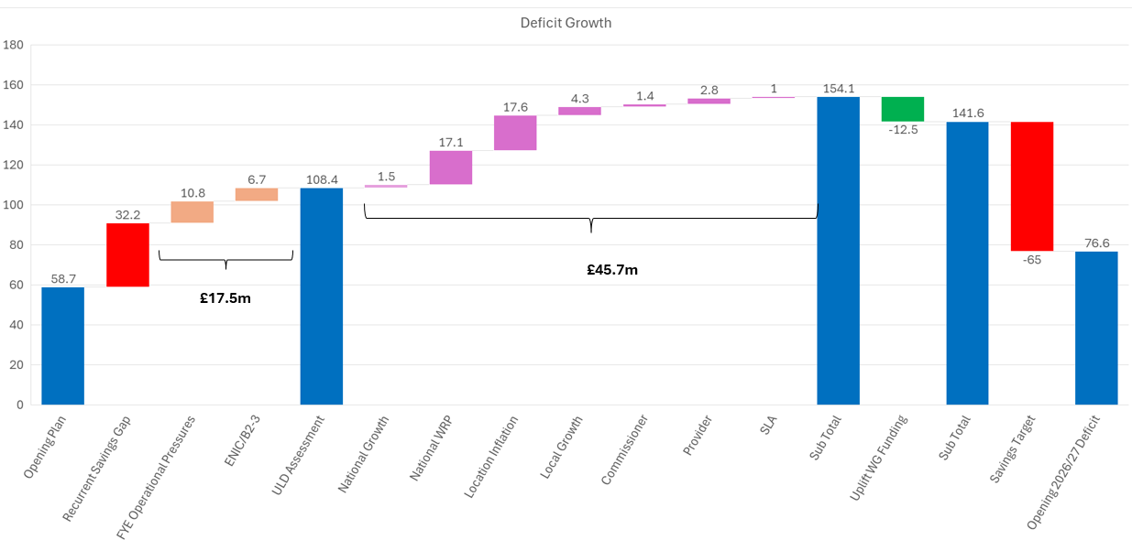
Summary of the Financial Plan for 2026/27
:
29

Slide 33
The full 3-year assessment 2026/27 – 2028/29 is provided in the table below, which shows how the Health Board could reach and exceed its Target Control Total (£17m Deficit) over the 3 Years. However, this will require significant ongoing delivery of recurrent savings, which will be more than £180m over 3 Years. Details on savings and further opportunities are provided in a further section within this report.
A Board development session on 18th May considered the further opportunities and stretch that would be needed against an already high savings plan target for 2026/27. Whilst the Board has the ambition to improve on the £76.6m deficit plan, there is a realism of translating and delivering the improvements needed into savings. Therefore through 2026/27 further work on the plans needs to be undertaken, which will need to align with the Total Opportunities List detailed below.
:
29

Slide 34
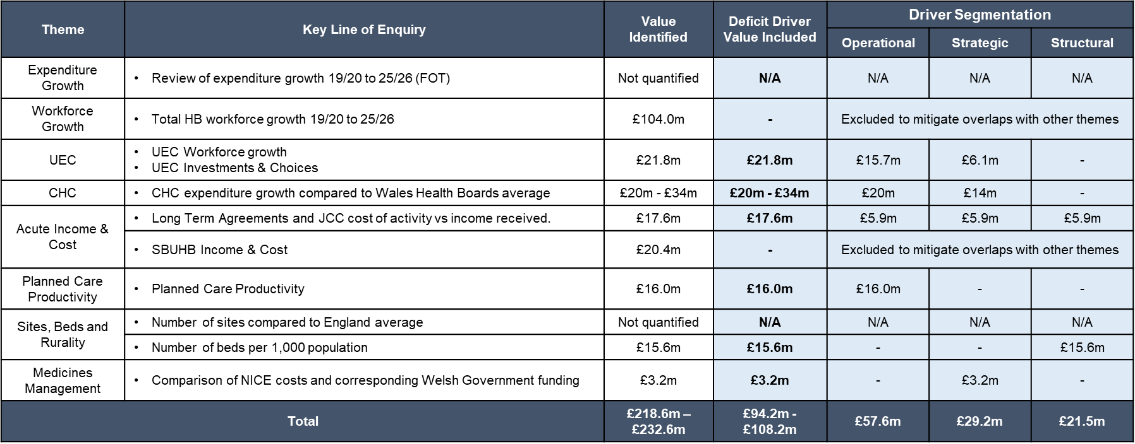
Savings, Opportunities & Grip & Control
The previous section on the Financial Plan has summarised the high-level journey through 2025/26, which resulted in savings that have not been delivered recurrently and non-recurrent opportunities have been used as the mitigating approach to supporting the delivery of 2025/26. The Health Board recognises that this approach alongside the historic non-delivery of recurrent savings has added to the Financial Assessment and that is not acceptable to either Welsh Government or the Board. Going into 2026/27 to achieve financial sustainability the organisation must deliver a sustainable model of care whilst focusing on reducing its expenditure on a recurrent basis, through recurrent savings delivery.
The outputs from Phase 1 of the work by the External Strategic Partner in 2025/26 included a comprehensive assessment of the drivers of the Health Board’s deficit, from 2024/25 into 2025/26, above the non-delivery of savings. This work has provided the organisation with an overview of the areas of focus for delivery of savings at operational, strategic and structural level for the next 3+ years, and the drivers and allocation of these by category is summarised in the table below. These will be critical in the delivery of savings over the next 3 years.
:
29

Slide 35
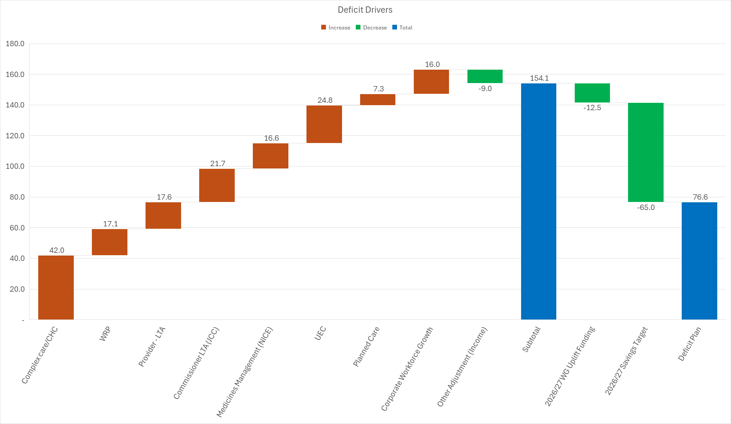
At the start of 2026/27 the Health Board undertook its own assessment of the Drivers of the Deficit. The output of this work is summarised in the chart below, which sets out the value of the drivers on the deficit plan of £76.6m. Full details on this Deficit Driver work are provided within the Appendices that accompany this submission:
:
29

Slide 36
The output from this work builds on and remains consistent with the drivers identified by the Health Boards External Strategic Partner. As such the associated opportunities identified by the Health Boards External Strategic Partner continue to remain relevant and serve to set out why the Health Board has a deficit plan but also present an opportunity to address the financial deficit. This golden thread has been a key focus in the development of the Health Board Total Opportunities List.
Overall, the 2026/27 £65m savings target remains focused on the Health Boards Executive Lead Thematic Programme, supported by the Delivery Unit for which a Director was appointed to and commenced in April 2026. The Delivery Unit will provide:
    Oversight and Coordination: To oversee and coordinate the identification, development, and monitoring of savings plans.
    Programme Support: To support the delivery of transformational, operational improvement and productivity programmes.
    Benefits Realisation: To track and evidence the realisation of benefits arising from these programmes.
    Unified Framework and Methodology: To operate within an agreed accountability framework and apply a single, consistent improvement methodology.
    New Performance and Accountability Framework
    Performance Management: To establish and maintain a performance management infrastructure, including KPIs, tracking, reporting and data analysis to support insight driven decision making.
Key to the delivery of the 2026/27 Plan will be the achievement of the £65m of savings recurrently. The Health Board been working since January 2026 on the development of robust Projects Initiation Documents and Plans on a Page, with the external strategic support assisting in the development of these and setting out the level of maturity, which has been discussed at Board Development sessions throughout February and March. The focus on the transition of these through Q1 from Pipeline to Green will be a core area of the Delivery Unit, with a clear expectation from the Board and WG that by the end of Quarter 1 all £65m must be Green or Amber. The current assessment is that Planned Care/UEC and Workforce: Medical are two of the more challenging areas to move to Green and Amber.
The delivery of £65m will sit alongside and complement the focus on ‘Grip & Control’, which is ensuring the Health Board Makes Every £ Count. Given the scale of the financial challenge, it is essential that the Health Board can demonstrate that the wider governance and control environment mechanisms are robust and sufficient assurance is received on their effectiveness. The Finance Department is leading on Grip & Control, although this is focusing on all areas of the Health Board, including Workforce, Procurement, Board Governance and Roster/Rota compliance and processes.
:
29

Slide 37
In addition to the specific Grip & Control actions, other core areas of focus aligned to the 2026/27 Planning Process have been Budget Planning, Budget Delegation and Budgetary Control, which has concluded with:
  a change to the management of the central deficit which will be removed.
  review of Budget Holders with a focus on those with ability to influence change.
  and the process by which the Health Board engages and supports these individuals, so they are clear on their responsibilities.
As part of these changes for 2026/27 all core Budget Holders will receive a specific Accountability Letter and face to face training. These will all be undertaken in May to ensure they are equipped with the required skills to perform this role. Going into Quarter 1 the Performance & Finance Committee will be updated on those accessing the financial data and the financial performance by each Budget Holder in 2026/27.
Total Opportunities List
Through 2025/26 the Health Board identified many opportunities to reduce run rates and deliver savings, with options presented on 11 September Finance Update, December 2025 Special Board update and other non-recurrent opportunities. For 2026/27, to improve and consolidate the options, one Total Opportunities List has been development, which brings together areas for further consideration by the Board. This will be a ‘Live’ document that will support both in year delivery, recurrent and future year opportunities to allow the Health Board to achieve the Target Control Total of £17.1m over 3 Years. A clear governance process has been developed by which things are added, reviewed and moved to the live trackers or are no longer deemed relevant following a review.
Summary of Total Opportunities List at the end Month 1 is provided in the table below. Of note are the following points:
  There remain further opportunities for 2026/27, which may be required to address the current issues in delivery of Workforce: Medical and Planned Care/UEC.
  There remain significant opportunities to address the underlying deficit over the next 2-3 years. Further work on the timing and delivery expectations of schemes will need to be a focus for the Delivery Unit over the next 6 months but the quantum of opportunities exists.
  Years 2 and 3 of the current 3 Year Plan set a savings requirement of £122m. If achieved, and all other elements of the plan remain stable, this would provide a route to achieve the Target Control Total by the end of 2028/29.
:
29

Slide 38
Risks
Where the Health Board has certainty, the financial impact is reflected within the 3 Year Assessment, but there are other areas that have the potential to impact on the delivery of the plan, but certainty, timing and choices has meant they are reflected only as a risk at this point. The risks in 2026/27 have been categorised as those:
  Risks Aligned to Choices Made in Development Plan – for example Health Board chose a high level of savings delivery and there is the risk that target will not be met in full.
  Risks the HB will need to Manage Above Plan that may have a financial consequence – for example planned changes to contractual workforce changes.
  The risks are set out in detail within the Minimum Data Set and have been reviewed following the initial submission in March 2026.
For 2026/27 based on the current cost, risk, quality, safety and funding assumptions outlined above, the Health Board cannot see a position where a safe and sustainable service model can be contained within a financial plan for 2026/27 that meets the Target Control Total, however the opportunities and choices the Health Board can explore over the next 3 Years, as set out in a single Total Opportunities List could allow this target to be achieved by the end of 2028/29.
:
29

Slide 39
Appendix 1 – Delivery Plans 26/27
34

Slide 40
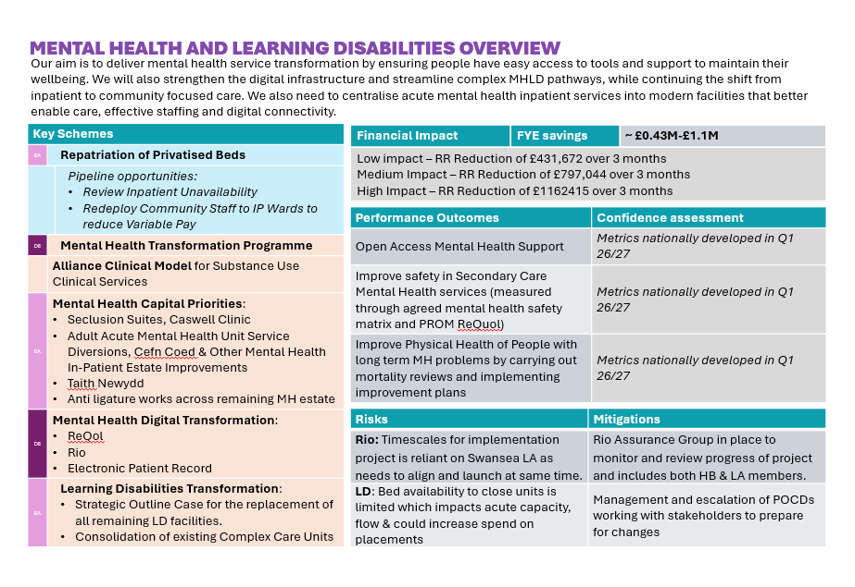
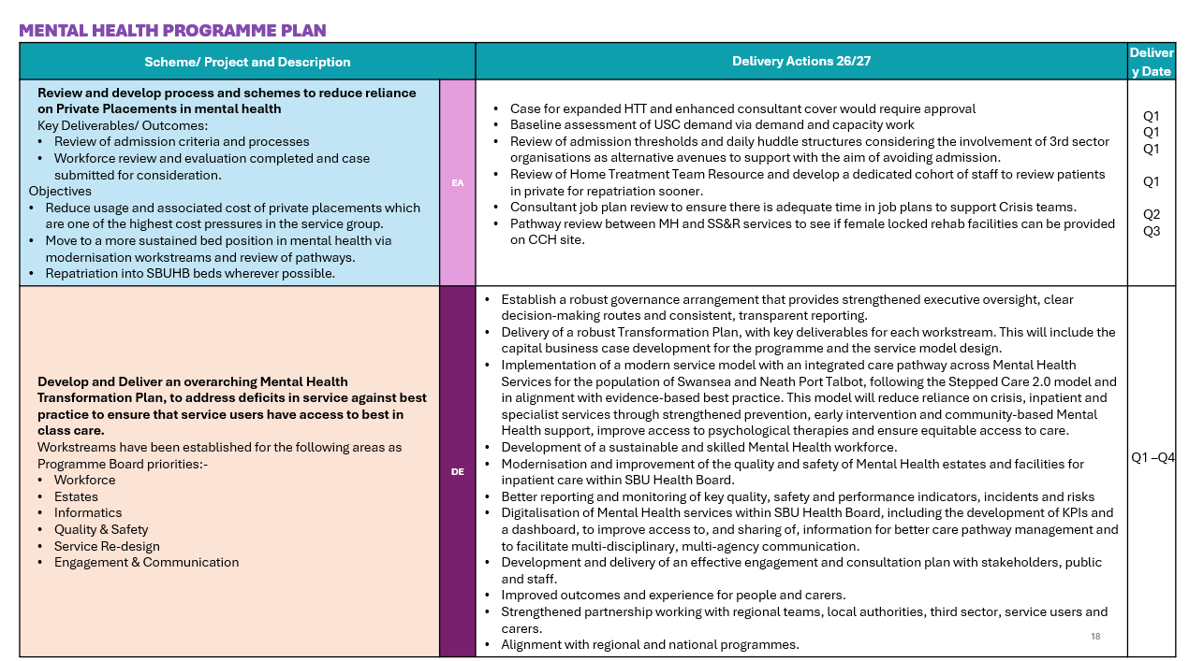
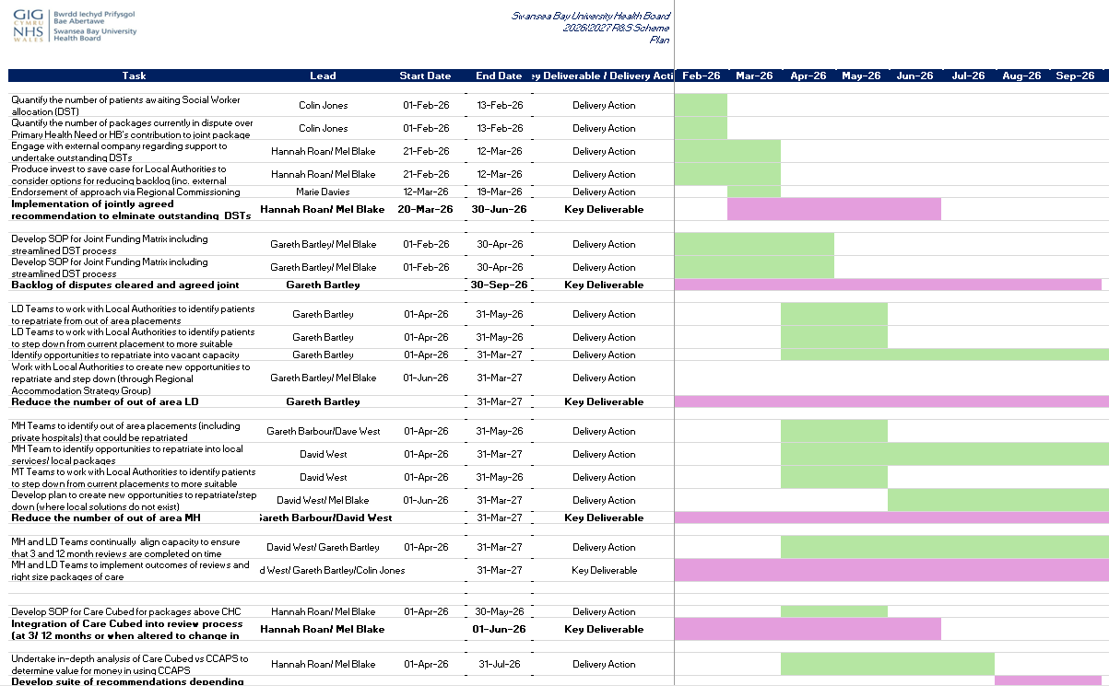
PLANNING APPROACH
This Annual Plan for 2026/27 is set in a three-year context that enables us to develop our strategic direction while focussing on our immediate priorities that will establish the foundations for success. This section is divided into 'system areas'; Primary and Community Care, Urgent and Emergency Care, Planned Care and Cancer, Mental Health, Learning Disabilities, Women’s Health, Babies, Children & Young People and Population Health & Prevention. For each we have set out an overview that describes the key schemes and impacts of including financial implications, performance and achieving national targets (indicated by Confidence Assessments: Red – No Improvement towards target; Amber – Improvement towards target; Green – Meets target)
The 26/27 delivery plans comprise three main components:
1. | Recovery and Sustainability Schemes : These schemes are the priority schemes identified and developed in response to the Drivers of the Deficit work. They are explicitly linked to the delivery of financial savings. | These schemes are in blue
2. | System Enablers and Improvement: These schemes have been developed to support system transformation nationally mandated programmes Cabinet Secretary Enabling Actions and enabling priorities. These schemes will also enable the delivery of the Recovery and Sustainability schemes. | These schemes are in orange
3. | Business as Usual : These actions are in place to ensure we deliver against our business-as-usual commitments. | These schemes are in green
We have also indicated the key risks and dependencies of the schemes.
Where schemes support delivery of WG Enabling Actions or Delivery Expectations these are also indicated: |  | Addresses Delivery Expectations 26/27
 |  | Addresses Enabling Actions 26/27
The delivery plan included in this document provide an overview. They are each supported by a more detailed Plan on a Page which where schemes support recovery and sustainability, are in turn supported by detailed PIDs.

Slide 41
URGENT AND EMERGENCY CARE OVERVIEW
Our programme aligns with National Six Goals policy to deliver a unified system that helps patients understand where and when to access the right support. We will do this through consistent and integrated delivery of the Six Goals for UEC, and strengthened joint planning and accountability with partners, to ensure the best possible outcomes, value and experience for patients and staff.
Key Schemes
CIP_05 | Bed Base Reconfiguration (also including Planned Care Elective Beds)
CIP_31 | Review UPCC Contact First Service
CIP_33 | Review Physio and OT weekend working
TBC | Pipeline opportunities: Review Integrated Discharge Hub service
UEC_B_01 | Community Redesign: Integrated models of Health and Social care aligned to Community by Design Community Nursing Review
UEC_B_02 | Community Based Falls Service/ Pathway
UEC_B_03 | Single Point of Access
UEC_B_04 | SDEC and Acute Front Door Frailty Service
UEC_B_05 | Acute and Community Hospital ‘Back Door’ flow
UEC_B_06 | Communities and Older People Strategy
UEC_B_07 | UEC Digital Transformation – Electronic Patient Record Signal WICIS
UEC_B_08 | UEC Capital Priorities: UEC Pathway & Foul Drainage, Wards A & B, Morriston Helipad Safety works, Morriston Progressing key infrastructure designs, including - Strategic Outline Business Cases for a new ED, Critical Care & Theatres building/Access Road at Morriston
UEC_C_01 | Improving Ambulance handover times – Implementation of Handover 45 and associated enablers
UEC_C_02 | Reducing Clinically Optimised Patients
UEC_C_032 | Maintaining Stroke/ SNAP targets
Finance Impact | FYE £ savings | £18.71M
Performance Outcomes | Confidence assessment
Ensure no ambulance patient handover waits over 45 minutes | 0 by Sept 2027
Ensure no patient spend spends 12 hours or more in all major and minor emergency care facilities from arrival until admission, transfer or discharge. | 10% reduction
Deliver a 12-month reduction trend in both the number of people who are delayed in hospital and the total days delayed for these patients, as measured by the Delayed Pathways of Care dashboard. | Trajectory to achieve 100 DPoC patients waiting by the end of March 2027
Increase in capacity at the weekend of community nursing and specialist palliative care nursing to at least the required levels previously set for 2024/25 and greater where possible | Aligned to Community Services Review
Risks | Mitigations
Limitation of resources impacting on the delivery of actions | Delivery prioritisation to be determined through UEC Programme Board. Director level discussion. Regional workshops planned for March/ April.
Reduced capacity and flow within acute services due to delay in the implementation of the Community Services Review | Senior leadership engaged with LA and RPB, Director level discussions , Deputy COO co-chairs C&OP, Regional workshops planned March/ April.

Slide 42
PLANNED CARE AND CANCER OVERVIEW
Our Planned Care and Cancer programme focuses on rightsizing services, efficiency and productivity to maximise value for money, ensuring quality and improving waiting times
Key Schemes
CIP_06 and 07 | Infrastructure Consolidation via Productivity (Theatres and Outpatients)
CIP_27 | Review Vascular Interventional Radiology Service Development
TBC | Pipeline opportunities: Cap Diagnostic Services to reduce Variable Pay Review of non statutory and waiting list pathway work Low Value Interventions and INNUs
PC_B_01 | Community By Design Programme
PC_B_02 | Theatre Transformation Programme
PC_B_03 | Diagnostics Transformation Programme and Delivery of 8 weeks Diagnostics Waits
PC_B_04 | Outpatients Redesign Programme
PC_B_05 | Cancer Improvement Programme
PC_B_06 | Planned Care Digital Transformation:
 | LIMS and RISP Digital Health Assessments Patient Portal and Hybrid Mail | Ambient Voice Technology Internal Referrals Digital Cellular Pathology
PC_B_07 | Capital Planned Care/Cancer Priorities
 | Radiotherapy expansion 5th Linac/6th Bunker and Replacement Linacs at SWWCC PET CT | Regional Cellular Pathology relocation Urology OR1 Theatres Hybrid Theatre Morriston | Regional Cellular Pathology relocation Urology OR1 Theatres Hybrid Theatre Morriston
PC_C_01 -02 | RTT Delivery Plans and SCP Delivery Plans A key assumption underpinning the revised trajectory for SCP is successful implementation of the Cellular Pathology recovery scheme, including outsourcing arrangements to support backlog reduction and stabilisation of ongoing reporting capacity.
Financial Impact | FYE savings | £2.27m
Performance Outcomes | Confidence assessment
No patients waiting more than 104 weeks for referral to treatment. | Ambition to maintain 0 however recognising current gaps and risks
Number of patients waiting more than 8 weeks for a specified diagnostic | Achieve reduction
Follow up outpatients Backlog (TI)
Achieve the suspected cancer pathway target of 75% through implementing the nationally agreed pathways, while reducing the backlog of patients waiting more than 62 days by end of March 2027. | 76% in Q4
%SCP >60% 3 months consecutive (TI) | Confident to exceed TI Target
Risks | Mitigations
Productivity not achieved in line with plan | Executive oversight and benchmarking
Delays in workforce plan progress and workforce resistance | Early engagement and vacancy control
Activity/performance delivery risk | Phased consolidation, close monitoring

Slide 43
MENTAL HEALTH AND LEARNING DISABILITIES OVERVIEW
Our aim is to deliver mental health service transformation by ensuring people have easy access to tools and support to maintain their wellbeing. We will also strengthen the digital infrastructure and streamline complex MHLD pathways, while continuing the shift from inpatient to community focused care. We also need to centralise acute mental health inpatient services into modern facilities that better enable care, effective staffing and digital connectivity.
Key Schemes
MH_A_01 | Repatriation of Privatised Beds
MH_B_01 | Mental Health Transformation Programme
MH_B_02 | Alliance Clinical Model for Substance Use Clinical Services
MH_B_03 | Mental Health Capital Priorities: Seclusion Suites, Caswell Clinic Adult Acute Mental Health Unit Service Diversions, Cefn Coed & Other Mental Health In-Patient Estate Improvements Taith Newydd Anti ligature works across remaining MH estate
MH_B_04 | Mental Health Digital Transformation: ReQol Rio Electronic Patient Record
LD_B_01 | Learning Disabilities Transformation: Strategic Outline Case for the replacement of all remaining LD facilities. Consolidation of existing Complex Care Units
Financial Impact | FYE savings | ~ £0.43M-£1.1M
Low impact – RR Reduction of £431,672 over 3 months Medium Impact – RR Reduction of £797,044 over 3 months High Impact – RR Reduction of £1162415 over 3 months
Performance Outcomes | Confidence assessment
Open Access Mental Health Support | Metrics nationally developed in Q1 26/27
Improve safety in Secondary Care Mental Health services (measured through agreed mental health safety matrix and PROM ReQol) | Metrics nationally developed in Q1 26/27
Improve Physical Health of People with long term MH problems by carrying out mortality reviews and implementing improvement plans | Metrics nationally developed in Q1 26/27
Risks | Mitigations
Rio: Timescales for implementation project is reliant on Swansea LA as needs to align and launch at same time. | Rio Assurance Group in place to monitor and review progress of project and includes both HB & LA members.
LD: Bed availability to close units is limited which impacts acute capacity, flow & could increase spend on placements | Management and escalation of POCDs working with stakeholders to prepare for changes

Slide 44
CHC AND COMPLEX CARE OVERVIEW
Our CHC/Complex Care Transformation Programme is a strategic overhaul designed to address rising demand for Continuing Healthcare/ complex care, tackle fragmented commissioning across departments in the Health Board, enhance partnership working with our Local Authority colleagues and strengthen operational and financial sustainability. Our aim is to commission quality services and ensuring out residents are getting the right care in the right place.
Key Schemes
CIP_01-04 | Review, right sizing and repatriation of CHC and Complex Care patients Implement a comprehensive review and rightsizing programme to ensure timely, accurate, and economically sustainable care planning across all CHC and Complex Care
TBC | Pipeline opportunities: Hold cases presented to MH and LD Complex Case panel Out of area Repats
CHC_B_01 | Market Management Deliver recurrent CHC savings by actively managing the market to control inflation, negotiation of high-cost packages, and reduce reliance on spot purchasing
CHC_B_02 | Joint working arrangements Standardise joint funding processes and funding splits in collaboration with Local Authority partners
CHC_B_03 | CHC Operating Model Design and implement a future-ready CHC operating model through a structured transformation programme underpinned by a robust digital case management system
CHC_B_04 | CHC Direct Payments implementation plan
Financial Impact | FYE savings | £0.973M
This will also be addressing growth in demand estimated at £7M
Risks | Mitigations
Lack of centralised digital CHC case management system results in inconsistent data management, increased risk of data loss, payment errors, and missed reviews. | Implement RIO and ADAM - digital case management systems
No agreement between SBUHB and Local Authorities to resolve outstanding | Commission an external review to clear the DST backlog and confirm case responsibility; share proposals early with Directors of Social Services to secure agreement.
Local Authorities refuse to accept the outcome of the external reviews | Share plans regularly with Directors of Social Services; take proposal through the Regional Commissioning Group for endorsement; include cases pending LA input to ensure balanced review

Slide 45
BABIES, CHILDREN YOUNG PEOPLE AND WOMEN OVERVIEW
This plan will improve the quality and safety of care for babies, women and families by strengthening maternity and neonatal services, reducing delays, and delivering more consistent, outcomes‑focused pathways
Key Schemes
PCYPWH_B_01 | Perinatal Improvement Plan Expansion of current paediatric radiology offer Establish elective obstetrics theatre to reduce delays to induction of labour Trauma informed and psychology-led perinatal care All-Wales Perinatal single point of access maternity triage service Perinatal staff experience, wellbeing and retention plan (SEWR) and education and training framework
PCYPWH_B_02 | Maternity Digital Transformation Integration of systems into Maternity Digital Record
PCYPWH_B_03 | Women’s Health Plan Embed national women’s health pathways and reporting against agreed national indicators
PCYPWH_B_04 | Regional Gynae Oncology
PCYPWH_B_05 | CYP and Womens Capital Priorities: Morriston Paediatric footprint redesign and relocation Creation of new Obstetric Suite and Theatres, Singleton
PCYPWH_B_06 | CYP Strategic Programme - Defining vision and objectives for Children & Young People’s Care
PCYPWH_B_07 | CYP Regional Programmes with partners WG: ND Service Improvement Programme and HCW2 RPB: No Wrong Door, NPT PSB: NPT Early Years CYP Strategy Swansea PSB: Ealy Years Programme NPT and Swansea LA Education: ALN
PCYPWH_C_01 | NDD waiting times
Performance Outcomes | Confidence assessment
CAMHS TI metrics | Confident to meet the de-escalation criteria
Maternity and Neonates TI criteria | Confident to meet the de-escalation criteria
Further expansion of the Women’s Health Hub model in each health board area by March 2027 (aligned to the Women’s Health Plan | Expansion only if external funding available Mitigation: Should anticipated in‑year funding not materialise services are being consolidated and improved through pathway standardisation, SPOA and self-referral where appropriate, workforce upskilling, digital pathway site, analysis of PNA, primary‑care‑led models that make better use of existing capacity, prioritise prevention, reduce variation and phased implementation
Improving quality of maternity services by reducing peri-natal mortality rates | Unable to predict
Risks | Mitigations
All Wales model for maternity triage detailed workings of model not confirmed. Women’s Health –Guidance on 26/27 Women’s Health Priorities from Women’s Health Network not yet received. CYP - Reduction in ASD or ADHD assessment dependant on Welsh Government funding – currently non recurrent funding received. | Local model in place to ensure single point of access for maternity triage (implemented Feb 26) Anticipated timeline requested from WHN and building flexible planning assumptions

Slide 46
PRIMARY CARE AND COMMUNITY OVERVIEW
We aim to provide equitable, safe and timely access to high‑quality, data‑driven care that supports people to stay well and receive the right help at the right time. We seek to deliver coordinated, person‑centred services that improve outcomes, reduce inequalities, and empower individuals to manage their health effectively.
Key Schemes
CIP_29 | Review National Exercise Referral Scheme (Physio and COPD services)
CIP_30 | Review Primary Care Audiology Services
TBC | Pipeline opportunities: Review Integrated Sexual Health
PCC_B_01 | Digital Transformation in Primary Care
PCC_B_02 | HMP Swansea Improvement Plan
PCC_B_03 | Dental Services Implement Community Dental Service changes to safeguard access, capacity and sustainability by optimising pathways, reconfiguring clinics, reducing waiting times, improving workforce retention and strengthening workforce planning Maintain access and waiting times for Specialist Dentistry services
PCC_B_04 | Primary Care Estates Refresh of Primary and Community Estates strategy and Progress Primary Care Estates proposals: Croserw Ty'r Felin Participate in development of Swansea Wellness Hub
PCC_B_04 | General Medical Services
PCC_B_05 | Community Optometry Services Continued implementation of Optometry Contract Reform and increase capacity and coverage for WGOS Levels 4 & 5
Financial Impact | FYE £ Savings | £0.7M
Performance Outcomes | Confidence assessment
% population receiving NHS dental care | Maintain
% Community Pharmacies providing Pharmacist Independent Prescribing Services | Maintain
Risks | Mitigations
Significant programmes of work requiring capacity building in the community including the transfer of resources/ staff into the community | SBUHB Clusters considered mature in providing excellent footprints for the delivery of services that it would not be prudent to operate in all community. Developing Primary Care and Community at the heart of the CSSP. Key forums i.e. Pan Cluster Planning Group and Community by Design Group identifying opportunities and unlocking barriers to drive forward further service change.
Limitations in Primary Care Estates | Development of strategy is key priority, as well as capital development projects in train to invest in primary care estates.
Access to diagnostics and digital capability in Primary Care | Close alignment with Planned Care/Diagnostics/ Digital programme to take forward opportunities to improve access, communication and digital capability - including systems and intelligence sharing.
Significant contract reform being undertaken simultaneously | Involvement in national working groups/ Close communication with primary care practices and their representative bodies.

Slide 47
POPULATION HEALTH AND PREVENTION OVERVIEW
Our goal is to expand prevention, early intervention and evidence‑based pathways reducing inequities, improving management of long‑term conditions like diabetes, and ensuring more consistent, proactive support across the life course
Key Schemes
PH_B_01 | Healthy Weight/ Obesity Services Building sustainable weight management services to meet present and future need. Building opportunities for healthy weight and wellbeing in pregnancy to improve maternal and neonatal outcomes Prioritisation of GLP-1 provision and Level 3 service wrap around support System‑Wide Collaboration to support healthier behaviours
PH_B_02 | Tobacco Control Building sustainable services to meet present and future need.
PH_B_03 | Diabetes Programme Tackling Diabetes Together programme – reducing inequity in most deprived communities Review resource allocation within the diabetes pathway (primary to secondary care) by adopting the STAR (socio-technical allocation of resource) methodology Prevention of Type 2 diabetes onset and remission - Structured education programmes to enable improved self-management of diabetes Community diabetes model redesign Expand hybrid closed loop approach for Type 1 diabetics
PH_C_01 | Vaccinations and Screening Increase uptake and decrease inequity in Vaccinations and Screening
PH_C_02 | Healthy Child Wales Programme
Financial Impact
Prevention and Early Years funding allocation for WG priorities tobacco control and healthy weight services Diabetes: Expected to deliver within existing resources or re-allocation of resources
Performance Outcomes | Confidence assessment
Increase the proportion of children in Wales who are a healthy weight by halting the rise and contributing to a year-on-year decrease in the levels of overweight and of obesity as measured and reported through the National Child Measurement Programme, focusing on those most disadvantaged. | Annually reporting metric
Reduce inequity in the uptake in the most and least deprived areas in preventing ill-health especially in relation to vaccination, screening and diabetes prevention and care. | Annually reporting metric
Increase in % of patients (aged 12 years and over) with diabetes who received all eight NICE recommended care processes | TBC data for T1 diabetes under review
Risks | Mitigations
Diabetes: Demand for services is expected to increase – additional investment not available PEY funding - confirmed for 26/27 but uncertain from 27/28 | Reviewing allocation of resources across the pathway

Slide 48
WORKFORCE OVERVIEW
Our workforce plan will build a stable, skilled and efficient workforce by strengthening recruitment, improving productivity, and developing flexible, sustainable staffing models that support safe, high‑quality care.
Key Schemes
CIP_26 | Turnover Management Controls
CIP_25 | A&C Fixed Term Contracts
CIP_24 | A&C Reduction In Variable Pay
CIP_21 | Medical Workforce Job Planning Principles (Reducing SPAs)
CIP_19 | Maximise Substantive Medical Capacity (DCC) and Rostering
CIP_20 | Medical Cease Above Vacancy 26-27
CIP_18 | Medical Targeted Recruitment
CIP_22 | Reducing unavailability of Medical workforce
CIP_16 | HCSW reduction in variable pay
CIP_14 | HCSW Vacancy Substantiation
CIP_15 | Nursing & Midwifery Workforce Programme
CIP_17 | Home First – Review Bonymaen Beds/ Nursing workforce
TBC | Pipeline opportunities: AHP Workforce Estates and Facilities Workforce Maximisation of digital ways of working e.g. Microsoft 365, co-pilot
Finance Impact | FYE savings | £28.87M
Significant WTE reduction (substantive and variable staff) equating to 5% across all staff groups aligned to the plans
Performance Outcomes | Confidence assessment
% sickness absence rate
Turnover rate
Agency spend
Risks | Mitigations
Workforce resistance to establishment and model of care changes | Early engagement with leaders, clear safety narrative, phased process and clear governance
Insufficient operational capacity to deliver programme | Provide dedicated programme support, clear SRO ownership, and prioritise high‑impact areas.
Unforeseen surges in demand | Build flexible workforce models for temporary scaling; broaden skill mix and cross‑cover; prioritise stabilisation in high‑demand areas; implement contingency plans to limit premium‑rate staffing
Persistent national workforce shortages | Run targeted recruitment for hard‑to‑fill roles; strengthen links with training bodies; use alternative workforce models (e.g., SAS doctors, ANPs); develop local talent pipelines and grow‑your‑own schemes.

Slide 49
NON-PAY, PROCUREMENT, ESTATES OVERVIEW
This programme will ensure we maximise our non pay expenditure, improving efficiencies in the way we work to deliver the best value possible. This includes the implementation of clinically endorsed and mandated products and taking forward plans for estates rationalisation.
Key Schemes
CIP_08 | Clinical Consumables
CIP_11 | Estates Rationalisation
CIP_09 | Spend control
CIP_10 | Maintenance
TBC | Pipeline Opportunities: Omnicell 3rd Party Contract Rationalisation
Financial Impact | FYE savings | £4.59M
Risks | Mitigations
Significant inflationary pressure in some commodity areas | Work closely with suppliers to manage cost pressures
Clinical resistance to change and quality risk in product switches | Ensure that we continue to engage with stakeholders, with early involvement relating to all procurement decisions. Escalate any non-acceptance of change where a valid procurement process has been completed. Any product change must be in line with robust certification, testing and trials where appropriate
Delays in sales and lease expiry may limit financial savings | Prioritise highest savings areas first and early termination cost impact. Ongoing engagement with NWSSP Land & Property Teams
MEDICINES MANAGEMENT OVERVIEW
CROSS SYSTEM/ OTHER OVERVIEW
Key Schemes
CIP_12 | Drug Switches
CIP_13 | Primary Care medicines
Financial Impact | FYE savings
£3.25M
Key Schemes
CIP_34 | General /Housekeeping
 | Pipeline Opportunities: LTA Commissioning
 | Rehab Framework
Risks | Mitigations
Considerable pharmacy and pharmacy homecare team input is required to drive the biosimilar switch programme | Prioritisation of resource directed to supporting drug switching /financial saving opportunities
All Wales Value and Sustainability Medicines Management indicators are currently under review, and new recommendations are expected to be issued covering 2026/27. | Ongoing engagement with national forums and reflect in programme of work once recommendations available
Financial Impact | FYE savings | £4.689M

Slide 50
Ways of Working and Enabling Delivery

Slide 51

REGIONAL WORKING:
WEST GLAMORGAN REGIONAL PARTNERSHIP
Area Plan 2023-2027: Key Strategic Programmes 2026 /2027
The West Glamorgan Area Plan guides our work, focusing on person‑centred care, prevention, early intervention, and seamless integration across services. Through embedding our Integrated Community Care System (ICCS) outcome‑focused approach, the RPB is supporting and driving whole‑system working across the region. The RPB has re focussed its programmes and governance to addresses the most significant risks we are facing across the region, maximising the impact of available resources. Key Priorities 2026/2027:
Older People Programme | Mental Health Transformation | Regional Commissioning (Complex Care Programme) | Cross-Cutting Foundations
Develop sustainable, integrated community health and care to support people 65+ to live well at home. Enable people to remain as independent as possible at home, reduce reliance on long term packages of care and reduce unscheduled hospital admissions/ length of stay in hospital. This programme will also encompass the work to support people with living with Dementia and their carers. | To develop models of care that address and improve critical challenges, including workforce shortages, unsafe estates, and fragmented pathways. The programme will also incorporate the work of the Emotional Wellbeing and Mental Health Programme, continuing to review and support the development of opportunities that promote emotional wellbeing and mental health within the community. | To design innovative, financially sustainable models of integrated care that enable people with complex needs to live safely, independently, and closer to home. This programme also includes the oversight and delivery of: Capital programme: Section 16, Microenterprise, and Social Enterprise Children and Young Peoples Programme, Wellbeing and Learning Disability Programme Neurodiverse Programme. | Carers Partnership Digital Transformation: Integrated care record (Mosaic/RIO) linking all programmes. Strong partnerships across RPB, APB and Pan Cluster Planning Prevention, wellbeing and self‑care embedded in all activity. Regional Integration Fund Support and Delivery. Communications and Engagement
46

Slide 52
WEST GLAMORGAN REGIONAL PARTNERSHIP
Area Plan 2023-2027: High Level Priorities 2026 /2027
The West Glamorgan Area Plan guides our work, focusing on person‑centred care, prevention, early intervention, and seamless integration across services. This approach is strengthened through our Integrated Community Care System (ICCS), which embeds outcome‑focused, whole‑system working across the region. Together, these commitments align with the vision set out in A Healthier Wales, emphasising long‑term, integrated services that support people to live healthier lives through collaboration and shared responsibility. Key Priorities 2026/2027:
Older People Programme | Mental Health Transformation | Regional Commissioning (Complex Care Programme)
Performance & Finance of S33 Integrated Community Care System: Strengthening financial transparency, performance oversight, live data, and governance to improve flow, reablement, and outcomes. Pathways of Care Delays Action Plan: Monitoring delays weekly, escalating high risk cases, improving collaboration, ensuring timely access and recovery across pathways. Discharge to Recover & Assess Processes: Standardising discharge criteria, mapping pathways, expanding specialist pathways, strengthening reablement capacity and implementing Trusted Assessor models to enable faster, safer discharge. Unscheduled Care Board: Six Goals for Urgent & Emergency Care - Integrating urgent care pathways, improving ED/AMU/OPAU flow, implementing community falls response and strengthening the Single Point of Access. Dementia Memory Assessment Service (MAS) Review: Reviewing and redesigning Memory Assessment Services to ensure consistent pathways, equitable access, improved data, co produced SOPs and Dementia Connector involvement post diagnosis. | Develop a whole‑system mental health model for adults: creating a single, shared, integrated model across partners to reduce duplication, improve coherence and ensure a person‑centred, seamless pathway. Integrate NHS and third‑sector psychological therapies: mapping provision, reducing duplication and waiting times, and designing an integrated model to address the 3,000‑person waiting list in LPMSS. Redesign Community Mental Health Teams: developing a shared model for CMHTs and outpatient services aligned to national strategy to improve access, flow and continuity of care. Redesign the inpatient model and strengthen alternatives to admission: shifting to assessment/treatment models, updating policies and improving crisis pathways to enhance safety, flow and discharge. Implement estates, digital and workforce improvements critical to safety and system functioning: including ligature risk work, digital infrastructure upgrades, and workforce transformation. | Strengthen regional joint working for people with complex needs: delivering a consistent region wide approach to joint commissioning, pooled budgets and dispute resolution to reduce delays, improve transparency and provide timely coordinated support. Regional commissioning accommodation strategy for people with complex needs: defining service models, understanding capacity and demand, shaping the market to deliver high quality sustainable accommodation closer to home and reduce out of area placements. Regional Market Stability Report: creating a shared evidence-based view of care market using data to forecast demand, inform capital decisions and support a sustainable provider market. Strategic capital programme: delivering a coordinated long term capital plan aligned to population need and service pressures. Establish integrated region wide pathways for children and young people with complex needs: progressing No Wrong Door and multi agency working to create single access points, coordinated decision making and joined up emotional mental health and care support.
47

Slide 53

PARTNERSHIP WORKING WITH OUR PUBLIC SERVICE BOARDS
We continue to build strong collaboration and robust partnership arrangements across the Health Board working with the Swansea and Neath Port Talbot Public Services Boards (PSBs).
Key Priorities 2026/27:
Refresh and strengthen the Wellbeing priorities and objectives for both PSBs for the final two years of the current plans and ensure regional priorities remain aligned with the Well‑being of Future Generations (Wales) Act (WBFGA).
Improve outcomes for children and young people including the Healthy Child Wales Pathway, speech and language and flying start.
Climate adaptation - complete the Climate Change Risk Assessments – outcomes to be used to inform Well-being Plan 2027
Regional Whole Systems Approach – Improving Access to Food through the development of a regional Public Food Procurement Strategy
Progress the Dyfatty, Clear, Hold, Build Project in Swansea, through the Community Safety Partnerships arrangements. Initial focus on stakeholder mapping and communications and engagement plan
Undertake regionally aligned Well-being Assessments - to be published May 2027.
48

Slide 54









PRIMARY CARE CLUSTERS
The Health Board works as part of the Pan Cluster Planning Group in both planning and delivering local health care services. Working as a cluster ensures care is better co-ordinated to promote the wellbeing of individuals and communities. Clusters aim to:
  Have safe & effective systems to direct people to the right person at the first point of contact
  Provide care closer to or at home, by the right person, when it’s most needed
  Deliver high quality integrated primary, community health, social care & third sector services
  Understand & respond to the health and care needs of their population
  Plan to prevent ill health and promote well-being
Pan Cluster Plan: Priority Areas for 2026/27 Summary:
Following the success of the 2025/26 Plan Cluster Plan we continue to take a more refined approach, considering the predominating areas of activity put forward within the Local Cluster Collaboratives which align with the Health Board and Regional Partnership Board priorities. This year there are three agreed Pan Cluster Priority areas.
Older people and frailty
Implementation of a falls action plan
Delivery of cluster-based services for frailty
Seek opportunities for wider rollout of community clinicians
Women’s health
Develop primary care role in virtual health hub
Develop local primary care action plan exploring potential for further primary care provision
Emotional mental health and well being
Further embedding and rollout of community-based psychology
Deliver integrated mental health model in conjunction with stepped care 2.0 mental health model
In addition to these three key priority areas the Pan Cluster Planning Group is also exploring additional priority areas of cardiovascular health, cancer prevention, substance misuse and dementia. Work will proceed in scoping these early in 26/27. Individual plans for each of the 8 clusters are included within the Pan Cluster Plan and contain a wide range of actions at cluster level to improve health and well-being and deliver excellent services close to home.
Afan
City
Bay
Upper Valleys
Cwmtawe
Llwchwr
Penderi
Neath
49

Slide 55
SOUTH-WEST WALES REGIONAL JOINT COMMITTEE (RJC)
Swansea Bay and Hywel Dda UHB are committed to a stronger more sustainable West Wales Regional Health Economy and we continue to expand and develop our regional portfolio through the RJC.
As a formal Board Committee RJC provides joint leadership for the regional planning, commissioning, and delivery of services for both University Health Boards taking into account the service challenges, financial challenges and population health needs of both organisations and the work previously undertaken through ARCH. The Regional Drive and Delivery Group coordinates joint action. The RJC Programme Management Office coordinates and supports subgroups, planning, delivers programmes, and governance.
SWW Regional Joint Committee
Regional Drive and Delivery Group
The RJC’s Sub-Structure (above) aligns with the 5 agreed objectives within the RJC’s Terms of Reference:
Regional Health Economy Subgroup (OB1)
Regional Clinical Services Planning Subgroup (OB2+5)
Regional Workforce and OD Subgroup (OB3)
Regional Data & Digital Subgroup (OB3)
Regional Finance and Contracting Subgroup (OB3)
Regional Research, Innovation & Excellence Subgroup (OB4)
  Objective 1 (OB1): Regional Health Economy Group – we will drive forward projects that have been identified as priorities for joint working to deliver the Ministerial Priorities. It will consider and prioritise the regional projects included within the RJC’s work programme, approve Business Cases pre–sovereign Boards ratification, and identify and agree any further projects for inclusion in the RJC programme to deliver significant in-year progress and pace in delivery within the regional health and care system.
  Objective 2 (OB2): Clinical Services Group – we will oversee the review of baseline activity undertaken, based on both Health Boards’ Clinical Services Plans, focusing on cost efficiencies, quality, and service fragility. Current regional service planning work programme Sub-Groups include Orthopaedics, Ophthalmology, Pathology, Diagnostics, and Cancer.
  Objective 3 (OB3): Corporate Functions – we will deliver various themes and enablers that will enable collaboration and achievement of improved service efficiencies and value to deliver the required regional aspirations, including Digital & Data; Workforce & Organisational Development; and Finance & Contracting. These themes and enablers will underpin the RJC to deliver the strategic infrastructure rather than being identified as direct reporting groups.
  Objective 4 (OB4): Regional Research and Innovation Delivery and Oversight Group – opportunities for research, innovation, excellence, and training opportunities will be driven through this group, working with the three Universities within the region and through partnerships with Universities outside the region where there is benefit to the population. This group will also oversee the required preparatory work to enable the regional health economy to become a designated World Health Organisation sub regional health network, for the RJC to benefit from the shared learning opportunities this will bring.
  Objective 5 (OB5): Regional Capital Programme – this will and oversee a joint approach to the prioritisation of capital programmes as part of the clinical service plans underpinning the regional health economy approach.
50

Slide 56
SOUTH-WEST WALES REGIONAL JOINT COMMITTEE (RJC)
Regional Delivery Assumptions
Welsh Government approve funding to produce the Cell Path full business case.
Programme Manager appointed for Cancer Centre Modernisation.
Operational Resource availability to support planning and delivery (all programmes).
Finance, contracting and SLA / LTA models can be agreed – dependency Finance and Contracting Subgroup
Orthopaedics
Products/Actions/ Deliverables | Quarter |  | Impact
Includes hip, knee, foot and ankle, shoulder and elbow, and hand and wrist—with a current focus on reducing long waits for hip and knee arthroplasty.
Regional Hand Network within the Day Surgery Unit at Prince Philip Hospital | Q1 | Outcome for patients, improved efficiency, regional collaboration | Outcome for patients, improved efficiency, regional collaboration
Iterative development of the regional Arthroplasty Model complete | Q2 | Outcome for patients, improved efficiency, regional collaboration | Outcome for patients, improved efficiency, regional collaboration
Integrated regional service, standardised pathways, protocols | Q4 | Outcome for patients, improved efficiency, regional collaboration | Outcome for patients, improved efficiency, regional collaboration
South-West Wales Cancer Centre Programme
Products/Actions/ Deliverables | Quarter | Impact
Regional radiotherapy and oncology outpatient services modernisation.
Radiotherapy
Complete scoping/detailed options appraisal for satellite centre | Q1 | Potential (expansion of Linacs to 7 total in line with D&C) within HDd area or Singleton site.
Approved business case for additional (5th) Linac | Q2 | Utilises the current empty bunker at Singleton and includes options to coincide increased 2nd CTSIM capacity as required.
Approved business case for additional / spare (6th) Bunker in Singleton | Q4 | Maintains capacity for next RT Linac replacement due 2028.
Oncology Outpatients
Support HDd in Implementing a sustainable oncology outpatients model for Bronglais | Q2 | Improved alignment between outpatient capacity and forecast oncology demand
Complete demand modelling and baseline establishment. | Q2 | Reduced outpatient waits and improved compliance with cancer pathway standards – improved patient experience
Capacity optimisation and pathway redesign – Agreed regional standards for follow-up, clinic models and workforce utilisation Implementation of priority capacity improvements and pathway changes | Q3 Q4 | Improved utilisation of specialist workforce
51

Slide 57
SOUTH-WEST WALES REGIONAL JOINT COMMITTEE (RJC)
Eye Care
Products/Actions/ Deliverables | Quarter |  | Impact
The South-West Wales Regional Eye Care Programme is focusing on Glaucoma, Cataracts, Medical Retina, and Paediatric Ophthalmology.
Create a regional dashboard | Q1 | Q1 | Performance and service intel to inform planning and decision making
Recruitment two regional consultant posts in Vitreoretinal and Medical Retina | Q2 | Q2 | Increase capacity and capability
Implement a regional Vitreoretinal service | Q3 | Q3 | Improve access to services, patient outcomes, reduced waiting list
Develop and implement a series of targeted improvements | Q4 | Q4 | Improve access to services, patient outcomes, reduced waiting list
Diagnostics – Cellular Pathology
Products/Actions/ Deliverables | Quarter |  | Impact
Develop the case for a new single site and transition to a SWW Regional Pathology ODN
Submit FBC for a SWW Cellar Pathology Laboratory Site to WG | Q4 | Q4 | Sets out the case for future investment, Ability to progress to acquisition and implementation of new regional laboratory
Development of full-service specification for Regional Cellular Pathology Operational Delivery Network | Q4 | Q4 | Operational functionality of the new regional cellular Pathology team outlined, including function specialist roles like Financial, Workforce and Digital. Underwritten by transitional MoU.
Acquisition and development of new Laboratory Site (subject to FBC approval). | Q4 | Q4 | Enabling developments to commence
Development of Regional Cellular Pathology ODN MoU | Q4 | Q4 | Outlines the formal agreement for the permanent Regional Cellular Pathology Operational Delivery Network
Vascular & Interventional Radiology
Products/Actions/ Deliverables | Quarter | Impact
To develop and deliver a quality vascular service, across the whole pathway and in line with the agreed service specification for the South West Wales Vascular Network, on behalf of its constituent health boards, Swansea Bay UHB (host organisation), Hywel Dda UHB, Cwm Taf Morgannwg UHB (Bridgend area only) and Powys THB (south Powys only).
Strengthen VIR workforce to support Hybrid and DSA suite – building on the VIR business case submitted to SBUHB BCAG June 2025 | Q1 | Improved length of stay, intervening earlier, better outcomes
Submit South West Wales Amputation Reduction Strategy (SWWARS) business case – address Vascular Nurse Specialist (VNS) and Podiatry resourcing | Q1 | Better outcomes, earlier intervention, reduced amputations, lower waiting list
Agreement and sign off SWW Vascular Network (VN) MOU and Service Spec | Q1 | Formally establish SWWVN
Hybrid Theatre delivery – Expected completion September 2026 | Q3 | Increased planned care capacity, better outcomes
52

Slide 58
SOUTH-WEST WALES REGIONAL JOINT COMMITTEE (RJC)
Subgroup
Ambitions
Projects / Actions
Regional Health Economy Subgroup (OB1)
Improve home energy efficiency to reduce health interventions and support independent living.
Regionally aligned plans amplify activity to drive sustainable systems change and improve health equity.
Better understand the impact of regional deprivation on current and future healthcare demand.
Whole Systems Approach addresses healthy weight through regional action on food access and procurement.
Long-term Regional Health Economy Strategic Approach
Warm & Healthy Homes
Regional Whole Systems Approach (WSA) to Healthy Weight
Health Intelligence
Regional Health Economy Subgroup (OB1)
Improve home energy efficiency to reduce health interventions and support independent living.
Regionally aligned plans amplify activity to drive sustainable systems change and improve health equity.
Better understand the impact of regional deprivation on current and future healthcare demand.
Whole Systems Approach addresses healthy weight through regional action on food access and procurement
Regional Clinical Services Planning Subgroup (OB2+5)
Deliver a more resilient, safer, and equitable services.
Improve equity of access across the region through a single regional waiting list and standardised pathways.
Reduce waiting times and backlogs by increasing activity and optimising end-to-end diagnostic capacity.
Improve patient outcomes through timely diagnostics, targeted pathways and clearer follow-up.
Strengthen workforce capacity and sustainability.
Standardise protocols to reduce unwarranted variation.
Orthopaedics
Eye Care
Pathology
Diagnostics
SWW Cancer Centre
Stroke
UEC
Vascular
Regional Clinical Services Planning Subgroup (OB2+5)
Deliver a more resilient, safer, and equitable services.
Improve equity of access across the region through a single regional waiting list and standardised pathways.
Reduce waiting times and backlogs by increasing activity and optimising end-to-end diagnostic capacity.
Improve patient outcomes through timely diagnostics, targeted pathways and clearer follow-up.
Strengthen workforce capacity and sustainability
Standardise protocols to reduce unwarranted variation.
Regional Workforce and OD Subgroup (OB3)
Joint workforce plans for vulnerable services
Joint recruitment plans for hard to fill roles/ areas of high variable pay.
A joint workforce impact assessment on the impact of the “left shift”, and on the future impact of digital and Artificial Intelligence.
Virtual collaborative learning, interspersed with physical connectivity Scope Opportunities for Joint Working (x15).
Regional Workforce and OD Subgroup (OB3)
Improved workforce retention, recruitment, succession planning, resilience, and apprenticeships.
Shared expertise enables cross-skilling, knowledge transfer, and faster development of specialist capabilities.
Widen access to programmes (leadership, coaching, mentoring), improving quality while reducing duplication.
Reduced reliance on bank and agency.
Better workforce alignment ot population health needs where workforce planning and decisions better match changing demographics, and demand across pathways.
Joint workforce plans for vulnerable services
Joint recruitment plans for hard to fill roles/ areas of high variable pay
A joint workforce impact assessment on the impact of the “left shift”, and on the future impact of digital and Artificial Intelligence
Virtual collaborative learning, interspersed with physical connectivity Scope Opportunities for Joint Working (x15)
Improved workforce retention, recruitment, succession planning, resilience, and apprenticeships
Shared expertise enables cross-skilling, knowledge transfer, and faster development of specialist capabilities
Widen access to programmes (leadership, coaching, mentoring), improving quality while reducing duplication
Reduced reliance on bank and agency
Better workforce alignment ot population health needs where workforce planning and decisions better match changing demographics, and demand across pathways.
Regional Data & Digital Subgroup (OB3)
Regional Data & Digital Subgroup (OB3)
Dedicated digital innovation fund –public investment, innovation grants, partnerships, and efficiency gains.
Align around Purpose – Harness digital innovation to empower healthier lives, connect communities, and deliver proactive, equitable care, anytime, anywhere.
Assess the Landscape – HDdUHB and SBUHB with local authority, academic and industry partners.
Design for Leverage – A codesigned system architecture that strengthens feedback loops between domains, linking. population health data to service design, finance, and workforce planning.
Deliver and Demonstrate – predictive analytics in community care, shared data between health & social care.
Develop Agile and Phased Delivery plans and actions to progress priorities.
Regional digital capability and deficit review
Co-design a system architecture.
Launch a small number of high-leverage pilots at domain interfaces.
Establish a Regional Digital Transformation Board.
Dedicated digital innovation fund –public investment, innovation grants, partnerships, and efficiency gains.
Align around Purpose – Harness digital innovation to empower healthier lives, connect communities, and deliver proactive, equitable care, anytime, anywhere
Assess the Landscape – HDdUHB and SBUHB with local authority, academic and industry partners.
Design for Leverage – A codesigned system architecture that strengthens feedback loops between domains, linking population health data to service design, finance, and workforce planning.
Deliver and Demonstrate – predictive analytics in community care, shared data between health & social care
Regional Finance and Contracting Subgroup (OB3)
Regional Value through – Building the analytical foundation; Designing from community up, not institution down; Strengthening governance for delivery; Bringing value-based procurement into the regional model.
Improved capabilities and capacity for resource allocation and value-led activities.
Improve clinical outcomes and reallocate resource.
Set the basis for future contracting models and decisions.
Collaborative working across finance functions – learning, finance literacy, training, career development, frameworks/controls, and process alignment.
Contracting redesign.
Set up STAR programme.
Value-based Procurement (Swansea University proposal) delivery.
Diabetes STAR project.
Develop Collaborative working programme.
Regional Research, Innovation & Excellence Subgroup (OB4)
Support the health and social agenda in South-West Wales.
Regional Themes – Mental Health & Learning Disabilities, Population Health & Prevention, Chronic Disease Management, Social Care & Integrated Research, Cancer & Genomics, Rural Health & Digital Innovation.
Regional opportunities for innovation, including with academic partners to be more attractive to trial sponsors.
Optimising use of facilities at local hospital sites and universities and potential to create centres of excellence.
Early adoption site for digital health solutions, regional testbed for AI in imaging, telemedicine, and population health analytics.
Strategic Plan for Regional Model.
Establish Research, Innovation and Excellence Subgroup.
Finalise South-Wales Regional Research and Innovation Partnership Model and Functions.
53

Slide 59
TERTIARY SERVICES PARTNERSHIP
We are the second largest provider of specialised healthcare services in Wales, serving patients from across the country. Although, we predominantly function as a provider of specialised services for the populations of West Wales and South Powys. Providing specialised and tertiary services to the South Wales population presents well-recognised sustainability challenges. These services depend on a critical mass of patients to maintain clinical expertise, support workforce development, and deliver consistently high-quality outcomes. However, the relatively small catchment size in South Wales makes achieving this scale inherently difficult.
Our partnership with Cardiff and Vale University Health Board (CVUHB), the largest provider of specialised services in Wales, is critical to addressing these challenges. Achieving the critical mass required for safe, effective care often demands regional or cross-border collaboration to prevent fragmentation and maintain quality. Building on this principle, we are working together to identify opportunities for joint delivery and closer collaboration to improve sustainability.
These challenges are compounded by the absence of a formal commissioning framework for many specialised services that have not yet been delegated to the NWJCC. Such services cannot be delivered or planned in isolation. It is essential to identify and manage interdependencies and co-dependencies across the wider system, both within Swansea Bay UHB and with partner organisations, to maintain resilience and ensure continuity of care. A collaborative, system-wide approach is critical to safeguarding these services, preventing fragmentation, and delivering equitable, high-quality outcomes for patients across Wales.
In response to these challenges, the Regional Specialised Services Provider Planning Partnership (RSSPPP) has agreed a focused work programme to deliver urgent and coordinated action, recognising that several specialised services face significant sustainability risks.
The tertiary services partnership predominantly functions as a provider of specialised services for the populations of South Wales (South Wales, West Wales, and South Powys).
Swansea Bay UHB
Cardiff & Vale UHB
54
54

Slide 60
NWJCC IMTP - Specialised Services Outlook for 2026-27
The specialised commissioning outlook for 26–27 presents significant operational, workforce and financial uncertainty for providers of specialised services. The NHS Wales JCC IMTP indicates that commissioning for 26–27 will be based on 25–26 baseline activity, with no growth, removal of under‑performance from baselines, and no additional funding for activity above plan, other than the application of the 1.11% inflationary uplift. Providers of specialised services are also required to deliver a 2% efficiency and productivity target to support the overall financial position.
The NWJCC IMTP assumes a level of service stability that is not financially supported, increasing the likelihood of deterioration within pathways already identified as fragile. For services with high fixed staffing, estate and infrastructure costs, reductions in commissioned activity do not produce equivalent reductions in expenditure. As a result, there is a real risk that some specialised pathways could become financially or clinically unsustainable if commissioned solely at current activity levels.
In the absence of a national strategy for specialised services (commissioning and delivery), NHS Wales providers of specialised services must plan against a backdrop of significant uncertainty and variable assumptions. This reinforces the importance of establishing a coherent and unified provider position in collaboration with Cardiff and Vale UHB through the Regional and Specialised Services Provider Planning Partnership, to ensure that commissioners receive consistent, evidence‑based advice and a consistent collective view of service sustainability, system risk and minimum safe operating thresholds. Against this backdrop, SBUHB will use a structured approach to managing the risks within specialised service. The Tertiary Service Oversight Group will conduct a comprehensive review of all services where risks have not been addressed within the NWJCC IMTP, with the aim of determining where internal mitigations are possible.
Where internal mitigations cannot be secured, SBUHB will need to consider a range of options to protect patient safety and organisational sustainability. These options may include seeking alternative commissioning arrangements with Health Boards outside the NWJCC, disinvesting from services that cannot be sustained safely, decommissioning services and securing provision from alternative providers, or capping activity at funded levels. Early engagement will take place with the NWJCC and referring Health Boards to assess the implications of these options and to agree the appropriate way forward.
Informing Commissioning of Specialised Services
Another critical function of the partnership is to provide a unified and consistent specialised provider response to the NWJCC. This role is essential in ensuring clarity, alignment, and credibility when engaging with commissioners on complex service issues. By coordinating our input, we avoid duplication, overlap, and conflicting messages that could undermine planning and decision-making.
A single, coherent provider perspective enables us to articulate shared priorities, highlight common sustainability challenges, and present evidence-based solutions that reflect the needs of patients across South Wales, West Wales and South Powys. Consistency in our approach also ensures that commissioner requests are addressed in a timely, structured, and collaborative manner, reducing inefficiencies and promoting transparency. However, it is also important to recognise that over half of the specialised services delivered by SBUHB fall outside the NWJCC commissioning framework, presenting substantial challenges for strategic coherence and effective system-wide planning.
55

Slide 61
Hepato-Pancreato-Biliary Surgery
Progress on the HPB Programme was paused in June 2025 due to the inability to secure commissioning support for establishing the Shared Delivery Network (SDN) for Severe Acute Pancreatitis (SAP), despite strong clinical engagement and widespread recognition of the need for change. District General Hospitals (DGHs) currently provide the majority of initial care for patients presenting with acute pancreatitis, including early assessment, stabilization, and delivery of supportive interventions. Their role is critical in ensuring timely management before escalation to specialist services when required. However, the absence of consistent pathways and access to specialist input can lead to variation in practice and potential delays in care. This setback underscored the urgency of tackling longstanding service fragilities, fragmented commissioning arrangements, and the absence of an integrated HPB centre for South Wales.
Lessons learned during this period have shaped a refreshed approach, ensuring the programme moves forward with clearer governance, stronger alignment, and renewed commitment from all partners. It has now been agreed that the NWJCC will lead the HPB Programme, supported by the tertiary services team. This collaboration will provide strategic oversight and commissioning leadership, aligning service redesign with national priorities and securing equitable, sustainable access to specialist care for patients across South Wales. The immediate priority is to establish the SDN for SAP, creating clear pathways for timely specialist input and consistent standards of care.
Severe Acute Pancreatitis
SAP is a complex, unpredictable, and potentially life-threatening condition, affecting up to 25% of patients presenting with acute pancreatitis. It is frequently associated with multi-organ dysfunction and failure, prolonged hospitalisation, and significant critical care bed occupancy. In Wales, approximately 100 SAP patients are admitted to critical care units across South Wales annually, with a crude mortality rate of around 30%. A larger cohort of SAP patients is likely managed at ward level, though this number remains unquantified.
Gynaecological Oncology Surgery
The Gynaecological Oncology (GO) workstream is focused on tackling urgent service fragility and rising demand across South Wales. In 2025, both Cardiff and Vale UHB and Swansea Bay UHB faced severe workforce shortages, fragmented pathways, and inconsistent access to care, with SBUHB particularly reliant on temporary arrangements to maintain delivery. These challenges, highlighted in the Senedd’s Unheard: Women’s Journey Through Gynaecological Cancer report, reinforced the need for a sustainable, regionally coordinated model. The RSSPPP is now progressing plans to establish a South Wales Gynae-Oncology Operational Delivery Network (ODN) by spring/summer 2026. This will introduce a centralised MDT to ensure consistent decision-making, strengthen training pathways, and improve equity of access. Longer term, the model will centralise high-complexity surgery within a dedicated centre while enabling lower-complexity procedures to be delivered locally, ensuring women across South Wales receive timely, safe, and effective care.
Cardiac Surgery
Cardiac Surgery services in South Wales face significant sustainability challenges, with Cardiff and Vale UHB and Swansea Bay UHB operating two of the smallest units in the UK. In 2025, long waiting times, particularly in South East Wales, highlighted the fragility of the current dual-site model. Despite strong clinical outcomes, workforce pressures and fragmented pathways have reinforced the need for a more resilient, regionally coordinated approach. The RSSPPP is progressing work to establish a South Wales Cardiac Surgery ODN in 2026. This will provide a platform for shared leadership, consistent protocols, and integrated patient flow management, laying the foundation for future service integration.
56

Slide 62
RESEARCH AND DEVELOPMENT
A thriving culture of Research, Development and Innovation is a critical factor in the provision of safe, high-quality care and aligns with health boards' Duty of Quality to continually improve the quality of the services they provide. This through a continued two-pronged approach
  Development of a Regional RD&I strategy with Hywel Dda UHB under the Joint Committee arrangements, recognising the strengths both organisations bring, along with opportunities for wider academic partnerships with Swansea University and University of Trinity St David.
  Further development of its RD&I Strategy for SBUHB pending the establishment of the regional RD&I plan with Hywel Dda UHB
The Research, Development and Innovation Strategy has been developed to align to the pillars of the NHS Research & Development Framework, supported by a current self-assessment. Underneath each pillar are associated objectives which are supported by a delivery plan, including:
  Visibility of research, development and innovation at board level​
  Effective Use of research delivery staff​
  On-time trial initiation, higher research income and full access for all eligible patients
  Introduce research, development and innovation showcase events
Introduce modern facilities and equipment
Introduce pump-prime schemes​
Strengthen access to oncology clinical trials across south-west Wales as the cancer centre for the region, as well as working collaboratively with Velindre Cancer Centre to enhance the offer across Wales
New governance arrangements are an opportunity to define a clear process through which research impact on service development and clinical pathway design is tracked and disseminated, including identification and use of linked research accounts to support innovative service change.
Workforce
Strategy, Finance and Governance
Patient and Public Involvement
Partnership Working
Joint peer review committee to share learning
Partnership with Swansea Uni:
Co-signed sponsorship model
Joint Clinical Research Facility
Partnership board to be established
Alignment to organisation strategy and clinical service plan
Patient reps on health board sponsored studies
Time recognition in job planning guidance
Research leads in non-medic roles
Commercial income and grant funding to support further activity and service change
Monthly surgeries and clinical advisory group with local trials units
Communications Plan
Shadowing links with medical and nursing schools
Regional work with Hywel Dda
Board oversight through DDRI Committee, support by R&D Governance group
Increase number of clinicians with Good Clinical Practice Training
Plans for patient involvement group with Swansea Trials Unit
Annual showcase events
57

Slide 63
GENOMICS AND ADVANCED THERAPIES
We ensure training in genomics for all relevant staff within the Health Board to either enable the identification and referral of eligible patients to specialist teams for genomic intervention, or implement genomic testing into clinical practice, in areas aligned with clinical priorities:
(Please note – it is recognised that there are clinicians in the areas below who already use genomic referrals in their patient pathways, but the aim is to ensure equitable access for patients regardless of their health board and the professional/s managing their care)
Diabetes: Medical consultants and clinical nurse specialists in diabetes to be trained to identify individuals who may have monogenic diabetes and arrange genomic testing for them
Around 1% of individuals with diabetes have monogenic diabetes. They require different treatment and have different risks for complications, so identification of these individuals results in better outcomes. It also enables family members to be identifies at risk before they develop symptoms, allowing early intervention, resulting in better outcomes and reduced costs for the health board.
Cardiac: Specialist nurses or healthcare professionals in lipid clinics should be educated to offer familial hypercholesterolaemia genomic testing to eligible patients. Diagnosis of familial hypercholesterolaemia allows patients to be monitored and treated to keep their cholesterol level normal and avoid cardiac disease
Cardiologists and clinical nurse specialists to identify individuals who may have an inherited cardiac condition where screening or intervention may be advantageous. Identification of those with inherited cardiac conditions enables appropriate targeting of screening and intervention to those at risk of significant cardiac symptoms, and removal of those not at risk from unnecessary screening.
Pharmacogenomics (relevant to several clinical areas): Preparatory planning is needed in collaboration with the clinical networks and local clinical teams within each organisation to enable future implementation of commissioned pharmacogenomic testing safely and effectively into current clinical pathway using a phased approach. The need for Point of Care (POCT) testing approaches may also need to be explored including the commissioning aspects depending on the clinical indication.
Infectious disease: Infection Prevention and Control staff, medical consultants and other relevant healthcare staff to be trained to utilise pathogen genomic data to support the detection and response to outbreaks. This training should also cover the use of genomics to support retrospective analysis to help prevent outbreaks in future.
Cancer: Medical doctors, surgeons and other appropriate clinical professionals caring for patients with cancer (including haematological malignancies) to be trained to offer tumour or germline genomic testing to eligible patients, to inform diagnosis and treatment decisions, in line with national recommendations for precision medicine. Genomic test results on tumours or germline DNA can inform cancer treatment and identify those eligible to take part in clinical trials, both resulting in better outcomes for patients.
Mental health: Psychiatrists and psychiatric nurses to identify patients who would benefit from referral to the psychiatric genomics service for further investigation. Some psychiatric conditions and neurodevelopmental disorders are associated with underlying genomic variants, and individuals with these genomic variants have worse health and social outcomes, and reduced life expectancy. Identifying possible genetic causes enables people to have a clearer understanding of their condition, creates an opportunity to discuss and assess potential risk, provides enhanced physical testing and monitoring where appropriate and signposting to specialised support.
Women’s health: Specialists in women’s cancer should be trained to offer genomic testing as appropriate (see Cancer above)
Healthcare professionals who look after women during pregnancy should be trained to include genomics as appropriate in the clinical pathways.
58

Slide 64






2026/27 Priorities:
STRATEGIC COMMISSIONING
We have a responsibility to commission services that meet the needs of our population by assessing demand, planning and prioritising provision, as well as purchasing and monitoring services to ensure they deliver the best possible health outcomes for our communities. Below are the essential elements of our approach.
Strengthen contract and performance management to ensure value, outcomes and accountability.
Use robust NHS contracts with clear activity, quality, performance, financial, dispute‑resolution and data requirements.
Align SBUHB service changes with commissioning intentions across partners and providers.
Implement an Alliance commissioning model for Drug and Alcohol Services with the Western Bay APB.
Progress the CHC and Complex Care Transformation Programme, focusing on joint funding, operating models, market management and package rightsizing.
Work with the West Glamorgan Regional Partnership to enhance community services and support care closer to home.
Ensure regional models have commissioning arrangements enabling pooled lists, shared capacity and cross‑boundary resource use.
Deliver National Planned Care Programmes via independent‑sector capacity, active demand management, faster access for long waiters and implementation of new national policies.
Our Aim: Commission high-quality, evidence-based, sustainable services that improve outcomes, reduce inequalities and deliver value
Partnership & System Leadership
  Strengthen collaboration with Health Boards through clearer expectations, improved engagement and shared accountability. Contribute to national and region commissioning groups to strengthen All-Wales commissioning expertise. Work in partnership with other statutory organisations, independent providers and the voluntary sector to maximise the needs of the population.
Quality & Outcomes
  Clear service specifications detailing activity, quality indicators and outcomes expectations . Align pathways with national quality frameworks to improve consistency and equity.
Equity & Access
  Reduce variation in waiting times and access thresholds across commissioned pathways. Target priority areas where inequity or poor outcomes re most evident.
Assurance & Performance
  Strengthened monitoring and reporting mechanisms for commissioned services.
Transformation & Innovation
  Support adoption of innovative models, digital solutions and new treatment options identified through horizon scanning. Ensure commissioned pathways contribute to NHS Wales sustainability and decarbonisation goals.
Value & Financial Control
  Maximise value though efficiency, reduced unwarranted variation and pathway redesign. Commission within clear affordability enveloped with demonstrable return on investment.
59

Slide 65
DIGITAL
Leadership, Strategy and Planning for Digital
Value, Productivity & Financial Alignment
The 10‑Year Digital Strategic Plan (2025–2035) sets out the Health Board’s digital vision and key deliverables, aligned with national, regional and local strategies including the Digital Strategy for Wales, A Healthier Wales, and the Population Health Strategy. Developed in line with the NHS Wales Planning Framework and IMTP, and published in 2025, it will support with the National Architecture Programme to ensure local priorities fit within a nationally consistent, interoperable framework.
Digital services work closely with clinical teams to ensure user‑centred design and clinical requirements are met. Clinicians shape ongoing development of Signal through change requests and User Groups, and are directly involved in Rio implementation planning, testing and configuration throughout 26/27 to support safe, effective, coordinated care. Clinical input also informs the Cancer MDT AI pilot, identifying required data items for regional AI‑supported MDT efficiencies in colorectal and lung cancer. All digital transformational programmes of work are underpinned by a benefits framework which captures qualitative and quantitive benefits for all programmes.
We are also phasing out unsupported/legacy systems on a planned basis:
  Indigo Review: Decommission legacy diagnostic‑results viewing system.
  Symphony (WEDS): MIU system contract ends 31/05/26 (extendable to Sept 2026). Mitigation plan is to revert to WPAS as the interim solution. WEDS database will be copied and hosted locally, with a web‑based viewer for ED episodes and images.
  SharePoint: 2016: End of life.
  LIMS 1.0: To be discontinued and decommissioned in line with transition to LIMS 2.0.
  Sexual Health System: To be decommissioned.
  TOMS: Theatres Operation Management System to be decommissioned.
We use digital to drive productivity and efficiencies including through the expedited implementation of hybrid mail, facilitated by the Swansea Bay Patient Portal; releasing cash efficiencies. And exploiting AI capability to reduce the administrative burden by automating documentation and eliminating routine manual tasks. We also converge solutions regionally where appropriate to standardise pathways and share information:
  3Ps Waiting Well – Phase 2: Identifying complex patients early and optimising them using the Waiting Well website and a Digital Waiting Well Health Assessment sent automatically at referral.
  PROMs Digital System: Expanding PROMs/PREMs collection via Promptly : remaining Waiting Well priority services, Frailty Screening (Stages 1 & 5), additional hand surgery specialties, and other prioritised services. Embedding national Promptly work, including NHS App integration, NDR submission, PSOM compliance, and PROMs visualisation in WCP.
  PES & F&F: All surveys are bilingual: SMS sent in preferred language (via WPAS), with easy‑read, BSL, IVR and Welsh options; additional languages due Feb 2026. Font size is adjustable. Demographic/equality data is shared across services to support improvement, and reports are shared with LGBT+ leads for learning.
60

Slide 66

DIGITAL
Governance, Clinical Safety, Cyber & IG
Swansea Bay UHB has strong governance for digital clinical safety, cyber security and information governance through groups such as IGCAG and the DDRI Committee, providing clear assurance and escalation to the Board. This framework will be strengthened by enhancing the Digital Leadership Group and establishing a Clinical Design Authority (subject to resources) to ensure robust, clinically led oversight of digital risk across the organisation.
Cyber Security and Information Governance mandatory training compliance is 86% for 2025/26, with reporting and assurance processes in place to maintain target compliance in 2026/27. This is supported by monthly cyber‑awareness video training, which will continue. The cyber risk remains at 20 (L4, C5). The Health Board has strengthened cyber defences through modern security tools, enhanced monitoring, and replacing legacy systems where feasible, alongside building a cyber‑aware culture through mandatory training, regular updates and phishing simulations. Despite improvements, evolving cyber threats remain a significant external risk. Cyber risk is routinely monitored, updated and reported to the DDRI Committee.
SBUHB has a documented Cyber Incident Response Plan which details the process for handling cyber incidents. This aligns with the Digital Disaster Recovery Plan to handle cyber attacks as well as operational incidents. SBUHB also reports all cyber incidents that meet the minimal reportable threshold to the Cyber Resilience Unit (CRU) in DHCW. Regular assessments and gap analyses are carried out with the CRU. All Digital investment incorporates cyber security by design.
The SBU Architecture Community of Practice, established in 2025/26, will be formalised under the new 26/27 governance structure to ensure alignment with national standards. System mapping into Ardoq has been completed and will be maintained on an ongoing basis.
Data for Equity, Language & Experience
Digital services should be citizen‑centred, inclusive and bilingual and we work to ensure that we record/track/share language and communication needs in line with Mwy na geiriau and Accessible Communication Standards. We will continue the adoption of the patient portal which supports capturing patients' language preference whilst also providing timely access to clinical and administrative correspondence. We will also embed real‑time feedback in planning and improvement through:
  PROMs: All validated bilingual digital health assessments continue to be used.
  Promptly: All patient communications are bilingual.
  PROMs BI: Dashboards will be developed for each onboarded service to provide situational awareness.
  Waiting Well Website: Fully bilingual and continuously updated.
  PES & F&F: 540 feedback areas captured, with real‑time alerts via Civica Action Manager. Weekly and monthly reports go to service leads to identify improvements, and changes are added to the website.
61

Slide 67
DIGITAL
National Systems & Once‑for‑Wales Delivery
We work with Digital Health & Care Wales (DHCW) to plan local implementation of national programmes and systems, adhering to the Once‑for‑Wales approach. In 2026/27 this will include:
  Digital Maternity: After the Q4 25/26 go‑live, continue with phase 2 go live, enabling service transformation across maternity services e.g. 24hr advice line.
  Open ERS: Implement the Ophthalmology e‑referral solution; reducing time to patient triage and consultation.
  LIMS 2.0: Continue rollout of Blood Science and Blood Transfusion modules into 2026/27.
  EPMA; intensive care: reducing medicine errors, improving safety by providing real time (and remote) access to information.
  Rio (MH & Community EPR): Implement for paper‑based MH teams in Q4 25/26, then migrate 750 WCCIS users by Oct 2026. Develop an Integrated Care Record (AICP) with The Access Group to link health and social care data; improving decision making and reducing delay to patient care.
  WICIS: Agree Phase 1 scope and plan.
  CHC: support national procurement.
  NHS Wales App: empowering patients to self manage whilst supporting waiting list pressures.
We will also extend the deployment of the Healthy IO wound app to support care closer to home and in conjunction with the performance and improvement team, work with patients to provide tailored home monitoring devices to track vital signs and symptoms. For 26/27, Electronic Test Requesting (ETR) will focus on significantly increasing radiology and pathology requesting adoption across clinical services. This will facilitate more speedy receipt and processing of samples and / or images, reduce duplication in requested tests, whilst also providing better quality of information via the referral process adhering to IR(ME)R guidance.
Standards & Data Quality
SBUHB implements core digital standards in Welsh Health Circulars and complies with DHCW Data Standards Change Notices (DCSNs).Each standard is reviewed for impact and changes to local/ third party systems built into roadmaps where required or requested via change requests to DHCW for national systems.
We have embedded the operational standards for the NHS number as approved by Welsh Information Standards Board (WISB)regarding how the NHS number MUST, SHOULD and MAY be used in all information systems which contribute to patient care across the health community. This is reviewed on an ongoing basis as systems are developed/ procured.
A revised 3‑year plan and trajectories have been submitted to the DDRI Committee for assurance. The AI Auto‑coder will be deployed mid‑February 2026, starting with Neurology, with further specialties identified for exploration, including cataracts and short‑stay electives.
62

Slide 68



DIGITAL
AI, Automation & Responsible Innovation
We will adopt national advice, guidance and standards for AI issued by the Office for AI and the AI Advisory Group for Health & Social Care, ensuring that all AI technologies are implemented safely, ethically and transparently. We will develop local guidance and policies aligned to the national framework to support the safe and innovative use of AI that delivers meaningful benefits for our staff and the population we serve. To achieve this, we recognise the need for dedicated investment in robust governance, clinical safety assurance and the expertise required to evaluate, monitor and deploy AI responsibly across the organisation. A draft governance plan has been developed awaiting board approval.
SBUHB will prioritise proven AI and automation technologies that improve care, reduce waits and streamline administration, focusing on HTW/NICE‑endorsed or validated in‑house/academic solutions. Building on the All‑Wales MS365 agreement, CoPilot use will be expanded to release staff time and improve efficiency. Pilots of Ambient Voice Technology in Outpatients—and a proposed 25/26 pilot in Community Learning Disabilities (subject to a successful bid)—will support faster clinic‑letter turnaround and reduce documentation burden. AI‑assisted clinical coding work will also expand to increase throughput and address recruitment challenges, while further AI opportunities that benefit patients, staff and organisational performance will continue to be identified.
We will exploit digital innovation opportunities across treatment, prevention, testing, monitoring and patient‑level devices where evidence shows benefit through continuing to expedite the implementation of the NHS Wales App with integration to the local patient portal. Enhanced features will include functionality targeted to support delivery of the Women’s Health plan and the virtual hub model deployed across Swansea Bay and we will extend the deployment of the Healthy IO wound app to support care closer to home.
63

Slide 69
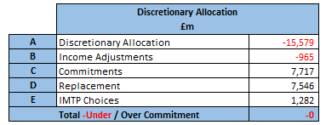
CAPITAL & ESTATES
The Health Board’s Estates Strategy approved by the Board in 2023, identified the need for significant capital investment to support the Clinical Services Plan and a programme of backlog maintenance works identified by Condition Surveys. Following feedback on the NHS All Wales Capital Prioritisation in 2025, a new Estates Task Force under the leadership of our vice-chair was established to provide the board with strategic oversight of the implementation of the Estates Strategy. Whilst the main elements of the prioritised 10-year plan remain intact, the Task Force recommended an urgent focus on five schemes which will require urgent short-term capital funding support from WG (in addition to long term strategic support) to ensure Operational Resilience and Safety & Clinical Suitability
  Helipad Safety Works, Morriston
  Adult Acute Mental Health Unit Service Diversions, Cefn Coed & Other Mental Health In-Patient Estate Improvements
  UEC Pathway & Foul Drainage, Wards A & B, Morriston
  Regional Cellular Pathology relocation
  New Obstetrics Theatre & Birthing Suite, Singleton
We will be investing over £1m from our discretionary capital programme in 2026-27 on designs for some key infrastructure projects. These will include production of Strategic Outline Business Cases for a new ED, Critical Care & Theatres building/Access Road at Morriston Hospital and reprovision of Mental Health In-Patient Wards.
Capital funding of £31.993m is already in place for 26/27 through the All-Wales Capital Programme. This includes £8.134m from the national TEF (Targeted Estates Fund) to invest in our highest estates risks across six areas a)Decarbonisation, b)Decontaminations, c)Fire, d)Infrastructure, e)Infection Prevention Control (IPC) and f)Mental health. An increased discretionary capital programme to £15.579m will focus on maintaining the highest risks in our equipment & digital asset base, along with maintenance of our building estate alongside a contribution to the TEF programme and the PFI contractual commitments at NPT hospital.
We are investing £1.9m from our discretionary capital funding to undertake urgent short-term improvement works at the Adult Acute Mental Health wards in Tawe Clinic, Cefn Coed. Additional proposals are being progressed which will require WG support to stabilise the Mental Health estates across the Health Board in anticipation of an accelerated programme to move to a longer-term solution.
Morriston Hospital - Hybrid Planning Application was submitted in July 25 for the development of the current site plus additional 55 acres (Outline Planning) and the provision of a new access route to J46 of the M4 (Full Planning). The development of alternative funding models, estates utilisation, disposals and decarbonisation from part of the 10-year programme. During 26-27 we will focus on developing our plans to provide modern estate to support our Community and Mental Health services in Swansea City Centre, looking at partnership models with Swansea Council and their development partners.
64

Slide 70
ESTATES RISK AREAS
Effective risk management is fundamental to the successful operation of the Health Board estate. The top estates risks form part of a forward investment programme and mitigation plans. Investment required will require a mixture of funding sources, including discretionary capital, TEF and major business cases through the AWCP.
Risks | Description | Current Mitigations | Future Mitigations
N+1 both acute sites | Good practice requires back up for generators that support services on essential power. | Funding secured to install temporary generator hook-ups which provide temporary mitigation at Morriston. | Design consultants commissioned to review the feasibility of HV generation on site & local LV generation. Discussions are underway with National Grid on a HV solution.
Services on essential supply | There is limited information on whether key services at Morriston are on essential supply | Working through any issues highlighted from the black start tests undertaken at Morriston Hospital in Q3. | Commissioned a design consultant to confirm electrical capacity &feasibility to move the Pathology Plantroom electrical supply on to an essential supply.
Uninterrupted power supply (UPS). | Battery back-up that kicks in as soon as there is a power ‘spike’ or failure that could adversely affect the operation of key kit | We have compiled an asset list of existing UPS' which is under review. Funding secured to replace the highest priority UPS during 2025-26. | Additional capital to establish a rolling replacement programme.
Obsolete electrical infrastructure, CWB, Singleton | Original infrastructure in Central Ward Block is over 60 years old. | A design consultant has been commissioned to review options to replace the ageing electrical infrastructure. | Design fee funding being allocated from 2026-27 discretionary capital programme.
Replacement of core plant and equipment | Air handling units (AHUs) for Theatres and Critical Care, which are crucial for air changes and therefore infection prevention and control (IPC). | Rolling programme commenced to replace obsolete AHUs at Morriston and Singleton using TEF funding. Current intelligence of priorities is established from NWSSP-SES reports and Ventilation Authorised Persons (AP) site knowledge. | Rolling investment programme via TEF and discretionary capital is being established.
65

Slide 71
ESTATES RISK AREAS
Risks | Description | Current Mitigations | Future Mitigations
Foul drainage, both sites | Leaks are increasingly common. One of the main causes is age & state of the network. Cast iron drainage system in original nucleus building at Morriston is rotting away and unplanned closures are impacting clinical services. | Reactive ad-hoc repairs as required. Concluding the review of high-level cost options to replace the failing foul drainage at Morriston Hospital | Likely to be a significant investment but with good cause due to the risk to business continuity to the site. Singleton Hospital failures are to be reviewed to prepare any potential short or long-term resolutions.
Electrical load, Sub Stations, Morriston | The demand on 5 of the 6 Sub Stations (SS) is excess of available capacity and not complaint with current HTM standards (Health Technical Memorandums). | Site wide electrical infrastructure study commissioned to review electrical constraints, single points of failure and technical risks. Report expected in May - to determine the next priority based on business continuity, risk and backlog maintenance. | High level cost options are being reviewed to determine the most cost-effective approach to upgrade SS3, providing greater electrical capacity & compliance where practicable with current standards.
Main steam supply from Boiler house, Morriston | The main conduit from the Boiler house to Plant Room 5 is leaking and at risk of future collapse. | Works have commenced to replace the existing corroding main steam line for the site | Additional funding required to provide a second line for resilience.
Resilience | There are two incoming HV supplies to both Morriston and Singleton Hospitals. Singleton only has one dedicated incomer HV. | Discussions have commenced with National Grid (NG) to review the existing site loads & future plans for the Health Board sites. | Estimated max demand electrical loads for the Morriston masterplan under review to determine future capacity requirements.
66

Slide 72
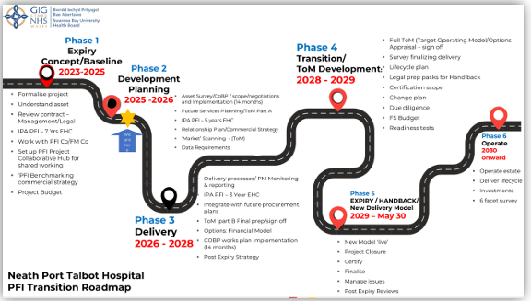
CAPITAL & ESTATES – PFI (PRIVATE FINANCE INITIATIVE)
HANDBACK, NEATH PORT TALBOT HOSPITAL
Neath Port Talbot Hospital, opened in 2002 under a PFI funding model, will reach the end of its 30‑year contract in May 2030. The handback is a major and complex process, and we are following UK Government best‑practice guidance led by NISTA, which advises organisations to begin expiry planning 4–7 years before contract end. We completed the initial 7‑year Expiry Health Check in October 2023.
To support this work, we have invested in an internal PFI Expiry and Contract Management Team, bringing together key professional disciplines and external advisers. The programme is overseen by a PFI Exit Project Board reporting to the Performance and Finance Committee. The PFI expiry process aims to ensure a smooth transition, minimise risks, and shape the future operating model for the hospital. Our vision is a safe, compliant estate at Condition B standard that delivers value for money and aligns with NHS Wales and SBUHB strategic priorities. A 4‑year Expiry Health Check has recently been completed with NISTA, with findings expected in April 2026.
Key Steps for Successful Exit |  | Current Status
Governance & Resourcing | Treat expiry as a major project, not business as usual. Assign a Senior Responsible Officer and ensure adequate financial and human resource. | Expiry Team established. We expect to invest between £0.750m & £1m annually over the next 4 years following the NISTA recommendations. SRO and PFI Expiry Board established.
Asset Condition & Surveys | Understand lifecycle obligations and conduct condition surveys well before expiry to avoid disputes. | Agreement reached with Project Co on commencing asset condition surveys in April 2026. Final reports expected in March 2027.
Legal & Commercial Strategy | Review contract terms for hand back requirements, TUPE for FM staff, and settlement agreements. Early engagement with legal advisors is critical | Initial legal advice received. PFI legal preparation workshop completed. Non-Executive PFI Expiry Project overview sessions in Q1 2026-27.
Financial Implications | Loss of ring-fenced funding post-expiry means liabilities for maintenance and operation revert to Health Board. Budget planning and options appraisal are essential | Financial baseline data collated to support future services financial modelling. Advisors appointed to provide specialist VAT advice. Initial work commenced using IPA Financial Distress Guidance on future financial investigation.
67

Slide 73
CAPITAL & ESTATES – ENABLING ACTIONS
Estates Rationalisation
Following the submission of our Estates Rationalisation of Non-Clinical Space in 2023, we have continued to review our clinical and non-clinical property needs. Following the disposal of two sites in 2024-25, a land transfer was completed in Morriston during 2025-26. The Health Board recognises the need to consolidate our services on fewer sites as part of our path to recovery and sustainability. Once the development of the Clinical Services Strategic Plan (CSSP) is completed in 2026-27, work will commence to look at options and sequencing. We will continue to develop our disposal strategy for the remaining surplus areas of the Cefn Coed site, although this work will need to be linked to the provision of funding support to stabilise the Mental Health estates across the Health Board in anticipation of an accelerated programme to move to a longer-term solution.
Alternative Financing Models
The newly formed Estates Task Force group will consider the commercial opportunities to deliver capital solutions using public and private partnerships to assist in developing the estate strategy and the implications. We are continuing to benefit from funding from the Swansea Bay City Deal, with the hybrid planning application for the development of the Morriston Hospital site and new Access Route from the M4 submitted in July 2025.
Working with the West Glamorgan Regional Partnership Board, we secured design funding to produce business cases for a new Learning Disabilities home in Dan-y-Deri (HCF) and a replacement for Cymmer Health Centre (IRCF). The completed Dan-y-Deri business case was presented to the WG HCF panel in January 2026, which we are awaiting an announcement on. Design work has completed on the replacement for Cymmer Health Centre and we expect to proceed to tender in Q1 2026-27.
Some of our schemes also have revenue funded options which require IFRS 16 technical capital support under Right of Use (ROU) Capital. We will be continuing to work with our Energy Service partner and the WG Energy Services and Health & Social Care Finance teams to explore how we can access alternative financing to de-steam and decarbonise the estate. These schemes are more about reducing carbon rather that also cost reduction. We have proposals for major capital developments linked to the provision of a new ED, Critical Care and Theatres development at Morriston and reprovision of Mental Health In-Patient Wards. As the availability of national capital funding may be constrained, we are keen to explore other funding opportunities, including the MIM (Mutual Investment Model).
68

Slide 74
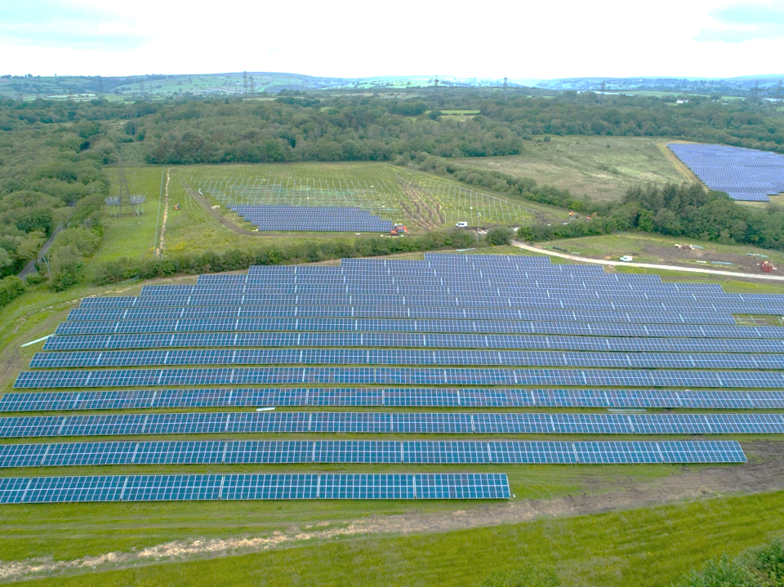


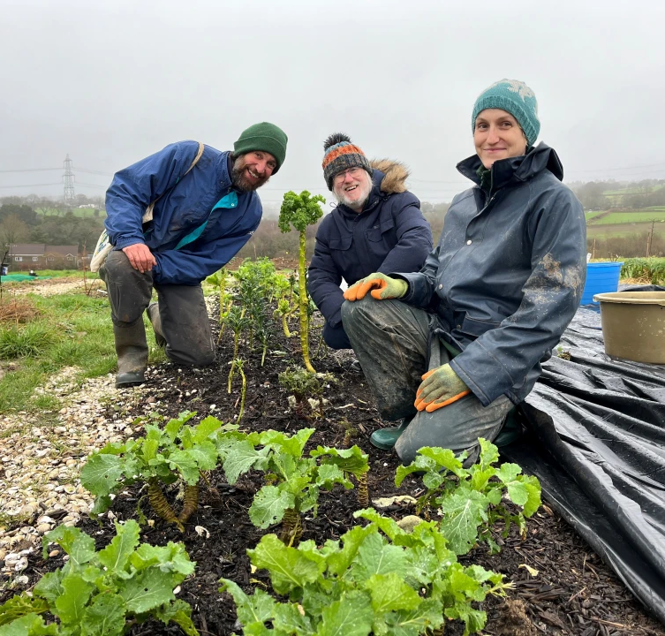
SUSTAINABILITY /CLIMATE ACTION PLAN
The Health Board’s Climate Action Plan (2026-30) addresses the requirements of the NHS Wales Decarbonisation Strategic Delivery Plan (SDP), A Healthier Wales, Just Transition, and findings of the Health Board Climate Change Risk and Opportunity Assessment.
Climate Action Plan 2026-2030
Aim: To build the Health Board’s climate resilience across the four roles: ‘Healthcare provider’, ‘Employer’, ‘Major local organisation’, and ‘Productive Partner’ , as defined in ‘A Healthier Swansea Bay - Swansea Bay University Health Board’.
This will be achieved through reducing emissions and developing a proactive approach to climate adaptation. The objectives of the plan include:
Build adaptive capacity and understanding of low-carbon models of care
Build the evidence and data base around climate risk and opportunity gaps
Build emissions reduction and climate adaptation into existing processes
Continue reducing emissions from our buildings and estate
Enhance sustainable procurement and waste reduction
Improve biodiversity on sites to benefit staff, patients, and local environments
Work collaboratively across NHS Wales and wider system to ensure that adaptations between organisations are not conflicting
Governance: Managed through Health Board performance reviews & assurance to the Sustainable Swansea Bay Steering Group.
Welsh Government Reporting: Bi-annual SDP, annual Public Sector Emissions reporting, qualitative climate adaptation reporting (frequency to be decided), annual Socio-Economic Duty, annual Well-Being of Future Generations report
Morriston Hospital’s Solar Farm
Biophilic Wales Project
Cae Felin Community Supported Agriculture Project
69

Slide 75





SUSTAINABILITY /CLIMATE ACTION PLAN
 | Our Culture & Ways of Working: Understanding and empowering staff to be sustainable & engaging with wider NHS and public sector to: Develop a workforce strategy to implement ‘Delivering sustainable healthcare’ position statement (Dec-26) Understand potential increased demand from climate change (Mar-27) Provide resources to staff to reduce emissions & adapt (ongoing) Build understanding of climate impacts to support business continuity (Mar-27) Continue collaboration between NHS Wales orgs and PSBs to build adaptive capacity (ongoing)
 | Our Buildings & Estate: Using Estate more efficiently, building greener, and improving biodiversity of our sites, including: Monitor and address excess building energy consumption (Sep-26) Embed energy management in day-to-day operations (Sep-26) Review climate risk before leasing/purchasing properties (Apr-26) Utilise green infrastructure and how new developments can support nature (Sep-26)
 | Our Travel: Moving more sustainably, from active travel, to public transport, and supporting electric vehicles, including: Develop agreed approach to Electric Vehicle Charging infrastructure across the Health Board and with partners (Mar-27) Develop user friendly guides for staff and public on low-carbon / sustainable travel options to Health Board sites (Sep-26)
 | Our Procurement: Buying less, buying sustainably, and building supply chain resilience with the system, including: An organisational environmental sustainability representative on all procurement exercises >£6million (Sep-26) Suppliers to include ‘climate resilience’ in their business continuity plans (Apr-26) This will build on the sustainability KPI work through the 3rd sector recommissioning.
 | Our Approach to Healthcare: Working with the system for sustainable healthcare, trialling and implementing projects in SBU, and sharing our learning, including: Participating in the ‘Your Medicines, Your Health’ programme (Sep-26) Continue to digitalise clinical records (annual review) Baseline of nature-based interventions by the Health Board (Mar-27) Build temperature monitoring into server room management (May-26) Develop review of what low carbon and climate adapted healthcare looks like (Aug-26) Develop Health Board waste management plan, building in circularity principles and targeting actions higher in the waste hierarchy (Sep-26)
70

Slide 76
WELSH LANGUAGE
We have a commitment to developing a confident workforce where all staff can greet, reassure and engage safely with Welsh speaking patients and service users.
2027 - 2028
System Priorities | Areas to Deliver (2026/27) | Outputs
Maintain compliance with Welsh language standards | Develop our work with schools and colleges to nurture our future workforce. | Increased awareness among pupils and students about career pathways and benefits of language skills to the NHS workforce. Professional development benefits to existing workforce by acting as mentors.
 | Work collaboratively with Swansea University and Coleg Cymraeg, identifying opportunities for students to access mentoring support.
 | Improved integration of process for handling complaints and concerns in Welsh, or about our use of Welsh into corporate feedback, concerns and complaints procedures.
 | Improved evaluation and sharing of patient feedback so that departments across our organisation can draw on valuable information relating to the experiences of people trying to access our services in Welsh. | A more robust process leading to better quality data identifying gaps in delivery of Welsh language services. Increased confidence amongst Welsh speaking patients that concerns are valued and addressed.
Develop our Welsh language work in line with ‘More Than Just Words’ Strategy | Develop a group of stakeholders to steer our work related to the Welsh language.
 | Continued commitment to leadership visibility on language and organisation-wide commitment to Welsh language services, embedding expectations into governance and performance frameworks.
 | Continue our roll out of language skills training at ‘Courtesy’ level for all staff with skills currently recorded at level 0. | Creation of a healthy culture of belonging for the Welsh language at SBUHB leading to a transformation of outcomes for Welsh-speaking patients and service users.
 | Maintain progression towards full implementation of the active offer in all clinical settings. Increasing recognition of language as a key component of person-centred care.
Introduce the CEFR for languages as the common framework for measuring staff language skills
Introduce a specific apprenticeship for school leavers with level 4/5 Welsh skills.
Embed Active Offer audits into Quality Assurance Frameworks
Completion of language skills gaps by roles, service areas and key priority areas under the More Than Just Words framework.
Workforce recruitment and retention plans to take skills gaps into account – with targeted interventions included in IMTPs
71

Slide 77
GOVERNANCE AND DELIVERY
We are strengthening our operating model to ensure clear accountability, consistent improvement, and a culture grounded in our values. The Organised for Success programme underpins this work by aligning leadership, management capacity and performance frameworks to support delivery.
Emergency Preparedness, Resilience and Response (EPRR) and Recovery
EPRR enables the Health Board to meet statutory duties and strengthens our ability to deliver safe, effective, and equitable services during both normal operations and disruptive events. The programme supports organisational resilience by ensuring robust planning, risk assessment, training, response and recovery capabilities across all services.
Through embedding EPRR within the Health Board’s strategic work programme, we enhance our readiness for emergency incidents, protect the quality and continuity of care, particularly for vulnerable populations and safeguard staff wellbeing. This approach also contributes to long‑term operational and financial sustainability by reducing service disruption and supporting effective recovery.
Mitigating Risks to Delivery
All risks have mitigating actions and are continually reviewed through the Health Board Risk Register. The Plan is a dynamic document and risks to delivery are constantly assessed and acted upon. Key risks to delivery include:
Capacity to Deliver: System pressures continue to affect our ability to release staff and resource for change programmes. To mitigate this, we are prioritising delivery against the most critical areas, tightening governance to maintain focus, and putting in place robust seasonal and operational escalation frameworks. This ensures progress continues even during periods of high demand.
Workforce: There is a continued risk that workforce pressures, sickness, and organisational change could impact staff morale, wellbeing and culture, affecting our ability to engage colleagues. To mitigate this, we are strengthening leadership and values‑based behaviours through Organised for Success, enhancing wellbeing and pastoral support, improving staff experience feedback, and sickness‑reduction actions to build a stable, compassionate and resilient workforce.
Digital: Digital transformation is essential for improving clinical quality, efficiency and performance. Risks relate to legacy systems, digital capacity and the scale of change required. Mitigations include progressing actions in the refreshed Digital Strategy, modernising infrastructure, strengthening cyber‑resilience, and embedding digital governance within Board structures.
Capital: Delivering an ambitious capital programme within constrained national allocations presents risk. We continue to prioritise investment through a clear risk‑based process focused on safety, compliance and sustainability, while sequencing major service changes to maintain operational continuity.
Emerging International Risk – Middle East Conflict (Iran): The escalating Iran‑related conflict poses potential risks to supply chains, fuel and energy costs, cyber security and staff wellbeing. Although there is no immediate threat to UK supply, national monitoring highlights likely disruption if tensions persist. The Health Board is strengthening business continuity arrangements, mapping critical suppliers, enhancing cyber‑vigilance, supporting staff wellbeing, and maintaining Executive oversight of risk escalation and communication to ensure organisational resilience.
73
72

Slide 78
Appendices
Appendix 1: Detailed Delivery Plans
Appendix 2: Enabling Actions
Appendix 3: Ministerial Templates
Appendix 4:MDS
Appendix 5: Planned care assumptions
Appendix 6: Climate Action Plan
73

Slide 79
GLOSSARY
Promote, Prevent and Prepare for Planned Care – 3Ps
Administrative & Clerical – A&C
Allied Health Professions - AHP
Artificial Intelligence - AI
Additional Learning Needs – ALN
Acute Medical Unit - AMU
Advanced Nurse Practitioners - ANPs
Area Planning Board - APB
A Regional Collaborative for Health - ARCH
Autism Spectrum Disorder - ASD
Ambient Voice Technology - AVT
All Wales Capital Programme - AWCP
Business Case Assurance Group - BCAG
Business Intelligence - BI
British Sign Language – BSL
Common Assessment Framework - CAF
Child & Adolescent Mental Health Service - CAMHS
Community by Design - CbD
Cancer Centre - CC
Common European Framework of Reference - CEFR
Continuing Healthcare - CHC
Community Mental Health Teams - CMHTs
Clinically Optimised Patients - COP
Chronic Obstructive Pulmonary Disease - COPD
Continuing Professional Development - CPD
Crisis Resolution and Home Treatment Team - CRHTT
Core Surgical Training - CST
Clinical Services Strategic Plan - CSSP
Computed Tomography - CT
Computed Tomography Simulator - CTSIM
Cardiff and Value University Health Board - CVUHB
Cardiovascular Disease - CVD
Children & Young People - CYP
Discharge to Recover then Assess – D2RA
Direct Clinical Care - DCC
Digital Data Research a& Innovation Committee - DDRI (IC)
Digital Healthcare Wales - DHCW
Did Not Attend - DNA
District Nurse - DN
District General Hospitals - DOHs
Disabled Student’s Allowance - DSA
Data Standards Change Notices – DSCNs
Decision Support Tool – DST(s) Deep Vein Thrombosis- DVT
Estates & Facilities – E&F
European Age-standardised rate - EASR
Emergency Department - ED
Expiry Health Care - EHC
Emergency Medical Retrieval Services – EMRTS
Electronic Prescribing - EPMA
Emergency Preparedness, Resilience & Response - EPRR
European Age Standardised Rate - ERS
Electronic Staff Record - ESR
Electronic Test Requesting - ETR
Full Blood Count - FBC
Facilities Management - FM
Full Year Effect - FYE
General Admission - GA
General Medical Services - GMS
Gynaecological Oncology - GO
General Practitioner - GP
74

Slide 80
GLOSSARY
Health & Safety – H&S
Health Board (HB) / Well-being (WLG – HB WLG
Healthcare Support Worker - HCSW
High Dependency Unit - HDU
Hywel Dda - HDd
Health Education and Improvement Wales - HEIW
Healthcare Inspectorate Wales - HIW
Healthcare Information and Management Systems Society - HIMSS
Help Me Quit - HMQ
Hepato-Pancreato Biliary - HPB
Health Technology Wales - HTW
High Volume - HV
ICCS – Integrated Community Care System - ICCS
Information Governance - IG
Integrated Medium-Term Plan - IMTP
Interventions Not Normally Undertaken - INNU
Infection Prevention Control - IPC
Independent Professional Advocate - IPA
Health and Social Care Integration and Rebalancing Capital Fund - IRCF
Interactive Voice Response - IVR
Joint Commissioning Committee -JCC
Key Line Of Enquiries - KLOEs
Local Authority - LA
Learning Disabilities - LD
Lesbian, Gay, Bisexual, Transgender, and more – LGBT+
Laboratory Information Management System – LIMS (1.0,2.0)
Length of Stay - LoS
Local Primary Mental Health Support Service - LPMHSS
Long Term Agreements - LTAs
Level - LV
Memory Assessment Service - MAS
Multidisciplinary Team - MDT
Mental Health - MH
Mental Health Ward - MHW
Minor Injuries Unit - MIU
Mutual Investment Model - MIM
Memoranum of Understanding - MoU
Magnetic Resonance Imaging - MRI
Neurodevelopment Delay - NDD
National Data Resource - NDR
National Health Service - NHS
National Institute for Health and Care Excellence - NICE
National Infrastructure & Service Transformation - NISTA
Neath Port Talbot - NPT
NHS Wales Joint Commissioning Committee - NWJCC
Organisational Development – OD
Operational Delivery Network - ODN
Older Persons Admission Unit - OPAU
Outpatients Department – OPD
Pathway (1,2) - P (1,2)
Performance & Improvement – P&I
Primary Care & Therapies - PCT
Prevention and Early Years - PEY
People’s Experience Survey - PES
People’s Experience Survey Friends and Family - PES F&F
Performance & Finance Committee - PFC
Private Finance Initiative - PFI
Population Health Committee - PHC
Patient Initiated Follow Up - PIFU
Perinatal Improvement Plan - PIP
74

Slide 81
GLOSSARY
Pathway of Care Delay - POCD
Point Of Care Testing- POCT
Patient Reported Experience Measures - PREMS
Patient Reported Outcomes Measures - PROMS
Public Service Boards - PSBs
Part Year Effect – PYE
Quarter (1,2,3,4) - Q (1,2,3,4)
Quality & Safety Committee - QSC
Research & Development – R&D
Research, Development & Innovation – RD&I
Recovering Quality of Life - ReQoL
Memory Assessment Service - MAS
Multidisciplinary Team - MDT
Mental Health - MH
Mental Health Ward - MHW
Minor Injuries Unit - MIU
Mutual Investment Model - MIM
Memoranum of Understanding - MoU
Magnetic Resonance Imaging - MRI
Neurodevelopment Delay - NDD
National Data Resource - NDR
National Health Service - NHS
National Institute for Health and Care Excellence - NICE
National Infrastructure & Service Transformation - NISTA
Neath Port Talbot - NPT
NHS Wales Joint Commissioning Committee - NWJCC
Organisational Development – OD
Operational Delivery Network - ODN
Older Persons Admission Unit - OPAU
Outpatients Department – OPD
Pathway (1,2) - P (1,2)
Performance & Improvement – P&I
Primary Care & Therapies - PCT
Prevention and Early Years - PEY
People’s Experience Survey - PES
People’s Experience Survey Friends and Family - PES F&F
Performance & Finance Committee - PFC
Private Finance Initiative - PFI
Population Health Committee - PHC
Patient Initiated Follow Up - PIFU
Perinatal Improvement Plan - PIP
Pathway of Care Delay - POCD
Point Of Care Testing- POCT
Patient Reported Experience Measures - PREMS
Patient Reported Outcomes Measures - PROMS
Public Service Boards - PSBs
Part Year Effect – PYE
Quarter (1,2,3,4) - Q (1,2,3,4)
Quality & Safety Committee - QSC
Research & Development – R&D
Research, Development & Innovation – RD&I
Recovering Quality of Life - ReQoL
Radiology Informatics System Procurement - RISP
Regional Joint Committee - RJC
Right Of Use – ROU
Regional Partnerships Board – RPB
Recovery & Sustainability – R&S
Regional & Specialised Services Provider Planning Partnerships - RSSPPP
Radiotherapy - RT
74

Slide 82
GLOSSARY
Referral To Treatment - RTT
Specialty, Associate Specialist and Specialist Doctors - SAS
Severe Acute Pancreatis - SAP
Swansea Bay University Health Board - SBUHB
Swansea Bay Patient Portal - SBPP
Suspected Cancer Pathway - SCP
Same Day Emergency Care - SDEC
Strategic Delivery Plan - SDP
Staff experience, wellbeing and retention plan - SEWR
Service Level Agreements - SLAs
Short Message Service - SMS
Strategic Outline Case - SOC
See on Symptom - SOS
Supporting Professional Activities - SPAs
Shared Delivery Network – SPN
Sentinel Stroke National Audit Programme - SSNAP
Sociotechnical Allocation of Resource – STAR
Senior Responsible Officer = SRO
South West Wales - SWW
South West Wales Amputation Reduction Strategy - SWWARS
Task & Finish – T&F
To Be Confirmed - TBC
Targeted Estates Fund - TBF
Teaching Health Board - THB
Targeted Intervention - TI
Theatre Operating Management System - TOMS
Transfer of Undertakings (Protection of Employment) Regulation - TUPE
University Health Board – UHB
Underlying Deficit – ULD
Urgent & Emergency Care - UEC
Urgent Primary Care Centre - UPCC
Uninterruptible Power Supply - UPS
Urgent Suspected Cancer - USC
Value Added Tax - VAT
Value Based Health Care - VBHC
Vascular Interventional Radiology – VIR
Vascular Network - VN
Vascular Nurse Specialist - VNS
Well Being of Future Generations Act – WBFGA
Welsh Community Care Information System - WCCIS
Welsh Clinical Portal – WCP
Welsh Emergency Department System – WEDS
Welsh Government – WG
Women’s Health - WH
Women's Health Network - WHN
Welsh Intensive Care Information System - WICIS
Workforce & Organisational Development - WOD
Welsh Patient Administration System – WPAS
Whole System Approach - WSA
Whole Time Equivalent - WTE
74

