Slide 1
Annex 1
Detail Financial Position
Month 5 FY 2026/27

Slide 2

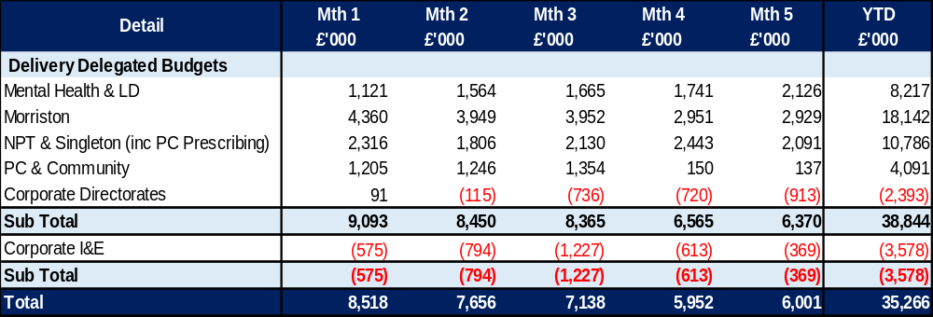
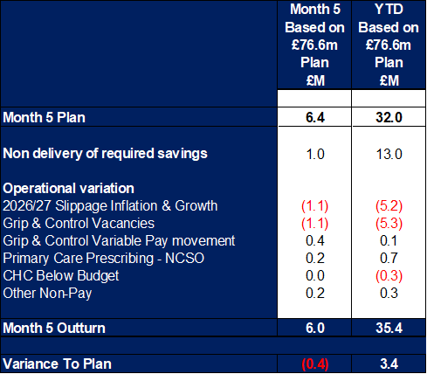
Financial Summary
In-Month Variance
£6.001m
Variance to Plan £(0.4)m
YTD Variance
£35.266m
Variance to Plan £3.4m
Executive Summary
Income and Expenditure Insights
Operational and Financial Performance
Appendices
Key Information
Operational Variation. The following operational variation between Month 4 and 5 has been incurred: NPTS: There was an increase to Bank and ADH in month of £0.1m offset by other pay improvements. Non pay reduced by £0.1m in relation to Surgery and theatres expenditure. MHLD: Nursing variable pay was up in month by £0.1m and Temporary Out of Areas Placements increased linked to the stepped change seen in patient numbers during August. Morriston: Variable pay increased by £0.2m in month mainly within the HCSW job family and driven by sickness and acuity within Care of the Elderly (COE). PCT: Variable pay increased by £0.1m. LTA Performance: There continued to be a benefit in month on Provider and Commissioner LTA performance, however this reduced compared to previous months, particularly in relation to JCC.

Slide 3
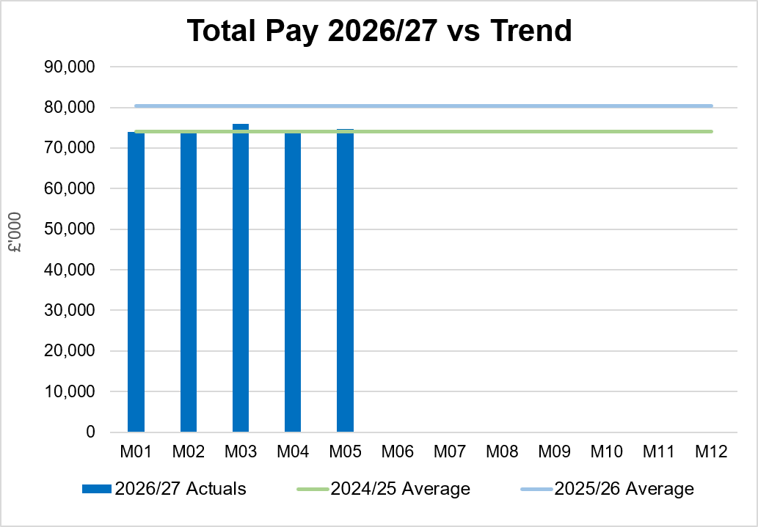
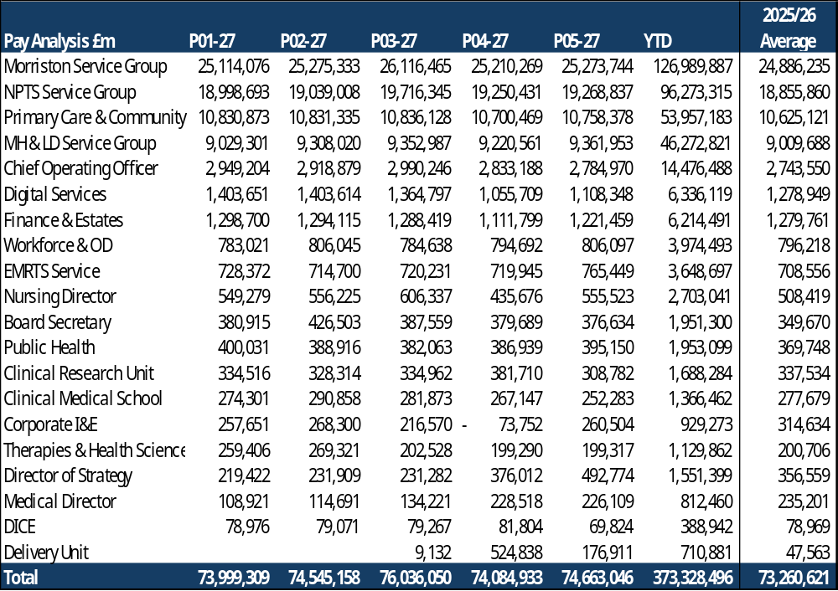
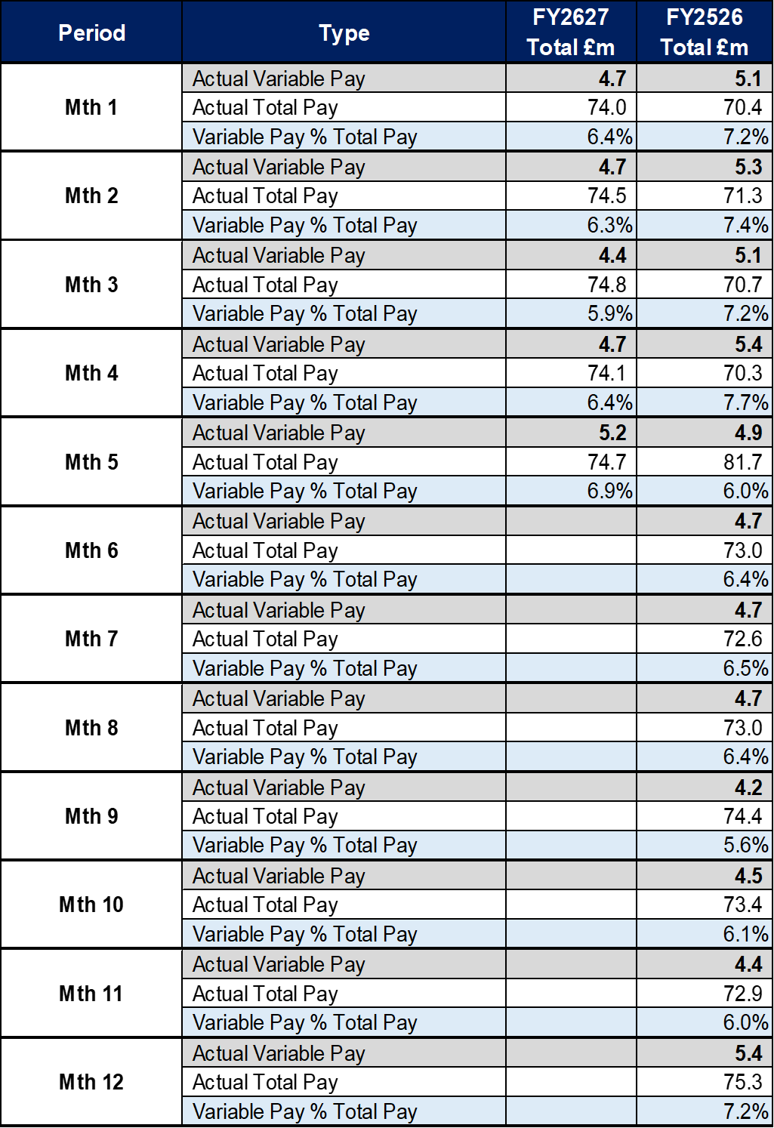
Total Pay Insights (1)
In-Month Actual
£74.663m
Variance to Ledger £0.63m
YTD Actual
£373.328m
Variance to Ledger £3.30m
Executive Summary
Income and Expenditure Insights
Operational and Financial Performance
Appendices
Key Information
Variable Pay expenditure increased by £0.5m in Month 5. Overall Month 5 pay was higher than Month 4in main driven by increase in variable pay, however the vacancies are offsetting the pressures in medical and dental and nursing linked to high levels of sickness absence and a continuation of staffing surge bed capacity. The benefits from the vacancy position is linked to the increased Grip & Control in place to oversee recruitment.

Slide 4
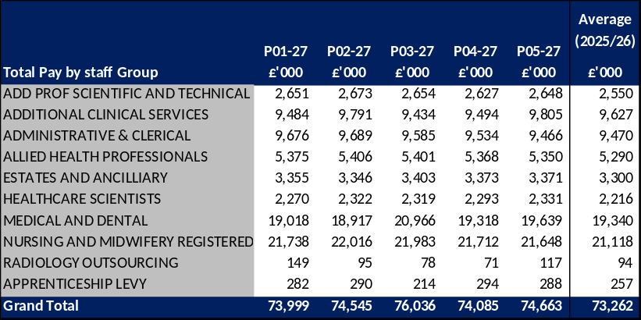
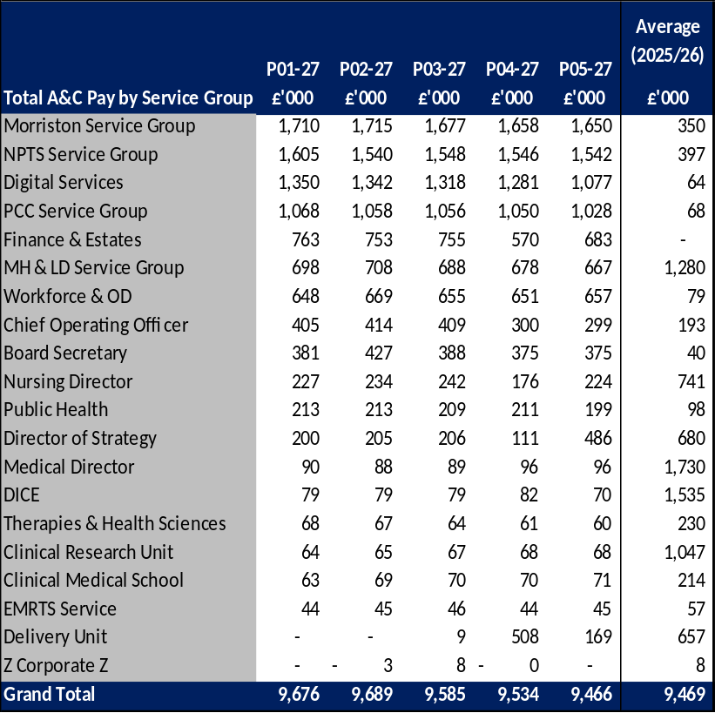
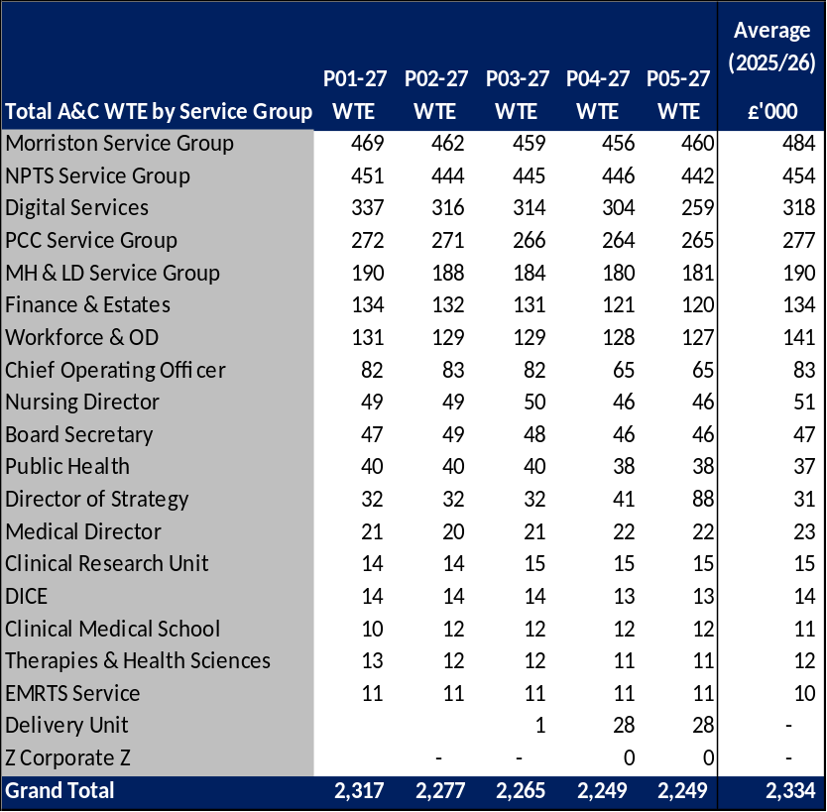
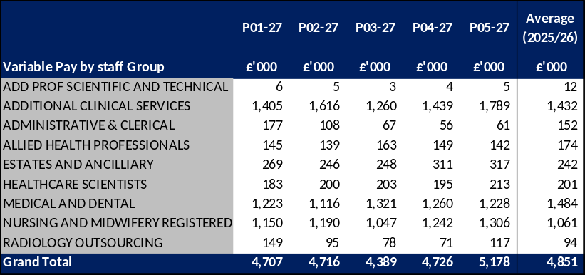
Total Pay Insights (2)
In-Month Actual
£74.663m
Variance to Ledger £0.63m
YTD Actual
£373.328m
Variance to Ledger £3.30m
Executive Summary
Income and Expenditure Insights
Operational and Financial Performance
Appendices
Actual Expenditure By Staff Group
Actual Expenditure & WTE For A&C Staff Group As Per Ledger
Key Information
Month 03 contains the YTD Medical and Dental 2026/27 pay award, total value = £7.1m or £0.6m per month (£1.2m arrears in Month 03) A4C Pay Award 2026/27 = £22.5m and paid from 1st April 2026. The 2 tables on the right detail the total A&C Pay and WTE by Service Area, with a steady reduction through Q1 and into Month 5 in both actual spend and WTE. Average 2025/26 does not include 2026/27 pay award of 3.3% for A4C and 3.5% Medical & Dental.

Slide 5
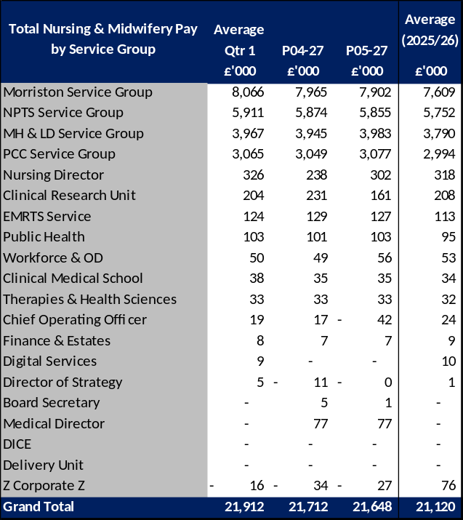
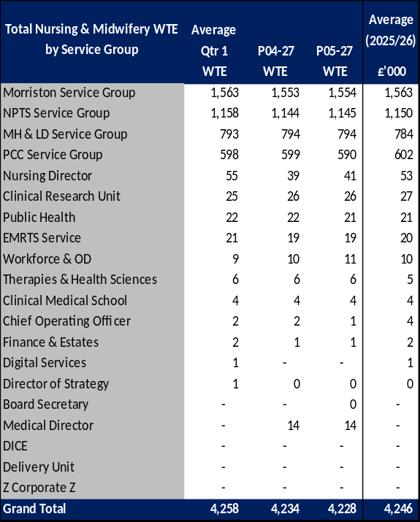
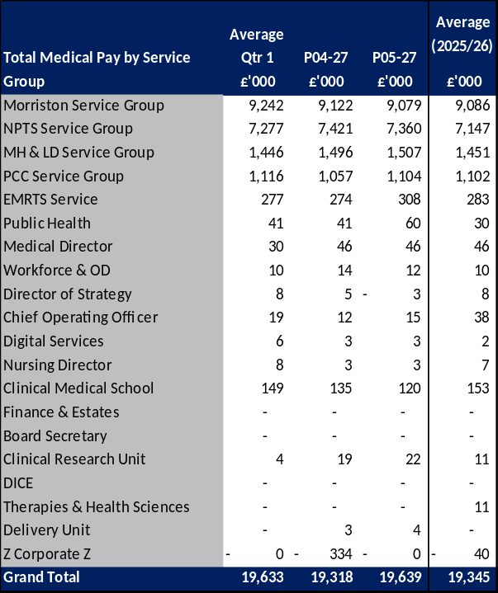
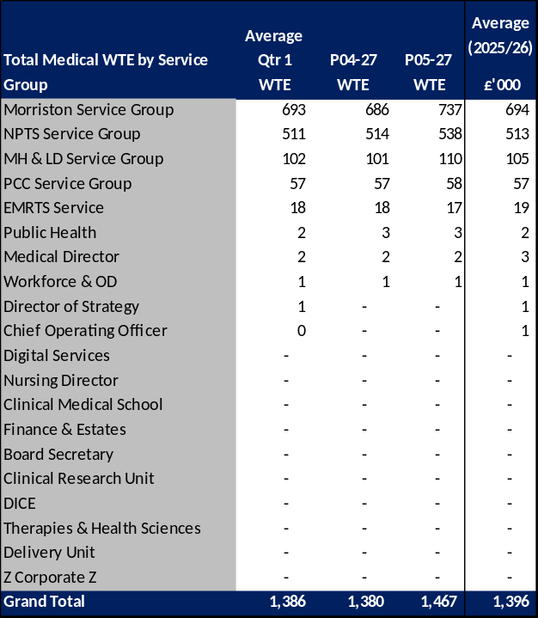
Total Pay Insights (3)
In-Month Actual
£74.663m
Variance to Ledger £0.63m
YTD Actual
£373.328m
Variance to Ledger £3.30m
Executive Summary
Income and Expenditure Insights
Operational and Financial Performance
Appendices
Actual Expenditure & WTE for Nursing & Midwifery By Staff Group As Per Ledger
Actual Expenditure & WTE for Medical & Dental By Staff Group As Per Ledger
Key Information
The above tables detail the total Nursing & Midwifery and Medical & Dental Pay and WTE by Service Area Month 03 contains the YTD medical and dental 2026/27 pay award, total value = £7.1m or £0.6m per month (£1.2m arrears in Month 03). A4C Pay Award 2026/27 = £22.5m and paid from 1st April 2026. Average 2025/26 does not include 2026/27 pay award of 3.3% for A4C and 3.5% Medical & Dental. Medical & Dental WTEs have increased in Month 5, but this is linked to the rotation of Single Lead Employer Resident Doctors in August and should return to standard levels in Month 6.

Slide 6
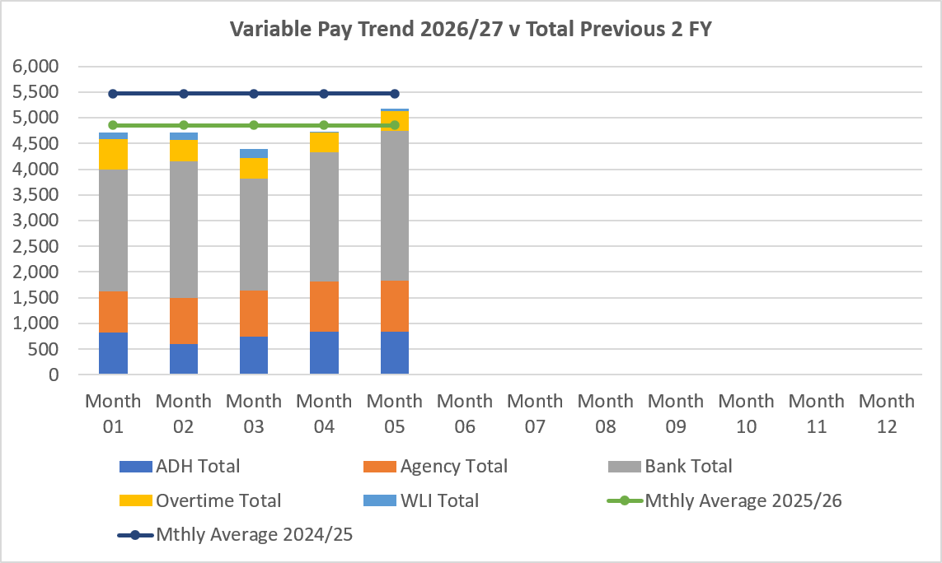
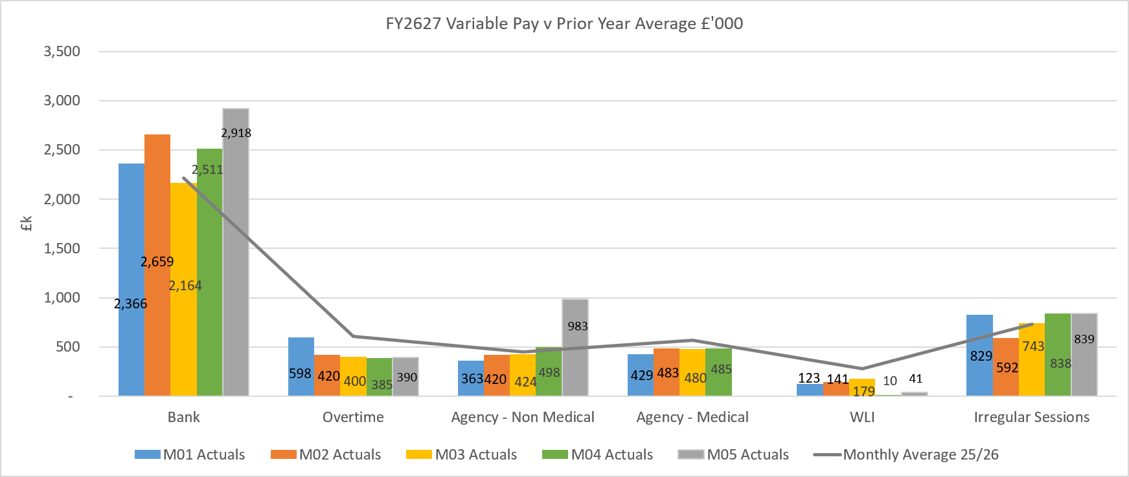
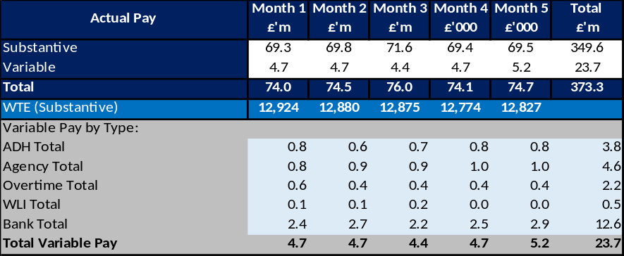
Variable Pay Insights
In-Month Actual
£5.178m
YTD Actual
£23.716m
Executive Summary
Income and Expenditure Insights
Operational and Financial Performance
Appendices
Key Information
The actual variable pay spend at Month 05 was £5.2m. Bank and agency continue to be the key driver for this continued high spend, with bank spend increasing from Month 4 figures. The in month increase in bank was seen in Morriston, PCT and MH/LD Service Groups.

Slide 7
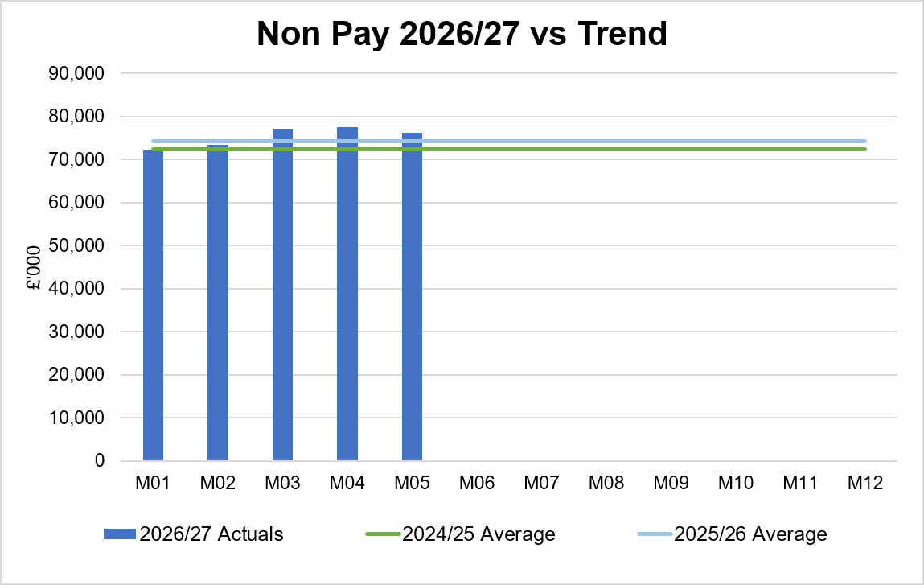
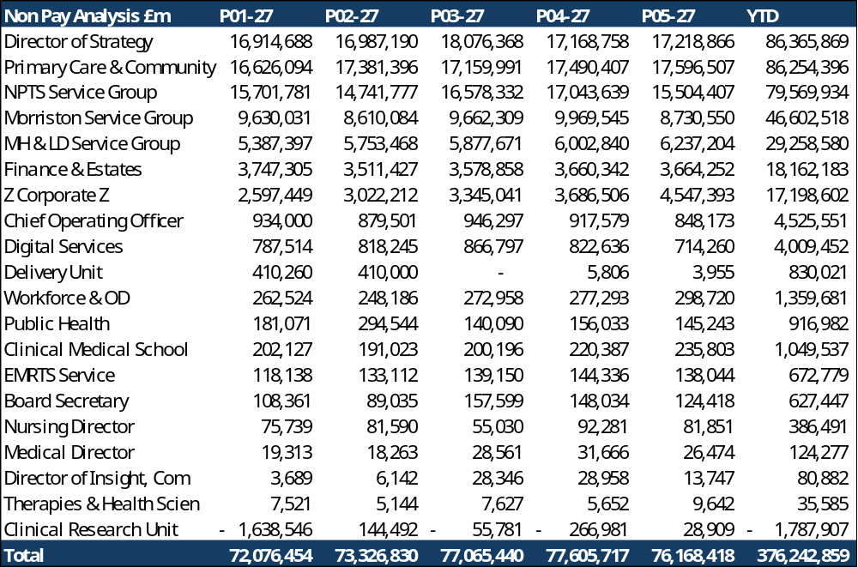
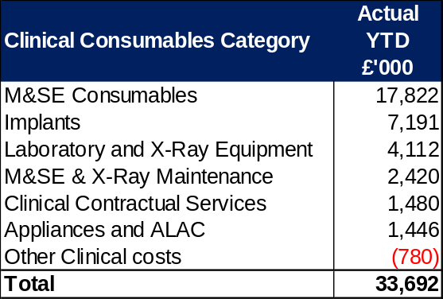
Non-Pay Insights
In-Month Actual
£76.168m
Variance to Ledger £5.6m
YTD Actual
£376.243m
Variance to Ledger £31.6m
Executive Summary
Income and Expenditure Insights
Operational and Financial Performance
Appendices
# includes saving non-delivery
Key Information
Key issue in Clinical Services & Supplies linked to M&SE (General Clinical consumables), bed contracts, additional costs linked to increased activity through improved productivity and transport costs for patient transfers. Within the ledger the gross Joint Commissioning Committee (JCC) income is reflected within the income lines and not netted off against expenditure and so overall the Health Board position is not adversely affected. If JCC activity increases the gross level of expenditure and income will increase. The main drivers within this category of clinical consumable expenditure include heart valves & pacemakers, linked to some JCC activity. Non-Pay also includes secondary care drugs; a breakdown of the categories of Clinical Consumables based on actual spend is provided in the table on the right. Prescribing is overspent by £0.4m in-month (Month 4, £0.2m) following receipt of the latest datasets (June 2026, PAR data is received 2 months in arrears); the overspend is driven by the No Cheaper Stock Obtainable (NCSO) position. Global conflicts are affecting shipping routes which is adversely impacting on the availability of medicines and increasing prices of procurement due to additional delivery costs.

Slide 8
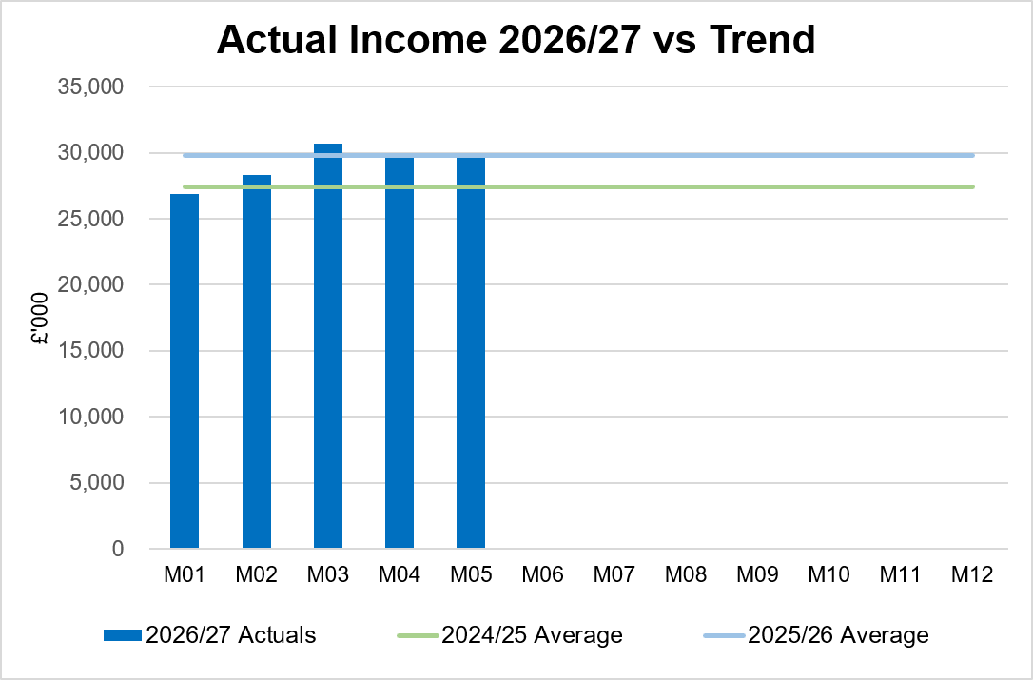
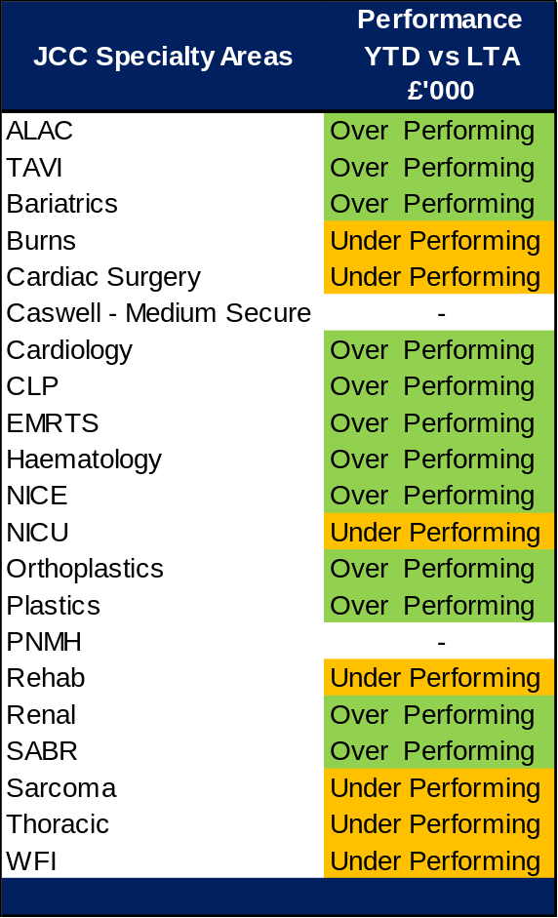
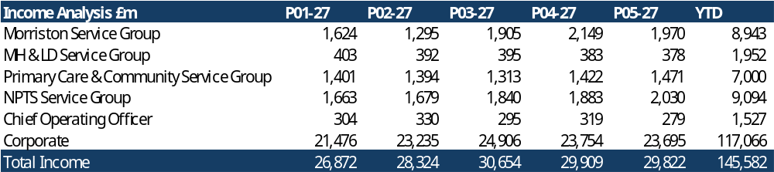
Income Insights
In-Month Actual
£29.822m
Variance to Ledger (£0.2m)
YTD Actual
£145.582m
Variance to Ledger £0.4m
Executive Summary
Income and Expenditure Insights
Operational and Financial Performance
Appendices
Key Information
Income remains stable for Month 05. Higher level of recharging other Health Boards for blood products along with other one-off benefits in month including within nuclear medicine. An uplift to reflect the 111 arrangements was also recognised for the year. The rebates relating to Mounjaro continue to provide an increase in income. The Joint Commissioning Committee (JCC) income as a provider reported a breakeven position in Month 5 (Month 4, overperformance of £0.6m), largely due to a reduction in Plastics activity. Dental contract income underperformed in-month by £0.1m.

Slide 9
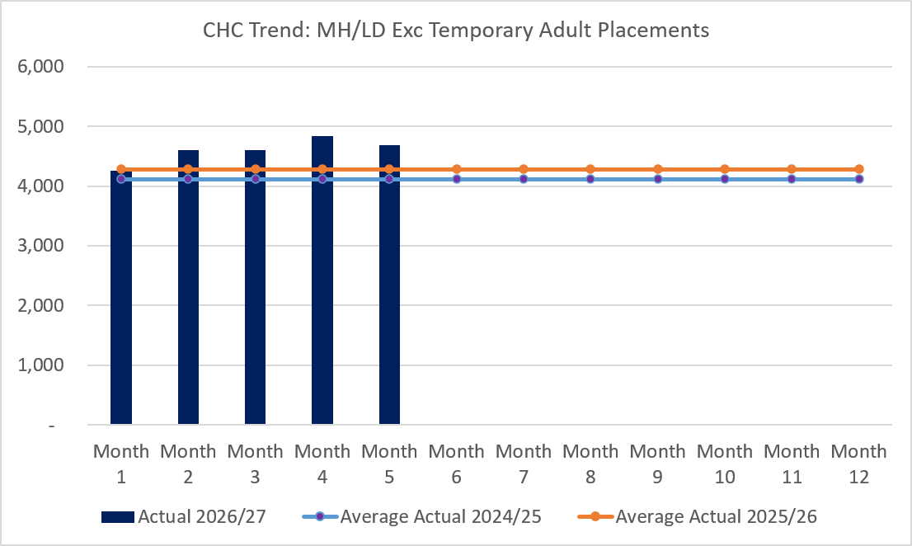
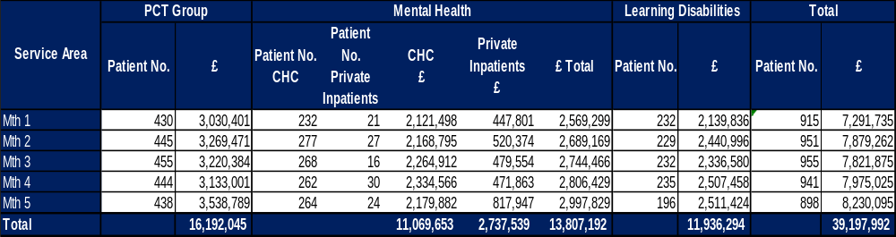
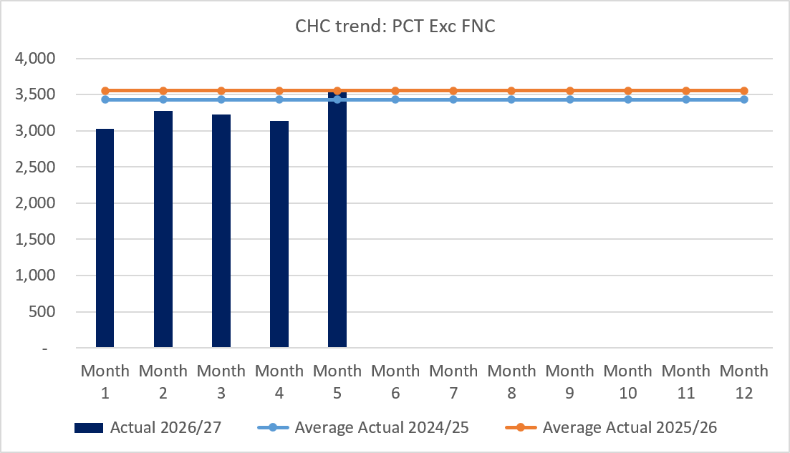
CHC Insights
In-Month Actual
£8.230m
Variance to Ledger £0.5m
YTD Actual
£39.198m
Variance to Ledger £2.0m
Executive Summary
Income and Expenditure Insights
Operational and Financial Performance
Appendices
Key Information
In Month 5 CHC was overspent by £0.6m, (Month 4, £0.6m), with a minimal reduction in case numbers. Given this position the impact of CHC has been clearly set out as a risk. An analysis of actual expenditure and patient numbers for 2026/27, is provided in table above. The table also includes the Adult Mental Health temporary placements within the Private Sector for transparency. The graphs on the left reflect average expenditure in the last two financial years, compared to the in- month position. MH/LD excludes the temporary placements and PCT excludes Free Nursing Care/Self Funders. Patient No. Private Inpatients (or Out of Areas Placements) exceeded 32 at points during August, but by end of the month had reduced. However, this still resulted in a £0.3m increase in costs from Month 4. This is now reported as a separate Financial Risk to WG as part of the MMR.

Slide 10
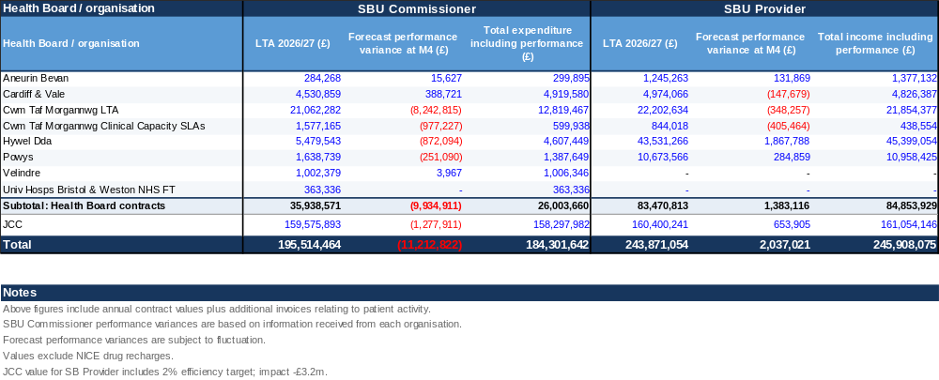
LTA Performance Insight
In-Month Actual
Provider/Commissioner
Variance Ledger = (£0.56m)
YTD Actual
Provider/Commissioner
Variance Ledger = (£2.92m)
Executive Summary
Income and Expenditure Insights
Operational and Financial Performance
Appendices
SBUHB LTA/SLA values and forecast performance 2026/27 per Month 4 activity

Slide 11
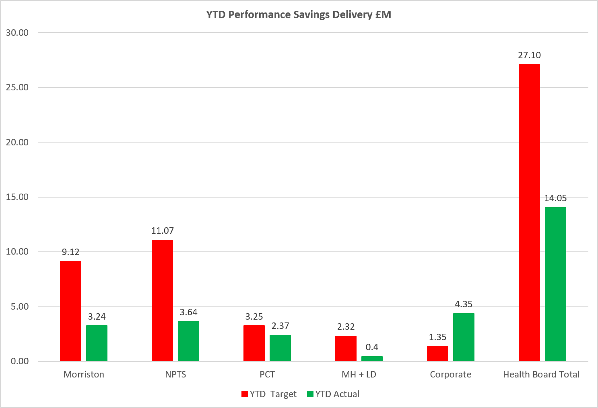
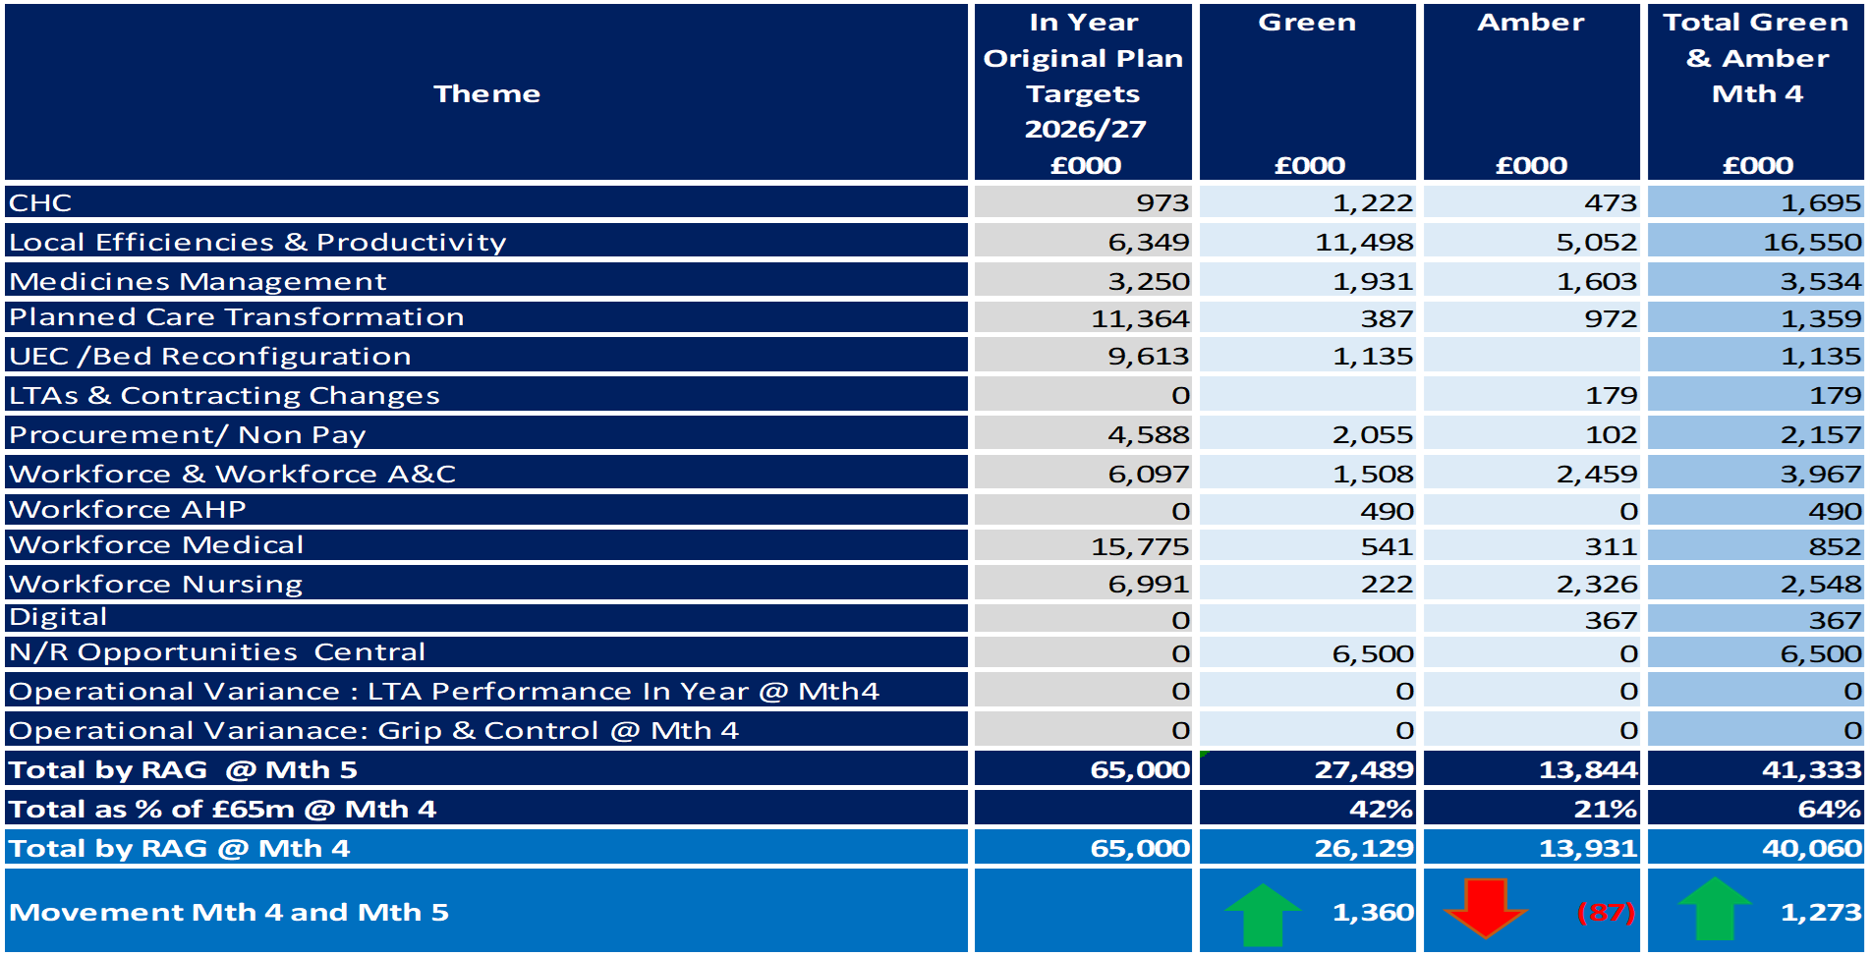
Savings Insights
Executive Summary
Income and Expenditure Insights
Operational and Financial Performance
Appendices
Savings
In Year Savings
Target = £65.0m
Green & Amber = £41.3m
Green & Amber % Target = 64%
Recurrent Savings
Target = £65.0m
Green & Amber = £29.4m
Green & Amber % Target = 45%
In Month Delivery
Target = £5.4m
Achieved = £4.4m
Gap = £1.0m
YTD Delivery
Target = £27.1m
Achieved = £14.1m
Gap = £13.0m

Slide 12
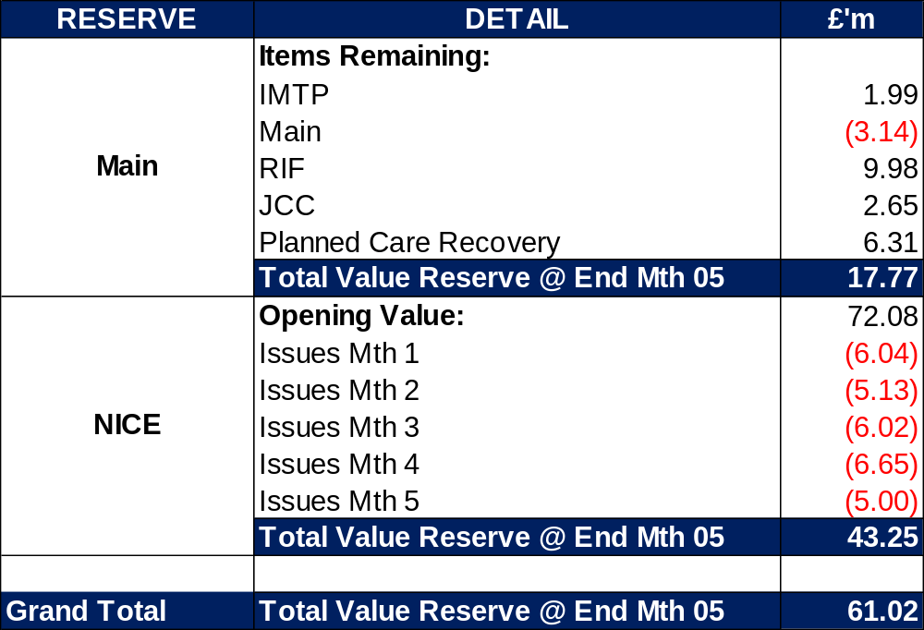
Reserves Insights
Executive Summary
Income and Expenditure Insights
Operational and Financial Performance
Appendices
Key Information
For 2026/27, the Health Board will hold two central reserves and the purpose of these reserves are below: Main – this holds funding from Welsh Government or the plan that has yet to be issued to Budget Holders. These items are not surplus but either due to timing have not been issued or is an area where funding is issued based on actual values consumed in future months. NICE – this holds the total Health Board funding for all NICE costs (drugs and infrastructure) and is issued to the service each month based on the actual costs consumed as reported through the Pharmacy system.

Slide 13
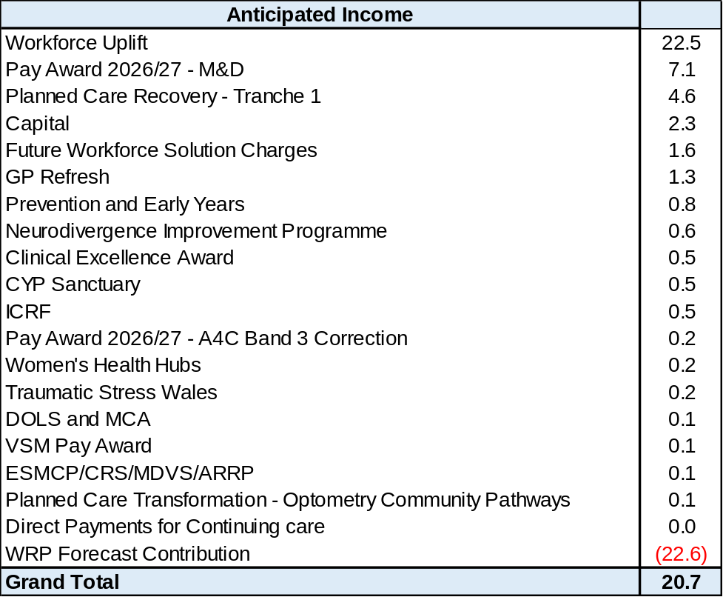
Anticipated Allocations
Executive Summary
Income and Expenditure Insights
Operational and Financial Performance
Appendices
Key Information
The current deficit plan of £76.6m is predicated on receipt of Welsh Government funding at the levels anticipated in the table opposite.

Slide 14
Appendices

Slide 15
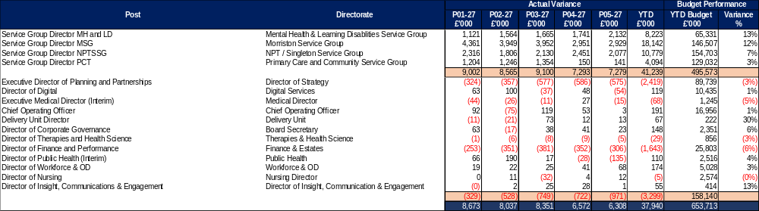
Appendix 1 – Variance by Budget Holder (Directors)
Executive Summary
Income and Expenditure Insights
Operational and Financial Performance
Appendices
Appendices

Slide 16
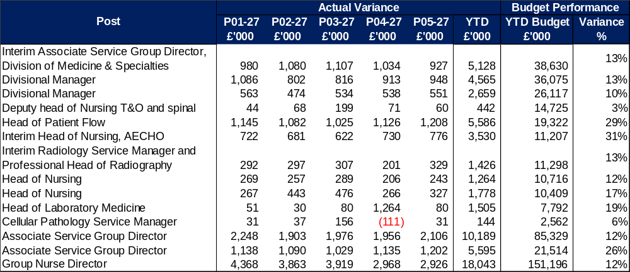
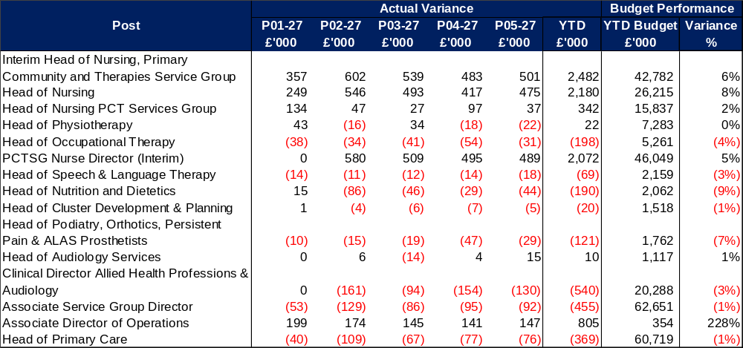
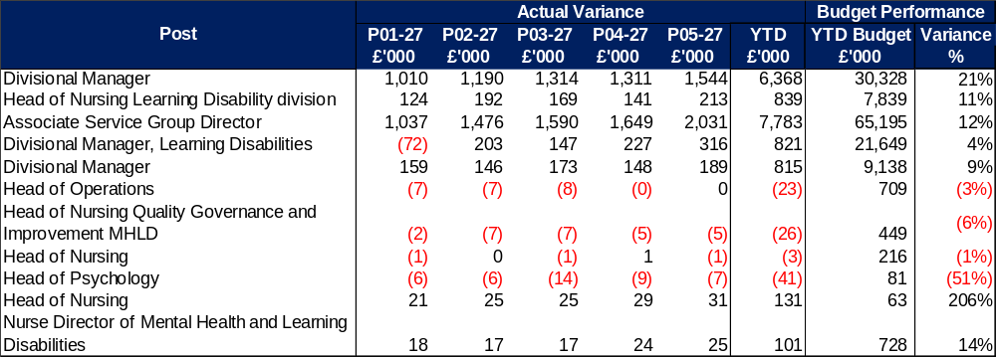
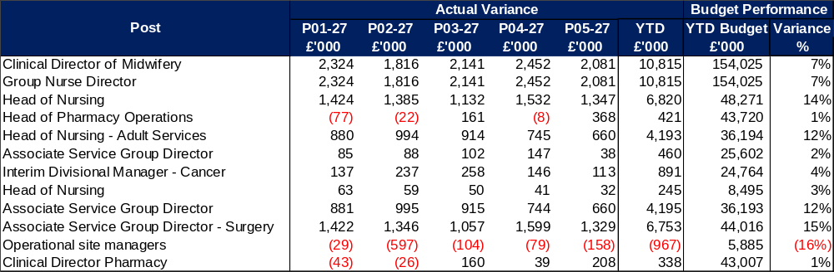
Appendix 2 – Variance by Budget Holder
Executive Summary
Income and Expenditure Insights
Operational and Financial Performance
Appendices
Appendices
Morriston Service Group
PCC Service Group
MH & LD Service Group
NPTS Service Group

Slide 17
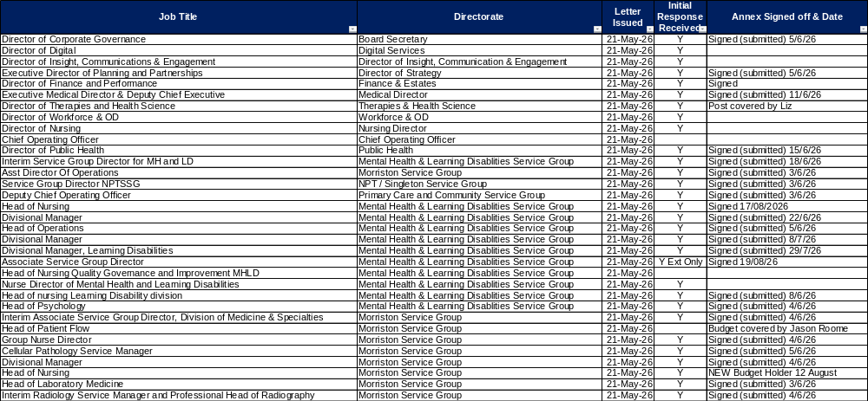
Appendix 3 – Accountability Letters (1)
Executive Summary
Income and Expenditure Insights
Operational and Financial Performance
Appendices
Appendices

Slide 18
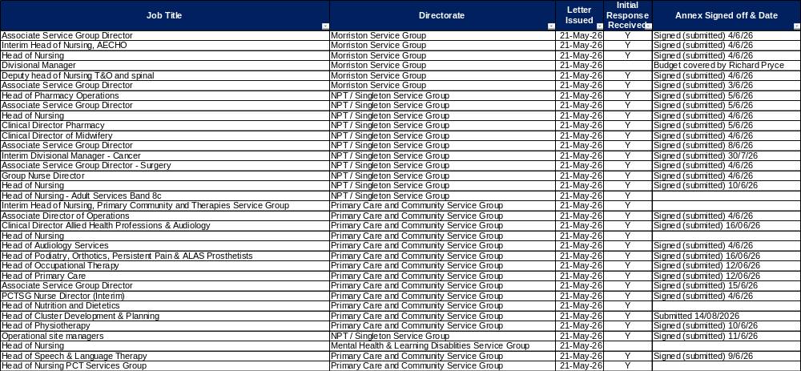
Appendix 3 – Accountability Letters (2)
Executive Summary
Income and Expenditure Insights
Operational and Financial Performance
Appendices
Appendices

Slide 19
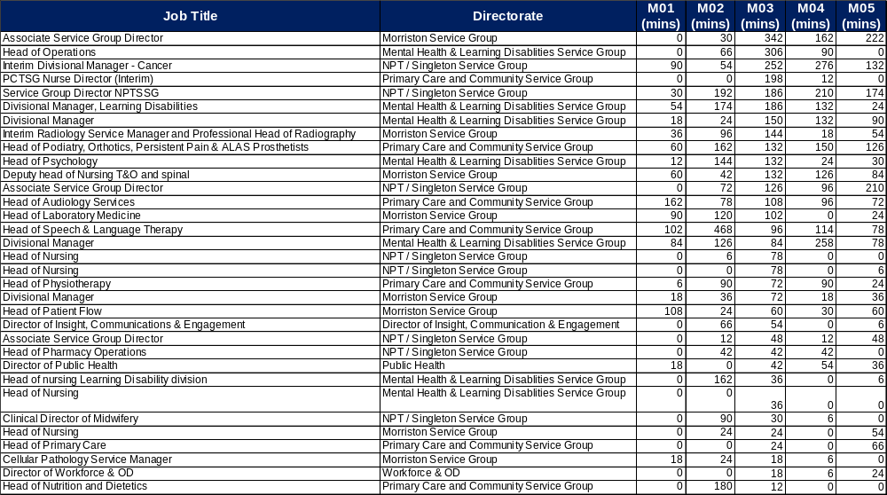
Appendix 4 QlikSense – Finance Dashboard Usage
Executive Summary
Income and Expenditure Insights
Operational and Financial Performance
Appendices
Appendices
These tables monitor the Qliksense Dashboard usage for Month 05 for all 67 budget holders reporting usage in minutes.

Slide 20
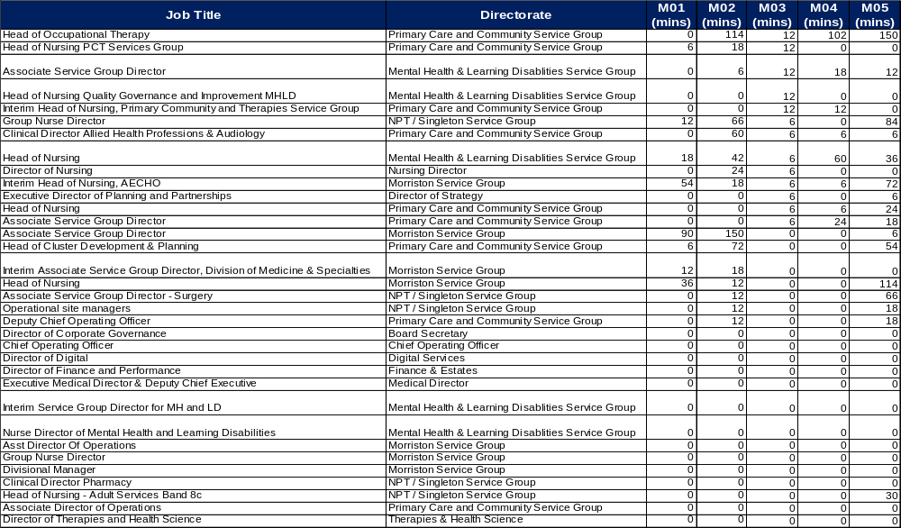
Appendix 4 Qliksense – Finance Dashboard Usage
Executive Summary
Income and Expenditure Insights
Operational and Financial Performance
Appendices
Appendices
These tables monitor the Qliksense Dashboard usage for Month 05 for all 67 budget holders reporting usage in minutes.

Slide 21
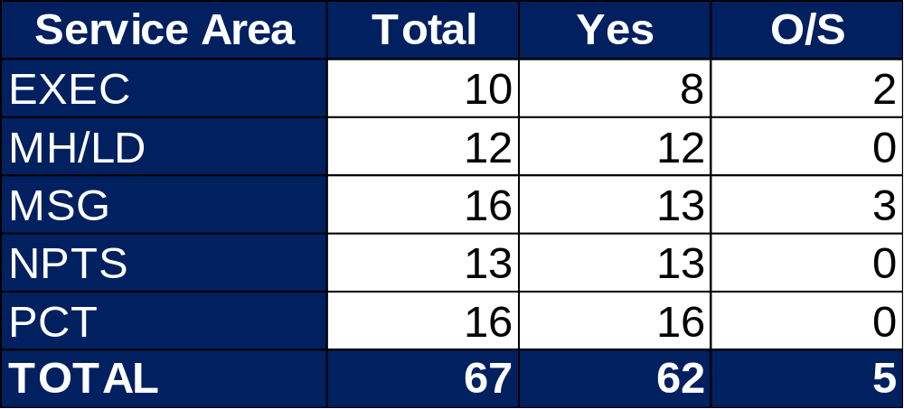
Appendix 5 Summary Budget Holder Training
Executive Summary
Income and Expenditure Insights
Operational and Financial Performance
Appendices
Appendices
Status @ 8 September 2026
Key Information Outstanding Training
2 Executives 1 newly appointed – training will be provided in September 1 scheduled for w/c 14 September following annual leave 1 Service Group 1 changed roles post letters published and role covered by another existing Budget Holder whilst HB recruits 1 retired and training will be provided once replacement postholder commences but covered by another Budget Holder 1 on maternity leave – responsibilities covered by another existing Budget Holder

Slide 22
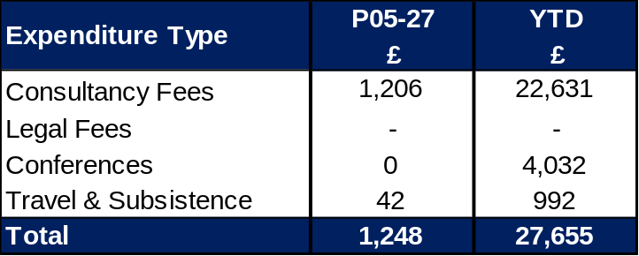
Appendix 6 Summary Other Data
Executive Summary
Income and Expenditure Insights
Operational and Financial Performance
Appendices
Appendices
Maternity Review
The total costs for this are allocated to a dedicated Cost Centre (6F34).
Key Information Central Z Codes
Contracting: SLA /LTA performance: JCC (previously WHSSC), LTA and SLA contract income and expenditure are transacted within this area and financial performance reported. NICE approved high-cost drugs and associated LTAs are also transacted and monitored against targets set. In addition to this, non-contracted activity income in relation to English foundation trusts invoiced on a quarterly basis are reported. Capital: The Finance Capital Team manage a number of cost centres covering the PFI, IFRS16 and Depreciation charges for assets both owned and donated are transacted here. RRL and Central Reserves: The Welsh Government funding received at the start of the year is tracked within this area. Any anticipated allocations in year are also transacted through these codes. Other HB wide funding received from HEIW and SIFT is also captured in here. All central reserves remain within the Z cost centres and details of these are provided in Appendix 2. Corporate income and expenditure. Any income and expenditure that is not service group specific is transacted and reported through a number of corporate Z cost centres, examples include, payroll and pension costs, VAT recovery, losses and receipts in relation to funding from Welsh Risk Pool, overseas visitors’ income and Road Traffic Accident income.

Slide 23
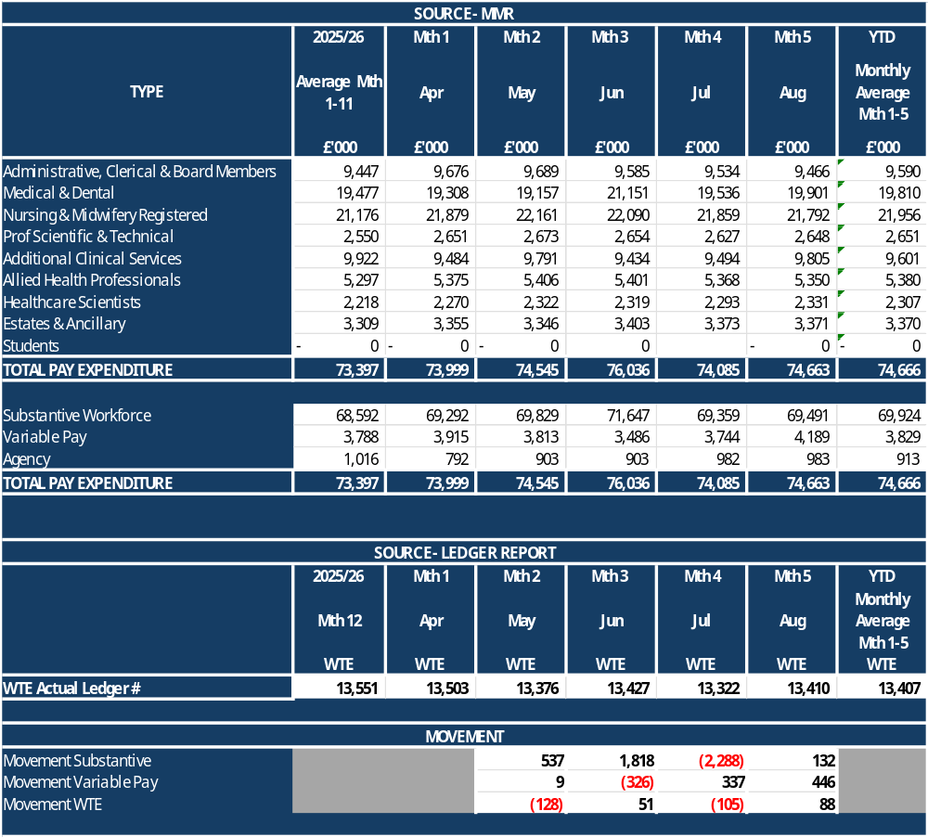
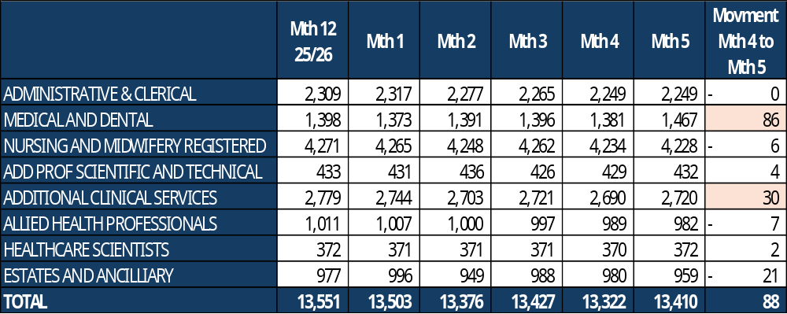
Appendix 7 – Overall Pay Movements
Executive Summary
Income and Expenditure Insights
Operational and Financial Performance
Appendices
Appendices
Key Information
Slide 3 to Slide 5 provide overview of pay position and Appendix 7 provides a summary of position, with breakdown of WTE by Month. Reconciliation key movements between Month 4 and 5: Substantive Staff remained static with small increase £0.1m Variable Pay increased by £0.4m driven Bank costs WTE increased by 88 WTE: 86 WTE = Resident Dr WTE and is impacted on by August rotation. This will need to monitored for Mth 6 to check WTE return to ‘previous’ levels; 30 WTE = bank cost increase as noted above for HCSW (25 WTE) and Registered Nurses.

