Slide 1


Performance & Finance Committee
Mental Health and Learning Disability
Service Group
August 2024

Slide 2

High Level Summary
Top 3 Actions to address position:
Service Group to action decisions made at 19th August Star Chamber noting outcome for further discussion with Health Board on 5th September.
Service Group to action cost control measures as per Health Board’s Recovery and Sustainability programme.
Continue to identify revenue savings and run rate reduction options to target
Notes:
Service Group to follow up on 28th June submission of potential opportunities for feedback
Present revenue reduction options at Star Chamber for consideration and subsequently decision
Continue to identify revenue reduction options and associated impacts for assessment

Slide 3
Agenda Detail
Health Board & Service Group Financial Summary
In-Month Revenue Position
Savings Performance
Key Drivers
Risks, Next Steps & Mitigating Actions
Appendices

Slide 4

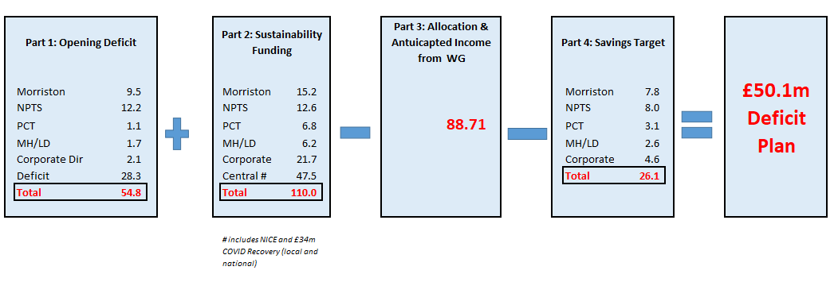
Health Board Summary Elements of Financial Plan
Note: Specific elements from Part 1, 2 and 4 of the plan that relate to this service area are summarised on the next slide.

Slide 5

Service Group Element of Financial Plan
End of year forecast
As at the end of Month 5 reporting, the Service Group are forecasting a £1.2m overspend against budget which is inclusive of all Green and Amber Savings schemes.
At the time of writing this report the Service Group had summitted £8m of Red options. Following confirmation of which Red schemes are recommended to proceed the Service Group will confirm revised forecast for 2024/25.

Slide 6

2024/25 In Year Health Board Position

Slide 7
Service Group Position By Month & Divisions
Overall Service Group
The overspend position is primarily driven by pay expenditure compared to budget due to high Medical and Nursing variable pay. Some of this expenditure has been offset by some benefit from the release of balance sheet.
MHLD Operations, Head of Psychology, Head of Nursing, Development and Commissioning and Other Cost Centres
Combined underspend due to various vacancies across several staff groups.
Mental Health Division
Pay £321k: Overspend due to high Medical and Nursing variable pay.
Non pay £36k: Overspend due to high transport, drugs and premises expenditure offset by the release of CHC balance sheet benefit.
Learning Disabilities Division
Pay £81k: Overspend due to high Medical staffing and Nursing variable pay.
Non pay £(345)k: Overspend in drugs and premises expenditure offset by the release of CHC balance sheet benefit.
Secure Services and Recovery Division
Pay £290k: Overspend largely due to Nursing variable pay.

Slide 8
In month Service Group Position By Division & Type Expenditure/Income
Key Drivers:
Income
Net under recovery due to staff related income where there is a vacancy and corresponding underspend in pay.
Pay
High Medical variable pay to cover vacancies and other absence, £270,723.
High Nursing and HCSW (Within the Additional Clinical Services staff group) variable pay to cover for vacancies, sickness absence and increased acuity, £904,918.
Some underspending in Psychology and A&C budgets from vacancy.
Non-Pay
Underspending against CHC budgets from release of balance sheet benefit £(437,384).
Patient furniture purchases and temporary mattress rental £35,155.
Retrospective premises lease costs £15,452.
Private transport costs £23,170.
High Drugs and FP10 expenditure, £43,452.

Slide 9

financial performance: Overall trends
Key Messages:
Income
Where income is below target, this relates to income from staff where there is vacancy and there is corresponding underspend in pay.
Increased income was received in relation to Access to Work funding in Month 4.
Pay
High variable pay, primarily in Medical and Nursing staff groups, and to a lesser extent within Administrative and Clerical.
Underspending in Psychology and Administrative & Clerical budgets from vacancy.
Non-Pay
There are a numerous cost pressures against non-pay budgets including Drug and FP10 expenditure, transport costs, provisions, and commissioned services.
The step up in Month 5 actual and budgeted non-pay expenditure is associated with the partial transacting of inflationary uplifts to CHC packages of care commissioned by the Health Board.

Slide 10
Pay Summary
Key Messages:
Continued high Nursing variable pay in 20024-25 driven by cover for vacancy, sickness and acuity, some improvement in Months 3 and 4 following high in Month 2.
Continued high variable pay in Medical staff covering absence and backfill into rota gaps.
WTE movements are primarily due to reduced HCSW Band 2 staff, movements in bank usage, Band 6 Nurse movements and HCSW apprentice recruitment.

Slide 11
Pay : Variable pay
Extract from Reportinhg Dashboard
Key messages:
Medical agency and ADH expenditure across all service areas for vacancy, sickness and other absence.
Nursing and HCSW variable pay, agency, overtime and bank to cover for vacancies sickness absence and increased acuity across all services within the Service Group.
Agency cover for Administrative & Clerical and Ancillary staffing.

Slide 12
Pay : Variable pay
Governance & Oversight of Variable Pay:
Roster efficiency meetings (Weekly): Nurse Director, Corporate Nursing, Workforce, PMO and Finance meet to review WTE and financial performance of wards based on a risk-assessed timetable.
Variable pay report (Weekly): A Nursing variable pay report is issued weekly by Finance to the Service Group triumvirate, Heads of Nursing and Divisional Managers to report Bank and Agency wte utilisation by Division and Ward.
Medic Roster scrutiny meetings (Monthly): Representatives from the Medical and Service leadership team, Workforce and Finance to review Medical establishment, financial position and potential exit strategies for Agency Medical staff.
Nurse Roster scrutiny meetings (Monthly): Directorate meetings which include the Lead Nurse, Ward Managers, Workforce, E-Roster team and Finance to review roster compliance and financial performance.
Nurse Workforce meeting (Monthly): Nurse Director, Heads of Nursing, Workforce, PMO and Finance meet where WTE and financial performance is reviewed as part of the agenda.
Directorate finance reviews (Monthly): Directorate Management, Lead Nurse and a Finance Business Partner meet to discuss the overall financial performance which includes a review of pay.
Inpatient Ward performance reviews (Quarterly): The Service Director, Nurse Director, Finance and Workforce meet with Heads of Nursing and Lead Nurses to review WTE and Financial performance.
Roster efficiency and budget holder training (Annual): Training sessions have taken place led by Finance and supported by Heads of Nursing, Workforce and the E-Roster team to provide training and improve financial awareness for Ward Managers, Roster co-ordinators and Directorate Managers.
Service Group actions to address variable pay pressures:
Increased scrutiny of rosters: The focus of roster scrutiny meetings has now been refreshed with increased focus on finance and workforce. These meetings will now be chaired by the Head of Nursing rather than Directorate Lead Nurse.
Justification of agency use: In recent months, all Agency requests must be submitted on a pro-forma and authorised by the Director of Nursing justifying the reason required. This action has seen a reduction in agency use however due to patient acuity, the use of bank has increased.
Red savings opportunities: The Service group have submitted a range of proposals to Board which will reduce variable pay expenditure if enacted. These opportunities include the potential cessation of all HCSW bank and agency over and above budgeted establishment, the cessation of agency on weekends and bank holidays. Whilst these will generate financial savings, there is a potential impact to safe Nurse staffing levels and bed availability if these are enacted at a time when demand is at an all-time high and patients are presenting with increasingly complex needs. If schemes are enacted, performance against these opportunities will be monitored through the weekly Nurse Agency report, Roster scrutiny meetings with Directorates and Nurse Workforce meetings with corrective measures imposed if actual performance deviates from plan.

Slide 13
Non Pay: key drivers
Key Messages:
High drugs and FP10 expenditure in year due to increased Buvidal expenditure for Substance Misuse services. There is some variance in expenditure month on month due to the timing of the payment of invoices for homecare drugs.
Establishment expenses include high stationery and postage expenditure and transport costs. The increased transport costs relate to increased patient transfer costs to and from private commissioned placements outside the Health Board due to Inpatient pressures.
Increased CHC expenditure in year due to growth, however this is managed with funding for from the financial plan. The step up in budget and actual expenditure during Month 5 is in relation to the transacting of inflationary uplifts including retrospective costs relating back to Month 1. From Month 4, a budgetary benefit has been realised from the release of excess balance sheet provisions.

Slide 14

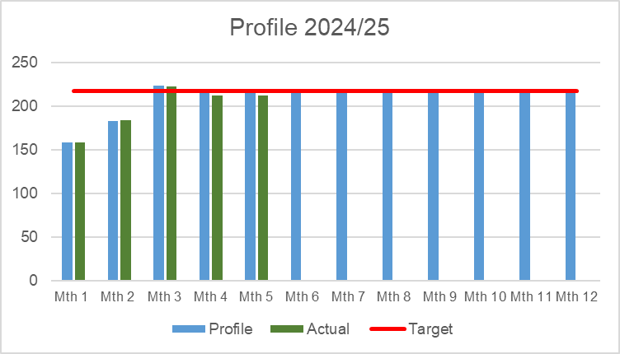
Savings Summary (Proportion HB Target £26.1m)
Identification of Opportunities & Profile
The Service Group have a target of £2.602m. Savings of £2.468m have been identified for delivery in 2024-25 which is 95% of target and recurrent savings of £2.068m being 79% of target. The value on the Savings Trackers is excess of the £2.468m but there are schemes on the trackers to mitigate run rate as opposed to delivery of Savings target for 2024/25, as reported on Slide 5. The Service Group are actively reviewing opportunities to close the gap in the current and future years.

Slide 15
Savings Detail

Slide 16

Identification Opportunities & Risk (Including Hot Spots)

Slide 17
Action & Next Steps To Be Taken By Service Group
Actions and Next Steps:
Service Group to action decisions made at the 19th August Star Chamber noting outcome for further discussion with Health Board on 25th September.
Service Group to action cost control measures as per Health Board’s Recovery & Sustainability programme.
Continue to identify revenue savings options against targets delegated to divisions and directorates.
Continue to identify revenue reduction options and associated impacts for assessment.

