Slide 1
Performance & Finance Committee
September 2024
Supporting Staff Attendance and Reducing Sickness Absence
Notes:
This slide can be used for presentations which are from a health board-wide perspective or for a whole HB audience as the graphic device to the right of the slide includes all four service group colours and red for the corporate team.

Slide 2
Contents
Executive Summary – Managing attendance at work
Health Board sickness trend headlines and August 2024 data
Managing attendance at work Action Plan summary
Template report for escalation
Appendices –
  How OH & Wellbeing support our staff
  Update by Service Group
Notes:
Emma – our intensions for this session

Slide 3
Managing Attendance at Work
Executive Summary
Reflecting the themes of our People Strategy, staff wellbeing is a priority for the Health Board to ensure an engaged, motivated and healthy workforce that provides high quality and effective care for our patients.
Our sickness data is showing overall an improving trend since the pandemic, but our current levels remain higher than we would want them to be and indeed the All Wales target (see next slide).
The Workforce and Organisational Development Directorate supports Service Groups using best practice and evidence-based strategies to promote attendance at work and support the reduction of sickness absence.
Management of sickness is a managers’ responsibility.
There is a continued focus across the organisation on pro-active absence management and increased collaboration with staff-side colleagues in areas of high sickness absence to support this approach. TU partners have indicated one of their preference focus areas for our non-pay deal work is on sickness absences. This will feed into our Best Practice Review and we are creating a Healthy People forum.
Early intervention and prevention focused Occupational Health and Staff Wellbeing support is ensuring more staff are supported to manage their health whilst in work, reducing the need for sickness absence. The Service continues to deliver timely support for managers and staff with key KPI’s, developed between Welsh Government and staff-side, being consistently achieved.
We are shaping a workforce performance framework to ensure organisational wide impact around accountability for workforce and sickness will be a key metric within this. This will be a balanced scorecard approach considering all metrics together for example – consideration of staff utilisation as a whole. This will also allow a more targeted focus on positive performance in this area.
Notes:
Emma – our intensions for this session

Slide 4
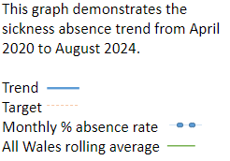
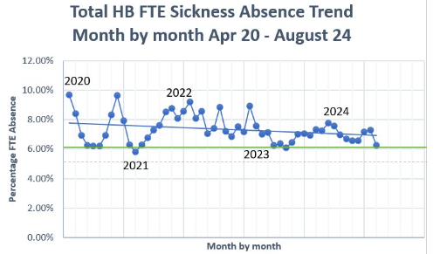
Health Board Sickness Trend headline
Target 5.5%
August 24 update:
Health Board rolling 12 month figure – 7.07%
NHS Wales rolling 12 month figure – 6.2%
Health Board in-month figure – 6.67%
Notes:
Emma – our intensions for this session

Slide 5
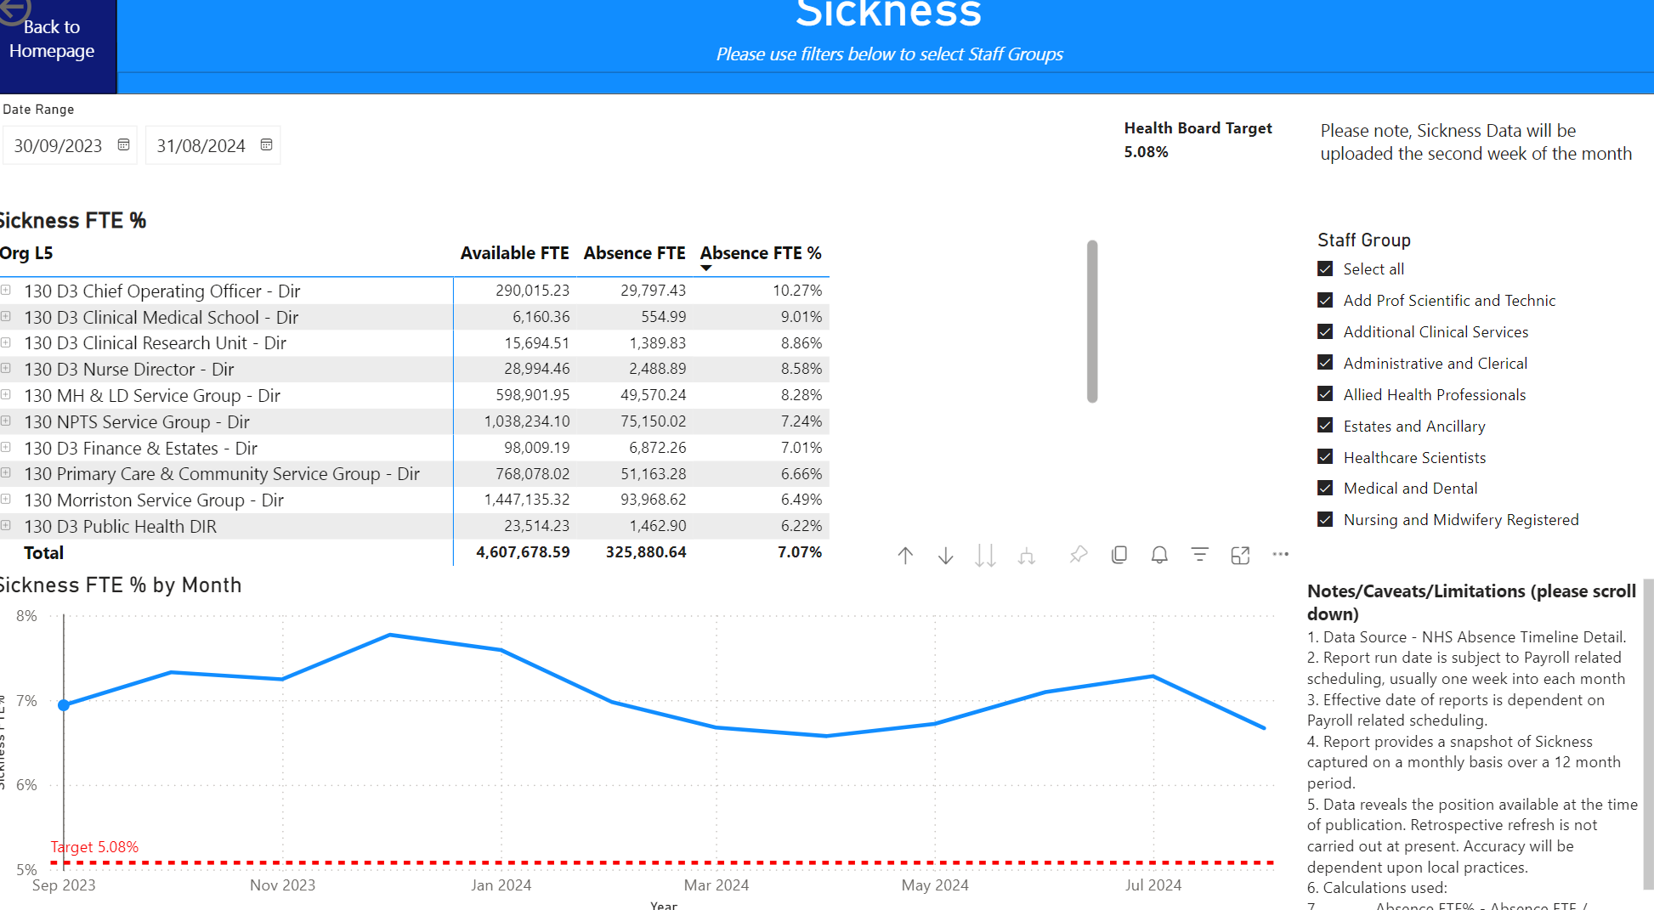
August 2024 data
Notes:
Emma – our intensions for this session

Slide 6
Sickness data context August 2024
Health Board total for in month sickness absence for August 2024 has decreased from the last reporting period to 6.67%(compared to 7.28% July 24) against a Health Board/All Wales target of 5.08%
Anxiety/stress related absence remained the highest reason for long term absence, with MSK remaining second. This is consistent across NHS Wales and is a long-term pattern.
Long term absence has decreased since the last reporting period (4.35% in August 24 compared to 5. 00% in July 24). Short term absence has decreased slightly since the last reporting period (1.77% in August 24 compared to 1.81% July 24)
Notes:
Emma – our intensions for this session

Slide 7
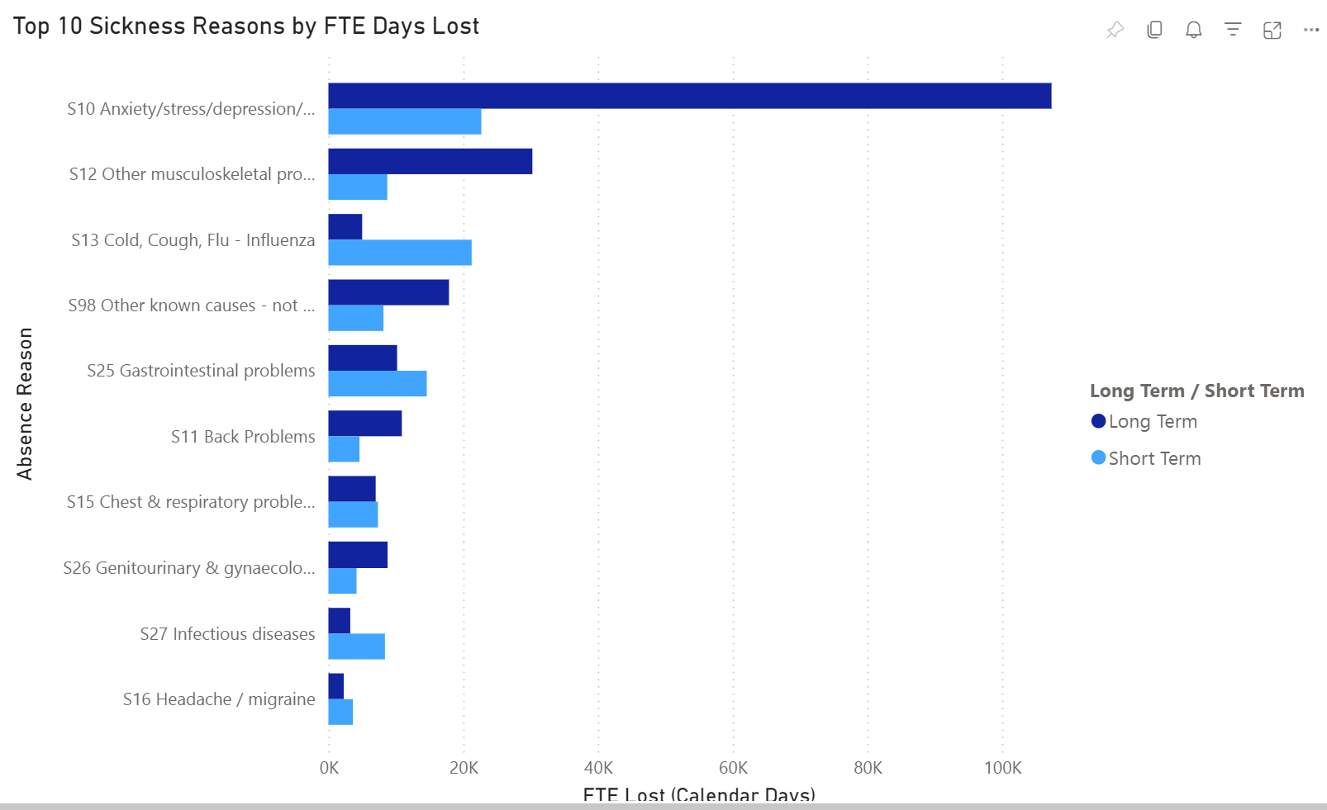
Health Board Absenteeism Reasons
% Jan - August 2024
Notes:
Emma – our intensions for this session

Slide 8
Absence vs Cost
* Data extracted from SBUHB Workforce Dashboard August 2024
Notes:
Emma – our intensions for this session

Slide 9
Managing Attendance at Work Action Plan
Goal - Engaged, Motivated & Healthy Workforce
Action | Target Date | Driven by | Progress Update
Develop a standardised Performance Framework for Health Board sickness absence reporting – common targets with Hywel Dda linked to Joint Committee | 01/09/2024 | Emma Owen/Jessica Rogers/Melanie Dellibovi | Completed for the HB. Next step is to roll out standardisation of Performance Frameworks across Service Groups
Establish Healthy People Forum | 30/09/2024 | Paul Dunning/Melanie Dellibovi | Developing TOR and identifying working group to include staff side
Service Group Deep Dives – identify hot spot areas, further develop action plans | 01/10/2024 | HRBPs | Findings and action plans developed from each deep dive will be reported to WOD Committee
Publicise MAAW ‘How To’ guides to include bite size training as part of our Brilliant Basics platform | 01/11/2024 | HR Team | How to guides developed – actively working with Communications on a comms plan
Conduct a holistic review of process & practices Service Groups – identify opportunities for improvement | 01/11/2024 | Melanie Dellibovi | A report on findings will be produced and shared with key stakeholders – what are we doing, what is working and what do we need to stop doing.
Absence data to reflect current position; identify HB trends LTS/STS, HB hot spot areas | 01/11/2024 | Emma Evans/Melanie Dellibovi | Workforce Dashboard has been developed – actively engaging with key stakeholders to obtain feedback to support further role out
Utilise Partnership Compact to enhance opportunities for employees to return to work which aligns with our commitment in the Welsh Government Non-Pay agreement | 01/11/2024 | HR/TU | Currently exploring what more we can do in partnership - actively exploring any gaps in order to streamline the process
Deliver further Managing Attendance at Work Training to all leaders – monitor attendance through ESR | 01/12/2024 | HR Team | Metric reporting on MAAW training attendance will be provided
Continue to deliver OH&WB early interventions and managers trainings | Ongoing | OH & Wellbeing | Mens Health, Staff Health Checks and Menopause training in-situ and related Comms for managers training in place
Notes:
Emma – our intensions for this session

Slide 10
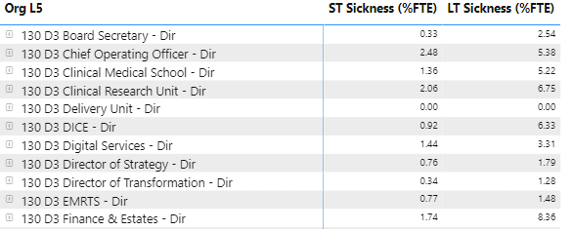
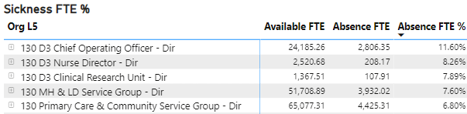
Engaged, Motivated & Healthy–August
Sickness Absence Metrics – Health Board Wide
Key Performance Indicator | 2024/2025 NHS Wales Target | NHS Wales 12m av. | Jan 24 | Feb 24 | Mar 24 | Apr 24 | May 24 | June 24 | July 24 | Aug 24 | Sep 24 | Oct 24 | Nov 24 | Dec 24
Sickness Absence | 5.5% | 6.2% | 7.59% | 6.98% | 6.68% | 6.57% | 6.72% | 7.09% | 7.27% | 6.67%
LTS vs STS Analysis – August 2024
Supporting our employees to maintain attendance:
Monthly Events Calendar for Occupational Health & Staff Wellbeing
Wellbeing resource pack available to all employees
Access to Guardian Services and working in partnership with Trade Union colleagues
Refresh and roll out of MAAW Training to all leaders, reinforcing compassionate leadership and supporting employees to maintain attendance, return to work
Introduction of Tailored Adjustment training for leaders – encouraging flexibility to work arrangement and prevent absence
Carers Support Group – our data supports that a high percentage of Anxiety/Stress is due to caring responsibilities. Leaders are encouraged to provide flexible working arrangements to support and to signpost employees to the Carers Support Group at each Service Group
Top 5 Hot Spot areas – August 2024
Action plans in place to reduce absenteeism in hot spot areas:
11.60% in COO Directorate mainly driven by Morriston Domestic and Porters within Support Services. Morriston Engineering in Estates. Targeted Intervention Groups have been established within these areas to ensure clear actions and deliverables are set and achieved
7.60% absence reported in MH & LD for August 2024. Anxiety/Stress/Depression reported as highest reason for absence. Dedicated staff counsellor to support early intervention/prevention of sickness absence, targeting areas of high work related stress, TRIM support continues and psychology group wellbeing sessions twice a month for overseas nurses to prevent absence and to support the anxiety of transition.
6.80% reported for August 2024 in PCT. Anxiety/Stress Depression reported as highest reason for absence. TRIM support available, deep dive into absence continues, Wellbeing action plan in development.
6.25% absence reported in NPSG. Data supports a high level of sickness absence within Maternity Services in particular. Retention plans are in place which includes wellbeing support. A deep dive analysis of sickness absence is currently underway.
Notes:
Emma – our intensions for this session

Slide 11

Diolch / Thank You

Slide 12
APPENDICES
Notes:
This slide can be used for presentations which are from a health board-wide perspective or for a whole HB audience as the graphic device to the right of the slide includes all four service group colours and red for the corporate team.

Slide 13
Appendix 1
Engaged, Motivated & Healthy Workforce: How Occupational Health & Staff Wellbeing Services Support Our Staff
Notes:
This slide can be used for presentations which are from a health board-wide perspective or for a whole HB audience as the graphic device to the right of the slide includes all four service group colours and red for the corporate team.

Slide 14
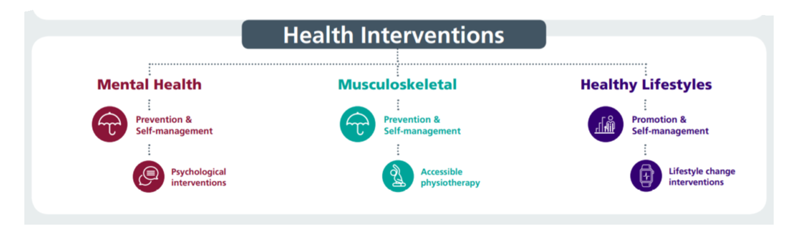

Our Staff Wellbeing Services supporting physical and mental health
1313 referrals to staff wellbeing service 23/24 –12.5% increase on previous 12 months
53% referrals to the service are staff in work (presentees) supporting early intervention
47% of referrals are sickness absentees
Specialist Psychological interventions for trauma & PTSD. Increased capacity in self-management for anxiety, depression, self-harm and suicide
Suicide Prevention – 50 disclosures of related thoughts in 12 month period with significant reductions post-intervention.
TRiM team rolling out preventative and post-incident support - 76 staff TRiM trained to deliver and support, 3483 staff REACT trained, 33 bespoke interventions for teams/services after adverse incidents
634 Wellbeing Champions (+9% from 22/23) supporting teams with wellbeing info/signposting and health promotion activities– regular update workshops facilitated
Manager training - use of work-related stress assessment and managing mental health at Work
Staff Wellbeing Forum – HB wide representation to share best practice/disseminate info across the HB with related presentations

Slide 15
Our Occupational Health Service supporting physical and mental health
OPAS G2 operating system = reduced waits for health clearance, more robust health surveillance programme & reduced waits for reports to managers. Progressing application for SEQOHS accreditation
OH waits (based on most available data) – average wait for management referrals is 20 working days as end of May 2024 (WG KPI is 20 working days)
Work-based Physiotherapy support - ergonomic assessments, early interventions and MSk advice. Leading on promoting health campaigns via Team Brief and other Comms
SBU has the only Occupational Health Service in Wales with full complement of Nursing Team using ‘grow our own’ model. 3 Nurses have completed the OH Diploma course and are awaiting exams - 1 Nurse has completed the Diploma. Leading HB menopause support and working towards Menopause Friendly Employer accreditation and only service with OT support for staff with Long Covid and other LTC’s
Time2Change Wales – regular presentations to reduce stigma & discrimination of mental health in work with other 1000 staff having attended. Shortlisted for a CIPD Award 2024 Awards 2024 Shortlist - CIPD Awards Wales 2024 (cipdwalesawards.co.uk)

Slide 16


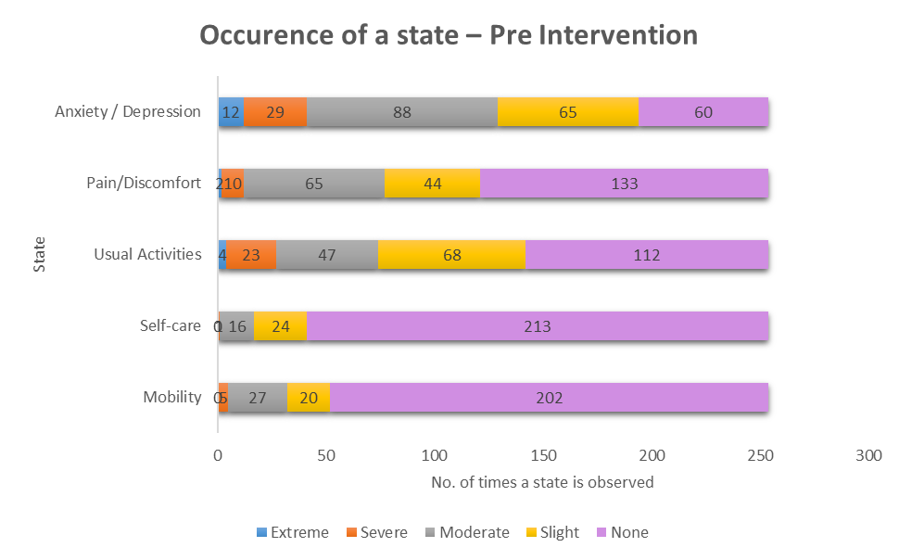
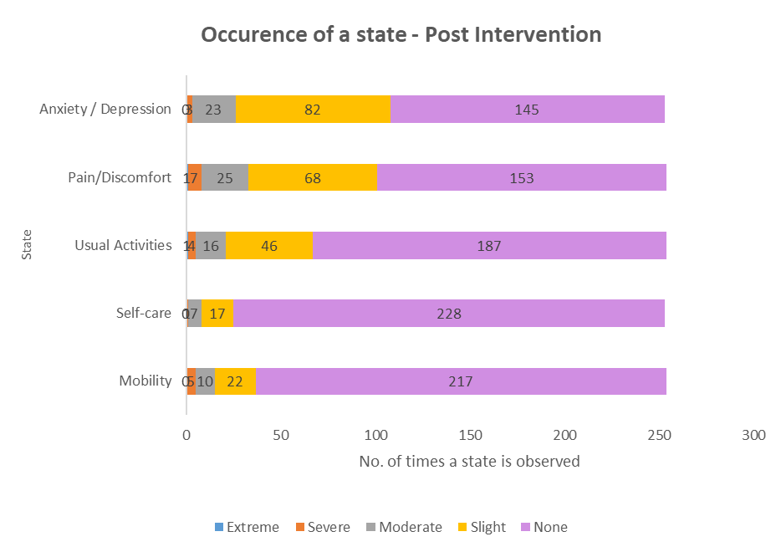
EQ5DL Pre and Post Outcome Scores

Slide 17
GTEP sessions (accumulative stress)
Wellbeing Champion Network
Compassion Rounds
React & Suicide Prevention
Staff Health Checks
Menopause Workshops
My Health Passport
Preventative Interventions
Mindful & Meaningful Living course
Steps to Wellbeing webinars
TRiM
Men’s Health Forum
Mental Health Awareness training
Work-related Stress Risk Assessment Training
Managing your Wellbeing course

Slide 18

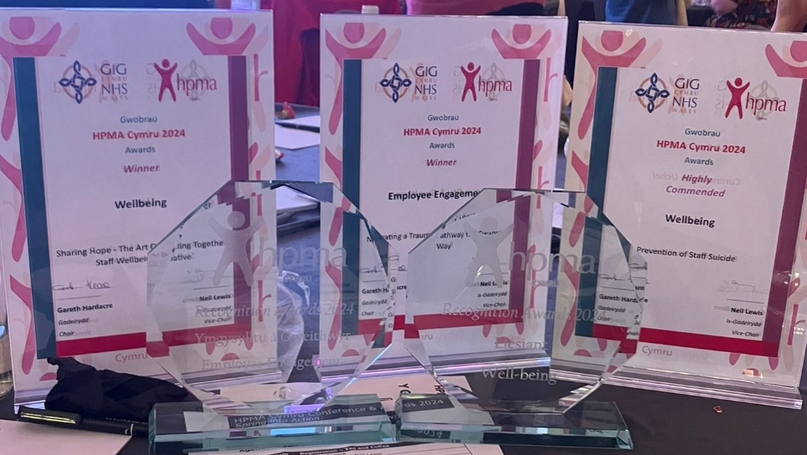
2024 HPMA Wales Awards Winners
Employee Engagement - Navigating a Trauma Pathway the Swansea Bay Way
Wellbeing: Sharing Hope - The Art Of Healing Together staff wellbeing initiative
Wellbeing Highly Commended – Swansea Bay Prevention of Staff Suicide
Recruitment Team of the Year: Central Resourcing and Overseas Nurse Recruitment Team - Reducing Variable Pay costs by Reducing Nurse and HCSW Vacancy Gap and Red.
Partnership working with Trade Unions - Working Together as part of our One Bay Way: Our Trade Union Compact

Slide 19




Slide 20
Appendix 2
Managing Attendance at Work
Service Group Updates
July 2024
Notes:
This slide can be used for presentations which are from a health board-wide perspective or for a whole HB audience as the graphic device to the right of the slide includes all four service group colours and red for the corporate team.

Slide 21
Singleton/Neath Port Talbot
Notes:
This slide can be used for presentations which are from a health board-wide perspective or for a whole HB audience as the graphic device to the right of the slide includes all four service group colours and red for the corporate team.

Slide 22
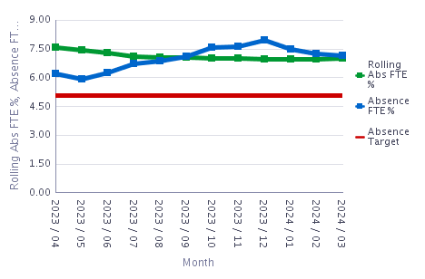
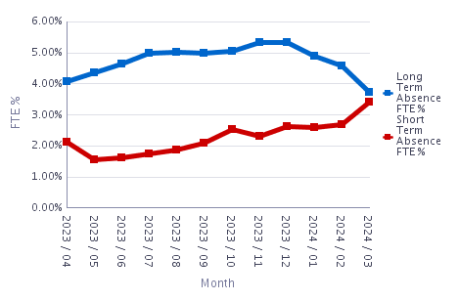
NPTSSG – Sickness Absence Q4 2023/24
LTS across NPTSSG = 3.73% as at 03/24. LTS has been reducing since 12/23
STS across NPTSSG = 3.43% as at 03/24. STS has increased since 11/23
Total absence across NPTSSG as at 03/24 = 7.15%. As at 05/24 this overall level of absence had reduced slightly to 6.94%
A sickness ‘Deep Dive’ pilot is taking place across Maternity Services as from 07/24
Absence management continues to be monitored via the monthly workforce groups / rostering scrutiny meeting
Staff Experience, Wellbeing and Retention Plans will incorporate the evidence-based Staff Health and Wellbeing – A Best Practice Guide for NHS Wales) – see themes identified in previous slide

Slide 23
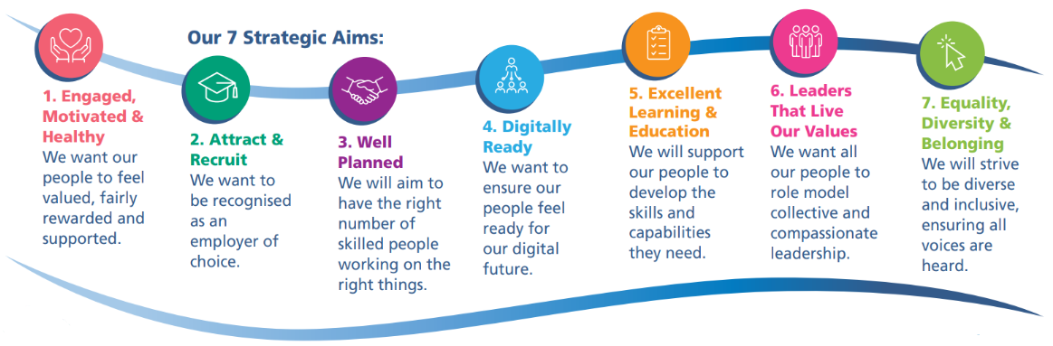

NPTSSG Workforce Priorities 2024/25
Workforce Plans
Staff Experience, Wellbeing and Retention Plans
The NPTS Service Group will have a planned rollout of developing Workforce Plans and Staff Experience Plans across each Division throughout 2024/25 to progress towards fully implementing the People Strategy. Progress will be monitored and evaluated through the Service Groups Business Assurance Accountability Groups (BAAM)

Slide 24
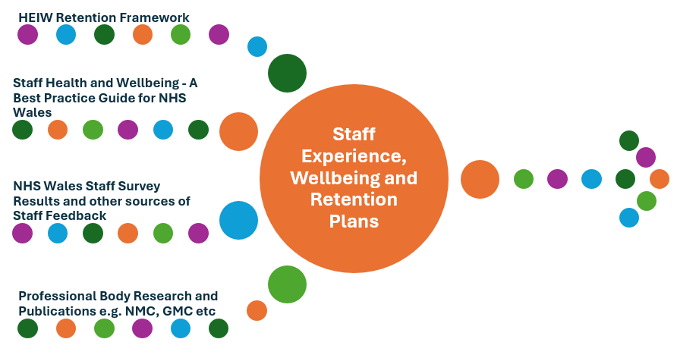
NPTSSG Staff Experience, Wellbeing and Retention Plans 2024/25
These Plans will be data driven (Workforce and Quality/Safety KPI) and evidence based using national resource guides and frameworks.
A compassionate, collective and inclusive approach will be adopted to develop and implement the plans. An evaluation process will be critical for the Service Group to understand the impact and value of the plans both for staff, Patients and Service Users
Stage one will focus on plans for MatNeo (aligning with WG Escalation requirements / HIW Improvement Plans / MatNeo SSP) and Stage two will focus on developing a plan for WFI and Theatres, before initiating a roll out across all Divisions.
The People Strategy and 10 Year Vision becoming a High-Quality Organisation

Slide 25
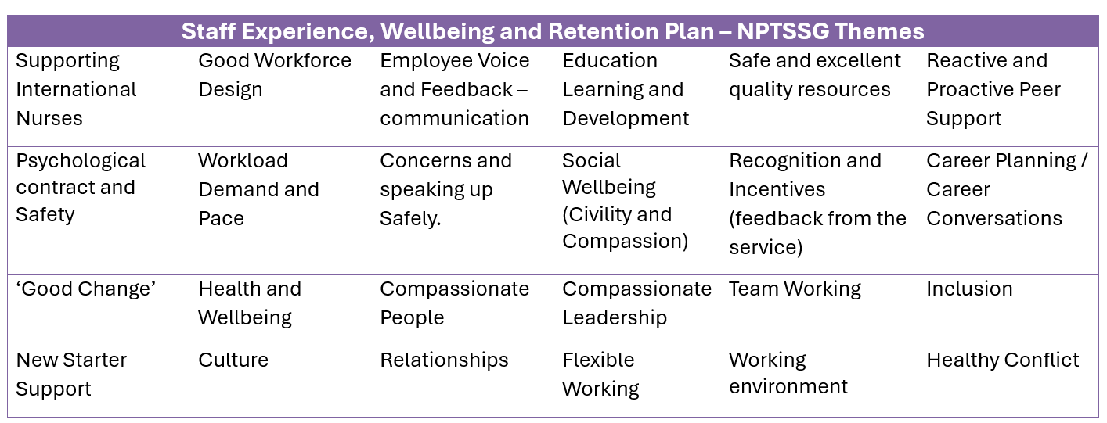
NPTSSG Staff Experience, Wellbeing and Retention Plans 2024/25

Slide 26

NPTSSG Workforce Plans
There is an aim to develop Workforce Plans for each service across the NPT Service Group. A number of Workforce Planning Workshops have already taken place since 1/24.
The Workforce Plans will provide services with the opportunity to focus on effective workforce design (using the principles in the Staff Health and Wellbeing – A Best Practice Guide for NHS Wales).
The HEIW Strategic Workforce Planning Toolkit will be used, and the plans will complement and support the Staff Experience, Wellbeing and Retention Plans.
Workforce Plans will enable more effective recruitment practices (particularly for ‘hard to fill’ posts) and the more efficient deployment of staff to reduce unnecessary variable pay spend
Workforce Design and Workforce Plans
The People Strategy and 10 Year Vision becoming a High-Quality Organisation

Slide 27
NPTSSG Workforce Priorities and Programmes of Work 2024/25
Engaged Motivated and Healthy
MAAW Training
Cardiac Theatres RRP Exit Plan
Well Planned
Variable Pay/ Rostering Scrutiny arrangements
Finalise implementation of the new NPTSSG Clinical, Operational Management and Nursing Structure
Leaders that live our Values
Sickness Audit Pilot in Maternity
Transforming Access to Medicine (TrAMS) programme
Excellent Learning and Education
SLT and SMT Team Development Programme
SLT Listening Events
PADR Deep Dive (supporting teams to improve the quality of PADRs / using PADR as enablers to improve quality and safety)
Effective Job Planning Project
TrIM Training
Partnership Compact (Partnership Group / Touch Point Sessions / Involvement in Project Task and Finish Groups)
Bespoke Wellbeing Pack - MatNeo

Slide 28
NPTSSG Workforce Priorities and Programmes of Work 2024/25
Attract and Recruit
Supporting Internationally Recruited Nurses
Digitally Ready
Digital solution in Community Midwifery team to support and improve the working day for Community Midwives (and improve service user experience)
Equality Diversity and Belonging
Promotion of 'We belong'
Working collaboratively with the Central Resourcing Team
Developing proposal for introducing Apprenticeships across the Service Group (linking to the SG's Population Health agenda)
Supporting and promoting staff networks (Calon / Neurodiversity
Neurodiversity Celebration Week (03/24)

Slide 29
NPTSSG Workforce Priorities and Programmes of Work 2024/25
Other workforce priorities and programmes of work include:
WFI Assurance, Recovery and Accountability
MatNeo Welsh Government Enhanced Monitoring / MatNeo SSP
Maternity Services – Transformation Programme / Caring for you Charter
Neath Port Talbot Hospital site – Culture and Medical Model
Theatres Board
Employment arrangements for employees participating in Private Patient Activity

Slide 30
Primary Care & Therapies
Notes:
This slide can be used for presentations which are from a health board-wide perspective or for a whole HB audience as the graphic device to the right of the slide includes all four service group colours and red for the corporate team.

Slide 31
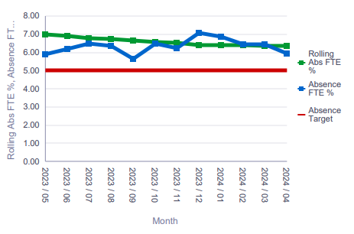
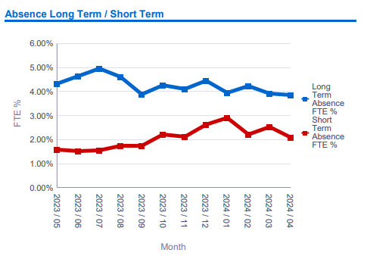
Workforce Performance
Workforce Performance
Employee Health and Wellbeing/Workforce Efficiencies
Source : ESR/BI Dashboard
Highlights
Achieved HB target of over 85% PADR compliance in Qtr1.
Source : ESR/BI Dashboard
Highlights
Improved position since Dec 2023.
Key risks/mitigation 2024/25
Deep dive in Anxiety/stress absence reasons over last two years completed.
Continued focus on long term sickness absences and development of improvement plans in hot spot areas e.g. Ty Olwen and Gorseinon.
Proactive management and scrutiny of vacancy gaps, recruitment forecasts and variable pay.
Promotion of Well-being support and training.
Highlights
Achieved HB target of over 85% compliance in Qtr. 4 & Qtr. 1.
Notes:
Service redesign/transformation and workforce efficiencies – meridian review.
Support service redesign and career progression but minimise impact of internal movement across SG – develop new B4 roles, B3-B4 movement (Nursing & Therapies). Skill mixing Nursing/Therapies posts to reduce vacancies.
Benchmark turnover to establish ‘normal’ across NHS Wales and internal to SBU.
Engagement – LPF, OBC, Staff Survey, Team Brief,

Slide 32
PCT – Attendance Improvement Plan
Target | Planned Action | Success Criteria | Who | When | Impact/Development | Outcome/Progress (RAG Rating)
To Improve and Support Line Manager’s confidence in using the MAAW Policy | Provide Initial and Refresher Training on the MAAW Policy. Training Sessions have been booked, and ongoing rolling Training Workshops are arranged. | To achieve attendance at the Training Sessions of those Managers within the Service Group who are new or who have never previously attended training. | Line Mangers attendance – Training provided by Workforce. | Training dates arranged: 1 July 2021 (16), 10 August 2021 (16), 4 October 2021 (5), 2 November 2021 (15) 4 November 2021 (16) 26 January 2022 (26)28 February 2023 (6) 2 March 2023 (5) 14 March 2023 (15) 18 April 2023 (3) Further Workshop dates arranged from July 2024 on rolling programme throughout the year. | Update knowledge, skills and ability for Line Mangers to undertake effective sickness management. Additional Absence Workshop to be arranged for follow up sessions. | 10 Training Sessions held, total 123 Manager attendees. Roll out to continue as required, with rolling programme.
Sickness Hot Spots | Deep Dive Sickness Review of Hotspot Areas | To conduct a review of highest sickness absence areas within the Service Group from the Hot Spot ESR RAG Report to ensure Management and Documentation compliance with the MAAW Policy, and any learning outcomes from case management. Action Plans to be drawn up from outcomes with recommendations. | Line Managers within Hot Spot areas – Reviews to be undertaken by Operational Workforce Team. | October 2022 July 2024 | Policy compliance and any learning outcomes reviewed. | Manager Reviews commenced in September and conclude the end of October 2022 Action Plans completed Dec 2022
Notes:
Emma – our intensions for this session

Slide 33
PCT – Attendance Improvement Plan
Sickness Hotspot Audits | Following Deep Dive Sickness Reviews of Hotspot Areas, sickness audits will be undertaken on the remaining 5 Hotspot Areas | To conduct an audit of the 5 top sickness hotspot areas, to ensure sickness cases are being managed, and documentation is being completed and maintained. | Operational Workforce Team, in conjunction with the Lead Managers within 5 Hotspot Areas | June-July 2023 July 2024 | Policy compliance, themes and learning. | Audits completed in July 2023 and July 2024
Sickness Surgeries | Monthly Sickness Surgeries with Lead Nurse/Manager within Hot Spot Areas. | To discuss sickness cases within Surgery and to draft action plans for sickness cases. | Lead Nurses/ Managers within Hot Spot areas – Surgeries held with Operational Workforce Support | August 2021 held monthly – ongoing | To ensure plans in place to support the Manager/Individual sickness absence cases. | Sickness Surgeries held and ongoing within each Hot Spot area
Review of Sickness Absence Reasons | As part of Sickness Hotspot Review reasons for absences to identify any patterns | Ascertain any preventative or proactive support within a specific Team/ Dept | Line Managers and Leads within Hot Spot areas . | October 2022 | To ensure early intervention support offered and appropriate OH referrals and Wellbeing signposting. | Reviews commenced in September 2022 and concluded October 2022
Wellbeing Support | As part of the Sickness Surgeries, to re-signpost Wellbeing Support available for staff and managers. To engage with Employee Wellbeing Team to review support available and share `Staff Engagement & Wellbeing Action Plan’ has been drafted by Workforce Business Partners. | To ensure current support is accessible as a preventative to absence or to support an early return to work. To maintain and update access to Wellbeing Support | Line Managers – Sickness Surgeries supported by Operational Workforce Line Managers to circulate – Workforce to update/maintain Action Plan | Monthly during Sickness Surgeries Regularly update `Staff Engagement & Wellbeing Action Plan’ as required. | To ensure support is being signposted by Line Managers within areas. Signpost staff support offered within Wellbeing, in addition to intranet site. | Wellbeing information is forwarded to Managers when received, updated within Surgeries, and Team Brief within the Service Group, and shared within the bi-monthly Service Group Wellbeing Champion Meetings/ SBU Wellbeing Forum
Wellbeing Champions | To engage with Service Group Wellbeing Champions. | To Agenda a plan to actively promote wellbeing across the Service Group. | Wellbeing Champions – Workforce Support. Ongoing meetings are held bi-monthly. | Bi-monthly meetings with Wellbeing Champions and Workforce support. | Wellbeing Champions to continue to raise awareness of wellbeing support, and promote and share ideas within the Group. | Wellbeing Champion Meetings being held bi-monthly for sharing good practice and wellbeing ideas within the Service Group.
Notes:
Emma – our intensions for this session

Slide 34
PCT – Attendance Improvement Plan
Staff `Drop in’ Sessions | To offer staff within Hot Spot areas the opportunity to meet with Manager/HR ad hoc drop in session to raise any concerns/ discuss absence management/ share good working practices/ wellbeing support. | Attendance at Sessions | Line Managers – Supported by Operational Workforce | Bi-monthly offer date/time to staff | To enhance good communications and promote staff support. | Staff `Drop In’ Sessions to be offered within Hot Spot areas from Sept 2024.
Manager `Drop in’ Sessions | To offer Heads of Service the opportunity to meet with Workforce Business Partner/Asst BP for session on ER queries/ absence management / share good working practices/ wellbeing support. | Attendance at Sessions | Workforce Business Partner/Asst Workforce Business Partner | Bi-monthly Meetings | To enhance good communications and promote support for Heads of Service. | Manager Meetings to be arranged by Workforce from September 2024.
Absence Data Sharing | To circulate information to the Service Group Heads of Service and Managers regarding the sickness data from BI and ESR Reports for information and action. | Using data: Workforce metric data to be issued to each Service Group management team on a monthly basis via email, Team Brief and Workforce Board Reports. Data issued to include:Open ended sick (> 90 days – identifies employees on long term sick and who may be reaching half or nil pay) RAG Report Sickness absence ‘Hot Spot’ Reports | Workforce Business Partner/ Asst Workforce Business Partner | Monthly | To ensure the Service Group and Managers are updated on their Sickness data for appropriate action. | BI/ESR Information circulated monthly to Managers when received
Using the PADR process to improve employee attendance and employee PADR | Continue to ensure via the PADR process that employees feel confident and competent to undertake their roles. Opportunity to have a conversation on Wellbeing, and support available. | Managers to continue to ensure PADR compliance, ensuring employee wellbeing `check in’ is part of the PADR discussion. | Service Group Managers/ Leads (Delegate to all line managers). Workforce Business Partner to share PADR compliance Rates monthly with the Service Group Leads. | Monthly / Review as necessary | To ensure Managers comply with PADR for all staff, and support for staff within the PADR process, ensuring all mandatory and statutory training requirements are complete, and wellbeing discussion held. | PADR KPI’s monitored monthly to review compliance
Notes:
Emma – our intensions for this session

Slide 35
PCT – Attendance Improvement Plan
Advise on absence/ attendance queries at Service Group E-Roster Scrutiny Panels | Workforce Business Partner / Asst Business Partner to attend all Roster Scrutiny Panels with Managers/ Leads. | Workforce support and advice on any sickness absences within the Roster, and ensure that the relevant Operational HR support has been sought by Managers. | Leads/ Managers – Workforce Support | Monthly Panels for all areas within the Service Group. | To promote early intervention for absences identified within the Roster. To ensure Managers supported to initiate an earlier return to work. | Ongoing attendance at monthly E-Roster Scrutiny Panels
Employee Feedback/ Voice | Exit Questionnaire / Interviews to be conducted when staff leave the Service Group or transfer posts internally. | To re-establish the exit questionnaire process with a clear advice for managers and staff to follow. Creating a new local exit interview process. Analyse exit data to provide valuable information to feed the employment lifecycle and any interventions that can be implemented to retain staff and improve staff experiences. | Line Managers Workforce | Provide all leavers with an exit questionnaire/ offer exit interview. Follow up exit interview and report data analysis quarterly and annually to Service Group. Also to provide quarterly reports to Service Leads for each of the specialties. | Information analysis to support staff retention and wellbeing. Identify any improvements to support with staff retention and attendance at work. Highlighting was is going well that supports staff wellbeing and attendance, and any improvements learning from feedback. | Exit Questionnaire Process introduced February 2022, and quarterly and annual Exit Questionnaire Reports being produced. In addition to reports being provided to Service Leads, where respondents consent. New Microsoft teams exit interview form introduced 2024.
Wales NHS Staff Survey Feedback | Feedback following completion of Wales NHS Staff Survey | Assessing received feedback comments for the Service and reviewing any themes. | HEIW undertaking the National NHS Staff Survey and providing Feedback. | National NHS Staff Survey being conducted on 2 October 2023 for 4 weeks. | Feedback expected from HEIW in December 2023, and reflection on responses received. | National Staff Survey commenced October 2023 for 4 weeks. Outcomes received June 2024. Initial feedback shared with senior team in July 2024. Julie Lloyd attended PCT tea brief in August 2024 to feedback results to the group. Action plan being finalised on key areas of improvement.
SBU Wellbeing Forum | To engage across with Managers/Leads across SBU. | Promote wellbeing across the Health Board. | Asst HR BP, Nursing and Therapy Representatives attend from PCTSG held monthly. | Monthly meetings with Asst HR BP and Nursing and Therapy representatives attending from the Group. | To raise awareness of wellbeing support, and promote and share ideas. | Meetings continue to be held monthly for sharing and good practice.
Notes:
Emma – our intensions for this session

Slide 36
Morriston
Notes:
This slide can be used for presentations which are from a health board-wide perspective or for a whole HB audience as the graphic device to the right of the slide includes all four service group colours and red for the corporate team.

Slide 37
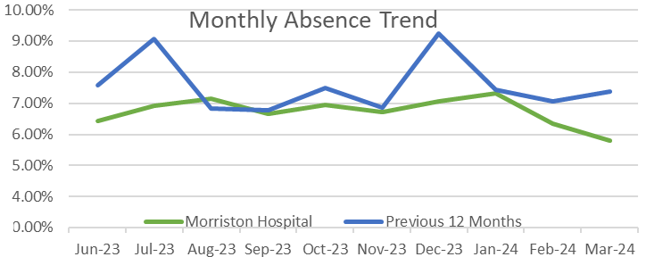
Morriston June Update
Quarterly% |  |  |  |  | Rolling year Cum %
Current FY2023 | Q1 | Q2 | Q3 | Q4 | Cumulative
 | 6.36% | 6.91% | 6.90% | 6.48% | 6.62%
Sickness Absence Overview
Hot spot areas include Phlebotomy and ED/AMU. Within Phlebotomy a recent decision surround a re-banding is driving short term absence. Short term absence appears to be increasing within ED/AMU also – some of which relates to the pressures within the team. Sickness absence audits are continuing in these areas to support leaders in managing attendance at work
Absence levels for quarter 4 have shown a reduction, with the overall cumulative position reducing, putting MSG at 1.48% above WG 5% target. This is a significant improvement in comparison to the 2022 Q4 position when MSG was at 7.47% and the cumulative position was at 7.66%.
Targeted improvement plans supported by absence audits, along with management training and HR support has seen absence in the majority of areas improve.
MSG’s Long term absence Q4 equates to approximately 57% of cumulative absences, a decrease from Q3 when LT cumulative absence was at 64% of all cases. Q3 ST absence seen an increase from Q3 position in cases largely due to cold/flu increases.
During Q4 S13 Cold/Flu was the top reason for absence, however S10 Anxiety/stress related conditions have constantly remained as a top reason for absence for LT cases with majority stating personal stress as the main reason for stress related absence.
Sickness Absence Actions
Overall MSG sickness absence action plan has been developed and is being actively worked to.
Targeted sickness absence action plans are in place for hotspot absence areas that have been identified and are reviewed and updated monthly.
Sickness absence audits have been conducted to ensure robust absence management processes are in place, each audit conducted generated a report with recommendations/action plan. 3 month re-audits have also been conducted each re-audit generated a report with recommendations/action plan where required. Random spot audits are now being conducted.
HR and management are actively reviewing process and introducing preventative measures in an attempt to reduce absence.
Additional support documents have been created for line managers to support with absence management, this includes absence management tracker, absence prompt calculator, line management guidance and wellbeing signposting.
Discussions held at Divisional Board Meetings, with reporting provided on absence performance.
Additional Absence management workshops are being provided by HR Ops team/HRPB team and Occ Health.
Weekly nursing unavailability meetings are held to review absence and focus on hotspot areas.
A staff wellbeing with focus on stress working group has been established, to understand reasons for stress related absence and the management of these absences, and looks to explore additional support or resources that can assist staff and prevent absence and/or reduce the time off absent.
Cumulative Top Reasons For Sickness Absence
S10 Anxiety/stress/depression/other psychiatric illnesses
S13 Cold, Cough, Flu - Influenza
S12 Other musculoskeletal problems
S25 Gastrointestinal problems
ST and LT Sickness Absence
 | Short term | Long term
Q4 Cumulative | 2.80% | 3.67%
Rolling 12 month Cumulative | 2.38% | 4.27%

Slide 38
Morriston – Deep dive Action Plan
ACTIONS & SUPPORT IDENTIFIED FOLLOWING RE-AUDITS
In order to ensure that all managers are compliant with the Managing Attendance at Work policy across the Service Group, further actions were identified to ensure sickness absence is being managed effectively. In total 40 areas have been re-audited and out of those 40 11 areas required further support as they had not fully implemented their recommendations.
The below points form the basis for further action or support;
Managers to ensure the correct process is followed for managing sickness & absence going forward.
Managers to ensure all sickness & absence documentation is filed securely & safely either electronically or on staff paper personal files.
Ensure employees are aware of their responsibility to ensure Medical Certificates are received within 3 days of the expiry of their last Certificate. If this is not possible, the employee should contact their line manager by telephone to advise them when the certificate will be received.
Where Phased Return to Work are in place or Reasonable Adjustments, ensure the documentations from the policy is completed.
A re-fresher of the absence notification procedure should be communicated to all. Staff are to telephone the ward if they are unable to attend work through sickness. It is recommended that a visual notification of absent for staff be placed on the ward notice board.
Manager and staff member should agree the notes after their meeting has taken place. A letter confirming the outcome of the meetings should be sent to staff.
Ensure return to work meetings are completed within a timely manner and the paperwork is completed fully and saved on the staff personal file.
Ensure a procedure is in place that provides a prompt to send an 8th day letter to the employee outlining what is expected from them going forward as well as what support is available.
The Sickness & Absence management tracker is updated fully to reflect the actions undertaken for the absence.
Since the audits have been undertaken there has been a noticeable impact on the absence across the Service Group, the absence percentage is currently 6.67% for Registered Nurses a reduction of 3.38%and Unregistered its currently 8.32% a reduction of 4.32%
Notes:
Emma – our intensions for this session

Slide 39
Mental Health & Learning Disabilities
Notes:
This slide can be used for presentations which are from a health board-wide perspective or for a whole HB audience as the graphic device to the right of the slide includes all four service group colours and red for the corporate team.

Slide 40
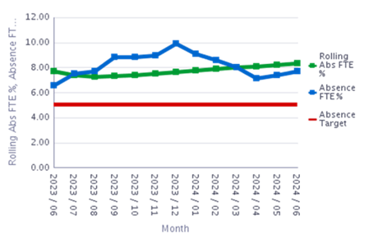

.
MH & LD June Update
Hot spots – high sickness levels due to increase anxiety/stress/depression, some of which are work related; complex client support. A number of support mechanisms are in place for our employees
Training sessions on supporting absence, sessions for carers and their managers, bereavement session with our staff counsellor, contacted all staff who had been absent over a 12 month period via a questionnaire to understand individuals knowledge of what they could access, reason for absence and what we could have done to prevent absence, correlation of absence with incident and client group.
Psychology group wellbeing sessions twice a month for overseas nurses to prevent absence and to support the anxiety of transition.
Dedicated staff counsellor to support early intervention/prevention of sickness absence, targeting areas of high work related stress
The TRIM support continues to be widely shared across the group and additional resource has been trained in month to expand the provision
Managers to continue to monitor patterns within their respective area particularly absences for stress and anxiety and escalate concerns to Workforce Business Partner and ensure all documentation is complete for each absence period and escalation trigger meetings held
Managers to ensure their direct reports are familiar with the Managing Attendance at Work Action plan and action plans for their own areas continue to be updated
Hot spot areas
Directorates short term absence and long term absence for June 2024. Those highlighted in red are above target level. Managers are asked to ensure that all absence is monitored and support is identified for staff within these areas.

Slide 41







MH & LD Workforce – People Strategy Quarter 1
Engaged, Motivated & Healthy Staff
Staff Attendance
  Sickness focus
  7.48% overall LT 5.23%↓ ST 2.25% ↑
  Wellbeing support / Champions
Recruitment & retention group established
  Flexible working
  Turnover 10.75% ↓
Union & Guardian engagement
Excellent Learning & Education enabled
Mandatory Training 90.91%↑
Buddying / Preceptorship / reflective practice in place
Rdial Hub actively enabling and monitoring research, development, innovation and learning’ across all staff groups
Promotion of Welsh Language
Attract & Recruit
Vacancies
Overall 120.23↓ Nursing 68.71↓ Medical 20↔
Widening Access
  Welcomed 13 HCSW Apprentices
Developing career pathways / preceptorship
Recruiting to gaps / reflecting on selection process / monitoring experience
Enhancing diversity
  Integration of 30 International Nurses
Leadership that lives our values
Evaluating our Talent and succession planning / new appointments
Enabling and reviewing access to leadership development via Rdial
PADR focus 73.68%↑
Equality, Diversity & Belonging
Established group to focus on this agenda reviewing both our people equality data and current practices, to enable wider representation in the service group across all protected characteristics from recruitment, through to improving work environments
International Staff enabling cultural conversations, reflections and wellbeing support
Well Planned / Digitally Ready
Workforce Planning training held in Qtr1
Review people data in various forums
  Focus on Variable pay & roster management
  Introduced Medical staff roster scrutiny
  Establishment control

Slide 42
MH&LD – Attendance Improvement Plan
Theme | Action | Outcome/Measure | Lead Responsible | Time Frame | Progress | Complete
Engagement | MH&LD Strategy / Service Development to be communicated and shared across the group to all staff in line with People plan and recovery and sustainability plan | MH&LD strategy to be shared with all employees for all to have a greater understanding of how their role fits within the organisation | Senior Team/Divisional Managers/Head of Nursing/ Head of Psychology/Clinical Directors | Ongoing | Senior team meetings each quarter open to all staff Divisional / Directorates monthly meeting Group email for all MH & LD staff utilised | Ongoing
 | Ensure staff have the opportunity to engage with Senior Management and ask questions or raise concerns | Meet the Senior Team Q &A to be held quarterly to ensure all staff are aware of changes within the group and can ask questions | Head of Operations | Commenced ongoing | Held each quarter Guardians regular visits across sites to allow staff access to escalate concerns Monthly Partnership meeting with union colleagues | Ongoing
 | Meet the Divisional Team Managers bi monthly Q & A sessions | Visible empowering compassionate leadership to communicate, create ownership, involvement and engagement | Divisional Manager |  | Not commenced yet – further discussions to be held
Notes:
Emma – our intensions for this session

Slide 43
MH&LD – Attendance Improvement Plan
To educate staff regarding the Respect & Resolution Policy and Just Culture & Values Ensure staff that are involved in investigations, safeguarding processes, tribunals, coronary courts are provided with support | To encourage positive interaction, reducing cases referred to the Guardian service and improved stress levels and attendance at work. All staff aware of mechanisms and policies they can access for support within the Health Board Managers to be aware of the potential impact to staff of internal /external processes, ensure access to wellbeing services, management support, counselling and Trim has required | Senior Team Workforce Business Team & Learning & Development Support All Managers | Ongoing Ongoing | Sessions available re MAAW, Manager awareness, banter and equality sessions, circulate the policy. OD work and staff survey action plan Guardians have been given permission to visit all premises Quality Assurance Visits Establishment of Equality & Diversity Group Aculturalisation work with OD | Ongoing Completed Initial pilot commenced in Swansea LD
Managers to ensure they understand the work environment | Identify areas for senior managers to go and spend a day working alongside front line staff Ensuring visibility of senior leaders | Service Managers / Directorate Manager & Lead Nurse / Head of Psychology | Ongoing | Senior staff working alongside staff as required on specific areas Quality Assurance Visits | Ongoing
Raise awareness of wellbeing champions, to assist in promoting the values and behaviours of the Health Board and policies and services available to staff | Recirculate detail of Wellbeing Champions that can be accessed within the group, enable the champions to be released to attend training and share information. | Workforce Business Partner in conjunction with wellbeing champions | Quarter 2 | Active Champions in the Group currently need to increase exposure | Completed but regular review
Improve staff health and wellbeing by using wellbeing champions | Service areas to explore additional ways to promote and use Wellbeing Champions to improve Staff Health and Wellbeing. | Service Managers / Directorate Manager & Lead Nurse / Head of Psychology | Quarter 3 | DU have so far supported over 55 members of staff to become Wellbeing Champions. Focus now needs to be on how each service can utilise the Wellbeing Champions in their areas to assist in sign posting staff to health and wellbeing support and advice accordingly. Also, how these roles can be used to promote staff health and wellbeing, e.g., lead on ‘Time to Talk’ day, Mental Health Awareness sessions etc. | Ongoing
Notes:
Emma – our intensions for this session

Slide 44
MH&LD – Attendance Improvement Plan
Managers to share wellbeing at work strategy and additional information and support available via email and team meetings | Staff are aware of what support is available to access in addition to team and management support | Service Managers / Directorate Manager & Lead Nurse / Head of Psychology | Ongoing | Staff have access to Wellbeing share point site. Courses circulated All new starters are sent a wellbeing pack of information. Overseas staff are invited to bespoke wellbeing sessions | Ongoing
Review data from staff who have been absent from work due to stress / anxiety | Circulate questionnaire to all staff absent in last 12 months due to stress / anxiety to capture reason for absence, what support staff were aware they could access and whether there was anything to prevent the absence from occurring | HR Business Partner, Head of Nursing Quality & Governance, Head of Psychology | Quarter 3 | Questionnaire prepared, list of staff identified. Data will be requested in Quarter 3 and responses will be reviewed against responses received a year ago
Bespoke Wellbeing Reflective sessions for Staff arriving from overseas to aid transition into UK and SBU HB | To prevent / reduce anxiety levels within overseas staff and sickness absence | HR Business Partner, Head of Nursing Quality & Governance, Head of Psychology | Ongoing, monthly | Sessions commenced in Qtr 1, one session is held each month in Bridgend and two sessions in Swansea each month, all staff are encouraged to attend, psychology led sessions | Ongoing
Group sessions offered by MH & LD Counsellor | To enable staff to attend group session to remain in work where specific concerns are identified in the work environment or commonality identified | HR Business Partner, Head of Nursing Quality & Governance, Head of Psychology | Ongoing, monthly review | Group session offered in departments that have been subject to employee relations processes, high short term sickness levels, or staff with commonality such has bereavement support | Ongoing
All areas to be aware of Trim and promote its use | Review of incident data to ensure that awareness and use of TRIM service is utilised across the service group | Senior Team in conjunction with Lead Nurse for Trim | Ongoing | All areas have been briefed on use of Trim. Additional staff trained to support, activity and request for Trim support is aligned with datix incidents and workforce data | Ongoing
Notes:
Emma – our intensions for this session

Slide 45
MH&LD – Attendance Improvement Plan
Utilise support networks and continue to promote their membership ie. Calon, Wellbeing champions, BAME network, Union support networks | Staff are aware of mechanisms they can access for support in the health board | Service Managers / Directorate Manager & Lead Nurse / Head of Psychology | Ongoing | Details of events and access circulated has appropriate | Ongoing
Establish a monthly Divisional Managing attendance action group | Establish a monthly Divisional Managing attendance action group to review absence, identify patterns | Workforce Business Partner Team Service Managers / Directorate Manager & Lead Nurse / Head of Psychology | Ongoing | Ongoing in all areas, meetings to be scheduled in CAMHS and Psychology and LD CTM | Ongoing
Each division to identify mechanism for improving attendance | Each directorate within each division to develop an action improvement plan | Workforce Business Partner Team / Service Managers / Directorate Manager & Lead Nurse / Head of Psychology | Ongoing | Ongoing - with the exception on CAMHS, Psychology and LD CTM | Ongoing
Managers to share with their teams at all team meetings sickness % rates for their area and discuss/share experience of sickness management and what would improve attendance at work | Share information and reports in respect of individual team performance. Consideration given to additional support in respect of managing attendance at work training and HR advice on difficult cases/scenarios | Service Managers / Directorate Manager & Lead Nurse / Head of Psychology | Ongoing | RAG report is currently circulated in additional to Divisional reports / Board reports Ongoing - with the exception on CAMHS, Psychology and LD CTM | Ongoing
Monitor and review ESR sickness reports | ESR reports to be shared for trigger reports, trends/patterns. | HR Operations / Workforce Business Partner Team linking in with Service Managers / Directorate Manager & Lead Nurse / Head of Psychology | Monthly | Already established process for sharing | Ongoing
Detailed information on sickness to be incorporated into HR Monthly Group Board Report & Divisional Meetings and exceptions/actions agreed as appropriate. | Workforce detailed metrics report shared and discussed at every Monthly Board meeting & Divisional meeting | Workforce Business Partner Team | Monthly | Mechanism in place | Ongoing
Identify hotspot areas undertake further analysis of sickness trends and agree additional support for managers and staff where necessary and possible to improve health and wellbeing of workforce. | Hotspot areas within each directorate to be identified and appropriate actions to be implemented which may include staff / management drop in sessions to raise concerns / ideas for improvement. | Service Managers / Directorate Manager & Lead Nurse / Head of Psychology together with Workforce Business Partner | Monthly | Weekly meeting held by Workforce, Finance, Rostering and HoN on hotspot areas. | Ongoing
HR Operations Team to link in with all Managers for staff on long term sickness leave to discuss case management and updates for each case | Position of each long term sickness case monthly to be obtained and an assessment made regarding level of support required | Operational HR Team | As required /Ongoing | Mechanism in place, but number of cases covered is dependent on resource | Ongoing
Notes:
Emma – our intensions for this session

Slide 46
MH&LD – Attendance Improvement Plan
Undertake review of short term absence cases and patterns | Monthly provision of short term cases. Assessed for patterns or audit requirements | Service Managers / Directorate Manager & Lead Nurse / Head of Psychology in conjunction with HR Business Partner team and HR Operational support | Ongoing | Information provided, further audit or explanation acquired undertaken where data has dictated | Ongoing
All Managers must ensure they conduct RTW in a timely manner, following their return to work from sick leave. | On first day of return /no later than 3 days of RTW. | All managers | Ongoing | Random audits to be undertaken by Service Managers / Directorate Manager & Lead Nurse
Audits | These will be undertaken where the data or processes needs further exploration | HR Operations team / Workforce Business Partner Team | As required |  | As required
Outstanding training needs for all managers to be identified as part of every managers PADR and PDP. | Using PADR process to improve employee attendance and wellbeing and identify relevant training that staff should attend. Minimum expectation that all staff managing sickness absence to attend the MAAW training. | All Managers | Ongoing | Ongoing – promotion in divisional meetings
All newly appointed managers to attend MAAW training as part of their local induction. | Managers to liaise with Workforce Business Partner Team as required for newly appointed managers. Staff should be nominated for the “Managers Pathway training” which includes MAAW | Directorate Managers / Lead Nurses / Service Managers / Head of Psychology | Ongoing | Ongoing
Review nominations and attendance for Band 4-7 Managers to attend Footprint Programme | Ensure that attendance is mapped. Nominations are made for all managers who have not attended or who need to be re-scheduled. | Service Managers / Directorate Manager & Lead Nurse / Head of Psychology | Ongoing | Identified Managers requiring training Reviewed – capacity not all been able to attend.
Review nominations and attendance for Band 8a Managers and above to attend Bridges Programme | Ensure that attendance is mapped. Nominations are made for all managers who have not attended or who need to be re-scheduled. | Service Managers / Directorate Manager & Lead Nurse / Head of Psychology | Ongoing | Identified Managers requiring training
Notes:
Emma – our intensions for this session

Slide 47
Estates & Facilities
Notes:
This slide can be used for presentations which are from a health board-wide perspective or for a whole HB audience as the graphic device to the right of the slide includes all four service group colours and red for the corporate team.

Slide 48
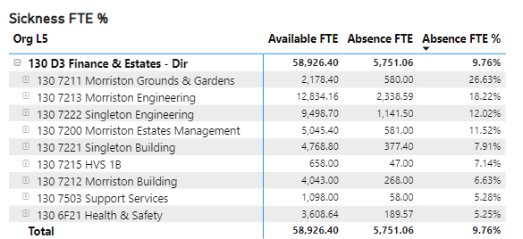
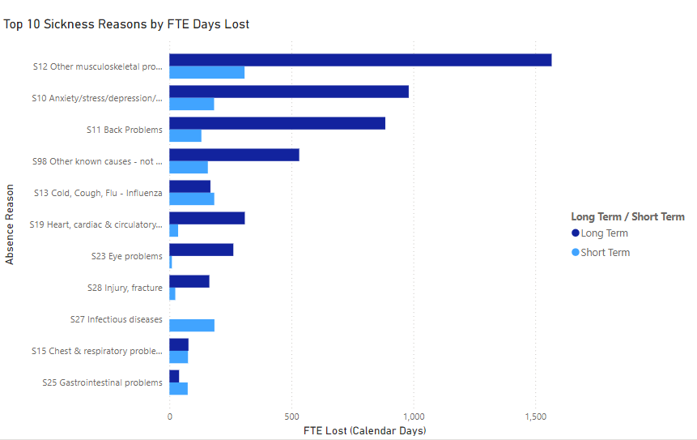
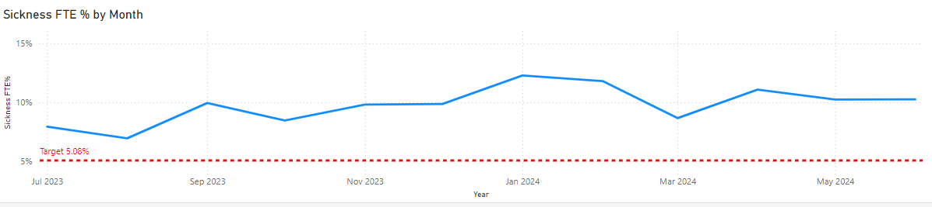
.
Estates & Facilities June Update
Hot spot areas such as Estates & Support Services, more specifically Morriston Domestic & Porters. Organisational change, shift pattern reviews are driving sickness absence levels.
Departmental Manager monthly meetings to monitor effectiveness of improvement plan in reduction of sickness absence
Operational Manager monthly caseload meetings to review absences on a case-by-case basis
Evaluation of MAAW pilot at Morriston
Regular sickness absence audits
Support development of management skills in MAAW
Increase use of preventative measures to support improvement in reduction of sickness absence focused on health & wellbeing
Improve partnership working to reduce sickness absence in hot spot areas
Undertake benchmarking exercise to determine and establish realistic, intelligent sickness absence target for department
Conduct 'deep dive' into sickness absence across support services, using an evidence-based approach to further develop improvement plan
Measure staff engagement
Tailored adjustment and case conference training for leaders e.g. supporting MSK cases

Slide 49
.
Absence Intervention Group – Morriston Porters
The Terms of Reference has been developed for Sickness Absence Management Intervention Group - Morriston Porters (inc. Management and staff side)
The purposes of this group will be to focus on improving sickness management, reducing absenteeism, and enhancing staff well-being.
The group will address both short-term and long-term sickness absence patterns, reasons for sickness absence, specific health conditions and broader wellbeing initiatives
During the meeting current sickness data will be shared to highlight patterns and trends. Reasons for sickness absence will also be discussed. Highlight communication channels with key stakeholders
Measurable objectives e.g., reducing sick days by a certain percentage or interventions will be agreed
Identify deliverables, such as guidelines, training programs, or policy recommendations.

Slide 50
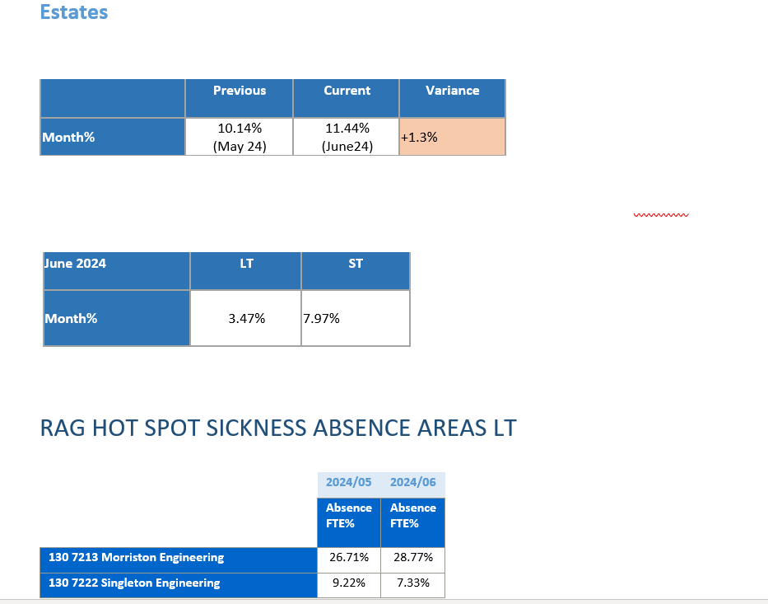
Estates – Sickness Absence
Hotspot absence areas have been identified as outlined and meetings with relevant managers to discuss absence management and support are being undertaken.
Review managers understanding of the short term and long term sick process. HR to provide guidance and support to assist in future management of cases from day one.
Confirm and challenge Meetings will be arranged with HR Ops team to review all current each long term case with managers.
Review reasons for absence in long term sick cases to identify if there is an underlying cause or work related reasons as to why S10 is the predominant reason for absence.
Absence management training / refresher training being completed.
Review temporary alternatives to allow staff to return in an adjusted role.
Notes:
Emma – our intensions for this session

Slide 51
SS – Attendance Improvement Plan
 | Support Services 1yr Plan (July23-24)
 | The purpose of the Improvement Plan is improve levels of attendance at work and reduce % of sickness absence across Support Services through objectives set within the Plan. The aim is to support health and wellbeing at work, sustain a high level of engagement and positive employee experience through the objectives and measures outlined below. The Senior Leadership Team and Operational Managers are responsible for delivery of the plan, supported by HR, Occupational Health and Trade Union colleagues. Performance against objectives will initially be monitored at monthly absence review meetings. Outcomes will be measured by staff survey results, % levels of absence. The outcome required from this plan is to support staff to receive any appropriate required support to enable sustained attendance at work and to improve the % of sickness absence across Support Services.
 | Improvement Measure | Deliverables | Timeline for Completion | Lead Responsibility | Outcomes | Progress
1.1 | Departmental Manager monthly meetings to montior effectiveness of improvement plan in reduction of sickness absence. | Managing Attendance at Work monthly meetings to be arranged to monitor sickness absence; development of improvement plan and progress against plan. Consider targeted intervention for hot spot areas only. Extend invite to OH. Meeting frequency to be reviewed in 3-6mths to assess whether meetings can be moved to Quarterly, subject to decrease in absence levels. | Q2 | Departmental Managers/HR | 1. Evaluate impact of proposed measures on reduction of sickness absence; 2. Adjust measures accordingly. | Monthly meetings set up for Singleton, Morriston & NPT
1.2 | Operational Manager monthly caseload meetings to review absences on a case-by-case basis. | Monthly sickness absence surgeries held by HR to review all absences (LTS & STS) on a case-by-case with Operational Managers to ensure compliance with all aspects of MAAW policy (includes prompt closure of open ended absences, accurate absence reason coding, progression through MAAW policy) and proactive management of sickness absence. Extend invite to OH colleagues. | Q2 | Operational Managers/HR | 1. Develop detailed understanding of sickness absence; 2. Develop targeted interventions to reduce sickness absence. | SHA has arranged monthly meetings. Plus monthly meetings held for Singleton, Morriston & NPT.
1.3 | Evaluation of MAAW pilot at Morriston. | Evaluate the MAAW pilot being undertaken within Support Services at Morriston (Domestics & Portering) to assess impact and effectivenss. Implementation to be considered across the service if results are successful. | Q2 | Head/Deputy of Support Services/HR |  | Review has been undertaken and report will collated with findings. As an oucome Informal Discussions have reverted back to be held by the line managers for completion after RTW. Further review will be undertaken by Governance Lead. Priority to recruit to Sickness absence officer post.
1.4 | Regular sickness absence audits. | Audits to be undertaken quaterly/bi-annually to audit compliance with MAAW policy and sickness absence process. Introduce targeted intervention for areas of low compliance; adjust audit frequency according to improvement. | Q2 | SHRM/Operational HR/Head/Deputy of Support Services | 1. Improve compliance with MAAW policy. 2. Assessment of the impact of improved compliance on reduction of sickness absence. | Governance Team will lead on audits with support from HR. Audits to commenced in New year and Morriston Domestic & Porters will be first areas.
Notes:
Emma – our intensions for this session

Slide 52
E&F – Attendance Improvement Plan
2.1 | Support development of management skills in MAAW. | Bespoke Toolbox talks/training on MAAW for managers to include coaching for difficult conversations; coaching staff to own and develop solutions to problems, coaching teams in responsibility for healthy working relationships; use of HEIW Healthy Working Relationships toolkit. Consider buddying/mentoring system for managers to support one another through action learning, develop a support network across LHB's. | Q2-3 | SHRM/Operational HR/Head/Deputy of Support Services | 1. Support effective management of attendance at work. 2. Reduction in levels of sickness absence. | * Training commenced in September and to date 33 supervisors/managers have been trained. Further date arranged for 10th October. Mike Powell, Portering Team Leader has undertaken the training at Morriston, which has been very well received and excellent feedback provided. Further training to be arranged at both Morriston and CCH. * Sickness absence toolbox guidance to be developed and training sessions to be held in the New Year
2.2 |  | Encourage use of the Work Related Stress Risk Assessment tool in management of stress related absences; provide support/guidance/training in use if needed. | Q2-3 | Operational HR/Head/Deputy of Support Services | 1. Effective management of absences related to work related stress. 2. Reduced absences due to work related stress. | Bespoke training session to be arranged for 11th January 2023
2.3 |  | Managers to attend the mental health awareness training session delivered by the Wellbeing Team. | Q2-3 | Departmental Managers/HR/Wellbeing Team. | 1. Effective management of absences related to mental health. 2. Reduced absences relating to mental health. | Training provided on 11th Nov by time to change Wales, further training to be held in New Year
2.4 |  | Identify staff to attend Footprints/Manager Pathway training. | Q3-4 | Head/Deputy of Support Services/OD | 1. Support effective management of attendance at work. 2. Reduction in levels of sickness absence. | List has been provided to OD and attend will attend in the New Year
3.1 | Increase use of preventative measures to support improvement in reduction of sickness absence focused on health & wellbeing. | Managers to receive support & guidance from Occupational Health to strengthen referral process and quality of reports. Departmental managers to identify training needs of managers/supervisors. Where required managers to attend training sessions to ensure robust OH referrals are made. Develop closer working relationships with OH to establish areas for improvement. | Q2 | Departmental Managers/SHRM/Operational HR/OH | 1.Imroved quality of Occupational Health referrals. 2. Support management ability to effectively manage absence. | OH referral training was held on 20th September and 25th October 18 managers have now completed the training
3.2 |  | Ensure all managers responsible for MAAW are aware of staff wellbeing advice and support services and actively promote these services across their areas. | Q2 | Departmental Managers/SHRM/Operational HR | 1. Increased access to health & wellbeing support available to staff, supports self help in managing attendance at work. 2. Increased attendance at work. | Each department now has a Wellebing board and Managers are aware of the services available
Notes:
Emma – our intensions for this session

Slide 53
E&F – Attendance Improvement Plan
4.1 | Improve partnership working to reduce sickness absence in hot spot areas. | Quarterly focus group to discuss attendance at work, health & wellbeing. Engagement with trade unions, staff, Occupational health, health & wellbeing champions, HR, departmental managers to review and discuss attendance at work, consider new initiatives to improve attendance. | Q2-3 | Head/Deputy of Support Services/HR/Wellbeing Team/TUP's/OH | 1. Develop joint approach to proactive management of attendance at work. 2. Working together to develop new initiatives with continued focus on health and wellbeing.
5.1 | Undertake benchmarking exercise to determine and establish realistic, intelligent sickness absence target for department. | Obtain absence rates across NHS Wales LHB's; review cumulative absence for past 3yrs across support services; use information to determine relative absence target. | Q2-3 | WOD/HRBP | 1. Develop a comparative, realistic absence target for support services. | 2% Reduction. Obtaining Other HB's % in order to undertake benchmark analysis.
6.1 | Conduct 'deep dive' into sickness absence across support services,using an evidence based approach to further develop improvement plan. | Deep dive into sickness absence to establish underlying reasons for absence (using evidence based approach); identify trends, hot spots; conduct analysis using metrics - turnover, employee relations casework, cultural assessment, workforce profiling etc. adjust improvement plan to ensure measures are appropriate and impactful in reduction of sickness absence and increased attendance. | Q2-3 | Head/Deputy of Support Services/HRBP/OD | 1. A robust, evidence based approach to continuous improvement in attendance at work. | Morriston Domestic dive analysis has commenced and findings wil be feedback into next meeting. Action plan being developed.
6.2 | Measure staff engagement. | Use staff engagement scores - pulse surveys to further develop improvement plan. | Q3-4 | Head/Deputy of Support Services/HRBP/OD | 1. Assessment of workforce motivation and engagement scores. 2. Appropriate improvement measures to increase motiviaton and engagement that support attendance at work. | Pulse survey will held in New Year with Morriston domestics and will encompass questions around the management of sickness absence.
Notes:
Emma – our intensions for this session

