Slide 1
Quality Priorities highlight report
February 2024
Author - Angharad Higgins and Quality Priority Teams
Sponsor - Gareth Howells, Director of Nursing and Hazel Powell, Deputy Director of Nursing

Slide 2
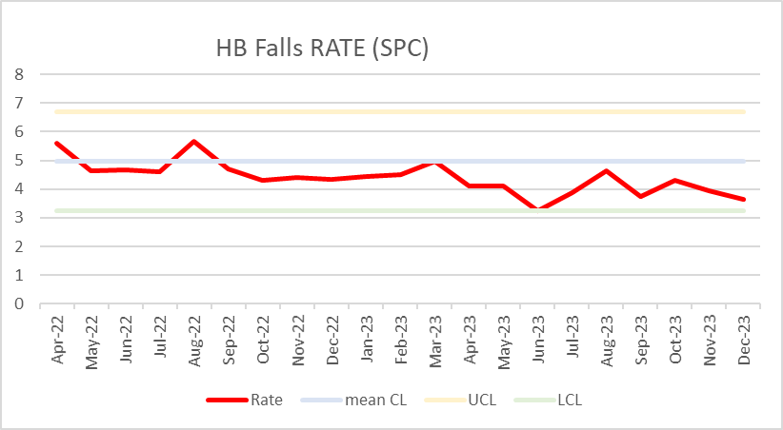
Quality Priority – Falls
Goal – Reduced falls and harm in hospital and across Primary Care and Community services by 10% in 2023/2024
Page 1
Project Team: Senior Responsible Officer: Helen Annandale, QI lead – Eleri D'Arcy
Month – February 2024
Methods
Build on Quality improvement programme.
Embed Falls audit programme.
Embed reporting structures from service groups Targeted QI input to high falls rate wards
Develop/Educate clinical workforce
Development of HB Falls Strategy / input into HB Frailty Strategy
Engagement with Improvement Cymru and participation in Safe Care Collaboration Consider training to be mandatory
Promote public health campaigns re: healthy lifestyle and physical activity e.g Reconditioning.
Community Falls services review
Other critical success factors
Regional falls prevention taskforce
Overarching Falls Prevention steering group
Identified lead for PCC&T
Key achievements
reduction of inpatient falls >10% 2022-2023
Agreed Governance structure with nominated SRO and Chair
Improvements noted in National Audit of Inpatient falls 2023
Inaugural Falls Summit held in March 2023
Active engagement with Safe Care Collaborative (SCC) programme with Improvement Cymru
Acceptance of Poster at BMJ conference 2024 – Intergenerational Falls prevention Project
Progress in the last month
HB Community Falls scoping exercise, Gap analysis and duplication report completed – scheduled for management board - February
National Falls Prevention education pack launched following success of falls Crime scene
Deconditioning project group established and two main objectives identified Patient Activity planning and Out of bed for all meals as default position.
Progression with Safe Care Collaborative Project – iSTUMBLE app use with Domiciliary Care agency. Initial data shows reduction of WAST callouts from 100% to 25% - however further analysis required
SCC project mirrored with Care homes in partnership with Swansea LA
Focussed work the falls rate analysis with AMU (MGH) and Ward C (NPTH)
AMU developing new falls prevention 'CRASHED' bundle – to look at supporting staff in creating individualised meaningful falls prevention care planning (identified need through NAIF)
Engagement with front door services at NPTH and MGH to launch falls screening tool
Patient deconditioning education leaflet in draft form.
PCCT have set up Quality Priority steering group and new rep for falls in SG identified – meeting to further develop scoping work in diary fir Feb 2024 (lead – Laura Turner)
Improvement Cymru comms team recording podcast using falls project as episode focus
Roll out of new reporting structures to include all SGs reporting in falls rates
Key Outcome Measure/s –
HB Falls Rate since April 2022 –
continued trend of reduction noted
Actions for the next month | Responsible Owner | Due Date
NHS Wales Internal Audit Process
Agree BAU Plan | HA/EDA | March 24
SCC Comms plan for falls project - podcast | EDA | Feb 24
Focus on establishing Community Governance structure and progressing individualised QI projects across HB | EDA | April 2024
Risks to delivery | Owner | Next Steps
Awaiting Digital dashboard | Digital | Under development
Governance process to investigated falls incidence – slowing learning and sharing of information | SGs/HB | Explore options

Slide 3
Quality Priority – Nutrition & Hydration
Goal -
Page 1
Project Team: Project Team: Senior Responsible Owner – TBC , Project Manager – Jayne Whitney, QI data lead – Samantha Scott, QI Lead Sheena Morgan
Month – February 2024
Methods
QI areas discussed by N & H committee:
1. Meet minimum standards all Wales catering standards
2. Nutritional screening & processes
3. Compliance with taking weights
4. Safe artificial nutrition non oral
5. Hydration - jugs
6. Nil by mouth days -
7. MH & LD, re-visit SLT & RD provision OPMH
Key achievements
Agreed several QI projects with H & N Committee
First QI project agreed as Weight Monitoring (WM) pilot area Morriston site
Data requested from WMCR system on estimated weights within in patient care at Morriston Hospital
1st phase of QI work to be focussed on above WM, Snack provision & Nil by mouth
QP rep from PCTG service group agreed
It was suggested that standards of catering and patient feedback would develop within the work already being undertaken.
Agreed N & H steering committee would be the forum in which the QI reporting on themes would be set as an ongoing agenda item so that updates and feedback can be established
First QI report presented at N & H committee in November 2023, next report February 2024
Site visit to Morriston Hospital – hot spot areas agreed by lead in Morriston (Louise Jenvy) -
Ward D, E, F,A,B, W & ITU visited week commencing 30th October 2023. (Current equipment, challenges and barriers discussed – explored equipment standards and best practice) .
Action Plan Template with GMOs & 100-day plan developed
Scoping report completed on hot spot areas and highlighting good practice and challenges
Delays in establishing data on weights across Morriston group due to sourcing and extracting data from the WMCR system which has impacted on measures being agreed.
Arrangements in situ with comms department to launch priority on intranet – this will feature information from stakeholders on the importance of the priority and will feature a learning and education approach regarding weighing patients. A “don’t weight to weigh” campaign will launch highlighting best practice from areas showing solutions and QI projects. Also on the provision of snacks and a poster of available snacks that can be cascaded to wards.
QI on pat slide on Ward W to be progressed and hydration jug pilot - 40% increase of compliance of weights since the launch of the weighted pat slide
Visits to the main catering sites has been completed and an SBAR delivered to the Catering strategy group.
Key Outcome Measure/s – To be identified by N & H committee (TBC)
Solutions needed for more frequent forums to meet and update as opposed to quarterley reporting. Baseline data is in progress but challenging to source. 3 main areas of QI are Weights, snacks and menus and hydration
Progress in the last month
Risks to delivery | Owner | Next Steps
To be confirmed by N & H committee | Stakeholders | 16/11/2023
No SRO agreed for QP N & H | Manager Q & S | To formally identify SRO in Nov 2023 – overdue
Actions for the next month | Responsible Owner | Due Date
SBAR catering complete & catering completing action plan | Jayne Whitney & Rob Daniels | April 2024
Comms campaign launch of priority March 2024 with a 400 article being published in March. A screen saver campaign scheduled to being in April 2024. Promoting "don’t weight to weigh campaign" Article. A week in May will be dedicated to the QP H & N and a learning symposium. An action plan following Catering SBAR will be progressed. QI team based training to evolve ideas regarding promoting catering department and QR codes | Jayne Whitney Susan Bailey Rob Daniels Catherine Craig | March – May 2024
GMO & 100 day plan template complete – to be agreed by N & H steering committee and % agreed | Jayne Whitney & Sheena Morgan | March 2024
Scope data on weights for Ward W and progress QI project for pat slide and hydration jugs. Seek data from dieticians on previous weight audits and continue to source baseline data over 3 main sites. | Jayne Whitney/Louise Samantha Scott/Lee McQuaid | March 2024 and ongoing

Slide 4
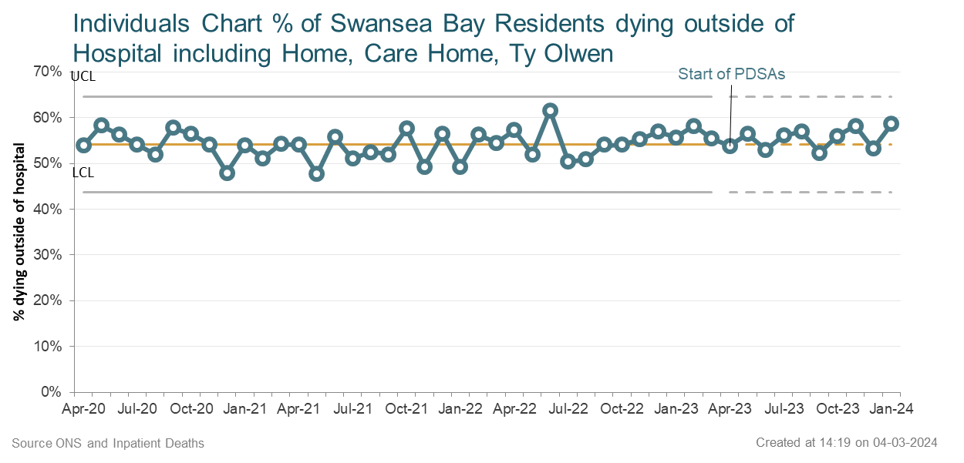
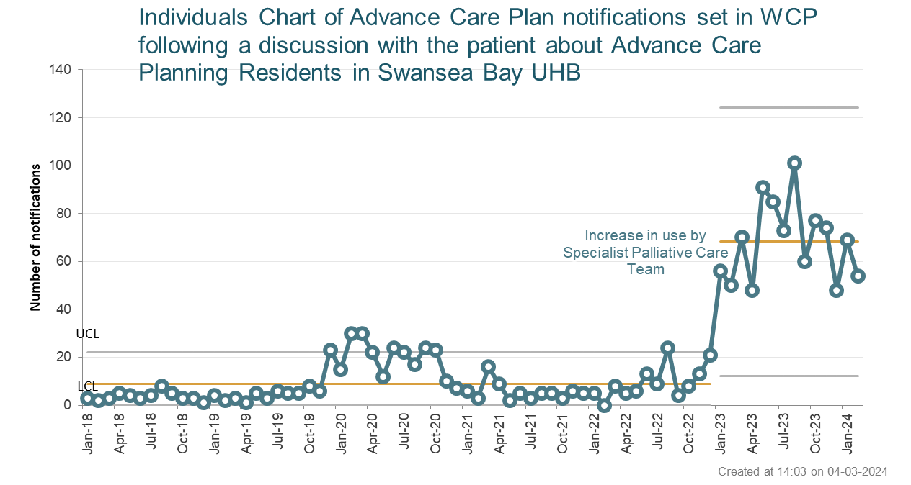
Quality Priority – End of Life Care (EOLC)
Goal - Increase proportion of Swansea Bay residents receiving the right care at the right place at the right time in the last year, months, weeks, days of life
Page 1
Project Team: Senior Responsible Owner – Sue Morgan (Clinical Lead), Project Manager – Tracy Rowe (part-time) , QI lead – Emma Smith
Month – February 2024
Methods
Increased correct identification of people who may be in the last year of life
Increase Advance & Future Care Planning (A&FCP) across all care settings
Increased correct identification of people who may be in the last days of life
Increase the number of staff given education and training to support high quality EOLC
Identify and produce systems that support sharing of A&FCP across all care settings
Other critical success factors
Medical engagement with EOLC throughout service groups, demonstrated through medical EOLC champions within each service
All Service Groups to participate in completing the Health Board End of Life Care audit.
Key achievements
EOLC training established and continues each month - Champion programme, Regular Education sessions, bespoke training requested by Service Groups and care home training.
Internal Audit Spring 2023 gave reasonable assurance for End of Life Care.
Some improvements seen in the National Audit of Care at the End of Life 2022 compared to 2021.
A shift in the number of Advance care plan notifications set in WCP from median of 6 to 72 per month
My life my wishes adopted by the HB – difficult to count use as is a paper document. Used by District Nursing, Virtual wards, handed out in training and public awareness events (534 given out) and available on COIN & NHS Executive sites to download.
Key Outcome Measure/s
By February 2024 31.5% of HB staff have been trained in EOLC training, also delivered to external organisations.
Deaths outside of hospital include Ty Olwen, the mean since 2020 is 54%.
Progress in the last month
Digital planning meetings have restarted with discussions for GMOs 2024-25
Digital intelligence discussions ongoing, progress has been made with some measures now included on the Dashboard
Recent bespoke training has taken place across Morriston, NPT&S and P,C&T service groups. GP training took place in Feb.
A&FCP notifications in WCP are increasing – Information now available by user, data to be reviewed
Treatment escalation plans to be tested in the coming weeks in Morriston wards D, E & F and NPT Ward D
Care decision guidance encouraged through education sessions, new national version to be released soon, will be taken to NMC and LMC.
EOLC Delivery group has agreed to continue in the months in between the Palliative & End of Life Care Steering Group
Risks to delivery | Owner | Next Steps
Limitations in digital systems to record discussions relating to EOLC and to share between care settings | Matt John | Meetings continue to develop plan
Actions for the next month | Responsible Owner | Due Date
Internal Sharepoint page and website development for EOLC & Palliative Care continues | Parasol team, Sue Morgan | April 2024
NACEL clinical note review and Quality Feedback Survey process being developed | Sue Morgan, Kim Hampton Evans | March 2024
Continue to develop measures in dashboards in line with Internal Audit recommendations. | Dai Williams and Emma Smith | March 2024

Slide 5
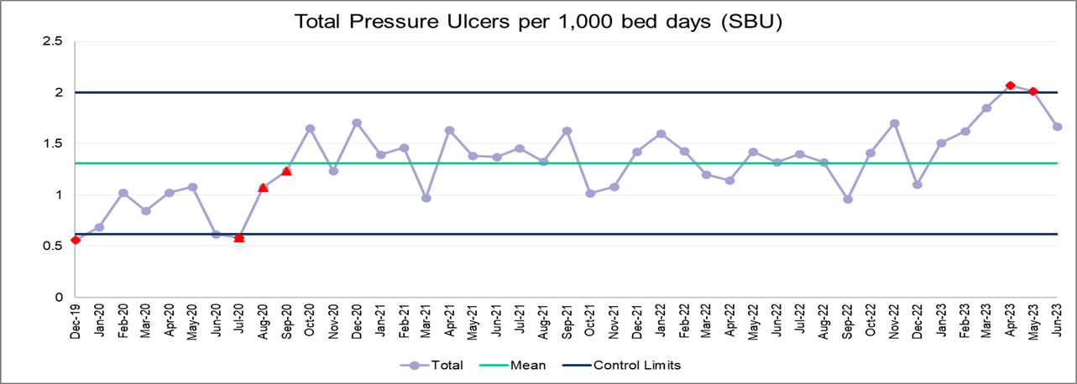
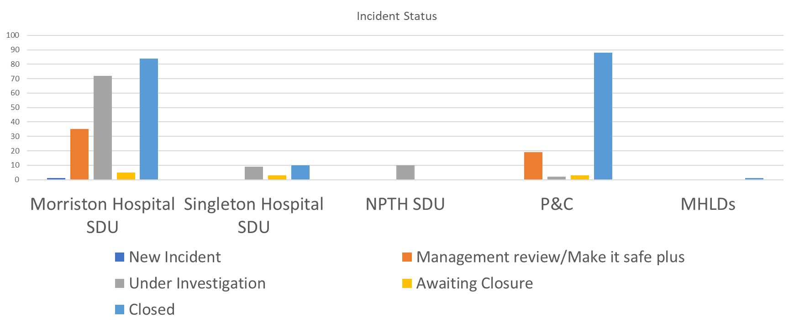
Quality Priority – Pressure Ulcers
Goal – To reduce the amount of patients developing HB acquired avoidable pressure damage by 10% by end of March 2024
Page 1
Project Team: SRO Sharron Price, Subject Expert Rachel Govier-Williams, Eleri D'Arcy (QP Lead)
Month – February 2024
Methods
To be finalised
Repositioning - Datix reporting - Governance Patient information - Digital
Platforms - Education & Skills - Equipment & Resource - Documentation
Other critical success factors
continue PUPSG.
Key achievements
Pressure ulcer information leaflet produced and translated into Cantonese and Bengali
Mapping exercise Maternity Service to review risk assessments
Electronic training register
Developed Tissue Viability Share point page, training pages including tone assessment
Quality Assurance Health board audit – learning shared via PUPSG
Reporting and investigating guidelines sent to WG for sign off (All Wales Document)
Pressure Ulcer training now delivered on overseas nurse induction.
Scrutiny terms of reference renewed and agreed via PUPSG.
WNCR skin tone bias being addressed
Repositioning Chart changes
Reporting structure amended out for comments
Medical Photography – Taken to QS
Key Outcome Measure/s
Progress in the last month
Agreement of main QP goal and primary/secondary drivers
Deep Dive ward 12 – Work plan under development
Health Board Datix Reporting Audit
National/worldwide statistic average of population per 1000 patients that develop a Pressure Ulcer is 0.7 (NICE 2023) there is no statistical average for inpatients per 1000 beds currently available. The HB inpatient average for previous Quarter was 2.34.
Actions for the next month | Responsible Owner | Due Date
PUPSG mapping All Services Groups | PUPSG | Feb 24
Agree Report Structure With SG | PUPSG | Feb 24
QI planning meeting with SG | PUPSG | Feb 24
Risks to delivery | Owner | Next Steps
No Tissue Viability Nurse Morriston - RR 20 | Ceri Matthews | Ongoing report
No Dashboards, delayed data reports. | Digital | Discussions ongoing
Governance –Delayed investigation and scrutinising | SG | Reported Quarterly
No Medical Photography In Neath, MHLD & Out of hours | PUPSG | Escalated

Slide 6
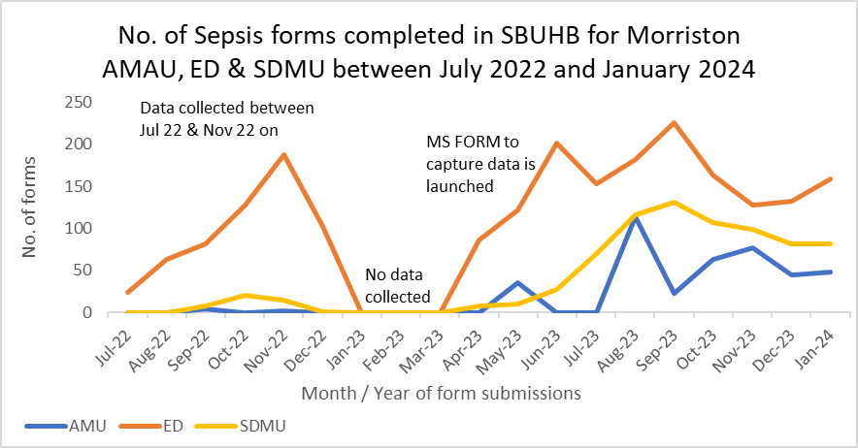
Quality Priority – Sepsis
Goal – Improvement in the recognition and management of Sepsis
Page 1
Project Team: Senior Responsible Owner – Ranga Mothukuri, Project Manager – Lisa Fabb, QI lead – Samantha Scott
Month – February 2024
Methods
Team are working with sepsis leads in clinical teams to develop an action plan.
Resus team are working with sepsis champions and ward mangers to complete sepsis audits across acute sites.
Establishment of trajectories for improvement for audit compliance
Other critical success factors
Increase the number of patients appropriately screened for Sepsis
Reduce harm from sepsis
Data consistently not available for all areas.
Priority was given to auditing the admitting units where there has been a significant increase in number of forms completed but percentage of appropriate patients screened remains about the same.
Plans in place to address this including reaudit, training and raising awareness
Key achievements
All service groups have identified nursing sepsis leads.
Around 2000 staff have received sepsis training in 2023.
Targeted action plans devised in collaboration with sepsis champions, many of these have focussed on placement of sepsis screening books to ensure timely screening of patients at risk of sepsis.
World Sepsis Day Symposium and launch of Sepsis hub site.
Development of a more robust sepsis alert on Signal
Development of Blood culture improvement package- video, sticker and poster.
District Nurse NEWS and Sepsis Plan- Policy
Progress in the last month
District Nurse NEWS and Sepsis Plan, which will become policy after trial.
Development of a more robust sepsis alert on Signal
Development of action plan around blood cultures to improve antibiotic stewardship.
Working with Morriston SG to review themes on sepsis admissions to ITU.
Awareness campaign including drop-in training sessions, ward-based training sessions and use of sepsis notice board displays are being used across the HB.
Review of audit data, due to ward changes and movement we have updated our audit results in collaboration with SGs
Key Outcome Measure/s
% of patients appropriately screened for Sepsis
Actions for the next month | Responsible Owner | Due Date
1st Dose antibiotic audit | Dr R Mothukuri | March 24
Roll out Blood Culture Improvement | Lisa Fabb/ Louise Wooster | March 24
Signal Sepsis screening | Lisa Fabb | April 24
ITU Case review | Lisa Fabb/ Morriston SG team | March 24
Risks to delivery | Owner | Next Steps
Lack of ownership within service groups, this is being mitigated through group nurse and medical director and designated service group leads | Lisa Fabb | Review of reporting structure to be agreed with SGCD.

Slide 7
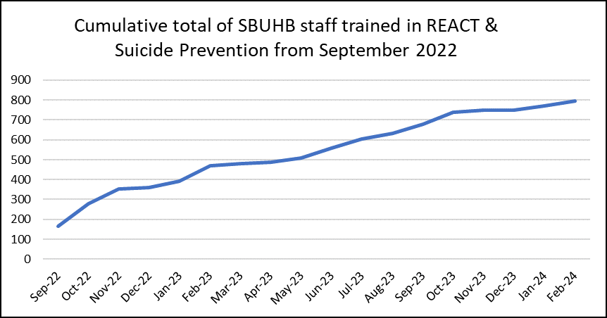
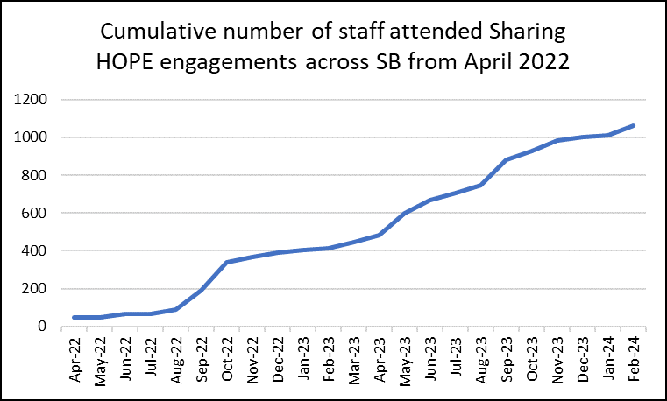
Quality Priority – Suicide Prevention
Goal – Suicide Prevention - early recognition of anxiety and depression leading to risk of suicide
Page 1
Project Team: Senior Responsible Owner – Stephen Jones, Project Manager – Jayne Whitney, QI lead – Samantha Scott
Month – February 2024
Methods
Engagement in Sharing Hope project
Delivery of training in suicide prevention across all teams
Other critical success factors
Time to Change Wales
TRiM Responses across the Health Board
REACT
Wellbeing (Early recognition of MH & Suicide ideation)
Quality, Safety & Improvement Intranet page (Quality Priority)
SBUHB Suicide and self-harm prevention strategy
SBUHB Response Policy following death of staff member by suicide & family
Priority places and people and remanded in custody / with high risk of suicide
Key achievements
•Successful integration of REACT and Suicide Awareness training.
•REACT & Suicide Prevention level 1 training to be included in Managers’ Pathway
•Continued success of Sharing Hope – The Art of Healing Together has won the improving lives through creativity award at the health board LOV awards 2023.
•Reached the final for the Best Staff Wellbeing project of the year at the HSJ Patient Safety Awards 18th
•Sharing HOPE – Poster finalist and displayed in CNO conference October 2023
•Time to Change Wales (Finalists of the NHS Awards)
•TRiM Trauma Pathway (Finalists of the NHS Awards)
Sharing HOPE Winner of Best Staff Initiative and recognised as a finalist in the best employer for staff recognition & engagement at the NT workforce awards November 21st 2023
Progress in the last month
•Sharing HOPE 1044 staff engaged since engagement events since April 2022 and 129 engagement events
•Social platforms Swansea NHS site on Facebook, Twitter and YouTube = 3.7k views as at end of May 2023.
•There have been several Sharing HOPE sessions in ITU Morriston Hospital for high-risk trauma these sessions are ongoing throughout the year.
•New combined REACT & Suicide Prevention Training including newly qualified induction nurses Total trained from Sep 2022 = 1222
•A bespoke REACT & Suicide Prevention training was delivered to Primary Care staff during there BT4L (Protective time for learning). Total trained in March 2023 = 263. Bespoke Suicide Prevention delivered to Swansea Primary Care Cluster 49 attendees
A bespoke session of Suicide Prevention training for MSC health management students Swansea University 32 attendees Feb 2024
•Child Health bespoke session was delivered since June 23 where 86 people attended in total. ED bespoke 30, GP trainees 14
•Between Mar 22 to Feb 2024 – 130 staff reported suicidal thoughts in the previous 7 days of initial contact.
•Between Jan 22 to Feb 2024 – 45 staff reported thoughts to end life.
•Level 3 Suicide Prevention training for Mental Health professionals (This has been successfully piloted and will be rolled out across the MH division, discussions currently in situ with MH & LD)
•Visited HMP Swansea to begin QI project
Key Outcome Measure's
Education of all available staff across the HB in recognising and managing suicide.
Continue to support and work with Swansea Multi Agency Group and other stakeholders across the HB in relation to obtaining a baseline assessment of suicide cases and map against national trends.
Occupational Health and Wellbeing support for staff with anxiety/depression to prevent escalation in risk of suicide.
Actions for the next month | Responsible Owner | Due Date
Quarterly meeting have been agreed following review of frequency of Suicide Prevention Steering group & GMO/100 day plan – next mtg April 2024 | Stephen Jones & Jayne Whitney | April 2024
QI SBAR for HMP Swansea completed and next steps discussions with stakeholders and problem statement – follow up meeting to discuss with MH & LD service | Marie Philips & Jayne Whitney & Marie Williams | April 2024
Sharing HOPE – Deep dive evaluation started, film being edited Regular progression meeting set for every 6 weeks. Presenting first phase of proposal March 2024. Events in NPT, CCH & Vexatious complaints. Sharing Hope documentary presented to management board 30/05/2024 | Jayne Whitney & Johan Skre | March 2024 & June 2024
Risks to delivery | Owner | Next Steps
There is a risk of being unable to measure impact within this priority due to the lack of real time information on suicide rates, this will be considered as part of the review of GMOs. | MAG | Meeting to reconvene

