Slide 1
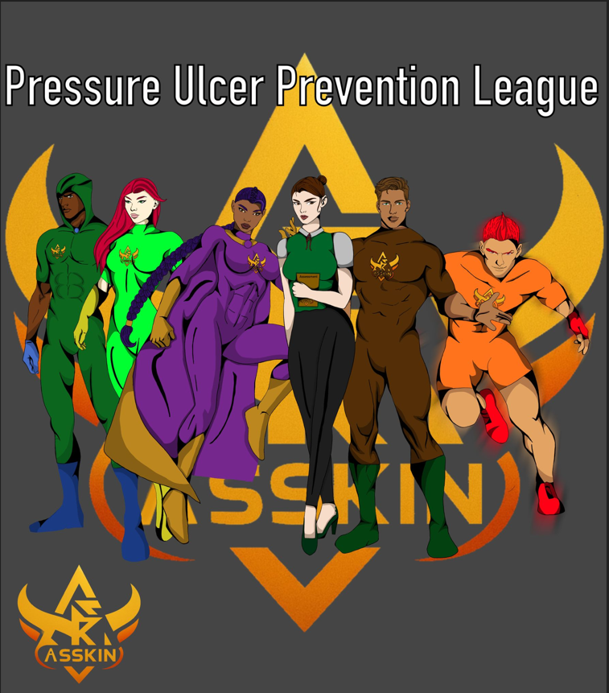


The Superhero League that prevent Pressure Ulcers
Character Graphics Designer: Caitlin Evans-Price (PDN Team NPTSSG)
Bios & Campaign leads: Sharron Price (Group Nurse Director)
Rachel Govier-Williams
(Lead Specialist Nurse Specialist Tissue Viability)
Emma Jones(Practice Development Nurse NPTSSG)

Slide 2
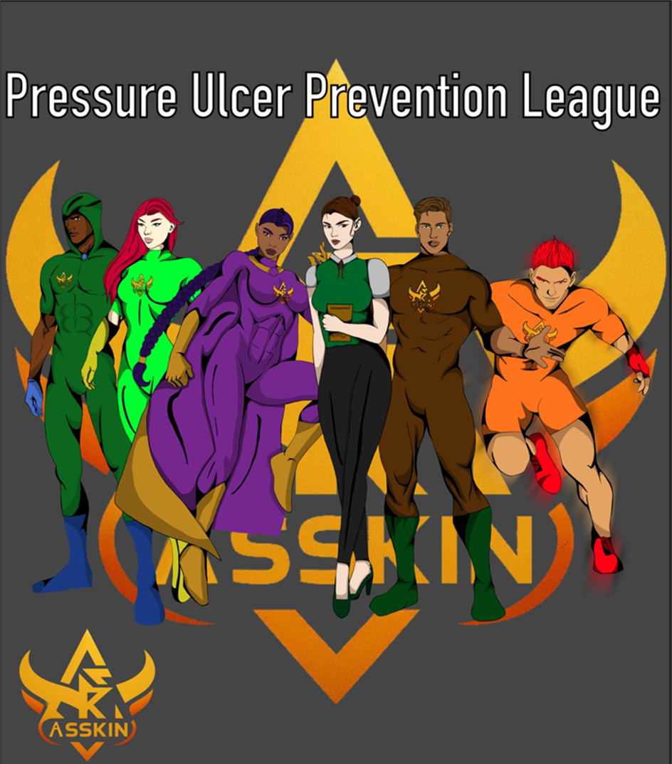
Pressure Ulcer Prevention League (PUPL) – Education Campaign Agenda & Timeline (2025–2026)
A Safety and Education Initiative
THE PRESSURE ULCER PREVENTION LEAGUE IS COMING!
One Team. One Mission. Zero Pressure Ulcers!
Campaign Overview
The Pressure Ulcer Prevention League (PUPL) is a creative, character-driven education campaign centred on the ASSKIN acronym.
Each superhero represents a component of the prevention bundle and fights against the villain Baron Bedrest and his minions.
Characters:
• A – The Assessor
• S – Skin Check
• S – Surface Pressure
• K – Kinetic Kid
• I – Inco-Nito
• N – Nutrina

Slide 3
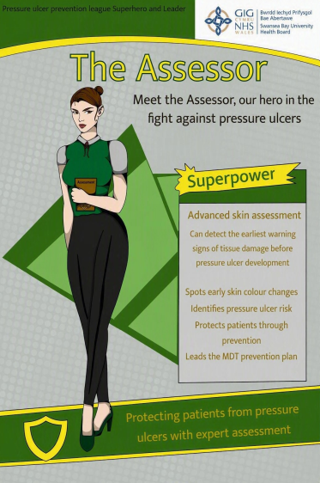
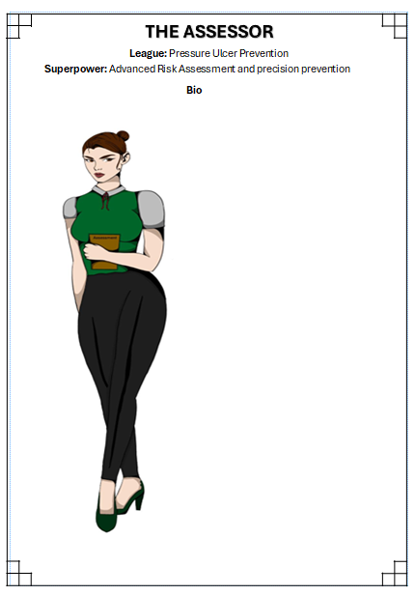
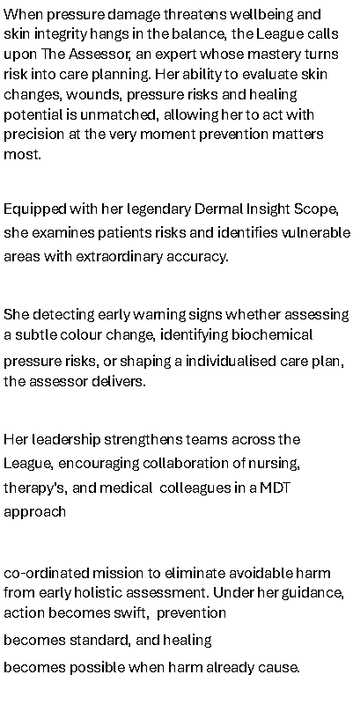
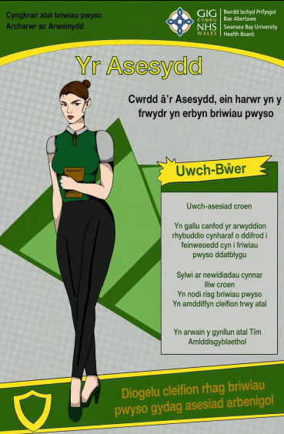


Slide 4
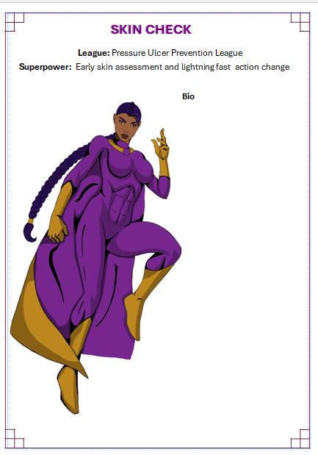
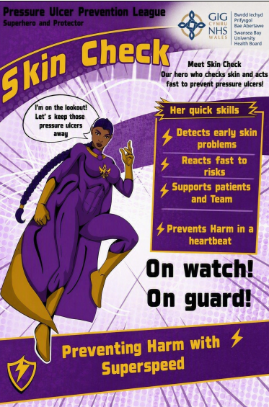
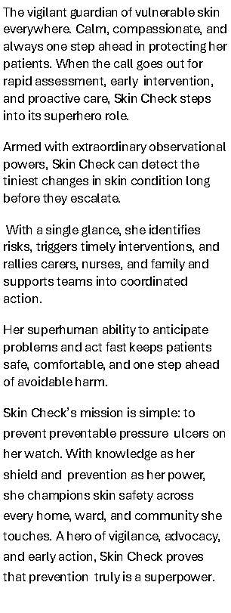


Slide 5
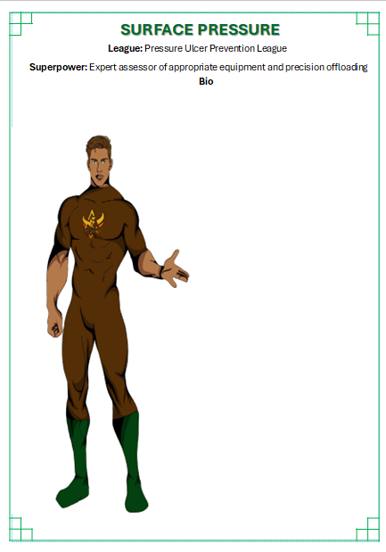
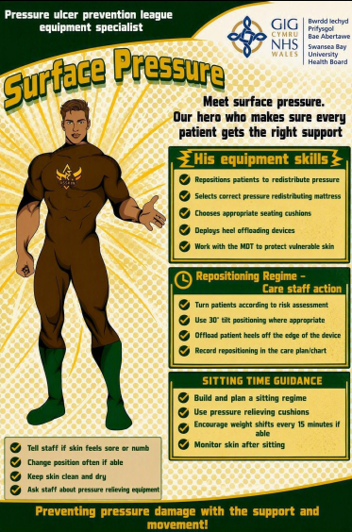
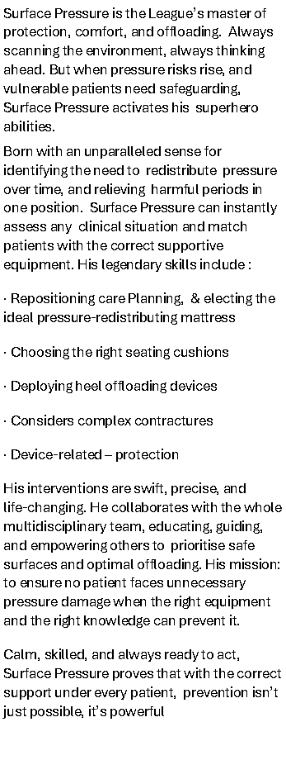
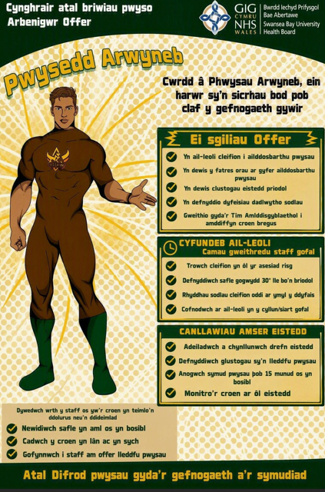

Slide 6
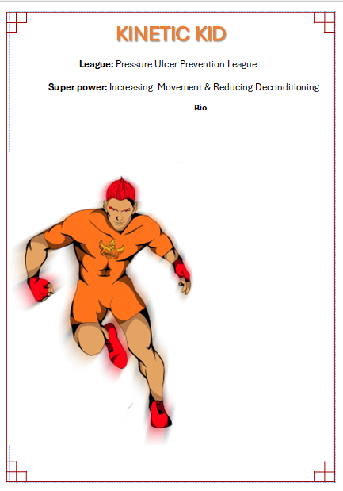
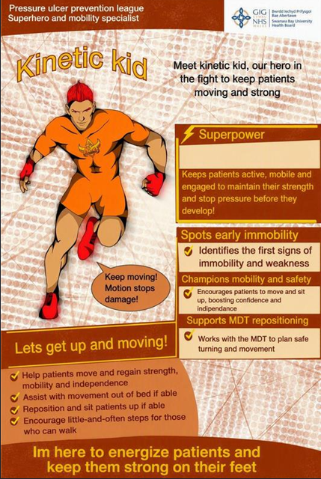
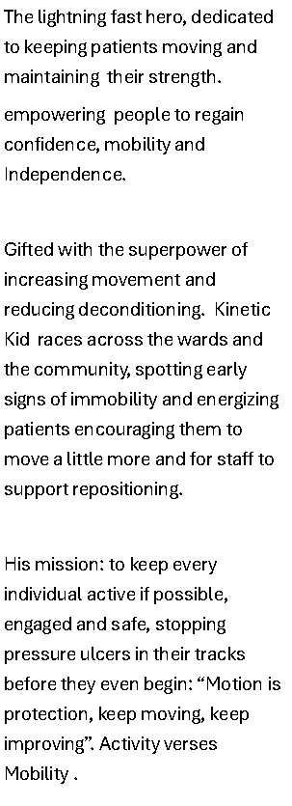
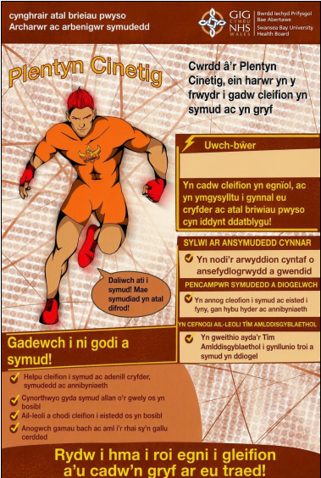

Slide 7
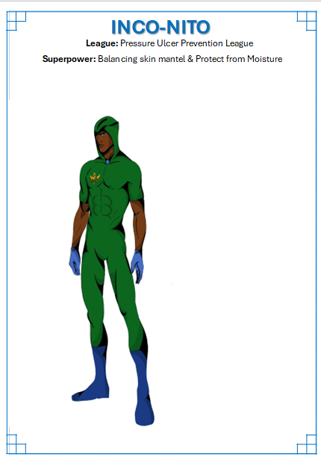
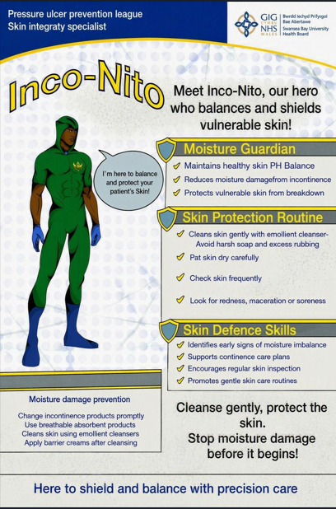
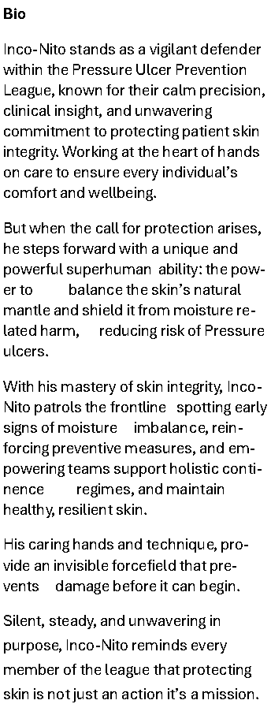
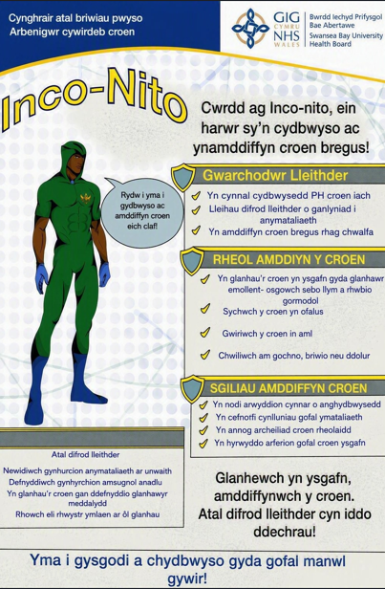

Slide 8
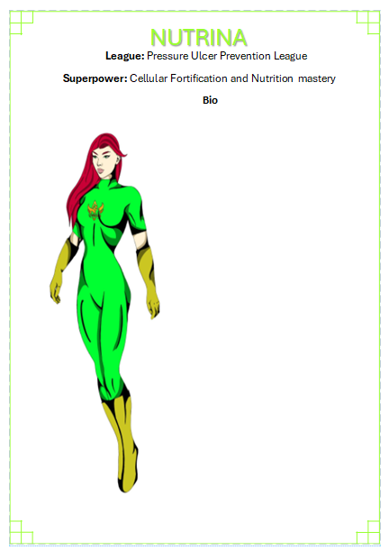
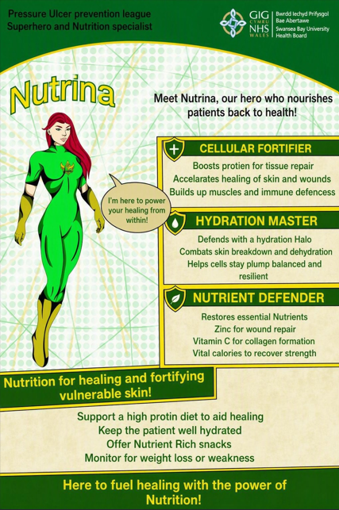
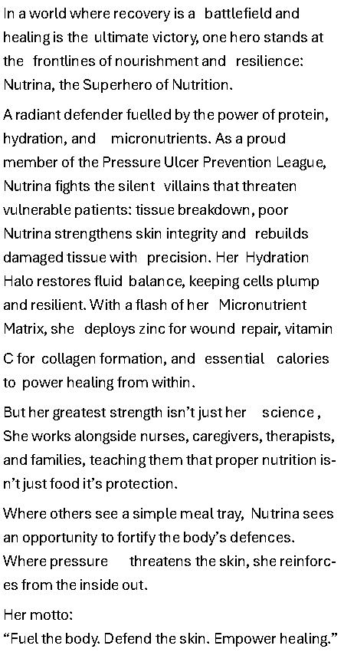


Slide 9
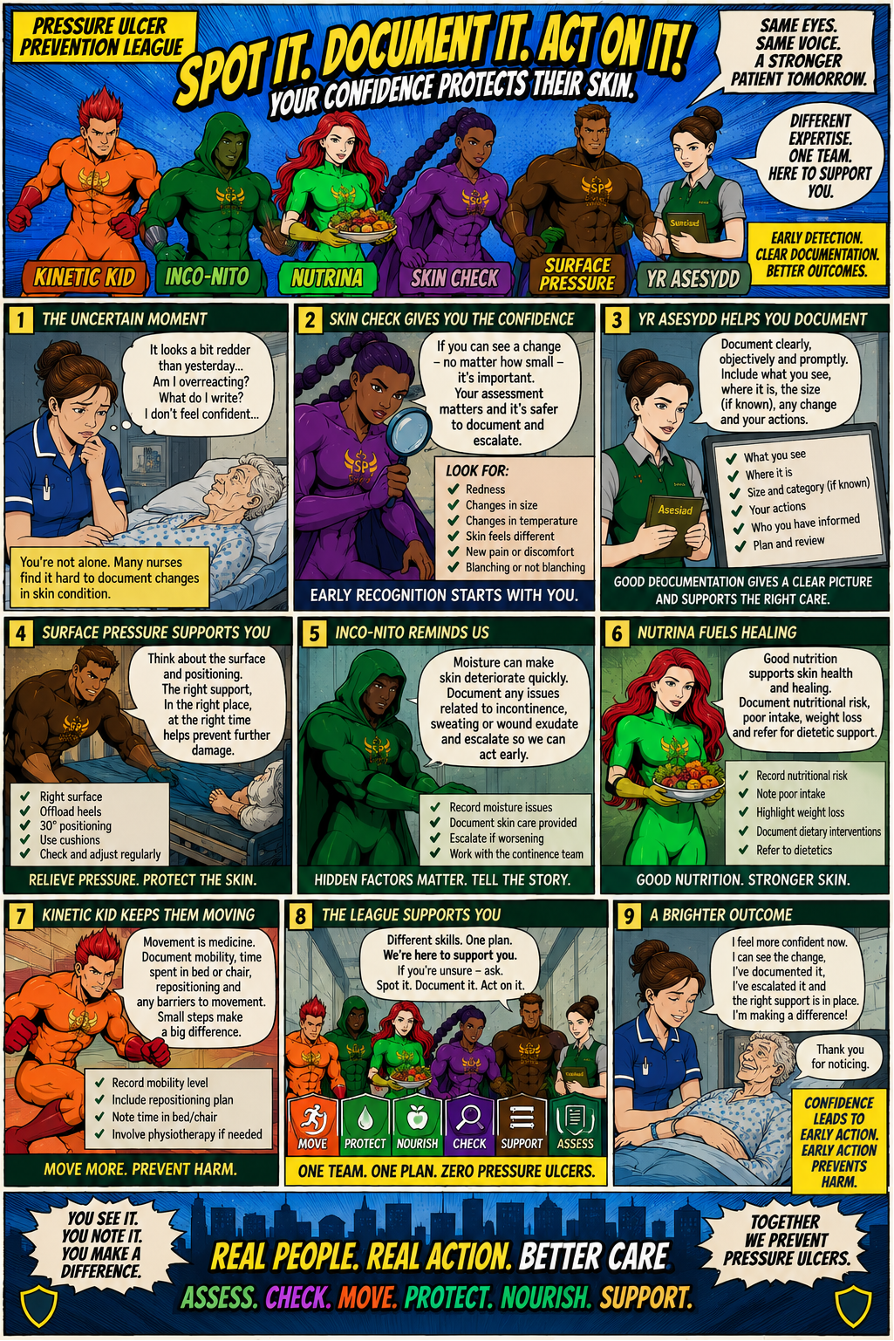
The campaign will include:
- Staff education posters & stands
- Monthly themed comics sent digitally
- Links with national and international health awareness days
- Future integration with Sepsis 6 and other safety indicators (Falls, Nutrition, Deconditioning)

Slide 10
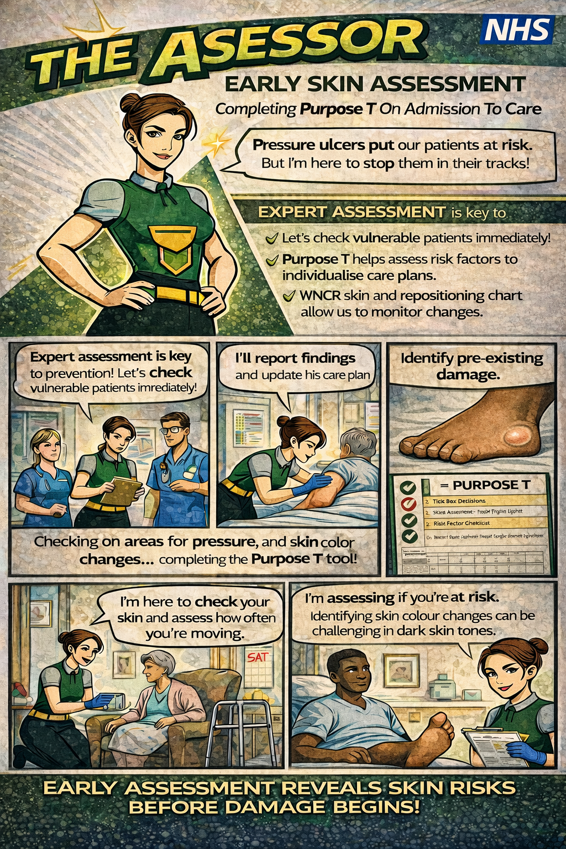
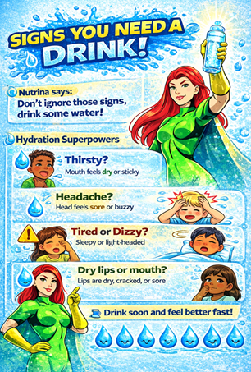
examples of other posters

Slide 11
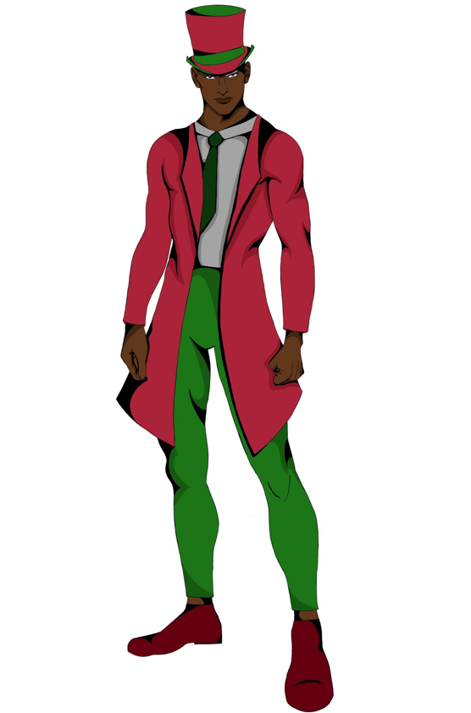
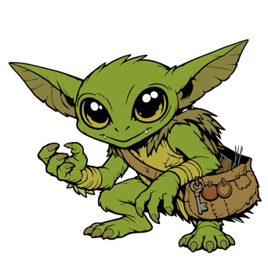
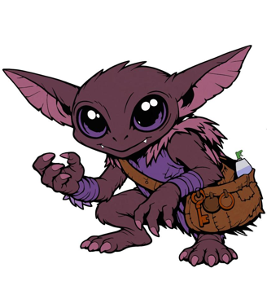
Barand posters on Bedrest and the Beddings … pending Bio

Slide 12

More to come…. From the Pressure Ulcer Prevention league

