Slide 1
National Audit of Care at the End of Life
Data Jan – Jun 2024
Quality Survey (Service Users)
Dr Sue Morgan

Slide 2
Introduction
Family members and others important to the dying person offered opportunity to participate in Quality Survey through Care after Death Team.
>100 return in 6 months
Quality survey exploring five priorities of the dying person
  Recognise
  Plan and do
  Communicate and involve
  Support

Slide 3
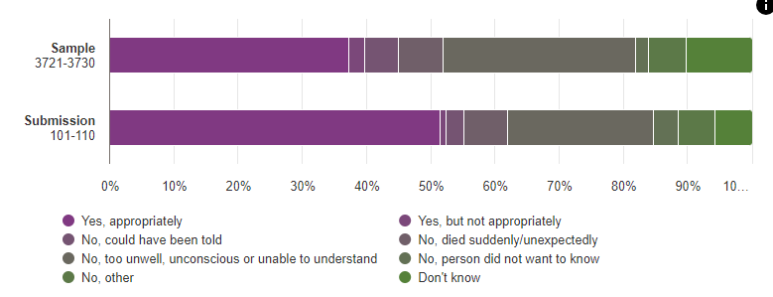
Recognising dying
A member of staff explained to the person that they were likely to die in the next few days – (2022 – 19% yes; 13% could have been told)

Slide 4
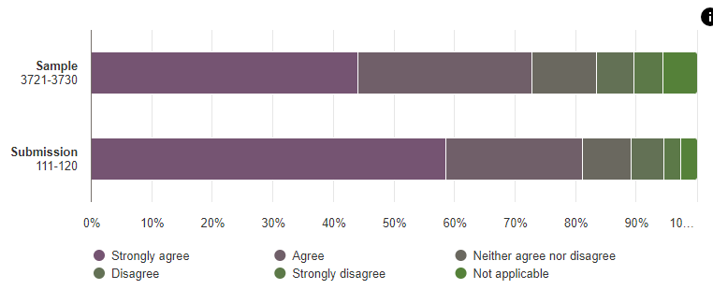
Plan and do – Individualised management of symptoms
The person was given enough pain relief (2022 – strongly agree 35%; agree 42%)

Slide 5
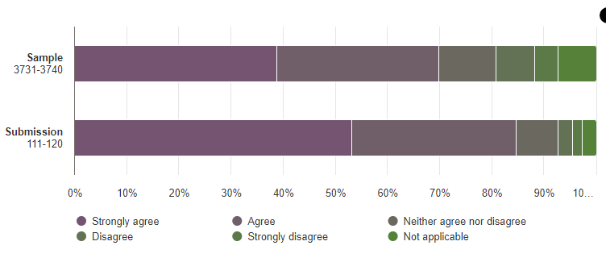
Plan and do – Individualised management of symptoms
The person enough relief of symptoms other an pain (such as nausea, breathlessness or restlessness) (2022 – strongly agree 33%; agree 30%)

Slide 6
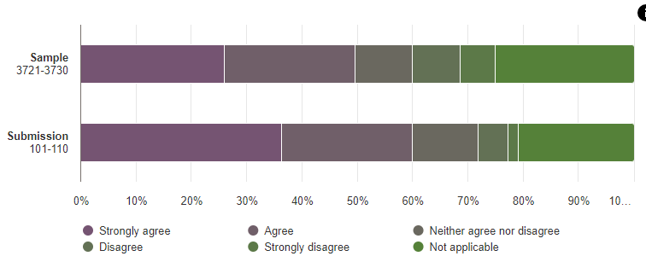
Plan and do – Individualised management of symptoms
The person had support to eat or receive nutrition if they wished (2022 – strongly agree 16%; agree 29% )

Slide 7
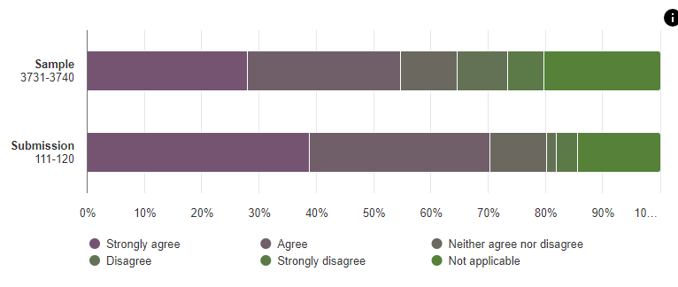
Plan and do – Individualised management of symptoms
The person had support to drink or receive fluid if they wished (2022 – strongly agree 6%; agree 35%)

Slide 8
Plan and do – Determine appropriate interventions – Case note review only

Slide 9
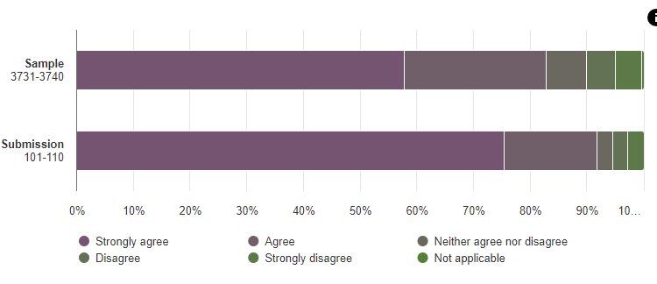
Plan and do – Actions to meet the holistic needs of the dying person
Staff looking after the person treated them with dignity

Slide 10
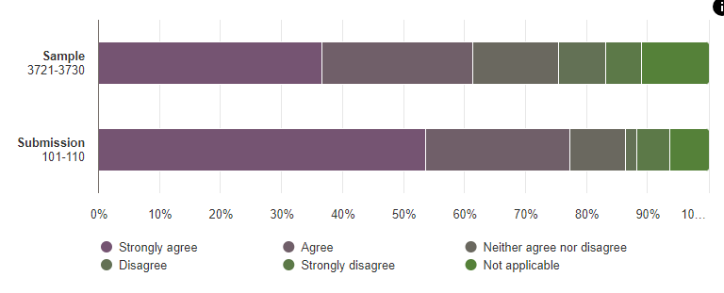
Plan and do – Actions to meet the holistic needs of the dying person
Staff at the hospital made a plan for the person’s care which considered the person’s needs and wishes (2022 – strongly agree 26%; agree 26%)

Slide 11
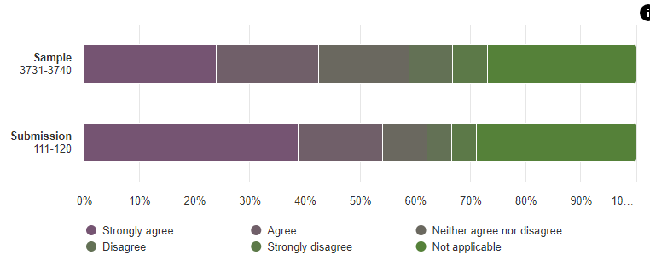
Plan and do – Actions to meet the holistic needs of the dying person
Staff tried to provided care for the person’s emotional needs (2022 strongly agree 10%; agree 26%)

Slide 12
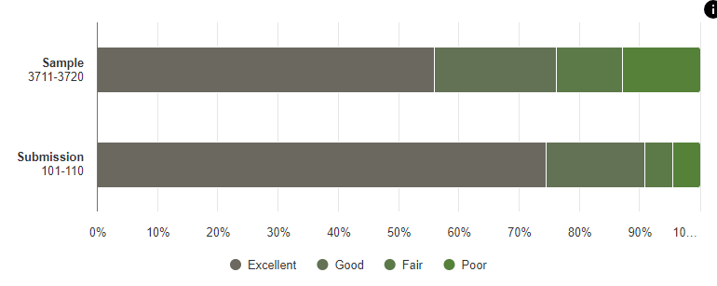
Plan and do – Actions to meet the holistic needs of the dying person
Overall rating of the care and support given by the hospital to the dying person (2022 – strongly agree 19%; agree 39%)

Slide 13
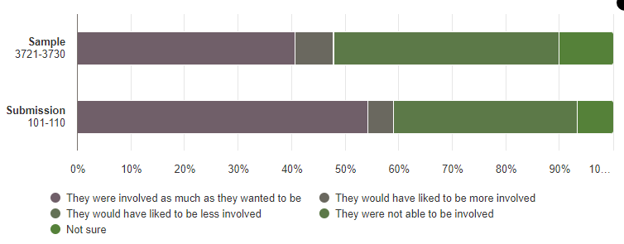
Plan and do – Actions to meet the holistic needs of the dying person
Staff a the hospital involved the person in decisions about care and treatment as much as they would have wanted in the last 2 to 3 days of life (2022 – 26%)

Slide 14
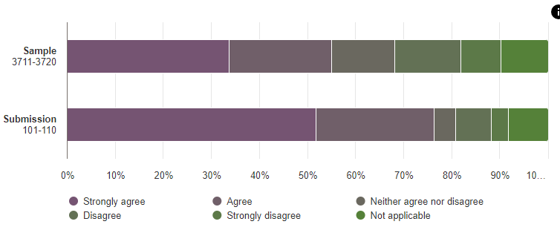
Plan and do – Actions to meet the needs of those important to the dying person
The needs of family and others were asked about by staff (2022 strongly agree 28%; agree 33%)

Slide 15
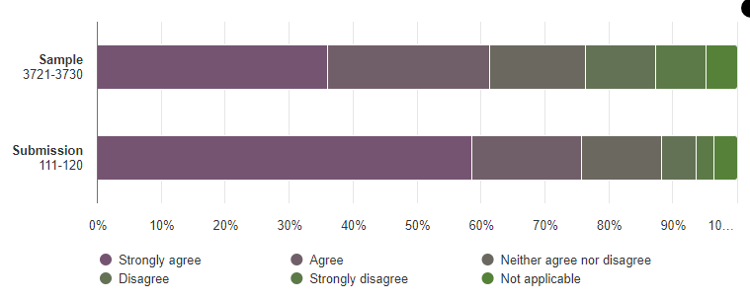
Plan and do – Actions to meet the needs of those important to the dying person
Family and others were given enough emotional support (2022 – strongly agree 16%; agree 35%)

Slide 16
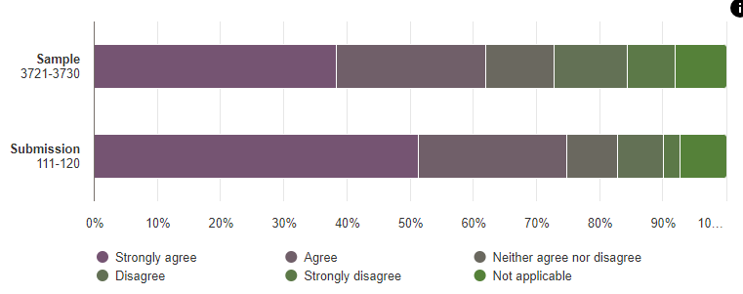
Plan and do – Actions to meet the needs of those important to the dying person
Family and others were given enough practical support (strongly agree 10%; agree 37%)

Slide 17
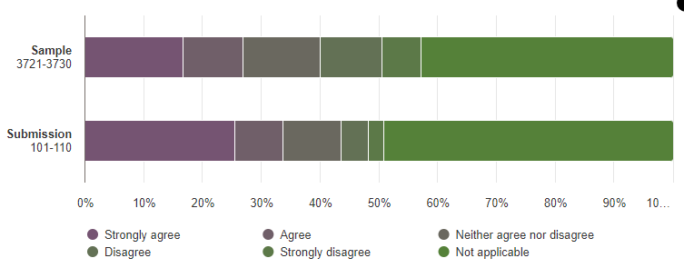
Plan and do – Actions to meet the needs of those important to the dying person
Family and others were given enough spiritual/religious/cultural support (2022 – strongly agree 6%; agree 13%)

Slide 18
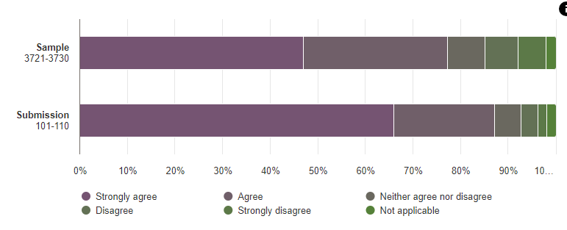
Plan and do – Actions to meet the needs of those important to the dying person
Family and others felt supported by hospital staff after the person had died (2022 – strongly agree 32%; agree 35%)

Slide 19
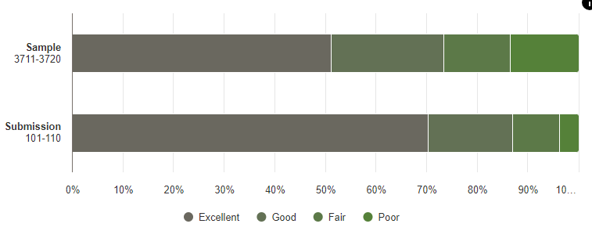
Plan and do – Actions to meet the needs of those important to the dying person
Overall rating of the care and support given by the hospital to those important to the dying person (2022 – outstanding 10%; excellent 35%; good 16%)

Slide 20
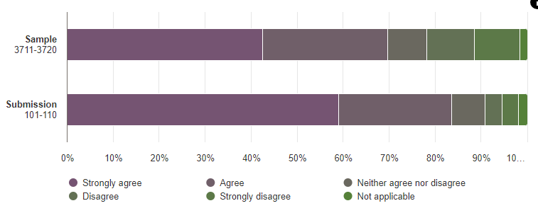
Plan and do – Actions to meet the needs of those important to the dying person
Families and others were kept updated and had enough opportunity to discuss the person’s condition and treatment with staff (2022 – strongly agree 23%; agree 39%)

Slide 21
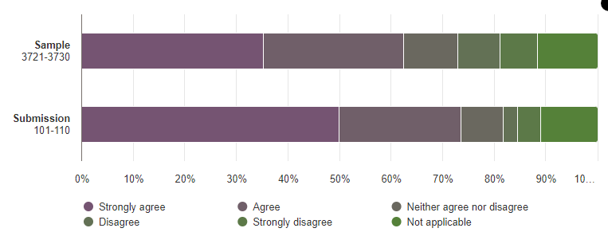
Plan and do – Timely review of the dying and deceased patient
There was a co-ordinated approach by hospital staff during the final admission including with health and care providers outside the hospital where appropriate (2022 – strongly agree 32%; agree 27%)

Slide 22
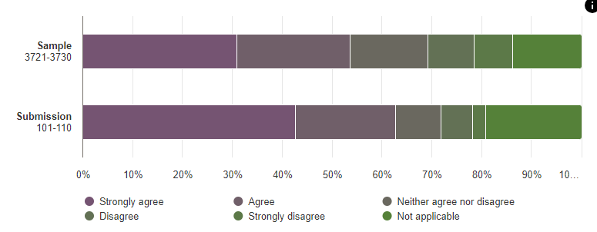
Plan and do – Timely review of the dying and deceased patient
The hospital staff regularly checked and addressed the person’s needs

Slide 23
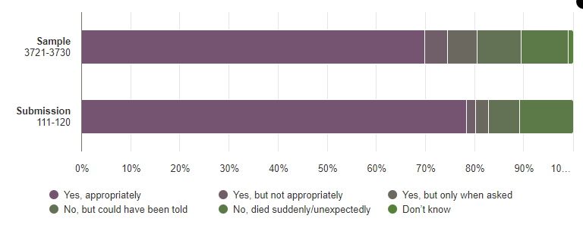
Communicate and Involve – Communication about dying
A member of staff at the hospital explained to families and other that the person was likely to die in the next few days (2-22 – Yes, clearly 52%; Yes but not clearly 19%)

Slide 24
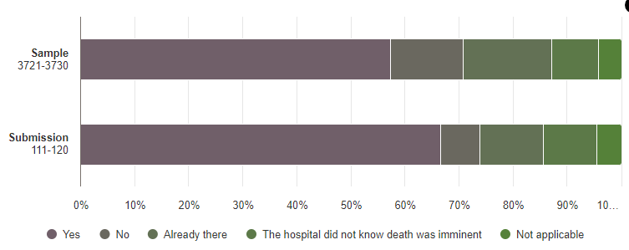
Communicate and Involve – Communication about dying
If families and others wanted to be with the person when they died, they received timely communication to be there (2022 – yes – 61%)

Slide 25
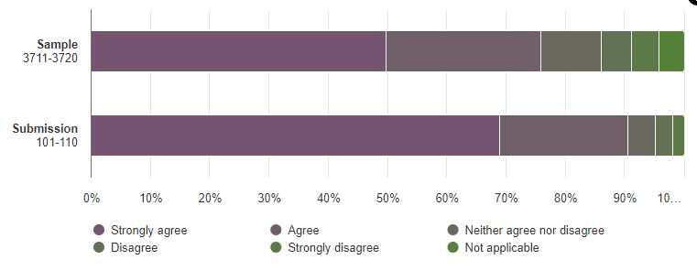
Communicate and Involve – Communication about dying
Staff looking after the person communicated sensitively with them (2022 – strongly agree 40%; agree – 32%)

Slide 26
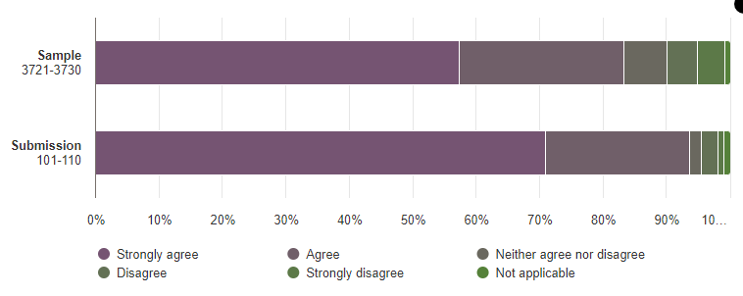
Communicate and Involve – Communication about dying
Families and others were communicated to by staff in a sensitive way (2022 – strongly agree 48%; agree 29%)

Slide 27
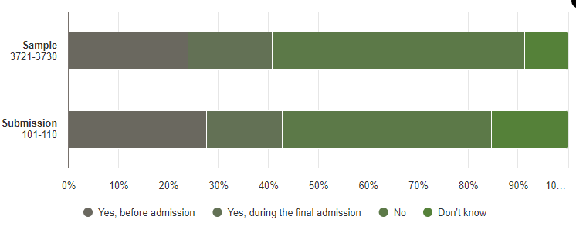
Communicate and Involve – Personalised care and support planning
The person had an advance care plan in place before they died (2022 – 21% prior to admission; 10% during admission)

Slide 28
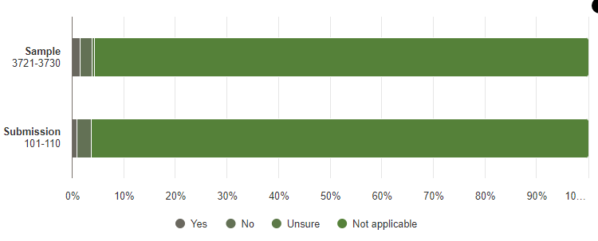
Support – Equitable care
The person was offered an interpreter or other language support so they could communicate with staff

Slide 29
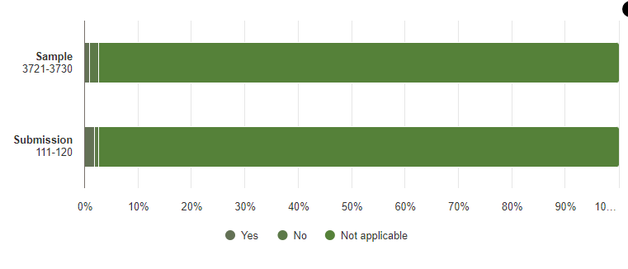
Support – Equitable care
Families and others were offered an interpreter or other language support so they could communicate with staff

Slide 30
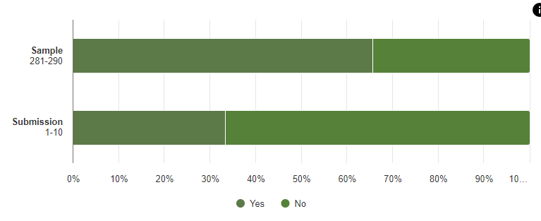
Support – Equitable care
Staff in Wales implement the active offer, providing services in Welsh without the patient having to ask for it

Slide 31
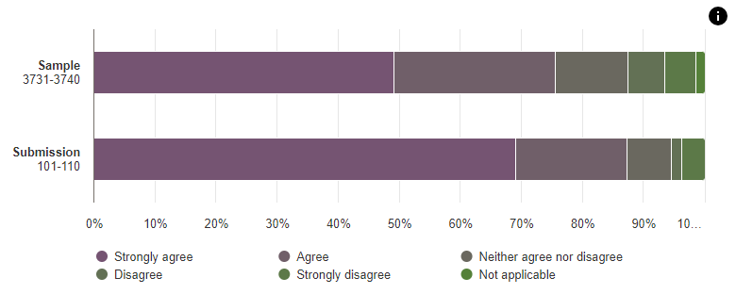
Support – Workforce supported, equipped and engaged to provide end of life care
Staff looking after the person had the skills to care for someone at the end of their life (2022 – Strongly agree 47%; agree 23%)

Slide 32
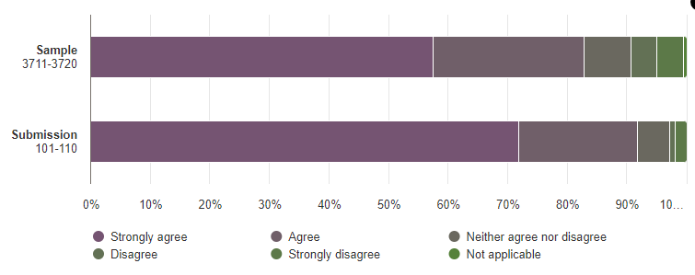
Support – Workforce supported, equipped and engaged to provide end of life care
Staff behaved with compassion and care

Slide 33
Support – Workforce supported, equipped and engaged to provide end of life care
Staff behaved with compassion and care

Slide 34
Conclusion
Swansea Bay compares extremely positively with the rest of England and Wales
The one (only element) scoring lower is access to language support, including Welsh
Service user feedback is very different to anticipated, given the Case Note Review
Limited evidence within the clinical case notes and WNCR of activity that is scored highly within service user feedback

