Slide 1
Authors:-
Angharad Higgins and Quality Priority Teams
Sponsors: -
Angharad Higgins, Head of Quality and Safety
Lesley Jenkins, Acting Deputy Executive Director of Nursing and Patient Experience
Please note where a QP has not been able to have an update for the month it is not included in the report.
Quality Priorities highlight report July 2025
Z:\ststorage2\QSIP HQ\Quality\Quality Planning\QP's\QP Monthly Report

Slide 2
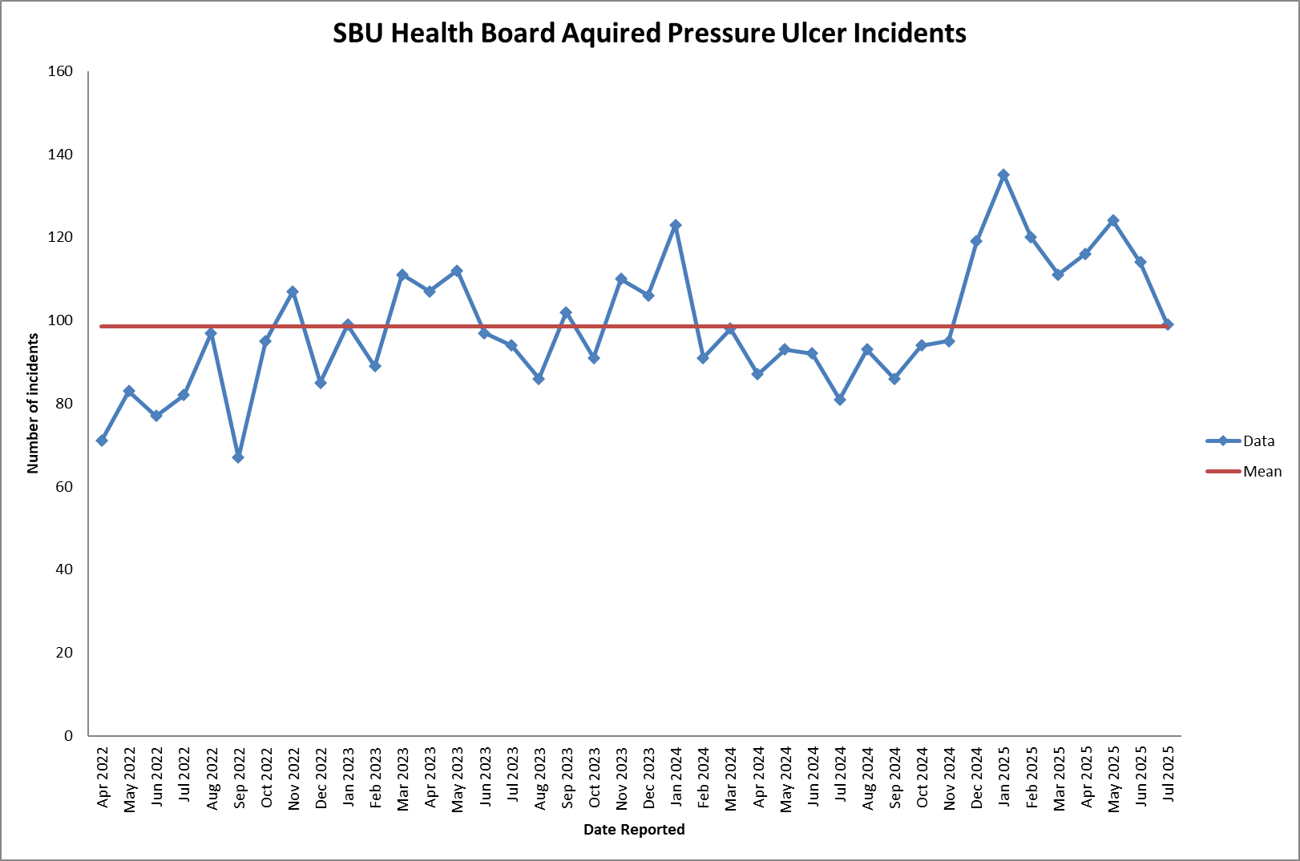
Quality Priority – Pressure Ulcers
Goal – To reduce the amount of patients developing HB acquired avoidable pressure damage by 20% by end of March 2026
Page 1
Project Team: Senior Responsible Officer (SRO) - Sharron Price, Subject Expert Rachel Govier-Williams, Eleri D'Arcy (QP Lead), QI measurement support – Emma Smith
Month – July 2025
Methods
Build Education and skills
Build on Documentation & Communication
Improve Governance & Datix, reporting and investigation
Address Digital risks
Provision of equipment MDT approach to prevention & Deconditioning
Focus on reduction of total incidents and avoidable deep damage
Strategic direction lead by PUPSG QI work planned to target HB hots spots.
Accountability of service groups
Pressure Ulcer Severity
-90% of the incidents comprised of pressure ulcers with unbroken skin , category 2 superficial epidermis loss or Suspected Deep Tissue injury.
-84.2% of deep damage ulcers developed under PCS in patients’ own homes.
-92% of community deep damage incidents were deemed unavoidable.
-15.8 % of deep damage ulcers developed within our inpatient sites. 8.6 % of the 15.8% developed in an admission area
Key Outcome Measure/s
Comparing the period 2023/2024 2024/2025 to 2023/2024 we have seen
50 % reduction in the number of incidents reports to WG as a National Reportable Incidents
4..3 % reduction in the total number of incident
10% total reduction of incidents in acute sites. Our current inpatient Pressure ulcer rate (per 1000 bed days) is 1.38, a 11% rate reduction.
An average rate reduction of 21% in NPSGG and 9% in Morriston, 17% increase PCS (no Average rate available)
Key achievements
Documentation updates
Pressure Ulcer Champions monthly meetings (Teams)
QI projects continued
Executive dashboards, require further changes
Educational pressure ulcer programme continued at All Levels
QI business plan for Healthy IO underway
HB 'hot spot' Deep Dive audit June 2025
Successful Training programmes
Progress in the last month
Safe Care Collaboration 'Hive project' underway- Pressure ulcers & deconditioning
Maternity Documentation review (pressure ulcer prevention /skin assessments)
ED and AMAU front door QA audit
Governance and Scrutiny Panel standardisation continued TOR PCS agreed, Merging of Swansea & NP PCS
Data collection undertaken
. Hot Spots mapping required with QI approach and focused plans – SG to outline in QI plan for PUPSG ongoing.
Acute Hotspot Training
champions Q&A sessions monthly via Teams continued
HCSW skills simulation study days delivered
Graph 1 : HB Acquired Pressure Ulcer incidents after quarter cleansing.
Actions for the next month | Responsible Owner | Due Date | Updates
Maternity Services Skin bundle | Rachel Govier-Williams | Sep 2025 | New
STOP Pressure Ulcer Campain week- Public facing and staff conference and campaign | Rachel Govier-Willaims | November 2025 | Planned
Pressure Ulcers ESR package Level 1-3 | All Wales Tissue Viability –Subgroup Rachel Govier- Williams | Feb 2026 | New
Digital photography mapping – Safe care Collaborative | Rachel Govier-Williams | Project plan June 2025 | Sent to director Digital for Approval Aug 2025
QI projects by SG to be updated | SG reps to report to PUPSG | Ongoing 2025 | Ongoing
Scrutiny Panel PCS to be merged and streamlined | Rachel Govier-Willaims & Karly Harvey | June 2025 | TOR complete pending pilot commences Sep 2025
Risks
Medical photography for validation
TVN service resource in MSG & PCS
Bed contract delays –risk to patients with failing equipment
National/worldwide statistic average of population per 1000 patients that develop a Pressure Ulcer is 0.7 (NICE 2023) there is no statistical average for inpatients per 1000 beds currently available.

Slide 3
Quality Priority – Acute Physical Deterioration
Goal – Improvement in the recognition and management of Physical Deterioration
Page 1
Project Team: Senior Responsible Owner – Dr. Clare Dieppe, Project Manager – Lisa Fabb, QI lead – Samantha Scott
Month – July2025
Methods:
Introduction or update of Early Warning Systems (EWS) in all appropriate areas, lead by appropriate Service Group, overseen by Acute Deterioration Safety Lead.
Core training provided through ESR eLearning, supported by local nurse educators and resuscitation service.
Measurement of appropriate use, accuracy and escalation through AMaT monthly ward audit.
Engage in national program to share learning.
Other critical success factors:
Engagement of all service groups
Robust understanding of EWS escalation data over time.
Key achievements:
Launch of NEWTT 2 on 4th March in all relevant areas.
MEWS and Pews launched July 2025
AMaT AD ward audit improved to ensure robust systems to collect AD data over time and develop improvement action plans for all in patient areas including paediatrics and maternity.
All EWS have implementation networks and e learning in progress.
All charts agreed and gone to print
Incorporated Patient reported wellness score to NEWS 2, putting the patient's voice at centre of care.
Early Warning System | Local implementation network | Training | Governance | Launch
NEWTT 2 | Delays in Morriston, all other implemented. | eLearning live on ESR | Via AMaT reported to RADAR | Launched 4th March 2025
MEWS | Established | eLearning live on ESR | Via AMaT reported to RADAR | 15 July 2025
PEWS | Established | eLearning live on ESR | Via AMaT reported to RADAR | Launched 1 July 2025
NEWS 2 | Established | eLearning live on ESR. | Via AMaT reported to RADAR | Posponed to 2 September, due to printing and procurment issues.
Call 4 Concern | Awaiting learning from national trials |  |  | Plan to be announced World Patient Safety Day 17 Sept.
Progress in the last month:
MEWS and Pews launched July 2025
Planning for WHO World Patient Safety Day- Safe care for every newborn and every child, celebration day 17th September 2025.
Implementation plans agreed in all Service Groups (SGs).
MEWS launched 15th July
PEWS launched 1 July
NEWS 2 launch rescheduled for 2nd Sept, although this is due to printing and procurement issues it has given us time to strengthen the training and learn from Welsh colleagues who launched in July.
Discussion continue for Call 4 Concern to be launched on World Patient Safety day.

Slide 4
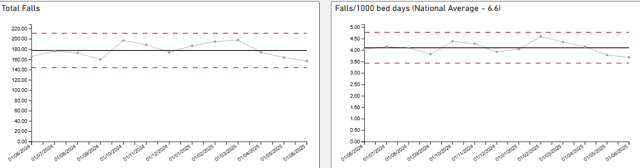
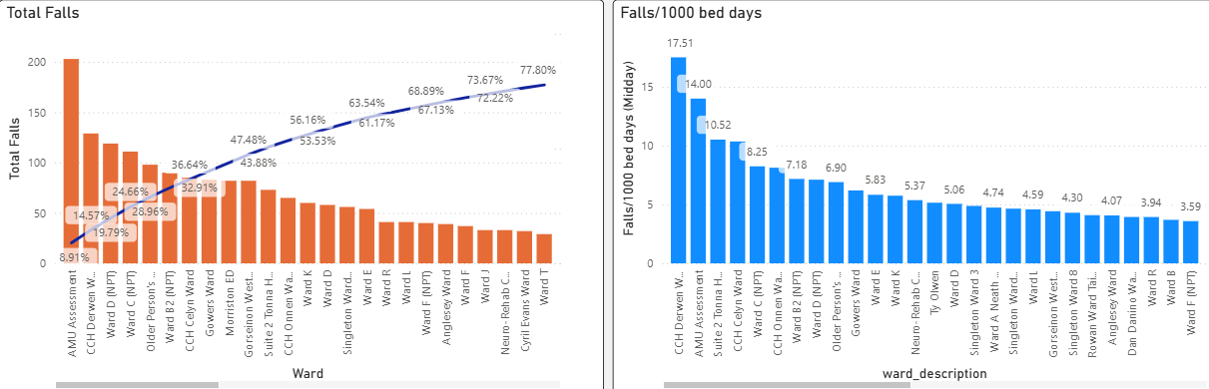
Quality Priority – Falls
Goal – Reduced falls and harm in hospital and across Primary Care and Community services by 10% in 2025/2026
Page 1
Project Team: Senior Responsible Officer: Helen Annandale, QP lead – Eleri D'Arcy
Month – July2025
Methods
Falls audit to be integral to ward assurance audits on AMAT
Embed reporting structures from service groups Targeted QI input to high falls rate wards
Development of National falls training
Promote public health campaigns re: healthy lifestyle and physical activity e.g Reconditioning.
Other critical success factors
Regional falls prevention taskforce
Overarching Falls Prevention steering group
Activity within 6 Goals framework
Key achievements
Serious incident reduction since QP start of 85% since 2022
Level 1 falls response in Dom care and care homes LIVE – currently supporting 500+ individuals
Level 1 falls response training completed: 281 individuals trained in falls prevention, safe retrieval from ground, use of iStumble App
Procurement of lifting equipment for use in care homes and Dom care as roll out of iStumble project
Agreement of Falls working model (to be utilised and populated in PCT Cluster falls prevention summit)
PCT GP cluster Falls summit held – Action Plan generated with key deliverables
Development of Dom care and Home care iStumble Falls response service Dashboard
Bespoke Falls training delivered to COPD team
National deconditioning assessment phase 2 complete – out for regional testing
Waiting well Falls prevention web page launched
Key Outcome Measure/s –
Progress in the last month
Development of Stay Strong, Stay Well app – avoiding deconditioning – pt self help tool
National Pilot of level1 / 2 St Johns ambulance response unserway (started June 2025)
Shortlisted for NHS Wales Award – Working together – regional falls response model
Falls made national priority – 6 Goals governance
Actions for the next month | Responsible Owner | Due Date
Upload historic data to care home falls dashboard | EDA | Aug 25
SCP – further deconditioning app development and testing | EDA | Sept 25
Active August – comms campaign plus 2 staff/patient/visitor training sessions | EDA with RAs | Aug 25

Slide 5

Quality Priority – End of Life Care (EOLC)
Goal - Increase proportion of Swansea Bay residents receiving the right care at the right place at the right time in the last year, months, weeks, days of life
Page 1
Project Team: Senior Responsible Owner – Sue Morgan (Clinical Lead), Project Manager – Tracy Rowe (part-time) , QI measurement support – Emma Smith
Month – July 2025
Methods
Increased correct identification of people who may be in the last year of life
Increase Advance & Future Care Planning (A&FCP) across all care settings
Increased correct identification of people who may be in the last days of life
Increase the number of staff given education and training to support high quality EOLC
Identify and produce systems that support sharing of A&FCP across all care settings
Other critical success factors
Medical engagement with EOLC throughout service groups, demonstrated through medical EOLC champions within each service
All Service Groups to participate in completing the Health Board End of Life Care audit.
Digital resources – informatics and systems
Key achievements
•30% of HB staff have received training in EOLC - Champion programme, Regular Education sessions, bespoke training requested by Service Groups and care home training.
•NACEL service user feedback 2024 shows significant improvement in experience reported compared with 2022 and compared to rest of England and Wales
•Public facing page about Palliative and End of Life Care in Swansea Bay on HB internet site – more content being added
•Engagement in the national Dying Matters Week each year.
Data around availability of A&FCP for population in care home better understood
.
Progress in the last month
NACEL Case Note review – Approximately 130 completed across Morriston, Singleton, NPT and Gorseinon hospitals
District Nursing Service replication of NACEL Staff Survey May- June 2025 – 116 responses (English version 116; Welsh version 0)
Revamp of Palliative and End of Life Care Steering Committee and Clinic Service Group forums
Detail of A&FCP and DNACPR in discharge summaries presented to HB's P&EOLC steering committee
Details of availability of A&FCP to support clinical decision making for Paramedics attending deteriorating residents of care homes presented to HB's P&EOLC steering committee
End of Life Care in Practice study day hosted by PARASOL looking at heart failure, COPD and Parkinsons disease as well as the ethics around end of life care clinical decision making, recognising dying and advance and future care planning
Key Outcome Measure/s
•Deaths outside of hospital 56%
•A&FCP plan notifications in WCP has stabilised at approximately 60 per month
•Approx. 34% HB staff have been trained in EOLC training, (estimated % as may be duplicate staff in both the various training offers) also delivered to external organisations largely university and care homes – LA and private.
Risks
Resources to support distribution of DNACPR form have not been identified – either digitally or physically
NACEL data Family feedback Jan-Jun 2025 – Staff behaved with compassion and care
England/Wales Morriston Singleton/ NPT/Gors
Actions for the next month | Responsible Owner | Due Date
Summary of findings of District Nursing Team | Sue Morgan/Katie Jones | August 2025
Work with members of Bay Health Cluster to identify projects for promoting A&FCP | Sue Morgan/Multiple | Dec 2025
Pilot of Would You Be Surprised...? Question on morning Safer Board Round (Neath Port Talbot Hospital) - Needs some modifications | Sue Morgan | Nov 2025
Ongoing Case Note Reviews for NACEL | Service Group Med Directors Sue Morgan | Dec 2025
Addition of Care Decision Guidance usage to hospital ward monthly audit | Sue Morgan / Clare Baker | Sept 2025
Agree/Strongly agree
Neither agree nor disagree
Disagree/Strongly disagree

Slide 6
Quality Priority – Nutrition & Hydration
Page 1
Project Team: Project Team: Senior Responsible Owner – Sarah Collier, Project Manager – Jayne Whitney, QI data lead – Samantha Scott, Project Support, Paul Evans
Month –July 2025
Methods
QI areas discussed by N & H committee:
1. Meet minimum standards all Wales catering standards
2. Nutritional screening & processes
3. Compliance with taking weights
4. Safe artificial nutrition non oral
5. Hydration - jugs
6. Nil by mouth days -
7. MH & LD, re-visit SLT & RD provision OPMH
Key achievements
Agreed several QI projects with H & N Committee
First QI project agreed as Weight Monitoring (WM) pilot area Morriston site
Data requested from WNCR system on estimated weights within in patient care at Morriston Hospital
1st phase of QI work to be focussed on above WM, Snack provision & Nil by mouth
QP rep from PCTG service group agreed
First QI report presented at N & H committee in November 2023, next report February 2024
Launch of Nutrition & Hydration QP officially launched on Intranet
Nutrition & Hydration Day held with catering departments across 3 main sites
First Learning Symposium held in June – 33 attendees, 10 evaluations requesting more events
Progress in the last month
Snack provision digital ordering form QI project launched in Ward W, on the 6th May 2025. Following PDSA cycle, it was found that the digital package was not a compatible system as a long-term solution and will be testing a different approach.
Task & Finish Group for Nutritional Risk Assessments confirmed and 3 trial sites in Morriston nominated as pilot areas.
Baseline data established for the Nutritional Risk Assessment is showing the health board is performing at 50% compliance via WNCR. AMAT core ward audits are showing since January 25 – July 25 that we are compliant by 81.4% further analysis of data is underway to clarify the correct baseline.
"Don’t Wait to Weigh" campaign still showing positive improvement – next steps, a deep dive into hot spot areas across the health board to be sent to service groups to encourage improvement. AMAT data is showing a weight via audit compliance of 62.5%
3rd phase - work is underway within the NPTSSG on non-oral feeding.
Scoping exercise underway to align projects across service groups, under the original themes identified within the phases. There is an aim to work towards business as usual by January 2026.
3 new questions agreed to be added to the AMAT system under N & H by September 2025, these questions align with the themes and phases
The Graph below shows the accurate weight compliance % throughout inpatient care. The launch of the Quality Priority "Don’t wait to weigh" campaign started in January 2024 with the aim to increase SBUHB performance to above the national average of only 13.5% - 55% of patients being weighed. Currently the HB in June 2025 shows a median of …. with an aim to increase to 60% within 6 months. The % accurate weight chart shows from February 2025 there has been a shift in the data showing an improvement. Subsequently, the weight available reported by patients / carer or estimated and measured by staff shows a median of 61%.
Actions for the next month | Responsible Owner | Due Date
Snack ordering system | JW &stakeholders | Ongoing
Continue to monitor weight compliance | JW & stakeholders | Ongoing
Nutrition Assessment Campaign | JW & stakeholders | Ongoing
Hydration pilot site to be agreed | JW & stakeholders | August/September 25
On going data analysis on weights | JW & stakeholders | Ongoing

Slide 7
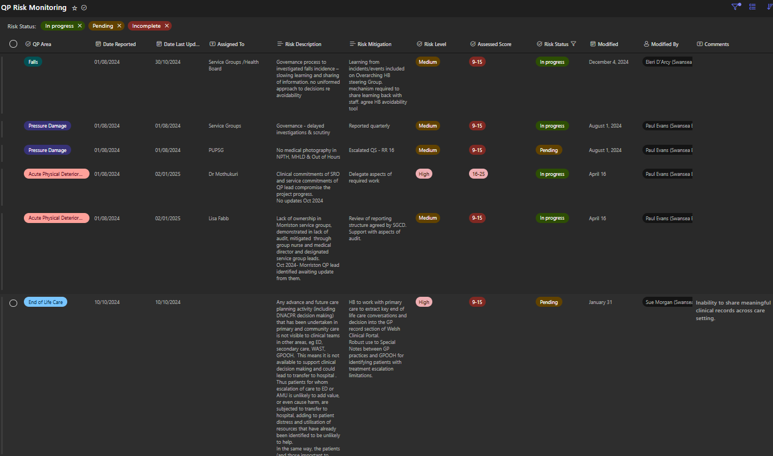
QP Risk Monitoring
Quality Priority Risks - Link to

