Slide 1



Our Big Conversation Up-date
Notes:
Today’s is quite a brief up-date as the current focus is on the practical vision as a result of Our Big Conversation… before I go into that however, I just wanted to start with a reminder of why we are here

Slide 2
Findings Report from Phase 1 & 2 – Informing the ‘One Bay Way’
Our vision into reality has 6 key benefits:
Leadership culture behaviour
A focus on the patient or service user
Activated and engaged staff
Reliable, designed systems and processes
A focus on evidence, measurement and outcome to continually improve our services, commissioning and populations health
Alliances and Partnerships
Notes:
Our vision will have a consistent branding and messaging around – ‘One Bay Way’, linked to the culture agenda with the ethos being us building one culture and one direction, whilst promoting empowerment, diversity and inclusivity.
Our vision of One Bay Way, aims to bring about 6 key benefits, which Mark outlined in his presentation to public board at the end of March and links to the findings of OBC around leadership approaches and behaviours, improving patient & Service User experience, improving staff experience through a promise to our people, reducing bureaucracy, improving quality and enhancing partnership working.

Slide 3
Leadership Masterclass – April 2023
‘Compassionate and Collective Leadership in Health and Social Care’ – linked to principles of a quality driven, learning organisation with Professor Michael West
122 attended
2 key questions:
What do you think is unnecessary in our system, which negatively impacts on teamwork, autonomy, behaviour and wellbeing?
How can we release your time so that you can lead differently?
Responses being used to inform practical vision and action plans
Notes:
Not only has the vision been informed through the survey and focus groups, but through additional partnership meetings with trade unions, feedback from management board, Board Development as well as the Leadership Masterclass in April where a 122 leaders and managers attended on … with Prof M West.
Mark posed 2 questions at the end…

Slide 4
Feedback / Results
21 Respondents via e-mail and MS Forms:
Unnecessary / volume of Meetings – Impacting on visibility / leadership
Bureaucracy – paperwork, processes i.e. recruitment and VCP, sickness absence process
Mandatory training and ESR
Silo working
E-mail overload
Staffing levels impacting on leadership
Need to focus on Wellbeing
Data and communication
Changing goal posts and last minute deadlines
Notes:
Colleagues from L&OD sent a reminder with an anonymous form for attendees to complete and return. From that 21 responses were received both via e-mail and the form, we have been able to identify these key issues…
The feedback has been consolidated and translated into actions which will be discussed with Executive team this week…

Slide 5
Our Big Conversation – Up-date cont…
The new vision for a high quality organisation is currently being finalised, as well as a reinstatement of our values and behaviours framework
Working in partnership to develop a ‘Promise to our people’, based on what staff, trade union partners, students and volunteers told us during phase 1 & 2 of Our Big Conversation. It will focus on the key areas for improvement identified, including;
reducing bureaucracy / streamlining processes,
flexibility – linked to reducing sickness absence and improving staff retention
leadership culture and behaviours
equality and inclusion
staff health & wellbeing
learning and improving
recognition and reward
trust and autonomy
A two-way commitment of what staff can expect from the organisation and the expectations on staff when they come to work
Engagement on vision – June to August 2023
Notes:
Mark’s Midweek Message has been launched as an action to improve communication based on OBC Feedback and to start communicating the actions that are being taken as a result of the feedback we heard.
An initial action, linked to the culture work will be a re-instatement of our values in a simplified format that people can understand and relate to.
There will also be a setting out of a 2-way commitment outlining what staff can expect from the organisation (promise to our people) and what the organisation expects from staff. The people promise and what we heard from staff has much parity to the feedback from leaders and managers.
There will be a full engagement paper issued by the Summer of 2023.

Slide 6
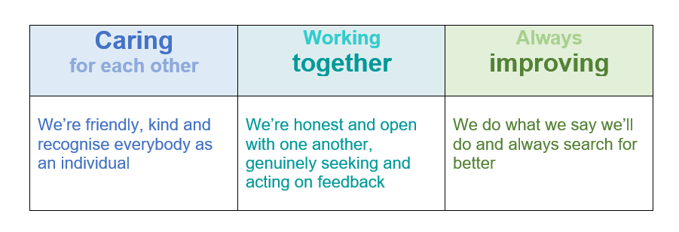
Draft – Reinstatement of Our Values & Behaviours
‘One Bay Way’
Notes:
Share the draft re-instatement of the Values…

Slide 7
Thank you for listening!

