Slide 1

Staff Wellbeing Deep-Dive into Staff Trauma and Suicide Prevention
Workforce & Digital Committee 14th June 2023
Dr Debbie Rees-Adams, Clinical Psychologist, Occupational Health & Staff Wellbeing
Paul Dunning, Professional Head of Staff Health & Wellbeing

Slide 2

Supporting Staff Suicide Disclosures - National Context
Themes
WG Reviewing 5 year strategy – new Strategy launch Autumn 2023
Collaborative policy; 'everyone's business' - focus on high-risk workplaces including ED and Primary Care
28% people who attempt suicide have had contact with MH services; 72% have not.
Continued focus on men in mid-life
New focus includes; social media and on-line image sharing, trauma, gambling, domestic violence, financial adversity and impact of Covid-19.
Integrated Motivational Volitional Model (IMV) of suicidal behaviour: Prof Rory O’Connor – CPsych; Uni Glasgow 2011, 2018.

Slide 3
Working collaboratively in SBU
Suicide Prevention = one of HB's quality improvement areas
Senior WB reps on HB's Suicide Prevention Steering Group to ensure joint working
‘Real Time, Suicide Surveillance System’ – National repository for suspected suicides (until inquest report concluded) in Wales and of Welsh people outside Wales. Monthly data from police forces, HB’s etc – includes SBU's staff data (see related staff suicidal thoughts/plan graphs)
Wellbeing Team trained in Applied Suicide Interventions Skills Training (ASIST) and HB's Tier 1 Suicide Prevention training
Wellbeing risk assessment includes suicide - recently modified based on WG Suicide Prevention Conference information
Staff Stress and Emotional Wellbeing Policy – clear guidance for managers to support suicide disclosures with 'traffic light' risk-based approach and signposting resources
Work related stress assessment and MH for Managers training – supports awareness, early intervention and prevention approaches

Slide 4
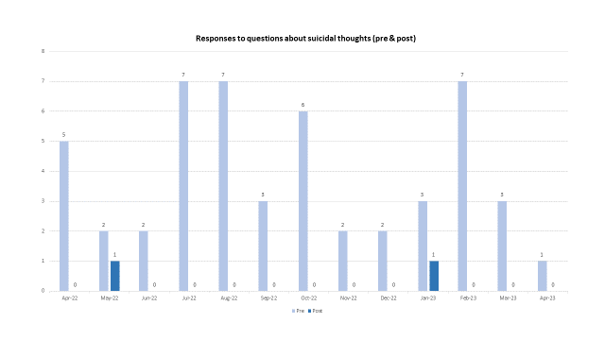

Slide 5
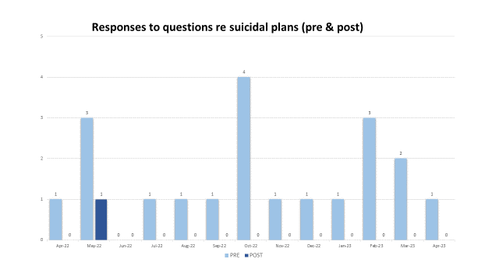

Slide 6
Trauma support for Staff
Development of clinical pathway in service – evidence base: NG116: December 2018.
Linked with HB Trauma lead, local implementation group & national TSW network.
Had training for team – T-CBT, G-TEP, EMDR to deliver NICE guidance interventions.
Further resources & supports for staff with moral injury.
TRiM/React development: 72 staff TRiM trained, 2500+ REACT trained. 34 TRiM responses for teams/services after adverse/critical events.
Notes:
Pathway / Post-traumatic stress disorder RATIONALE = psychological component (meds may be required).
NICE guideline [NG116]Published: 05 December 2018: watchful waiting (28 days). Offer individual TF CBT / EMDR 8-12 sessions 1/12 after incident. Trained practitioners with supervision in place.
TRiM - types of incidents: Unexpected death of a child, Unexpected death of colleague, Unexpected death of a patient, Assault on member of staff, Traumatic self-harm (patient), Homicide review, Traumatic episode of care, Staff experienced traumatic event.
Some challenges : promoting of sessions, release of staff to attend, getting TRiM staff to respond to an incident (time to attend, release to deliver support, confident & competence). Work is ongoing.. Recent refresher session – only 3/74 attended. Same small handful of staff.
TRiM Also linked with ERP group.(emergency response preparedness group).
Re Trauma data – new workflow software (cohort) in integrated service – will be able to provide specific trauma outcomes going forward (individual cases currently measured).
Vicarious trauma – anecdotally – more cases of moral injury, rather than vicarious trauma. Staff either with direct trauma themselves and / or moral injury issues. Some exceptions ; medical records / clinical coding staff / reception staff – having to read all details (tend to be non clinical roles, no clinical supervision / supports).
Some cases where trauma intn is not enough, we have 1 member in team with further skills / resource available to help staff with this (Gill).
TTCW evaluation headlines:

Slide 7
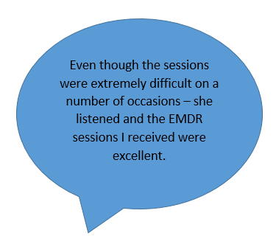
Feedback / Evaluation
T2C Wales (anti stigma training) – evaluation May 23– 99% SBU engagement; 9.4/10 rating for training overall (incl. increased recognition of signs, confidence in techniques to reduce, relevance to workplace).
The evaluation of the TRiM/REACT training programme demonstrates significant changes between pre and post measures in relation to confidence in having psychologically informed conversations in the workplace. 59% trained have used REACT in some capacity and content was helpful in facilitating conversations & supported staff’s confidence in opening and having wellbeing conversations in practice. (4.4 & 4.24 / 5 on scale - 1- not helpful at all, 5 - extremely helpful).
Improved health outcomes on EQ5D-L outcome measure (improvements in depression/anxiety, and participation in valued activities)
Integrated service workflow software (Cohort) will now
allow analysis of trauma data (collectively).

Slide 8
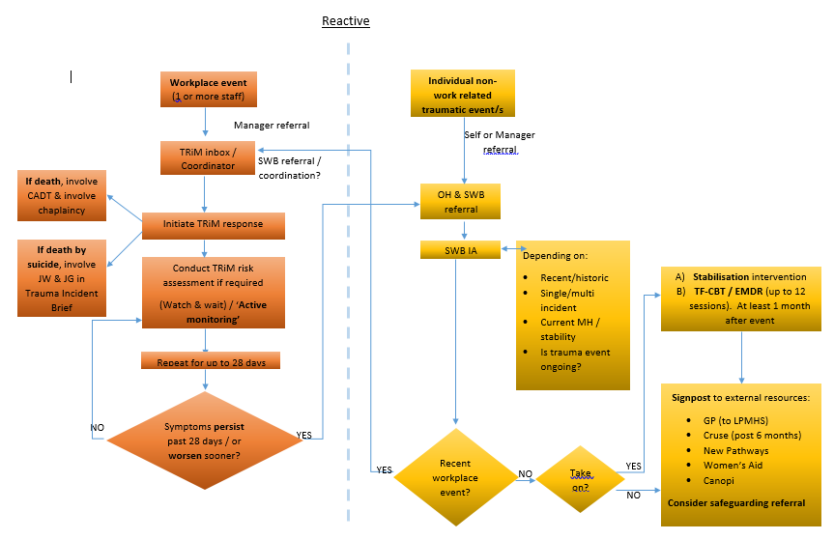
Trauma Pathway

Slide 9
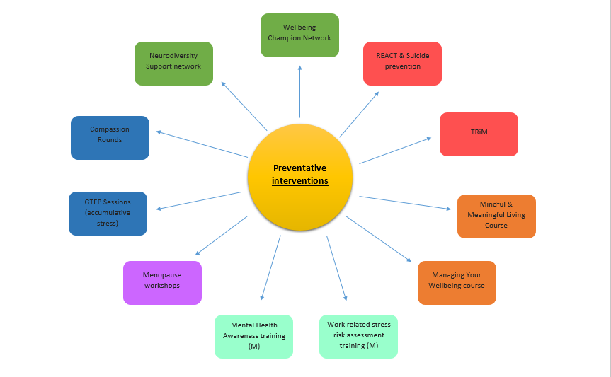
Notes:
Much proactive work is being done = area we want to get to. Prevention being better than cure.

Slide 10
A review of referrals into the Staff Health & Wellbeing service indicates an increase in staff presenting with increasingly complex difficulties, including trauma experiences, traumatic bereavements and post-traumatic stress disorder (PTSD). Some cases appear to be related to workforce deployments during Covid-19, exposure to traumatic events during the course of their work, whilst others are largely due to purely personal or historic circumstances or are a mixture of personal and work-related factors, with the pandemic exacerbating existing mental health difficulties.
Some service areas known for repeat exposure of staff to trauma/ death – several of these are on the priority list for development from HB Psychology lead perspective. Embedded Psychology roles have significant benefit to staff wellbeing and absence of these embedded roles continues to be a risk – joint working with Head of Psychology to try and progress these roles.
Notes:
Some areas – known as repeat / frequent users of service.
Need for embedded CHP roles e.g. ITU & Cancer / Ty Olwen in particular. SBU is an outlier for both. But been known for many years...

