Slide 1
Anti-racist Wales Employment Action Plan Update
Workforce and Digital Committee - October 2023
Katy Goss - Head of Widening Access, Equality and Careers

Slide 2
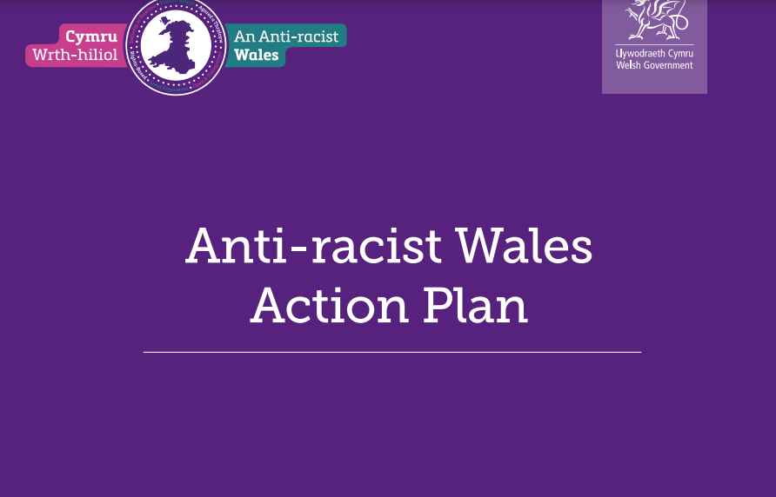
Anti-racist Wales Action Plan Background
Published on 7th June 2022
WG press release outlined the aims for Wales to become an Anti-Racist Nation. The actions are focused on the next two years, set against the vision of a Wales which is anti-racist in 2030.
One of a number of Action Plans being produced by Welsh Government over the next few years with the next being LGBTQ+
Notes:
2

Slide 3
Goals / Actions / Updates
Goal | Actions | Update
1.SBUHB will be anti-racist, and will not accept any form of discrimination or inequality for employees and service users. | Develop anti-racism action plan for employment as a specific part of the wider approach to equality, inclusion and diversity. Progress will be monitored and reported via IMTP and Annual Plan, and the Joint Executive Team process with Welsh Government. | SBUHB Anti-racist Workforce Action Plan (sharepoint.com) launched at the end of Black History month with Director of WOD presenting it at the Team Brief on 2 November 2022. Next Strategic Equality Group meeting is on 29th November 2023.
 | Gather written commitment/ video messages from CEO and other senior leaders endorsing support and commitment around anti-racism not only around staff but also access to services etc | With a new interim CEO appointed, there is an opportunity to capture and share their commitment. Conversations with DICE have commenced on this.
 | All Board members and Service Group Triumvirates to undertake an anti-racist education programme and implement and report progress against personal objectives to meet vision of an anti-racist Wales. | Anti-racist training was delivered to Board Members by Prof Uzo Iwobi, CEO of Race Cymru Council, and Dr Heather Payne from Welsh Government at the February 2023 Board development session.
Notes:
3

Slide 4
Goals / Actions / Updates
Goal | Actions | Update
2.Staff will work in safe, inclusive environments, built on good anti-racist leadership and allyship, supported to reach their full potential, and ethnic minority staff and allies, both empowered to identify and address racist practice. | Require anti-racist leadership at all levels and report demonstrable progress in driving anti-racism at all levels by: - appointing Executive Equality Champions and Cultural Ambassadors; - implementing a leadership and progression pipeline plan for Black, Asian and Minority Ethnic staff; - providing Ethnic Minority Networks appropriate levels of resource and access to the Board. | WG indicated their intention to issue a role description for the Executive Equality Champion. Not received as yet, have followed up with WG.
 | Ensure anti-racism is embedded into ‘the Big Conversations’ and Quality Improvement work streams and action plans. | In conversation with the ‘Our Big Conversation’ and Quality Improvement leads to ensure and understand how anti-racism is embedded/evidenced.
 | Work with HEIW and other NHS organisations to co-design anti-racist education programmes with Black, Asian and Minority Ethnic people. This will include setting a requirement for all NHS Staff, NHS Volunteers and students to complete redesigned anti-racist education programmes.
Notes:
4

Slide 5
Goals / Actions / Updates
Goal | Actions | Update
2. (Continued) | SBUHB to commit involvement in Academi Wales Aspiring Board Members Programme, ensuring education, mentoring and support to participants who will be from a Black, Asian and minority ethnic background. | This is still being developed by Academi Wales. Have linked with Paul Schanzer to establish relationship (new Head of WAEC) for an update and further information.
 | Ensure that SBUHBs commitment to be a values and behaviours driven, anti-racist organisation is embedded into key messages at induction. | Vales Led Virtual Induction is constantly being reviewed and evaluated to ensure up to date and appropriate messaging.
 | Coaching and Mentoring will be available for staff and will be an integral part of our talent pathways and coaching and mentoring strategy. This will include mutual mentoring with a focus on lived experience. | Coaching and Mentoring now sits with Widening Access, Equality and Inclusion. Work being carried out to broaden number of coaches in the org, and work has started to develop mentoring pathways.
 | Ensure all leadership and management training is anti- racist and where appropriate includes messages of how to manage/ lead in an anti-racist way. | Leadership and management programmes are constantly being reviewed and evaluated to ensure up to date and appropriate messaging
 | Ensure that talent schemes are designed to attract applicants from ethnic minority communities. This will include the implementation of our new Talent Management Strategies aimed at internal staff development ie Talent Gateway, Tiers 1-3 Talent and succession programme. This action will cover internal programmes and external recruitment to schemes.
Notes:
5

Slide 6
Goals / Actions / Updates
Goal | Actions | Update
3.Data in relation to race, ethnicity and intersectional disadvantage will be routinely collated, shared and used transparently, to level inequalities and provide assurance that the NHS Wales is an anti-racist and safe environment for staff | Improve workforce data quality and prepare for the introduction of WG Workforce Race Equality Standard (WRES) | WRES – Professor Anton Emmanuel met NHS Wales Equality Managers on 25 May 2023 with WG. Highlighted lessons learnt from WRES in England and updated on the work ongoing in Wales. Communications from WG to health organisations in September 2023 with further information.
Notes:
6

Slide 7



Updates (Linked Work)
Staff Networks
Discussion about support for staff networks at Management Board and Service Delivery Boards. Protected time remains an issue and concern for those who have sought information on applying for roles.
Expressions of interest (EOI) were invited from staff who would like to be the new Chair, Deputy Chair or
Secretary for 5 staff networks.
As of 12th September, the following posts have been recruited into:
Calon – Chair
Neurodiversity – Chair, Co-Chair, Secretary
Due to the number of expressions of interest received for the position of BAME Chair, a competitive process
is taking place on 28th September.
A celebration article will be launched via comms early October, with a further drive to recruit into
the remaining positions.
Notes:
7

Slide 8

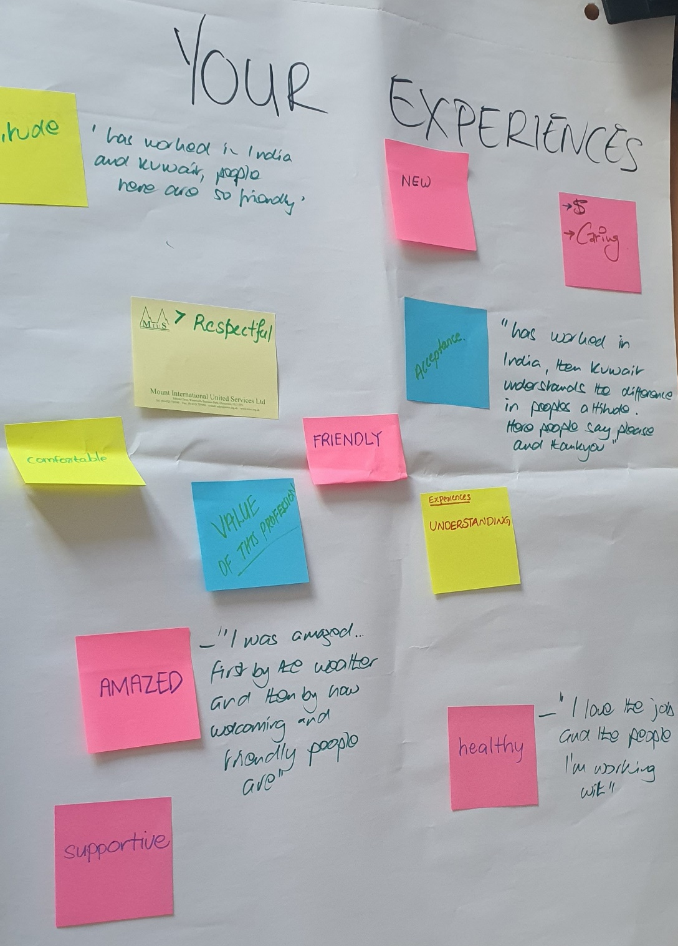
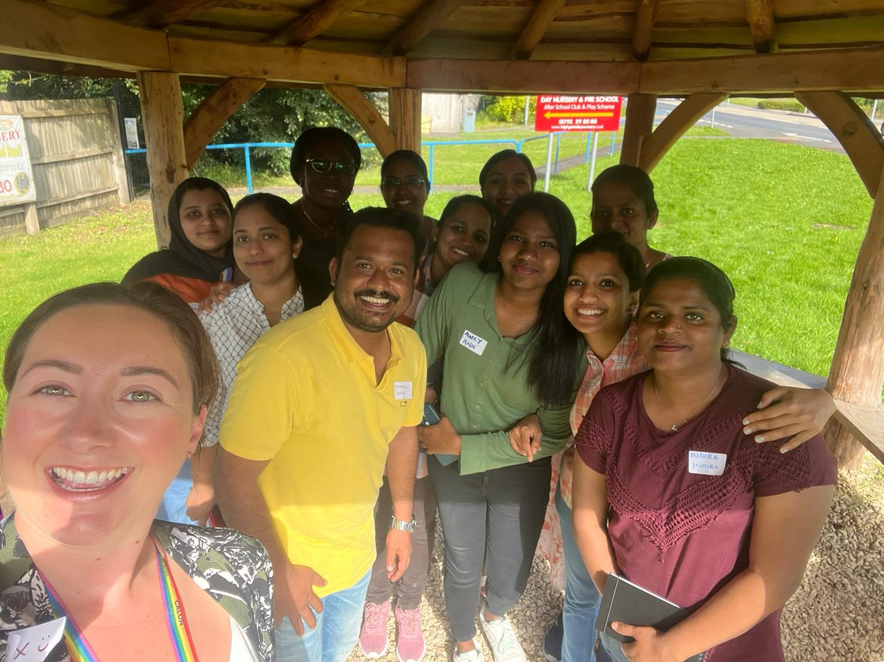
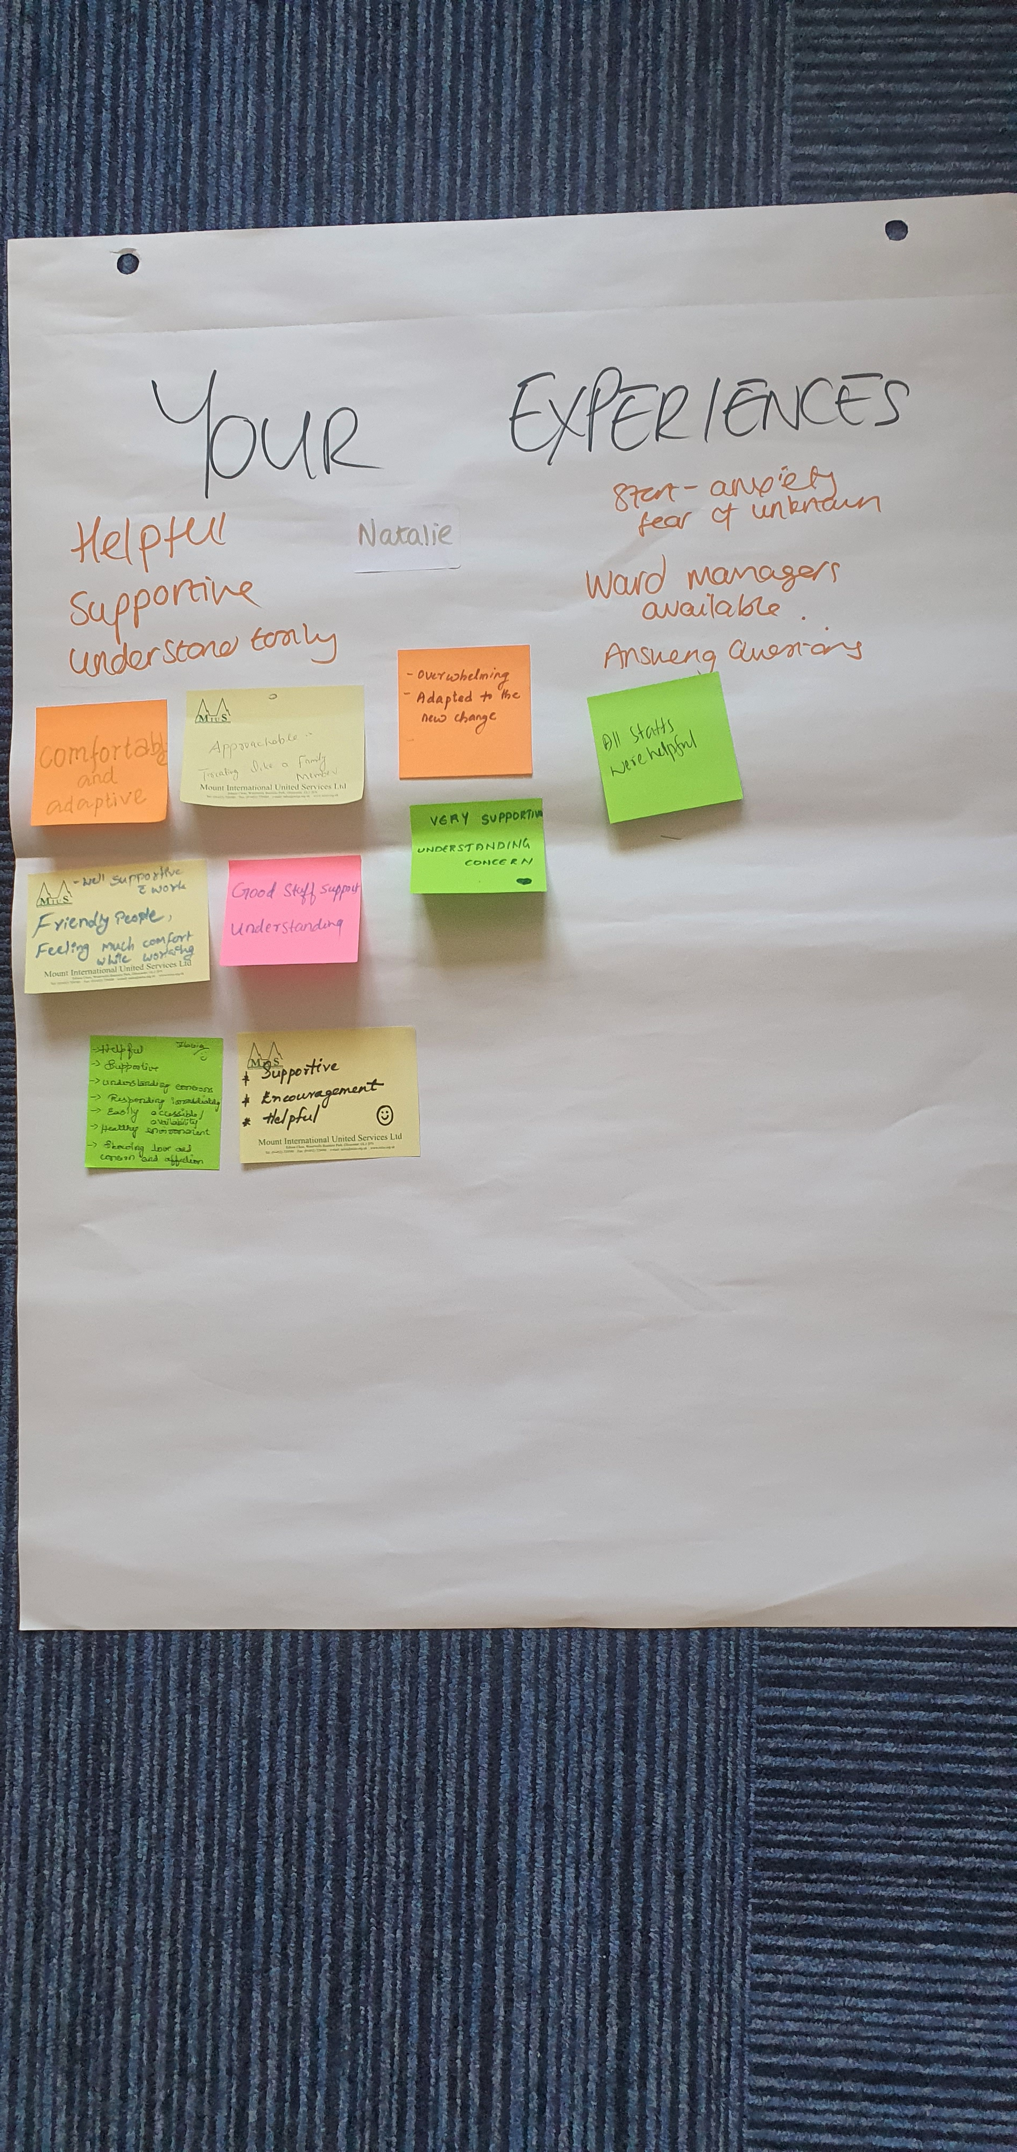
Overseas Nurses Cultural Conversations
The Cultural Conversations continue with the cohorts being recruited. Information has been shared with colleagues in Nurse Education, who have been able to raise concerns nationally (for example cost of living). From the information shared changes have already been made to improve the experiences of new cohorts including welcome packs and prepaid travel passes.
The next phase will see us engaging with previous cohorts, engaging with them as in line with their Service Groups. Part of this work will involve us working with the Service Groups to establish the support mechanisms they have in place, and how they are meeting the needs of this staff group in line with retention and progression.
Notes:
8

Slide 9
Optimise / Optimise Advanced
2 places on each cohort are ringfenced. Working with the Global Majority Lead to identify staff who are eligible to attend. Staff identified by the Global Majority Lead have attended and provided positive feedback around their experience of the programme. Demand for the programme continues to be high from across the organisation, with cohorts being planned into 2024/2025. To align with International Men's Day, a cohort is being planned for November to men in the organisation with the themes being focused around men's health and wellbeing.
ED&I Sessions Delivered to GP Trainers
The L&OD team have recently delivered 1 hour Equality, Diversity and Inclusion sessions to GP Trainers in the Swansea and Bridgend areas. The sessions were well attended, approximately 65 participants in total. The training was very well received and included an update/refresher on Equality principles and legislation as well as an interactive exercise around equality in employment and business decisions.
Black History Month October 2023
The Widening Access, Equality and Careers Team are linking with colleagues across NHS Wales, and comms to share opportunities for learning and celebrating Black History Month. The lead up to this will be communicated via SharePoint and email, that will also raise awareness of National Inclusion Week (25th September – 1st October).
Notes:
9

Slide 10
DICE
The Widening Access, Equality and Careers meet with colleagues from DICE on a 4-weekly basis to review the action plans and discuss areas of work around EDI where there is close working and crossover. This also provides opportunities for more frequent updates and identifying where we can collaborate.
Talent Development and Succession Planning
The Talent Development and Succession Planning Lead is working closely with Hazel Powell on a pilot that links with work Hazel is doing as part of her Florence Nightingale Foundation project. This work is focusing on the talent development and succession planning for our overseas nurses with the project focusing initially on Ward 12 in Morriston and CCU.
LGBTQ+ Action Plan
The Widening Access, Equality and Careers team will be conducting staff engagement to gather feedback from staff and share with colleagues in DICE who have already conducted public engagement for this action plan.

