Slide 1

E-rostering Performance report

Slide 2
Journey to date
Nursing | 8469
Admin & Clerical | 1476
AHP | 793
Estates & Facilities | 1158
Medics | 703
Add Prof & Tech | 755
Bank only | 995
Agency | 897
 | 15246
Notes:
Since 2016 we have expanded the use of Healthroster. To date we have the following numbers actively using Healthroster.

Slide 3
Benefits realisation –
Key achievements
Decommissioned KRONOS – saving approximately £45,000 per annum.
Consistency in one rostering solution being utilised.
Consistent key performance indicators for all professional groups.
Increased Visibility
Information dashboard
Scrutiny discussions
Education
Notes:
Strategic vision of creating and developing one solution.
Develop key performance indicators to benchmark and monitor progress.
KPI’s include: Unavailability, approvals, bank usage.
Medics: current rollout plan.
Scrutiny sessions: take place within the service groups and get reported corporately for nursing.
Education: Managers pathway programme

Slide 4
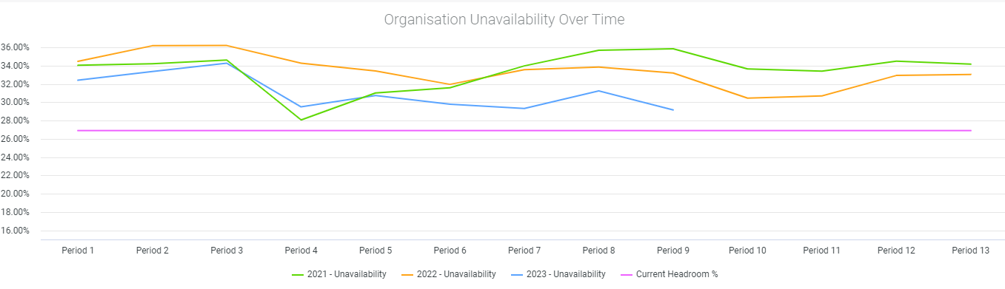
Benefits realisation
Unavailability during 2023
Notes:
This is the average total unavailability for the organisation for the last three years. It is possible to see that the unavailability position for 2023 has improved on previous years.

Slide 5
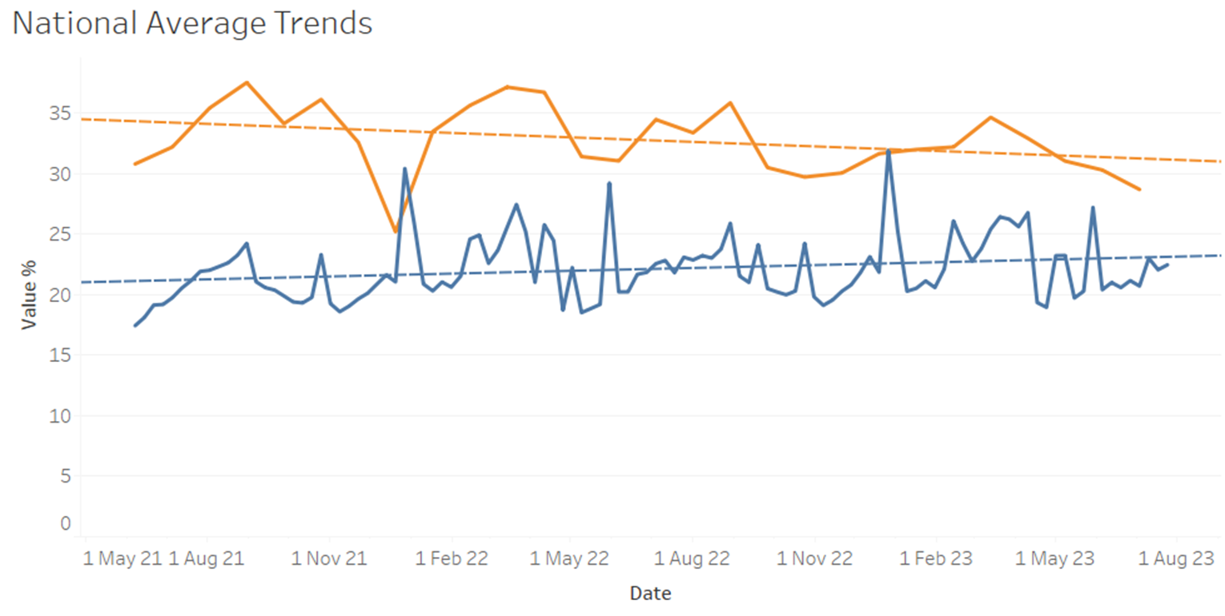
Benefits realisation
Unavailability during 2023
Notes:
This graph plots the Health Board (orange line) unavailability against similar size organizations in the UK (blue line).
Although as a health board, unavailability is higher than the national average, there is a distinct downward trend whilst the national average is trending upwards.
Unavailability has continuously fallen since March ‘23.
Current unavailability figures show lower unavailability averages than Wales as a region – 32.76%

Slide 6
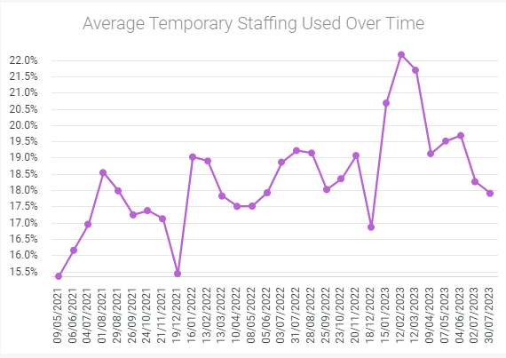
Benefits realisation – temp staffing usage
Notes:
The data is showing us that the amount of total temporary staffing utilisation has been dropping since February 2023.

Slide 7
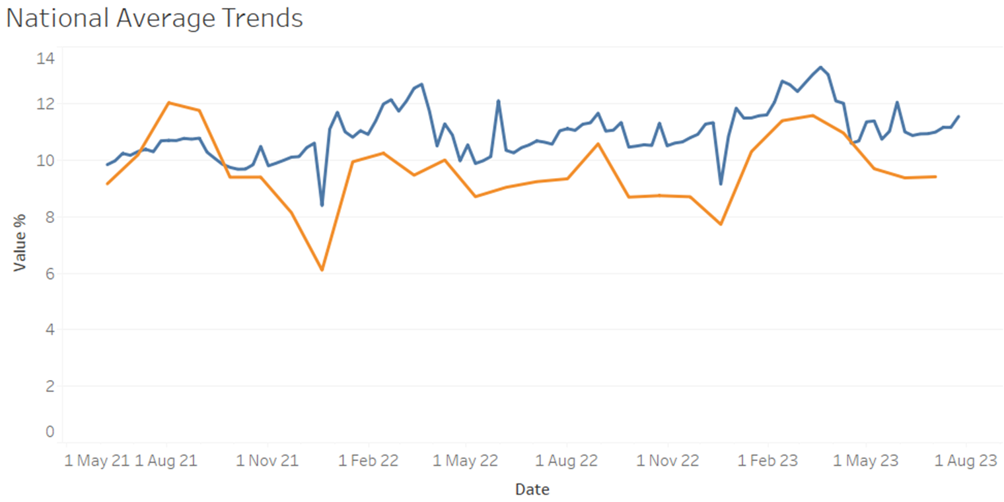
Benefits realisation
Bank usage
Notes:
Health Board utilisation is lower than the national average.

Slide 8
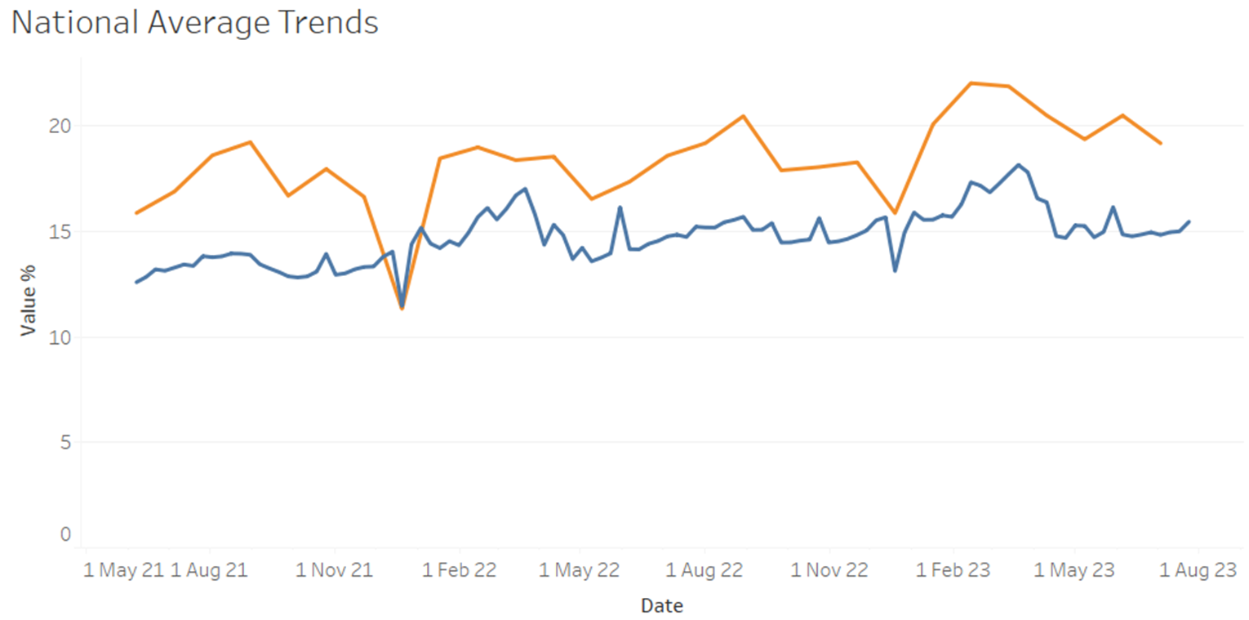
Benefits realisation
Total Temporary staffing usage
Notes:
Whilst total temp staffing for the whole health board is higher than the national average, it trends with that average as we see an increase everywhere

Slide 9
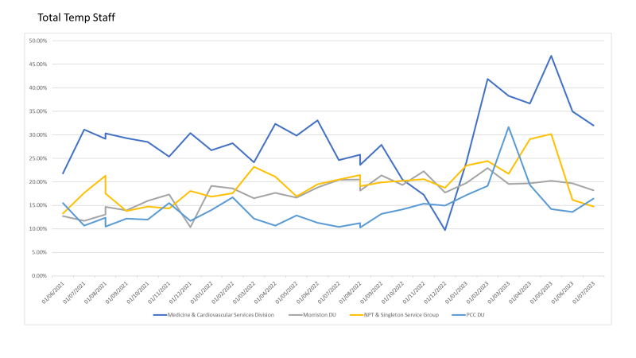
Benefits realisation
Temporary staffing usage

Slide 10
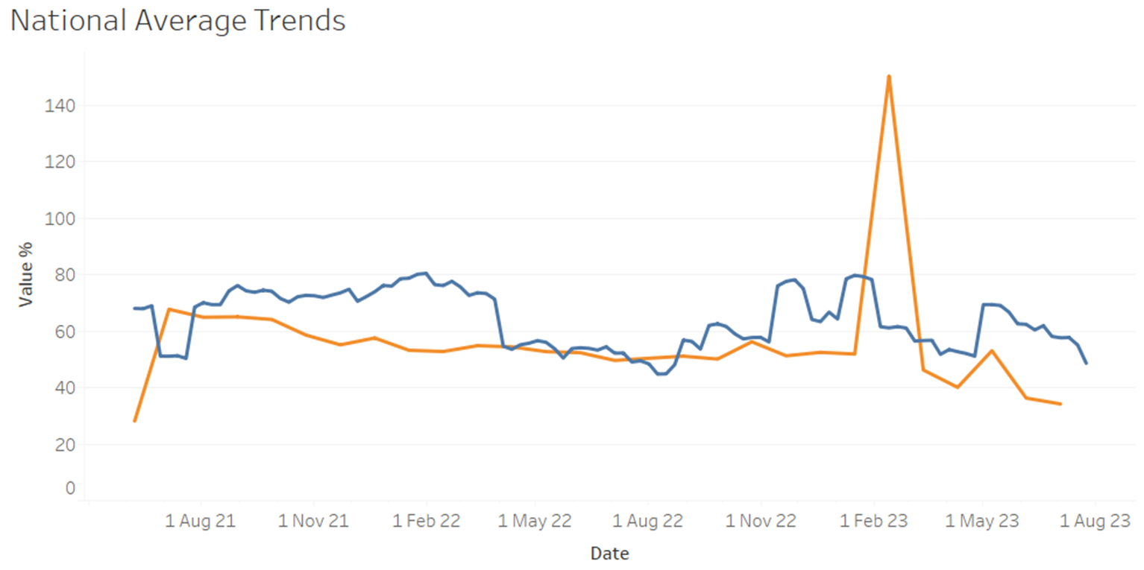
Benefits realisation
Net Hours
Notes:
Net hours is currently much lower than the national average and has been below that average since Nov ‘22.
Net Hours is also much lower than the average for Wales
The spike in Feb ‘23 is caused by ECG, NPT Generic HV, Patient Pathway and Dietetics Morr showing very high values

Slide 11
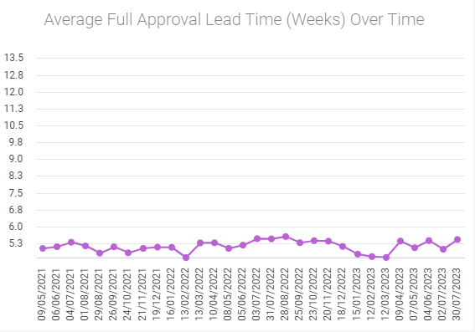
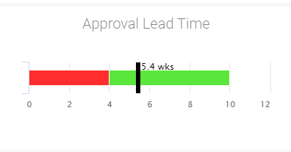
Benefits realisation
Approvals
Notes:
Roster approval lead times have grown steadily with the majority of divisions hitting 6 weeks.
PCC DU has shown a huge increase from 2.6 weeks in Oct ‘21 to 6.2 weeks now.

Slide 12
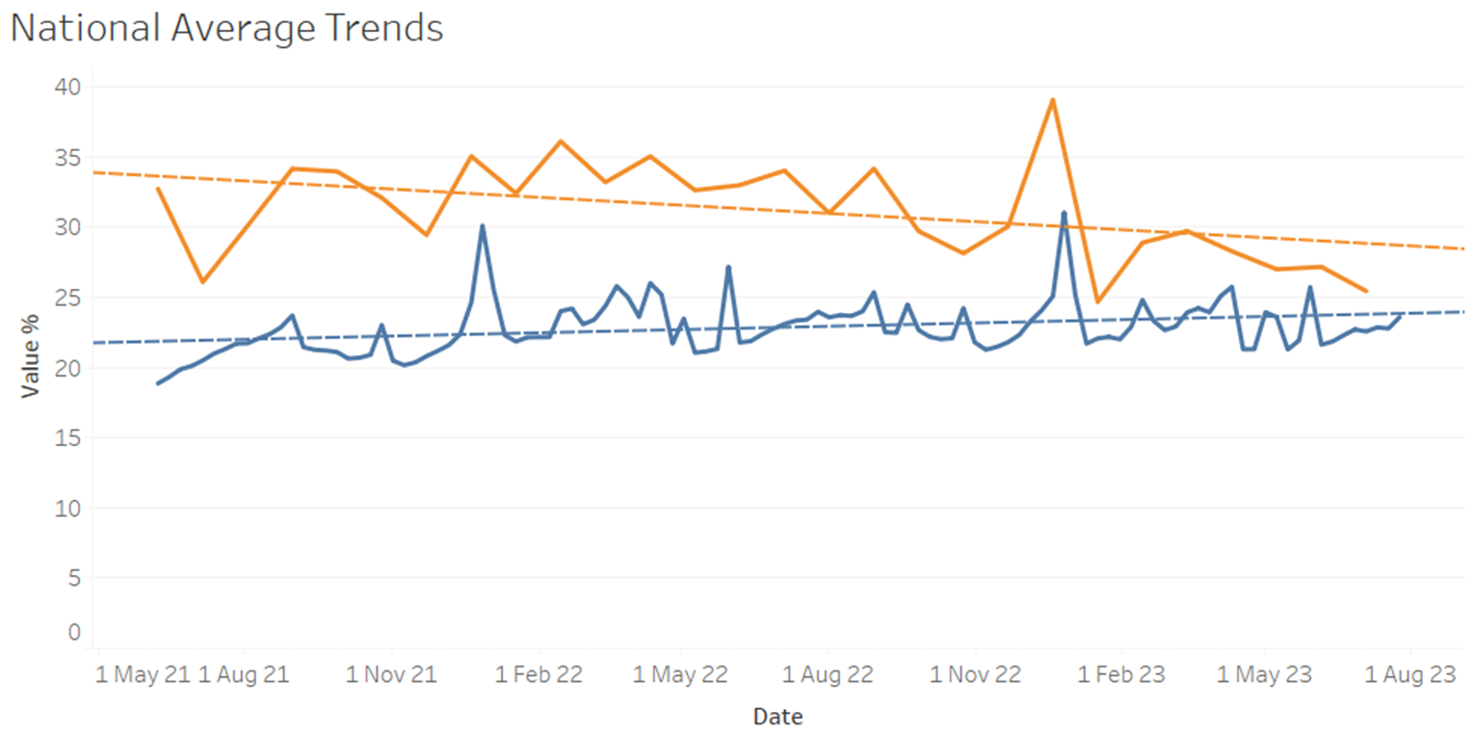
Benefits realisation
Unfilled shifts
Notes:
Unfilled roster show a continuous downward trend as opposed to the national average which is showing slight increases. We are now almost exactly on target with the national average

Slide 13
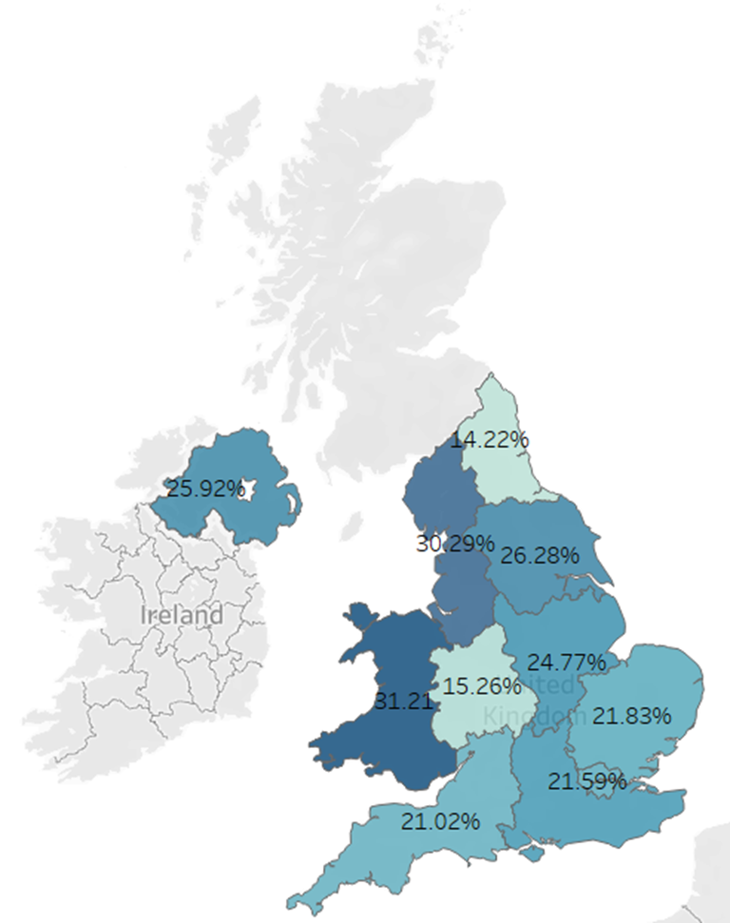
Benefits realisation
Unfilled shifts
Notes:
Current unfilled roster averages show less than the Wales average of 31.2%

Slide 14
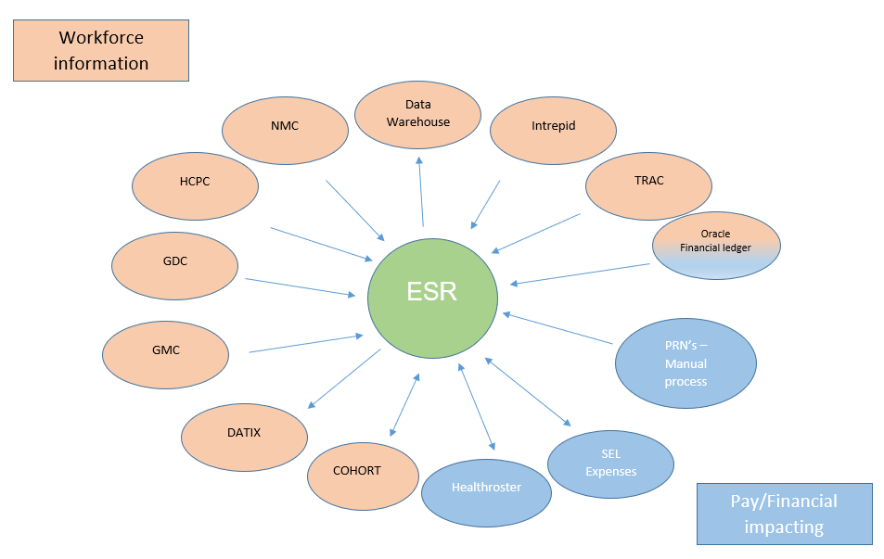
Digital Integration
Notes:
ESR is the main workforce information system.
Healthroster has a bi-directional interface with ESR which means that manages only need to enter information once.
Rostering holds a host of information on staff, patterns of work and activity that feeds a number of workforce activities e.g workforce planning.
System inter-operability is critical to have the information needed to operationally manage the services and workforce.

Slide 15
Digital Future Developments
People strategy - Digital readiness
Implementation of Establishment Control
  Health Board implementation
  National programme
Increased use of ESR Self-service

