Slide 1
SBUHB Workforce & OD Best Practice Review

Slide 2
INTRODUCTION TO OUR BEST PRACTICE REVIEW
Our Big Conversation (2022) staff engagement programme enabled us to better understand what our staff and our Trade Union colleagues felt about working in Swansea Bay.
This has helped to inform the creation of our:
People Strategy; and
Trade Union Compact
The wellbeing of our staff and providing positive working environments is crucial to achieving the Swansea Bay’s One Bay Way. To achieve this, we recognise the proven research available that directly correlates physical and psychosocially safe environments with improved performance and workplace engagement. In order to create a psychologically safe working environment, we must acknowledge and address the risks and potential for harm to employee wellbeing that may occur as a result of inappropriate or suboptimal deployment of workforce processes and policies.
We launched our Best Practice Review in 2023.

Slide 3
WHAT IS THE BEST PRACTICE REVIEW
The Best Practice Review is a way for us to evaluate how our workforce policies, procedures and practices across the organisation are applied through a best practice lens and what impact they have on our staff.
WHAT IS THE OBJECTIVE OF BEST PRACTICE REVIEW?
Ensure we are person centred in the way we manage ER
Working collaboratively with our Trade Union colleagues
Establish the base line application of policies, procedures and practices across the Organisation –
  what are we doing well and need to do more of?
  where can we improve practices to enhance employee experience and prevent avoidable employee harm?
Analyse available employee relation data to establish a baseline position of cases over a 4 year period to allow in-depth analysis of case management, allowing a data driven approach to benchmarking to allow us to target improvement and identify trends

Slide 4
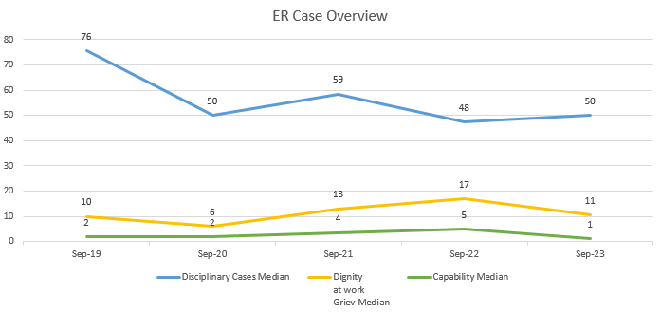
WHAT IS THE CURRENT DATA TELLING US
Between the months of October 23 to December 23 the below cases have been recorded;
Disciplinary: 50 cases (an increase on average of 5 cases for the same period in 2022)
R&R: 14 (an increase on average of 4 cases for the same period in 2022)
Capability 6 (an increase on average of 3 cases for the same period in 2022)
Disciplinary cases:
The data on disciplinary cases shows a steep reduction between 2019 and 2020 with a 41% reduction in cases. In 2021 cases rose with 17% increase. In 2022 cases decreased again, with a 20% reduction. During the period of 2020 – 2023 the case average was 51.
Respect & Resolution:
Dignity at work / Grievance cases have been combined to reflect the new Respect and Resolution policy scope.
The data shows consistent average of 13 cases. Between the periods of 2019 – 2023, (with the exception of 2020 when cases numbers reduced 50%, believed to be as a result of the pandemic).
Capability:
The data shows a fluctuation between the periods of 2019 – 2023, fluctuating within the median range of 1 to 5 and generating an average of 3 cases for the period.

Slide 5
Disciplinary case analysis:
 | Disciplinary average cases open in month | Disciplinary average cases closed in month | Disciplinary over 2 years | % cases over 2 years
Sep-19 | Data unavailable | Data unavailable | 3 | 0%
Sep-20 | 3 | 7 | 5 | 1%
Sep-21 | 11 | 12 | 9 | 1%
Sep-22 | 12 | 11 | 20 | 3%
Sep-23 | 6 | 7 | 21 | 4%
Sep-23 to Dec-23 | 5 | 6 | 4 | 3%
On review of the available data the number of disciplinary cases opened on average in a 12 month period Vs the number of cases closed in a 12 month period is balanced, which for overall case management is positive.
Cases that have been ongoing for 2+ years has shown an increase, meaning we are now taking longer to close cases down. In the four month period between Sept-23 and Dec-23 3% of open cases had been open for 2 or more years.
 | % of cases where suspension has occurred | % of Suspensions that have lasted over 6 months
Sep-19 | 14% | 48%
Sep-20 | 23% | 75%
Sep-21 | 15% | 39%
Sep-22 | 8% | 54%
Sep-23 | 9% | 29%
Sep-23 to Dec-23 | 11% | 76%
On review of the available data the number of disciplinary cases that resulted in suspension over a 12 month period ranges between 8% – 23%. Encouragingly the number of cases resulting in suspension has reduced significantly since 2021 with an average of 8.50% cases resulting in suspension.
Cases where a member of staff has been suspended resulted in suspension lasting 6 months or more on average affected 50% of cases, with a range of 39% - 75%

Slide 6
OUR BEST PRACTICE STORY SO FAR
Listened to our staff: Using the feedback from our Big Conversation, feedback from the WOD team, in particular HR Ops and BP team, mangers involved in processes, and feedback from trade union colleagues.
Initial feedback we have had;
Have we really listened to our TU colleagues?
The fast track process reduces time and stress
The Respect and Resolution Policy is a good opportunity to look for a resolution rather than blame
Processes can be too long
There can be a lack of communication during processes
Processes are felt to be punitive rather than restorative
Processes can be stressful for all those involved
Processes can be confusing
Some decision makers can be bias in their approach
Not everyone understands each others roles in a process
R & R – often issued to avoid OCP progression
Alternative duties can be more detrimental to suspension in some cases
“Raising Grievances are sometimes the only way , not just for resolution, but for organisational learning”
(TU rep)

Slide 7
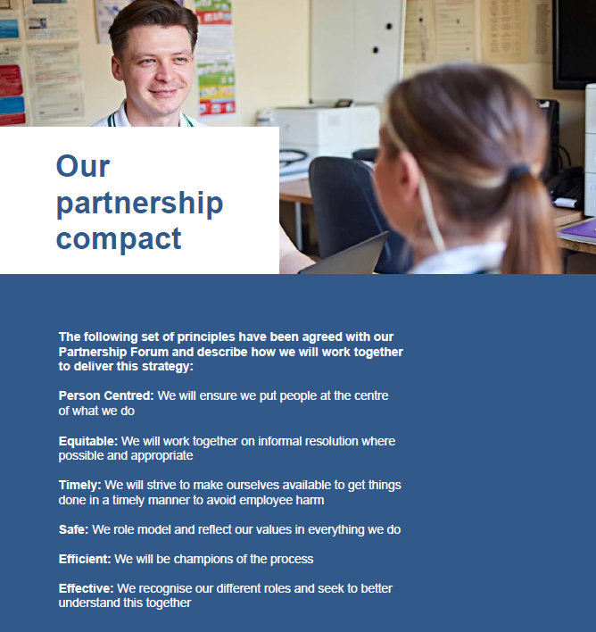

Slide 8
OUR BEST PRACTICE STORY SO FAR
What have we already changed in the way we manage ER?
Any TU rep can bring any case at any time for discussion
Sub group regular agenda item (with W & OD)
Focus on informal resolution where at all possible
All ER correspondence templates now on our intranet for full transparency
Learning from Events process
Managing ER processes linked to criminal allegations differently
Managing ET cases differently
MDT case reviews for complex matters
Sharing more openly with our TU colleagues back stage to understand impact and risks to enable better support and outcome
Aligning our approach to the One Bay Way – means we are trying to put people at the centre of what we do.
Working in partnership with trade union to start the journey together in a collaborative way through the establishment of a working group.
We have held an avoidable employee harm workshop with key stakeholders to kick start our Best Practice journey.
Developing our new Partnership Compact between SBU and the Trade Unions (launched with our People Strategy).
Running workshops to explore how we want to change the way we do each ER process.

Slide 9
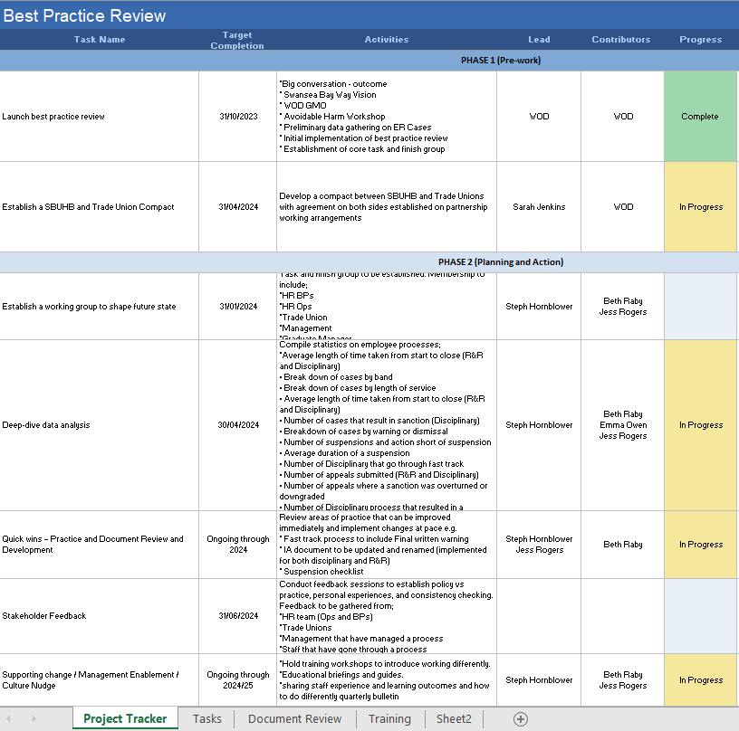
BEST PRACTICE NEXT STEPS…. OUR PROJECT PLAN

Slide 10
BEST PRACTICE NEXT STEPS….
Work together in partnership utilising the Best Practice collaborative working group to support the review and recommend and support with the implementation of improvements to practice.
Improve the reporting of ER data and conduct an in-depth data analysis to support process mapping and to understand the true impact that sits behind the numbers.
Conduct feedback sessions with key stakeholders to understand how policies and procedures translate into practice and gaining valuable first hand experience from those who manage, support and are subject to a process.
Hold regular training workshops to introduce new ways of working and support a cultural change to approaching Er matters.
Focusing on quick wins: In practice and through the development of supporting documents. Enabling change at pace by focusing on areas that will have the most impact.
Develop a fluid action plan to capture and record actions and tasks resulting from the review. (ER wont sit still)
Present a summary report following the next phase of the best practice review.
Next phase will consider how we embed the changes and measuring the impact of change.

Slide 11
BEST PRACTICE NEXT STEPS….
As part of what we can do now and our ‘quick wins’ we are actively prioritising and progressing the below;
A new initial assessment process and form is being developed to support a more structured approach to conducting an initial assessment. The form will now have management checklist sections that prompt the manager to review all contributing and mitigating factors to any allegations/complaints they are assessing. The form also facilitates how allegations/complaints should be managed from the outset, by allowing the reviewing manager to choose an appropriate outcome based on their findings that aligns with a just and restorative culture.
Example:
Section 6: Management Review Checklist
Operational Review
Is the employee appropriately trained? | Yes | No | N/A | (add details)
Is there an Organisation SOP/process/ protocols in place and applicable? | Yes | No | N/A | (add details)
Is there an accepted practice being worked to by colleagues that deviates from Organisational SOP/process/ protocols? | Yes | No | N/a | (add details)
Was a suitable risk assessment in place at the time of the incident? | Yes | No | N/A | (add details)
Was suitable supervision available at the time of the incident? | Yes | No | N/A | (add details)
If applicable, were staffing levels sufficient on the shift? | Yes | No | N/A | (add details)
Personal Review
Has the employee had a recent PADR? | Yes | No | N/a | (add details)
Is there anything relevant in the PADR that relates to the allegation? | Yes | No | N/a | (add details)
Are there any health, or personal circumstances that need to be taken into consideration? | Yes | No | N/a | (add details)
Are there any indications of substance abuse that need to be taken into consideration? | Yes | No | N/a | (add details)

Slide 12













BEST PRACTICE NEXT STEPS….
As part of what we can do now and our ‘quick wins’ we are actively prioritising and progressing the below;
Suspension practice and guidance – a review of our suspension practice and guidance is under review to enable better decision making and management of suspensions from work. Based on the initial data we are currently averaging 8.5% of all disciplinary cases result in suspension and 50% last 6 months or more. Informal feedback gathered so far suggests that those on suspension have a negative experience whilst on suspension with limited or poor communication and support and detriment to their wellbeing.
Training and development to engage and support key stakeholders who manage or support processes and practices with cultural change aligned to best practice.

