Slide 1


Organised For Success
Delivery Unit Staff Survey Outcome

Slide 2

Organised for Success (O4S) –
Shaping and Strengthening how we work as ONE Health Board
Staff Survey
Formation of the DU
Job title sift
Survey of all staff in scope = 116
58% response rate
Thematical review undertaken

Slide 3
Organised for Success (O4S) –
Shaping and Strengthening how we work as ONE Health Board

Slide 4
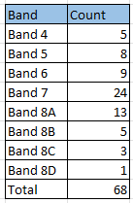
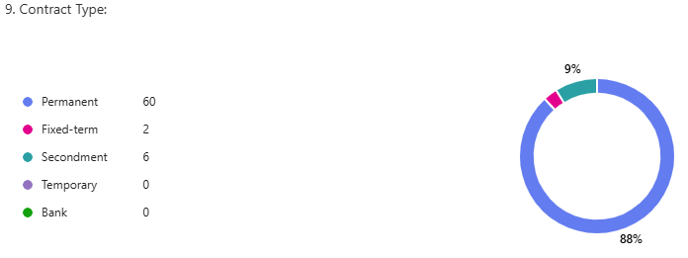

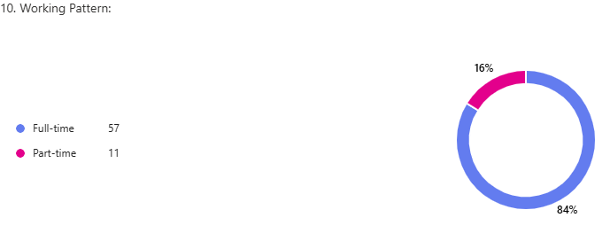
Organised for Success (O4S) –
Shaping and Strengthening how we work as ONE Health Board
Banding:
Contract Type:
Working Pattern:
42 different job titles

Slide 5
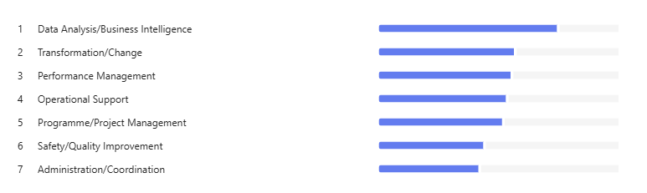
Organised for Success (O4S) –
Shaping and Strengthening how we work as ONE Health Board
Work areas ranked in order of time spent:

Slide 6
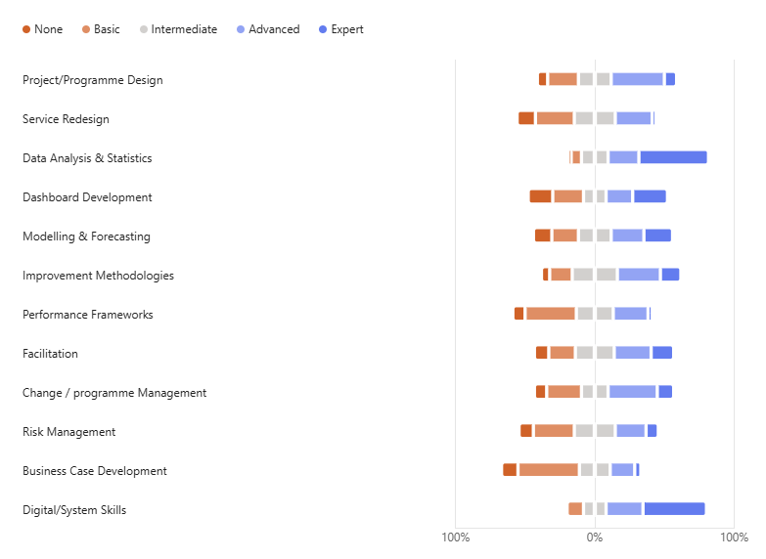
Organised for Success (O4S) –
Shaping and Strengthening how we work as ONE Health Board
Level of experience:

Slide 7
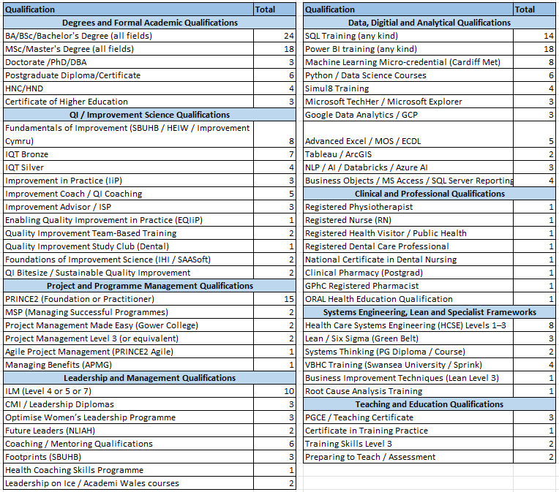
Qualifications:

Slide 8
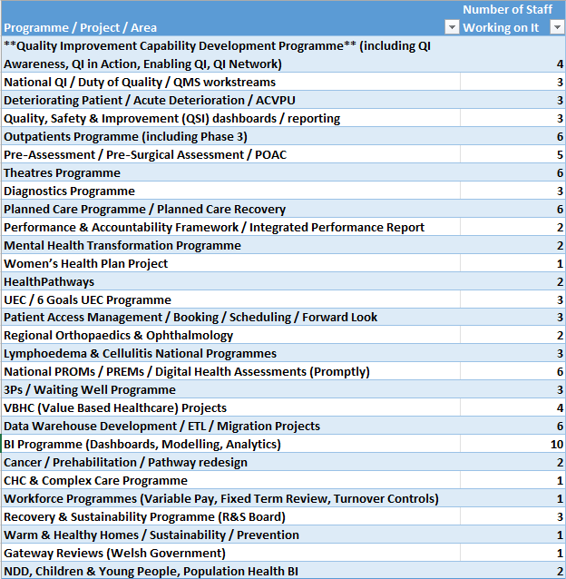
Programmes of work:

Slide 9
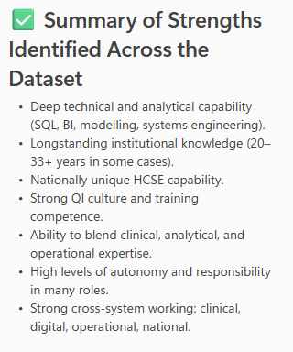
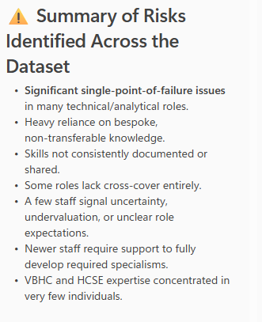
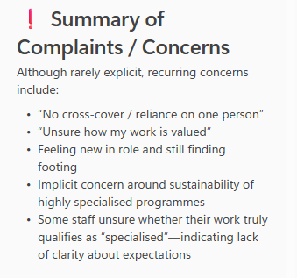
Organised for Success (O4S) –
Shaping and Strengthening how we work as ONE Health Board
Key strengths, risks and concerns raised from role description:

