Slide 1
Increasing Presenteeism
Best Practice Review
Notes:
This slide can be used for presentations which are from a health board-wide perspective or for a whole HB audience as the graphic device to the right of the slide includes all four service group colours and red for the corporate team.

Slide 2
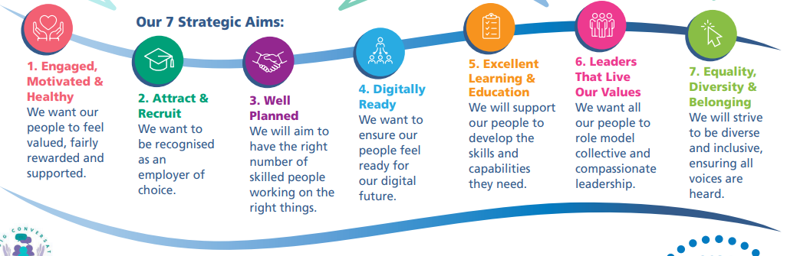
People Strategy 2024-2029;
supporting the 10 year vision of a high quality organisation
The content:
is aligned to national workforce strategies, our Health Board vision and responds to Our Big Conversation feedback
includes 7 strategic people aims/ goals, each outlining methods of delivery and success measures

Slide 3



People Strategy 2024-2029; supporting the 10 year vision of a high quality organisation
‘Focus on the wellbeing of our people with timely access to Occupational Health and Wellbeing support, providing relevant training and information and extending our wellbeing champions network’
‘Continue to listen to our people and take action when they speak up.’
Supports staff retention – empowered staff with the right skills and resources in supportive teams contributes to high quality patient outcomes
‘Review and refresh our existing Leadership Development Programmes to include collective and compassionate leadership principles’
‘Design a suite of new leadership development initiatives for all levels of clinical and non-clinical leaders that support us to embed our values, behaviours and deliver our ‘One Bay Way’ 10-year vision’

Slide 4
Increasing Presenteeism: Best Practice
We strive to increase presenteeism across the Health Board in order to ensure ‘An Engaged, Motivated & Healthy Workforce’ whilst ensuring best practice, using processes and practices which are ‘Well Planned’. All of which is contributing and in direct alignment with our 5 year People Strategy
We would like to share with you some of the excellent work ongoing across our Service Groups by the HR Business Partner & HR Operational Team. We are enabling our leaders to provide support to our staff with the aim of increasing presenteeism in the workplace
We have worked in partnership with staff side and Occupational Health throughout our efforts
In completing this work we are fulfilling the requirements of the recent Audit carried out; MAAW Standalone training developed and rolled out, attendance at MAAW training recorded and monitored, best practice shared and implemented across each Service Group
Notes:
Emma – our intensions for this session

Slide 5


Support Services
Sickness Absence
Action Plan
Rhian Mansel HR Business Partner Estates & Facilities

Slide 6

.
Support Services Sickness Absence plan
Introduction
Reducing sickness absence is a key area focus for the Support Services Department.
A commitment to reduce sickness absence consistently by 2% was made in July 2022- 11.98%
In aiming to achieve the reduction a sickness absence improvement plan was implemented, with the main aim to support health and wellbeing at work, sustain a high level of engagement and positive employee experience through the objectives and measures outlined within the plan.
Key actions of the plan were as follows:
Departmental Manager monthly meetings to monitor effectiveness of improvement plan.
Evaluation of MAAW pilot at Morriston.
Regular sickness absence audits.
Support development of management skills in MAAW.
Increase use of preventative measures to support improvement in reduction of sickness absence focused on health & wellbeing.
Conduct 'deep dive‘ analysis into hot spot sickness absence areas
*

Slide 7
Support Services
Monitoring of Progress
Performance against objectives were monitored at monthly hospital site sickness absence meetings, plus a quarterly Senior Support Services sickness absence group, which included Occupational Health Colleagues.
Actions completed:
Review of MAAW pilot at Morriston and appointment of an additional Governance officer post
Sickness Absence Toolbox Guidance developed by the HR operational team and HR monthly memos
MAAW training completed with 20 Supervisors/Managers trained
OH referral, Menopause awareness, Tailored adjustment, Work Related Stress Risk Assessment Mens Health Awareness Sessions & Stigma Surrounding Mental Health Training
19 Wellbeing Champions
Weekly Case discussions with Management & HR operational team
Deep dive analysis into high absence areas, Morriston Domestic & Portering

Slide 8
Pay Period Ending 15/04/23 Overall Sickness was 10.51%
Pay Period Ending 30/03/24 Overall Sickness was 8.81%
Reduction of 1.70% over a 12 month period

Slide 9
Hospital Site Progress

Slide 10
Sickness Absence and Staff Wellbeing
Reduction and Improvement Interventions
Morriston Service Group
Notes:
This slide can be used for presentations which are from a health board-wide perspective or for a whole HB audience as the graphic device to the right of the slide includes all four service group colours and red for the corporate team.

Slide 11
SICKNESS ABSENCE INTRODUCTION
Morriston Service group had been actively managing sickness absence in-line with established action plans; however, absence levels remained well above the WG target of 5.5%, with cumulative percentage for 2022/23 residing at 7.55%.
Some areas within the service group were exceeding 10% absence, and in December 2022 absence levels for the month reached 9.48% for the service group as a whole, the highest in month absence levels seen 2020.
As a result Morriston Service Group transferred resource to the HR Business partner team to provide focused support in an attempt to reduce sickness absence.
Sickness absence reduction plans were then developed in collaboration with the senior management teams. With Trade Union discussion and updated provided on the approach.

Slide 12
THE SICKNESS ABSENCE PLAN: STAGE 1
Initial focus was on the Nursing workforce. where sickness absence for registered nursing was at the time 9.67% and HCSW was 12.87%.
Our first step was to understand how sickness absence was being managed;
49 sickness absence audits were conducted across the Service Group, covering all nursing areas
Audit results were scored and rag rated
A findings report, containing recommendations and an action plan was sent to the ward manager, matron, HoN and HR.
Bespoke training, support documents; including a sickness tracker, review prompt calculator, a sickness absence resource pack and coaching were provided to managers to support them in implementing the recommendations.
A re-audit was scheduled with all areas 3 months after the initial audit.
A re-audit findings report, containing any further recommendations and an action plan if required was sent to the ward manager, matron, HoN and HR. – for those areas that required an action plan further audits were scheduled as necessary.
Senior nurse meetings held weekly to discuss unavailability, absence and updates on the absent action plan.

Slide 13
THE SICKNESS ABSENCE PLAN: STAGE 2
Our next steps was to bring sickness absence to life for managers and understand drivers for sickness absence;
All areas received a presentation that highlighted their areas absence over a 12 month period. The presentation detailed;
- Broken down by staff band: Number of absence cases, number of working days lost, number of cases against reasons for absence, the cost associated for each band and the total for the area.
All areas had 1:1 sessions on the impact to the individual and the team when absence is managed poorly.
Worked in collaboration with HR Operational team to ensure regular sickness case management and de-briefs were held and appropriately supported.
Completed a full review on the reasons for absence, we found stress/anxiety/depression being the highest reason for absence within the service group.
In areas with high level of sickness and know ER issues we conducted pulse surveys to assess the working environment, taking a wholistic approach that looked at management and leadership, staff experience, team working etc.

Slide 14
THE SICKNESS ABSENCE PLAN: STAGE 3
Our next step was to understand why stress/anxiety/depression was the top reason for absence;
We analysed the data and found:
255 files were selected from a report run from Allocate for a 6 month period where Stress/Anxiety/Depression was recorded as sickness - Out of the files viewed, 57% identified personal stress as the reason for absence, 10% identified the workplace as the reason for absence and 33% did not identify the reason.
Top 3 reasons for personal related stress found; 30% were related to bereavement,16% related to dependants and 10% relating to stress at home.
Top reasons for work related stress found; 42% were related to workplace pressures,15% related to dignity at work.
Stress management audits were conducted with managers to understand how absences related to stress are managed. We found that stress in the majority of areas is managed the same as any other absence.

Slide 15
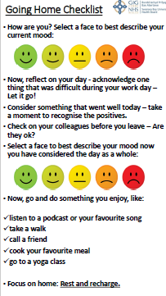
THE SICKNESS ABSENCE PLAN: STAGE 4
Our next step was to put actions in place to better support our staff and support our managers to manage staff who are experiencing stress before they go absent, whilst they are off absent and when they return to work:
The following actions have been put in place:
Bereavement support group established, supported by CAD team, run monthly (commenced in
Developed a bespoke Bereavement support letter template for managers to send staff instead of the generic absence letter, that provides a more compassionate correspondence and outlines support available.
Staff wellbeing (with a focus on stress) working group has been established, to collaboratively develop an action plan to implement activities to support managers and staff when dealing with or experiencing stress.
Working with Carers Wales to provide a Carers support group, first session is to commence in July.
Health and Wellbeing resource pack has been developed that provides links/QR codes for resources both internal and external that staff can access. This is now sent out to staff who report absent. Hard copies are also being developed for ward areas supported by charitable funds.
‘Going home end of day checklist’ continued to be promoted with ‘Going home checklist’ signage around the site/at exits
to promote the checklist and allow staff visual aids to engage its usage. Managers are provided with credit size checklist
cards which have been distributed and are provided to new staff who join. Charitable funds were secured for this initiative.

Slide 16
THE SICKNESS ABSENCE PROGRESS
Absence trend data:
Over the last 15 months MSG has seen an average of 0.87% reduction in absence 22 vs 23/24.
Over the last 15 months MSG has seen an average of 0.93% reduction in absence 22 vs 23/24 for registered nursing and 2.12% reduction in absence for HSCW’s.

Slide 17
THE SICKNESS ABSENCE PLAN: STAGE 5
What we have planned next:
Admin and Clerical audits have started for this staff group, with 69 audits planned.
Random audits being continued across nursing areas on a rolling basis.
Setting up peer support groups for band 7 ward managers and band 6 sisters to provide support for each other, with HR support and input.
Celebrating positive changes and absence reductions.
Continuing with weekly nursing meetings – focus on absence.
Continuing with the Staff wellbeing (with a focus on stress) working group to develop a collaborative targeted action plan
Holding staff focus groups to discuss stress related absence, support and their experiences.
Working with Carers Wales to introduce Cares Champions.
Staff Wellbeing and support fair to be held on site in September, support stalls from internal and external support with stress reduction activities.
Staff wellbeing area is being created in the Library, funded by charitable funds.
HCSW Deep dive into absence reasons for this staff group.
Continuing reviewing areas with high absence levels to provide support and intervention. This may include running pulse surveys where applicable.

Slide 18
Sickness Absence and Staff Wellbeing
Leaders that live our values: Supporting our leaders in compassionate leadership
Notes:
This slide can be used for presentations which are from a health board-wide perspective or for a whole HB audience as the graphic device to the right of the slide includes all four service group colours and red for the corporate team.

Slide 19
MAAW Training Refresh
16th May 2024
Working group finalised final training module to include;
-Compassionate leadership
-Wellbeing support on offer
-LTS & STS step by step
-Welfare discussions
-The importance of RTW interviews
-Case study x3 – real life scenarios to encourage engagement
- A link to refreshed ‘How to’ Guides in one central location
Next Steps: June 2024
-Focus group to test training module content
- Develop script aligned with training module
- Finalise roll out plan – dates, target audience
ESR set up finalised
Finalise evaluation process; immediate,
6 months later
30th April 2024
-Working group Kick off meeting
-Define Audit requirements
-Define scope of training refresh
Divide and conquer – 2x subgroups
10th May 2024
-Working group sub groups reviewed;
- Current programme and supporting materials
-Shared Best Practice from within their SG
-OH support available to be integrated into training
-Implemented BP into revised training
-Developed ‘How to’ Guides to support training
22nd May 2024
- Met with BPs and Ass. Director W&OD to share
project aims and achievements
Shared project aims and achievements with staff side
Sought feedback
Programme set up on ESR progressed
1st July 2024
-Training Kick Off
-Virtual
-Every 2 weeks to begin with
Notes:
Emma – our intensions for this session

Slide 20
How will we measure our success?
Working group to re-group 6 weeks following launch of training module
Feedback from the BP and Operations team on attendance management
Feedback from OH on whether there has been a step change in attendance management e.g. Increased referrals, queries
6 month temperature check with leaders who have attended – has the training provided them with additional skills to manage attendance – what more can we do
Notes:
Emma – our intensions for this session

Slide 21
Sickness Absence and Staff Wellbeing
Engaged, Motivated & Healthy workforce: How our wellbeing service supports our staff
Notes:
This slide can be used for presentations which are from a health board-wide perspective or for a whole HB audience as the graphic device to the right of the slide includes all four service group colours and red for the corporate team.

Slide 22
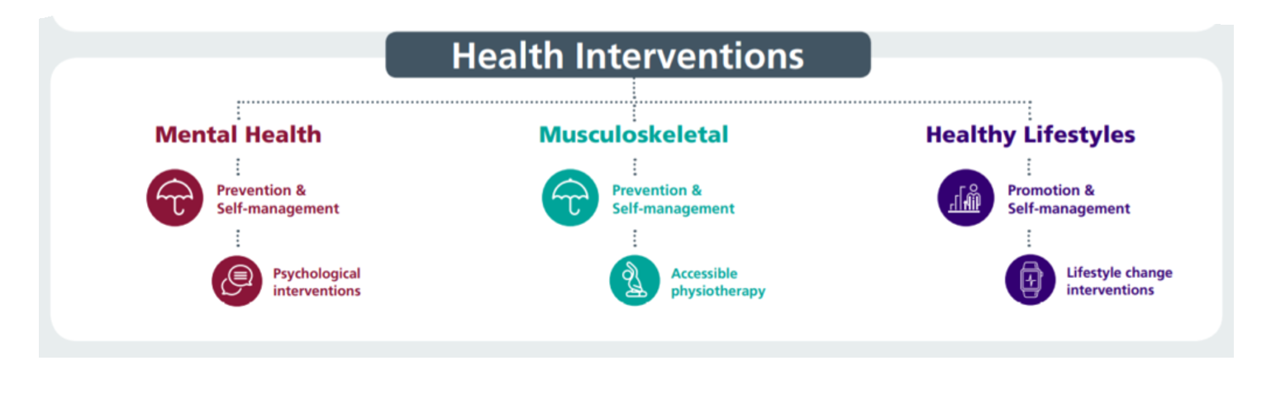

Our Staff Wellbeing Services supporting physical and mental health
1313 referrals to staff wellbeing service 23/24 –12.5% increase on previous 12 months
53% referrals to the service are staff in work (presentees) supporting early intervention
47% of referrals are sickness absentees
Specialist Psychological interventions for trauma & PTSD. Increased capacity in self-management for anxiety, depression, self-harm and suicide
Suicide Prevention – 50 disclosures of related thoughts in 12 month period with significant reductions post-intervention.
TRiM team rolling out preventative and post-incident support - 76 staff TRiM trained to deliver and support, 3483 staff REACT trained, 33 bespoke interventions for teams/services after adverse incidents
634 Wellbeing Champions (+9% from 22/23) supporting teams with wellbeing info/signposting and health promotion activities– regular update workshops facilitated
Manager training - use of work-related stress assessment and managing mental health at Work
Staff Wellbeing Forum – HB wide representation to share best practice/disseminate info across the HB with related presentations

Slide 23
Our Occupational Health Service supporting physical and mental health
OPAS G2 operating system = reduced waits for health clearance, more robust health surveillance programme & reduced waits for reports to managers. Progressing application for SEQOHS accreditation
OH waits (based on most available data) – average wait for management referrals is 20 working days as end of May 2024 (WG KPI is 20 working days)
Work-based Physiotherapy support - ergonomic assessments, early interventions and MSk advice. Leading on promoting health campaigns via Team Brief and other Comms
SBU has the only Occupational Health Service in Wales with full complement of Nursing Team using ‘grow our own’ model. 3 Nurses have completed the OH Diploma course and are awaiting exams - 1 Nurse has completed the Diploma. Leading HB menopause support and working towards Menopause Friendly Employer accreditation and only service with OT support for staff with Long Covid and other LTC’s
Time2Change Wales – regular presentations to reduce stigma & discrimination of mental health in work with other 1000 staff having attended. Shortlisted for a CIPD Award 2024 Awards 2024 Shortlist - CIPD Awards Wales 2024 (cipdwalesawards.co.uk)

Slide 24


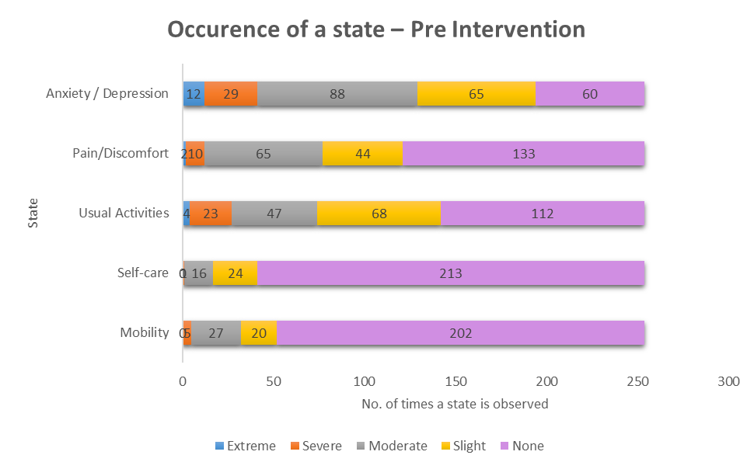
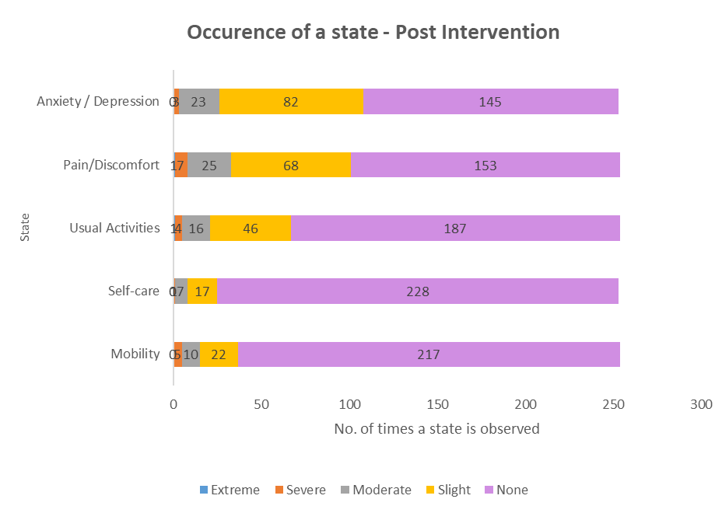
EQ5DL Pre and Post Outcome Scores

Slide 25
GTEP sessions (accumulative stress)
Wellbeing Champion Network
Compassion Rounds
React & Suicide Prevention
Staff Health Checks
Menopause Workshops
My Health Passport
Preventative Interventions
Mindful & Meaningful Living course
Steps to Wellbeing webinars
TRiM
Men’s Health Forum
Mental Health Awareness training
Work-related Stress Risk Assessment Training
Managing your Wellbeing course

Slide 26

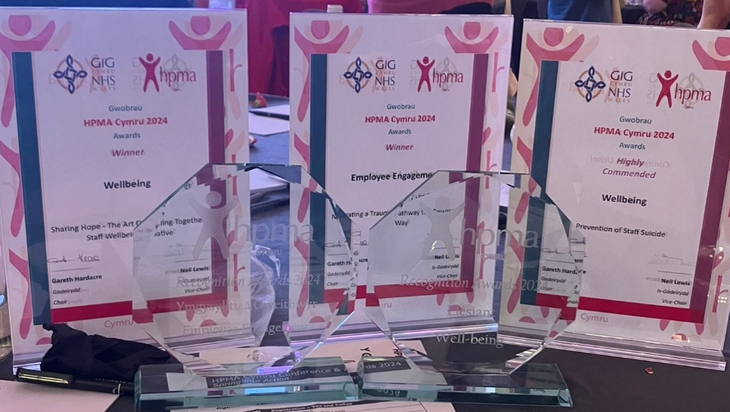
2024 HPMA Wales Awards Winners
Employee Engagement - Navigating a Trauma Pathway the Swansea Bay Way
Wellbeing: Sharing Hope - The Art Of Healing Together staff wellbeing initiative
Wellbeing Highly Commended – Swansea Bay Prevention of Staff Suicide
Recruitment Team of the Year: Central Resourcing and Overseas Nurse Recruitment Team - Reducing Variable Pay costs by Reducing Nurse and HCSW Vacancy Gap and Red.
Partnership working with Trade Unions - Working Together as part of our One Bay Way: Our Trade Union Compact

Slide 27

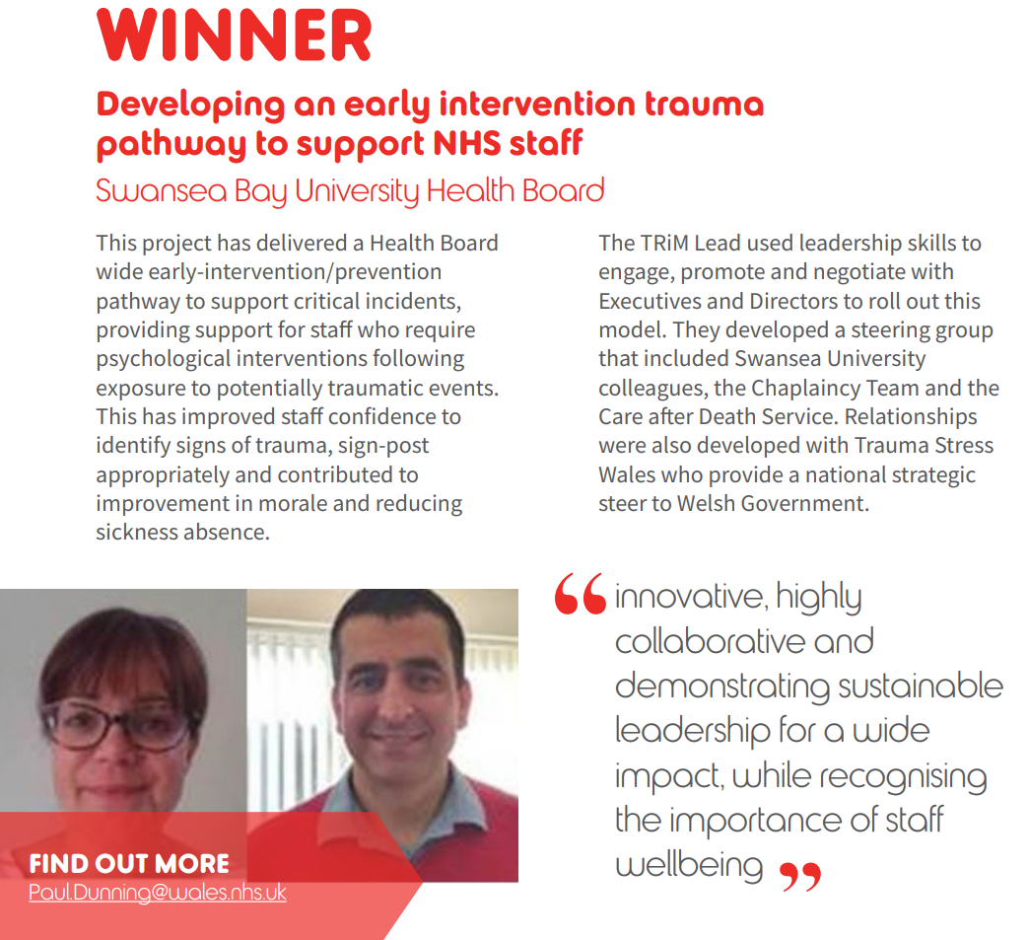
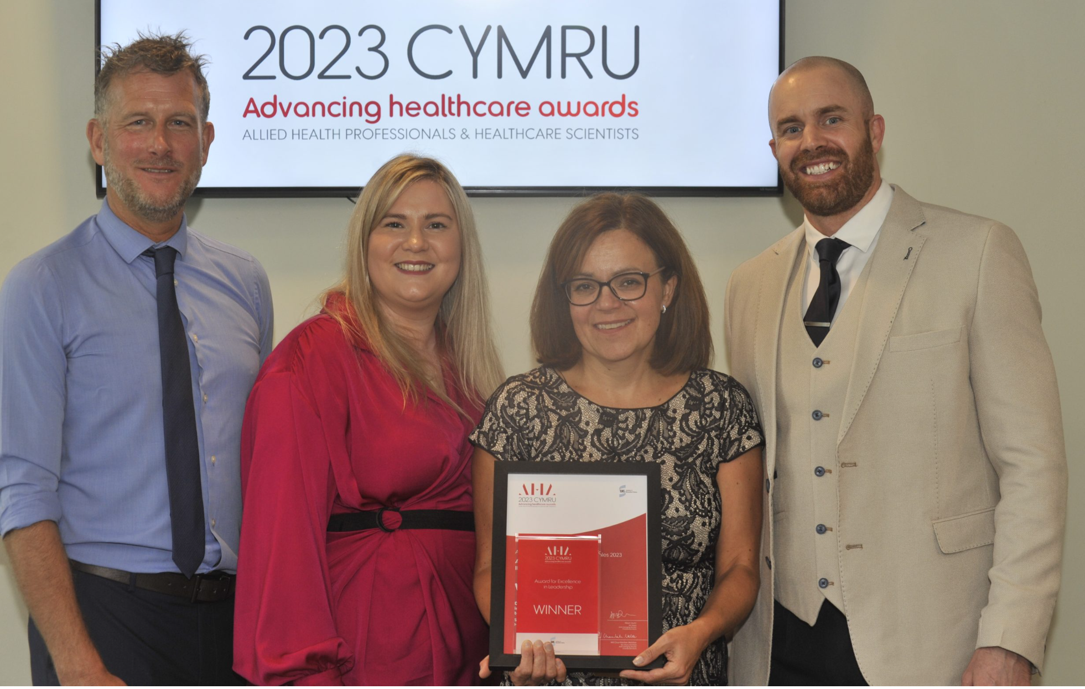

Slide 28
Diolch / Thank You

